Slide 1
Membership Seminar
Christ Presbyterian Church, New Haven

Slide 2
Session 1: Dinner with Our Story

Slide 3
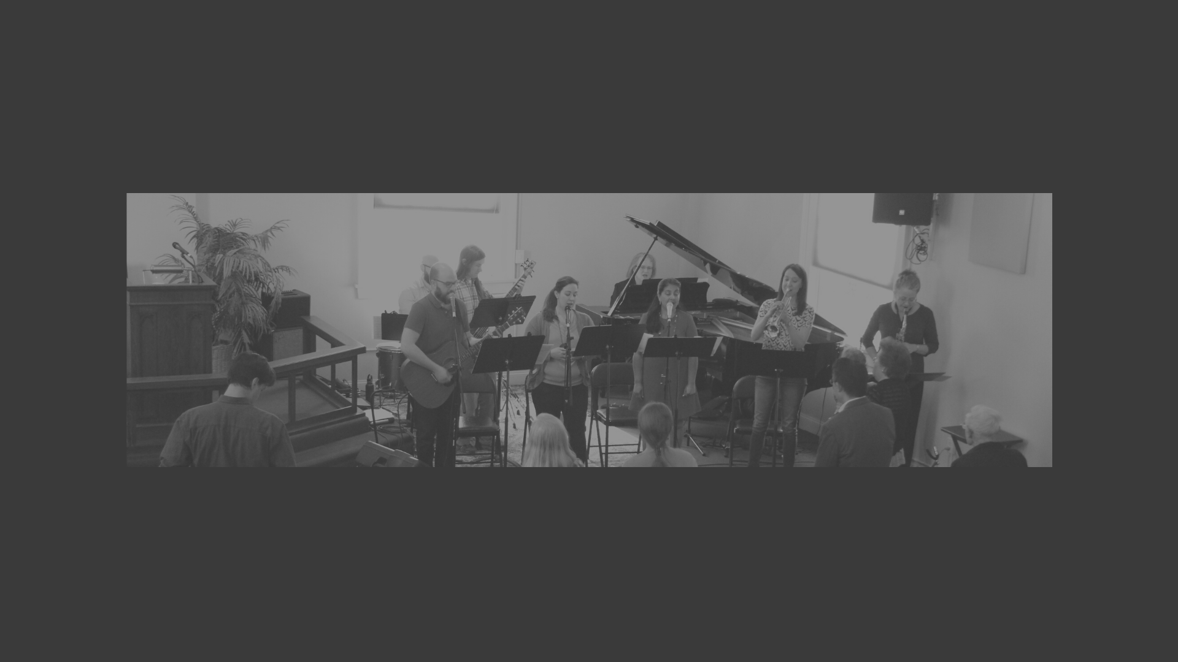
OUR STORY
How We Came To Be

Slide 4
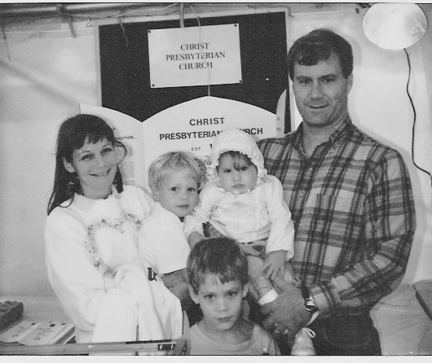
1991
1992
1992
‘
A summer boat ride, a strategic meeting, a seminarian/Yale graduate student, the beginnings of a vision wherein by Fall a small group study in “confessional theology” in Westville is formed and a church conceived (9 adults)
A final visit of the ideal candidacy in Atlanta, an unexpected encounter with Yale Senior and “THE” question- “As a Yale Grad, why haven’t you thought about planting a much needed church in New Haven?”
Assessment Center, Fund Raising, a name, a shoestring total 1st year budget of 73k, an ordination and commissioning on September of 1992 by then Northeast Presbytery of the PCA wherein Preston Graham Jr. is appointed as ”evangelist” to plant a church in New Haven under the supervision of a church in distant Nashua New Hampshire.
Graham’s at CPC Booth, Orange CT Fair.

Slide 5
92-’94
1994
of
CPC NH’s first worship service on October 11,1992 at 9:30 am at the Amity Regional Junior High in Orange CT (choir rehearsal room), Matthew 28 sermon and a mission church is born (28 people, more children than adults). First sermon series: Ephesians.
A sermon series in Jonah, the call to move “center-city,” the rental of a study center (basement level 383 Orange St.), 1st worship service in New Haven on August 28, 1994 (Neighborhood Music School).
After about 7 months of worship.

Slide 6
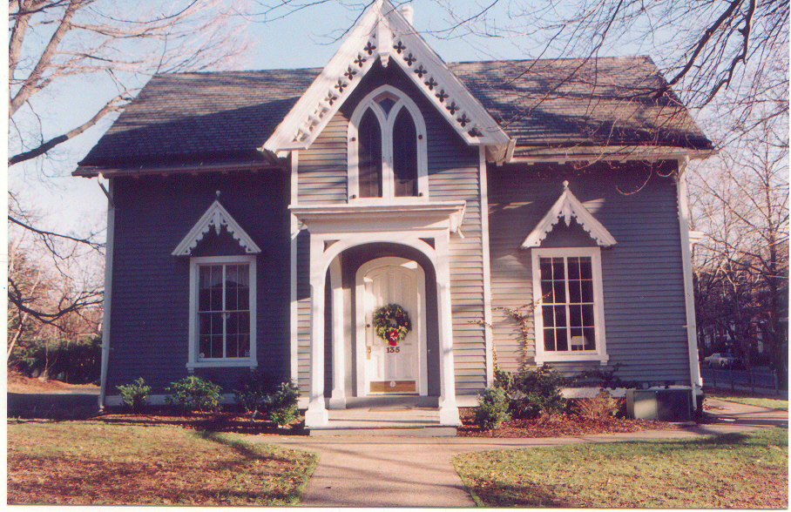
1994
’94-’95
1997
On November 6, 1994 at 4:00 PM, a special service of "organization" whereby church planter-evangelist Preston Graham Jr was installed as lead pastor and Cliff Bogue, Robert Hawkes and George Levesque were ordained as ruling elders
Between the months of September 1994 and August 1995, 7 professions of faith and by the end of August 1995, total membership of 77 and the weekly worship attendance was averaging 140.
September 5, 1997, Christ Presbyterian Church became the 4th owner of 135 Whitney Avenue with it’s 1850 Gothic Revival Cottage design (Architect Jackson Downing featured in his The Architecture of Country House (1850), “A Symmetrical Cottage Design # 7) for the price of $500,000. Involving both the sweat and financial equity of CPC members and friends, CPC immediately initiated renovation and restoration to it's original design.

Slide 7
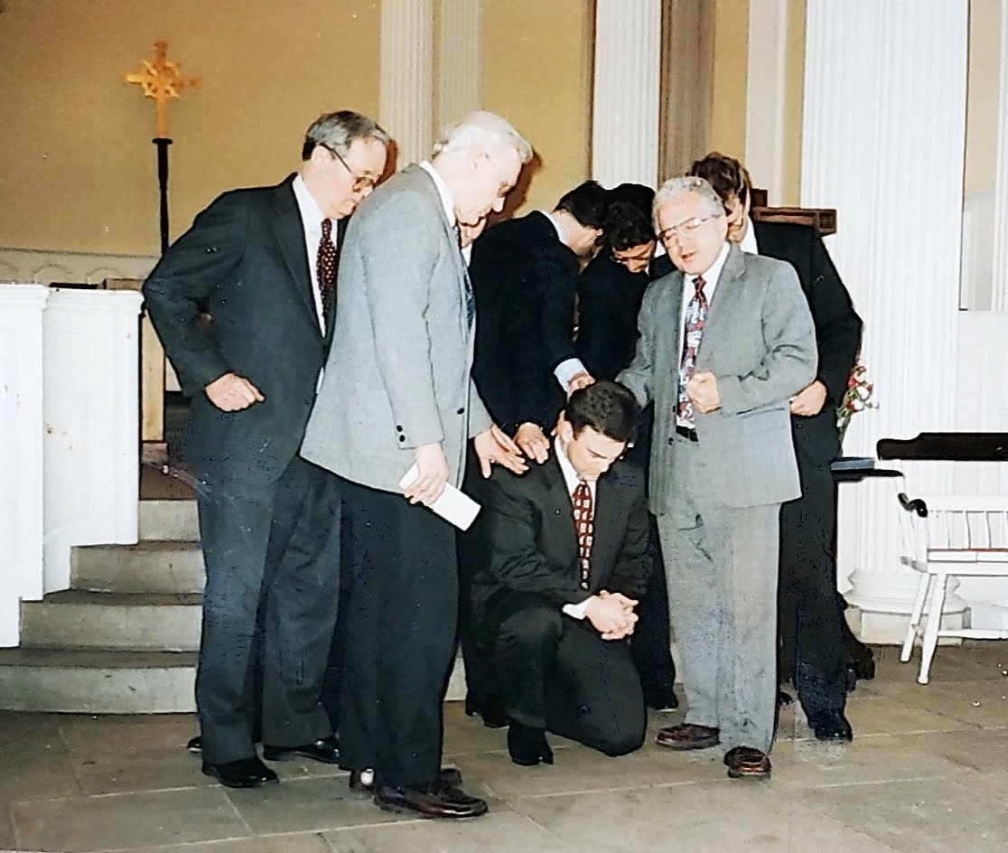
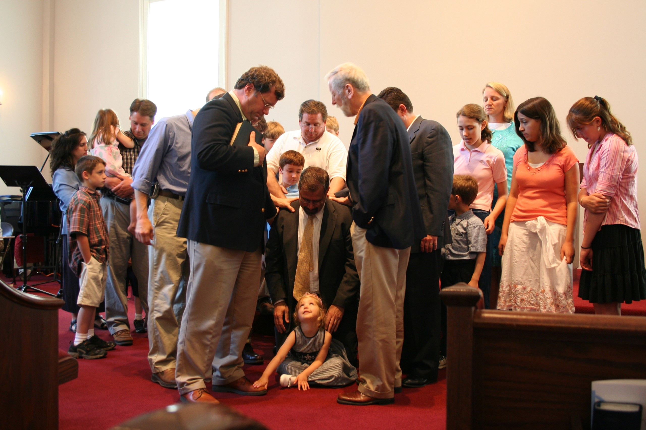
‘96-’97
1998
Committed to planting a first church prior to purchasing a building, plans were laid with Yale Divinity Student and CPC intern, Mel Sensenig, toward planting a daughter church in downtown Providence R.I. in the Fall of 1997 paving the way to a 2nd church plant in Danbury Ct August 2005.
Moved worship to the Marquand Chapel at the Yale Divinity School the summer of 1998 having outgrown NMS, grew to approx. 200.
The Ordination of Providence RI Church Planter Mel Sensenig
The Commissioning of Danbury Church Planter David Hutchinson

Slide 8
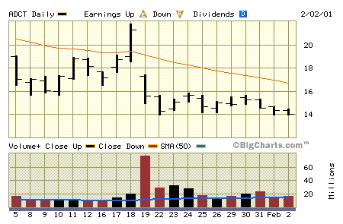
’99-2000
‘00-’02
Hired 1st Associate Pastor (Tom Morrison), 1st Music Director (Dan Kellogg (google him), established 1st PCA college ministry in NE (Yale), Started Hope For New Haven childcare and counseling center.
A 3.5 million building campaign, city-politics, the Becket Fund, churchwide participation in support raising and church savings bonds, the post-9/11 850k added burden, a sad congregational meeting, “an unexpected call, THE miracle on wall street right before it crashed-- 750!!, ground-breaking April 1, 2001, a bare bones certificate of occupancy a week before 1st worship service @ 135 Whitney on Easter Sunday, April 2002, no carpet, “piss-poor” seats, exposed dry-wall, no chancel, no paint- CPC HAS A HOME!
Last minute revised asking price from 22.0 to 21.5.
The stock finally bottomed out at around 5

Slide 9
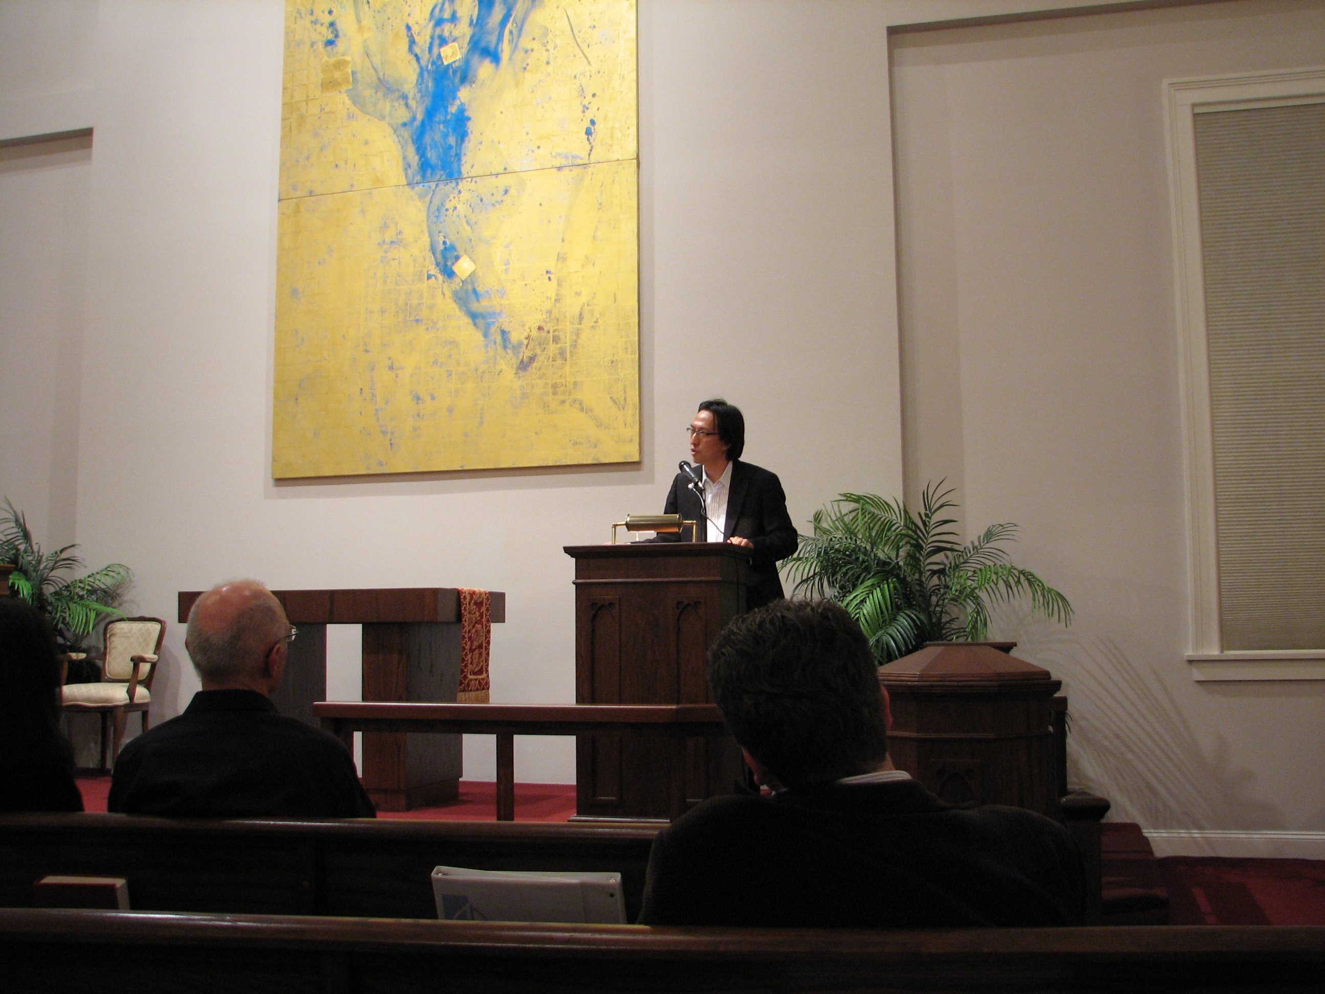
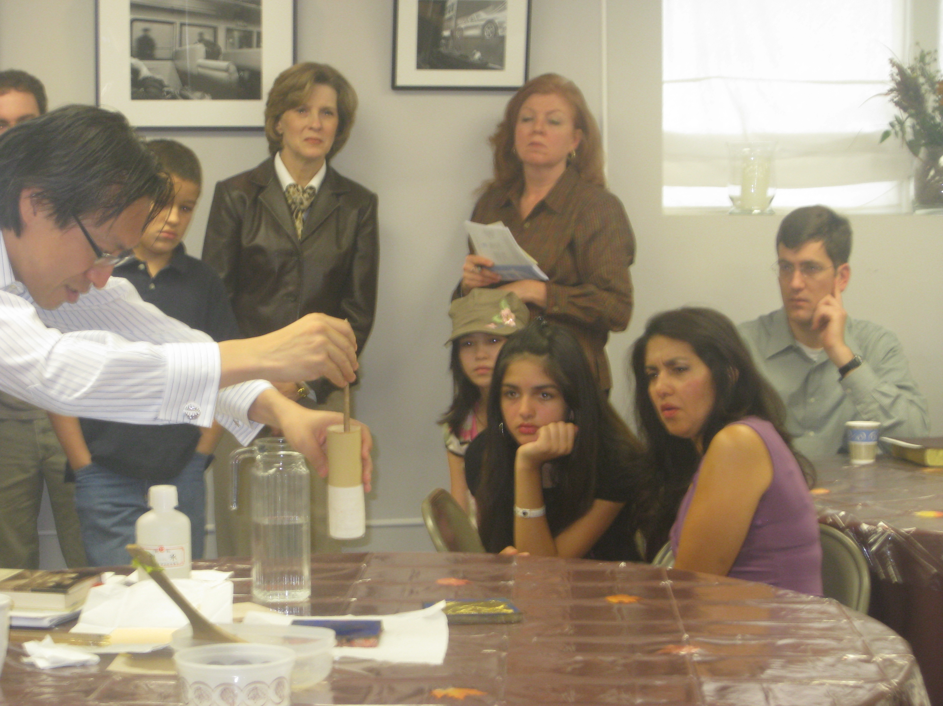
‘05-’07
2008
An ambitious campaign of prayer and sacrifice to pay down the enormous debt in order to be more financially committed to mission. The “burning of the lien” ceremony in less than 2 years, 2nd daughter church plant in Danbury CT and 1st “Impact Week” in the Hill which led to a Bible Study the Summer of 07 and church plant in 011.
Spring of ‘08, commissioned artist Makoto Fujimura to paint “Anabaino” for the permanent location at CPC NH chancel wall.

Slide 10
2009
2011-”20
‘
Inspired by God’s provision, 2nd campaign for God to raise up another 3.5 mil was initiated with the ambition of it all being dedicated to planting Total Christ, Five Mark churches both in S. CT and beyond with the strategy of 10-10-10 (10 churches locally, 10 church globally, in 10 years).
God answered prayer with 3.5 mil “cash in hand” and the organizational formation of Mission Anabaino 10-10-10-- a ministry of Christ Presbyterian Church New Haven committed to gathering, energizing, deploying, and coaching a collaborative effort to plant churches in locations where Christ’s five mark presence is not geographically or socio-culturally accessible- 10 churches locally, 10 churches globally in 10 years. As of 2020- 6 churches locally, 15 churches globally,

Slide 11
‘
A Historical Perspective
The great 18th century Congregationalist pastor, scholar and revivalist Jonathan Edwards once wrote to a friend that "the Presbyterian way has ever appeared to me most agreeable to the word of God and the reason and nature of things."*
At the time Edwards would never have imagined a high gospel and high church “Presbyterian” congregation in Congregationalist saturated New Haven right across the street from his alma mater. Such was the dream that was begun on October 11, 1992 at 9:30 AM.
To be sure, CPC utilizes the same Westminster Shorter Catechism used by Edwards and printed in New Haven in 1786. And yet it seeks to express the same elements of faith in progressive and socially relevant forms that fits the 21st century. To date, Christ Presbyterian Church worships in downtown New Haven while continuing to make history in church planting around the globe.
Most especially our story begs yet yet a greater story, how it is that Christ’s promise that started it all can be trusted and inspires us to this day.
I will build my church, and the gates of hell shall not prevail against it. I will give you the keys of the kingdom of heaven, and whatever you bind on earth shall be bound in heaven, and whatever you loose on earth shall be loosed in heaven.” (Mt. 16:18-19)
*The Works of Jonathan Edwards, Volume 1, p. cixiii (Letter to Timothy Dwight)
The Presbyterian way has ever appeared to me most agreeable to the word of God and the reason and nature of things.
Jonathan Edwards

Slide 12
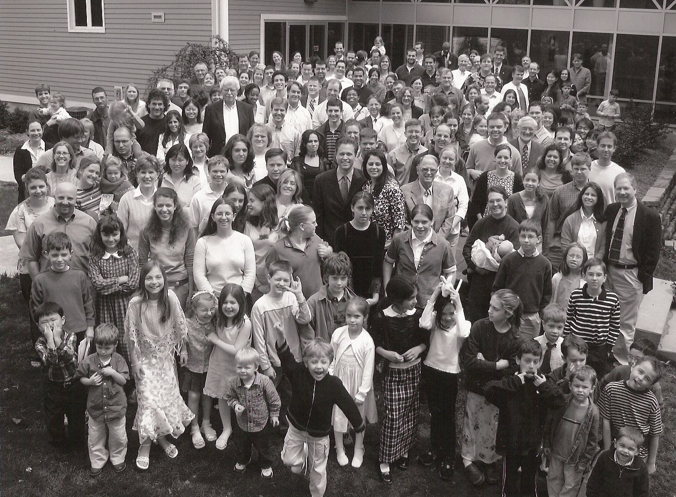

Slide 13
Observations

Slide 14
Session 2: Our Identity

Slide 15
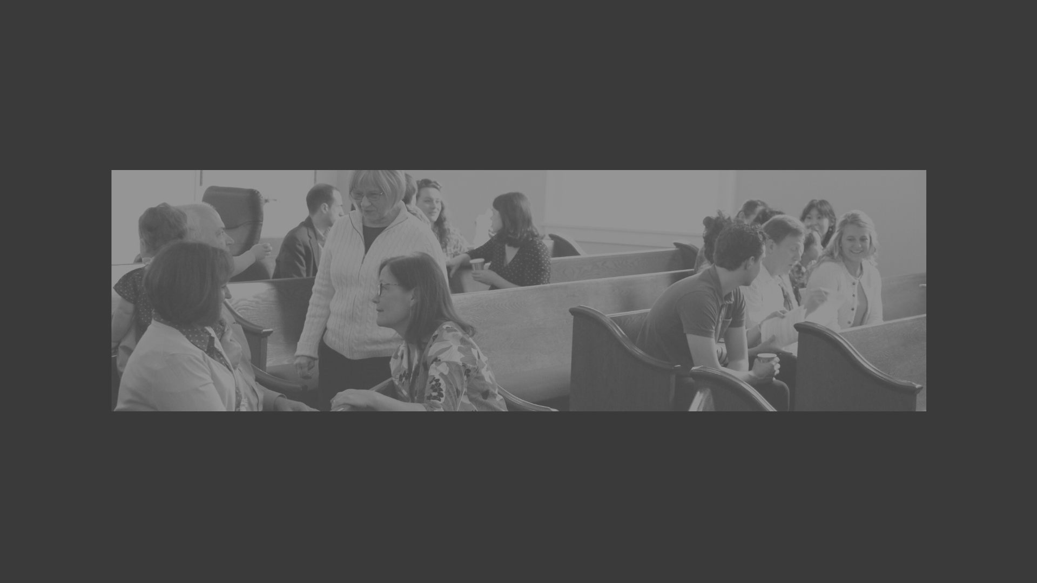
OUR IDENTITY
What the Church is by Nature

Slide 16
Church Questions?
Why should I go to church?
Is the church an essential element of the gospel?
Is membership in the church necessary?
What is the mission of the church?
What strategy should the church utilize to accomplish this mission?
What is essential to the church being the church, and what is not but needed for the sake of contextualization.
All these questions beg THE question:
What is the church in relation to Christ?
or
What is the church by her very nature?)

Slide 17
The Church IS “Christology Applied”
that Christ might come to have first place in everything
Col. 1:18
Whatever else we aspire to be, it is Christ-centered, not just in purpose (Col 1:18), but in methodology (Luke 24:27) and identity (Eph 1:23).
Our methodology is informed by a theological vision grounded in redemptive history wherein it can be said that there was never a time when salvation was accomplished without BOTH Christ our Covenant Head (Divine Word) AND Christ our Temple Presence (Human Flesh).
John’s gospel therefore introduces Christ’s incarnation:
”The word became flesh and templed among us”
(Jn 1:14)
The relation of word to temple has been described by Jonathan Edwards as God’s saving activity as Light to heat respectively.
Likewise, Meredith Kline described it as God’s “power (of presence) and “paradigm” (of law).

Slide 18
Covenant (Law) As An Essential Element of the Gospel
Biblically, we can say that there was never a time in all of Redemption history when salvation was transacted apart from a covenant transaction such as to satisfy God’s Divine Law.
In the Old Testament, the Hebrew word for “covenant” (berith) is used at least 289 times. It is explicitly used to summarize the whole of the Genesis history in Exodus 2:24 and the Old Covenant “Bible” itself was called the “book of the covenant” in Exodus 24:7.
In the New Covenant, the covenant figures prominently even as to introduce Christ as saying: “Do not think that I have come to abolish the Law or the Prophets; I have not come to abolish them but to fulfill them. “(Matthew 5:17-18) Christ is later described as the ”mediator of the new covenant” (Heb 9:15, 12:15) even by his own atoning “blood of the new covenant” that is then specifically related to the meaning and practice of the Eucharistic meal in the new covenant church (Luke 22:20, 1Cor.11:25).
The covenantal nature of the church by positive institution of Christ is explicitly stated in Matthew 16:18-19 as further explained by Paul wherein Christ is described as covenant “head over all things regarding the church” in Eph 1:22.

Slide 19
Word (Covenant) As An Essential Element Of The Gospel
Without covenant, there can be no justification (forgiveness) by grace through faith alone as applied to our relation to God.
Our creation itself is under the terms of the covenant (c.f. Gen 2:16) such that we remain right with God by “works of the law” (e.g .covenant).
And because of the “fall” (Gen 3:6-7) no person can fulfill the works of the law and be justified in God’s sight. (Rom 3:20)
Grace, by definition, cannot be earned but must be freely given. (Rom. 6:23)
And yet by the terms of the covenant Christ is legally appointed by God to represent us in satisfying the covenant as our ‘covenant executor.” (Rom 5:15-21)
By this transaction, we are “legally” justified in Christ by grace such as to be set free from the fear of God’s righteous condemnation. (Rom 8:1ff)

Slide 20
Temple (Presence) As An Essential Element of The Gospel
Biblically, we can say that there was never a time in all of Redemption history when salvation was transacted apart from the power of his presence as mediated by His temple.
Salvation History in the Old Testament was accomplished with such words as dwelling place and tabernacle God was PRESENT with his people. (Cf. Gen. 15; 26:24; Exod. 29:42; Deut. 12:5; Lev. 22:3; Ps.76.2; Num. 35:34). “God in the midst of us” (Ps 49), was the single most coveted reality, even as “excommunication” was the most feared curse (Gen.3).
Salvation History in the New Testament is not a transition from temple to “no temple.” Rather Christ is introduced as temple fulfilled (John 1:14, 2:19). When told that Christ must ascend into heaven, Christ was careful to clarify that his ”temple-presence: would remain with a House of many rooms” (Jn. 14:1-3, 17- 18) referencing the church (20:21ff) Therefore, Christ’s ascension ministry is describe by Paul as “filling all in all” vis-à-vis that temple built upon the apostolic foundation with Christ as the cornerstone (Eph. 2:18ff).
The temple nature of the church is explicitly stated with words like “temple” and “tabernacle” and “dwelling place” to describe God’s saving presence as pertaining to the “household of God” or “the church of the living God.” (c.f. Eph. 2:18-22, Rev. 21:3)

Slide 21
Temple (Presence) As An Essential Element Of The Gospel
Without temple presence, there would be no life giving power wherein we are spiritually unable to embrace Christ as our savior by our being mystically united to Christ on earth by the Holy Spirit through the church on earth to his vivifying flesh in heaven.
The curse of our original sin is death which we brought upon ourselves by rejecting God as the true source of life and rightful Lord. (Rom 3:23)
Death is not just physical, but moral such that we are morally incapable of believing in and walking with Christ without being “born again.” (John 3:16)
By our mystical union with the ascended Christ as mediated by the Holy Spirit utilizing the appointed means of grace given unto the church wherein we are enlightened and empowered to new life with Christ.

Slide 22
Summary: What IS The Church?
The Church As United In and To Christ
John 17: 22 The glory that you have given me I have given to them, that they may be one even as we are one, 23 I in them and you in me, that they may become perfectly one, so that the world may know that you sent me and loved them even as you loved me.
The Church As Christ’s Body
Eph. 5:30 because we are members of his body.
The Church As God’s People (Polis/City, Household/Family)
Eph. 2:19 So then you are no longer strangers and aliens, but you are fellow citizens with the saints and members of the household of God,
The Church As Temple of God
1Cor. 3:16 Do you not know that you are God’s temple and that God’s Spirit dwells in you? 17 If anyone destroys God’s temple, God will destroy him. For God’s temple is holy, and you are that temple.
The Church As Kingdom of God Epicenter
Matt. 16:18 And I tell you, you are Peter, and on this rock I will build my church, and the gates of hell shall not prevail against it. 19 I will give you the keys of the kingdom of heaven, and whatever you bind on earth shall be bound in heaven, and whatever you loose on earth shall be loosed in heaven.”
6. The Church As Place
Heb. 10:25 not forsaking assembling together…
Acts 20:7 On the first day of the week, when we were gathered together to break bread,

Slide 23
My Dear Wormwood,
You mentioned casually in your last letter that the patient (Young Christian being tempted) has continued to attend one church, and one only, since he was converted, and that he is not wholly pleased with it. May I ask what you are about? Why have I no report on the causes of his fidelity to the parish church? Do you not realize that unless it is due to indifference it is a very bad thing? Surely you know that if a man can't be cured of church going, the next best thing is to send him all over the neighborhood looking for the church that 'suits' him until he becomes a taster or connoisseur of churches.
Your affectionate uncle, SCREWTAPE

Slide 24
Christology Applied Part 1: Incarnation Christology Clarified
The two nature identity of Christ (Word/God and Flesh/Temple) loomed large in the 5th century debates leading up to the Council of Chalcedon in 451 AD (word-Cyril and temple-Nestorius) which resulted in the orthodox conclusion that the two natures of Christ must always be kept “distinct but never separate.” We do not have access to the salvation accomplished by Christ without Christ as Temple, and vice versa. Both are essential to salvation!
During Christ’s incarnation ministry, this was accomplished by Christ’s person ON EARTH! John’s Gospel will want to focus on Christ as the fulfillment of temple (2:19) wherein Matthew's gospel will focus more on Christ’s fulfillment of Covenant (5:17).
But the question is raised: How is this fulfilled now during Christ’s ascension ministry?

Slide 25
Christology Applied Part 2: Ascension Christology Clarified
The term “Total Christ” originates from 5th century pastor-theologian Augustine of Hippo about the relationship of Christ’s incarnational ministry (past) to his ongoing ascension ministry (present). Applying John 1:14 to Eph.1:21-23 and 2:19ff, Augustine concluded:
And he put all things under his feet and gave him as head over all things to the church, which is his body, the fullness of him who fills all in all.
Eph. 1:22-23
The Word was made flesh, and templed among us; to that flesh is joined the church, and there is made total Christ, both head and body.
St. Augustine

Slide 26
YOU (plural as organized upon the apostolic foundation) Are Christ! (Truly, if not perfectly!)
“The spirit operates by creating out of the word a body which St. Paul calls the Body of Christ…. As such this body becomes matched to Christ as His vis-à-vis in history and as the instrument of His saving purpose in the Gospel. It is the sphere where through the presence of the Spirit the salvation-events of the birth, life, death, resurrection and ascension are operative here and now in history, the sphere wherever within the old creation the new creation has broken in with power.”
T. F. Torrance, Royal Priesthood

Slide 27
According to the nature of the church, how then would you answer the question:
Q: Why should I participate in the visible church?
NOT answered by “best practices.” BUT answered by what the church is by nature–
A: The Life of Christ is unique life giving presence in/with/through the life of the church built upon the foundation of the apostles with Christ as the cornerstone.
Q: How is Christ present in the Church?
NOT answered by just remembering or declaring even, but really present by the Holy Spirit as:
A: The mediatorial vocation of Christ our Prophet(Ministry of Word/Confessionalism)
A: The Mediatorial Vocation of Christ as our Priest(Ministry of Presence/Sacramentalism
A: The Mediatorial Vocation of Christ as our King (Ministry of Government/Communalism)

Slide 28
A Confessional Summary:
The visible church, which is also catholic or universal under the gospel (not confined to one nation, as before under the law), consists of all those throughout the world that profess the true religion; and of their children: and is the kingdom of the Lord Jesus Christ, the house and family of God, out of which there is no ordinary possibility of salvation.
WCF 25.2
She is one mother, plentiful in the results of fruitfulness: from her womb we are born, by her milk we are nourished, by her spirit we are animated... Whoever is separated from the Church is separated from the promises to the Church. Nor can he who forsakes the Church of Christ attain to the rewards of Christ... He can no longer have God for his Father, who has not the Church for his mother. If any one could escape who was outside the ark of Noah, then he also may escape who shall be outside of the Church.
Cyprian, Bishop of Carthage (c.250 AD), On the Unity of the Church
Quoted by Jon Calvin, Institutes 4.1.4
I trust that none of my readers is that grotesque anomaly, an unchurched Christian. The New Testament knows nothing of such a person. For the church lies at the very centre of the eternal purpose of God.
John Stott, he Living Church: Convictions of a Lifelong Pastor

Slide 29
Session 3: Our Mission & Strategy

Slide 30
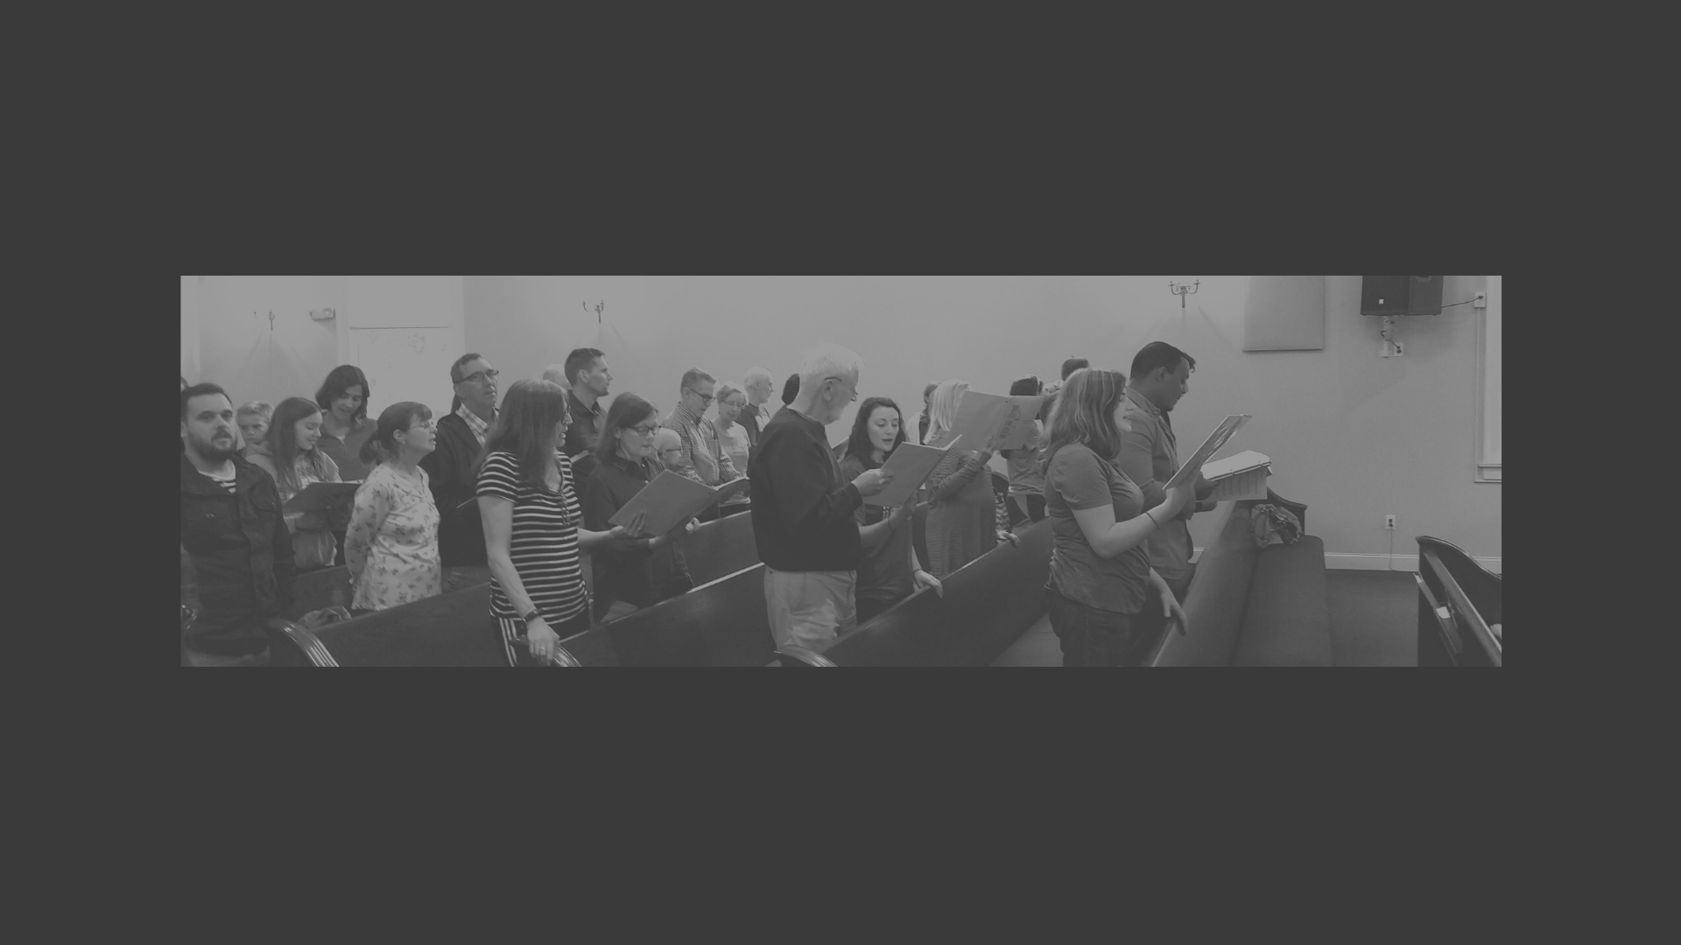
OUR MISSION
Christ’s “Commissions” To The Church

Slide 31
The Great Commission According To The Gospel of John
“Just as the father has sent me, so also I am sending you [plural]”
John 20:21
Therefore, beginning with a theology of the missional God- God the Father sends the Son, and God the Father and the Son send the Spirit—even as this then is expanded to include yet another 'movement': Father, Son, and Holy Spirit sending the church into the world" (Bosch, Transforming Mission, 390).

Slide 32
Who Is Christ Sending? Greater Things??
“Let not your hearts be troubled. Believe in God; believe also in me. 2 In my Father’s house are many rooms. If it were not so, would I have told you that I go to prepare a place for you? 3 And if I go and prepare a place for you, I will come again and will take you to myself, that where I am you may be also.
Jn 14:1-3
What place? “House” = “Temple Presence of God”
And he told those who sold the pigeons, “Take these things away; do not make my Father’s house a house of trade.” John 2:16
At this time Moses was born; and he was beautiful in God’s sight. And he was brought up for three months in his father’s house, Acts 7:20
Who’s there? (the church)
In that day you will know that I am in my Father, and you in me, and I in you.Jn 14:20 (c.f. 11)
And I will ask the Father, and he will give you another Helper, to be with you forever, 17 even the Spirit of truth, whom the world cannot receive, because it neither sees him nor knows him. You know him, for he dwells with you and will be in you. Jn14:16-18
Where?
Christ in Heaven?
“Truly, truly, I say to you, whoever believes in me will also do the works that I do; and greater works than these will he do, because I am going to the Father. “ Jn 14:12
Christ on Earth?
“I will not leave you as orphans; I will come to you. Yet a little while and the world will see me no more, but you will see me. Jn 14:19
Both And! What? How so??? Mystic Union by the Holy Spirit
for he dwells with you and will be in you. Jn14:18

Slide 33
What Is Our Corporate Mission?
Jesus said to them again, “Peace be with you. As the Father has sent me, even so I am sending you.” And when he had said this, he breathed on them and said to them, “Receive the Holy Spirit. If you forgive the sins of any, they are forgiven them; if you withhold forgiveness from any, it is withheld.
John 20:21-23
Who alone can forgive Sins? God
How Does He Do this Today? Mediated
How so?? Just As… So
And the Word became flesh and dwelled (templed) among us, and we have seen his glory, glory as of the only Son from the Father, full of grace and truth. John 1:14

Slide 34
The Church IS The Mediated Presence of a Missional God!
“Just as we insist that a Church which has ceased to be a mission has lost the essential character of a Church, so must we also say that a mission which is not at the same time truly a Church is not a true expression of the divine apostolate. An unchurchly mission is as much a monstrosity as an unmissionary church.”
Lesslie Newbigin

Slide 35
Matthew’s Commission
“All authority in heaven and on earth has been given to me. As you go therefore, make disciples of all nations, baptizing them in the name of the Father and of the Son and of the Holy Spirit, teaching them to observe all that I have commanded you. And behold, I am with you always, to the end of the age.”
Mt 28:18-20
Our Mission:
Make Disciples of all Nations (ethnos)
The three defining ’ vocations of the Church as mediatorial Body of Christ.
Christ as Prophet → Preaching of the Word (teaching them)
Christ as Priest → Sacraments (baptizing them)
Christ as King → Pastoral care/church discipline/govt (to obey)
Matthew’s Great Commission framed in Christ’s Presence
And Behold, I am with You…

Slide 36
Christ’s Presence: Heaven To Earth vis-à-vis Church
“And I tell you, you are Peter, and on this rock I will build my church, and the gates of hell shall not prevail against it. I will give you the keys of the kingdom of heaven, and whatever you bind on earth shall be bound in heaven, and whatever you loose on earth shall be loosed in heaven.”
Mt. 16:18-19
Keys? Power to open and close the Kingdom of Heaven on Earth
binding and loosing = The power to bring someone under into the protection/order of of God’s kingdom...
Associated with the Mission of the Temple in OT
1 Chron. 9:17-27, Neh 7.1ff, etc describes the “gatekeepers” (puvlai) of the Temple have the duty of employing keys
Associated with the Mission of Christ
Is 22:22 I will place on his shoulder the key of the house of David; he shall open, and no one shall shut; he shall shut, and no one shall open.
What does this say about our primary strategy for expanding God’s Kingdom and the gospel of Jesus Christ?

Slide 37
OUR STRATEGY
Simple: Just BE The Church and Get The World To Jesus!
Where Is Jesus? The Five Marks of A Total Christ Church

Slide 38
Total Christ
Ascension Christology Applied to Vocation:
As applied to Christ’s ascension ministry today, we seek to experience and practice the many implications that accompany Christ’s ministry as BOTH justifier (covenant head) AND missional power (temple presence), through a ministry that is BOTH “high gospel” (the good news of Christ's person and work) AND “high church” (the good news of Christ's mediated presence for salvation in our present age as our prophet, priest and king. All together, the “Five marks” of the “Total Christ” church are Christ’s mediated Purpose, Nature and Means (relative to the three vocations of Christ) E.g.
Our Christ-Centered Purpose:
High Gospel/Grace- Christ Our Covenant Executor
Our Christ-Centered Nature
High Church/Missional- Christ Our Temple Presence
Our Christ Centered Vocations (Instrumental)
High Scripture/Confessional- Christ Our Prophet
High Worship/Sacramental- Christ Our Prophet
High Shepherding/Communal- Christ our King

Slide 39
High Gospel/Grace : Christ Our Covenant Executor
The gospel IS grace — amazing, free, unlimited grace — such that where sin abounds, grace abounds all the more, and received through faith alone! It has as much to do with the A’s of the Christian life (new birth) as the Z’s of the Christian life (growing in Christian maturity). The gospel is at once the message and power of holistic salvation. We seek to live a gospel centered spirituality that effects everything — how we suffer, how we feel about ourselves, how we relate to others, everything (Rom 1:16, Rom. 5:6-11, 20, Eph 2:1-10)
The experience of Christian assurance of God’s favor based on God’s grace.
People who are identity-oriented as adopted sons/daughters vs. performance-oriented as orphans/slaves.
Transparency in willingness to confess REAL sins.
A different approach to suffering related to God’s training vs. God’s punishment.
A new motivation for service that is internal and gratitude based vs. external and duty based.
More and more set free from a self-promoting, self-defending, self-justifying, and blame-shifting approach to life..
Worship Service that follows the logic of the Gospel
Church that keeps the “main thing” (reconciliation with God through Christ) the “main thing.”

Slide 40
High Church/Missional: Christ Our Temple
More than a source of missiothen, the carefully designed, apostolically-organized, church is the locus of mission, the very life-giving mediatorial presence of Christ. Just the church being the church with the whole world present is God’s missionary strategy to the world (Mt. 16:18, John 1:14, 20:21 with Eph 1:22-23, 2:18ff)!
Worship and Life that not only proclaims the gospel but “habituates” the gospel as through a liturgical “constellation of practices, rituals, and routines” that embodies gospel. (c.f. K. A. Smith, Desiring the Kingdom
An emphasis upon hospitality and presence vs. just declarative.
A confidence in the outward means of grace as a missionary strategy to our world (Word, prayer, sacraments, community).
A church that assumes a missionary mentality both locally and globally.
A church that knows itself to be God’s life giving presence in its city or town.
Worship that at once practices the sacred otherness of God while practicing the nearness of God such as to be a safe place for people to be morally flawed skeptical.
Where everything we do is don’t as if our neighbors are present
Being careful not to speak in “them-us” terms or Christianized language.

Slide 41
High Word/Confessional: Christ Our Prophet
We aspire to hear God’s voice in a robust appreciation and experience of Biblical theology and expositional preaching. Whereas the Scripture is our only rule of faith and practice, we want to read and interpret the scripture with the consensus of the church that is passed down from every age and place through the use of Confessions of Faith. We strive to apply our beliefs to all of life (Luke 24:13ff, Acts 20:27, 2 Tim. 3:16, Titus 2:1,7)
A conviction that God’s revealed word is contained to the Old and New Testament scriptures such that nothing can be added to it as revelatory, whether by private revelations or traditions as a rule of faith and life.
A culture of humble submission to scripture revealed in a willingness to fully engage in biblically regulated worship and practice.
A high regard for liberty of conscience that is exclusively under the Lordship of Christ such that the church will self-regulate as to declare as a rule of faith and practice nothing save what is discerned in scripture by good and necessary inference.
A high regard for the scriptures in preaching that is expositional and Christ-centered, careful to discern the original intent by preaching right doctrines/practices from right texts.
Bible study groups characterized by the “noble Berean” passion to study the Scriptures in community in order to form their faith.

Slide 42
High Worship/Sacramental: Christ Our Priest
An emphasis on sacramental spirituality seeks to “flesh out” Christ’s presence in our midst as Priest in a carefully designed, five movement, worship service. More than talking about the gospel, worship after the pattern of temple participation invites us to do the gospel. Sacramental spirituality is expressed both in doing sacraments weekly and being sacramental throughout the week. By participating in the local cultural manners specific to a socio-cultural neighborhood of each congregation, Christ’s flesh is joined in mystic union to the flesh of the church, the “body of Christ” (1 Cor. 10:14-17, Heb. 12:22-24, Rev. 4-5)!
Worship that is characterized by the full range of emotions fitting an encounter with the living God (yearning, wonder, joyfulness, sadness, resoluteness, humbleness, etc).
An assurance of divine presences that results in a culture of anticipation and expectancy in worship and life.
The sacramental mystery of local presence that transforms the meaning of menial, local, social-cultural mannerisms by Christ’s mediated presence.
A church that can distinguish the word-based elements in worship from the socio-cultural based forms that the elements must assume in order to transact God’s living presence.
A Church that is committed to localism, the more local, the more sacramental!

Slide 43
High Shepherding/Communal: Christ Our King
It’s not that modernist churches are too organized, but that they are not organized enough! We seek a more intentional, studied, and worked out strategy of community formation that is carefully built upon the apostolic foundation with Christ as the cornerstone! We emphasize a local-oriented ministry where community in the sacramental flesh of the neighborhood really matters. This community formation is manifest by an emphasis on life-on-life “one anothering” and holistic empowerment under the shepherding care of Christ’s under-shepherds and servant leaders (Jn 13:34, Gal. 6:2, 1 Peter 5:1-5)!
A communal (vs. individual) approach to everything – such as to change the way we think about our possessions, time, decisions, ethics – everything in relation to one-anothering!
A community that shares its burdens with one another.
A community that values the Christian village in child raising.
A communal consciousness that feels the relation of the part to the whole, both in flourishing as each member flourishes and in suffering as one member suffers.
A missional method that focuses less on the individual evangelist and more on the communal evangelist as a strategy for reaching those not yet Christians.
Intentional shepherding and life-on-life (vs. just curriculum-on-life) discipleship.

Slide 44
Session 4: Our Family Tree, Presbyterianism & Contemporary Comparisons

Slide 45
OUR FAMILY TREE
A Creedal Geneology

Slide 46
Some Tongue and Cheek

Slide 47
Reading Scripture With the Church Of All Ages by The Use of Creeds (Confessionalism)
Confessionalism is the process whereby the church adopts a corporate consensus as to what the scriptures principally teach, based upon shared exegetical conclusions and utilizes this consensus as the basis for Christian faith, practice and unity when acting as a church. Stated plainly, the confessional church is any church whose identity is most essentially “what it believes” and whose beliefs drives “what it does.”
The Ultimate Goal of Confessionalism Is To Preserve the Apostolic Faith, not supplant it!
Our own confession teaches about itself that it is fallible (WCF 1:9, 31.3) and that "all controversies of religion are to be determined, and all decrees of councils, opinions of ancient writers, doctrines of men and private spirits are to be examined and in whose sentence we are to rest, can be no other but the Holy Spirit speaking in the Scripture" (WCF 1.10). And yet, without a corporate reading of scripture as within the organizational structure established by Christ through the apostles (Mt. 16, Eph. 2), we are left with private interpretations and a corporate identity crisis.

Slide 48
Why Creeds Preserve Scripture Rather Than Competes with Scripture
The real question is not, as often pretended, between the Word of God and the creed of man, but between the tried and proved faith of the collective body of God's people, and the private judgment and the unassisted wisdom of the repudiator of creeds.” Consider who has the best chance of interpreting God’s Word, me alone with my bible or the church through the ages.
Charles Hodge

Slide 49
The Usefulness of Creeds:
If not unity of confession, then unity of what?
Amos 3:3, "How can two walk together unless they be agreed'?
Eph.4:13, "until all of us come to the unity of the faith and of the knowledge of the son of God.
As a basis for instruction
1 Tim. 4:6, If you put these instructions before the brothers and sisters, you will be a good servant of Christ Jesus, nourished on the words of faith and of the sound teaching that you have followed.
2 Thess.2:15, So then, brothers and sisters, stand firm and hold fast to the traditions that you were taught by us, either by word of mouth or by our letter.
3. In order to preserve the faith against false teaching
2 Tim.4:3, For the time is coming when people will not put up with sound doctrine, but having itching ears, they will accumulate for themselves teachers to suit their own desires.
Romans 10:2, they have a zeal for God but not according to knowledge.
2John 1:10 Do not receive into the house or welcome anyone who comes to you and does not bring this teaching;
4. In order to be candid
Romans 10:2, they have a zeal for God but not according to knowledge
2Tim. 2:2 and what you have heard from me through many witnesses entrust to faithful people who will be able to teach others as well.

Slide 50
Worship, Scripture, Tradition

Slide 51
Worship, Scripture, Tradition

Slide 52
Worship, Scripture, Tradition

Slide 53
A History of “Saying So…”
Let the Redeemed of the Lord say so…
Ps.107:2
A Confessing history of Israel-- see Dt.6:4-9, 26:5-9
Peter’s Confession—see Mt.16:13-18
Perhaps the earliest and briefest Christian confession—1 Cor.12:3, “Jesus is Lord.”
Early Apostolic “statements”—Rom.1:3-4, 1Cor.15:3-4, 1Tim.3:16
A call to confess—Rom.10:9, 1 Cor.11:2, 12:3, Jude 3, 2Thess.2:15

Slide 54
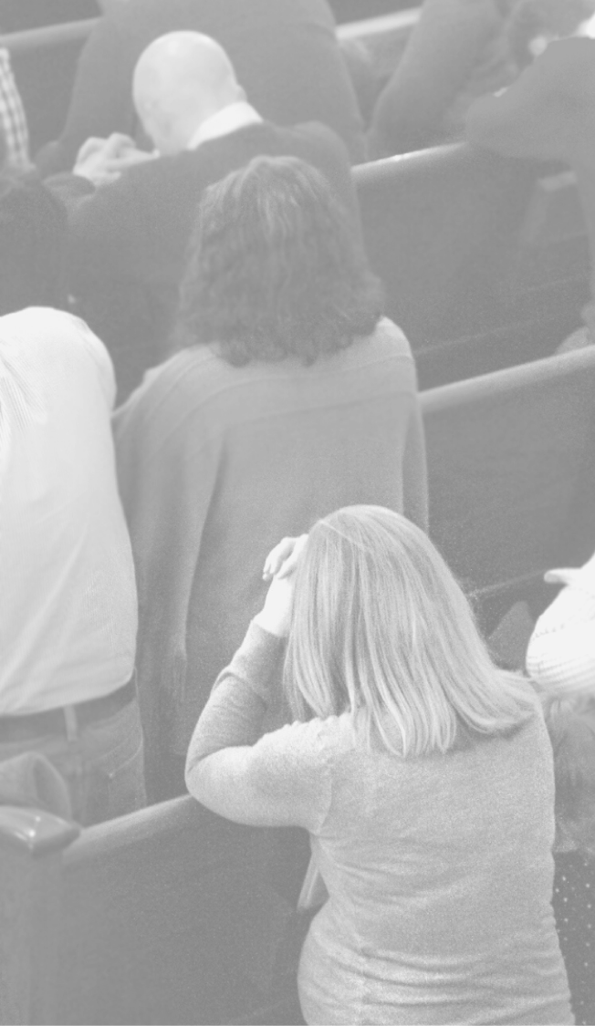
History of Saying So… The Ecumenical Creeds
1st Century: Cornerstone of Christ Upon The Foundation of the Apostles (Eph.2:20)
2nd-3rd Century– Canonical Controversies (The Issue of Scripture)
A.C.208 - Tertullian published his five-book treatise, Adversus Marcionem (Against Marcion) (rejected OT and NT dependency upon OT– Excepted only 10 Books of Paul and portions of Luke)
A.D. 350 Synod of Laodicea-- Whereas the “canon” was all but settled by 200 AD as ”recognized” (vs. conferred) the Synod of Laodicea formally settled the issue of canon (rule of faith)
Apostles Creed (A. D. ??)
Legend has it that the Apostles wrote this creed on the tenth day after Christ's ascension into heaven. That is not the case, though the name stuck. However, each of the doctrines found in the creed can be traced to statements current in the apostolic period. The earliest written version of the creed is perhaps the Interrogatory Creed of Hippolytus (ca. A.D. 215). The current form is first found in the writings of Caesarius of Arles (d 542)
The Nicene Creed (A. D. 381)
The Creed of Nicaea (A. D 325) As approved by Nicene Counsel
Associated with the Council of Constantinople this symbol is an expansion and revision of the earlier Creed of Nicaea
The Athanasian Creed ( A.D. 500)

Slide 55
History of Saying So… The Ecumenical Creeds
1st Century: Cornerstone of Christ Upon The Foundation of the Apostles (Eph.2:20)
2nd-3rd Century– Canonical Controversies (The Issue of Scripture)
A.C.208 - Tertullian published his five-book treatise, Adversus Marcionem (Against Marcion) (rejected OT and NT dependency upon OT– Excepted only 10 Books of Paul and portions of Luke)
A.D. 350 Synod of Laodicea-- Whereas the “canon” was all but settled by 200 AD as ”recognized” (vs. conferred) the Synod of Laodicea formally settled the issue of canon (rule of faith)
Apostles Creed (A. D. ??)
Legend has it that the Apostles wrote this creed on the tenth day after Christ's ascension into heaven. That is not the case, though the name stuck. However, each of the doctrines found in the creed can be traced to statements current in the apostolic period. The earliest written version of the creed is perhaps the Interrogatory Creed of Hippolytus (ca. A.D. 215). The current form is first found in the writings of Caesarius of Arles (d 542)
The Nicene Creed (A. D. 381)
The Creed of Nicaea (A. D 325) As approved by Nicene Counsel
Associated with the Council of Constantinople this symbol is an expansion and revision of the earlier Creed of Nicaea
The Athanasian Creed ( A.D. 500)

Slide 56
History of Saying So… Christological
4th –5th Century: East & West
East (Bishop Nestorius of Constantinople ) vs. West (Bishop Cyril of Alexandria )
Centered on the Person of Jesus Christ-- To what extent is he human/Temple? (Nestorius) To what extent divine/Word?(Cyril)
The Council of Ephesus (431 A. D.)-- did not arrive at a new definition of faith to modify that established at the Councils of Nicaea (325) and Constantinople (381). For that we must wait until the Council of Chalcedon in 451 A. D.
5th Century: Augustine vs. Pelagius
Augustine on Predestination/Grace
Pelagius on Perfectionism/Works
Pelagianism rejected at Synod of Carthage in A.D. 418.
It was again rejected at Council of Ephesus in A.D. 431.

Slide 57
History of Saying So… Christological
How We Compare to East??
Word/cognitive based spirituality vs. “image” based spirituality
✓ Original sin as per rebellion against God vs. original fall in that we “lost our way”
o Therefore, a higher view of sin which requires a more radical and fundamental correction
Difference between our loosing fellowship with God vs. never really having it and lost our way toward getting it.
Forensic Grace through Penal Substitution as a basis for objective Grace (vs subjective) (as a free unmerited atonement from sin by the historic work of Christ and received by faith alone) (vs. works based “theosis” as per becoming like God.)
✓ Sympathy with temple/communal spirituality and mystical communion with Christ in heaven and Christ’s body-church on earth.
Sympathy Ecclesial Ontology in mystical communion with Christ
.

Slide 58
Reformed and East compared Illustrated
“The Church is not simply an institution. She is a mode of existence, a way of being…It is a way of relationship with the world, with other people and with God, an event of communion, and that is why it cannot be realized as the achievement of an individual, but only as an ecclesial fact.
Eastern Orthodox John Zizioulas, Being As Communion, Studies in Personhood and the Church (St. Vladimir’s Seminary Press: Crestwood, NY, 1985).
"No extent of space interferes with the boundless energy of the Spirit, which transfuses life into us from the flesh of Christ"
"It is certainly a proof of truly divine and incomprehensible power that how remote so ever He may be from us, He infuses life from the substance of His flesh and blood into our souls so that no distance of place can impede the union of head and members.".
Reformer Jon Calvin. (John Calvin, Corpus Reformatorum, 37: 48
“The church is Body of Christ because in the striking expression of Calvin, it is renewed and nourished by his vivifying flesh.:”
(Reformed Protestant) Thomas Torrance, Royal Priesthood

Slide 59
History of Saying So… Reformed/Protestant
Late 15-16th Century: Luther/Calvin vs. Rome
Martin Luther (1484-1546)
Jon Calvin (1509-1564) Institutes of Christian Religion
Heinrich Bullinger (1504-1575), Theodore Beza (1519-1605) and John Knox (1514-1572
Late 16th Century: Calvinism vs. Arminianism
The Scots Confession (1560)—approved by Reformation Parliament and Church of Scotland, attaining full legal status with the departure of Mary, Queen of Scots in 1567.
The Second Helvetic Confession (1561) and approved by General Assembly in 1566 in the Reformed Scottish Church.
Heidelberg Catechism (1563)
Synod of Dort in A.D. 1618-1619
Westminster Confession (1646)*
Helvetic Consensus Formula (1675 A.D.)
The Genevan Confession (1536)—together with a translation of Calvin’s Catechism (1541)

Slide 60
Synod of Dort T.UL.I.P.
T otal Depravity- Everyone sins in the total person, not that everyone sins totally.There is common grace.
U nconditional Election- Our restorations begins with God’s free, unconditional grace applied by God’s choosing.
L imited Atonement- Not everyone is saved
I rresistible Grace- Faith is a free gift of God’s grace as granted through regeneration.
P erseverance of Saints- God will never let go of those who belong to him.

Slide 61
TULIP REVISITED F.A.I.T.H
F allen Humanity-
Rom.1:18ff, Rom.5:12ff, Rom.3:23ff, Eph.2:1
A dopted by God-
Eph. 1:3-12, John 6:35-40, Acts. 13:48
I ntentional Atonement-
Rom. 3:23-26, Heb. 5:4, Heb. 5:5, John 5:22, John 5:27, Matt. 28:18
T ransformed by Holy Spirit-
1Cor. 2:14, Rom. 5:5, Acts 16:14, Eph. 2:8
H eld by God-
Rom. 8: 35-39, Philip. 1:6, 1Pet.1:3-5, John 10:24-30

Slide 62
Protestant vs. Catholic (The 5 Sola’s)
Sola Scriptura: Christ speaking through Scripture as our only rule for faith and practice. (vs. Christ in scripture AND church (ecumenical councils)
Sola Fide: Justification by faith alone vs. faith plus sacraments/works… Only by God's grace through faith aloneare we saved (even as true faith is never alone), not be any works of our own. vs. Grace through the effectual application of it by the sacraments (baptism, mass, penance, etc) and good works until we are perfectly sanctified, at which time we are justified… thus the need for pergatory, etc.
Sola Gracia—salvation, from beginning to end, is entirely God’s work vs. salvation required human cooperation
Sola Cristus-- Christ alone is the priest of all believers: Our access to God is through Christ alone as the only redeemer of God's people. (vs.a human succession of the priesthood)
Sola Deo Gloria—To God alone is all glory honor and power… Church is a “means” of grace vs. “agent” of grace

Slide 63
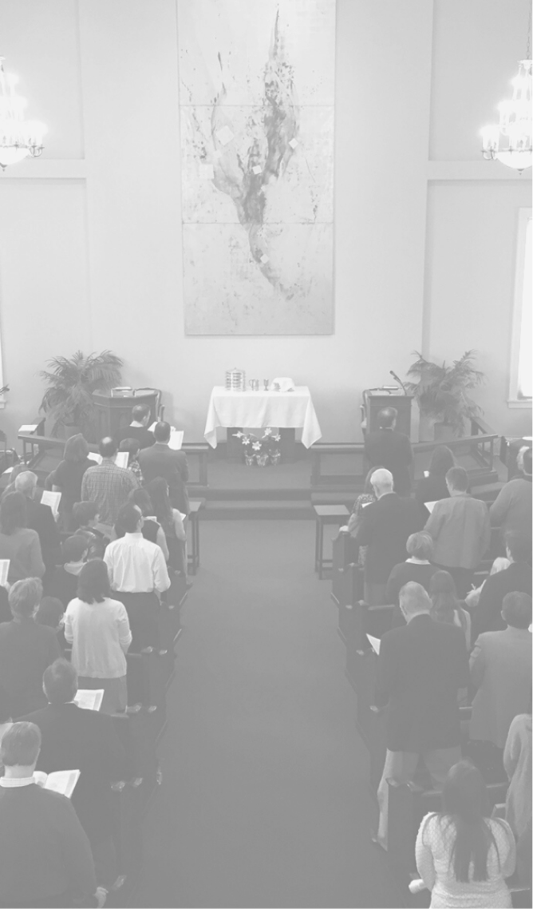
Historical Background of the Westminster Confession
In 1643 the English Parliament called an assembly of godly, scholarly men to write a confession of faith. This assembly, consisting of 121 ministers [Beveridge ,Schaff, Leith (citing Briggs), DeWitt] and 30 laymen from Parliament and the House of Lords, with two scribes or clerks, convened at Westminster Abbey in London. The seventeenth century English Puritan, Richard Baxter, remarked "the Christian world, since the days of the apostles, had never a synod of more excellent divines (taking one thing with another) than this and the Synod of Dort.”
The assembly met for at least 1,163 sessions over a course of five years. The fruit of their labors, the Westminster Confession of Faith and the Larger and Shorter Catechisms, came to serve as the doctrinal basis not only of the Presbyterians but also, with slight revisions, of early Congregationalists and Baptists.

Slide 64
The Accomplishment of the Westminster Confession Illustrated
Though not infallible, the Westminster Confession of Faith and Catechisms are the finest and most influential Protestant doctrinal standards ever composed. The Methodist Advocate magazine called the Westminster Confession "the ablest, clearest and most comprehensive system of Christian doctrine ever framed." The late Dr. Robert Strong called it an "incomparable summary of what the Bible teaches." Scottish theologian John Murray praised the Confession for its "fidelity to Scripture, precision of thought and formulation, fullness of statement, balanced proportion of emphasis, studied economy of words, and effective exposure of error..." (Collected Writings, IV, p. 260).
Consider, for example, how carefully the Confession articulates the relation between the human and divine natures of Jesus: "Two whole, perfect, and distinct natures, the Godhead and manhood, were inseparably joined together in one person, without conversion, composition, or confusion. Which person is very God and very man, yet one Christ, the only mediator between God and man" (VIII.2).
If someone were someone to come up to you on the street and ask "What is God?,” what would you answer? Where would you begin? If you knew the Shorter Catechism you could reply without missing a beat: "God is a Spirit, infinite, eternal, and unchangeable, in his being, wisdom, power, holiness, justice, goodness, and truth."

Slide 65
Presbyterianism To America
July 1, 1643­- February 22, 1649 Westminster Assembly and the adoption of the Westminster Confession of Faith­ (“An Anglican Renewal Movement,” J.I. Packer)
1705­ The first Presbytery was formed reflecting the efforts of first Presbyterian church planter, Francis Mackemie.
1716­ The first synod, the Synod of Philadelphia, was formed including the New York Region.
1729­ The Adoption Act Synod of New York wherein a slightly revised Westminster Confession of Faith became the American Presbyterian theological Constitution.
1786—The First Publishing of Westminster Shorter Catechism in New Haven on behalf of American Presbyterianism.

Slide 66
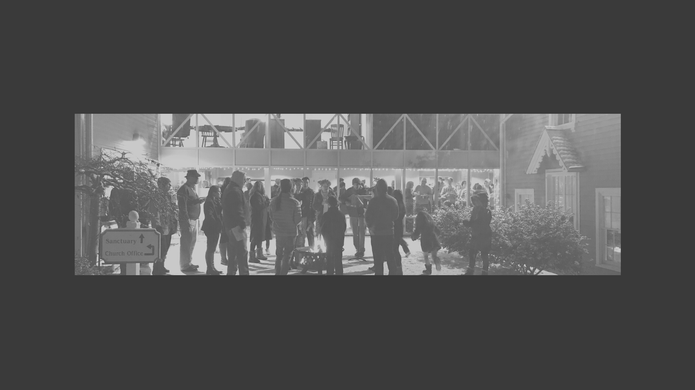
Presbyterianism
Distinctive Emphasis In Presbyterian Polity

Slide 67
What Makes Presbyterian, Presbyterian?
1. Mediatorial Body of Christ
PCA Book of Church Order, Preface
Jesus, the Mediator, the sole Priest, Prophet, King, Saviour, and Head of the Church, contains in Himself, by way of eminency, all the offices in His Church.
It belongs to His Majesty from His throne of glory to rule and teach the Church through His Word and Spirit by the ministry of office; thus mediately exercising His own authority and enforcing His own laws, unto the edification and establishment of His Kingdom.
All church power, whether exercised by the body in general, or by representation, is only ministerial and declarative since the Holy Scriptures are the only rule of faith and practice. No church judicatory may make laws to bind the conscience.
You .. members of the household of God.. being joined together, grows into a holy temple in the Lord In him you also are being built together into a dwelling place for God by the Spirit. Eph 2:18-22
He who descended is the one who also ascended far above all the heavens, that he might fill all things.) Eph 4:10

Slide 68
What Makes Presbyterian, Presbyterian?
2. Government By Two Classes of Elders
(Levitical Priesthood/Elders)
OT Witness
Patriarchal Era: Ex. 3:16 Go and gather the elders of Israel together and say to them, ‘The LORD, the God of your fathers, the God of Abraham, of Isaac, and of Jacob, has appeared to me, saying, …
Mosaic Era: Deut. 1:11-18: May the LORD, the God of your fathers, make you a thousand times as many as you are and bless you, as he has promised you! 12 How can I bear by myself the weight and burden of you and your strife? 13 Choose for your tribes wise, understanding, and experienced men, and I will appoint them as your heads.. 15 So I took the heads of your tribes, wise and experienced men, and set them as heads over you, commanders of thousands, commanders of hundreds, commanders of fifties, commanders of tens, and officers, throughout your tribes.
Era of the Kings: Elders still function during administration of the Kings. (1 Sam.16:4, 2 Kings 19:2
Prophetic Era: (Ezekiel 8:1; 14:1; 20:1-2; Ezra 5:5-9; 6:7-8

Slide 69
What Makes Presbyterian, Presbyterian?
2. Government By Two Classes of Elders
(Pastor/Deacon-Elders)
NT Witness
Acts 14:23 And when they had appointed elders for them in every church, with prayer and fasting they committed them to the Lord in whom they had believed.
1 Tim. 3:1 The saying is trustworthy: If anyone aspires to the office of Bishop (episkopo) he desires a noble task
1Tim. 3:8 Deacons likewise must be…
1Tim. 5:17 Let the elders who rule well be considered worthy of double honor, especially those who labor in preaching and teaching.
Phil. 1:1 Paul and Timothy, servants of Christ Jesus, To all the saints in Christ Jesus who are at Philippi, with the overseers and deacons…
The Proper and essential distinction between the two systems is the assertion by Episcopalians and the denial by Presbyterians of Scriptural warrant for a third order of ordinary and permanent office-bearers in the Church above presbyters and deacons, having exclusively in their hands the "power of ordination" and the "power of jurisdiction." (James Bannerman, Church of Godf, Vol.2, p.263-4)

Slide 70
What Makes Presbyterian, Presbyterian?
3. Organically Connected to Other Churches (Presbytery)
Questions that demonstrate local government within a jurisdictional/organic connection with other churches.
1. Biblically, are doctrinal matters local or general? Acts 15. Does the church at Antioch settle the issue of the status of Gentiles in the NT church, or is this issue settled by a general council?
2. Biblically, are disciplinary matters local or general? 1 Cor. 5. Does Paul remove the sinning individual from Corinth, or does he require the Corinthians to remove him?
3. Biblically, are diaconal matters local or general? 1 Cor. 16. Are the saints at Galatia and Corinth responsible for the relief of saints at Jerusalem, or is such relief the responsibility of the Jerusalem saints?
4. Biblically, are missionary matters local or general? 2 Cor. 8. Did the Macedonians’ gift to Paul contribute to “ministering to the saints” only in Macedonia or elsewhere as well, and does Paul exhort the Corinthians to abound in this grace also? Similarly, did the Philippians contribute to Paul’s sustenance as a minister only while he was in Phillipi, or when he was in Thessalonica also (Phil. 4)?
5. Is the church of Corinth a single congregation or a presbytery according to Paul's application of the word "church" in 1 Cor.16:19 and 1 Cor.1:2?

Slide 71
What Makes Presbyterian, Presbyterian?
Compared:
Prelacy: administered by archbishops, bishops, deans, archdeacons and other ecclesiastical offices on a hierarchical system by hierarchical appointment vs. representative or congregational determined offices. All things are general.(Roman Catholic, Episcopal, Greek Orthodox, Methodist)
Independency: Each separate congregation is under Christ subject to no external jurisdiction. All things are local. Congregational Independency (Baptist, Congregationalism) Representative Independency (Reformed Baptist)
Presbyterianism: Representative government that enjoy jurisdictional/ecclesiastical connectedness to other churches within same denomination. Some things are originally local; some are general. Even originally local matters may become general, through review, complaint, or appeal.
3.

Slide 72
What Distinguishes Presbyterian From Other Two Historic Forms??
4. Heavenly Epi-Center
With Earthly Multi-Form Congregations
(Elements/Forms)
The organic concept of the church that appears in the New Testament has made a particularly deep mark upon the Presbyterian mind. Presbyterian polity does not stand against the centralized Catholicism of rom and the decentralized independency of congregationalism as a mediating way. Rather it present not by one earthly hierarchical center nor by many earthly congregational centers, but by a heavenly center that requires multiform earthly manifestations. Earthly assemblies do not define gu5 manifest the nature and the center of the church.
Edmund Clowney, Distinctive Emphasis In PresbyterianChurch Polity
Heavenly Center– Globalism-- Universal Elements of Faith and Practice: as regulated by good and necessary inference from Scripture-- heaven to earth
Earthly Mult-Form-- Localism– Particular Forms as Directed (not regulated) By Scripture (not contrary to) by the light of nature and common circumstances.

Slide 73
What Distinguishes Presbyterian From Other Two Historic Forms??
5. The Regulative Principle
The regulative principle is predicated upon 3 very important reformational affirmation:
The Exclusive Lordship of Jesus Christ as Head over all thing related to the church.
Eph 1:22 And he put all things under his feet and gave him as head over all things to the church, 23 which is his body, the fullness of him who fills all in all.
The Sufficiency of Scripture:
2 Tim 3:16 All Scripture is breathed out by God and profitable for teaching, for reproof, for correction, and for training in righteousness, 17 that the man of God may be complete, equipped for every good work.
WCF 1.6. The whole counsel of God concerning all things necessary for his own glory, man's salvation, faith and life, is either expressly set down in Scripture, or by good and necessary consequence may be deduced from Scripture: unto which nothing at any time is to be added, whether by new revelations of the Spirit, or traditions of men.
The Liberty of Conscience that Christ purchased by his blood that we might be set free from all “Lords.”
Gal. 5:1 For freedom Christ has set us free; stand firm therefore, and do not submit again to a yoke of slavery.
WCF 20.2 God alone is Lord of the conscience, and hath left it free from the doctrines and commandments of men, which are, in anything, contrary to his Word; or beside it ..So that, to believe such doctrines, or to obey such commands, out of conscience, is to betray true liberty of conscience.

Slide 74
CONTEMPORARY COMPARISONS
MODERNITY TO POST-MODERNITY

Slide 75
“A plague o’ both your houses” - Going Beyond the Two Options!
Ps 85.10 - “Steadfast love and faithfulness meet; righteousness and peace kiss each other”
Though the Either/Or remains on the fundamentals - either Christ or nothing. Rock solid on the essentials, radically open on non-essentials

Slide 76
19th Century Revivalism
Tent Revivals - to stir up the dead orthodoxy of Christendom and get people to make decisions for Christ?
Guarding Church Tradition - preserving the past with our head in the sand?
=> Neither! Spiritual vitality of the tent revivals (without the emotional manipulation and individualism) PLUS theology of the Church (without the sacred cows of cultural heritage)

Slide 77
Fundamentalism vs. Liberalism (post Civil War)
Fundamentalism - reading Bible “literally”, generally anti-science, moralism esp. with regard to sexual ethic and culture wars, and the 5 “fundamentals” (1. Inerrancy of Bible; 2. Literal Creation; 3. Virgin Birth; 4. Bodily resurrection and physical return of Christ; 5. Substitutionary Atonement)
Liberalism - reading Bible “symbolically” to get to the important kernels “behind" the irrelevant literal/historical stuff; in sync with modern intellectual and scientific scene
=> Neither! Reading Bible according to its intent, letting God’s Word decide when science conflicts or not. No suspicion of intellectualism, but also no naivety because sin is everywhere. Sin:sins::disease:symptoms.

Slide 78
Politics and Worldliness
Completely “out” - Saving souls only, so politics is irrelevant
Completely “in” - Politics can help usher in the kingdom of God - identifying justice with the kingdom of God
Neither! In the world, not of the world, for the world. Church, not state, is God’s instrument of salvation and kingdom-building. Justice is common grace way of God sustaining the world, and maybe pointing to God’s kingdom, but not the kingdom itself.
Religious Right - too narrow in its moral causes, too partisan, too individualistic and not ecclesial
Religious Left - some overlap, better in its breadth of moral causes, but too partisan and not ecclesial
Irony: Both Left and Right Are Engaged in the Same Program (Cultural Transformation) whose mission is too “Of This World” partisanship

Slide 79
Politics and Worldliness

Slide 80
Hipster Hillsong Christianity
Full Support - make the church as accessible and hip as possible, in order to get the message across. Pragmatic for the sake of teaching
Full Resistance - Preservation of the Gospel to the detriment of Mission (don’t get off your nose to spite your face!)
Neither! Gospel is MORE than just a message, though not less. Pragmatic ONLY on the non-essentials, which will appear too hip to some, and not hip enough to others. Ex.: Smoke machine probably (though not necessarily!) disrupts the essentials because of entertainment feel and doesn’t fit our church’s culture
Reduces church to an Event vs. Five Mark Mediated Presence Christ as Covenantal Polis/Temple Presence/Household of God

Slide 81
Session 5: Is Membership Biblical? Membership Vows, Our Ministry Map, Process For Joining.

Slide 82
IS MEMBERSHIP BIBLICAL?
Responding To The Demise of Religious Commitment in America

Slide 83
Pre-Christendom Conversion Experience Augustine of Hippo: A Typical Story
A SEEKER--Through influence of Mother, friends and the “Garden Experience with Scripture-
My worldly life was all confusion. My heart had still to be rid of the leaven which remained over (1Cor.5:7) I should have been glad to follow the right road, to follow our Savior himself, but still I could not make up my mind to venture along the narrow path.
AN INQUIRER--Augustine initiated a conversation with a pastor named Simplicianus who told him of a conversation with another young man named Victorinus. .
Privately, as between friends, though never in public, he [Victorinus] used to say to Simplicianus, “I want you to know that I am now a Christian.” To which Simplicianus replied: “I want you to know that I am now a Christian “I shall not believe it or count you as a Christian until I see you in the Church of Christ.” At this, Victorinus would laugh and say, “Is it then the walls of the church that make the Christian?”
A HEARER-- But here especially is there the story goes different than in future stories of Christendom, like Victorinus before him, Augustine became a “Catechumen” in order to study the Christian faith together with experiencing the life and worship of the. Congregation. During this time, they were not allowed to pray publically, and they were not allowed to partake of the sacraments of Baptism and the Lord’s Supper. This could last as long as three years– “A Hearer”
Those who are newly brought forward to hear the Word shall first be brought before the teachers at the house, before all the people assemble. Then they will be questioned concerning the reason that they have come forward to the faith. Those who bring them will bear witness concerning them as to whether they are able to hear. They shall be questioned concerning their life…
A CONVERT: Longing for the salvific presence of God, Augustine was finally baptized by Ambrose on Easter, April 24, 387 along with others.
"We were baptized and all anxiety as to our past life fled away."

Slide 84
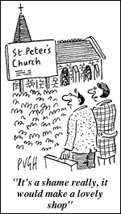
A Cultural Acknowledgement!!!
80% of Americans say you don’t have to go to church to be a Christian.
77% of students at Yale agree that their spirituality doesn’t depend on being involved in a religious organization.
And this was in 2002!! How much more so do you think now!
American religion is generally individualistic, uninterested in doctrine, distrustful toward tradition and institutions, practical and increasingly at home with the culture surrounding it?
Alan Wolfe’s The Transformation of American Religion: How We Actually Live Our Faith '

Slide 85
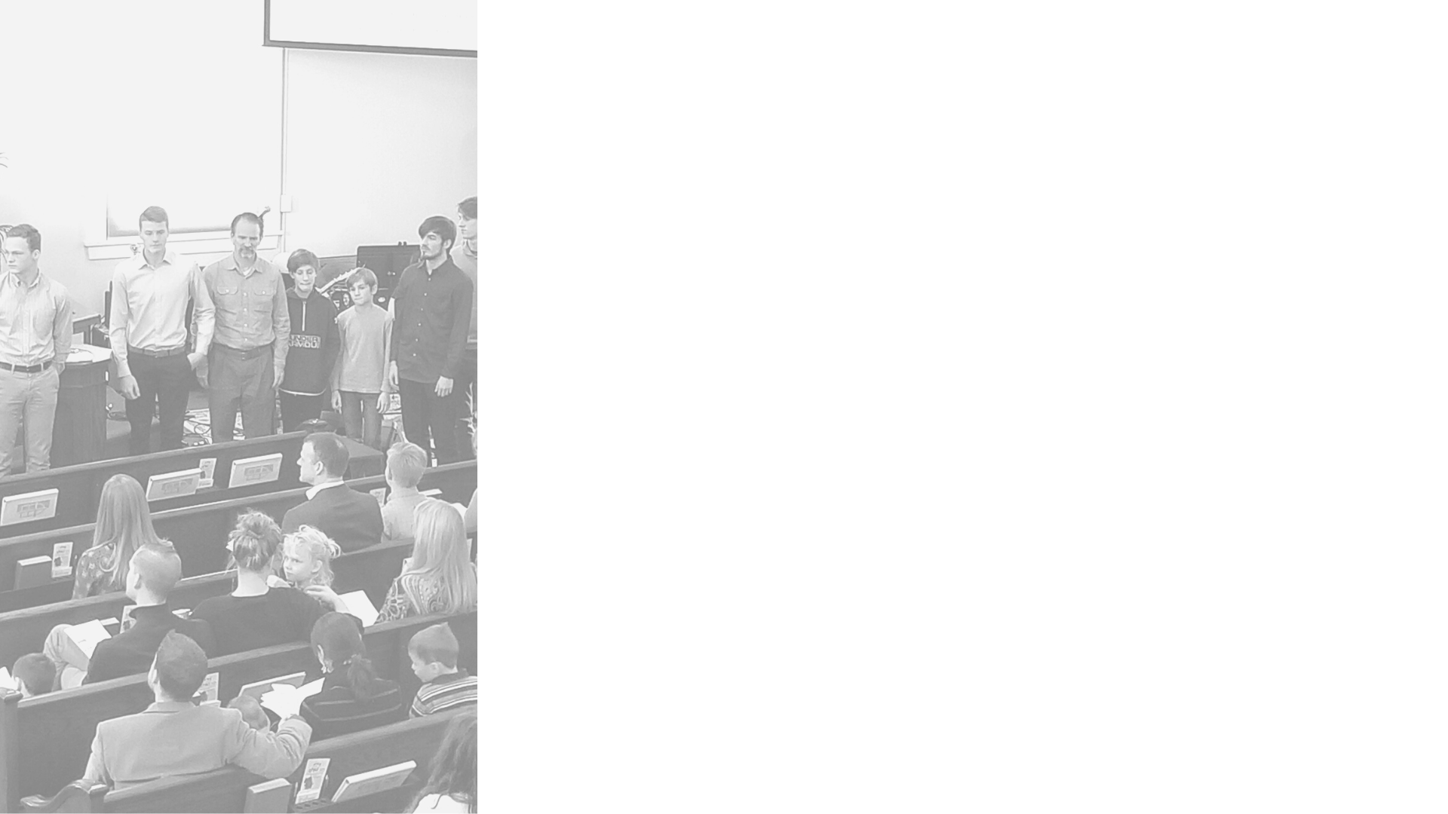
What makes us nervous about church membership?

Slide 86
“Membership” challenges a particularly modern-American assumption.
.
Compare to Robert Bellah et. al Habits of the Heart, Individualism and Commitment in American Life wherein the social analysis indicates that modern America is individualism as with its corollary the demise of real "commitment in American Life.”
For Americans, the traditional relationship between the individual and the religious community is to some degree reversed. On the basis of our interviews, we are not surprised to learn that 80 percent of Americans agreed that "an individual should arrive at his or her own religious beliefs independent of any church or synagogue." From the traditional point of view, this is a strange statement-- it is precisely within the church or synagogue that one comes to one's religious beliefs-- but to many Americans it is the Gallup finding that is normal.

Slide 87
MEMBERSHIP: A COLLISION IN COMMITMENTS ILLUSTRATED
It is not fashionable to say much nowadays of the advantages of the small community. We are told that we must go in for large empires and large ideas. There is one advantage, however, in the small state, the city or village, which only the willfully blind could overlook. The man who lives in a small community lives in a much larger world...
The reason is obvious. In a large community we choose our companions. In a small community our companions are chosen for us... That is why the old religions and the old scriptural language showed so sharp a wisdom when they spoke not of one's duty towards humanity, but one's duty towards one's neighbor. The duty towards humanity may often take the form of some choice which is personal or even pleasurable.. But we have to love our neighbor because he is there--a much more alarming reason for a much more serious operation. He is the sample of humanity which is actually given us. Precisely because he may be anybody he is everybody.
G.K. Chesterton, Heretics, 1905
Why is Small Bigger ?
How does membership make Church Smaller?
How might we envision this making Christ and His Kingdom Bigger for us?

Slide 88
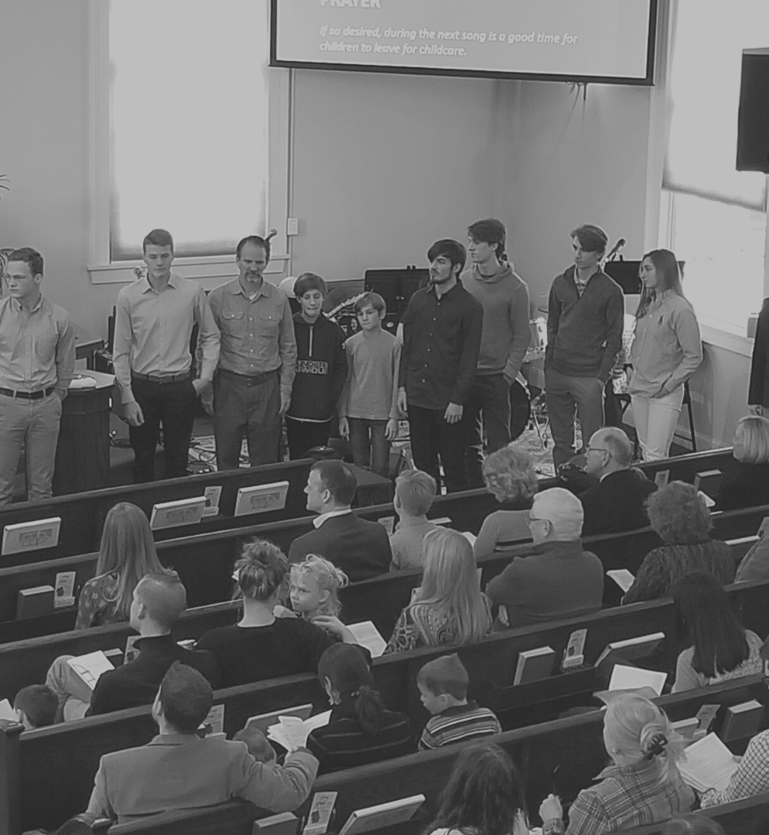
Begs the Question: What is Biblical “Orthodoxy?”
Thomas Oden, Beyond Modernity… What?
Where did we get the twisted notion that orthodoxy is essentially a set of ideas rather than a living tradition of social experience? Our stereotype of orthodoxy is that of frozen dogma, rather than a warm continuity of human experience-- of grandmothers teaching granddaughters, of feasts and stories, of rites and dancing. Orthodoxies are never best judged merely by their doctrinal ideas, but more so by their social products the quality of their communities... They await being studied sociologically, not just theologically.

Slide 89
Four Biblical Reasons To Join: # 2: Commands impossible to keep without membership
The command to obey/submit to leaders– Who’s Your Leader?
Heb. 13:17 Obey your leaders and submit to them, for they are keeping watch over. your souls and will give an account. Let them do this with joy and not with sighing-- for that would be harmful to you.
The Command for Shepherds to keep watch over/Shepherd the flock– Who’s Your Flock
Acts 20:28 Keep watch over yourselves and over all the flock, of which the Holy Spirit has made you overseers, to shepherd the church of God that he obtained with the blood of his own Son. 29 I know that after I have gone, savage wolves will come in among you, not sparing the flock. 30 Some even from your own group will come distorting the truth in order to entice the disciples to follow them. 31 Therefore be alert, remembering that for three years I did not cease night or day to warn everyone with tears.
1 Peter 5:1-3, I exhort the elders among you to shepherd the flock of god that is in your charge, exercising the oversight, not under compulsion but willingly, as God would have you do it...
The command to “one-another”– Who’s the “other” especially wherein in some instance the command necessarily requires prioritizing and distinguishing.
Rom. 15:7 Therefore receive one another, just as Christ also received us, to the glory of God. Rom. 16:16 Greet one another with a holy kiss. The churches of Christ greet you. (receive into what?)
1Cor. 12:25 that there should be no schism in the body, but that the members should have the same care for one another. (under what terms are we to have the same care?)
Eph. 5:21 submitting to one another in the fear of God. (to everyone?)
Eph. 4:32 And be kind to one another, tenderhearted, forgiving one another, just as God in Christ forgave you.

Slide 90
Four Biblical Reasons To Join: # 1: The word “Member” and It’s Use
Romans 12.3-8ff
For by the grace given to me I say to everyone among you not to think of himself more highly than he ought to think, but to think with sober judgment, each according to the measure of faith that God has assigned. For as in one body we have many members, and the members do not all have the same function, so we, though many, are one body in Christ, and individually members one of another. Having gifts that differ according to the grace given to us, let us use them
Grace given… each… one body… many members(X3)… Function....
Gift... grace given... Command… list ???
Ephesians 4:19-22
So then you are no longer strangers and aliens, but you are fellow citizens with the saints and members of the household of God, built on the foundation of the apostles and prophets, Christ Jesus himself being the cornerstone, in whom the whole structure, being joined together, grows into a holy temple in the Lord. In him you also are being built together into a dwelling place for God by the Spirit.
Fellow citizens… membership of the household…
joined together…dwelling place???

Slide 91
Four Biblical Reasons To Join: # 3: The Administration of Discipline
1Cor. 5:1-2, 4 It is actually reported that there is sexual immorality among you, and of a kind that is not tolerated even among pagans, for a man has his father’s wife. 2 And you are arrogant! Ought you not rather to mourn? Let him who has done this be removed from among you…4 When you are assembled in the name of the Lord Jesus and my spirit is present, with the power of our Lord Jesus, 5 you are to deliver this man to Satan for the destruction of the flesh, so that his spirit may be saved in the day of the Lord.
Question: In this passage, do individual's admit and demit themselves to the Lord’s supper, or are they to be admitted and demitted, if needed, by the church as then in relation to the counsel/judgments of the church acting through her "key bearers?
Commentary: What is excommunication? It is the church barring someone from the table. How can the church have power to bar from the Table, if it does not have power to admit to the Table? If we come to the Supper solely by our own volition, then how can we be removed by any other means? Admission to and exclusion from the Supper are by the same means; either our own individual volition or the volition of the church. Therefore, the language of "admission" is often used in the historic creeds when describing a person's relation to the Lord's table. C.f. Heidleburg # 82, 85, WLC #173. Whatever it is called, it is a membership!

Slide 92
Four Biblical Reasons To Join: # 4: The use of public vows unto true conversion
The Precedence of Public Vows in Redemptive History as related to Covenant Initiation and Renewal
Gen. 31:13 I am the God of Bethel, where you anointed a pillar and made a vow to me. Now arise, go out from this land and return to the land of your kindred.’”
Lev. 23:36 For seven days you shall present food offerings to the LORD. On the eighth day you shall hold a holy convocation and present a food offering to the LORD. It is a solemn assembly; you shall not do any ordinary work… 38 besides the LORD’s Sabbaths and besides your gifts and besides all your vow offerings and besides all your freewill offerings, which you give to the LORD.
Pss. 66:13 I will come into your house with burnt offerings; I will pay you my vows,
This practice is not annulled by Jesus but is rather affirmed by reforming the practice:
Matt. 5:33 “Again, you have heard that it was said to those of ancient times, ‘You shall not swear falsely, but carry out the vows you have made to the Lord.’... 37 Let your word be ‘Yes, Yes’ or‘No, No’; anything more than this comes from the evil one.
All this then makes sense of Paul’s teaching in Romans
Romans 10:9 because if you confess with your lips that Jesus is Lord and believe in your heart that God raised him from the dead, you will be saved. 10 For one believes with the heart and so is justified, and one confesses with the mouth and so is saved.

Slide 93
IF Not Membership As By Covenantal Union, Where is Christ In The Transaction?
For no one ever hated his own flesh, but nourishes and cherishes it, just as Christ does the church, because we are members of his body. “Therefore a man shall leave his father and mother and hold fast to his wife, and the two shall become one flesh.” This mystery is profound, and I am saying that it refers to Christ and the church.
Eph 5:30-32
Imagine Marriage without One member of the Marriage Couple Involved in establishing the terms of the covenantal union or participating in the vows of commitment?
Does Christa have anything to say about what our covenantal union should be? How it should be transaction.. Terms of Communion Together?
Without membership, Christ is suspiciously absent in the transaction!

Slide 94
VOW ONE
Do you acknowledge yourself to be a sinner in the sight of God, justly deserving His displeasure, and without hope save in His sovereign mercy?

Slide 95
A Sobering Truth: God is justified in condemning us to everlasting Hell
Rom. 1:18 For the wrath of God is revealed from heaven against all ungodliness and unrighteousness of men, who by their unrighteousness suppress the truth. 19 For what can be known about God is plain to them, because God has shown it to them. 20 For his invisible attributes, namely, his eternal power and divine nature, have been clearly perceived, ever since the creation of the world, in the things that have been made. So they are without excuse. 21 For although they knew God, they did not honor him as God or give thanks to him, but they became futile in their thinking, and their foolish hearts were darkened. 22 Claiming to be wise, they became fools, 23 and exchanged the glory of the immortal God for images resembling mortal man and birds and animals and creeping things.
Rom. 1:24 Therefore God gave them up..

Slide 96
No Exception: “None are Righteous, Not even one”
Rom 3:10 For we have already charged that all, both Jews and Greeks, are under sin, 10 as it is written: “None is righteous, no, not one;11 no one understands; no one seeks for God.
1 John 1:8 If we say we have no sin, we deceive ourselves, and the truth is not in us..

Slide 97
Paul’s Argument
No ‘innocent” people. (vs. 20)
The difference between “original sin” and “particular sins” that proceed from original sin. (c.f. 21-22 vs. 24ff)
What is Original (Cardinal)Sin-- Willful rejection of God, the source of life and rightful Lord. Behind every “sin” (small ”s”) is Sin (Capital “S”)

Slide 98
Is Hell Justified?
Hell IS people putting hurt on themselves without God’s constraint (common grace is gone) !!
Psa. 81:12 So I gave them over to their stubborn hearts, to follow their own counsels.
Acts 7:42 But God turned away and gave them over to worship the host of heaven, as it is written in the book of the prophets: “‘Did you bring to me slain beasts and sacrifices, during the forty years in the wilderness, O house of Israel?
Rom. 1:24 Therefore God gave them up in the lusts of their hearts to impurity, to the dishonoring of their bodies among themselves,
Rom. 1:26 For this reason God gave them up to dishonorable passions. For their women exchanged natural relations for those that are contrary to nature;
Rom. 1:28 And since they did not see fit to acknowledge God, God gave them up to a debased mind to do what ought not to be done.

Slide 99
VOW TWO
Do you believe in the Lord Jesus Christ as the Son of God, and Savior of sinners, and do you receive and rest upon Him alone for salvation as He is offered in the Gospel?

Slide 100
Saving Repentance
Repentance unto life is an evangelical grace wherein…so grieves for, and hates his sins, as to turn from them all unto God, purposing and endeavoring to walk with him in all the ways of his commandments. (WCF 15.2)
Confession and Turning– e.g. Confessing ones guilt and turning away from trusting in him/herself to attain abundant life and whatsoever idols he/she has trusted.
Repentance is not “stop sinning” but endeavoring to stop sinning
Repentance is turning away from self reliance as to put our faith and hope in God’s mercy
1 John 1:8 If we say we have no sin, we deceive ourselves, and the truth is not in us. 9 If we confess our sins, he is faithful and just to forgive us our sins and to cleanse us from all unrighteousness.

Slide 101
The Gospel: By Faith Alone!
By this faith, a Christian believeth to be true whatsoever is revealed in the Word… andembracing the promises of God for this life, and that which is to come. But the principal acts of saving faith are accepting, receiving, and resting upon Christ alone for justification, sanctification, and eternal life, by virtue of the covenant of grace. (WCF 14:2)
Ascent–Understanding the gospel- Knowledge
Receivr– Discerning in ourselves that we need and want the gospel—Will
Rest– Putting Our trust in the gospel wherein we are live with the assurance that I am right with God by grace through faith in Christ alone wherein I know longer live under the fear of rejection, condemnation or punishment and receive all things whatsoever that happens as from God who is for me and not against me, even as it may be His discipline (vs. punishment) unto our training in righteousness and greater flourishing in Him-- Assurance

Slide 102
The Gospel: God’s Justice Satisfied On Christ For US
Rom. 3:21 But now the righteousness of God has been manifested apart from the law, although the Law and the Prophets bear witness to it— 22 the righteousness of God through faith in Jesus Christ for all who believe.
For there is no distinction: 23 for all have sinned and fall short of the glory of God, 24 and are justified by his grace as a gift, through the redemption that is in Christ Jesus, 25 whom God put forward as a propitiation by his blood, to be received by faith.
This was to show God’s righteousness, because in his divine forbearance he had passed over former sins. 26 It was to show his righteousness at the present time, so that he might be just and the justifier of the one who has faith in Jesus.

Slide 103
The Gospel: Even while We Continue to Sin! No Condemnation!
Rom. 5:6 For while we were still weak, at the right time Christ died for the ungodly. … 8 but God shows his love for us in that while we were still sinners, Christ died for us.
Rom 5:11 More than that, we also rejoice in God through our Lord Jesus Christ, through whom we have now received reconciliation.
Rom. 8:1 There is therefore now no condemnation for those who are in Christ Jesus.. Rom. 8:31 What then shall we say to these things? If God is for us, who can be against us? 32 He who did not spare his own Son but gave him up for us all, how will he not also with him graciously give us all things? 33 Who shall bring any charge against God’s elect? It is God who justifies. 34 Who is to condemn? Christ Jesus is the one who died—more than that, who was raised— who is at the right hand of God, who indeed is interceding for us…, nor anything else in all creation, will be able to separate us from the love of God in Christ Jesus our Lord.

Slide 104
The Gospel: the Forensic Nature of Grace by Federal Representation
WCF 11.1. Those whom God effectually calleth, he also freely justifieth: not by infusing righteousness into them, but by pardoning their sins, and by accounting and accepting their persons as righteous; not for anything wrought in them, or done by them, but for Christ's sake alone; nor by imputing faith itself, the act of believing, or any other evangelical obedience to them, as their righteousness; but by imputing the obedience and satisfaction of Christ unto them, they receiving and resting on him and his righteousness, by faith; which faith they have not of themselves, it is the gift of God.

Slide 105
The Gospel: For everyone who wants it!
Luke 11:9 And I tell you, ask, and it will be given to you; seek, and you will find; knock, and it will be opened to you. 10 For everyone who asks receives, and the one who seeks finds, and to the one who knocks it will be opened.
1 John 1:8 If we say we have no sin, we deceive ourselves, and the truth is not in us. 9 If we confess our sins, he is faithful and just to forgive us our sins and to cleanse us from all unrighteousness.
It’s really that simple!
Emphatic and Unqualified!!
Eph 2:8 For by grace you have been saved through faith. And this is not your own doing; it is the gift of God, 9 not a result of works, so that no one may boast.

Slide 106
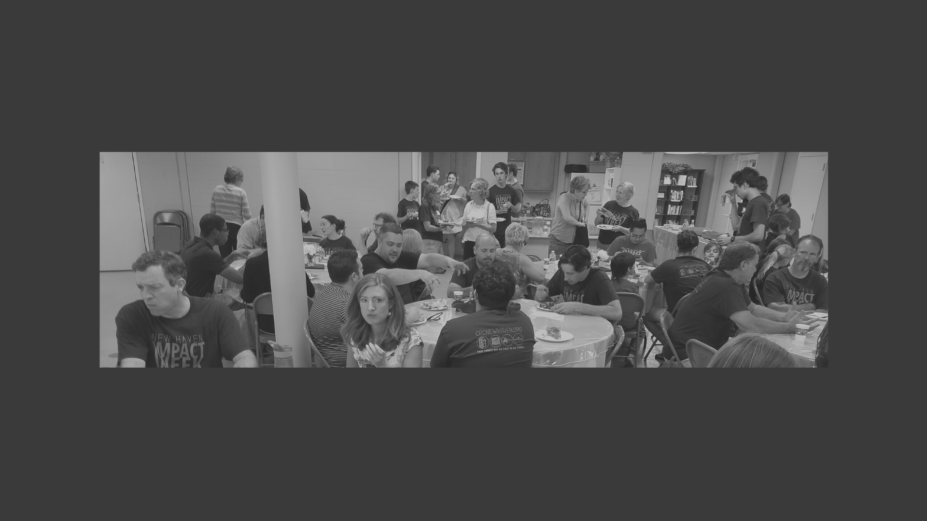
VOW THREE
Do you now resolve and promise, in humble reliance upon the grace of the Holy Spirit, that you will endeavor to live as becomes the followers of Christ?

Slide 107
The Grace of Stop Sinning and Good Works
Titus 2:11 For the grace of God has appeared, bringing salvation for all people, 12 training us to renounce ungodliness and worldly passions, and to live self-controlled, upright, and godly lives in the present age, …redeem us from all lawlessness and to purify for himself a people for his own possession who are zealous for good works.
Set Free To Flourish in the rediscovery of who we REALLY are and what REALLY syncs with the reality that God created
John 10:10 The thief comes only to steal and kill and destroy. I came that they may have life and have it abundantly.
Set Free From the oppressive bondage of idolatry (S Cycle Restoration)
Sin (Giving Ourselves to Idolatry) /Servitude( Idol can’t satisfy and when don’t blame us and asks for more) /Supplication: (Repentance and Faith)/’Salvation
Set Free to Participate with Christ In Kingdom Work
John 20:21 Jesus said to them again, “Peace be with you. As the Father has sent me, even so I am sending you.”
Set Free to partake of the divine nature in growing intimacy with Christ.
John 14:23 Jesus answered him, “If anyone loves me, he will keep my word, and my Father will love him, and we will come to him and make our home with him.
:
:

Slide 108
The Gospel Relation of “Law and Grace”
High Law /Low Grace
Moralistic
Low Law /Low Grace
Phariseistic
High Grace /Low Law
Hedenistic
High Grace /High Law
Gospel

Slide 109
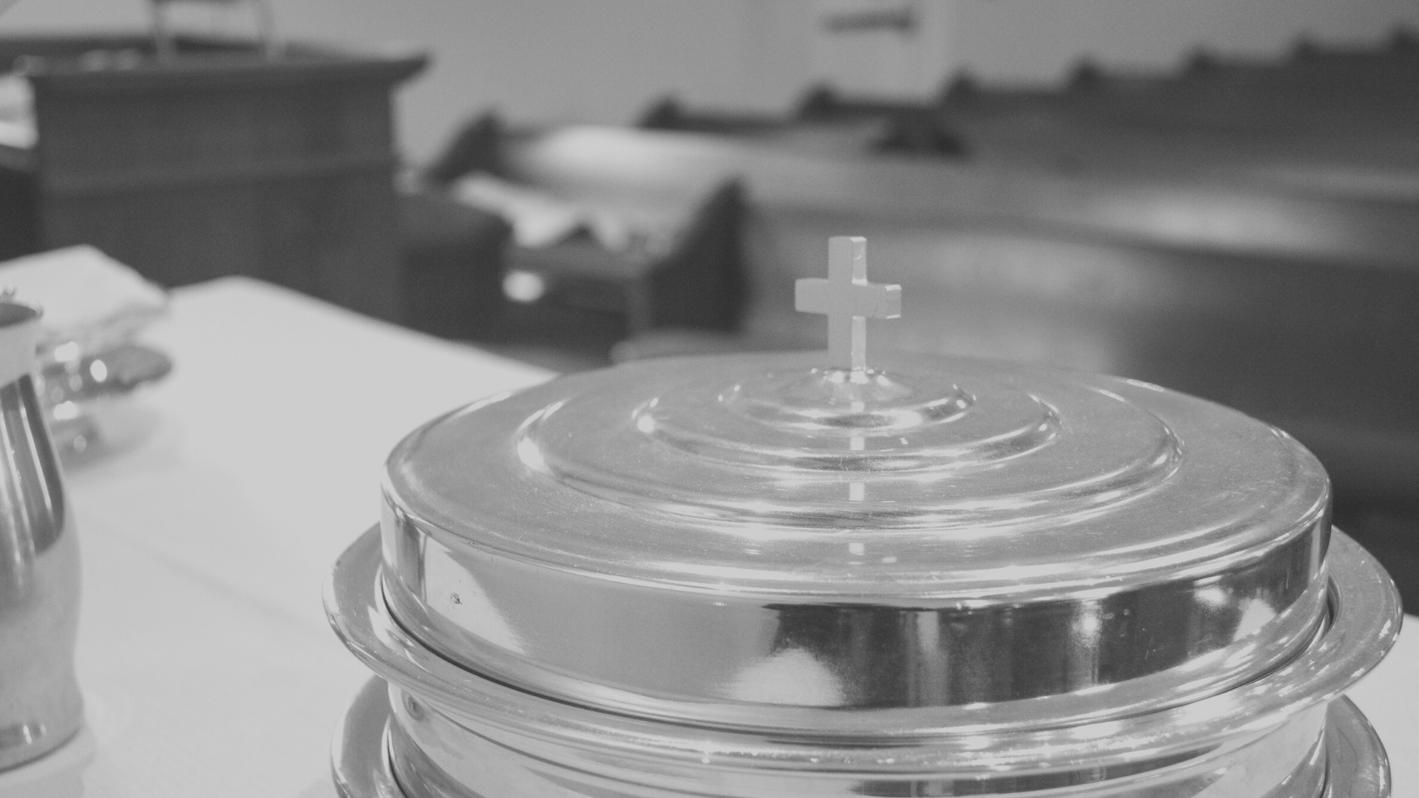
Vs. Moralism High Law /Low Grace “law obeying and law relying”
Works Righteousness
Feelings of guilt all the time
People are too big God is too small
Afraid of Religion and Religious Topics
Tends to stay away from church. (“When I get my life altogether I will go back to church)
If in church, will stay in the margins. Won’t get too close to center because will make them feel guilty if they do.
Within Christendom but not a happy Christian

Slide 110
Vs. Phariseeism Low Law/Low Grace “reduced law obeying and law relying”
Very works righteousness centered
Externally project confidence of being right all of the time
On the surface they are law obeying but in reality they are law disobeying
Emphasis personal ethics vs. communal ethics as per the needs of others
Internally lots of insecurity, reacts aggressively to criticism
Judgmental & condemning to others in order to make themselves feel more secure
Seems to be law-keeping but really reduced the law after their own image while denying the ultimate goal of love
Mainly consists of people who go to church
Self-righteous and a “them vs. us” orientation
It is a kind of Christendom without Christ

Slide 111
Vs. Hedonism Low Law /High Grace “law disobeying and not law relying”
Very works righteousness centered
Grace centered without righteousness
Post-Christendom
Monistic spiritualism – Christian Buddism, Hinduism
God is in all of us – own standard for you own religion
Their own moral standards is God’s standard
The ultimate goal is personal freedom
Usually they are happier and more of a joy to be with
Highly individualistic
Lack of a practical common good ethic.

Slide 112
The Gospel High Law /High Grace “law seeking not law relying”
Faith-righteousness and gracious
High view of the law
Saved by Christ’s works of the law as credited to us by faith
Safe to be morally flawed and broken such that we make it safe for others to be flawed and broken.
The Gospel centered life

Slide 113
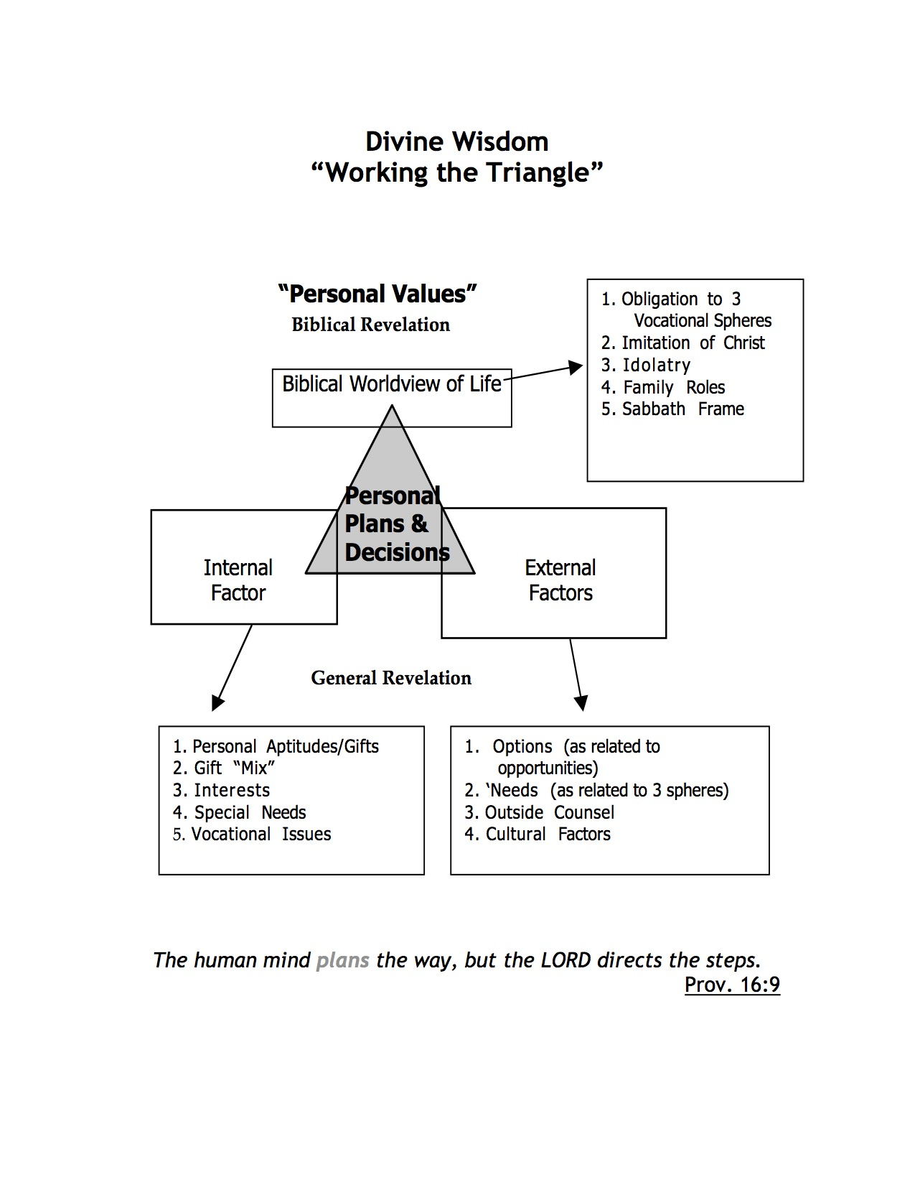
Wisdom Toward Sanctification
Prov. 3:5 Trust in the LORD with all your heart, and do not lean on your own understanding.6 In all your ways acknowledge him, and he will make straight your paths.

Slide 114
VOW FOUR
Do you promise to support the Church in its worship and work to the best of your ability?

Slide 115
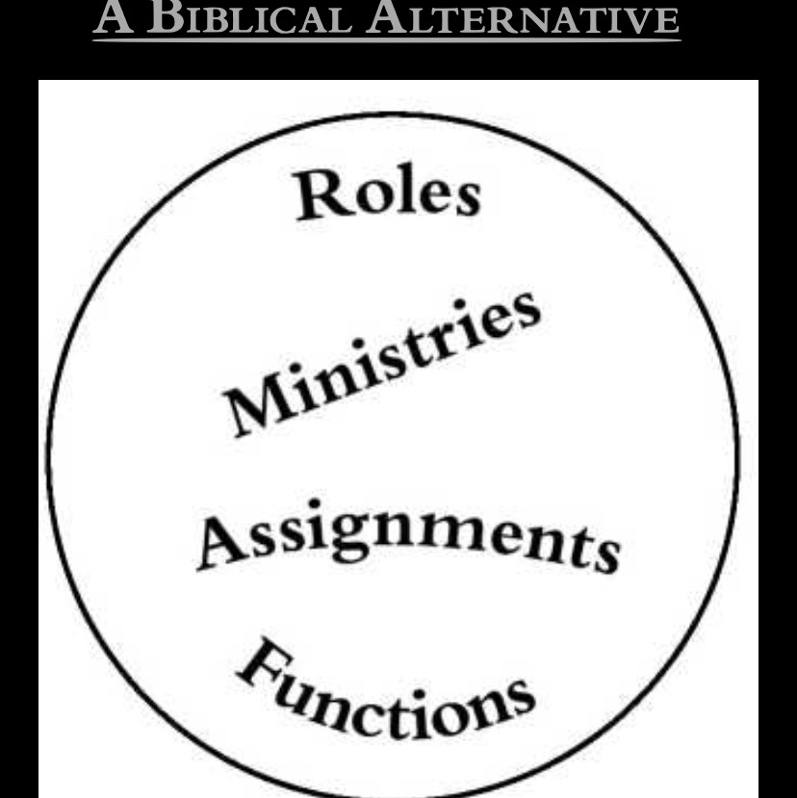
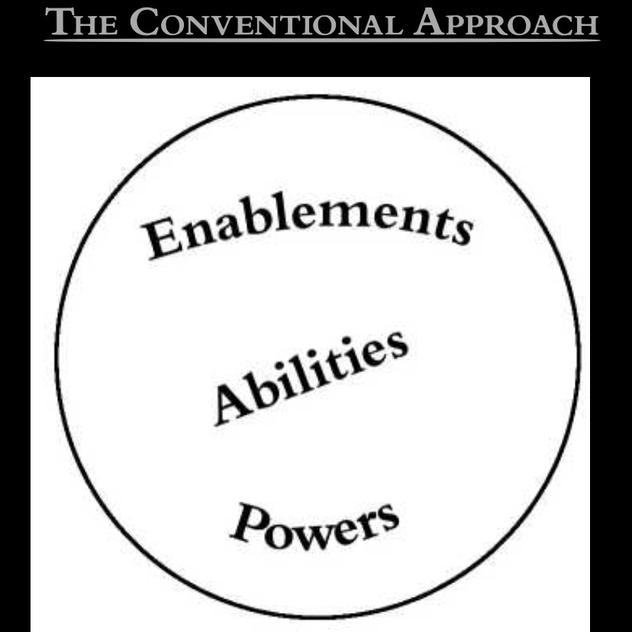
Spiritual Gifts? Or “Ministries”!
We believe that the so-called spiritual gifts should not be viewed as special abilities to do ministry; rather, they should be viewed as the ministries themselves. Every believer has been assigned by the Holy Spirit to specific positions and activities of service, small and large, short-term and long-term. These ministry assignments have been given by the Holy Spirit to individual believers and, in turn, these individuals in their ministries have been given as gifts to the church.
Note the Greek Word “Charismata” (often translated “spiritual gifts’ is really just “spiritually empowered”—e.g. begs the “what” is empowered-- Paul’s careful explanation and 1 Cor 12:4-6
Now there are distributions of spiritually empowerments (charismata), but the same Spirit. And there are distributions of areas of service [diakoniai], but the same Lord. And there are distributions of workings [energemata], but the same God who works all things in all persons.' (1 Cor. 12:4-6)

Slide 116
We All Are Empowered!
Every individual Christian related to the corporate Body of Christ is essential!
1 Cor 12: 15 18 But as it is, God arranged the members in the body, each one of them, as he chose. 19 If all were a single member, where would the body be? 20 As it is, there are many parts, yet one body... 21 The eye cannot say to the hand, “I have no need of you,” nor again the head to the feet, “I have no need of you.” 22 On the contrary, the parts of the body that seem to be weaker are indispensable, 23 and on those parts of the body that we think less honorable we bestow the greater honor, and our unpresentable parts are treated with greater modesty,
The focus of our individual spiritual services?
1Cor 12: 7 To each is given the manifestation of the Spirit for the common good (relative to the body of Christ).
WCF Chapter 20.1
All saints, that are united to Jesus Christ their Head, by his Spirit, and by faith, have fellowship with him in his graces, sufferings, death, resurrection, and glory: and, being united to one another in love, they have communion in each other's gifts and graces, and are obliged to the performance of such duties, public and private, as do conduce to their mutual good, both in the inward and outward man

Slide 117
“There’s no ‘I’ in “Church”
What does that mean about how we discern what our ministry/service/activity should be?
The conception of salvation as an individual matter between me and God is utterly foreign to Paul's preaching. To be in Christ, in the Lord, in the Spirit means to be in the community of Christ, the Lord, and the Spirit. The communal context of the believer's life is of the greatest importance for Paul's understanding of how the Christian is able to know what he ought to and ought not to do. It is always a matter of choosing and doing what is good for the brother and what will upbuild the whole community of brethren.
Richard Hayes, Ecclesiology and Ethics in 1 Corinthians,
The more clearly we learn to recognize that the ground and strength and promise of all our fellowship is in Jesus Christ alone, the more serenely shall we think of our fellowship and pray and hope for it.... We can meet others only through the mediation of Christ: before I could begin to act, Christ acted decisively for my brother; I must meet him only as the person that he already is in Christ’s eyes.
Dietrich Bonheoffer, Life Together

Slide 118
Our Ministry Map
Finding Your Way Around
Our Website and Church

Slide 119
Website: cpcnewhaven.org
Website

Slide 120
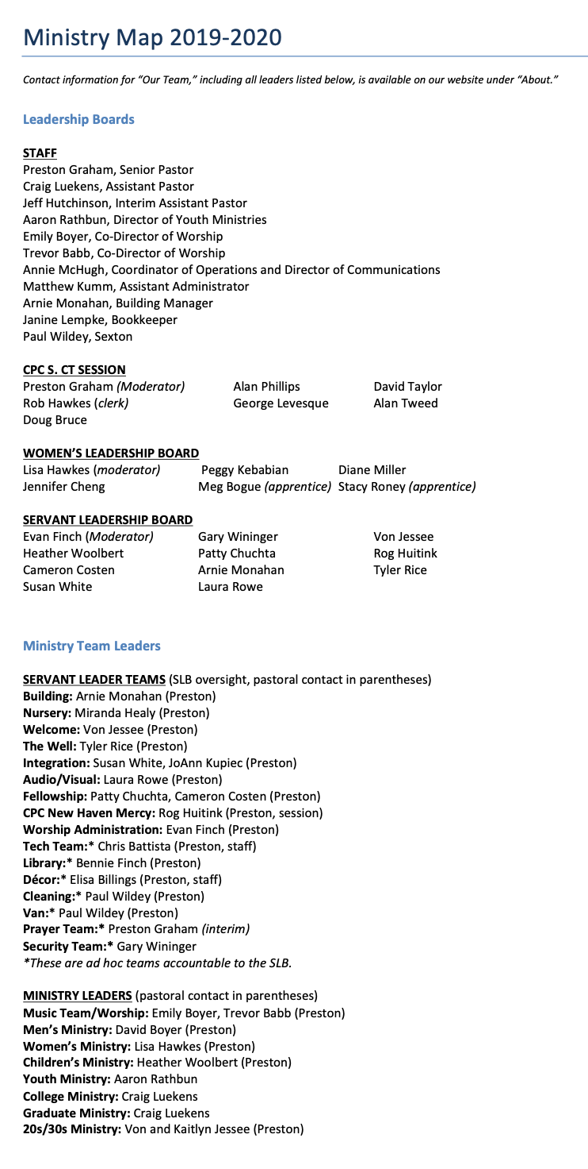
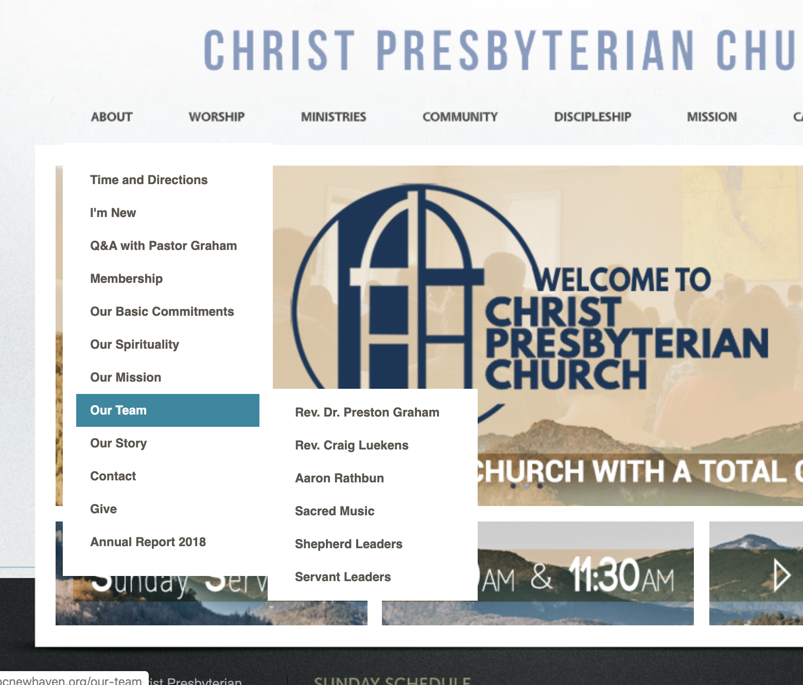
Ministry Map

Slide 121
Leadership Boards

Slide 122
Servant and Ministry Teams

Slide 123
Life Groups

Slide 124
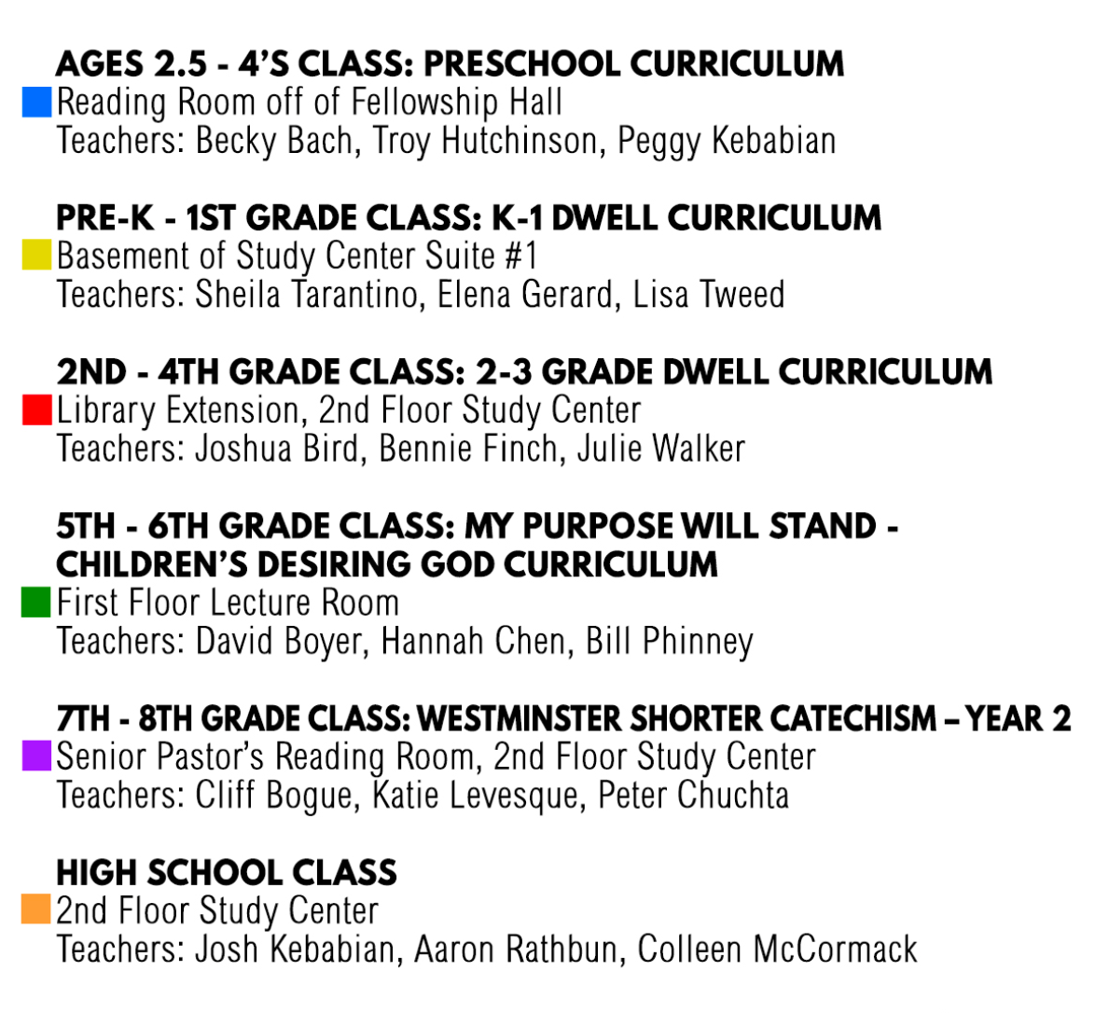
Sunday School

Slide 125
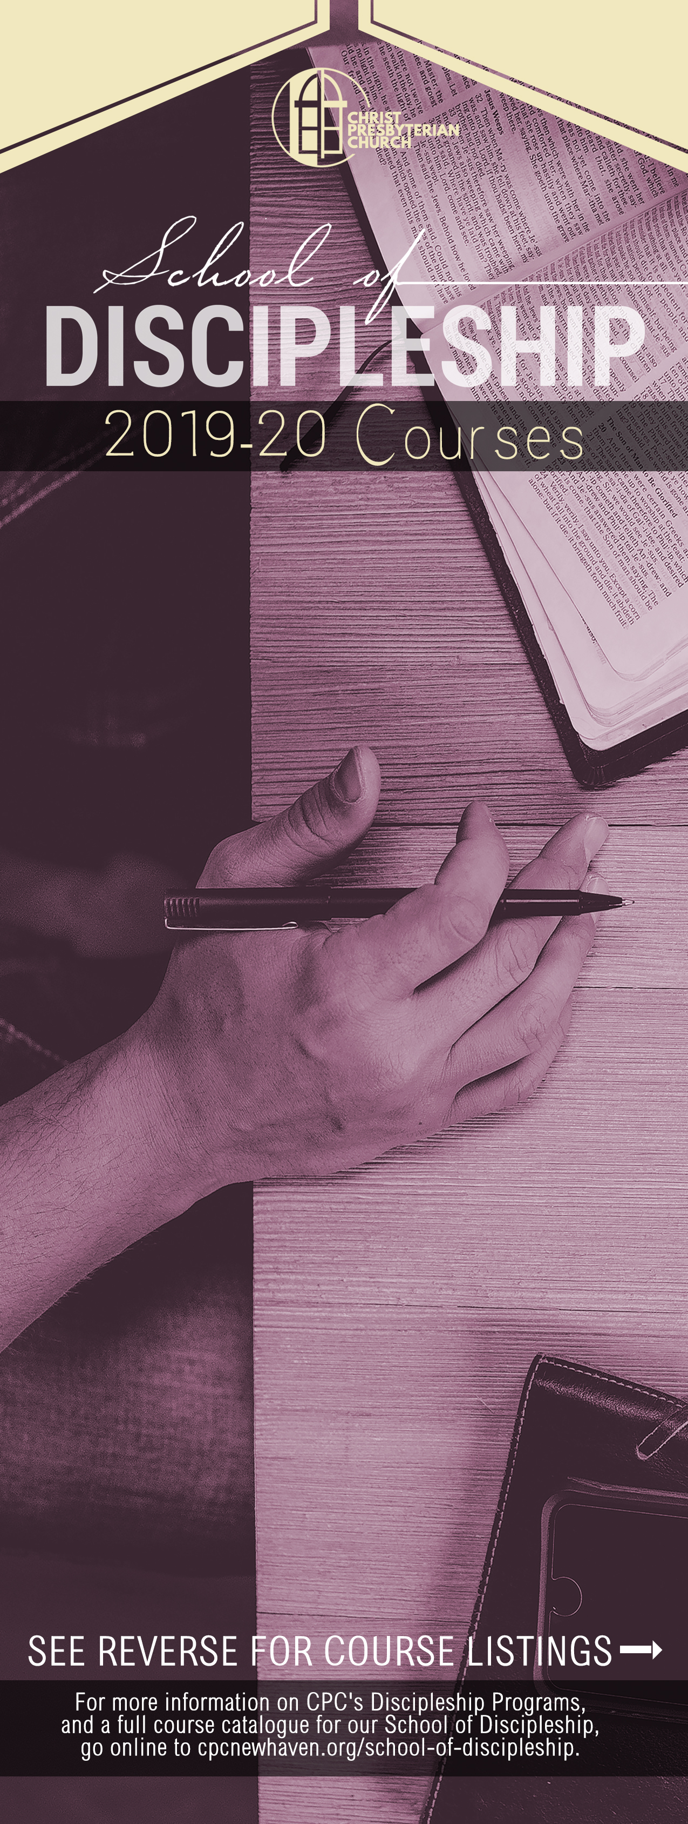
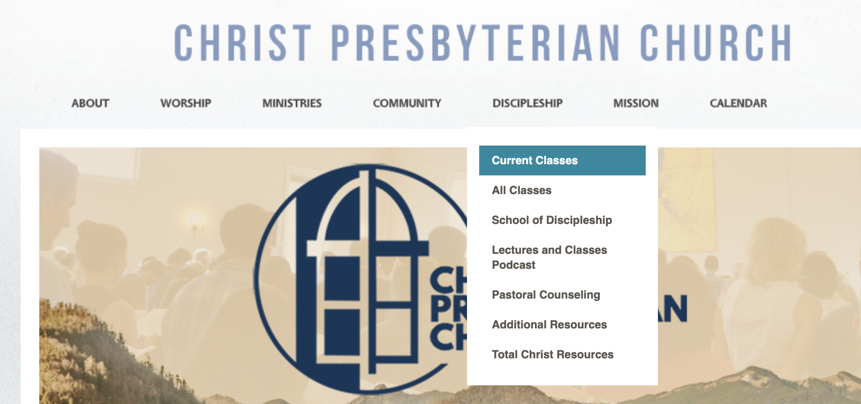
School of Discipleship

Slide 126
Forms and Handbooks

Slide 127
Calendar

Slide 128
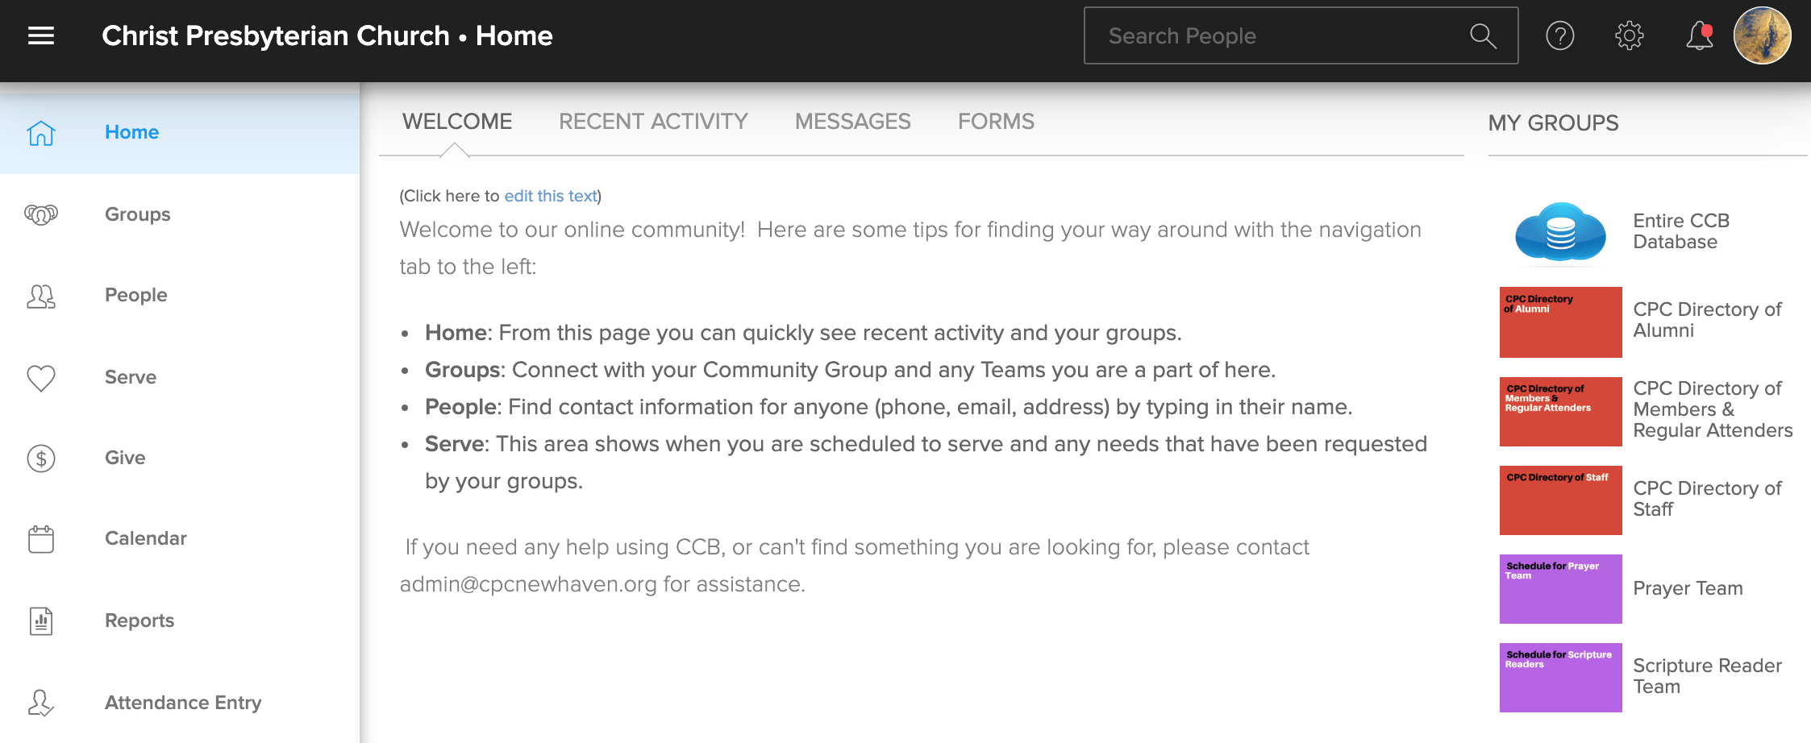
Church Community Builder

Slide 129
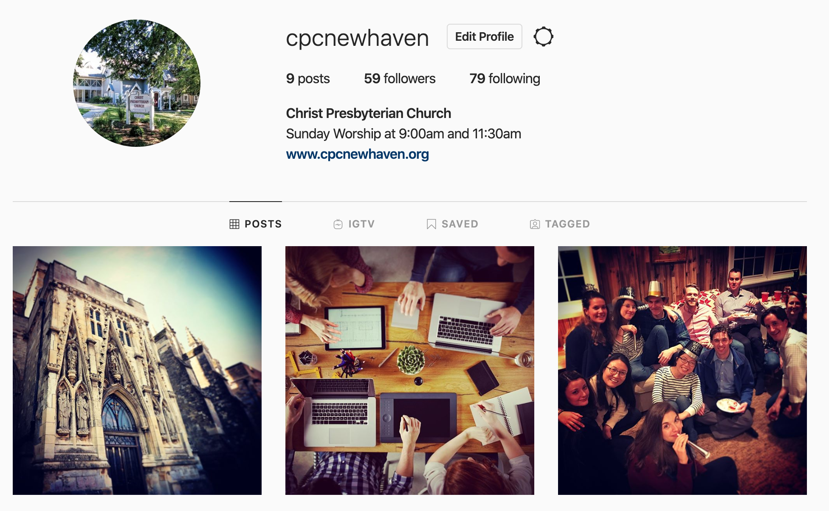
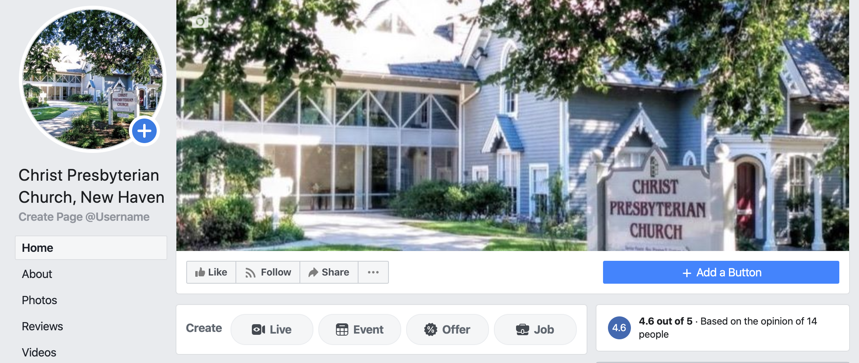
Social Media
cpcnewhaven
christ presbyterian church new haven

Slide 130
VOW FIVE
Do you submit yourselves to the government and discipline of the Church, and promise to study its purity and peace?

Slide 131
Leader- Member Relations In Scripture
The Charge to Leader:
1Pet. 5:1 So I exhort the elders among you.. 2 shepherd the flock of God that is among you, exercising oversight, not under compulsion, but willingly, as God would have you; not for shameful gain, but eagerly; 3 not domineering over those in your charge, but being examples to the flock..
The Charge to Members
Heb. 13:7 Remember your leaders, those who spoke to you the word of God. Consider the outcome of their way of life, and imitate their faith.
Heb. 13:17 Obey your leaders and submit to them, for they are keeping watch over your souls, as those who will have to give an account. Let them do this with joy and not with groaning, for that would be of no advantage to you.

Slide 132
Government as “Good News”
1 Peter 5:1-5
How does Peter describe church government- as doing what exactly?
Notice the “not’s” and the corresponding exhortations to those who are “elders.”
Notice also the exhortation to those who are the recipients of church government
How then would government in the spirit of 1 Peter 5 be “good news”?
Hebrews 13:7-17
Notice carefully how vs. 7 and vs. 17 are both directed to the recipients of church government even as to begin and end unified argument?
So what is the point of vs. 8-16 in relation to 7 and 17 do you think?
How then does vs. 8-16 explain the conclusion in vs. 17,
What do you think is the relation between the exhortation in vs. 7, and then the context of vs. 8-16? What are the dangers to the gospel that are in view here and that require church government?

Slide 133
Argument for Divine appointment of Church Discipline from Scripture:
1. Direct institution of Church discipline and ecclesiastical censures by Christ Himself:
(Matt.16:18ff, Matt.18:15-18, John 20:21-23)
2. Apostolic practice as foundation :
(Eph.2:20, 1 Cor.4:18-21; 5:1-13, 2 Cor. 2:1-10; 7:8-12;, 10:2-8; 13:2-10, 1 Tim..1:19-20)
3. Directions given in Scripture for the manner of its exercise:
(1 Tim. 5:20; 2 Tim.2:24-26, Jude 23, Tit. 3:10; 2 Thess.6-14ff
4. Directions given in Scripture for the manner of its reception:
(Hebrews 13:17ff, Romans 13:1-4, 1 Peter 5:5)

Slide 134
Three Goals of Discipline
1. Glory of God and honor of religion
(1 Cor.6:20, Eph. 3:20-21)
2. Purity of Church
(1 Cor. 5:6-8)
3. Reclamation of the wayward:
(Mt.18:15-20, 1 Cor. 5:5, 2 Tim.2:24-26

Slide 135
Three Goals of Discipline
1. The positive Dimension: "teaching to observe all that Jesus commanded
Instruction, Catechism, Corporate Worship, Godly example, Sacraments, Other?) ”
Matt. 28:18-20, 1 Tim.4:6-16
2. The prevenient dimension: "watching over souls to prevent their going astray.
Regular Visitations, Prayers
Heb. 13:17, 1 Peter 5:1-4
3. The remedial dimension: "correcting or pronouncing judgment on the wayward."
Private stage: "go and point out the fault when the two of you are alone.'
Arbitration stage: "But if you are not listened to, take one or two others along with you" (note: who one takes must be carefully considered as one who is a christian witness and is in him/herself a mature and responsible Christian. Preferably an officer of the church.)
Ecclesiastical/formal stage: "If the member refuses to listen to them, tell it to the church." (Note: "church" in Mt. 18 refers to ruling/ judicial courts. See previous study on "church.")
1 Cor. 5, 2 Tim. 2:24-26, 1 Tim. 1:19-20

Slide 136
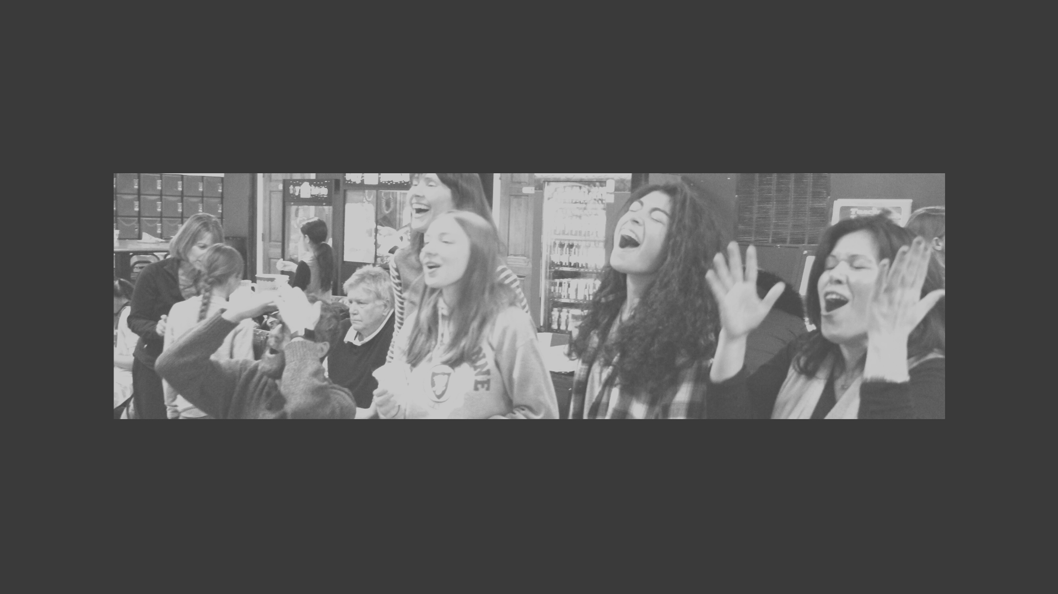
PROCESS FOR JOINING
“Sealing the Deal” (Five Steps)

Slide 137
Step 1:
Review CPC’s Five Commitments To You
(See below Slides)

Slide 138
1. We are committed to the Old and New Testament Scriptures as our only rule of faith and practice.
While believing that God powerfully manifests his infinite glory in a general way through creation, our Christian faith and practice is grounded in God’s works of redemption in history as explained to us through the divinely appointed means of inspired Scripture. We believe that all things necessary for salvation are sufficiently revealed to us by the Holy Spirit speaking through the Scriptures of the Old and New Testaments. We believe also that all special revelation has ceased until the next and final redemptive act of God in history when Christ will return to judge the living and the dead. It is, therefore, our ambition to teach the whole counsel of God’s word, neither adding to, nor subtracting from anything contained within it, recognizing no other source for divine revelation, whether by ecclesiastical traditions or private revelations.

Slide 139
Word (Covenant)) As An Essential Element Of The Gospel
Without covenant, there can be no justification (forgiveness) by grace through faith alone as applied to our relation to God.
Our creation itself is under the terms of the covenant (c.f. Gen 2:16) such that we remain right with God by “works of the law” (e.g .covenant).
And because of the “fall” (Gen 3:6-7) no person can fulfill the works of the law and be justified in God’s sight. (Rom 3:20)
Grace, by definition, cannot be earned but must be freely given. (Rom. 6:23)
And yet by the terms of the covenant Christ is legally appointed by God to represent us in satisfying the covenant as our ‘covenant executor.” (Rom 5:15-21)
By this transaction, we are “legally” justified in Christ by grace such as to be set free from the fear of God’s righteous condemnation. (Rom 8:1ff)

Slide 140
2. We are committed to reading scripture with the Church throughout the ages as summarized in the historic Westminster Confession of Faith.
Whereas the Holy Scriptures are our only rule of faith and practice, our Church unity is predicated upon a consensus about what the Scriptures principally teach. Our consensus is reflected in the 350–year-old Westminster Confession of Faith. In summary, it affirms that God is no less sovereign in our salvation than he is sovereign in our creation, to the praise of God’s glorious grace! This means that we are accepted by God, from beginning to end, not by our own works or attempts at being approved by God, but by faith alone in the perfect and all-sufficient work of Christ on our behalf, faith itself being the free gift of God! While many people join our church without knowing or affirming all the teachings contained in the Westminster Confession of Faith, our church, when acting and speaking corporately, seeks to be in accord with the Westminster Standards.

Slide 141
3. We are committed to God-centered worship designed after a covenantal pattern that is in the mediated presence of Christ through word and sacrament.
In every period of redemptive history, God has chosen to mediate his saving presence among his people through the divine institutions of word, sacraments, and prayers. Today, through the sacraments of the Lord’s Supper and Christian Baptism, together with the preaching of God’s word and corporate prayers (both sung and spoken), God has promised to be with us until the end of the age. Our worship is set to the pattern of covenant initiation and renewal, including the weekly participation in the Lord’s supper. Our music and style of worship is “blended” to reflect the vernacular context of those God has brought to our city. Our desire is for our worship to be as God-centered as our theology, communicating the truth and grace of God to the nations. We welcome all believers together with those who are searching.

Slide 142
4. We are committed to being a multi-cultural church and church planting movement.
We believe that the church, the household of God, is an essential element of the gospel into which people of every tribe and nation are welcomed. While affirming that every follower of Christ is called to be a witness to the truth and grace of God revealed in Jesus Christ in both word and deed, we also believe that true evangelism is best accomplished through church planting. It is therefore our ambition to be not only a growing church, but also a growing church planting movement. While holding to a time-honored understanding of faith, we are strategically progressive. Our aim is to plant churches that reach the different cultures in our city, Southern New England, and the world.

Slide 143
5. We are committed to a high view of Christian calling as reflected in the vocational spheres of family, church, and public service.
We believe that God has placed into our lives the boundaries of our habitation that reflect his own sovereign design to accomplish his work in the world. His work extends into the spheres of family, church, and civil vocations. We desire to help people find a balance that is unique to their individual callings as a disciple of Christ that reflects a high view of vocations and calling as “unto the Lord.” While believing that the Christian Scriptures do not address all things pertaining to life in this world, we do affirm that we should take “every thought captive to the obedience of Christ,” and that the Christian worldview is applicable and relevant to all spheres of life. While ”seeking first the kingdom of God, we are commitment to the restoration of “calling” wherein we are more and m=ore being restored as the image of God for the purpose of glorifying God as both our Creator and Redeemer and enjoying Him forever!

Slide 144
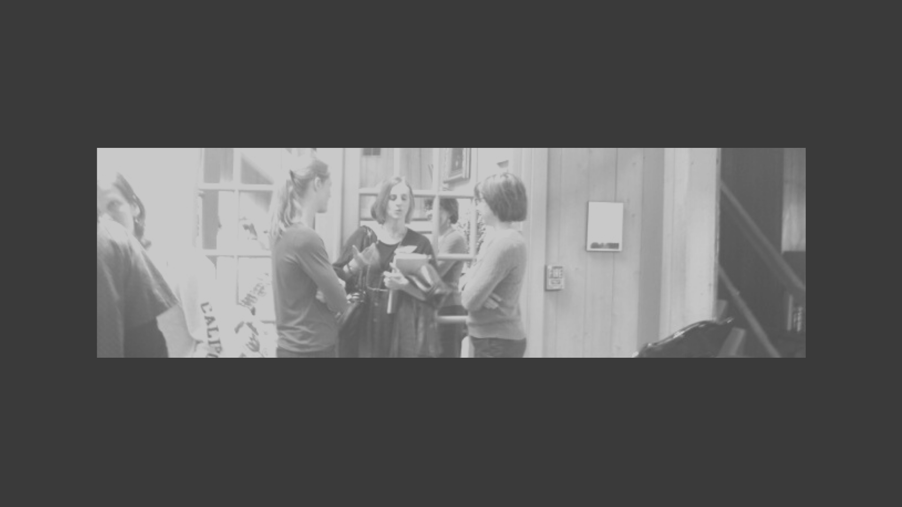
STEP 2:
Review Responsibilities of Membership
(See Below Slides)

Slide 145
Regular Attendance
All members are expected to be faithful and regular in their participation in Lord’s Day worship unless providentially hindered; we believe this to be a duty, not an option. With regard to other church activities (such as Sunday school, small groups, and men’s and women’s groups), members are strongly encouraged to take advantage of such opportunities in an effort to grow in God’s grace and build up the body of Christ
Heb. 10:25 not forsaking our own assembling together, as is the habit of some, but encouraging one another; and all the more as you see the day drawing near.

Slide 146
Service
The bread that we break, is it not a participation in the body of Christ? Because there is one bread, we who are many are one body, for we all partake of the one bread.
1 Cor 10:16-17
Every believer has been assigned by the Holy Spirit to specific positions and activities of service, small and large, short-term and long-term. These ministry assignments have been given by the Holy Spirit to individual believers and, in turn, these individuals in their ministries have been given as gifts to the church.
Therefore it is important for every member, with the help and guidance of the Church, to diligently search for opportunities to serve in the body of Christ. (Ephesians 4:7,16, Romans

Slide 147
Promotion of Edification and Peace
We are many members but one body, and thus we should all strive for the health and peace of that body (1 Corinthians 12:12-27; Ephesians 4:4, 11-16).
Members therefore ought actively to cultivate relationships with one another so that they may be better able to pray for one another; to love, comfort and encourage one another; to bear with one another and forgive whatever grievances they may have against one another; and to help one another materially as occasion may require.
Members ought to be careful to season their speech with grace such that the body of Christ is built up in peace. If one member notices another in sin, that member ought to follow the instructions of Matthew 18:15-20, namely to go to that person in private having said nothing to anyone else. If this fails, take another member, preferably an elder, to talk with the person. This failing, the issue ought to be brought to the attention of the session of elders (representing the whole church) for further instruction and discipline.

Slide 148
Systematic and Proportionate Financial Support
It is clearly taught in Scripture that it is the duty and privilege of all Christians to support financially the work of the Kingdom of God. Members should be committed to regular, proportional, significant, and sacrificial giving to the Lord’s work. No precise amount or percentage has been prescribed under the New Covenant. We should all be seeking to grow in the grace of giving and to demonstrate our commitment to Christ and his Kingdom in this most tangible and measurable way.
(1 Corinthians 16:1-4; 2 Corinthians 8 and 9)

Slide 149
Support of and Submission to Leadership
All who join this Church are expected to support and submit to the authority of the elders of the Church. Supporting the elders involves respecting them (1 Thessalonians 5:12-13); praying for them and their shepherding labors (Ephesians 6:18-20); and not entertaining false accusations against them (1 Timothy 5:19). Submitting to the elders entails heeding their teaching of and counsel from the Scriptures as those appointed to watch over the souls of Christ’s flock (Acts 20:28, Colossians 1:28; 1 Timothy 3:5-Hebrews 13:17; 1 Peter 5:1-4)

Slide 150
Prayer
Members ought to pray regularly for the church – namely that Christ may be glorified through the making of the disciples by the preaching, teaching and administration of the sacraments.
For God to open up many more opportunities for the Gospel of Christ to be proclaimed in truth and grace and for it to spread rapidly. (Col.4:3; 2 Thess.3:1)
For the Word that was preached on Sunday to remain steadfast in the minds and hearts of the hearers leading to Christian growth. (2 Thess. 3:1).
That God would enable us to grow in the grace and knowledge of Jesus Christ as evidenced in sound doctrine and holy living so that we might live to please God.. (Col.1:9-12; Rom.12:1-2)
For our Church and Teachers That God would be pleased to produce Spiritual fruit through their labors.(2 Th.3:1)
That our love for each other would abound more and more in Biblical knowledge as evidenced by many tangible manifestations.(Ph. 1:10-11, Rom. 12:9-13)
. For our worship to be God-centered and for His glory (Rom. 16:25-27; Col.3:15-17) rather than human centered for personal entertainment or aesthetic experience. (Acts 7:48-50, 17:24-25)

Slide 151
STEP 3:
Pastoral Consultation
(Review Questions From Membership Seminar and Confidential Spiritual Check-up and Consultation
Arrange for meeting through CPC Administrator

Slide 152
STEP 4:
Membership Interview with Committee of Shepherd Leaders
(Based on 5 Membership Vows)
Arrange for meeting through CPC Administrator

Slide 153
PUBLIC VOWS: (See above on Vows)
3 Ways to Join:
By Transfer
By Reaffirmation
By Profession of Faith (and if needed Christian Baptism)

