Slide 1
Fire Safety Training
Richardson Fire Systems Inc.

Slide 2
Supervisory Staff
Fire Safety Committee
Property Committee
Custodian

Slide 3
Supervisory Staff
CHIEF FIRE WARDEN
Day time hours | Custodian
 | Administrative Staff
Evening Hours | Administrative Staff – if present at a meeting
 | Program Coordinator – Cadets, Friendship, Youth Group, GEMS
All Hours when a large congregational group is present | Sunday Services – key holder of the day Congregational Gatherings/Meetings – whomever coordinated the event or designate.

Slide 4
Supervisory Staff
FIRE WARDEN
On Sundays | On duty Ushers, deacon #4+5, hall monitor
Weekdays
Mornings | Along with Administrative Staff
 | - LAFF – Coordinators - Office – Secretary - Coffee Break – Coordinator - Nursery Attendant, - Story Hour Leader – (Little Lambs and Home School group)
Evenings | Coordinators of each program or their designate - Cadets - GEMS - Friendship - Youth Group - Worship Teams - Church meetings – Administration or designate

Slide 5
Supervisory Staff
ASSISTANT FIRE WARDEN
On Sundays | - Nursery Attendants, - Sunday School Teachers - Sound Booth technicians - Worship Team

Slide 6
Implementation of Fire Safety Plan – Create Supervisory Staff, Posting of Emergency Procedures,
Maintain List of Non-Ambulatory Persons (Staff members)
Maintain records of all training of Supervisory Staff.
Maintain records of all Fire Drills
Review and ensure Kitchener Fire Department has updated FSP
Ensure all maintenance of Fire Protection equipment is completed as per Ontario Fire Code.
Ensure Fire Alarm panel is not silenced or reset until KFD has arrived.
Duties
Supervisory Staff – FIRE SAFETY COMMITTEE

Slide 7
Know and understand the Fire Safety Plan
Be familiar with your floor area, fire protection equipment and Exits
Participate in all fire drills
Assist in fire prevention by notifying the Property Committee of any hazards
Ensure Fire Alarm panel is not silenced or reset until KFD has arrived.
Assist in keeping the Non-Ambulatory List up-to-date
Duties
Supervisory Staff – CHIEF FIRE WARDEN / FIRE WARDENS

Slide 8
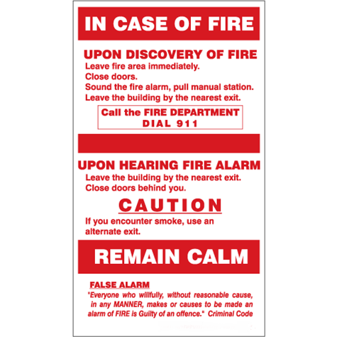
Emergency Procedures

Slide 9
Leave the fire area immediately.
Close all doors.
Sound the fire alarm; pull the closest pull station.
Leave the building by the nearest exit.
CALL 9–1–1
Do Not Re-enter until it is declared safe to do so by KFD.
Emergency Procedures
If You Discover A Fire

Slide 10
SUNDAY
Keyholder of the day will be the chief fire warden (c.f.w); will stay at the front.
Usher 1 (hall monitor) goes to help the Sunday school rooms and nurseries.
Usher 2a (f.w) infant nursery and Sunday school rooms.
Usher 2b (f.w) toddler nursery and Sunday school rooms.
Usher 3 (f.w) out sanctuary door 4, piano side double door, and directs flow of traffic.
Deacon 4 (f.w) goes to the welcome centre and directs out doors 1 + 2.
Deacon 5 (f.w) goes to the existing washrooms and directs out door 9.
Pastor will read slide off the pulpit then follow the congregation out.

Slide 11
Proceed to the main entrance with master keys (C.F.W./key holder).
Acquire the list of Individuals Requiring Special Assistance from Fire Safety Plan binder (C.F.W/key holder)
If safe to do so, send a fire warden (usher) try to find the cause the alarm (i.e. fire, false alarm, fire is extinguished, etc…) and report back conditions to C.F.W
Call 9-1-1 to report the fire alarm condition (C.F.W/key holder).
If safe to do so, at least 2 fire wardens will check all rooms to confirm total evacuation.
Meet the Fire Department at the main entrance to provide them with master keys, location of physically challenged persons, affected fire area and any pertinent information (C.F.W/key holder)
Receive an evacuation report from the evacuation area Fire Warden.
Emergency Procedures
If You Hear a Fire Alarm Signal – Chief Fire Warden

Slide 12
Sunday School Teachers duties
Take attendance each Sunday.
Upon hearing alarm, have children immediately line up at the door.
take clipboard with attendance
Leave room if it is safe to do so.
Proceed to evacuation point and do roll call for your Sunday School children and any other minor’s.
Show appropriate emergency response card;
green - all good
red – need help
DO NOT LEAVE evacuation point or let parents take children from the area
Follow usher’s and/or firefighter’s direction
Emergency Procedures
If You Hear a Fire Alarm Signal – Fire Warden

Slide 13
Infant Nursery Attendant duties
Identify at the beginning of each service - Nursery Attendant # 1
Maintain accurate attendance record of nursery children each Sunday
Upon hearing the alarm place children in emergency crib (do not take them out of car seats). Advised to exit door 5 as there is a ramp. If not accessible, use next closest exit.
Nursery Attendant #1 - collect clipboard and emergency bag.
Leave room if it is safe to do so.
Proceed to exit the building using the emergency crib
Proceed to evacuation point #2 –front right upper parking lot by hill gym/kitchen side
Take attendance of all Infants and other minors
Show appropriate emergency response card;
green - all good
red – need help
DO NOT LEAVE evacuation point or let parents take children from the area
Follow usher’s and/or firefighter’s direction
Emergency Procedures
If You Hear a Fire Alarm Signal – Fire Warden

Slide 14
Toddler and Preschool Attendant duties
Identify at the beginning of every service – Toddler Attendant #1
Maintain accurate attendance record of toddler and preschool children each Sunday
Toddler Attendant #1 - Upon hearing alarm collect clipboard
Leave room if it is safe to do so
Proceed to evacuation point #1 front upper left parking lot by hill office side
Take attendance of all Toddler and Preschool children and any other minor’s
Show appropriate emergency response card;
green - all good
red – need help
DO NOT LEAVE evacuation point or let parents take children from the area
Follow usher’s and/or firefighter’s direction
Calmly escort the occupants outside to the area of assembly. Ensuring that all students that require assistance to evacuate are assisted.
Provide the assistance necessary to maintain a calm and orderly evacuation.
Upon reaching the area of assembly; fire wardens will perform a head count and compare numbers with their attendance list if applicable.
Provide a total evacuation of area to the Chief Fire Warden.
Emergency Procedures
If You Hear a Fire Alarm Signal – Fire Warden

Slide 15
Fire Wardens - Weekdays
Staff and Program Coordinators will;
Acquire the day’s attendance list.
Close all windows in the room.
Exit the building to the area of assembly
Close all doors you pass.
Upon reaching the area of assembly; fire wardens will perform a head count and compare numbers with their attendance list if applicable.
At least one Fire Warden will remain in the area of assembly. Others, after exiting will report to the main entrance and will assist the Chief Fire Warden in looking for the cause of the alarm if safe to do so. (i.e. fire, false alarm, fire is extinguished, etc…)
Provide a total evacuation report to the Chief Fire Warden at the main parking lot entrance.
PREVENT PERSONS FROM ENTERING BUILDING.
Follow the instructions of the Fire Department.
Emergency Procedures
If You Hear a Fire Alarm Signal – Fire Warden

Slide 16
Note:
All groups will maintain and have immediate access to registration/attendance record for all minors/vulnerable persons as designated by Safe Church Policy
Emergency Procedures
If You Hear a Fire Alarm Signal – Fire Warden

Slide 17
The following staff will also;
Story Hour Leader – (Little Lambs and Home School group)
Know how many children you have every Story Hour, Little Lambs, and Home School Programs – take attendance
Upon hearing alarm have children immediately line up at the door
Take attendance clipboard and emergency bag.
Leave room if it is safe to do so
Close door
Proceed to evacuation point 2 – Front right upper parking lot by hill gym/kitchen side.
Perform a roll call for your Sunday School children and any other minor’s
DO NOT LEAVE evacuation point or let parents take children from the area
Follow usher’s or firefighter’s direction
Emergency Procedures
If You Hear a Fire Alarm Signal – Fire Warden

Slide 18
Infant Nursery Attendant duties
Maintain accurate attendance record of nursery children each Sunday
Upon hearing the alarm place children in emergency crib (do not take them out of car seats)
Nursery Attendant #1 - collect clipboard and emergency bag.
Leave room if it is safe to do so.
Shut door
Proceed to exit the building using the emergency crib. Advised to exit door 5 as there is a ramp. If not accessible, use next closest exit
Proceed to evacuation point #2 - front right upper parking lot by hill gym/kitchen side
Take attendance of all Infants and other minors
DO NOT LEAVE evacuation point or let parents take children from the area
Follow usher’s or firefighter’s direction
Emergency Procedures
If You Hear a Fire Alarm Signal – Fire Warden

Slide 19
Toddler and Preschool Attendant duties
Maintain accurate attendance record of toddler and preschool children
Upon hearing alarm collect clipboard
Leave room if it is safe to do so
Close door
Proceed to evacuation point #1 front upper left parking lot Office side
Take attendance of all Toddler and Preschool children and any other minor’s
DO NOT LEAVE evacuation point or let parents take children from the area
Follow usher’s and/or firefighter’s direction
Emergency Procedures
If You Hear a Fire Alarm Signal – Fire Warden

Slide 20
Vacation Bible School Group Leaders
Take attendance at the beginning of each day
Upon hearing alarm have children immediately line up
Leave area if it is safe to do so
Proceed to nearest evacuation point
Take attendance
DO NOT LEAVE evacuation point or let parents take children from the area
Follow VBS coordinators or firefighter’s direction
Emergency Procedures
If You Hear a Fire Alarm Signal – Fire Warden

Slide 21
Vacation Bible School Coordinators/Registrar
Maintain accurate attendance/registration forms
Have emergency bag at registration table
Registrar is responsible for collecting all registrations forms and emergency bag and to proceed to appropriate evacuation point
Coordinators will take on the role of fire warden
Vacation Bible School Activity Leaders
Will lead in evacuating their area to the nearest evacuation point as assigned at the beginning of VBS week
will check areas around them (washrooms and classrooms) as assigned at the beginning of VBS week
DO NOT LEAVE evacuation point or let parents take children from the area
Follow VBS coordinators or firefighter’s direction
Emergency Procedures
If You Hear a Fire Alarm Signal – Fire Warden

Slide 22
How to use a Fire Extinguisher
The production of toxic fumes in buildings makes fire fighting potentially dangerous
Only after ensuring that the alarm has been raised and the Fire Department has been notified, a small fire can be extinguished by experienced person(s) familiar with extinguisher operation.
Fire fighting is a voluntary act.
Use a portable fire extinguisher if the fire is small, your exit is unobstructed, and you have been trained to use one.
If it cannot be easily extinguished, leave the area and confine the fire by closing the door.

Slide 23
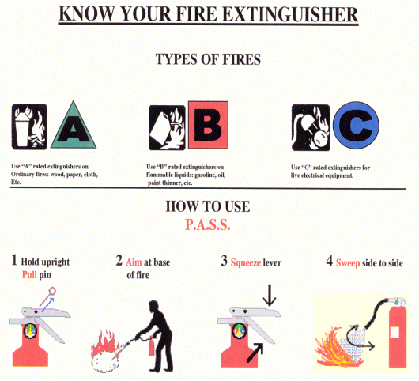
How to use a Fire Extinguisher

Slide 24
Fire Drills
The purpose of a fire drill is to ensure that all members of the FIRE SAFETY COMMITTEE are totally familiar with emergency evacuation procedures, resulting in orderly evacuation with efficient use of exit facilities.
Fire drills for all Supervisory Staff members are held at least 12 months.

Slide 25
Fire Drills
The Supervisory Staff members are to be notified of the time and date at least 24 hours in advance of the drill.
Notify the fire department of the drill by calling 519-741-2494. “I am conducting a fire drill at 1275 Bleams Road. I will call back when our drill is complete.”
The monitoring company shall be notified as well.
Activate one of the pull stations or use the drill feature of the fire alarm control panel.
Once the drill is underway and the fire alarm has been activated, the Supervisory Staff will go through their emergency procedures, as described in the “Emergency Procedures” section of this plan.

Slide 26
Fire Drills
After the fire drill has been conducted, one member of the Supervisory Staff will reset the fire alarm control panel and contact the Fire Department and the monitoring station.
A short debriefing session with all Supervisory Staff members will then take place at which time all questions should be raised regarding emergency procedures. A Fire Drill Report will be filled out with comments made as necessary.
Records of all such drills for a minimum of 1 year. Emphasis will be placed on an orderly evacuation and the training of the Supervisory Staff.
Occupants will be requested to advise the supervisory staff if they experienced difficulty hearing the alarm.

Slide 27
Maintenance Procedures
Must be done Daily, Monthly, Annually
Completed by On-site staff (or designate) or a contractor
Checking Fire Alarm Panel, Fire Extinguishers, Emergency Lighting, Fire Safety Plan, batteries monthly.
Please refer to 38-39 in the Fire Safety Plan

Slide 28
How to use the fire alarm panel
Alarm Silence
Panel
Reset
Fire Drill
Resetting a pull station

Slide 29
Questions? Talk to Danae Piersma (piersma.danae@gmail.com), Chris de Lange, John Vandervelde, or Coby Kooistra.
?

