Slide 1
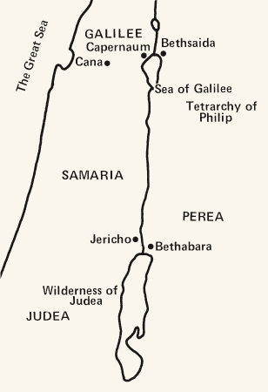
Interpreting the Gospels

Slide 2
Four Gospels
All Four Agree on Content
Synoptic Gospels: Matthew, Mark, Luke
Two clear halves (Mt 16, Mk 8, Lk 9)
  Early Ministry (Galilee: miracles, teaching, calling)
    Turning point: Peter’s confession, Transfiguration
  Road to Jerusalem (teaching on crucifixion, Triumphal Entry, Temple action, Arrest, Crucifixion, Resurrection)

Slide 3
Unity and Diversity in Gospels
Composition
[1:1] Inasmuch as many have undertaken to compile a narrative of the things that have been accomplished among us, [2] just as those who from the beginning were eyewitnesses and ministers of the word have delivered them to us, [3] it seemed good to me also, having followed all things closely for some time past, to write an orderly account for you, most excellent Theophilus, [4] that you may have certainty concerning the things you have been taught.
  Luke 1:1-4

Slide 4
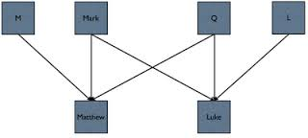
Literary Dependence

Slide 5
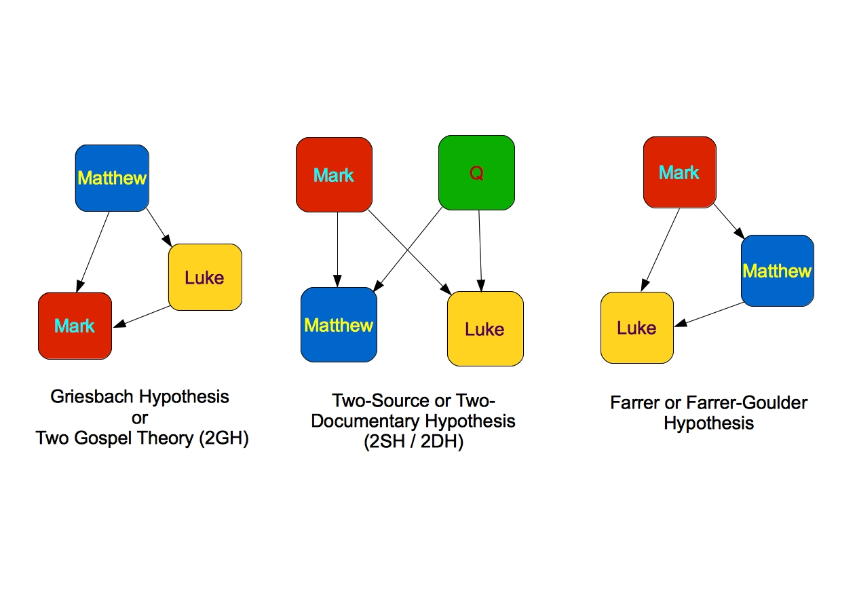
Literary Dependence

Slide 6
Benefitting from the Diversity
Compare your passage with parallels (if any) from other Gospels.
  “We can be fairly sure of each evangelist’s interest and concerns by the way he selected, shaped and arranged his materials.” (Fee & Stuart)
  Do not attempt to fill out the story in your passage from details from another.
  If your passage is not in the other Gospels, consider what this might mean in your Gospel, especially in relation to the major themes of your Gospel and immediate context.
  Compare word choice to discover differences
  Compare the context to determine unique ordering of your passage that might give you insights into the author’s intention
Look for Themes and a Theological message rather than attempt to reconstruct the historical Jesus

Slide 7
Uniqueness of the Gospel Genre
How would our reading of the Gospels change if we treated them like biographies or histories?
  Biographies don’t confront us. We can stay detached and unaffected by its message.
  Jesus’ identity could be defined by his example or his teachings and not his role in and for the world as savior and Lord.

Slide 8
Uniqueness of the Gospel Genre
How would our reading of the Gospels change if we viewed it as a spiritual self-help guide?
  We’d see the historical and biblical context (the big story) as unimportant.
  Most of the content of the Gospels wouldn’t make sense to us: judgment, conflict, miracles, the crucifixion, even the resurrection wouldn’t seem relevant.

Slide 9
Eschatology and Kingdom
What does Gospel mean?
  ⁹Get you up to a high mountain,
  O Zion, herald of good news;^{[e]}
  lift up your voice with strength,
  O Jerusalem, herald of good news;^{[f]}
  lift it up, fear not;
  say to the cities of Judah,
  "Behold your God!" Isaiah 40:9
  ⁷ How beautiful upon the mountains
  are the feet of him who brings good news,
  who publishes peace, who brings good news of happiness,
  who publishes salvation,
  who says to Zion, "Your God reigns." Isaiah 52:7

Slide 10
The Gospel to Rome
  The providence which has ordered the whole of our life, showing concern and zeal, has ordained the most perfect consummation for human life by giving to it Augustus, by filling him with virtue for doing the work of a benefactor among men, and by sending in him, as it were, a savior for us and those who come after us, to make war to cease, to create order everywhere…the birthday of the god Augustus was the beginning for the world of the glad tidings that have come to men through him…[Inscription from Asia Minor in 9BC]

Slide 11
OT Eschatology: Day of the Lord
After Adam sinned judgment was delayed, but still present. Humanity was exiled from the Garden symbolizing the state of sin and distance from God.
  Genesis 2:16-17 “And the LORD God commanded the man, saying, “You may surely eat of every tree of the garden, but of the tree of the knowledge of good and evil you shall not eat, for in the day that you eat of it you shall surely die.”
  Genesis 3:15 God says to Satan: “I will put enmity between you and the woman, and between your offspring and her offspring; he shall bruise your head, and you shall bruise his heel.”
  Genesis 3:20 “The man called his wife’s name Eve, because she was the mother of all living.”
  Genesis 3:21 “And the LORD God made for Adam and for his wife garments of skins and clothed them.”

Slide 12
Promise Continues
Abraham
  Genesis 12:1-3 “Now the LORD said to Abram, “Go from your country and your kindred and your father’s house to the land that I will show you. And I will make of you a great nation, and I will bless you and make your name great, so that you will be a blessing. I will bless those who bless you, and him who dishonors you I will curse, and in you all the families of the earth shall be blessed.”
Moses
  Deuteronomy 28-29: Covenant with Israel is ratified.
    If they obey, “The LORD will cause your enemies who rise against you to be defeated before you.” 28:7
    If they disobey, “The LORD will bring you and your king whom you set over you to a nation that neither you nor your fathers have known.” (i.e. Exile)

Slide 13
Israel and the Promise
The great conclusion that is clear from the OT is that the Law brought condemnation. It wasn’t because the Law was bad. The Law is good, yet when combined with a sinful people (in Adam) it acts as a magnifying glass exposing sin.
  Temple is set up as an ongoing, continual reminder that Israel is falling short of the Law and that the cost is death.
  Israel is given a Redeemer-king to lead it to temporal salvation
2 Samuel 7: Kingship
  12- “I will raise up your offspring after you, who shall come from your body, and I will establish his kingdom. He shall build a house for my name, and I will establish the throne of his kingdom forever.

Slide 14
Exile and Crisis of Hope
Both Temple and King are destroyed. Israel is taken out of the land and put in Exile.
  Isaiah-Malachi try to minister to God’s people in light of this crisis
  Some argue that this crisis is present in historical books from Deuteronomy-2 Samuel, 1&2 Chronicles-Ezra, and even in Psalms

Slide 15
Hope in Future: Eschatology
Isaiah 60
  “Arise, shine, for your light has come, and the glory of the LORD has risen upon you. For behold, darkness shall cover the earth, and thick darkness the peoples; but the LORD will arise upon you and nations shall come to your light, and kings to the brightness of your rising….Foreigners shall build up your walls, and kings shall minister to you…that people may bring to you the wealth of the nations with their kings led in procession. For the nations and kingdom that will not serve you shall perish; those nations shall be utterly laid waste.”

Slide 16
When will it come?
Jeremiah 29:10
  “For thus says the LORD: When seventy years are completed for Babylon, I will visit you, and I will fulfill to you my promise and bring you back to this place.”
Daniel 9
  9:2 “I, Daniel, perceived the books the number of years that, according to the word of the LORD to Jeremiah the prophet, must pass before the end of the desolations of Jersalem, namely, seventy years…
  9:24“Seventy sevens are decreed about your people and your holy city, to finish the transgression, to put an end to sin, and to atone for iniquity, to bring in everlasting righteousness…

Slide 17
Day of the Lord
Amos 5:18f “Woe to you who desire the day of the LORD!...Is not the day of the LORD darkness, and not light and gloom with no brightness”
Isaiah 2:12 “For the day of the LORD of hosts shall be upon every one that is proud and lofty, and upon every one that is lifted up; and he shall be brought low.”
Joel 2 On the Day of the LORD “everyone who calls on the name of the LORD will be saved.”
As the OT ends, there is roughly 400 years of silence. A puppet king, a corrupted Temple, an occupied Promised Land all point symbolically to the fact that God’s exile judgment of his people is still present. Sin has not been dealt with. The promise to Abraham and Adam has not been fulfilled.

Slide 18
1st Century Expectation
Level 1: Restoration of the nation, king, temple (Pharisees)
Level 2: Things symbolized the restoration of God’s promises to Israel (Disciples)
Level 3: The big problem of sin and death for ALL people (Jesus)

Slide 19
Eschatology in the Gospels
Mark 1:1-8
¹The beginning of the gospel of Jesus Christ, the Son of God. ² As it is written in Isaiah the prophet,
"Behold, I send my messenger before your face,
who will prepare your way,
³ the voice of one crying in the wilderness:
'Prepare the way of the Lord,
make his paths straight,'"
⁴ John appeared, baptizing in the wilderness and proclaiming a baptism of repentance for the forgiveness of sins.

Slide 20
Jesus’ First Sermon
Isaiah 61
¹ The Spirit of the Lord GOD is upon me,
because the LORD has anointed me
to bring good news to the poor;^{[a]}
he has sent me to bind up the brokenhearted,
to proclaim liberty to the captives,
and the opening of the prison to those who are bound;^{[b]}
² to proclaim the year of the LORD’s favor,
and the day of vengeance of our God;
to comfort all who mourn;
³to grant to those who mourn in Zion—
to give them a beautiful headdress instead of ashes,
the oil of gladness instead of mourning,
the garment of praise instead of a faint spirit;
that they may be called oaks of righteousness,
the planting of the LORD, that he may be glorified.^{[c]}
⁴ They shall build up the ancient ruins;
they shall raise up the former devastations;
they shall repair the ruined cities,
the devastations of many generations.

Slide 21
Jesus’ first sermon
Luke 4
¹⁶ And he came to Nazareth, where he had been brought up. And as was his custom, he went to the synagogue on the Sabbath day, and he stood up to read. ¹⁷And the scroll of the prophet Isaiah was given to him. He unrolled the scroll and found the place where it was written,
¹⁸ "The Spirit of the Lord is upon me,
because he has anointed me
to proclaim good news to the poor.
He has sent me to proclaim liberty to the captives
and recovering of sight to the blind,
to set at liberty those who are oppressed,
¹⁹ to proclaim the year of the Lord’s favor."
²⁰And he rolled up the scroll and gave it back to the attendant and sat down. And the eyes of all in the synagogue were fixed on him. ²¹And he began to say to them, "Today this Scripture has been fulfilled in your hearing."… ²⁹And they rose up and drove him out of the town and brought him to the brow of the hill on which their town was built, so that they could throw him down the cliff. ³⁰But passing through their midst, he went away.

Slide 22
Hope fulfilled frames Jesus’ ministry
Mark 1:15
¹⁴ Now after John was arrested, Jesus came into Galilee, proclaiming the gospel of God,¹⁵and saying, "The time is fulfilled, and the kingdom of God is at hand; repent and believe in the gospel."

Slide 23
Reaction of Demons, Miracles, and Healings
Matt 8, Mark 5, Luke 8
John 20:30-31 “Now Jesus did many other signs in the presences of the disciples which are not written in this book; but these are written so that you may believe that Jesus is the Christ, the Son of God, and that by believing you may have life in his name.”

Slide 24
OT POV & NT Realization
Now
Not Yet
Now
Not Yet

Slide 25
Mark 4:26-34
Already | Not Yet
Jesus fulfilled the role of King and continues to reign All nations come into his kingdom Jesus as the Suffering Servant died for sins Spiritual new life, new creation already at work in the lives of believers Spirit’s presence: God with us Freedom from the bondage of sin | Enemies of God were not immediately destroyed Kingdom came small and weak in the world’s eyes Final judgment was still to come Resurrection and new creation still to come Heaven and Earth becoming one still to come Freedom from the presence of sin

Slide 26
Parables
Many parables begin: “The kingdom of God is like…”
We will not understand the parables without understanding the kingdom of God.

Slide 27
Purpose of the Parables: Isaiah 6
A. Matthew 13:10-17 Disciples ask Jesus: “Why speak in parables?”
[11] And he answered them, “To you it has been given to know the secrets of the kingdom of heaven, but to them it has not been given. [12] For to the one who has, more will be given, and he will have an abundance, but from the one who has not, even what he has will be taken away. [13] This is why I speak to them in parables, because seeing they do not see, and hearing they do not hear, nor do they understand. [14] Indeed, in their case the prophecy of Isaiah is fulfilled that says:
“‘“You will indeed hear but never understand,
and you will indeed see but never perceive.”
[15] For this people's heart has grown dull,
and with their ears they can barely hear,
and their eyes they have closed,
lest they should see with their eyes
and hear with their ears
and understand with their heart
and turn, and I would heal them.’
[16] But blessed are your eyes, for they see, and your ears, for they hear. [17] For truly, I say to you, many prophets and righteous people longed to see what you see, and did not see it, and to hear what you hear, and did not hear it.

Slide 28
Purpose of Parables
Parables are not illustrations, but are used in response to Old Covenant anticipation of the coming of the Kingdom of God.
  v. 11 Given to understand the mysteries of the kingdom of God
  v. 12 One who gets it will understand more; one who rejects it will be more confused…Parables themselves enact a judgment!

Slide 29
Point per Parable
“A parable is a metaphor or simile drawn from nature and life, arresting the hearer by its vividness or strangeness, leaving the hearer in enough doubt about its significance to tease it into active thought.” C.H. Dodd
Not allegories: In an allegory every part has a “hidden” meaning foreign to the story itself
Parables typically have only one point.
To interpret parables you must locate the point of reference in the context. The point of the parable is not the point of the reference but the intended response to the story as a whole.

Slide 30
Theological Emphases of the Four Gospels
Matthew: Jesus as Moses
1. Highlights Jesus’ teaching ministry
2. He is both “deliverer” and “law-giver”
3. Five Books of Moses paralleled in the Five Discourses of Jesus
a. 5:1-7:27; 10:5-42; 13:1-52; 18:1-35; and 23:1-25:46
b. Each section ends with the phrase “When Jesus had finished these words…”
c. Jesus demonstrates great continuity with the Torah: He did not come to abolish the Law and the prophets but to fulfill them (5:17-20)
d. Not an expansion of the Law but an intensification. Why?
4. The church is the community who are taught (disciples, great commission)

Slide 31
Theological Emphases of the Four Gospels
Mark: Taking up the Cross
1. Emphasis on a call to discipleship and following Jesus to the cross
2. Mark contains very little explicit ethical teaching.
3. Identity of Jesus is crucial. The central question in Mark: Who do you say that I am? (Mark 8:29)
a. Mark 1:1 tells the readers he is Jesus Christ, Son of God, but throughout none of the characters knows—except the demons. This provides tension between what we know and what they know.
b. Throughout the first half Jesus seems so powerful and successful we expect things to work out differently/triumphantly
c. Disciples are afraid and have no faith. Jesus’ identity is a secret for them to know, but they struggle to grasp it. They fall away in time of trial.
4. Mark’s style is short, choppy, and abrupt.

Slide 32
Theological Emphases of the Four Gospels
Luke: Power of the Spirit
1. Luke’s narrative is a continuation of the Old Testament biblical history. Jesus’ life is a fulfillment of promises to Israel.
2. Emphasis falls less on Moses as law-giver and more on Moses as prophetic liberator for his people. Salvation becomes a key word.
3. Luke is more world-affirming. By that I mean, the gospel is for the nations.
4. Luke’s style is intellectual, well-written, and a well-constructed narrative.

Slide 33
Theological Emphases of the Four Gospels
John: That You May Believe
1. Jesus is concerned with belief.
2. Jesus is God in the flesh. Jesus is often imaged as the new Temple (i.e. God’s presence).
3. The community is told to love one another.
4. The world is an enemy of God, at war with him. Yet, God so loved the world.
5. John uses symbolism and emphasizes big abstract concepts like life, truth, and love.

