Slide 1


Bible Interpretation
The Reliability and Usability of Scripture In Our Present Age

Slide 2
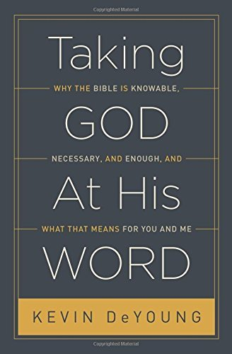




A Good Companion Book For This Class

Slide 3
Bible Interpretation
Why A Class On Bible Interpretation?
Because Christ warned that in the last days (our present time) there would be mass defections from the apostolic faith both from within and without the church.
    2Tim. 4:3 For the time is coming when people will not put up with sound doctrine, but having itching ears, they will accumulate for themselves teachers to suit their own desires,
Because many will aspire to teach that are not qualified, and is is given to the church as the “pillar and bulwark of the truth” (1 Tim 3) to protect the flock of God from false teaching.
    1Tim. 1:7 desiring to be teachers of the law, without understanding either what they are saying or the things about which they make assertions.

Slide 4
Bible Interpretation
Why A Class On Bible Interpretation?
Because it is the responsibility of every Christian to examine what we hear and believe such as to preserve the exclusive lordship of Christ over our conscience. C.f. Acts 17:10-12
    LC #160
    It is required of those that hear the Word preached, that they attend upon it with diligence, preparation, and prayer; examine what they hear by the Scriptures; receive the truth with faith, love, meekness, and readiness of mind, as the Word of God; meditate, and confer of it; hide it in their hearts, and bring forth the fruit of it in their lives.
Because it is our path unto salvation
My soul languishes for your salvation; I hope in your word. Psa. 119:81

Slide 5
Bible Interpretation
Why A Class On Bible Interpretation?
Because we love God’s Word and desire to handle with with great care:
  God’s word provides what is good. According to Psalm 119, the word of God is the way of happiness (vv. 1–2), the way to avoid shame (v. 6), the way of safety (v. 9), and the way of good counsel (v. 24). The word gives us strength (v. 28) and hope (v. 43). It provides wisdom (vv. 98–100, 130) and shows us the way we should go (v. 105). God’s verbal revelation, whether in spoken form in redemptive history or in the covenantal documents of redemptive history(i.e., the Bible), is unfailingly perfect.
Kevin DeYoung, Taking God At His Word

Slide 6
Course Description
Within an awareness of the present post-enlightenment and post Christian skepticism concerning the Christian Bible, the objective of this class is to provide the student with an introductory level of confidence in the Reliability, Usability and Sufficiency of the Christian Scriptures such as to adopt as a matter of Christian faith and application the following confessions: (c.f. Syllabus)

Slide 7
Course Description Continued
Concerning Reliability :
… an high and reverent esteem of the Holy Scripture… whereby it doth abundantly evidence itself to be the Word of God. WCF 1.4
Concerning Usability:
…[That} in a due use of the ordinary means, [we] may attain unto a sufficient understanding of them. WCF 1.5
Concerning Sufficiency:
The whole counsel of God concerning all things necessary for his own glory, man's salvation, faith and life, is either expressly set down in Scripture, or by good and necessary consequence may be deduced from Scripture: unto which nothing at any time is to be added, whether by new revelations of the Spirit, or traditions of men. WCF 1.6

Slide 8
PART 1: RELIABILTY OF SCRIPTURE
LESSON 1: TEXTUAL CRITICISM AND Challenges to HISTORICITY
To be fair, much of the Bible is not systematically evil but just plain weird, as you would expect of a chaotically cobbled-together anthology of disjointed documents, composed, revised, translated, distorted and 'improved' by hundreds of anonymous authors, editors and copyists, unknown to us and mostly unknown to each other, spanning nine centuries.
Richard Dawkins, The God Delusion
Post-Enlightenment Bias Against Miracles (The Issue of “Myth”)
Post-Enlightenment Politicization and Historicity (The Issue of Archeology)
Post-Enlightenment Bias Against Institutional Authority and Canonical Authenticity: (The issue of the Gnostic Gospels)

Slide 9
PART 1: RELIABILTY OF SCRIPTURE
LESSON 1: TEXTUAL CRITICISM AND HISTORICITY
Myth?
Known as the father of modern Historical-Criticism, Johann Salomo Semler reveals the basic yet subtle conviction of the adherents to the Historical-Critical method. He states, "The root of the evil (in theology) is the interchangeable use of the terms `Scripture' and the `Word of God’.”
Stated succinctly, the agenda established for the Historical-Critical method is the attempt to discover the "canon within the canon", one being the true "Word of God," the other being those portions of scripture depicting erroneous superstitions or myths of ancient history.

Slide 10
PART 1: RELIABILTY OF SCRIPTURE
LESSON 1: TEXTUAL CRITICISM AND HISTORICITY
Concerning “myth” it is not meant something “false” Rather, it is argued that while the facts of Scripture may not be believable, the larger, deepe.r truth still is.
E.g. If the historical-orthodox view of Biblical inspiration is that the words themselves are by divine inspiration (“verbal inspiration”), the historical critical approach wants to argue that the author was “inspired” even if the facts and historicity themselves were literary genre common to that day to articulate an inward/spiritual truth. The scripture then becomes a window into the experience of the writer wherein the true word of God is to be found.

Slide 11
PART 1: RELIABILTY OF SCRIPTURE
LESSON 1: TEXTUAL CRITICISM AND HISTORICITY
So for instance:
Plagues in Exodus and the crossing of the Red Sea may not be historical, but that need not call into question the power of God or his ability to set the captives free.
Jesus may or may not have walked on water, but the important point is that he will do anything to help us if we trust in him.
The resurrection of Christ is not to be taken literally as a bodily resurrection, but rather as a powerful symbol that God can give us new spiritual life and snatch victory from the jaws of defeat.

Slide 12
PART 1: RELIABILTY OF SCRIPTURE
LESSON 1: TEXTUAL CRITICISM AND HISTORICITY Answered
Biblical Response?
For we did not follow cleverly devised myths when we made known to you the power and coming of our Lord Jesus Christ, but we were eyewitnesses of his majesty. For when he received honor and glory from God the Father, and the voice was borne to him by the Majestic Glory, “This is my beloved Son, with whom I am well pleased,” we ourselves heard this very voice borne from heaven, for we were with him on the holy mountain. And we have something more sure, the prophetic word, to which you will do well to pay attention as to a lamp shining in a dark place, until the day dawns and the morning star rises in your hearts, knowing this first of all, that no prophecy of Scripture comes from someone’s own interpretation. For no prophecy was ever produced by the will of man, but men spoke from God as they were carried along by the Holy Spirit.
2Pet. 1:16-21

Slide 13
PART 1: RELIABILTY OF SCRIPTURE
LESSON 1: TEXTUAL CRITICISM AND HISTORICITY Answered
Biblical Response?
Myth in scripture is never used as a “positive” category, but something that must be refuted.
The Historical miracles were validated by “eyewitness” and formed the bases for believing wherein they where willing to die for that claim, which they would have knows was otherwise.
The very heart of the gospel of grace is a the message that our salvation and future hope is NOT by human effort and natural causes, but by the supernatural acts of God in history such as to be a supernatural salvation (e.g. the Kingdom not of this world, vs. a kingdom of this world
  c.f. Paul’s argument in 1Cor 15 for instance– the vanity of faith in the gospel if not based on a supernatural act of bodily resurrection).

Slide 14
PART 1: RELIABILTY OF SCRIPTURE
LESSON 1: TEXTUAL CRITICISM AND HISTORICITY ANSWERED
The Enlightenment Informed Skepticism Concerning The Bible
=
  Pertains to the historicity of the events recorded in the Bible and a resulting conclusion about the credibility of certain portions of text in the Bible Post enlightenment skepticism regarding the actuality of the miraculous events in the Bible has called into question the veracity of the Biblical record itself.
The Enlightenment Informed Presupposition of Textual Criticism Exposed:
  An analogous relationship between present historical realities and philosophical assumptions is made with the realities and assumptions of the ancient history concurrent with the Biblical period wherein as long as one makes analogous classification based on the present as a precondition for acceptance, much in the word of the Bible remains without foundation such as to significantly bias the anti-supernatural and ethical assumptions post-enlightenment.

Slide 15
PART 1: RELIABILTY OF SCRIPTURE
LESSON 1: TEXTUAL CRITICISM AND HISTORICITY
Response:
The historical critical program reveals not merely the idea that redemptive history is produced by a natural event(s) (providence?), but the vastly more ambitious idea that the “event(s) are not supernatural. That hardly seems to be an appropriate part of an empirical theory. It looks instead like a metaphysical or theological add-on. Faith is not an option, So faith in what? Why the bias against a personal, self-revealing God?
Why Bias Our Own Temporal Bound Experience and Perspective?
  Closed or. Open System Universe? (Experienced Based or Revelation Based).
  Gets to the question of GOD itself!? Does God exist, Is God Personal and does he communicate—if so where? (E.g. Two books of Revelation) If God created all things out of nothing, then already there is an open system universe and the possibility of miracles is assumed. I

Slide 16
PART 1: RELIABILTY OF SCRIPTURE
LESSON 1: TEXTUAL CRITICISM AND HISTORICITY
How is this different from the original sin?
    Gen. 2:17 but of the tree of the knowledge of good and evil you shall not eat, for in the day that you eat of it you shall surely die.”
    Deut. 12:8 “You shall not do according to all that we are doing here today, everyone doing whatever is right in his own eyes,
It comes down to a moral bias as then can only be “spiritually” appraised (e.,g new birth/regeneration)
      1Cor. 2:14 The natural person does not accept the things of the Spirit of God, for they are folly to him, and he is not able to understand them because they are spiritually discerned.

Slide 17
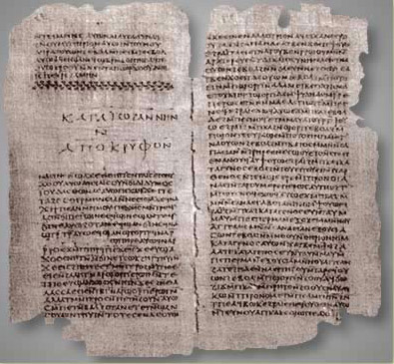
PART 1: RELIABILTY OF SCRIPTURE
LESSON 1: TEXTUAL CRITICISM AND HISTORICITY
Two Christianities? Two Scriptures?
The recent recovery of the original Gnostic compositions, has provided the wedge to challenge the traditional canon, and with it, the traditional construction of Christian identity... The implicit argument embedded in much scholarly and popular work is that historic orthodox Christianity is little more than a power-hungry conspiracy.
Timothy Luke Johnson

Slide 18

“Now that scholars have begun to place the sources discovered at Nag Hammadi, like newly discovered pieces of a complex puzzle, next to what we have long known from tradition, we find that these remarkable texts, only now becoming widely available, are transforming what we know as Christianity.”
Elaine Pagels. Beyond Belief: The Secret Gospel of Thomas

Slide 19
Two Christianities?
Based upon Nag Hammadi, we now know that there were two versions of Christianity that developed along side of each other during the first through third centuries.
The discovery of the more pure and authentic interpretation of Christ fell victim to the patriarchal power plays of the fourth century bishops.
In the Secret Gospel of John we can draw “connections to Christianity, Buddhism, Hinduism, kabbalistic Judaism, and Sufism...
[An] ardent call for self-awareness and introspection, and the empowering message that divine wholeness will be restored not by worshiping false gods in an illusory material world but by our recognition of the inherent divinity within ourselves.”
We are called not to a savior, but to a “deeper insight” wherein “the distinction between savior and saved ceases to exist” such that “you must save yourself and in doing so save God.”
The Secret Book of John: The Gnostic Gospel, Annotated & Explained, Translated and Annotated by Stevan Davies

Slide 20
Two Christianities?
Before Nag Hammadi, all discussions about Christianity would have inevitably assumed a set of twenty-seven ancient books compiled into a recognized New Testament canon against which the claim of authentic Christianity could be measured.
And on the basis of the traditional New Testament canon, there would have been relative unanimity of agreement across every known denomination about all the major beliefs of Christian Faith.
Predicated upon a new perspective based on Nag Hammadi being promoted by some today, all of this has supposedly changed and the above assumptions are in need of revision- or so it is argued.

Slide 21
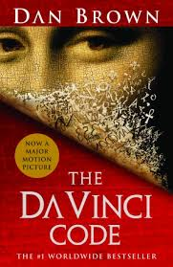
OTHER CHRISTIANITIES?:
The Issue of Canon

Slide 22
    Excerpts from Dan Brown’s
    DaVinci Code, chapter 55: About The Orthodox Scriptures
A product of man, not God”
False testimony
By men who possessed a political agenda to solidify their power base
Commissioned and financed by Constantine
“the gospels they attempted to destroy have been discovered as a part of an ancient library of Coptic Scrolls and highlight the glaring discrepancies and fabrications of the modern Bible

Slide 23
The Faithful Version Of Christianity Won The Orthodox Debate Then, and It Should Again!
Orthodox Response
  Recognized vs. Conferred by Church
  Test of OT Witness: “the prior rule of faith” already in tact by 1st century (Marcion Controversy settled in mid-second century! C.f. Thus the importance of the OT Interpretation of Christ ministry and message! (c.f. OT of OT: Ex.20:1, NT of OT:Mt.4:1-11,
  Test of Apostolicity: (c.f. 2 Peter, Eph. 2, )
    John 15:26 “When the Helper comes, whom I will send to you from the Father, that is the Spirit of truth, who proceeds from the Father, He will bear witness of Me, 27 and you will bear witness also, because you have been with Me from the beginning.”
  Bottom up vs. Top Down—“the battle was waged not in the fourth century but in the middle of the second century, wherein the “winners” were not the politically advantaged BUT disadvantaged… e.g. AD 140
  Canon mostly “settled” by 200 AD and formally ratified ecumenically in 350 AD at the synod of Laodicea.

Slide 24
Textual Reliability:
The Question of Canon
In his book, Can I Trust My Bible, R. Laird Harris concluded, "We can now be sure that copyists worked with great care and accuracy on the Old Testament, even back to 225 B.C. . . . indeed, it would be rash skepticism that would now deny that we have our Old Testament in a form very close to that used by Ezra when he taught the word of the Lord to those who had returned from the Babylonian captivity.

Slide 25
An Amazing Discovery: OT
Spring 1947: An Amazing Discovery in Wadi Qumran (near the north end of the Dead Sea) by a 15 year old Bedouin following a stray goat.
the most sensational discoveries of modern biblical archaeology - a complete copy of the book of Isaiah, and fragments of almost every book in the Old Testament
2,000 years old and coincided almost word for word with the text of our present version.

Slide 26
The Septuagint:
Greek Old Testament
The Septuagint is often referred to as the LXX because it was reputedly done by seventy Jewish scholars in Alexandria around 200 B.C.
The LXX is an almost word for word literal translation from the Hebrew that confirms the accuracy of the copyists who ultimately gave us the Massoretic text, the most complete manuscript that our modern Bible is based upon.

Slide 27
Textual Reliability:
NT Text
During the early Christian era, the writing material most commonly used was papyrus. This highly durable reed from the Nile Valley was glued together much like plywood and then allowed to dry in the sun.
Codex Vaticanus and Codex Siniaticus: Two excellent parchment copies of the entire New Testament which date from the 4th century (325-450 A.D.).
Earlier still, fragments and papyrus copies of portions of the New Testament date from 100 to 200 years (180-225 A.D.) before Vaticanus and Sinaticus. The outstanding ones are the Chester Beatty Papyrus (P45, P46, P47) and the Bodmer Papyrus II, XIV, XV (P46, P75).
From these five manuscripts alone, we can construct a most of our current NT.

Slide 28
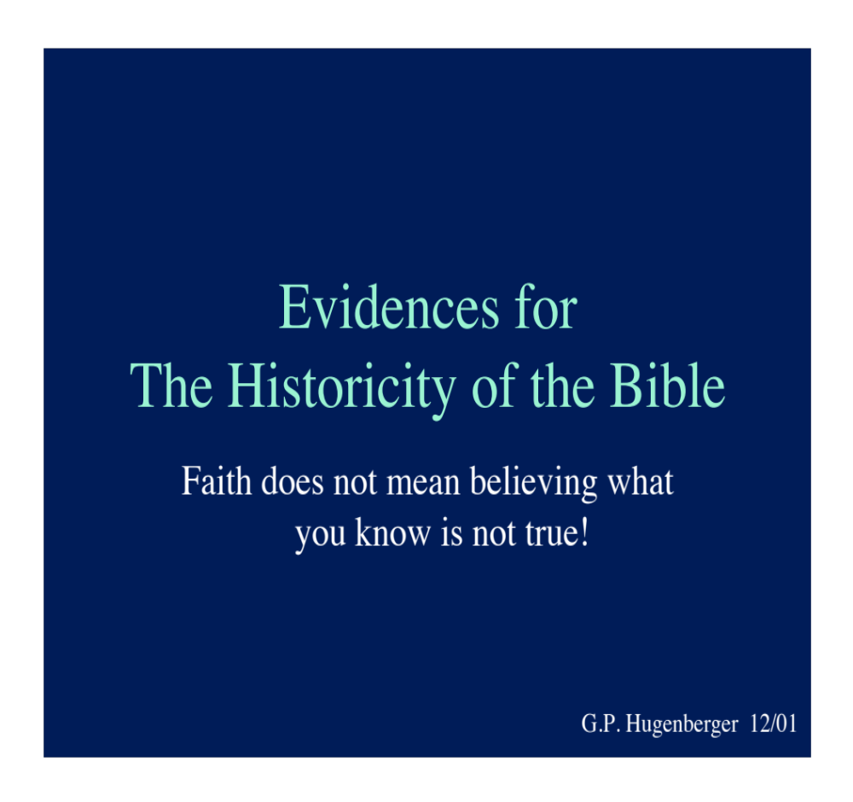
This Section on Archeology is taken From Gordon Hugenburger, Ot Professor (GCTS) and Pastor (Park Street, Boston)

Slide 29
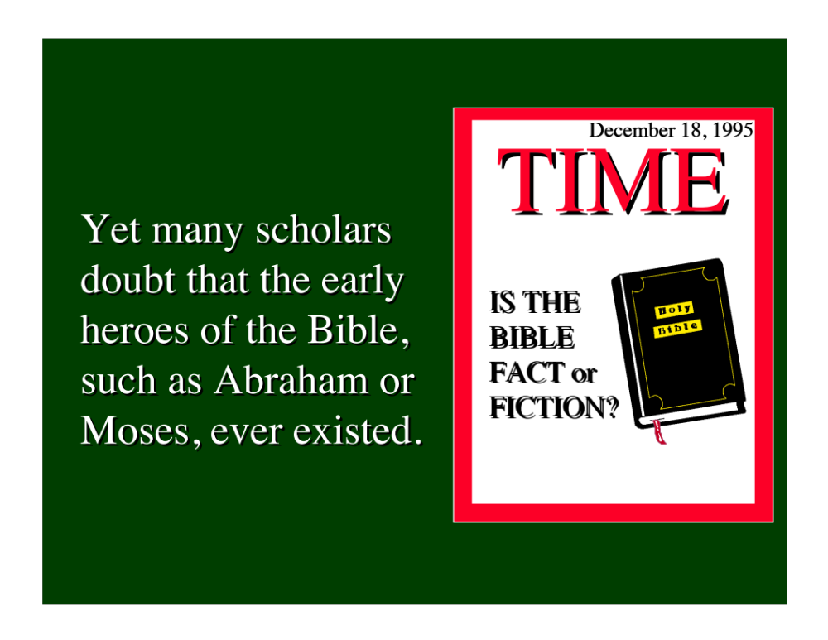

Slide 30
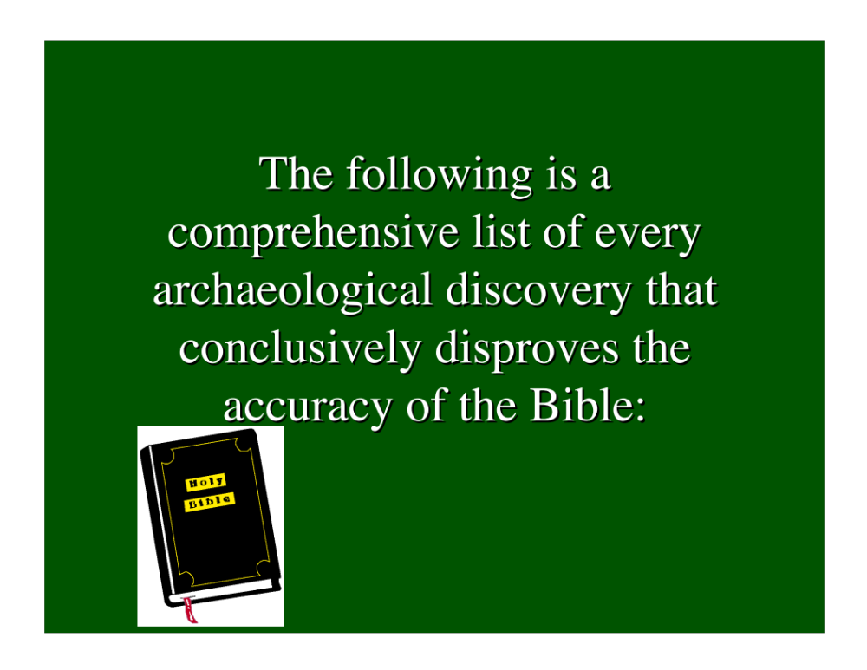

Slide 31


Slide 32
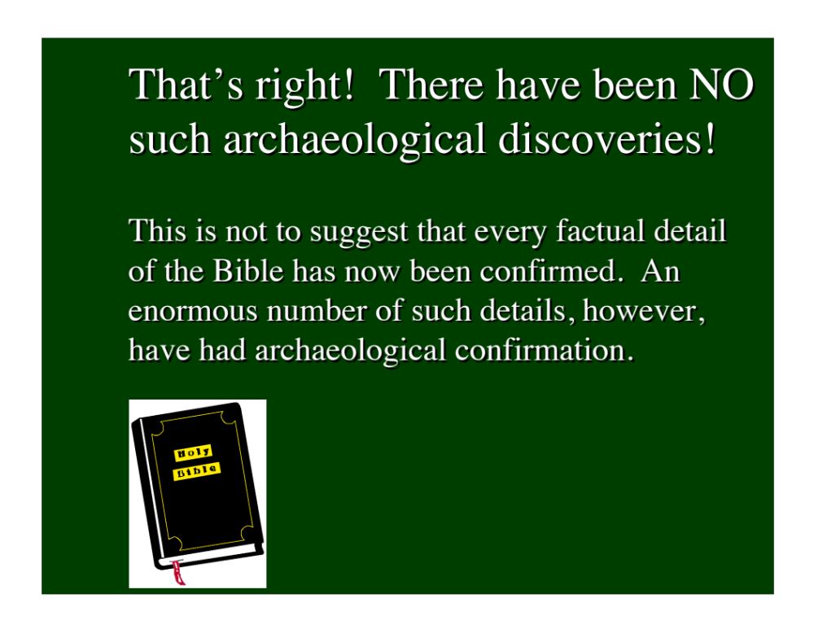

Slide 33
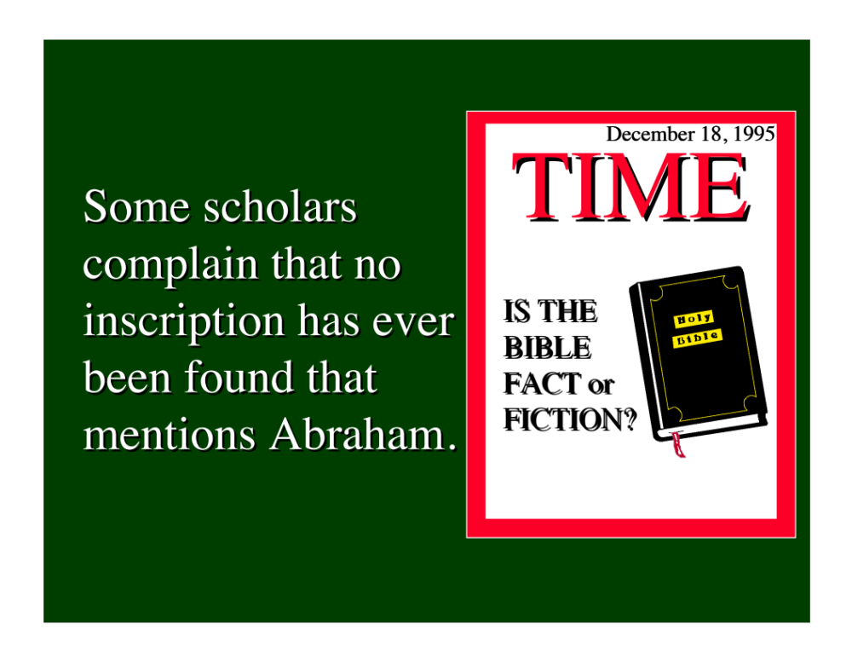

Slide 34
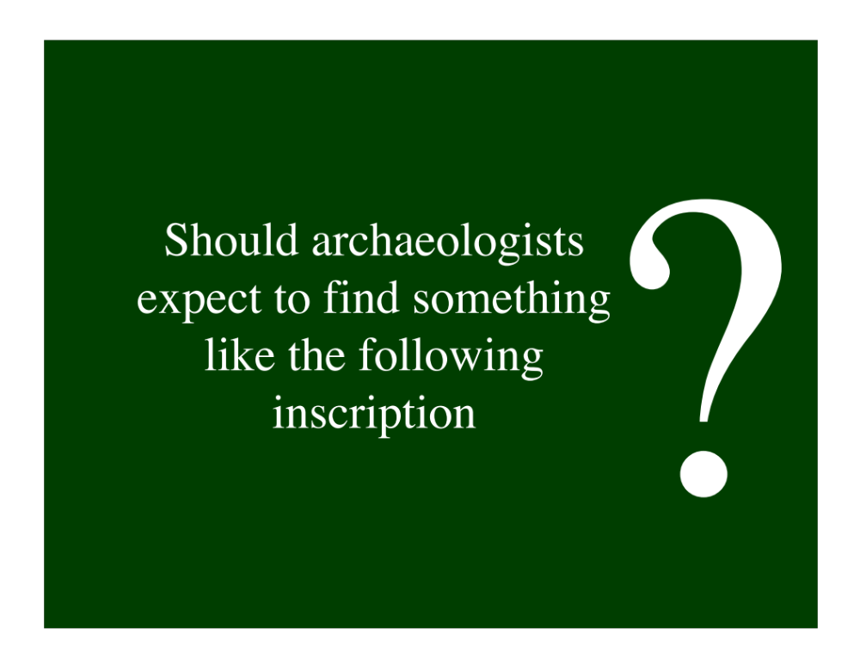

Slide 35


Slide 36
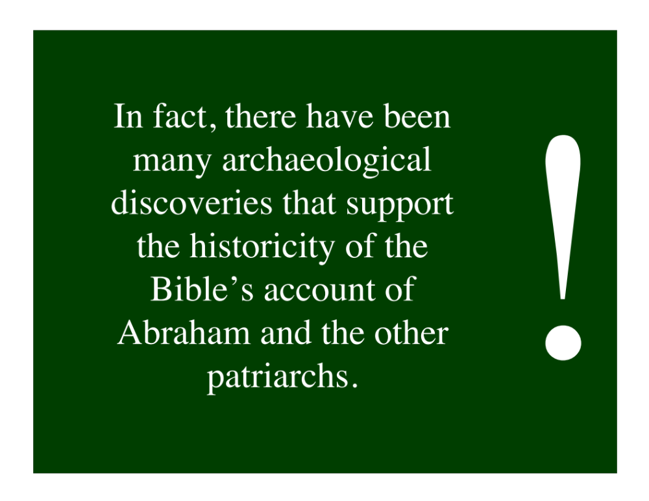

Slide 37
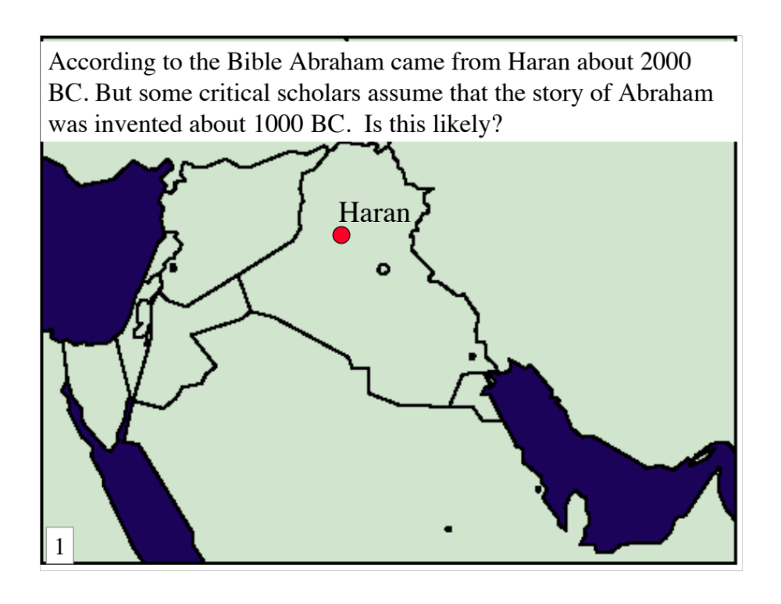

Slide 38
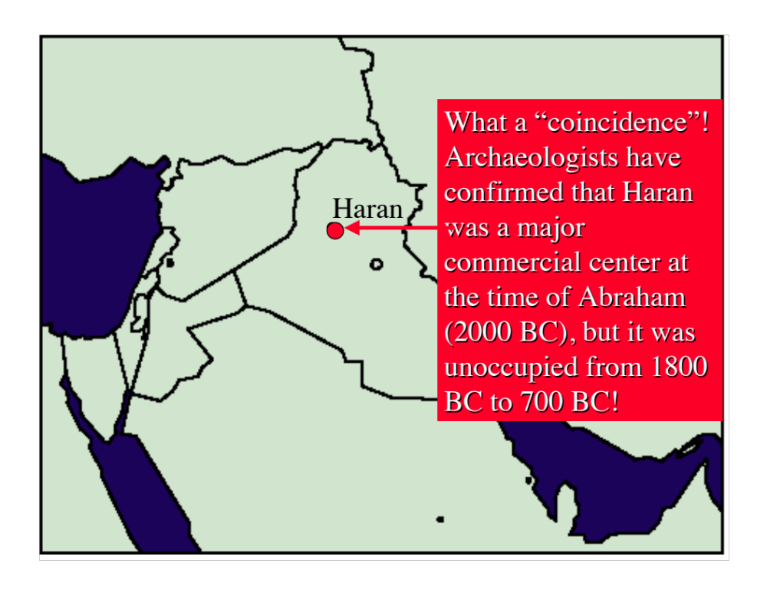

Slide 39


Slide 40
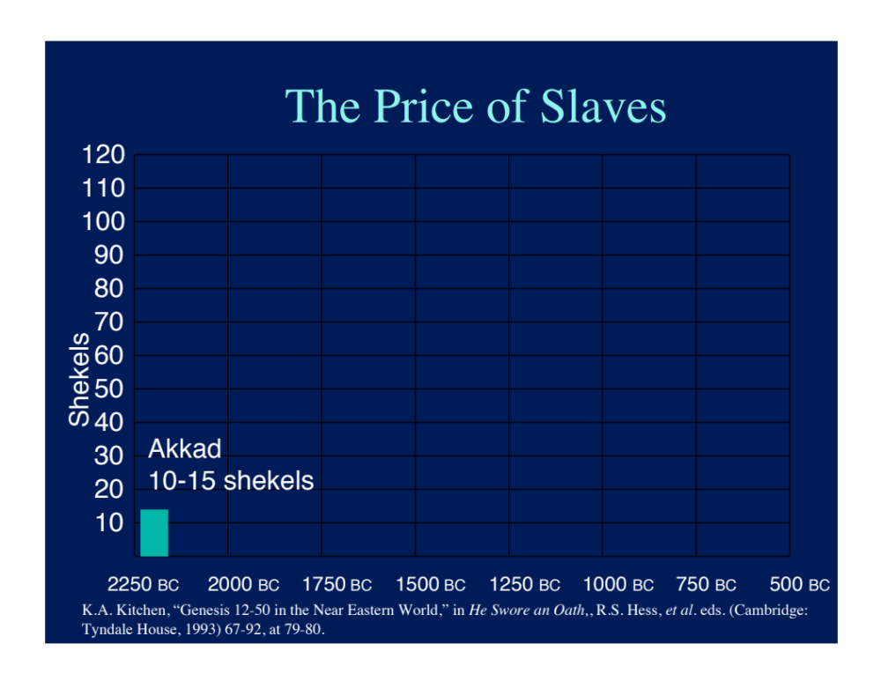

Slide 41
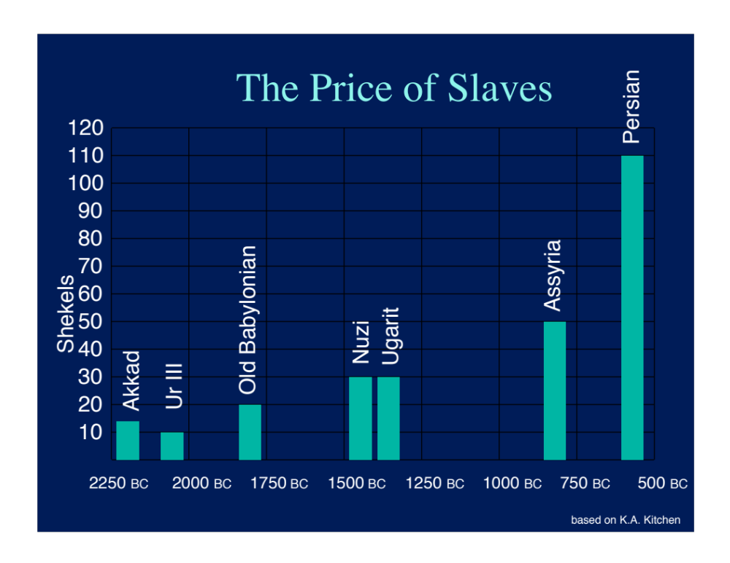

Slide 42
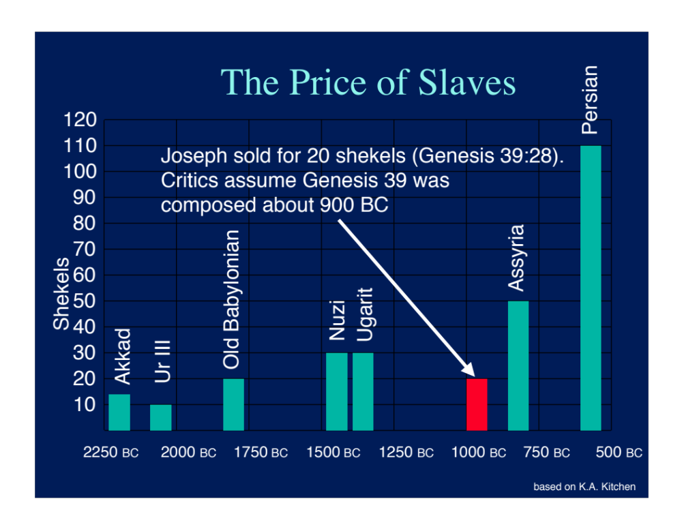

Slide 43
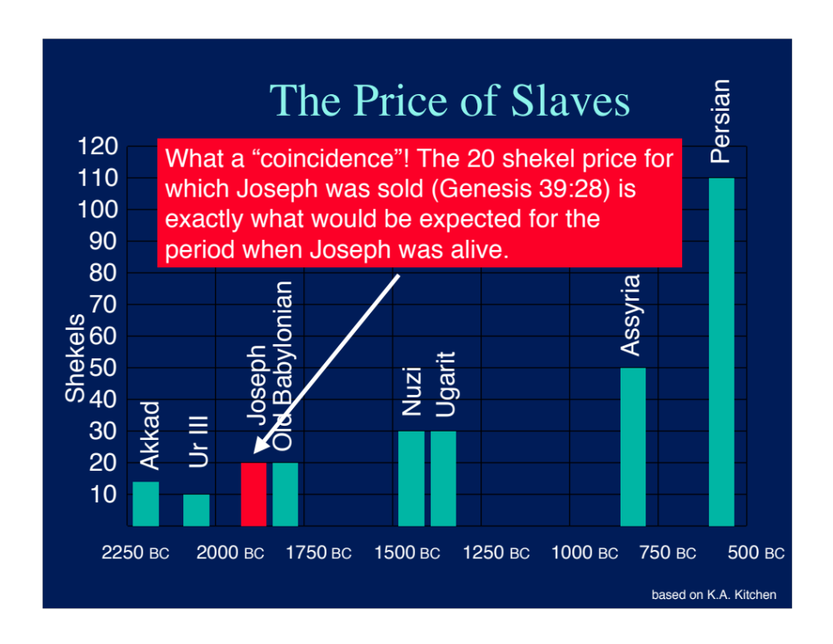

Slide 44
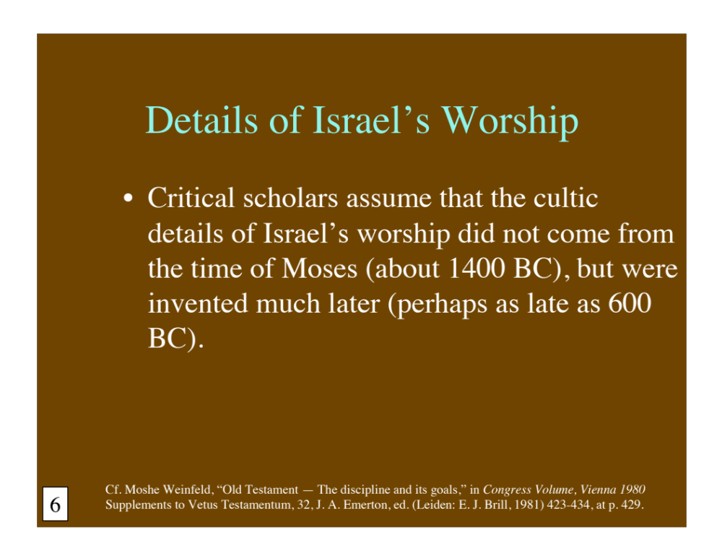

Slide 45
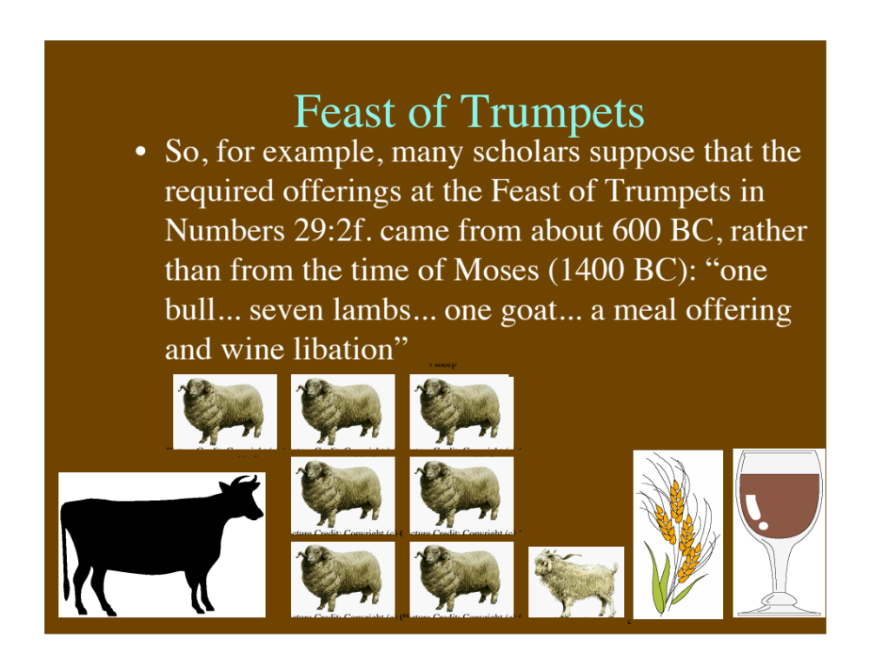

Slide 46
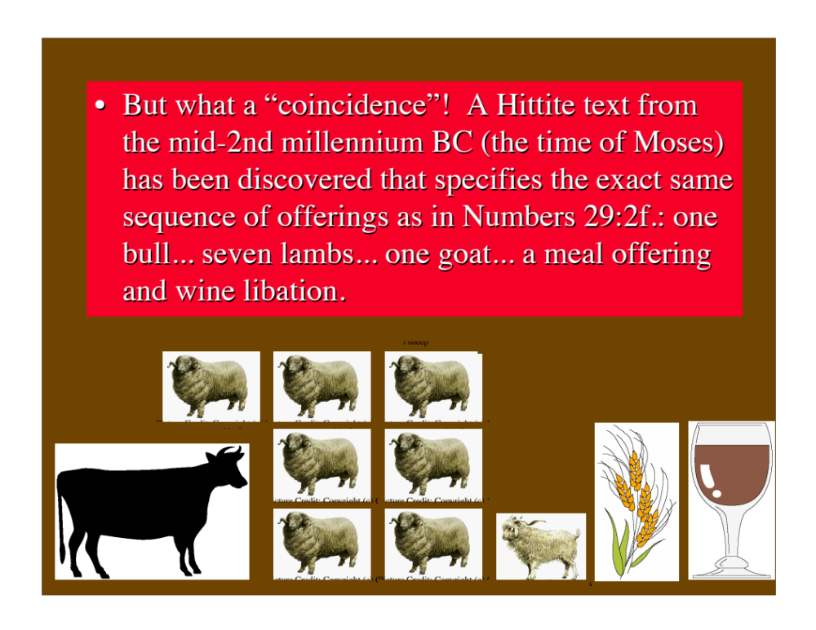

Slide 47
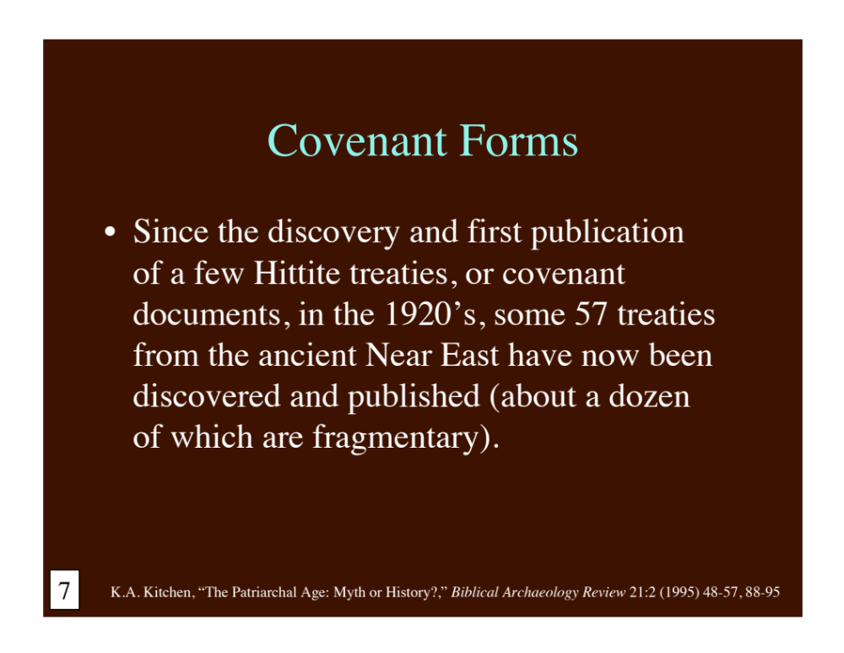

Slide 48
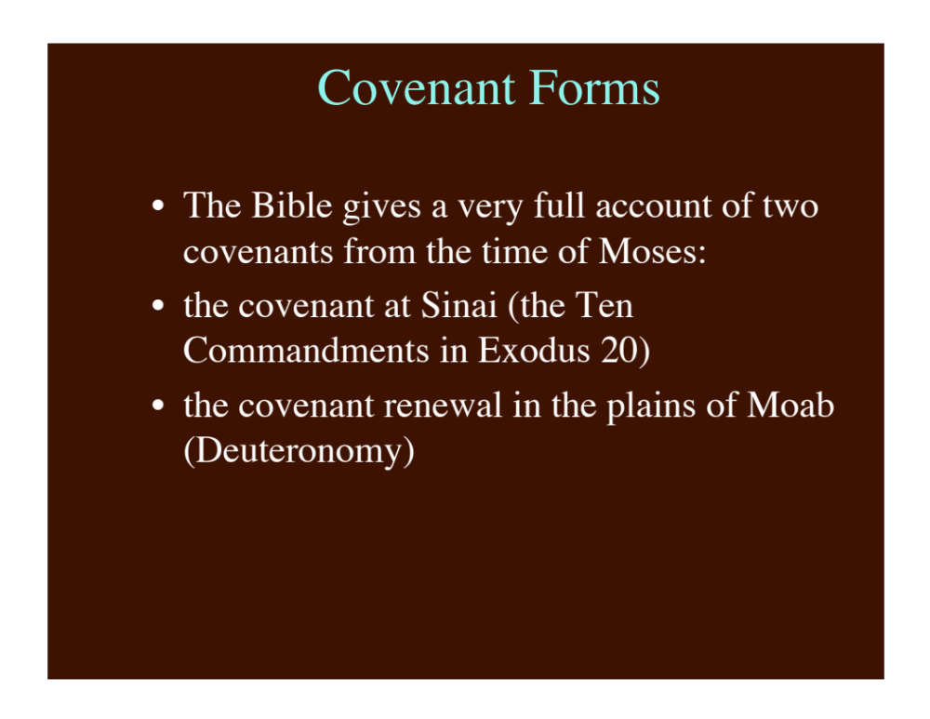

Slide 49
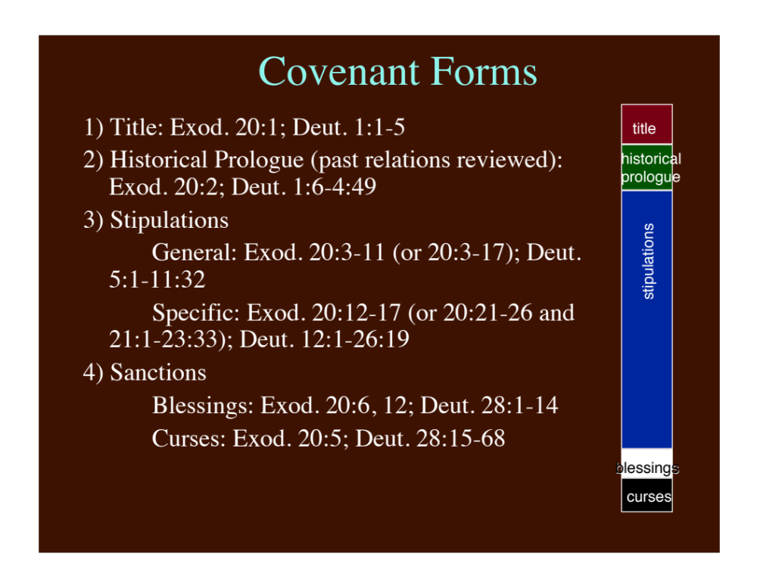

Slide 50
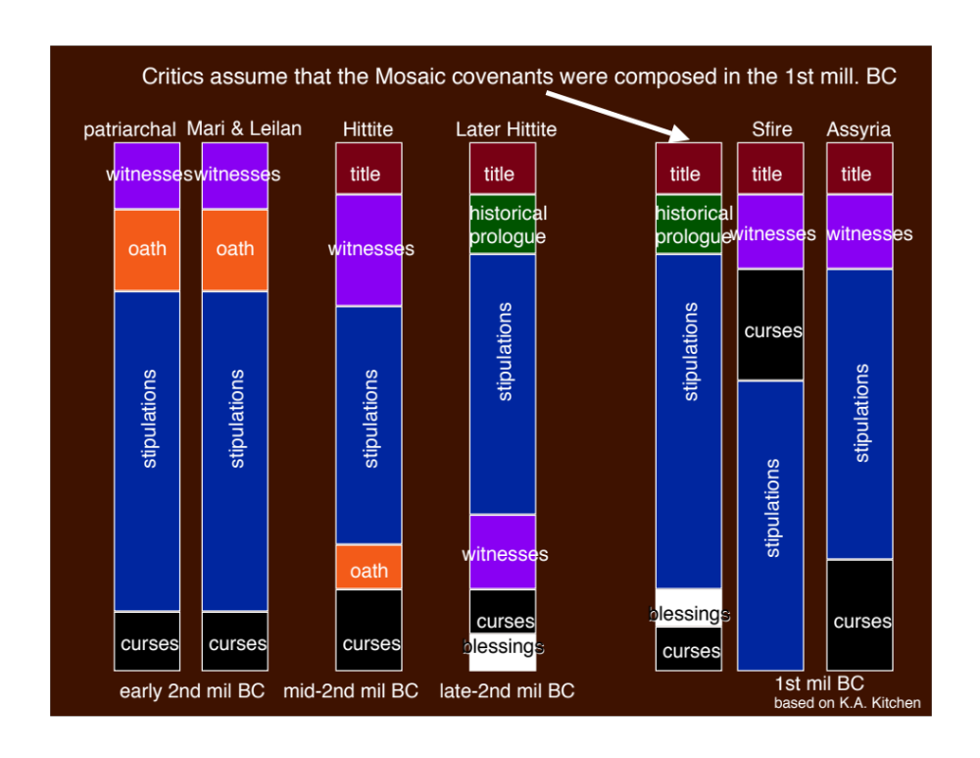

Slide 51
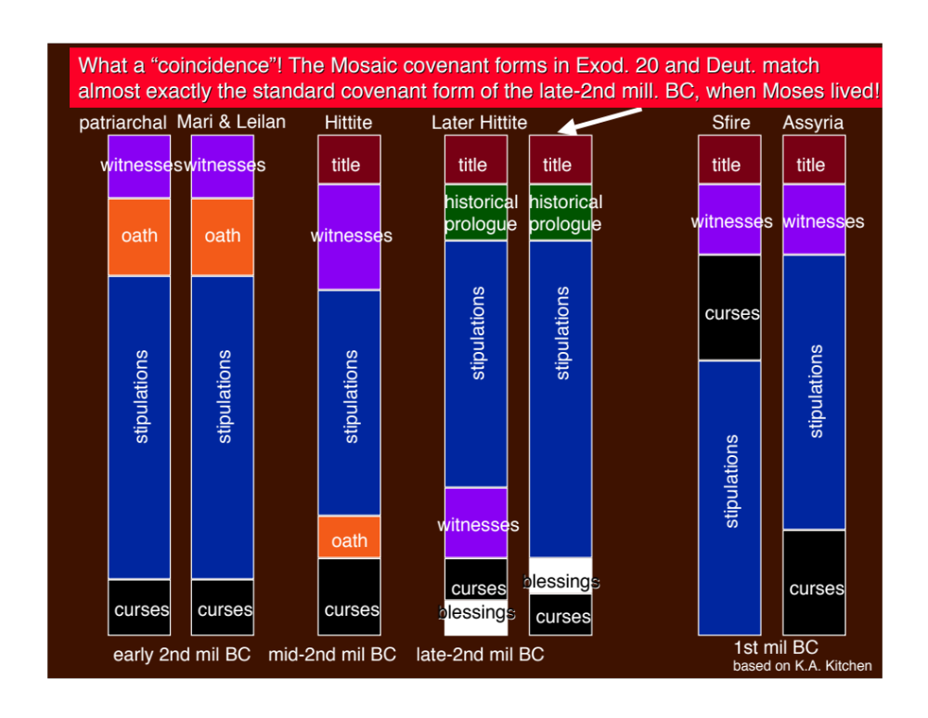

Slide 52
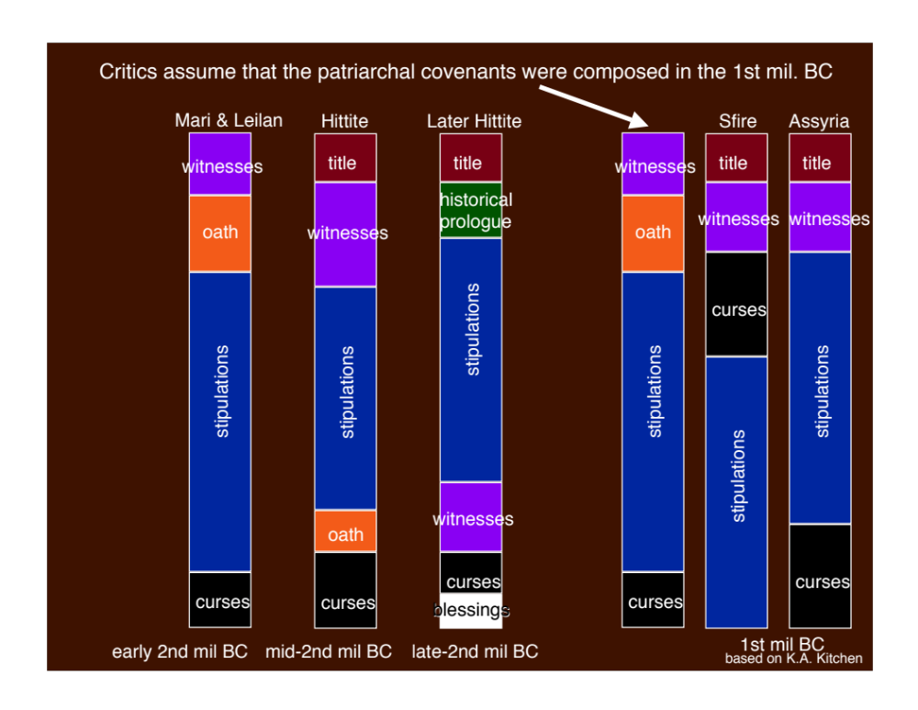

Slide 53
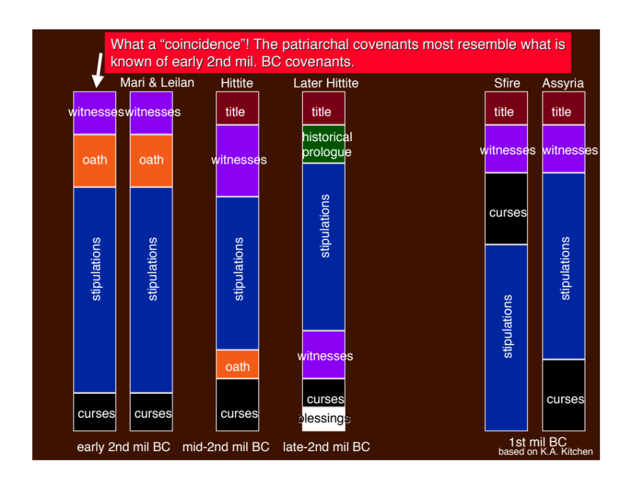

Slide 54
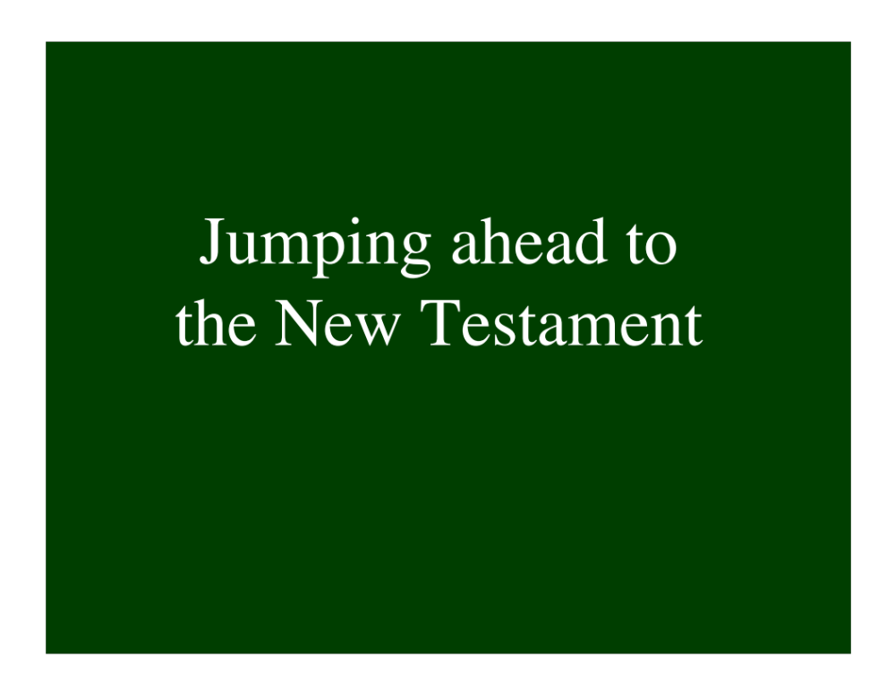

Slide 55
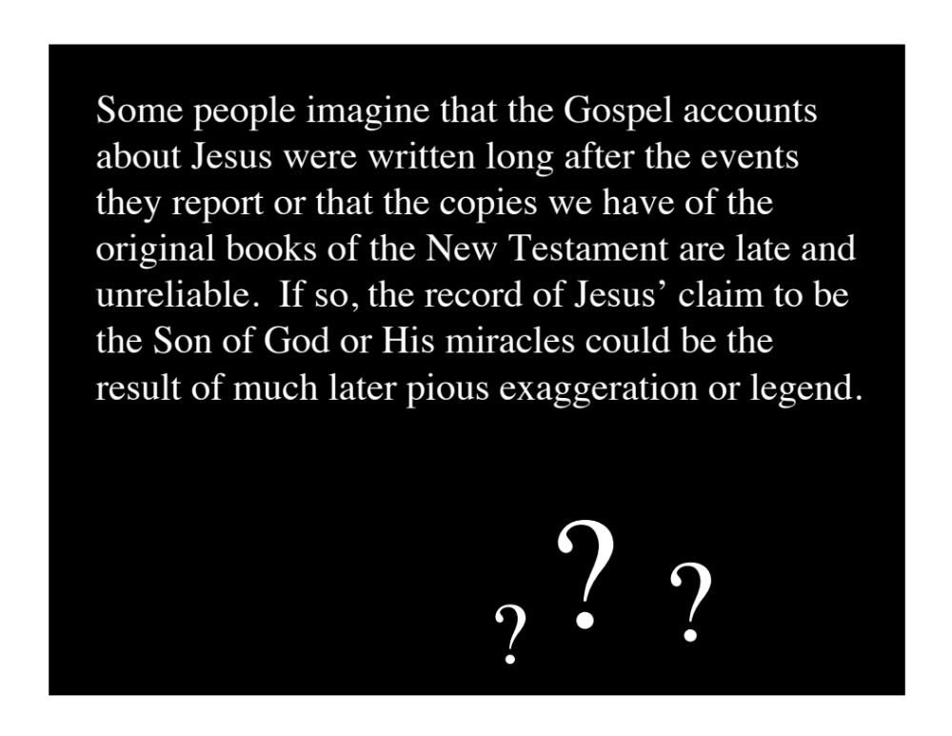

Slide 56
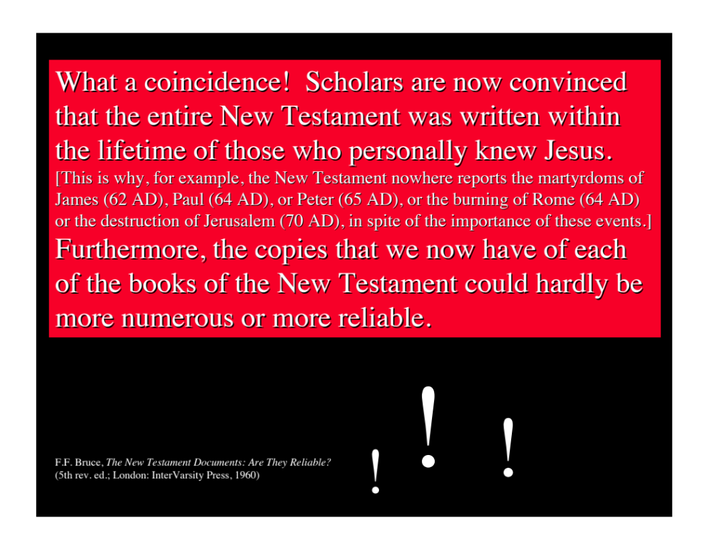

Slide 57
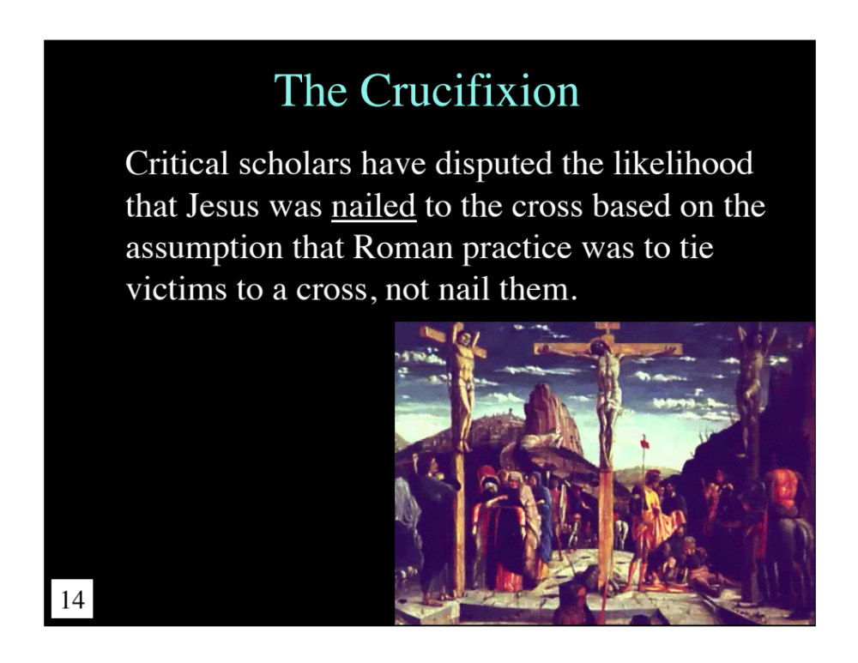

Slide 58
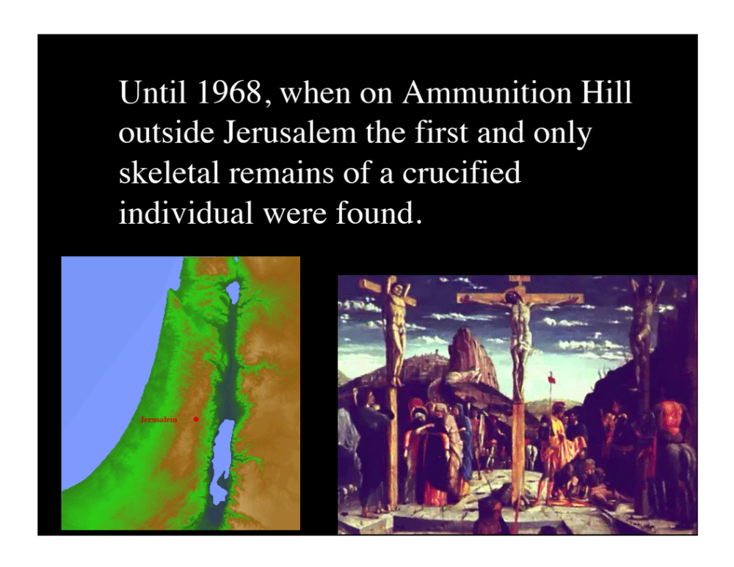

Slide 59
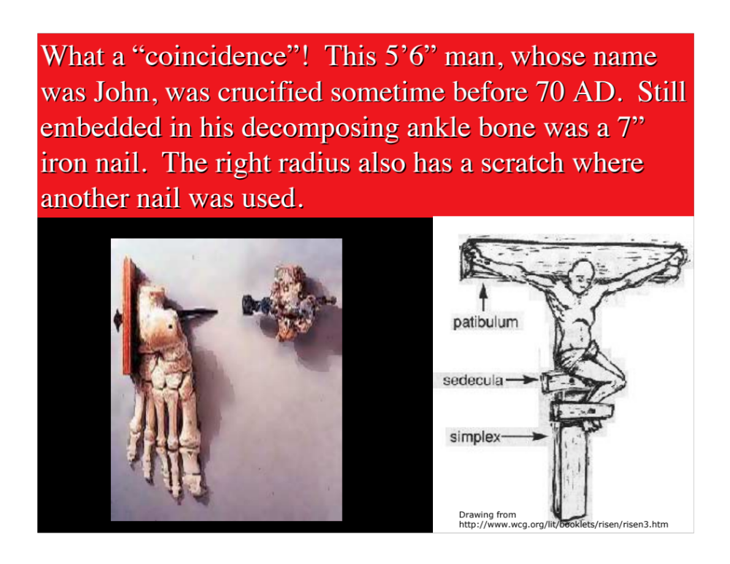

Slide 60
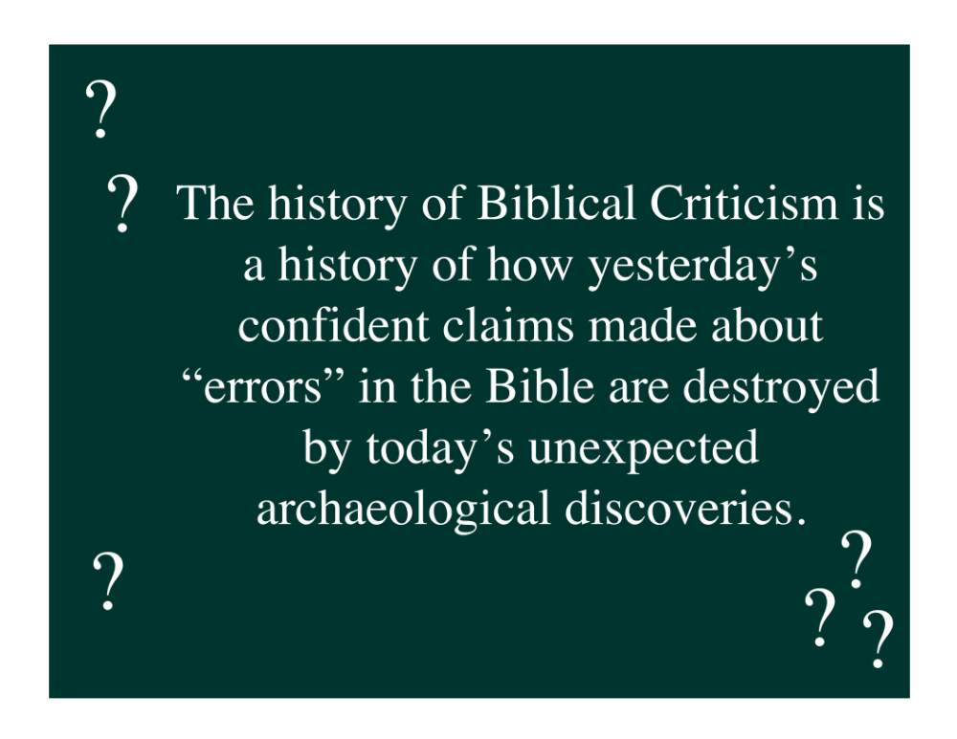

Slide 61
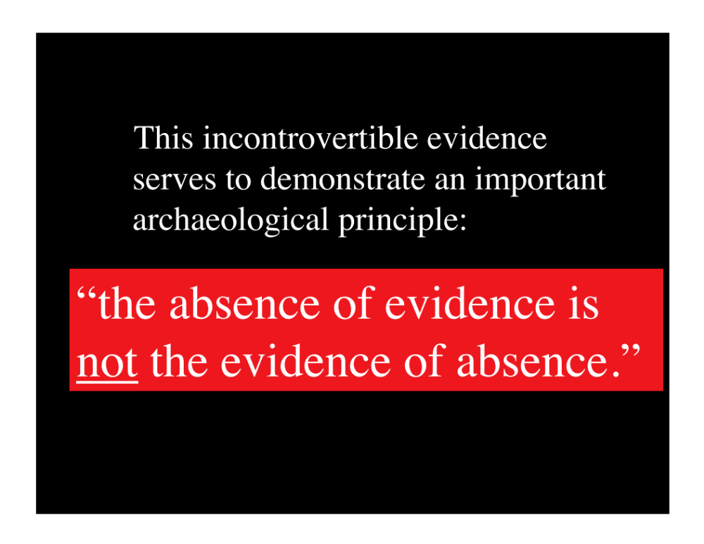

Slide 62
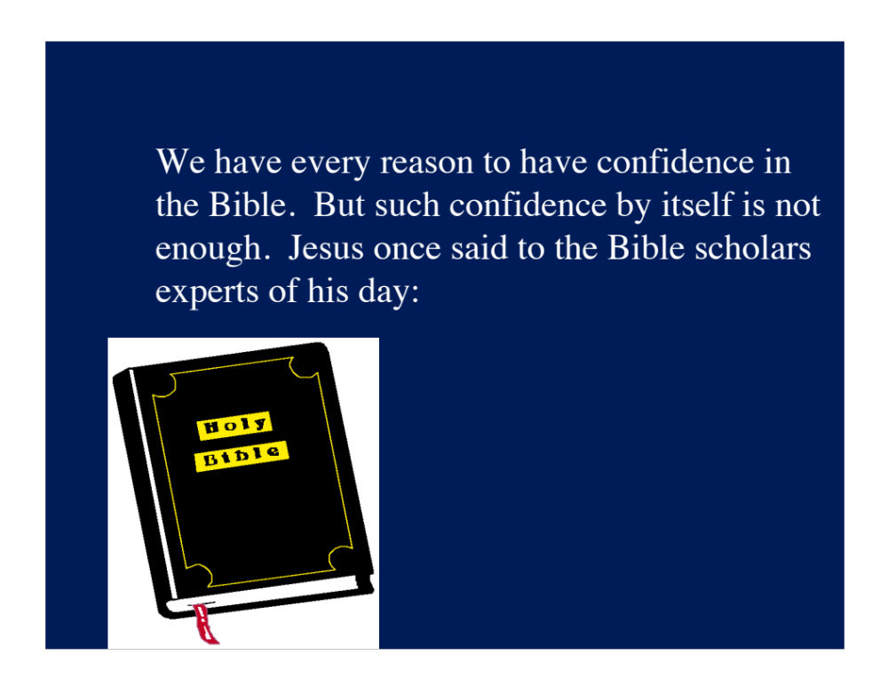

Slide 63
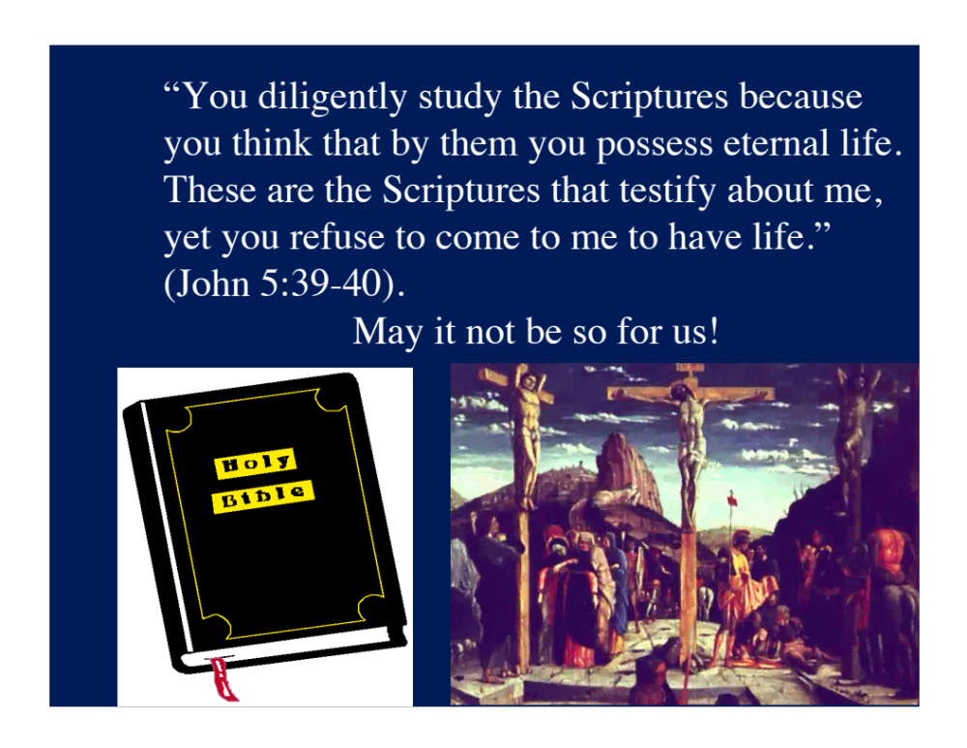

Slide 64
Conclusions:
Overwhelming Church Consensus
Westminster Confession of Faith’
Under the name of Holy Scripture, or the Word of God written, are now contained all the books of the Old and New Testaments, which are these... All which are given by inspiration of God to be the rule of faith and life. WCF 1.2
... it is to be received because it is the Word of God (1.4),
... high and reverent esteem of the Holy Scripture... (1.5)

