Slide 3
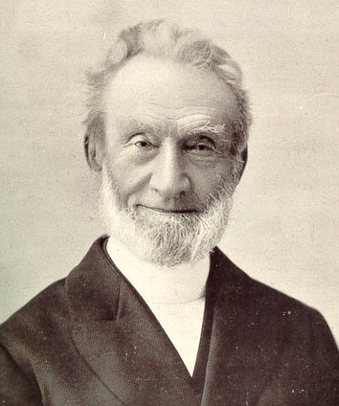
George Ferdinand Müller

Slide 5
I II I saw more clearly than ever, that the first great and primary business to which I ought to attend every day was, to have my soul happy in the Lord. The first thing to be concerned about was not, how I might serve the Lord, how I might glorify the Lord; but how I might get my soul into a happy state, and how my inner man may be nourished.... I saw that the most important thing I had to do was to give myself to the reading of the Word of God and to meditation of it.
George Mueller of Bristol

Slide 7
Ephesians 3:14-21
“14 For this reason I bow my knees before the Father, 15 from whom every family in heaven and on earth is named, 16 that according to the riches of his glory he may grant you to be strengthened with power through his Spirit in your inner being,

Slide 8
17 so that Christ may dwell in your hearts through faith—that you, being rooted and grounded in love, 18 may have strength to comprehend with all the saints what is the breadth and length and height and depth, 19 and to know the love of Christ that surpasses knowledge, that you may be filled with all the fullness of God.

Slide 9
20 Now to him who is able to do far more abundantly than all that we ask or think, according to the power at work within us, 21 to him be glory in the church and in Christ Jesus throughout all generations, forever and ever. Amen.”

Slide 11
AAAmid record violence, worried Baltimoreans see a city in crisis
Citizens see a city in crisis; Baltimore on pace to have deadliest year on record.

Slide 12
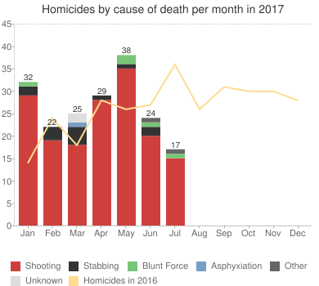
WWWanted: A plan to curtail killings

Slide 14
“””this grace was given, to preach to the Gentiles the unsearchable riches of Christ, 9 and to bring to light for everyone what is the plan of the mystery hidden for ages in God who created all things, 10 so that through the church the manifold wisdom of God might now be made known to the rulers and authorities in the heavenly places. 11 This was according to the eternal purpose that he has realized in Christ Jesus our Lord, 12 in whom we have boldness and access with confidence through our faith in him.
13 So I ask you not to lose heart over what I am suffering for you, which is your glory.
14 ¶ For this reason I bow my knees before the Father,…..

Slide 16
“”This mystery is that the Gentiles are fellow heirs, members of the same body, and partakers of the promise in Christ Jesus through the gospel.” Vs 6

Slide 18
First, each Church is part of the universal Church. The people of God are by His grace a unique multi-racial, multi-national, multi-cultural community. This community is God's new creation, His new humanity, in which Christ has abolished all barriers (see Ephesians 2 and 3). There is therefore no room for racism in the Christian society, or for tribalism--whether in its African form, or in the form of European social classes, or of the Indian caste system. Despite the Church's failures, this vision of a supra-ethnic community of love is not a romantic ideal, but a command of the Lord. Therefore, while rejoicing in our cultural inheritance and developing our own indigenous forms, we must always remember that our primary identity as Christians is not in our particular culture but in the one Lord and His one Body (Eph. 4:3-6).
The Willowbank Report - Lausanne Consultation of Gospel & Culture

Slide 20
Ephesians 3:14-16
“14 For this reason I bow my knees before the Father, 15 from whom every family in heaven and on earth is named, 16 that according to the riches of his glory he may grant you to be strengthened with power through his Spirit in your inner being,

Slide 22
PPRAYER FOR THE RECONCILING GOSPEL
The Indwelling Christ
The Rooting in Love
The Surpassing Dreams

Slide 24
“14 For this reason I bow my knees before the Father, 15 from whom every family in heaven and on earth is named, 16 that according to the riches of his glory he may grant you to be strengthened with power through his Spirit in your inner being,

Slide 26
The Indwelling Christ
“16 that according to the riches of his glory he may grant you to be strengthened with power through his Spirit in your inner being,17 so that Christ may dwell in your hearts through faith —
The Indwelling Christ
“16 that according to the riches of his glory he may grant you to be strengthened with power through his Spirit in your inner being,17 so that Christ may dwell in your hearts through faith —

Slide 28
If you remain in me and my words remain in you, ask whatever you wish, and it will be given you. 8 This is to my Father’s glory, that you bear much fruit, showing yourselves to be my disciples. 9 ¶ "As the Father has loved me, so have I loved you. Now remain in my love.
John 15

Slide 30
2) The Rooting in Love
“that you, being rooted and grounded in love, 18 may have strength to comprehend with all the saints what is the breadth and length and height and depth, 19 and to know the love of Christ that surpasses knowledge, that you may be filled with all the fullness of God.”

Slide 32
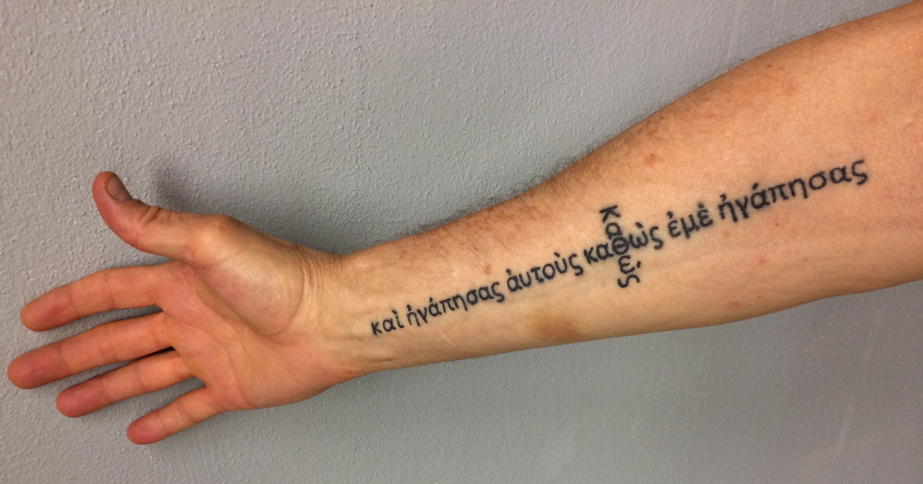
“I in them and you in me. May they be brought to complete unity to let the world know that you sent me and have loved them even as you have loved me.”
John 17:23

Slide 34
3) The Surpassing Dreams
“20 Now to him who is able to do far more abundantly than all that we ask or think, according to the power at work within us, 21 to him be glory in the church and in Christ Jesus throughout all generations, forever and ever. Amen.”

Slide 36
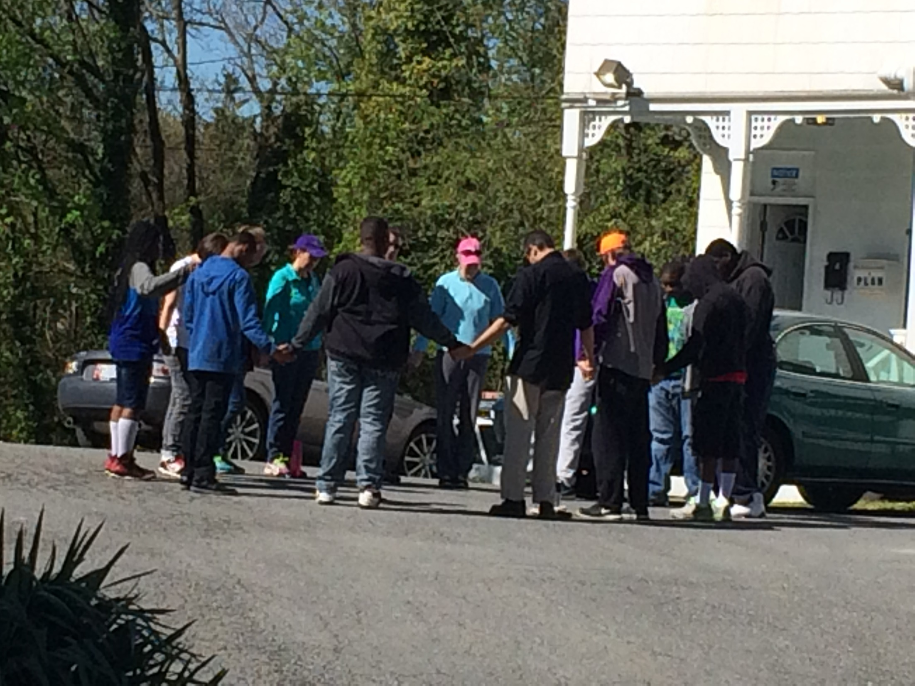
FCF Youth & Leaders Praying before serving in Sandtown after the Riots

Slide 37
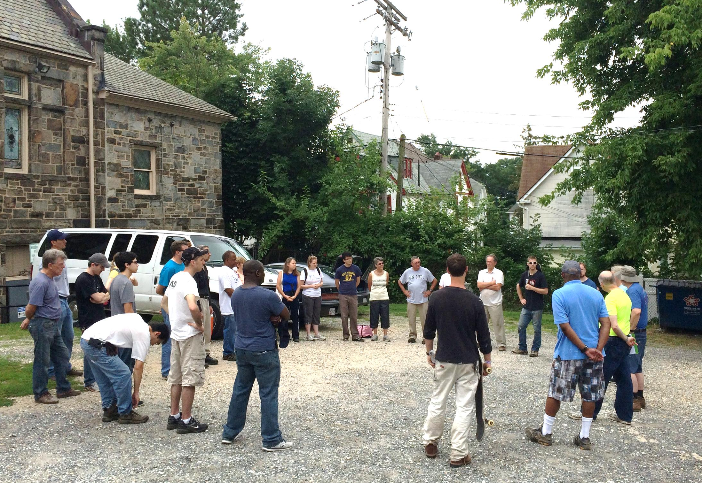
Pen Lucy Works Weekend 2015

Slide 38
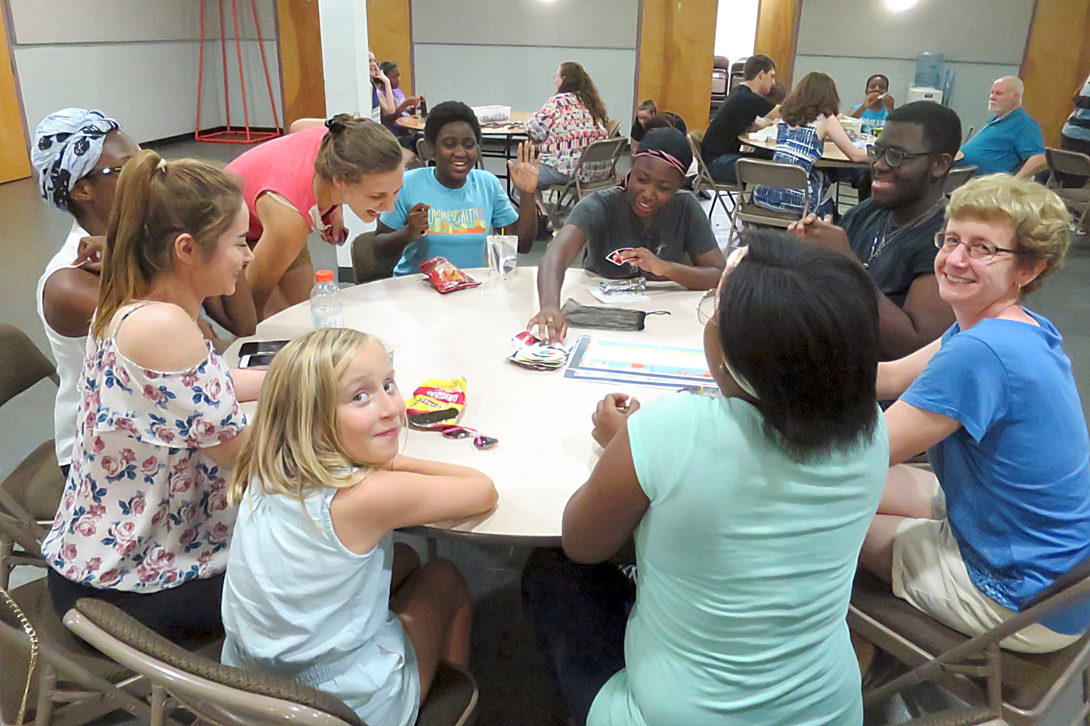

Slide 39
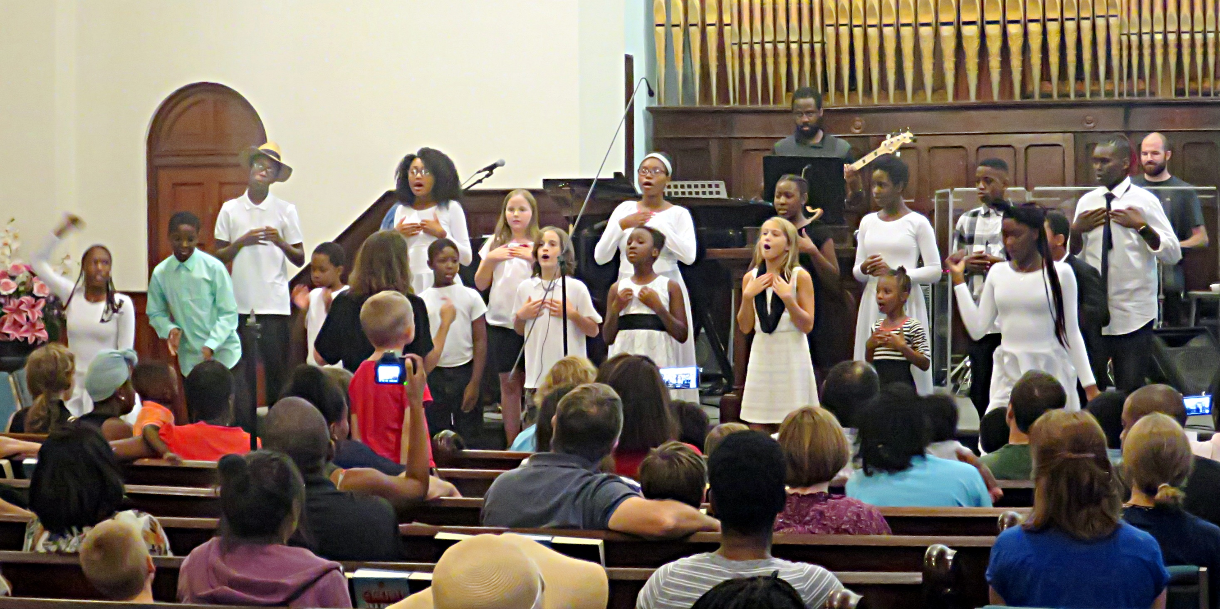

Slide 40
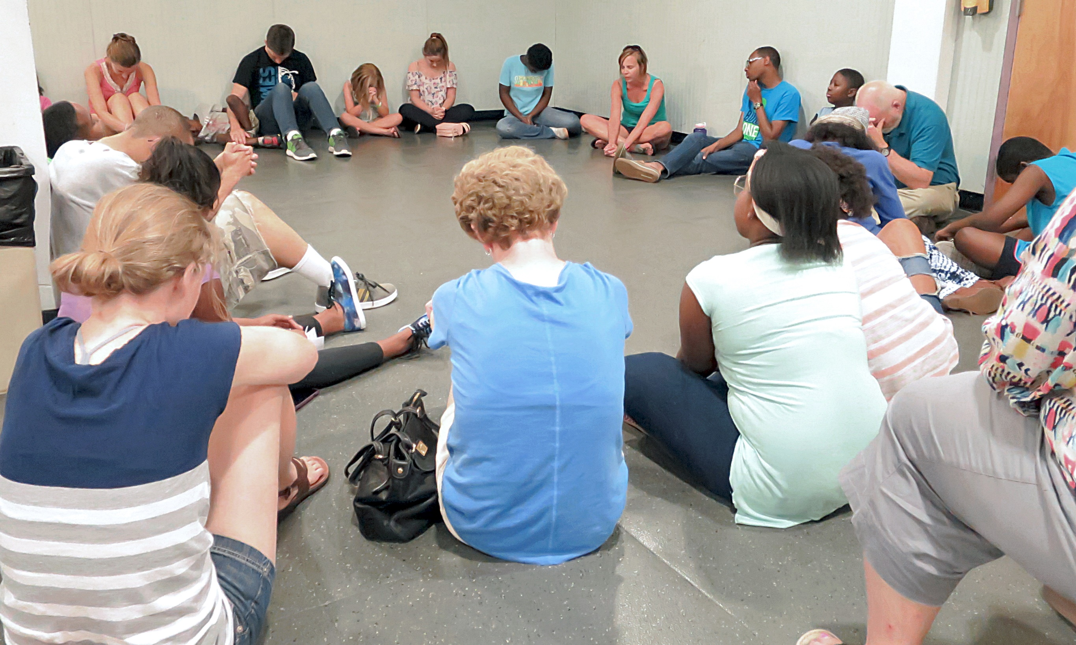

Slide 41
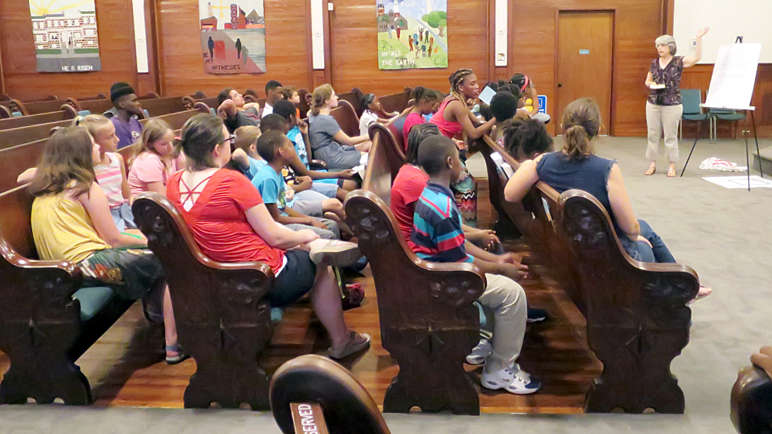

Slide 42
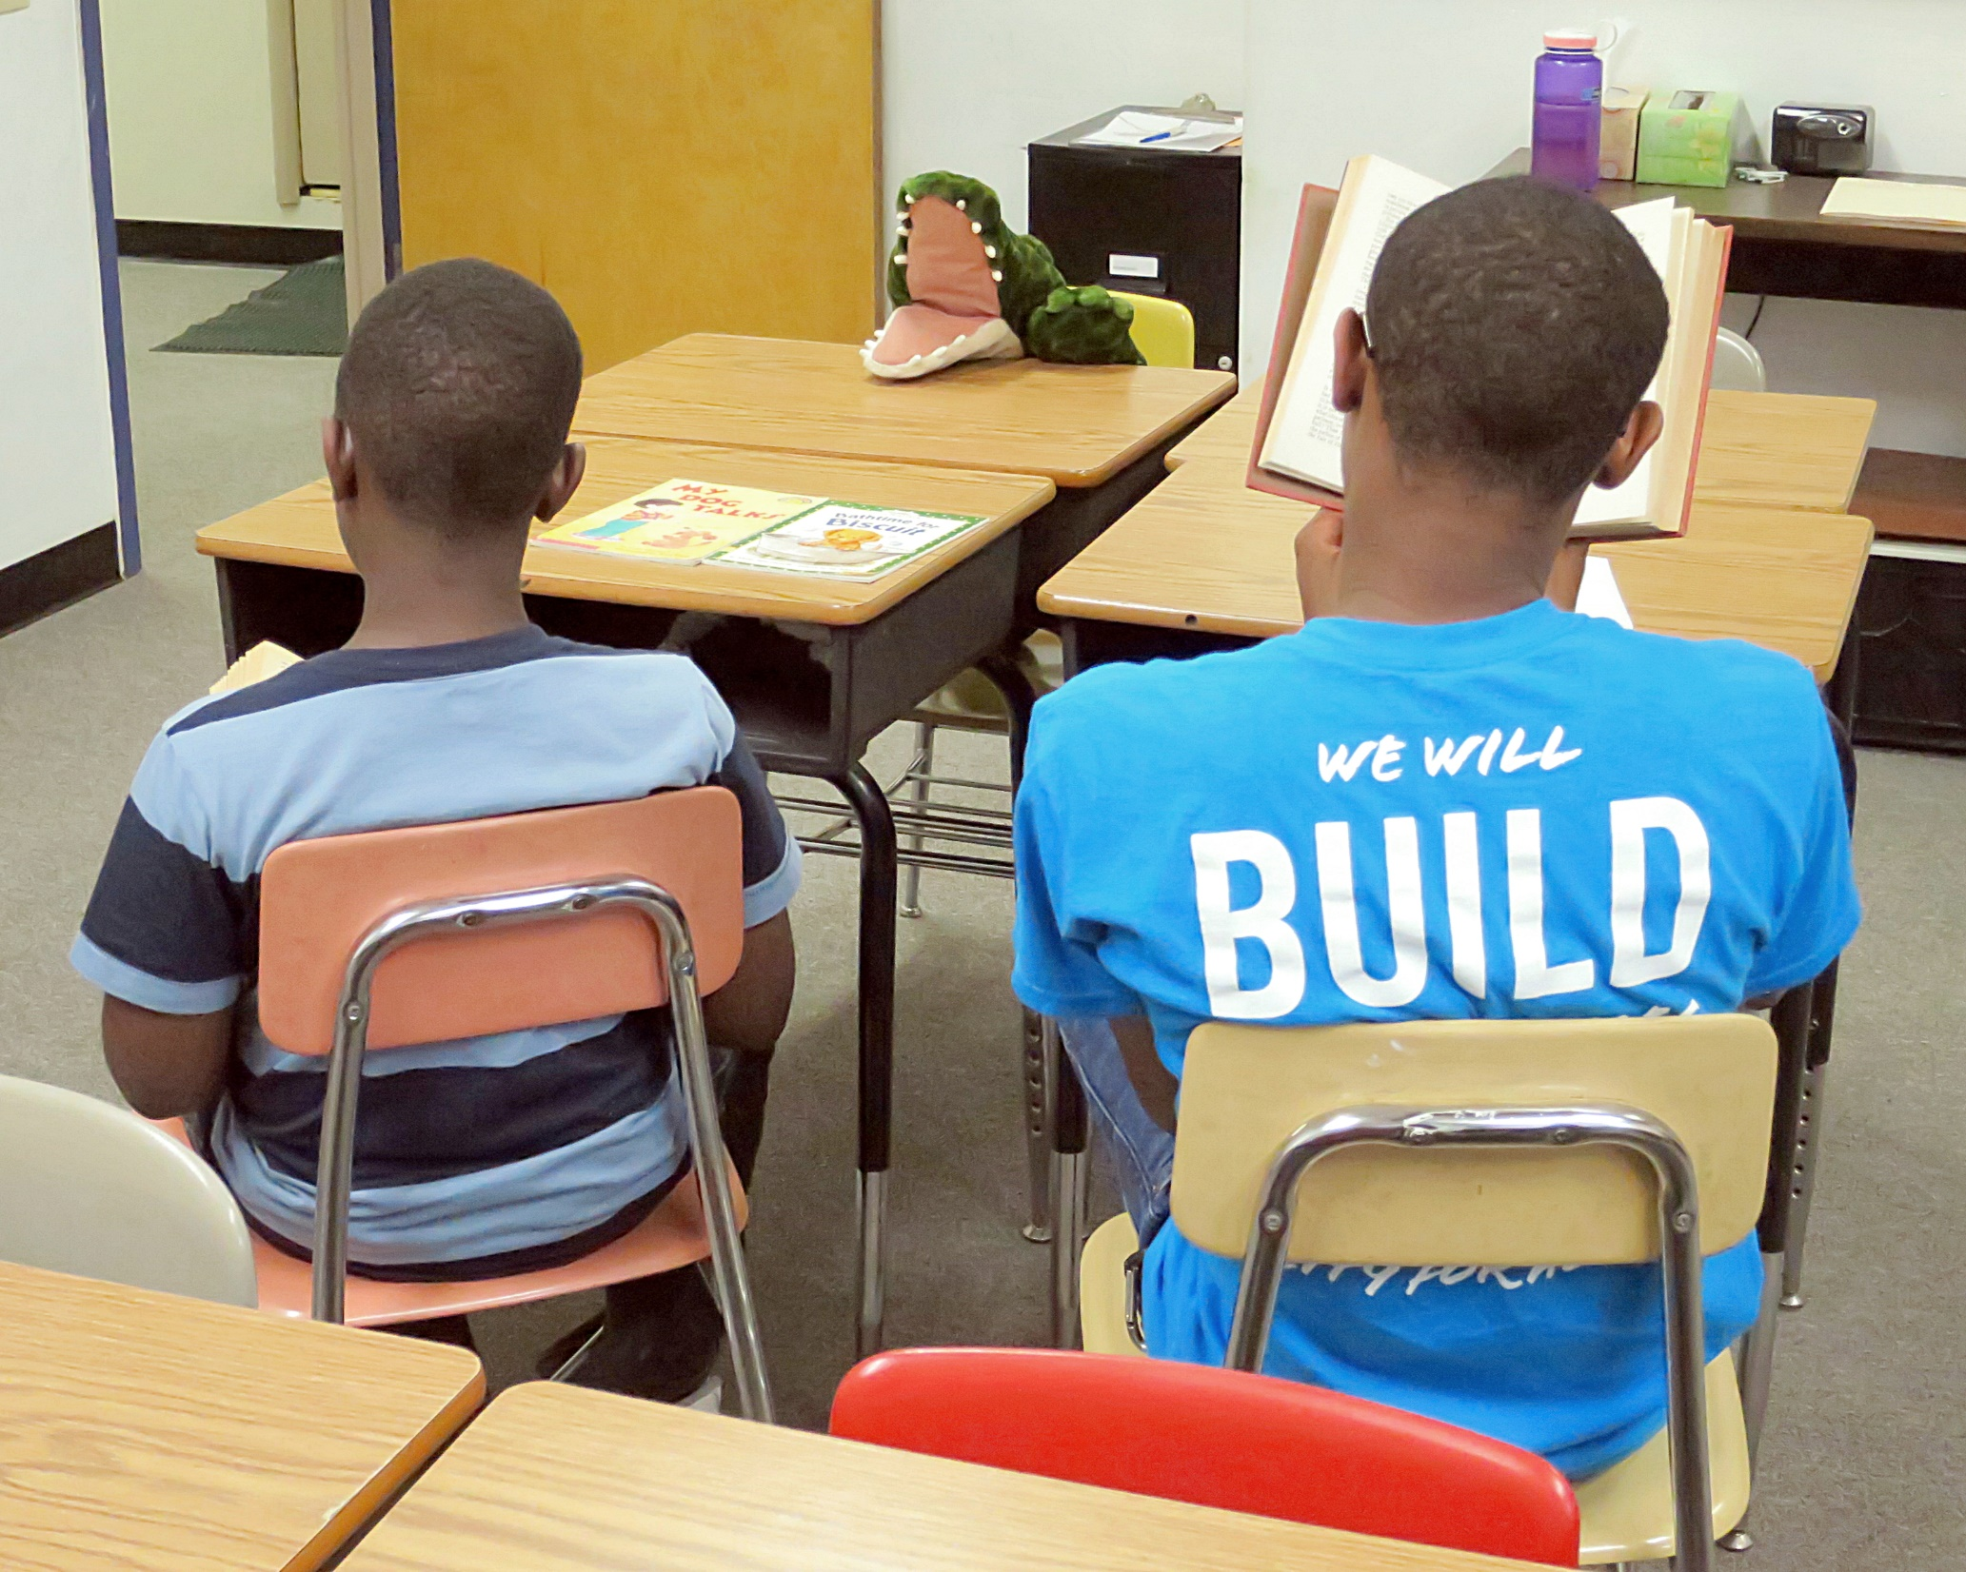

Slide 43
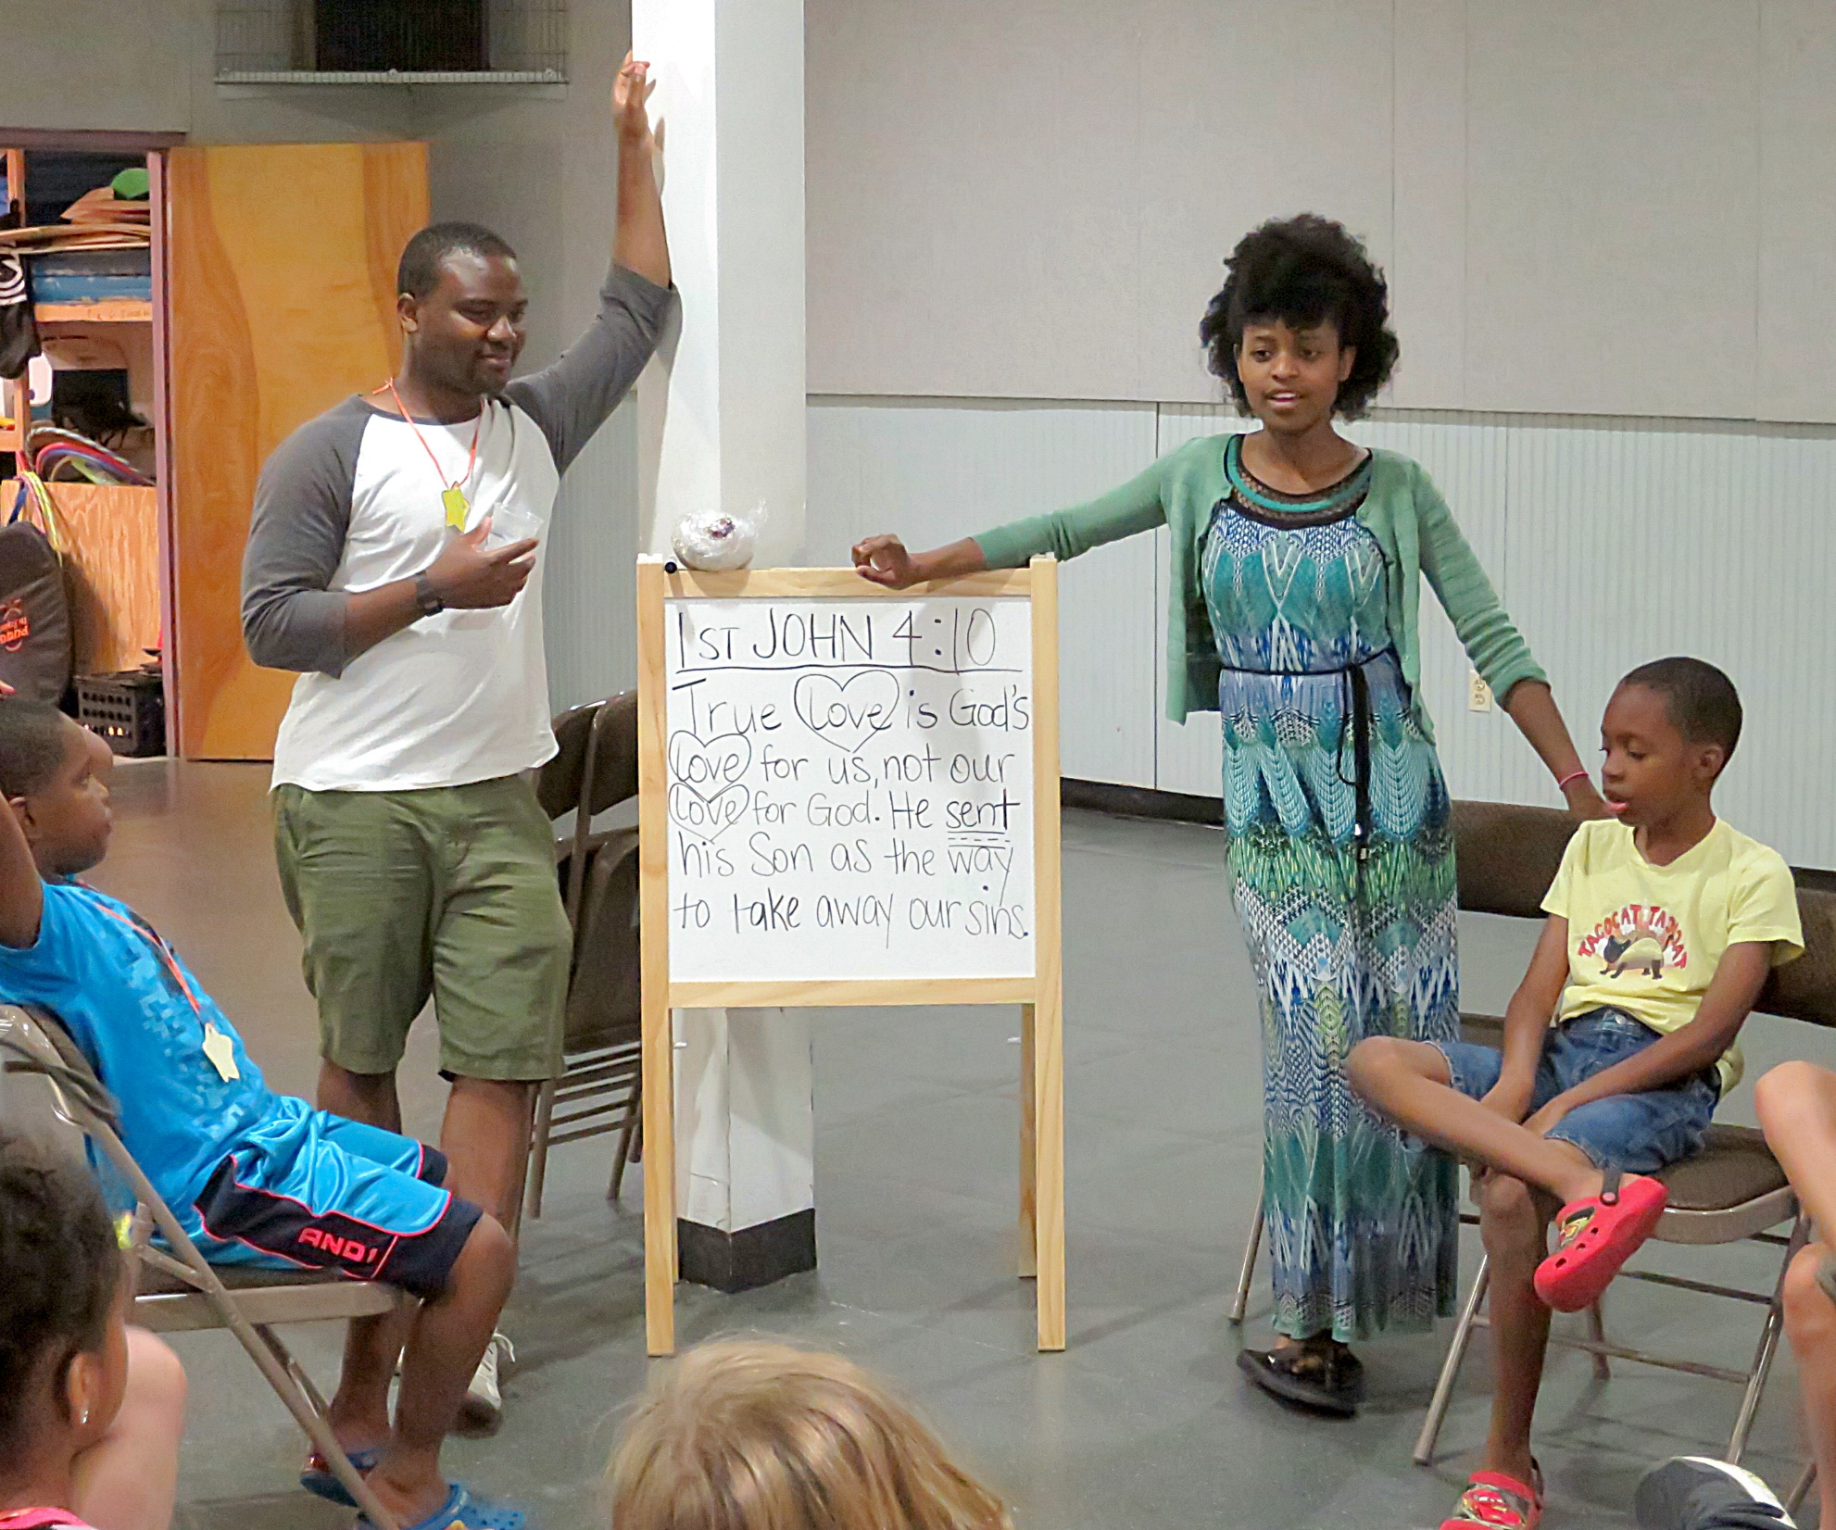

Slide 44
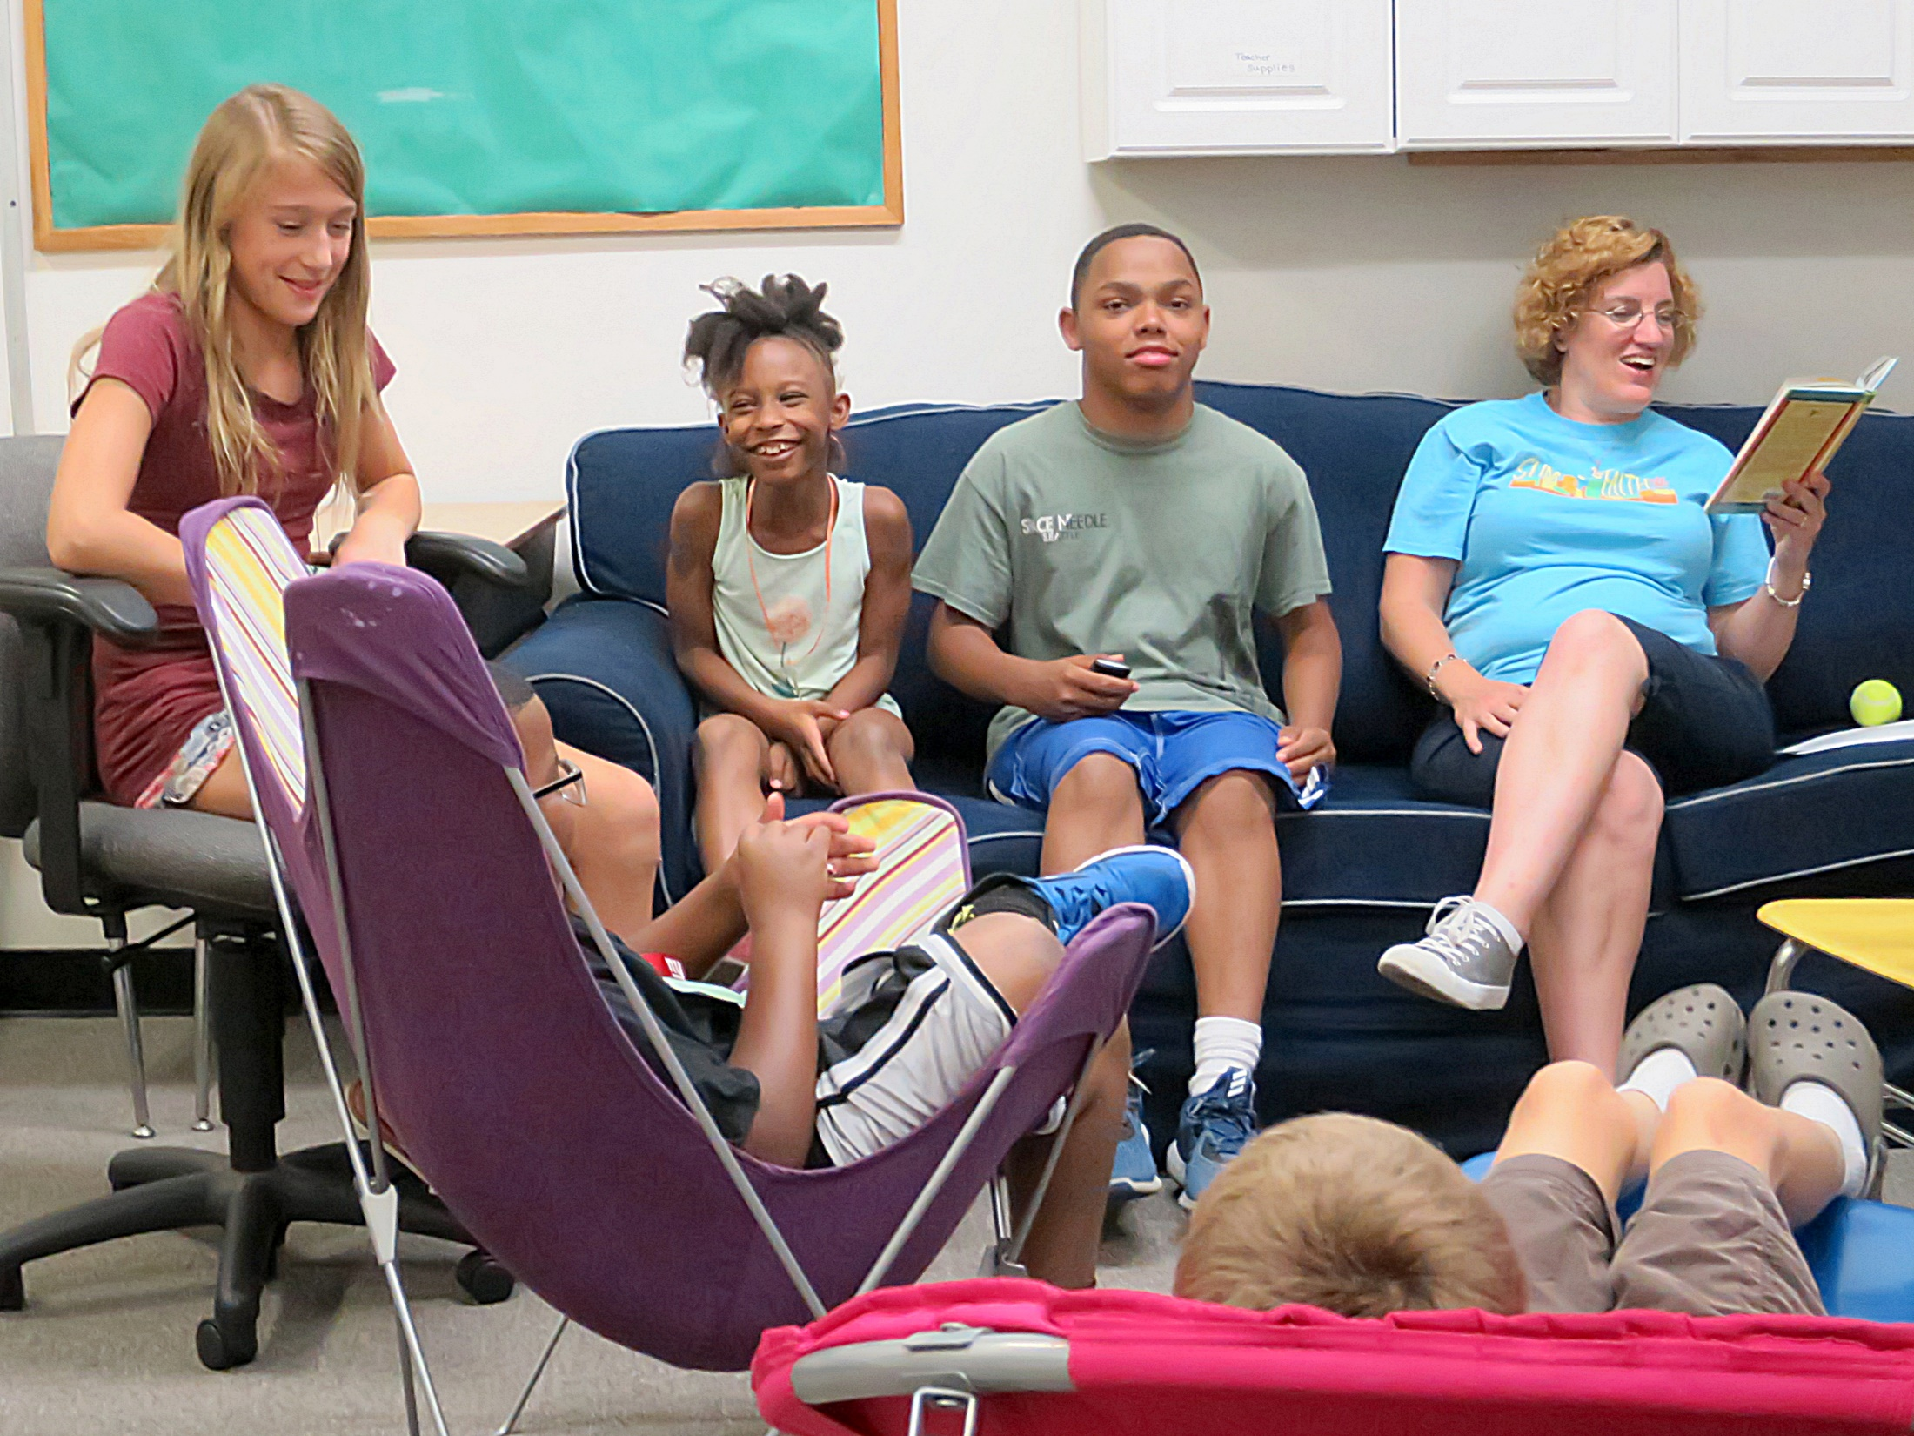

Slide 45
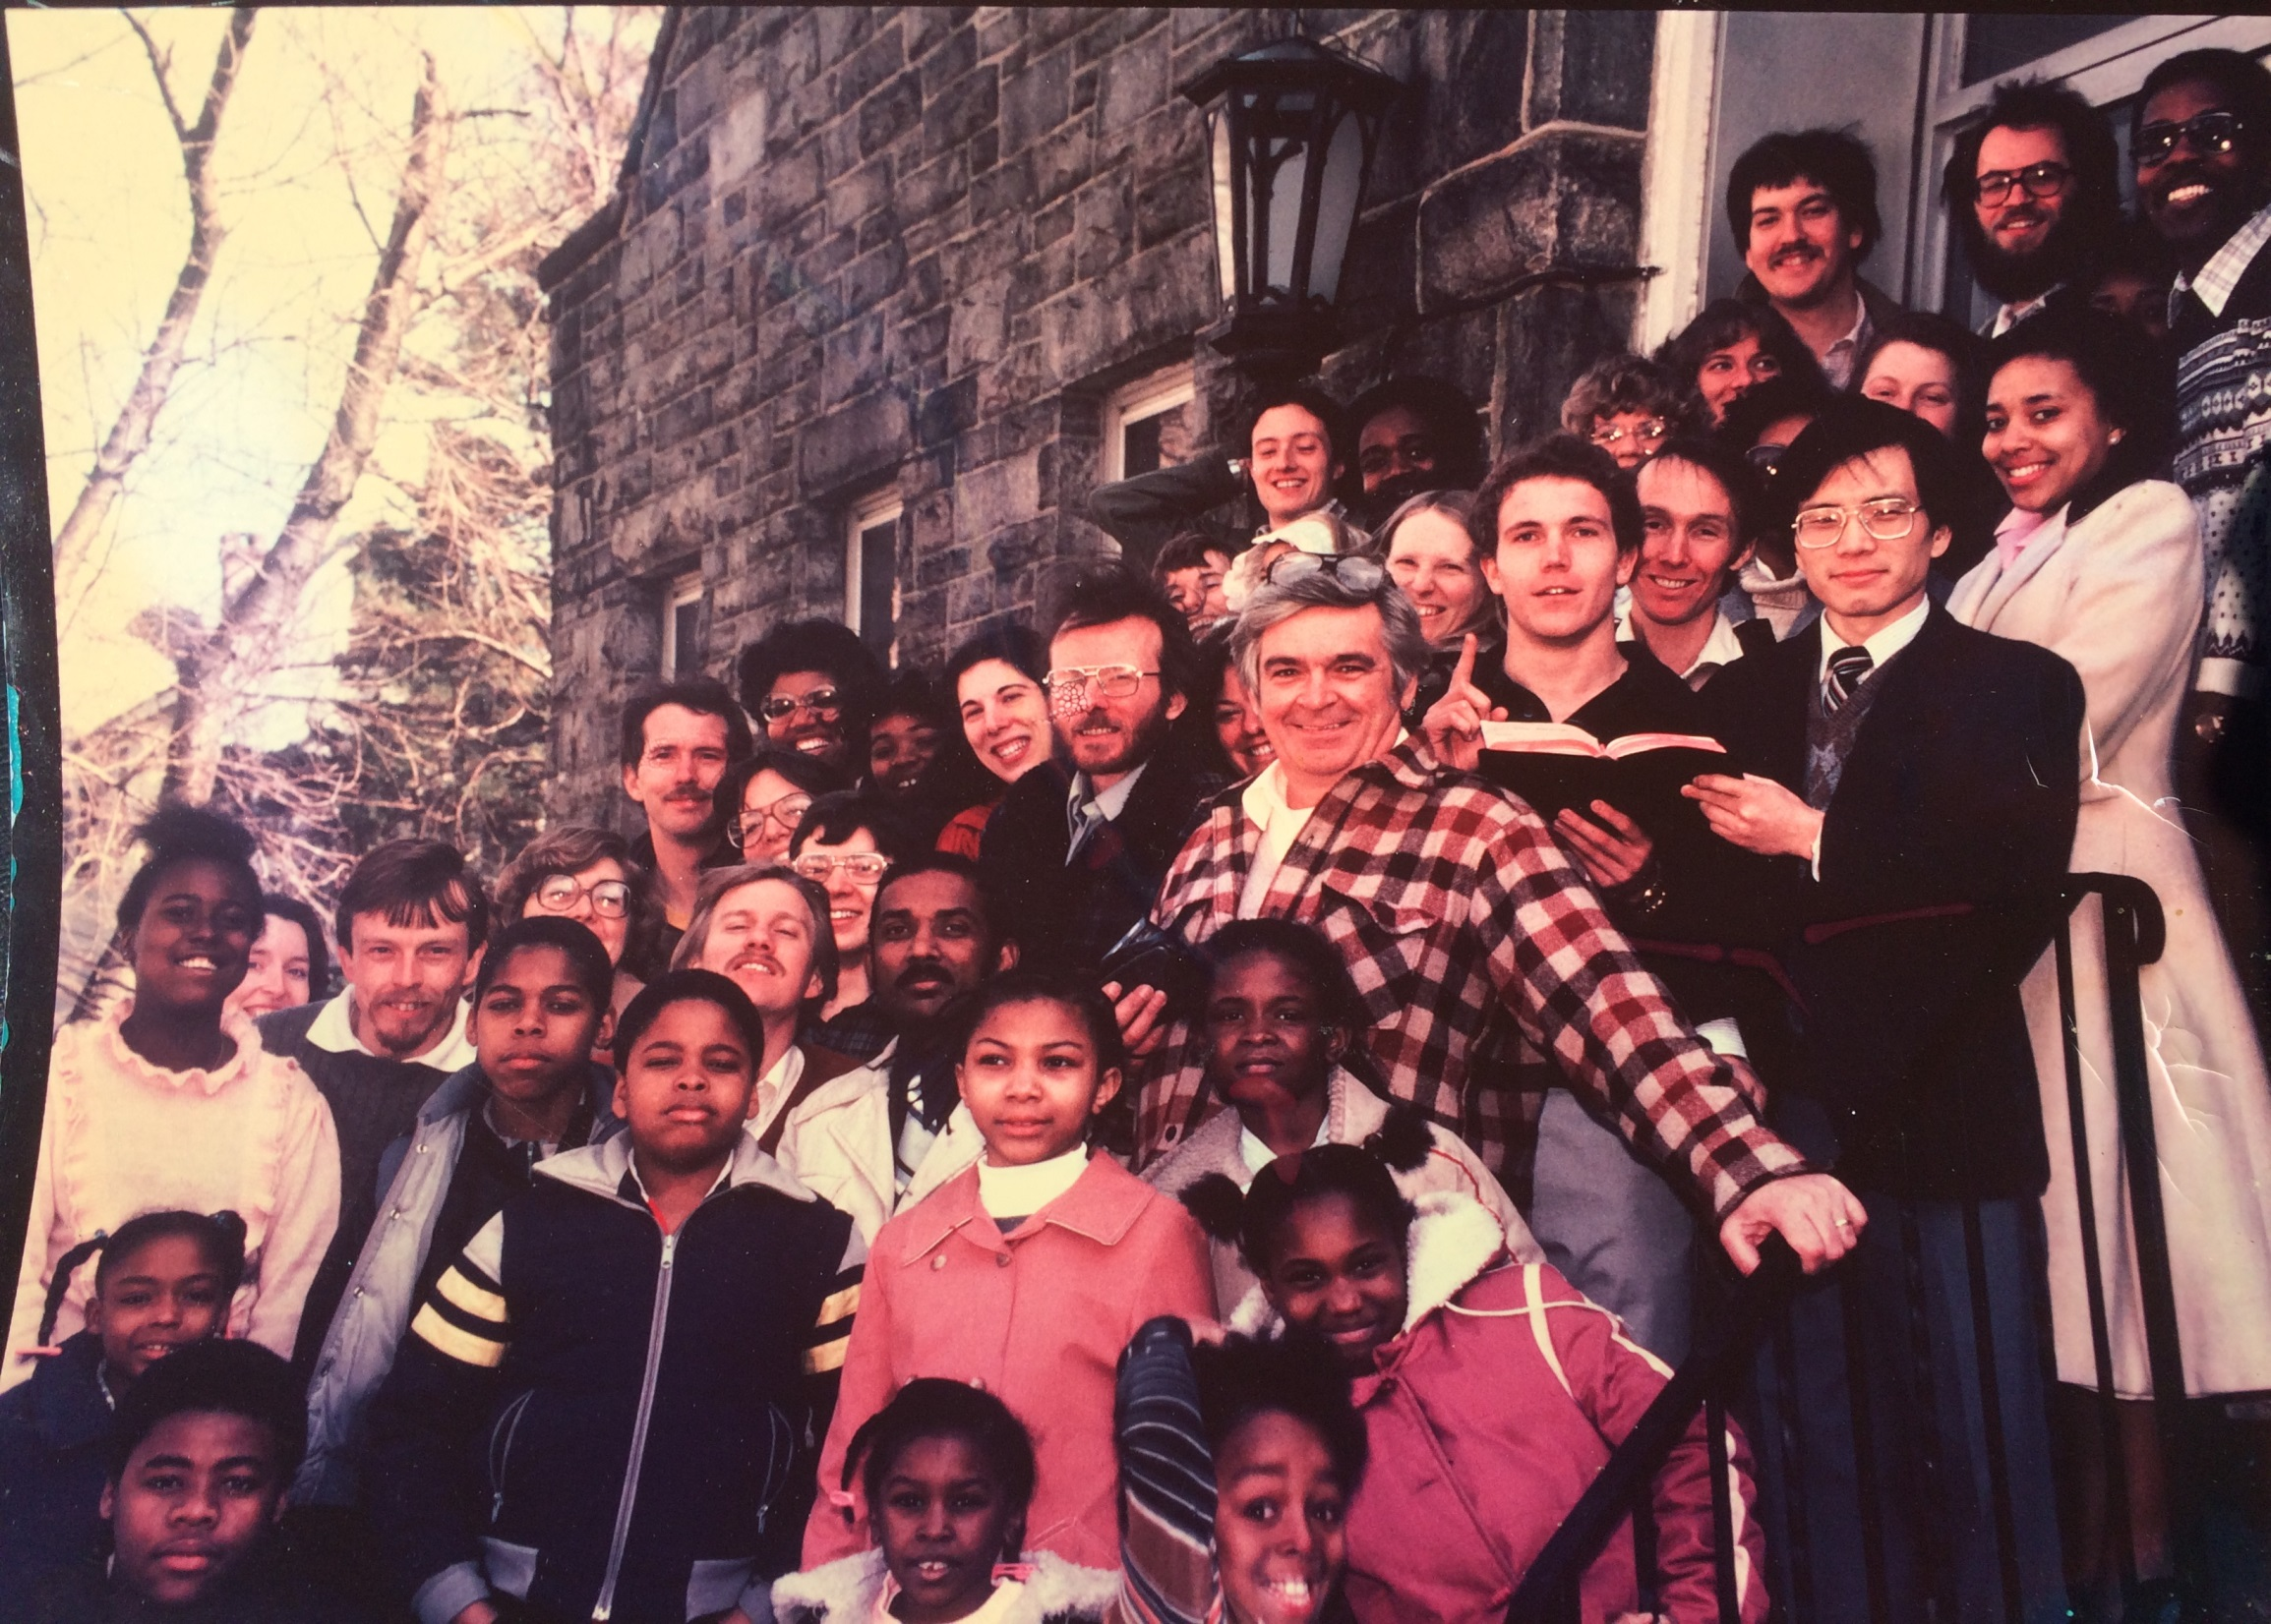
FCF 1983
FCF 1983
Notes:
Faith Christian Fellowship became a multiethnic, diverse socio-economic fellowship and a particular PCA church in the spring of 1983 with 48 members. (FCF was one of 5 church plants that Liberty PCA church helped plant within three years under the leadership of Dr. Rev. Mark Pett. In 1987 Mark Gornik (top center) with five other members from FCF launched New Song Community Church in Sandtown, Baltimore. )

