Slide 1

DEPRESSION CYCLE
TIM KEETER
counseling@gcchsv.org

Slide 2

Problem
Sinful response
Depressed feelings
Event (not sinful)
Depression Cycle
Used as excuse to handle subsequent problems
sinfully or to shut down in some areas of life,
thus neglecting God-given responsibilities.
Cycle increases in amplitude and
contributes to habitual pattern ...
Increased/continued
bad feelings
Guilt

Slide 3

Problem
Sinful response
Depressed feelings
Event (not sinful)
Depression Cycle
Functionality returns
Habitual pattern & guilt remain ...
Increased/continued
bad feelings
“Bad” feelings
cease
Guilt

Slide 4
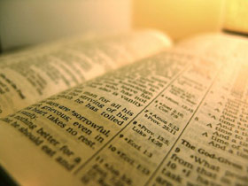
Problem
Sinful response
Depressed feelings
Event (not sinful)
Biblical response /Repentance
✗
Cycle reverses until new habits formed ...
Increased/continued
bad feelings
Guilt

