Slide 1

BIBLICAL DISCIPLINES & TOOLS FOR INTERNET-CAPABLE TECHNOLOGIES
TIM KEETER
counseling@gcchsv.org

Slide 2
ASSUMPTIONS
“ADVANCD WORKSHOP”
A BIBLICAL UNDERSTANDING OF SEXUAL IDOLATRY

Slide 3

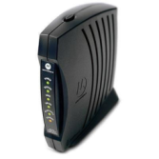


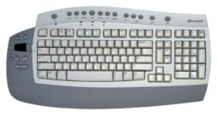
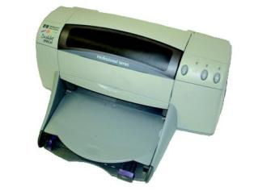
THE HOME NETWORK (THEN)
www
INTERNET
MODEM

Slide 4

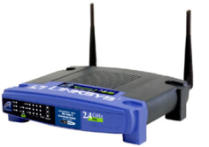
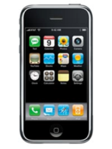

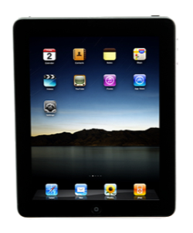
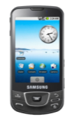


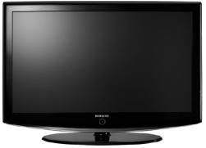


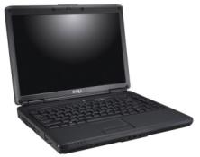

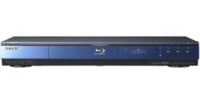
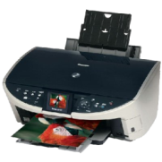
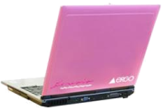
THE HOME NETWORK (NOW)
www
INTERNET
MODEM
WIRELESS ROUTER
MOBILE DEVICES
GAMING CONSOLES
HOME ENTERTAINMENT CENTERS
PRINTER
COMPUTERS

Slide 5
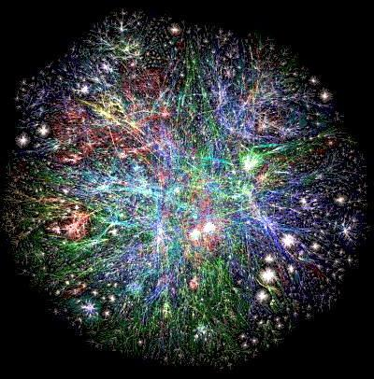
I. SETTING THE STAGE
ACCESS TO THE INTERNET IS BECOMING INCREASINGLY INTEGRATED WITH EVERYDAY LIFE
  Estimated 5 billion devices connected to the internet in August 2010
  Projected to be 20 billion by 2020
  “There will come a day in the not too distant future when every product you buy will connect to the internet.” Parrack, Dave, tech.blorge.com

Slide 6

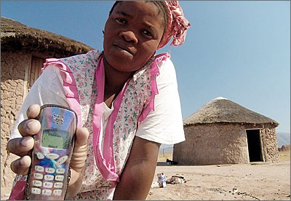
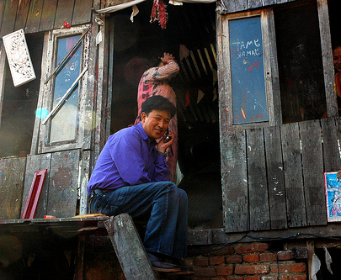
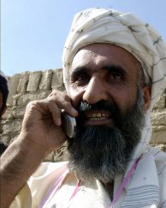
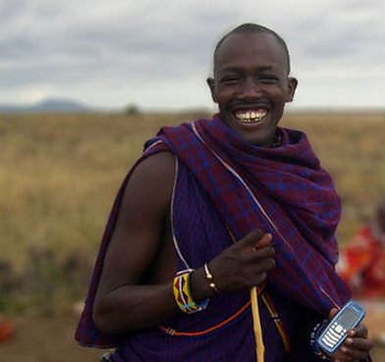

Slide 7
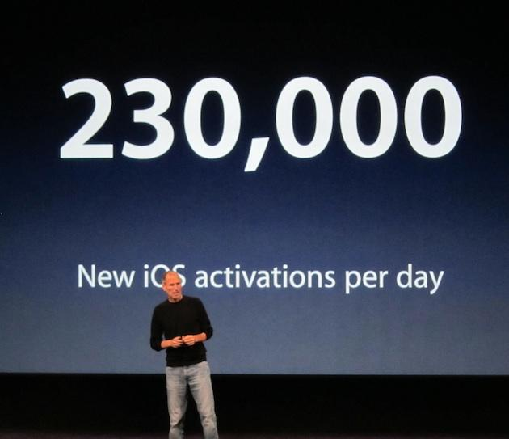
SEPTEMBER 2011

Slide 8
I. SETTING THE STAGE
FOUR GOALS TO SHAPE OUR APPROACH
  CHRISTIANS NEED TO LEARN TO HANDLE THIS TECHNOLOGY IN A GOD-HONORING WAY
    COUNSELORS
    FAMILY MEMBERS
    COUNSELEES
Whether, then, you eat or drink or whatever you do, do all to the glory of God. 1 Co. 10:31

Slide 9
I. SETTING THE STAGE
  OUR STRATEGIES AND PRACTICES WITH WIRELESS COMMUNICATIONS SHOULD ELIMINATE TEMPTATIONS DUE TO “CARELESS MISTAKES” (AS MUCH AS POSSIBLE)
“And do not lead us into temptation, But deliver us from the evil one.” Mt. 6:13

Slide 10
I. SETTING THE STAGE
  OUR STRATEGIES AND PRACTICES WITH WIRELESS COMMUNICATIONS SHOULD HINDER DELIBERATE ATTEMPTS TO SIN (I.E., PROVIDES MANY OPPORTUNITIES TO RECOGNIZE/ACKNOWLEDGE/DEAL WITH SIN)
“Watch and pray, lest you enter into temptation. The spirit indeed is willing, but the flesh is weak.” Mk. 14:38

Slide 11
I. SETTING THE STAGE
  OUR STRATEGIES AND PRACTICES WITH WIRELESS COMMUNICATIONS SHOULD CULTIVATE SELF-CONTROL
    Wise use of the computer is both a dominion and a stewardship issue (of our time & energy)
All things are lawful for me, but I will not be brought under the power of any. 1 Co. 6:12b
Therefore, to one who knows the right thing to do and does not do it, to him it is sin. Jas. 4:17
Notes:
Want to build a history of good uses/practices; “I can live godly with this technology – it does not have to rule me.”

Slide 12
I. SETTING THE STAGE
IN THE COUNSELING CONTEXT
  1. STRATEGIES CANNOT CHANGE THE HEART
    Even a “foolproof” setup (which does not exist) without biblical discipleship only serves to divert an unrepentant heart to other manifestations of sin.
    They are not the missing ingredient for obedience
    They are a way to hinder temptation and sin

Slide 13
I. SETTING THE STAGE
  INTERNET DISCIPLINES & STRATEGIES MUST NOT …
    … be seen as what’s keeping them from sin
    … detract from recognizing our need of grace
    (2 Co. 12:7-10)
    … steal glory from God when obedience is present
    … shift blame from counselee when sin/failure is present
    … mask/dismiss sin even when attempts to further their sin are thwarted

Slide 14
I. SETTING THE STAGE
  ADAPT AND REVISE STRATEGIES TO ADDRESS THE COUNSELEE’S:
    Sinful tendencies (past and present)
    Spiritual maturity
    Potential for enslavement
    God-given responsibilities
    “What does the way the counselee handles this technology say about them as a worshipper?”

Slide 15
I. SETTING THE STAGE
  A COUNSELEE’S RESISTANCE TO LOSS OF CONVENIENCE NEEDS TO BE CONFRONTED AS A LACK OF REPENTANCE
For observe this very thing, that you sorrowed in a godly manner: What diligence it produced in you, what clearing of yourselves, what indignation, what fear, what vehement desire, what zeal, what vindication! In all things you proved yourselves to be clear in this matter. 2 Co. 7:11

Slide 16

I. SETTING THE STAGE
  4. PITFALLS FOR COUNSELORS TO AVOID:
“THIS IS NOT MY STRONG SUIT, SO I’LL JUST DEAL WITH THE HEART”
OVEREMPHASIS ON TECHNOLOGICAL “FENCES”

Slide 17
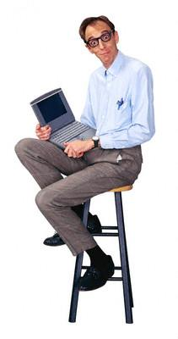
I. SETTING THE STAGE
  IDENTIFY GODLY MEN IN THE CONGREGATION WHO ARE GIFTED IN THIS AREA TO EVALUATE TOOLS, ASSIST COUNSELORS, TRAIN SPOUSES, TRAIN PARENTS, ETC.

Slide 18
II. DISCIPLINES
HELP THE COUNSELEE TO “KNOw Self”
  “What are my tendencies with regard to the internet and other communication devices?”
  CATEGORIZE THEM …
    Sinful (Commission)
    Sinful (Omission)
    Not sinful

Slide 19
SINFUL (Commission)
SINFUL (Omission)
REPENT
AVOID/FLEE
REPENT
REPRIORITIZE
NOT SINFUL
MODERATE
KEET WATCH
STAY ACCOUNTABLE

Slide 20
II. DISCIPLINES
  IDENTIFY THEIR GENERAL TENDENCIES
  (“WHEN GIVEN TIME, I WILL LOG ON IN ORDER TO …”)
    Surf (How? For What?)
    Game
    Socialize
    Etc.

Slide 21
II. DISCIPLINES
  DISCERN THEIR SINFUL TENDENCIES
    Fantasizing (Mt. 5:27-28; Phil. 4:8)
    Lust (Ps. 101:3a; Job 31:1; Pro. 4:23,25;
    Ro. 13:14; 2 Ti. 2:22; 2 Thes. 5:22)
    Excessive time (Eph. 5:15-16)
    Socializing with ungodly people or
    ungodly purposes
    (1 Co. 15:33; Pro. 13:20; Pro. 22:24,25)

Slide 22
II. DISCIPLINES
    Love of pleasure (pleasing self; laziness) (Eph. 4:17-19)
    Love of control (Pro. 3:5-7)
    Escape (When? From what?) (false refuge – getting online when hurt, angry, avoiding responsibility, etc.)
    Deception (Pro. 28:13)
    Financial irresponsibility
    Etc.

Slide 23
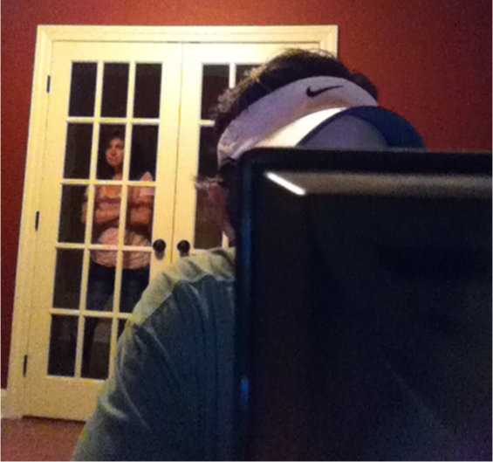
II. DISCIPLINES
NO-TECH
HELP THE COUNSELEE TO ESTABLISH
WISE PRACTICES
  COMPUTER SCREENS IN “PUBLIC” LOCATION
    Minimize privacy
    (E.g., no bedrooms or
    backing into corners)
    “Spy-friendly”
    Singles: Administrative
    account for someone else to monitor (unscheduled)

Slide 24
II. DISCIPLINES
NO-TECH
  ENFORCE TIME LIMITS
    Especially useful for young people
    Many ways to do this electronically
  ADD “EDIFYING” DECORATIONS

Slide 25
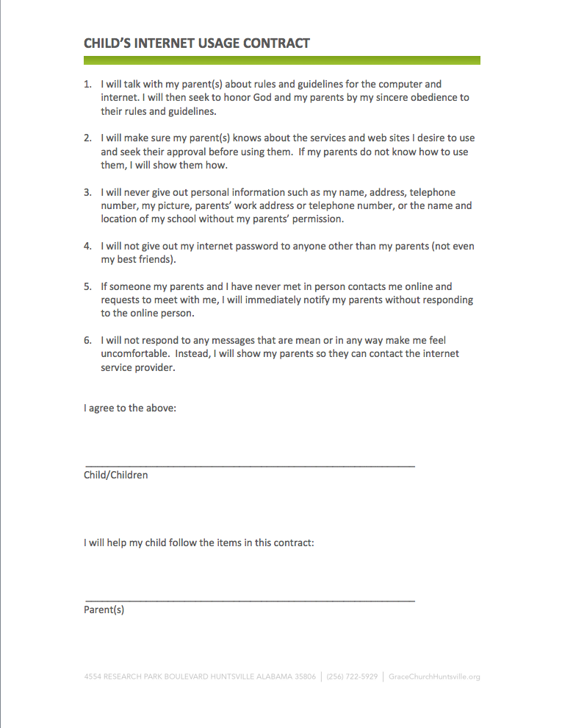
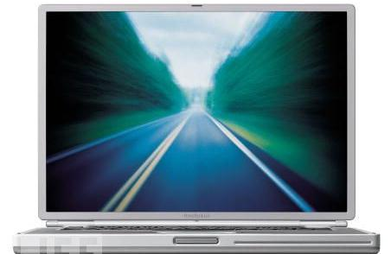
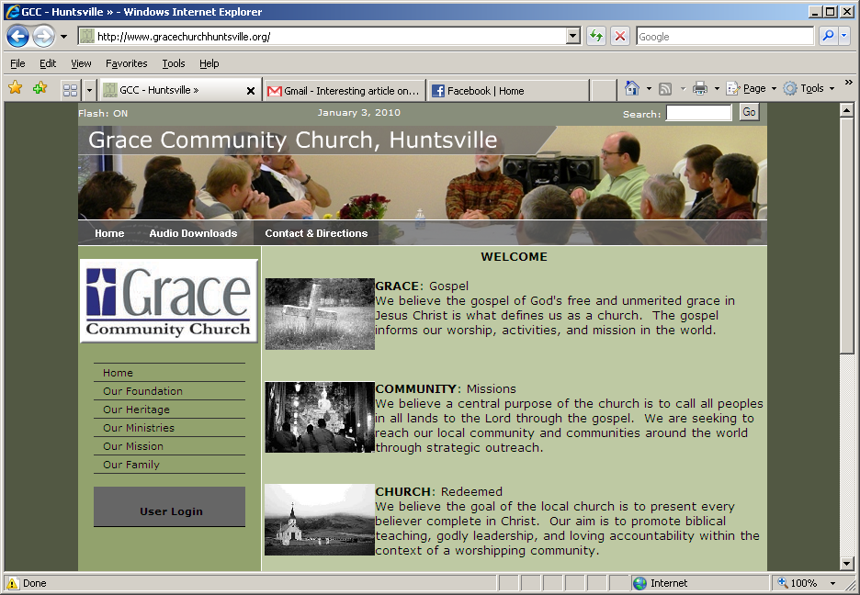
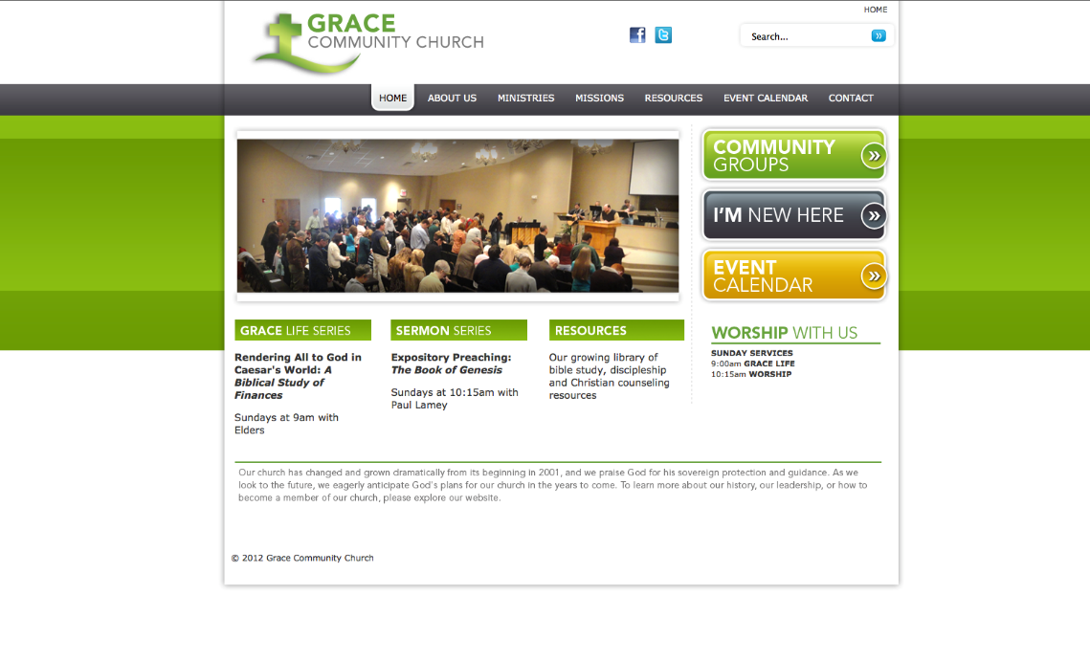
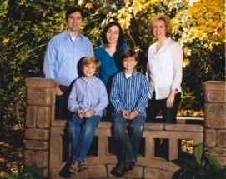
HOW AM I BRINGING GLORY AND HONOR TO GOD RIGHT NOW?
As a dog returns to his own vomit, So a fool repeats his folly. Pro. 26:11

Slide 26
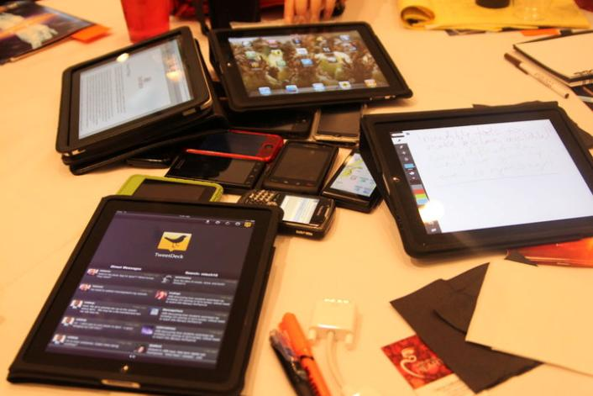

II. DISCIPLINES
NO-TECH
  INSPECT WHAT YOU EXPECT
    Learn how to use basic software tools
    Teach to wives, parents, counselors
    E.g., Sunday afternoon “History Checks”
Notes:
Build the mindset of my wife/mom/dad is gonna check …

Slide 27

II. DISCIPLINES
NO-TECH
  Ask specific questions regularly
    How might a prideful heart manifest
    itself when questioned?
    “How have you been doing with
    diverting your eyes?”
    “What efforts have you made to build godly relationships within your church family lately?”
    “Tell me how you spent your evenings this
    past week”
    “Can I see the internet history on your phone?”

Slide 28
II. DISCIPLINES
LO-TECH
  NO ADMINISTRATOR PRIVILEGES FOR YOUNG PEOPLE OR ADULTS WHO HAVE FALLEN WITH PORNOGRAPHY, ETC.
    Why? Will not be able to install software or change critical settings
    Record a list of all installed software and check against that list on occasion

Slide 29

II. DISCIPLINES
LO-TECH
  SET PARENTAL CONTROLS ON ALL DEVICES THAT ACCESS THE INTERNET
  INSTALL FILTERING AND/OR REPORTING SOFTWARE ON ALL DEVICES THAT ACCESS THE INTERNET

Slide 30
II. DISCIPLINES
LO-TECH
  PASSWORDS FOR ALL ADMINISTRATOR PRIVILEGES.
    Nothing “obvious”
      Combination of lower/uppercase letters, numbers, and/or special characters
    Never written down or placed in “accessible location” for young people/counselee
    Short life (change periodically)
B y f N c a g b!
Buy your favorite Nouthetic counselor a good book!

Slide 31







II. DISCIPLINES
LO-TECH
  DECREASE THE NUMBER OF INTERNET SERVICE PROVIDERS (ISPS)
    Ideally to one
    Why? Easy to bypass some filtering with
    additional ISPs
    Types: Dial-up, broadband, Wireless

Slide 32





II. DISCIPLINES
LO-TECH
  DECREASE THE NUMBER OF WEB BROWSERS
    Ideally to one
    Why? Browsers usually store information and histories in different places, so much more difficult to monitor online activity

Slide 33





II. DISCIPLINES
LO-TECH
  REMOVE ALL PEER-TO-PEER (P2P) SOFTWARE
    Why? An easy way to “tunnel” past filters. Also, promotes illegal activity and increases susceptibility to malicious software

Slide 34
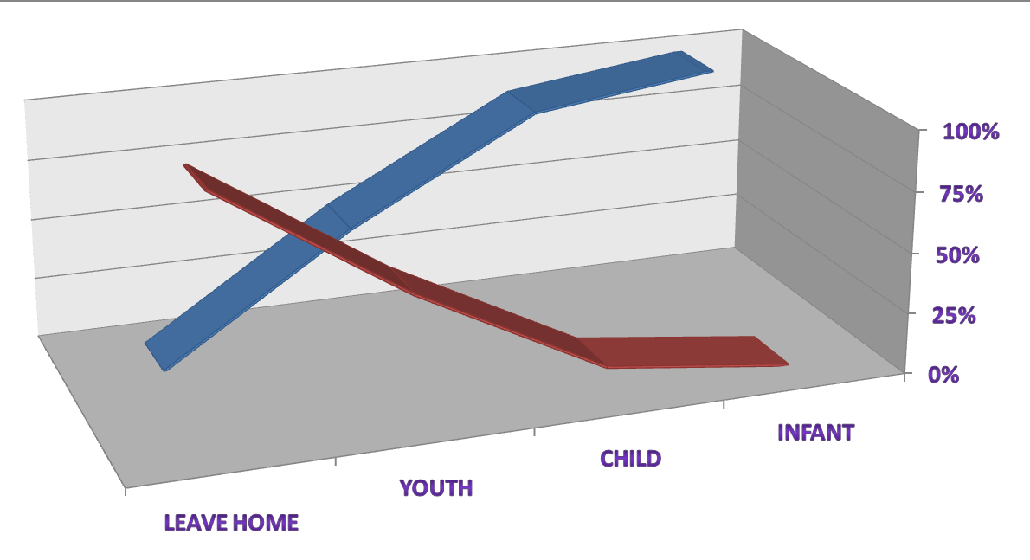
II. DISCIPLINES
WORKING WITH CHILDREN (& THEIR PARENTS)
  WORK TOWARDS BUILDING MATURITY AND WISDOM
PARENTAL CONTROL
WISDOM & FREEDOMS
Notes:
Gradually exposing them to responsibility with accountability (e.g., iPod, std cell phone, smart phone, ...)

Slide 35


II. DISCIPLINES
  BE A GOOD EXAMPLE
  STAND GUARD
  STIMULATE SPIRITUALITY
  FORMAL INSTRUCTION
    Child’s Internet Usage Contract
    Parent’s Internet Pledge
Parents: Bookmark a good website that provides a (censored) glossary of acronyms and slang used in chat and email.

Slide 36
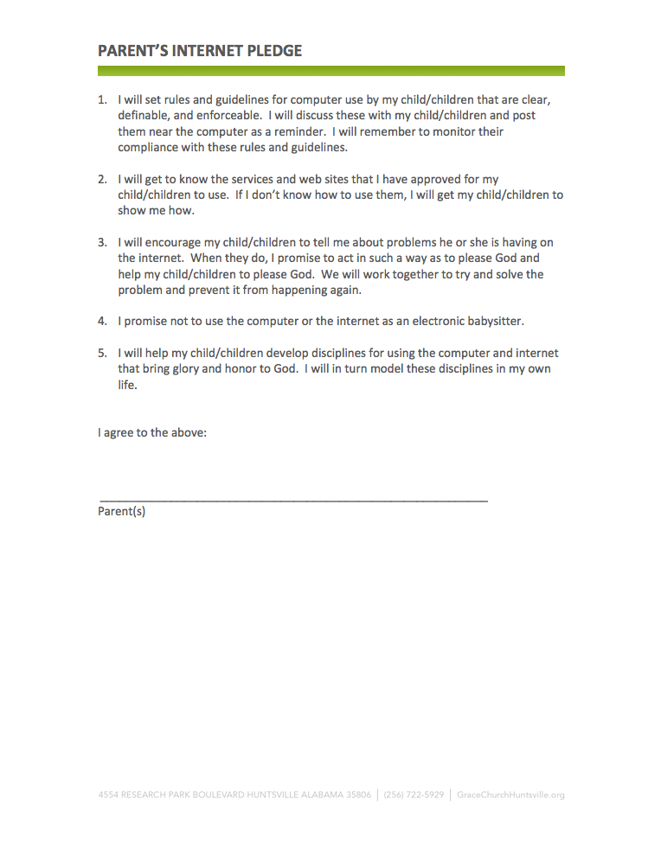
II. DISCIPLINES

Slide 37

INTERNET SLANG POP QUIZ
lol
rotf
ftw
brb
btw
ltns
pos, cd9
bbs
imho
ur
w00t
LAUGHING OUT LOUD
ROLLING ON THE FLOOR
FOR THE WIN!
BE RIGHT BACK
BY THE WAY
LONG TIME, NO SEE
PARENT OVER SHOULDER (CODE 9)
BE BACK SOON
IN MY HUMBLE OPINION
YOUR
WOOHOO!

Slide 38
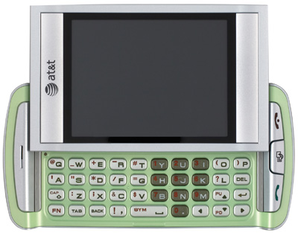
INTERNET SLANG POP QUIZ
it wud b much EZer 2 typ msgz n pln eng, bt wotz d :) n dat?
It would be much easier to type messages in plain English, but what’s the fun in that?

Slide 39
II. DISCIPLINES
WORKING WITH INDIVIDUALS ENSNARED WITH INTERNET PORNOGRAPHY
  THE COMPLEXITY OF TECHNO-COUNTERMEASURES SHOULD AT LEAST MATCH (IF NOT EXCEED) THE COUNSELEE’S SKILLS/CAPABILITIES USED TO ACCESS PORNOGRAPHY, ETC.

Slide 40
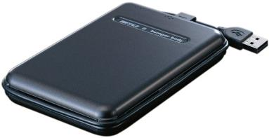
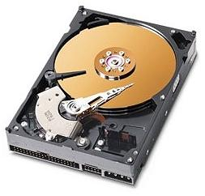
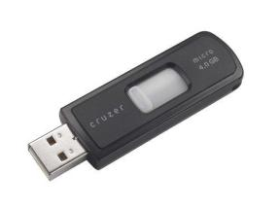

II. DISCIPLINES
  REMOVE “OFFENSIVE” FILES
    From hard drive
    From storage media
    Some can be creative where they
    “hide” things

Slide 41
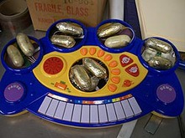
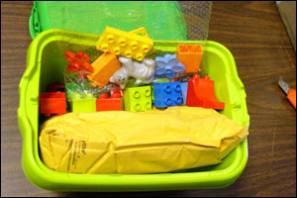
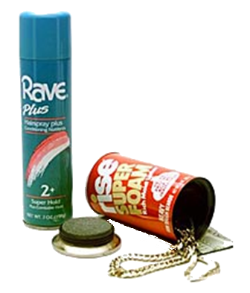
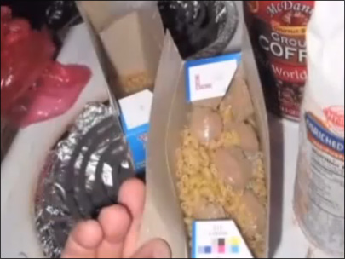
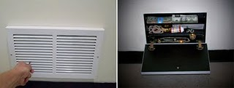

Slide 42
II. DISCIPLINES
  WHEN THE COMPUTER IS “LITTERED” WITH FILES, REFORMAT THE HARD DRIVE
    Reinstall the operating system (OS)
    Selectively install desired software
    May need to remove old email accounts
  FOR EXCEPTIONALLY “SNEAKY” COUNSELEES, TEMPORARILY DISABLE MASS STORAGE DEVICES
    E.g., CD/DVD writer, USB drives, etc.
    Why? Often a clandestine way to view, store, and hide downloads apart from the computer

Slide 43
II. DISCIPLINES
  IF NECESSARY, “RADICAL AMPUTATION”
    Mt. 5:27-30
    E.g., online activities allowed only with direct supervision/monitoring by another
    E.g., loss of all non-essential computers, devices, for a period of time
    E.g., downgrade to a cell plan/phone with no data service

Slide 44
III. TOOLS
FILTERING/REPORTING SOFTWARE
  Features to consider and compare
    Resistance to hacking
      “Thin client”
        Routes all electronic activity to a “cloud” of servers
        Does not use your computer’s resources to store or filter data

Slide 45
III. TOOLS
    RESISTANCE TO HACKING (CONTINUED)
      Anti-tamper
        Can shut down all internet access if any of the application’s files are manually deleted or altered
        Requires a password for uninstall
      No password override (option)
    TIME LIMITS

Slide 46
III. TOOLS
    ABILITY TO BLOCK …
      Objectionable sites
        Can list specific sites or categories to allow/deny
      Certain keywords for search engines
      Banner ads and pop-ups
      Peer-to-peer (P2P) software
      Which applications on your computer are allowed to send data to the internet
      Chats, IM, social networks, email (including disabling links & attachments)
      Online gaming (by category or all)

Slide 47
III. TOOLS
    RECORDING OF ACTIVITY
      History of all websites visited
      Chats and social network site activity
      Capture screen/text when key words typed
      (e.g., bad words, personal info)
    REPORTING (EMAIL, TEXT, CALL, STORE FILES ON COMPUTER OR SERVER)
      Including instant alerts

Slide 48
III. TOOLS
    MISCELLANEOUS
      Can set up different settings for different user accounts
      Scalable (load on multiple computers/devices or apply directly to a router)

Slide 49

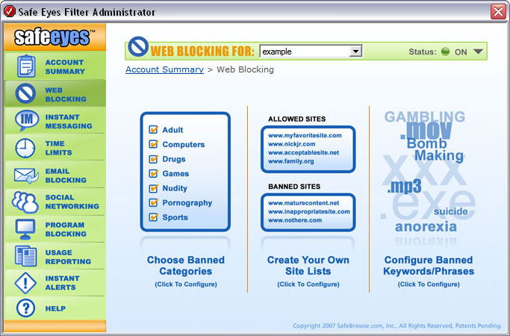
III. TOOLS
  SPECIFIC APPLICATIONS I HAVE REVIEWED

Slide 50
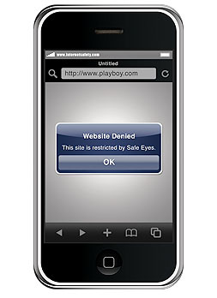

III. TOOLS
IPOD/IPHONE EXAMPLE:
  Disable access to Safari browser, YouTube app, iTunes, Apple App Store
  Password protect ability to download new apps or change account settings

Slide 51
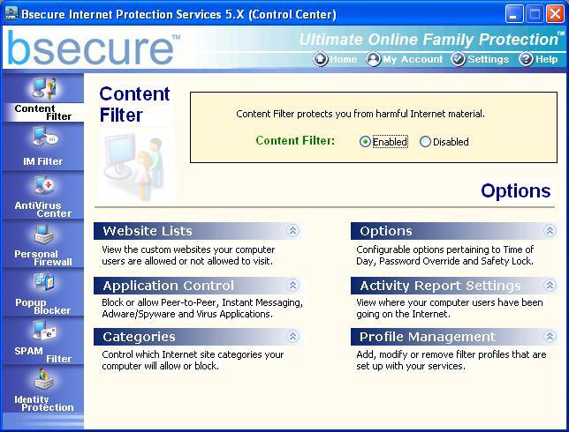

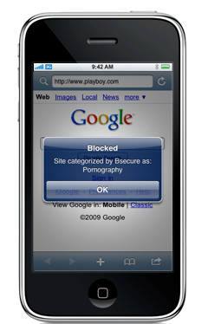
III. TOOLS

Slide 52
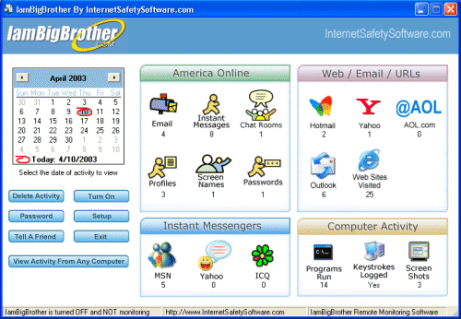
III. TOOLS

Slide 53
III. TOOLS
  CURRENT CHALLENGES OF WHICH TO BE AWARE
    Apple devices currently do not allow apps to “watch” other apps or intercept traffic to/from other apps
      Disable Safari when using a filtered browser service (e.g., Safe Eyes)
      Be aware that apps that access internet content will not register on the internet history or be blocked by other applications (Option to remove them and force the user to navigate through the filtered web browser)
      Sunday “History Checks” are a good way to go for any app that stores a history

Slide 54
III. TOOLS
  CURRENT CHALLENGES OF WHICH TO BE AWARE
    iTunes content
      I know of no filtering options for iTunes content
      Recommend loading their gift cards onto an account for which you (or parent) monitors and knows the password
      Make sure to use your email on iTunes for notification of purchases

Slide 55
III. TOOLS
  CURRENT CHALLENGES OF WHICH TO BE AWARE
    Virtual machines
      This is the ability to emulate an entirely separate operating system within a computer
      There are many practical advantages to VMs in business and software development activities
      However, filtering and monitoring on your computer will be tied to the host IP address, so it will miss the VMs (which can be created and deleted easily)
      Restricting administrator privileges will prevent others from establishing VMs on your computer

Slide 56

III. TOOLS
  CURRENT CHALLENGES OF WHICH TO BE AWARE
    SSL/TLS VPNs
      These are secure (encrypted), virtual private networks that can be established to tunnel past any level of filtering since most filters cannot “see” the encrypted content or even where the user goes on the web

Slide 57
III. TOOLS
  CURRENT CHALLENGES OF WHICH TO BE AWARE
    SSL/TLS VPNs
      These are secure (encrypted), virtual private networks that can be established to tunnel past any level of filtering since most filters cannot “see” the encrypted content or even where the user goes on the web
      Websites exist, by the way, with free software downloads and instructions to help your child install and use this technology
      Interesting that the primary market is for “gamers” (not pornography)
      These applications cannot be installed without administrator privileges

Slide 58
III. TOOLS
  CURRENT CHALLENGES OF WHICH TO BE AWARE
    OpenDNS
      Shows very good promise for home network solutions, even for SSL VPNs
      Loads at your router, so automatically covers anything that connects to your home network
      Compiles all sites visited by every device in one place
      For home use, it’s FREE!
      Use as a layer of protection – will still need individual filtering on all mobile devices that leave the home

Slide 59
BIBLICAL DISCIPLINES & TOOLS FOR INTERNET-CAPABLE TECHNOLOGIES
TIM KEETER
counseling@gcchsv.org

