Slide 1
Revelation 1:9-20
Christ’s Commission to John
By Eric Douma
Gospel of Grace Fellowship

Slide 2
John’s Exile
Revelation 1:9 I, John, your brother and fellow partaker in the tribulation and kingdom and perseverance which are in Jesus, was on the island called Patmos because of the word of God and the testimony of Jesus.
Old Age
Messianic Age
Thilipsis

Slide 3
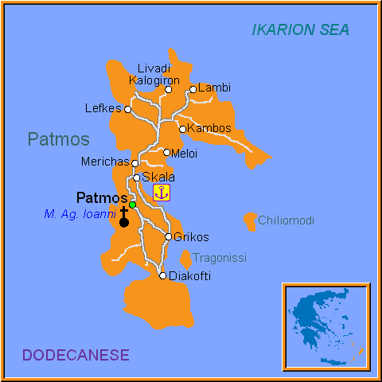

Slide 4
Jesus Commissions John
Revelation 1:10 I was in the Spirit on the Lord’s day, and I heard behind me a loud voice like the sound of a trumpet,
In the Spirit/spirit?
Revelation 17:3 And he carried me away in the spirit into a wilderness; and I saw a woman sitting on a scarlet beast…
Revelation 21:10 And in the spirit he carried me away to a great, high mountain and showed me the holy city Jerusalem coming down out of heaven from God.

Slide 5
John Commissioned to Write His “Vision”
Revelation 1:11 saying, “Write in a book what you see, and send it to the seven churches: to Ephesus and to Smyrna and to Pergamum and to Thyatira and to Sardis and to Philadelphia and to Laodicea.”
“see” = Present, active, indicative = “what you are seeing”
“Write” = 1:19; 2:1, 8, 12, 18; 3:1, 7, 14; 14:13; 19:9; 21:5

Slide 6
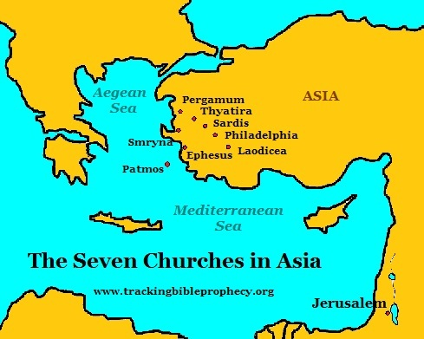

Slide 7
The Source of the Commission
Revelation 1:12-15 Then I turned to see the voice that was speaking with me. And having turned I saw seven golden lampstands; 13 and in the middle of the lampstands I saw one like a son of man, clothed in a robe reaching to the feet, and girded across His chest with a golden sash. 14 His head and His hair were white like white wool, like snow; and His eyes were like a flame of fire. 15 His feet were like burnished bronze, when it has been made to glow in a furnace, and His voice was like the sound of many waters.

Slide 8
The Source of the Commission
Revelation 1:16-19 In His right hand He held seven stars, and out of His mouth came a sharp two-edged sword; and His face was like the sun shining in its strength. 17 When I saw Him, I fell at His feet like a dead man. And He placed His right hand on me, saying, “Do not be afraid; I am the first and the last, 18 and the living One; and I was dead, and behold, I am alive forevermore, and I have the keys of death and of Hades.

Slide 9
The Outline of Revelation
Revelation 1:19:20 “Therefore write the things which you have seen, and the things which are, and the things which will take place after these things. “As for the mystery of the seven stars which you saw in My right hand, and the seven golden lampstands: the seven stars are the angels of the seven churches, and the seven lampstands are the seven churches.
Rev. 4:1 After these things I looked, and behold, a door standing open in heaven…
Rev. 22:6 God of the spirits of the prophets, sent His angel to show to His bond-servants the things which must soon take place.

