Slide 1
Revelation 2:12-17
Christ’s Address to the Church of Pergamum
by Eric Douma

Slide 2
Smyrna Review
Church at Smyrna:
Commendable: Suffered for Christ
Rebuke: none
Correction: none
The promise: Be faithful until death, and I will give you the crown of life (2:10).
Smyrna = “Bitter”
Greek term is used in the LXX to translate the Hebrew term for “myrrh”

Slide 3
Pergamum
“Citadel”
“Parchment” first came from here
The place of Satan’s throne.
Emperor Worship
Idol worship
Nicolaitans

Slide 4
Jesus Is the Ultimate Authority
Revelation 2:12-13 And to the angel of the church in Pergamum write: The One who has the sharp two-edged sword says this: 13 ‘I know where you dwell, where Satan’s throne is; and you hold fast My name, and did not deny My faith even in the days of Antipas, My witness, My faithful one, who was killed among you, where Satan dwells.
Isaiah 49:2 He has made My mouth like a sharp sword, In the shadow of His hand He has concealed Me; And He has also made Me a select arrow, He has hidden Me in His quiver.

Slide 5
Jesus Rebukes Their Nicolaitan Heresy
Revelation 2:14-15 ‘But I have a few things against you, because you have there some who hold the teaching of Balaam, who kept teaching Balak to put a stumbling block before the sons of Israel, to eat things sacrificed to idols and to commit acts of immorality. So you also have some who in the same way hold the teaching of the Nicolaitans.
Balaam -bela + am = “destroyer of the people”
Nicolaitan – nicol + laos = “conqueror of the people”

Slide 6
Sexual Immorality Destroys People
Jude 1:6-7, 11 And angels who did not keep their own domain, but abandoned their proper abode, He has kept in eternal bonds under darkness for the judgment of the great day, 7 just as Sodom and Gomorrah and the cities around them, since they in the same way as these indulged in gross immorality and went after strange flesh, are exhibited as an example in undergoing the punishment of eternal fire… 11 Woe to them! For they have gone the way of Cain, and for pay they have rushed headlong into the error of Balaam, and perished in the rebellion of Korah.

Slide 7
Sexual Immorality Destroys People
1 Corinthians 6:15-20 Do you not know that your bodies are members of Christ? Shall I then take away the members of Christ and make them members of a prostitute? May it never be! Or do you not know that the one who joins himself to a prostitute is one body with her? For He says, “The two shall become one flesh.” But the one who joins himself to the Lord is one spirit with Him. Flee immorality. Every other sin that a man commits is outside the body, but the immoral man sins against his own body. Or do you not know that your body is a temple of the Holy Spirit who is in you, whom you have from God, and that you are not your own? For you have been bought with a price: therefore glorify God in your body.

Slide 8
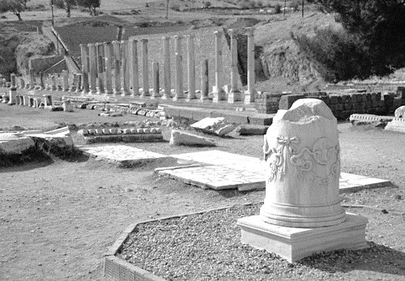

Slide 9
The Correction and Promise
Revelation 2:16-17 ‘Therefore repent; or else I am coming to you quickly, and I will make war against them with the sword of My mouth. ‘He who has an ear, let him hear what the Spirit says to the churches. To him who overcomes, to him I will give some of the hidden manna, and I will give him a white stone, and a new name written on the stone which no one knows but he who receives it.’

