Slide 1
Revelation 3:14-22
Christ’s Address to the Church in Laodicea
by Eric Douma
Gospel of Grace Fellowship
October 26, 2014

Slide 2
The Church in Laodicea
Wealthiest of the seven cities due to its rich wool and medicinal supplies.
More than likely founded by Epaphras while Paul was staying in Ephesus (Col. 1:6-7)
Suffered spiritual blindness by appealing to either angels or other deities to preserve wealth. Christ was just “one among many.”

Slide 3
Christ’s Credentials
Revelation 3:14 To the angel of the church in Laodicea write: The Amen, the faithful and true Witness, the Beginning of the creation of God, says this:
Beginning = Arche “source” or “originator”
Proverbs 8:22-23 The LORD possessed me at the beginning of His way, Before His works of old. 23 “From everlasting I was established, From the beginning, from the earliest times of the earth.

Slide 4
Christ: The Source of All Things
Colossians 1:18 He is also head of the body, the church; and He is the beginning, the firstborn from the dead, so that He Himself will come to have first place in everything.
John 1:1 In the beginning was the Word, and the Word was with God, and the Word was God. 2 He was in the beginning with God. 3 All things came into being through Him, and apart from Him nothing came into being that has come into being.

Slide 5
The Lukewarm Laodiceans
Revelation 3:15-16 ‘I know your deeds, that you are neither cold nor hot; I wish that you were cold or hot.
16 ‘So because you are lukewarm, and neither hot nor cold, I will spit you out of My mouth.
Two Views:
1. Christ could stand it if they were either spiritually hot or cold but He can’t stand indifference (Ac. 18:15; Rom. 12:11)
2. “Hot and cold” is a play on the water supply: They were like their own water supply – lukewarm and worthless!

Slide 6
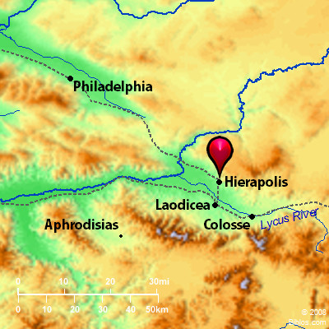
The Lukewarm Laodiceans

Slide 7
Jesus’ Diagnosis
Revelation 3:17 ‘Because you say, “I am rich, and have become wealthy, and have need of nothing,” and you do not know that you are wretched and miserable and poor and blind and naked…
Hysteron-proteron (“latter before”) – cf. 3:9; 5:2, 5; 10:4, 9; 12:10; 19:13
have become wealthy = “my wealth is due to my own exertions”
Wretched = Rom. 7:24 “O Wretched man that I am! Who will set me free from the body of this death?”

Slide 8
The Laodicean Self Sufficiency
Laodicean View
Biblical View
Self achieved spiritual protection
Christ saves and provides for His people
Physical wealth

Slide 9
The Remedy: Faith in Christ Alone
Revelation 3:18 I advise you to buy from Me gold refined by fire so that you may become rich, and white garments so that you may clothe yourself, and that the shame of your nakedness will not be revealed; and eye salve to anoint your eyes so that you may see.
Gold refined by fire = 1 Peter 1:7 so that the proof of your faith, being more precious than gold which is perishable, even though tested by fire, may be found to result in praise and glory and honor at the revelation of Jesus Christ;

Slide 10
Jesus’ Offer of Table Fellowship
Revelation 3:19-20 Those whom I love, I reprove and discipline; therefore be zealous and repent. 20 ‘Behold, I stand at the door and knock; if anyone hears My voice and opens the door, I will come in to him and will dine with him, and he with Me. 21 ‘He who overcomes, I will grant to him to sit down with Me on My throne, as I also overcame and sat down with My Father on His throne. 22 ‘He who has an ear, let him hear what the Spirit says to the churches.’
James 5:9 Do not complain, brethren, against one another, so that you yourselves may not be judged; behold, the Judge is standing right at the door.

