Slide 1
Mark 7:24-30
The Shining Jewel Of A Gentile’s Faith

Slide 2
Why This Account Here?
Three Contrasts
1. Scribal defilement versus true defilement
2. Faith of a Gentile versus that of the Jews
3. Gentile woman’s understanding versus that of the disciples
Purposes
1. Gentile inclusion = Messianic age is here!
2. Illustrates that faith is what pleases Christ.

Slide 3
Jesus Seeks Rest In Gentile Territory
Mark 7:24 Jesus got up and went away from there to the region of Tyre. And when He had entered a house, He wanted no one to know of it; yet He could not escape notice.
Those who seek Jesus in a house have full confidence in the Lord while the scribal leaders from Jerusalem reject the Messiah!

Slide 4
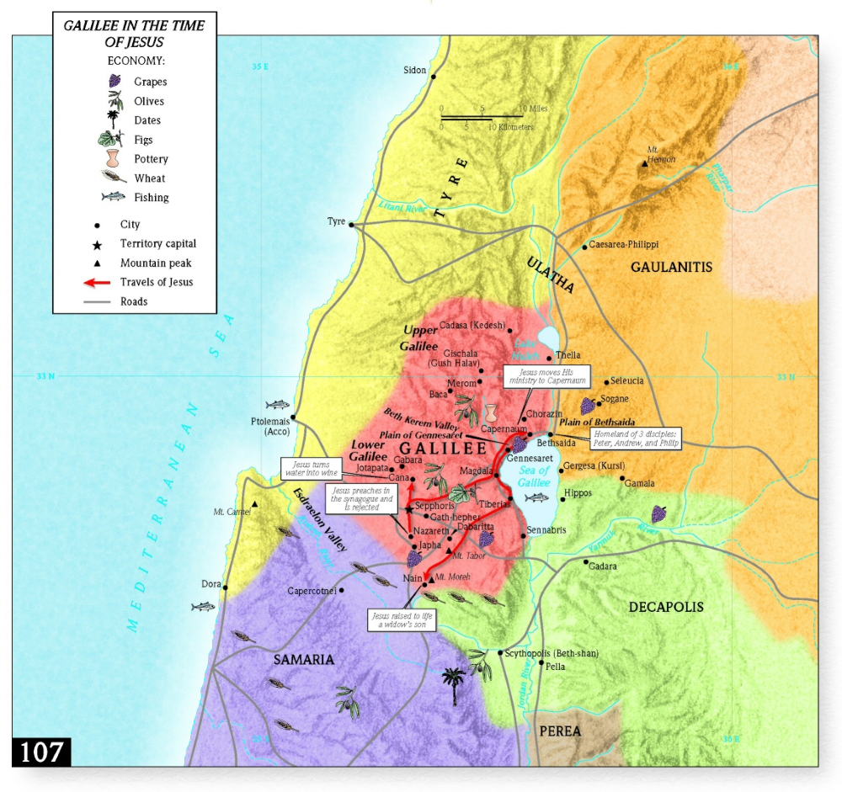

Slide 5
The Gentile’s Persistent Faith
Mark 7:25-26 But after hearing of Him, a woman whose little daughter had an unclean spirit immediately came and fell at His feet. Now the woman was a Gentile, of the Syrophoenician race. And she kept asking Him to cast the demon out of her daughter.

Slide 6
Jesus’ Seemingly Harsh Response
Mark 7:27 And He was saying to her, “Let the children be satisfied first, for it is not good to take the children’s bread and throw it to the dogs.”
Matthew 15:24 But He answered and said, “I was sent only to the lost sheep of the house of Israel.”

Slide 7
The Gentile Woman’s Great Faith
Mark 7:28-30 But she answered and said to Him, “Yes, Lord, but even the dogs under the table feed on the children’s crumbs.” And He said to her, “Because of this answer go; the demon has gone out of your daughter.” And going back to her home, she found the child lying on the bed, the demon having left.

Slide 8
Application
1. Jesus’ healing and saving of Gentiles is further proof that in His person and work – the messianic age had dawned.
2. The Syrophoenician woman’s faith pleased Christ, and therefore her faith is one from which we can all learn.

Slide 9
1. The Messianic Age Has Dawned
Mark 7:26 Now the woman was a Gentile, of the Syrophoenician race…
Matthew 15:22 And a Canaanite woman from that region came out and began to cry out…
Isaiah 11:10 And in that day there shall be a Root of Jesse, Who shall stand as a banner to the people; For the Gentiles shall seek Him, and His resting place shall be glorious.

Slide 10
1. The Messianic Age Has Dawned
Isaiah 49:5-6 And now says the LORD, who formed Me from the womb to be His Servant, To bring Jacob back to Him, so that Israel might be gathered to Him… He says, “It is too small a thing that You should be My Servant To raise up the tribes of Jacob and to restore the preserved ones of Israel; I will also make You a light of the nations So that My salvation may reach to the end of the earth.”

Slide 11
2. The Gentile Woman’s Model of Faith
A Persistent Faith
Mark 7:26 And she kept asking Him to cast the demon out of her daughter.
Matthew 15:22-23 … “Have mercy on me, Lord, Son of David! My daughter is horribly demon-possessed!” But he did not answer her a word. Then his disciples came and begged him, “Send her away, because she keeps on crying out after us.”

Slide 12
2. The Need For Persistence
Luke 18:1-2, 4-5 Now He was telling them a parable to show that at all times they ought to pray and not to lose heart, saying, “In a certain city there was a judge who did not fear God and did not respect man…For a while he was unwilling; but afterward he said to himself, ‘Even though I do not fear God nor respect man, yet because this widow bothers me, I will give her legal protection, otherwise by continually coming she will wear me out.’ ”

Slide 13
2. The Gentile Woman’s Model of Faith
A Humble Faith
Mark 7:28b … “Yes, Lord, but even the dogs under the table feed on the children’s crumbs.”
1 Peter 5:5-6 You younger men, likewise, be subject to your elders; and all of you, clothe yourselves with humility toward one another, for ‘God is opposed to the proud, but gives grace to the humble.’ Therefore humble yourselves under the mighty hand of God, that He may exalt you at the proper time…

Slide 14
2. The Gentile Woman’s Model of Faith
A Faith Without Sight
Hebrews 11:27 NET By faith he left Egypt without fearing the king’s anger, for he persevered as though he could see the one who is invisible.
1 Peter 1:8 and though you have not seen Him, you love Him, and though you do not see Him now, but believe in Him, you greatly rejoice with joy…

