Slide 1
Mark 10:1-12
God’s Purpose For Marriage
Notes:
Intro: My mom watches William (my son) a couple days a week. She’s a wonderful grandma ( A BELIEVER!). She asked me, “what did speak about last week?” – (HELL) What are you speaking about this weak (MARRIAGE AND DIVORCE) – She said “I’ll be praying for you!”
In this passage this morning Jesus is going to show God’s intention for marriage. Ultimately God designed marriage to glorify Himself by depicting the union of a mam and a woman (takes both to reflect God’s image) in marriage as a type for the union between Christ and His people. Saying this, I want everyone here to realize that my task this morning is not to heap guilt upon those that have had a divorce. This gathering is the fellowship of the forgiven – not the meeting place of the self-righteous. So please understand that my intention – is to follow the text of Scripture so that God can speak to us about how we should live HERE AND NOW AND GOING FORWARD!
God’s purpose for marriage certainly includes the protection of His people. Marriage is the one institution where a man and woman can truly be “NAKED” – with all that means - and not feel ashamed (Genesis 3). But God’s purpose is also that He would be glorified by His church that is faithful to Him by being faithful to one another. It makes no sense to be called the bride of Christ, while being unfaithful to one’s spouse!
So this morning, I write all of you a permission slip – to let the word of God work on your heart, so that by His gracious work – we may be a people that are faithful to our marriages – as we seek to be faithful to Him!

Slide 2
The Setting For The “Set Up”
Mark 10:1-2 Getting up, He went from there to the region of Judea and beyond the Jordan; crowds gathered around Him again, and, according to His custom, He once more began to teach them. Some Pharisees came up to Jesus, testing Him, and began to question Him whether it was lawful for a man to divorce a wife.
Notes:
1. We left off last week in Chapter 9 with Jesus warning the disciples about seeking for status in the house in Capernaum (By the Sea of Galilee) Now Jesus is in an area called Perea as He is heading toward Jerusalem.
2. The Pharisees’ question about divorce – is not an innocent request for information or truth seeking – IT IS A TRAP! “Testing Him” peirozo –
The Pharisees know that Herod Antipas murdered John the Baptist because of his involvement in calling for Herod to repent over taking his brother’s wife (Herodias).
They are probably trying to get Jesus in trouble with Herod Antipas as Jesus is traveling into his territory.

Slide 3
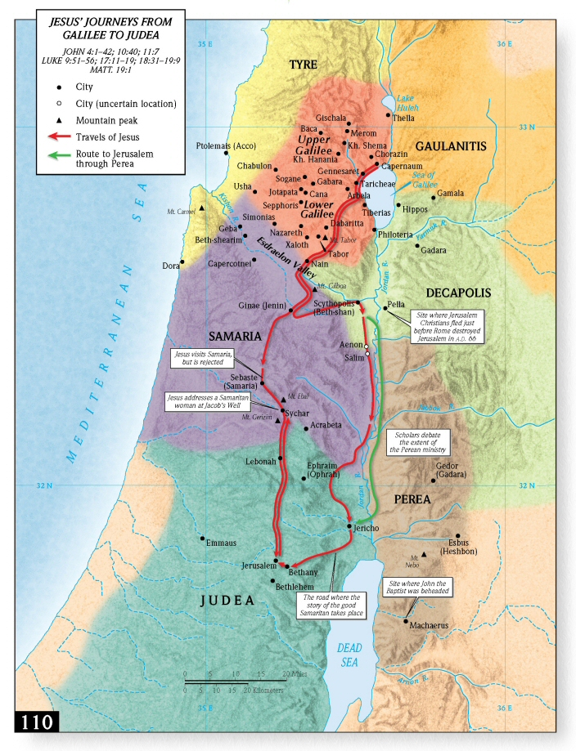
Notes:
1. Mark 10:1 states that Jesus “went to the region of Judea and beyond the Jordan”
2. Jesus on the way to Jerusalem
3. Jesus currently in Perea – Herod Antipas’ district

Slide 4
The Pharisees Misunderstand Moses
Mark 10:3-4 And He answered and said to them, “What did Moses command you?” They said, “Moses permitted a man TO WRITE A CERTIFICATE OF DIVORCE AND SEND her AWAY.”
Deuteronomy 24:1 When a man takes a wife and marries her, and it happens that she finds no favor in his eyes because he has found some indecency in her, and he writes her a certificate of divorce and puts it in her hand and sends her out from his house.
Notes:
1. Notice that Jesus cuts across all of the casuistry and tradition by asking them about what the word of God said!
2. The Pharisees summarize Deuteronomy 24:1 with the implication that it was God’s design. (1) We have to realize that the “certificate of divorce” was important to a woman, because prior to this Mosaic injunction in God’s Law – men could get rid of their wives, and the wives could not remarry. Because of the physical nature of most work – a woman without a husband was going to be destitute. (2) DEUT. 24:1 – the real debate going on during Jesus’ day was between the house of Shammai (1st Cent. B.C. Rabbi) which understood “indecency” as referring only to marital infidelity, and the house of Hillel (1st Cent. Rabbi) which understood “indecency” to include any pet peeve that might upset a man (how she cooked dinner!).
3. The heart of the Pharisees’ problem in understanding Deut 24:1 was that it was used by God as a concession because men’s hearts were sinful.

Slide 5
Jesus Explains God’s Intention For Marriage
Mark 10:5-9 But Jesus said to them, “Because of your hardness of heart he wrote you this commandment. “But from the beginning of creation, God MADE THEM MALE AND FEMALE. “FOR THIS REASON A MAN SHALL LEAVE HIS FATHER AND MOTHER, AND THE TWO SHALL BECOME ONE FLESH; so they are no longer two, but one flesh. What therefore God has joined together, let no man separate.”
Notes:
First: Jesus appeals to the creation: Gen. 1:27 (red) Gen. 2:24 caps not in red = Jesus does so to show the priority of God’s plan prior to the provision in Deut. 24:1
1. Notice Jesus points out it was because of “your hardness of heart” that Moses wrote Deut. 24:1. (1) It is the lesser of two evils. Yes –it’s sinful to divorce, but since men will do that anyway – there must be a protection for the woman (certificate of divorce) so that she can remarry again and not become destitute! (SHOWS GREAT CARE FOR WOMEN) (2) The citation of
2. Gen. 1:27 = Image bearers –(Male+Female) Being made in the image of God requires Male/female. GLORY TO GOD REQUIRES MALE FEMALE “For this reason a man shall leave…” So marriage is a means by which male and female become one and glorify God!
3. The term “leave” meant (in the original Hebrew) not that the man left the house of his father (they often built in or around the groom’s father’s house) but that the man “forsook” the priority of his relationship with mom+dad, and now his relationship with his wife is “priority #1”
4. Jesus highlights the “one flesh” because He wants the Pharisees (and all people) to know that it was GOD’S INTENTION FOR HUSBANDS TO BE UNITED TO THEIR WIVES!
Hence “Let no man separate” - It is sinful to divide what God desires to be “united”!!!!!!
>So the provision in Deut. 24:1 should be understood as a means to merely minimize the damage done by divorce – it was never sanctioning divorce!
>God’s plan was always that He be glorified by His male/female (represents the image of God) becoming ONE!

Slide 6
Jesus Stands Against Jewish Tradition
Mark 10:10-12 In the house the disciples began questioning Him about this again. And He said to them, “Whoever divorces his wife and marries another woman commits adultery against her; and if she herself divorces her husband and marries another man, she is committing adultery.”
Exelthe = “leaves” (not official divorce)
Notes:
1. Remember “the house” is often depicted as the place of instruction in Mark
2. Jesus takes on Rabbinic tradition through the phrase “Whoever divorces his wife…” Rabbinic tradition taught that a man could commit adultery only against another man by taking his wife. Jesus destroys this by saying that a man who “divorces his wife and marries another COMMITS ADULTERY AGAINST HER!
> Adultery: moichao – is used to link divorce to violation of the 7th commandment (Ex. 20:14)
3. Interesting: CIRCLE DIVORCE: = the better manuscript reading (in my humble opinion) comes from the Alexandrian and Western texts which contain “Exelthe” which is a woman “leaving” but is not the technical term for divorce. (1) This is probable because women didn’t have the authority to “divorce” in Jewish culture (2) But “leaving” in the less technical sense is still adultry and IT IS EXACTLY WHAT HERODIAS DID!
4. Jesus is boldly smashing all other authority except His/Scripture! HE takes on both Jewish tradition and the Kingdom of Herod!
Result: No person on this planet can break up a marriage (whether it be their own or someone else’s) and claim a moral right to do so!
3.

Slide 7
Applications
1. We must remember that honoring God by keeping our commitments is more important than being “happy” in this life.
2. We must understand that marriage is an object lesson designed to glorify God by depicting Christ’s soon union with the church.
Notes:
1. Bob – “There is no problem that the rapture won’t fix!”
2. Glorifying God is more important than our personal “happiness” (One of the solas: To the glory of God alone)

Slide 8
1. Honoring Our Commitments Is More Important Than Our Happiness
Marriage is a covenant before God:
Genesis 2:24 For this reason a man shall leave his father and his mother, and be joined to his wife; and they shall become one flesh.
Leave = (azav) “forsake” (Deut. 12:19; 29:25)
Joined = (davaq) “stick to” (Deut. 10:20; 11:22)
Notes:
1.Marriage is a covenant before God: I’ll show you how the careful reading of Genesis 2:24 demonstrates this:
2. Leave =Literally “forsake” – (1) it a relative rather than absolute sense. Example Luke 14:26 “If anyone comes to Me, and does not hate his own father and mother and wife and children and brothers and sisters, yes, and even his own life, he cannot be My disciple.” Compared to our love of Christ –it’s as if we hated our family/ Compared to the care a man has for his wife – it’s as if he has “forsaken” is father and mother. (2) A fact that points toward Marriage as a covenant – “azav” is often used when Israel “forsakes the covenant with Yahweh” Deut. 29:25 –”All the nations will say, ‘Why has the LORD done thus to this land? Why this great outburst of anger?’ 25 “Then men will say, ‘Because they forsook the covenant of the LORD…”
3. Joined = Literally “stick to” in a covenantal sense. Deut 10:20 “You shall fear the LORD your God; you shall serve Him and cling to Him, and you shall swear by His name.”
> God views our marriages as “covenants before Him” - REINFORCED BY “ONE FLESH” We became “One with Christ” His body – Story from Acts 9
> Let me ask you: “What’s more important – keeping a covenant before God – or your happiness? (1) You might be saying “Well you don’t understand how bad my spouse is! - NOW IS THE TIME TO MAKE UP YOUR MIND – BIBLICALLY!!!

Slide 9
1. Honoring Our Commitments Is More Important Than Our Happiness
Proverbs 5:18-21 Let your fountain be blessed, and rejoice in the wife of your youth. As a loving hind and a graceful doe, let her breasts satisfy you at all times; Be exhilarated always with her love. For why should you, my son, be exhilarated with an adulteress and embrace the bosom of a foreigner? For the ways of a man are before the eyes of the LORD, and He watches all his paths.
Notes:
Context: Prov. 5:1-5 My son, give attention to my wisdom, Incline your ear to my understanding; 2 That you may observe discretion And your lips may reserve knowledge. 3 For the lips of an adulteress (literally the other woman) drip honey and smoother than oil is her speech; 4 But in the end she is bitter as wormwood, Sharp as a two-edged sword. 5 Her feet go down to death, Her steps take hold of Sheol.
> To You young people (unmarried): Sexual sin (outside of marriage) is a path to Sheol!
> To the married: The grass is not greener on the other side! – It leads to Sheol! (Remember the warnings last week!)
Proverbs 5:18-21
1. It’s about being satisfied with the woman you marry.
2. Notice the ultimate reason (1) Yes – fulfilling life can happen now! (2) BUT – ultimately “For the ways of a man are before the eyes of YAHWEH – Sexual sin in marriage is the tearing apart the ONENESS that God created – and HE KNOWS ABOUT IT!
We need God’s Spirit!
Gospel: Gal.3:5 “So then, does He who provides you with the Spirit and works miracles among you, do it by the works of the Law, or by hearing with faith?”
Remember: Ecc. 12:13 The conclusion, when all has been heard, is: fear God and keep His commandments, because this applies to every person.
> The grass isn’t greener on the “other side”
> The grass is only greener in the Kingdom!

Slide 10
2. Glorify God In Marriage
Isaiah 62:5
For as a young man marries a virgin,
So your sons will marry you;
And as the bridegroom rejoices over the bride,
So your God will rejoice over you.
Isaiah 4:5 Then the LORD will create over the whole area of Mount Zion and over her assemblies a cloud by day, even smoke, and the brightness of a flaming fire by night; for over all the glory will be a canopy.
Notes:
1. Both Old and New Testaments use imagery of God being a husband to His people – who are likened to His Bride.
Context: Isaiah 62 is found in a periscope that has to do with Zion’s future restoration.
> Quatrain – two similes
“So your sons will marry you” – sons here were formerly estranged from the land (desolate vs. 4) “marry” = is better rendered “possess” – The sons of Israel will possess the land like a man “possess His virgin” (all in a good sense)!
God is likened now to a Bridegroom that “rejoices” over his bride. = Wedding/Honeymoon - The people of God will have their land – and God will be a husband to the bride that Christ has purchased!
2. Isaiah 4:5
> Context: The Kingdom has come as a result of the day of the Lord: Isaiah 4:2 “In that day the Branch of the LORD will be beautiful and glorious, and the fruit of the earth will be the pride and the adornment of the survivors of Israel.”
> Canopy =(chuppa) – “marriage chamber”
Israelite Wedding:
Betrothal – Young man would go to the woman’s father’s house to set the “bride price” (mohar) Isaiah 52:3 “For thus says the LORD, “You were sold for nothing and you will be redeemed without money.” 1 Cor. 6:20 “For you have been bought with a price: therefore glorify God in your body. “
Sanctified: From the moment the bride price was paid – the man and woman became husband + wife = wife was set apart exclusively for the groom. As a sign – the husband and wife drank a cup of wine with a betrothal benediction. Matt. 26:27-28 “And when He had taken a cup and given thanks, He gave it to them, saying, “Drink from it, all of you; 28 for this is My blood of the covenant, which is poured out for many for forgiveness of sins.”
Home: The young man then went home to his “father’s house” to prepare a place for his bride. John 14:2-3 “In My Father’s house are many dwelling places; if it were not so, I would have told you; for I go to prepare a place for you. If I go and prepare a place for you, I will come again and receive you to Myself, that where I am, there you may be also.”
4. Preparation: The woman had to be ready and be prepared – because she did not know when the groom would come for her. Matt. 24:36 “concerning the day and the hour – no one knows…”
5. Gifts: While the man was away – he would send his bride gifts to reassure her. Eph. 4:8, 11 Therefore it says, “When he ascended on high he led a host of captives, and he gave gifts to men….11 And He gave some as apostles, and some as prophets, and some as evangelists, and some as pastors and teachers.”
6. The arrival: Because the woman had no idea when the groom was coming – she was prepared – but when he did come – the groom’s party gave a SHOUT to let the bride know. 1 Thess. 4:16 “For the Lord Himself will descend from heaven with a shout, with the voice of the archangel and with the trumpet of God, and the dead in Christ will rise first.”
7. Consummation: When the man brought his wife to the father’s house – they went into the “chuppa” – the bridal chambers. Their the best man aided the couple until they had consummated the wedding – He would then give notice to the rest of the party- which was a cause for GREAT JOY! John 3:29 “He who has the bride is the bridegroom; but the friend of the bridegroom, who stands and hears him, rejoices greatly because of the bridegroom’s voice. So this joy of mine has been made full.”
> The bridegroom and bride remained in the chuppa (bridal chambers) for 7days while the rest in the father’s house feasted. The bride went into the bridal chambers veiled – when she came out after the 7 days with her groom – the veil was off so all could see who she was. Romans 8:19 “For the creation waits with eager longing for the revealing of the sons of God.”

Slide 11
2. Glorify God In Marriage
Ephesians 5:22-25 Wives, be subject to your own husbands, as to the Lord. For the husband is the head of the wife, as Christ also is the head of the church, He Himself being the Savior of the body. But as the church is subject to Christ, so also the wives ought to be to their husbands in everything. Husbands, love your wives, just as Christ also loved the church and gave Himself up for her…
Notes:
“In Eph. 5:22 ff. the point of the allegory is particularly clear. It serves to depict the love of Christ for His community, which is selfless even to the point of self-sacrifice, and the obligation of obedience and bridal purity which lies on the community.” TDNT

Slide 12
2. Glorify God In Marriage
Ephesians 5:31-32 ESV “Therefore a man shall leave his father and mother and hold fast to his wife, and the two shall become one flesh.” This mystery is profound, and I am saying that it refers to Christ and the church.
Will Jesus abandon His bride?
Will the church abandon their bride groom Jesus?
Notes:
Mystery
Roman Catholic view = The Catholic Church took from the Latin Vulgate’s translation “sacramentum” and therefore believe the mystery refers to marriage as a sacrament that conveys grace. “This has its origins in pagan rituals where marriage is seen as equivalent to a hieros gamos (“holy wedding”), the union of the divine and the human.” (Hoehner)
2. Some protestants also believe that human marriage is strictly in view.
3. Better: (1) Mystery refers to something formerly concealed but that is now revealed (human marriage isn’t that big of an anomaly) (2) Paul indicates what the Mystery is: “I am saying that it refers to Christ and the church.” (3) Christ’s union with the church is a paradigm for Christian marriage between a man and a woman, and a man and woman’s marriage points to the reality that Christ physically unite with the church! IN FACT – TDNT – sees this is PRIMARILY ESCHATOLOGCIAL: The image is further developed in Eph. 5:22–33. The saying in Gn. 2:24 concerning the union of man and wife is referred in v. 31f. to the union (at the parousia) of Christ the Bridegroom, who leaves heaven and comes for His bride, and the community. In Eph. 5:22 ff. the point of the allegory is particularly clear. It serves to depict the love of Christ for His community, which is selfless even to the point of self-sacrifice, and the obligation of obedience and bridal purity which lies on the community “ (TDNT).
Will Jesus abandon His bride?
Will the church abandon their bride groom Jesus?
Dear Ones: I know marriage is difficult. There are some hearing this that are saying – “You don’t understand how bad it is with my wife/husband.”
Do you want to glorify God? Stick it out. Was it not tough for Jesus in the wilderness? Gethsemane? Scourging? Crucifixion? He stuck it out for His Bride!

