Slide 1
Mark 11:15-21
For Whose Glory Are You Living?
Presented by Eric Douma
March 16, 2014

Slide 2
Jesus Finds a Fruitless Israel
A. Fig Tree: Found with no fruit (11:12-14)
B. Temple: Israel has no fruit (11:15-19)
A. Fig Tree: Found withered from root up (11:20-21)
Mark 11:15-16 Then they came to Jerusalem. And He entered the temple and began to drive out those who were buying and selling in the temple, and overturned the tables of the money changers and the seats of those who were selling doves; and He would not permit anyone to carry merchandise through the temple.

Slide 3
Jesus Is Zealous for His House
Mark 11:17And He began to teach and say to them, “Is it not written, ‘MY HOUSE SHALL BE CALLED A HOUSE OF PRAYER FOR ALL THE NATIONS’? But you have made it a ROBBERS’ DEN.”
Jeremiah 7:12 But go now to My place which was in Shiloh, where I made My name dwell at the first, and see what I did to it because of the wickedness of My people Israel.

Slide 4
The Fruitlessness of Israel
Mark 11:18 The chief priests and the scribes heard this, and began seeking how to destroy Him; for they were afraid of Him, for the whole crowd was astonished at His teaching.
4:41 fear after seeing Jesus calm the sea
5:15 fear after seeing Jesus heal the demoniac
6:50 fear after seeing Jesus walk on water
10:32 fear after seeing Jesus walk to Jerusalem

Slide 5
The Fruitlessness of Israel
Mark 11:19-20 When evening came, they would go out of the city. As they were passing by in the morning, they saw the fig tree withered from the roots up.
Isaiah 5:24 Therefore, as a tongue of fire consumes stubble and dry grass collapses into the flame, So their root will become like rot and their blossom blow away as dust; for they have rejected the law of the LORD of hosts and despised the word of the Holy One of Israel.

Slide 6
Applications
1. We must remember that God called Israel to bring Him glory by bearing fruit and by being a light to the nations.
2. We must remember that God has called us to do the same!

Slide 7
1. Israel Called to Be a Light to the Nations
Isaiah 42:6 I am the LORD, I have called You in righteousness, I will also hold You by the hand and watch over You, and I will appoint You as a covenant to the people, as a light to the nations,
Isaiah 44:5 This one will say, ‘I am the LORD’S’; And that one will call on the name of Jacob; and another will write on his hand, ‘Belonging to the LORD,’ and will name Israel’s name with honor.

Slide 8
1. The Sin of Israel in Jesus’ Day
Isaiah 56:4-5 For thus says the LORD, “To the eunuchs who keep My sabbaths, and choose what pleases Me, and hold fast My covenant, to them I will give in My house and within My walls a memorial, and a name better than that of sons and daughters; I will give them an everlasting name which will not be cut off.
Mark 11:17 ESV …“Is it not written, ‘My house shall be called a house of prayer for all the nations’? But you have made it a den of robbers.”
Notes:
First: I just had mentioned that Isaiah 40-55 was about the suffering servant Israel/Messiah. Isaiah 56 begins the last section of Isaiah about the coming conquering king. SO this chapter begins by describing the benefits of the suffering servant’s work – SALVATION FOR ALL NATIONS!
1.Isaiah 56:4-5 PUT UP “eunuchs” (castrated men) were considered cursed. They were more than likely made eunuchs either by being captured in battle or by pagan ritual. In the Jewish mind, if you didn’t have offspring, it was a sign of being cursed. You weren’t fulfilling the basic command of God “be fruitful and multiply” (Genesis 1:22)
You couldn’t get any more cursed than a Eunuch!
Captive
Foreign Gentile
Without offspring - YET even to them God promises “to the eunuchs who keep My sabbaths and choose what pleases Me, and hold fast My covenant (faith) READ RED!
2.”a name better than that of sons and daughters” The blessing of salvation and eternal life – is better than anything we may miss here and now.
3.HERE’S THE SIN IN JESUS’ Day – (1) Just two verses after Isaiah makes this promise, God promised, in Isaiah 56:7 that His temple would be “a house of prayer for all the nations” -Read Mark 11:17 - PUT UP “BUT YOU” (2) Remember- the High Priest in Israel had put markets in the one spot reserved for Gentiles!
Israel didn’t care to be a light! //They didn’t care about Gentiles coming to Yahweh!// They didn’t care about GOD’S GLORY!

Slide 9
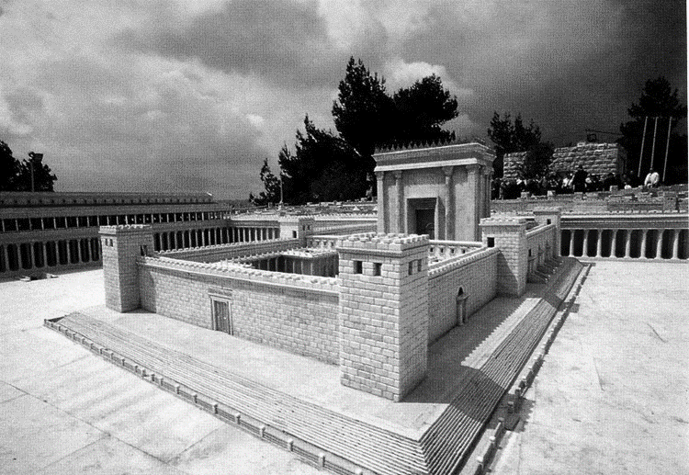
Notes:
First: Herod’s Temple as it would have looked in Jesus’ day – looking to the south west.
1.Explain different courts: Holy of holies (High priest once a year Lev. 16)//Holy place//Court of priests//court of Israel – men//court of women// This is the “naos” proper – outside is the “court of the Gentiles” separated by this balustrade.
2.So the one area separated for the Gentiles was turned into a market place of animals and moneychangers by this wicked High Priest – Caiphas!
JESUS GOES BALLISTIC – RIGHTFULLY SO – (1) Don’t you have concern for these peoples? (2) Don’t you have concern for the glory of God?
3.Now let me show you what Christ has done for us:
Epesians 2:11- 15 Therefore remember that formerly you, the Gentiles in the flesh, who are called “Uncircumcision” by the so-called “Circumcision,” which is performed in the flesh by human hands— 12 remember that you were at that time separate from Christ, excluded from the commonwealth of Israel, and strangers to the covenants of promise, having no hope and without God in the world. 13 But now in Christ Jesus you who formerly were far off have been brought near by the blood of Christ. 14 For He Himself is our peace, who made both groups into one and broke down the barrier of the dividing wall, 15 by abolishing in His flesh the enmity, which is the Law of commandments contained in ordinances, so that in Himself He might make the two into one new man, thus establishing peace,
Paul was saying that the real “balustrade” was the law – BUT JESUS FULFILLED THAT FOR US!!!! GOSPEL

Slide 10
2. Call to Bring Glory to God
1 Corinthians 3:16-17 Do you not know that you are a temple of God and that the Spirit of God dwells in you? If any man destroys the temple of God, God will destroy him, for the temple of God is holy, and that is what you are.
1 Corinthians 10:31 Whether, then, you eat or drink or whatever you do, do all to the glory of God.

Slide 11
2. Two Systems in Contrast
Man’s Temple By Works:
Genesis 11:3, 4b They said to one another, “Come, let us make bricks and burn them thoroughly.” And they used brick for stone, and they used tar for mortar. They said “…come let us make a name for ourselves…”
God’s Temple By Faith:
1 Peter 2:5 you also, as living stones, are being built up as a spiritual house for a holy priesthood, to offer up spiritual sacrifices acceptable to God through Jesus Christ.

