Slide 1
Mark 11:27-33
To Whose Authority Will You Submit?
By Eric Douma
April 13, 2014

Slide 2
The Debate Over Authority
Mark 11:27-28 They came again to Jerusalem. And as He was walking in the temple, the chief priests and the scribes and the elders came to Him, and began saying to Him, “By what authority are You doing these things, or who gave You this authority to do these things?”

Slide 3
Jesus Puts Israel’s Leadership in a Dilemma
Mark 11:29-30 And Jesus said to them, “I will ask you one question, and you answer Me, and then I will tell you by what authority I do these things. “Was the baptism of John from heaven, or from men? Answer Me.”
Mark 1:7 And he was preaching, and saying, “After me One is coming who is mightier than I, and I am not fit to stoop down and untie the thong of His sandals.

Slide 4
The Leadership Won’t Answer
Mark 11:31-33 They began reasoning among themselves, saying, “If we say, ‘From heaven,’ He will say, ‘Then why did you not believe him?’ “But shall we say, ‘From men’?”—they were afraid of the people, for everyone considered John to have been a real prophet. Answering Jesus, they said, “We do not know.” And Jesus said to them, “Nor will I tell you by what authority I do these things.”

Slide 5
Applications
1. Fallen humanity will rely on any authority except for God’s.
2. We have every reason to believe in God’s authority revealed through His spokesmen.
3. We, as believers in Christ, must have a love for the truth.

Slide 6
1. Fallen Man’s Reliance on Other Authorities
Jeremiah 5:31 The prophets prophesy falsely, And the priests rule on their own authority; And My people love it so! But what will you do at the end of it?
Jeremiah 7:25-26 Since the day that your fathers came out of the land of Egypt until this day, I have sent you all My servants the prophets, daily rising early and sending them. “Yet they did not listen to Me or incline their ear, but stiffened their neck; they did more evil than their fathers.

Slide 7
1. Fallen Man’s Reliance on Other Authorities
John 5:43-47 “I have come in My Father’s name, and you do not receive Me; if another comes in his own name, you will receive him. “How can you believe, when you receive glory from one another and you do not seek the glory that is from the one and only God? “Do not think that I will accuse you before the Father; the one who accuses you is Moses, in whom you have set your hope. “For if you believed Moses, you would believe Me, for he wrote about Me. But if you do not believe his writings, how will you believe My words?”

Slide 8
2. We Have Every Reason to Believe God’s Spokesmen
Isaiah 41:21-23a “Present your case,” the LORD says. “Bring forward your strong arguments,” The King of Jacob says. Let them bring forth and declare to us what is going to take place; As for the former events, declare what they were, that we may consider them and know their outcome. Or announce to us what is coming; Declare the things that are going to come afterward, That we may know that you are gods…
Isaiah 44:28 It is I who says of Cyrus, ‘He is My shepherd! And he will perform all My desire.’ and he declares of Jerusalem, ‘She will be built,’ and of the temple, ‘Your foundation will be laid.’ ”

Slide 9
2. We Have Every Reason to Believe God’s Spokesmen
Ezekiel 26:3, 7, 11-12 Therefore thus says the Lord GOD, ‘Behold, I am against you, O Tyre, and I will bring up many nations against you, as the sea brings up its waves…For thus says the Lord GOD, “Behold, I will bring upon Tyre from the north Nebuchadnezzar king of Babylon, king of kings, with horses, chariots, cavalry and a great army... “With the hoofs of his horses he will trample all your streets. He will slay your people with the sword; and your strong pillars will come down to the ground. “Also they will make a spoil of your riches and a prey of your merchandise, break down your walls and destroy your pleasant houses, and throw your stones and your timbers and your debris into the water.

Slide 10
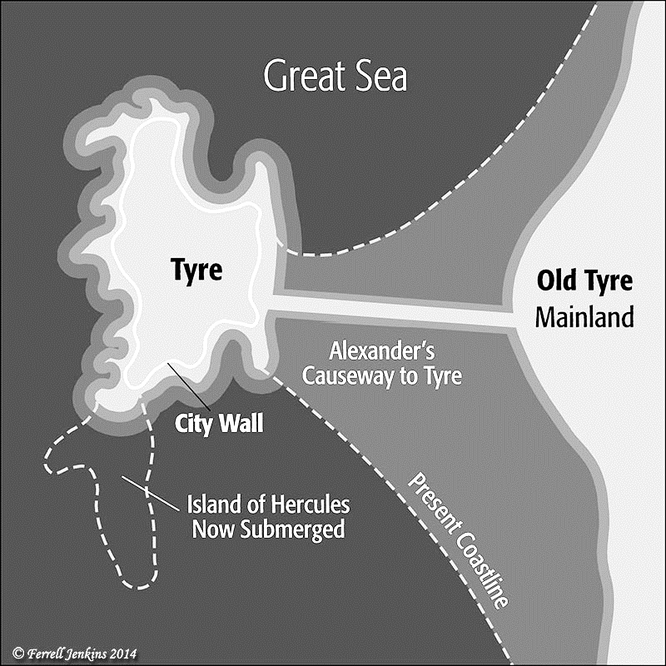
“Archaeologists have known for some time that Alexander used the debris of the abandoned mainland city to build a causeway 3,000 yards long and up to 180 yards across. Once within reach of the city walls, he used siege engines to batter and finally breach the fortifications” (London Telegraph. May 15, 2007).

Slide 11
3. We Must Have a Love for the Truth
2 Thessalonians 2:8-10 Then that lawless one will be revealed whom the Lord will slay with the breath of His mouth and bring to an end by the appearance of His coming; that is, the one whose coming is in accord with the activity of Satan, with all power and signs and false wonders, and with all the deception of wickedness for those who perish, because they did not receive the love of the truth so as to be saved.

