Slide 1
Mark 12:13-17
Jesus Gives the Correct Understanding of Church and State

Slide 2
The Attempt to Trap Jesus
Mark 12:13-14 Then they sent some of the Pharisees and Herodians to Him in order to trap Him in a statement. They came and said to Him, “Teacher, we know that You are truthful and defer to no one; for You are not partial to any, but teach the way of God in truth. Is it lawful to pay a poll-tax to Caesar, or not?”
Pharisees = religious – salvation by “law keeping”
Herodians = political – salvation through politics

Slide 3
Jesus’ Dilemma
In trouble with Pharisees, Zealots, and the people
In trouble with the Romans
Pay Poll Tax To Caesar
Don’t pay

Slide 4
It’s Not Blasphemy to Pay Taxes to the State!
Mark 12:15-17 “Shall we pay or shall we not pay?” But He, knowing their hypocrisy, said to them, “Why are you testing Me? Bring Me a denarius to look at.” They brought one. And He said to them, “Whose likeness and inscription is this?” And they said to Him, “Caesar’s.” And Jesus said to them, “Render to Caesar the things that are Caesar’s, and to God the things that are God’s.” And they were amazed at Him.

Slide 5
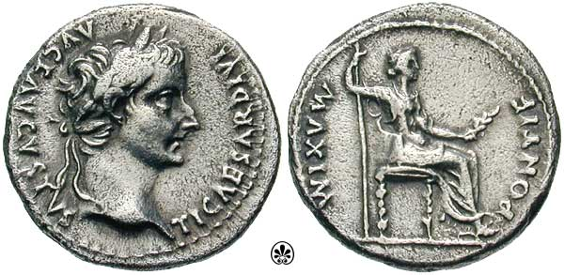
The Power of Jesus’ Answer
Two ways out of a dilemma:
1. Go between the horns (come up with 3rd option)
2. Grab bull by the horns (take issue with the premise)
It does not follow that paying taxes to the state is blasphemy against God – since God ordained the state!
The power of the answer:
1. Eliminated dilemma and ammunition for enemies
2. Proved that Caesar is not God!

Slide 6
Applications
1. We must understand that governments have been ordained by God to restrain evil in this fallen world.
2. We must do our civic duty, but we must remember that Christ alone brings the kingdom at His return.

Slide 7
1. God Ordained Human Government
Genesis 9:6 Whoever sheds man’s blood, By man his blood shall be shed, For in the image of God He made man.
Romans 13:1-2, 4 Every person is to be in subjection to the governing authorities. For there is no authority except from God, and those which exist are established by God. Therefore whoever resists authority has opposed the ordinance of God; and they who have opposed will receive condemnation upon themselves... if you do what is evil, be afraid; for it does not bear the sword for nothing; for it is a minister of God, an avenger who brings wrath on the one who practices evil.

Slide 8
2. Civic Duty and the Kingdom of God
Marxism Theonomists
Govt. is god Establish theocracy
Biblical
Jesus In Heaven
Government
Church
Restrain evil
Preach gospel
Jesus Returns

Slide 9
2. Civic Duty and the Kingdom of God
Submit to the governing officials unless they prohibit you from doing what God commands or command you to do what God prohibits.
1 Peter 2:13-15 Submit yourselves for the Lord’s sake to every human institution, whether to a king as the one in authority, or to governors as sent by him for the punishment of evildoers and the praise of those who do right. For such is the will of God that by doing right you may silence the ignorance of foolish men.

Slide 10
2. Civic Duty and the Kingdom of God
Participants in the kingdom of God are being added by gospel preaching, not by a dominion mandate.
“They do not want to hear about their comprehensive responsibility to master the word of God, and to apply His standards in every area of life, bringing the whole world under the reign of Jesus Christ. They prefer to minimize their responsibility, calling men out of the world, rather than calling them to rule over the world under the authority of Jesus Christ” (Gary North).

Slide 11
2. Civic Duty and the Kingdom of God
The kingdom comes when the King comes. It doesn’t come by political action.
John 18:36 Jesus answered, “My kingdom is not of this world. If My kingdom were of this world, then My servants would be fighting so that I would not be handed over to the Jews; but as it is, My kingdom is not of this realm.”
Revelation 11:15 Then the seventh angel sounded; and there were loud voices in heaven, saying, “The kingdom of the world has become the kingdom of our Lord and of His Christ; and He will reign forever and ever.”

