Slide 1
Colossians Prologue
Colossians 1:1-5
by Bob DeWaay
Gospel of Grace Fellowship
June 22, 2014
Notes:
COL 1:1 Paul, an apostle of Jesus Christ by the will of God, and Timothy our brother,
COL 1:2 ¶ To the saints and faithful brethren in Christ who are at Colossae: Grace to you and peace from God our Father.
COL 1:3 ¶ We give thanks to God, the Father of our Lord Jesus Christ, praying always for you,
COL 1:4 since we heard of your faith in Christ Jesus and the love which you have for all the saints;
COL 1:5 because of the hope laid up for you in heaven, of which you previously heard in the word of truth, the gospel

Slide 2
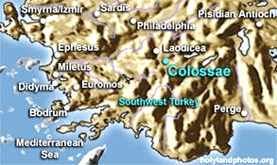
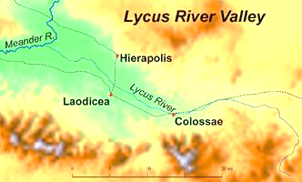
Images courtesy of
www.HolyLandPhotos.org

Slide 3
Paul Addresses a Church From Prison
Colossians 1:1 (NASB)
Paul, an apostle of Jesus Christ by the will of God, and Timothy our brother,
Paul is in Roman prison
Paul speaks for God with binding authority
Paul alone wrote Colossians

Slide 4
Paul’s Apostolic Greeting
Colossians 1:2 (NASB)
To the saints and faithful brethren in Christ who are at Colossae: Grace to you and peace from God our Father.
Though mostly unknown to Paul personally, these are “brothers” for whom he cares
“Grace” is a modification of a common Greek greeting and “peace” is the Hebrew greeting “shalom”

Slide 5
Prayer With Thanksgiving Is Offered
Colossians 1:3 (NASB)
We give thanks to God, the Father of our Lord Jesus Christ, praying always for you,
This is corporate prayer and thanksgiving, Timothy and others joined Paul in it
We honor God by praying for those He has saved

Slide 6
Faith Hope and Love
Colossians 1:4, 5a (NASB)
since we heard of your faith in Christ Jesus and the love which you have for all the saints; because of the hope laid up for you in heaven,
“Faith in Christ” includes the idea of Christ as the object of faith and the idea of being in the sphere of Christ
Love characterizes Christians
Hope includes both the heavenly sphere and eternal reward

Slide 7
The Gospel Is the Word of Truth
Colossians 1:5b (NASB)
of which you previously heard in the word of truth, the gospel
“The gospel” is in contrast to false teaching
It is the gospel which gives us hope

Slide 8
Implications and Applications
We must pray for one another
The gospel offers eternal hope

Slide 9
Devoted to Prayer
Romans 12:12 (NASB)
  rejoicing in hope, persevering in tribulation, devoted to prayer,
  Colossians 4:2 (NASB)
  Devote yourselves to prayer, keeping alert in it with an attitude of thanksgiving;

Slide 10
Gospel Hope
Colossians 1:23 (NASB)
if indeed you continue in the faith firmly established and steadfast, and not moved away from the hope of the gospel that you have heard, which was proclaimed in all creation under heaven, and of which I, Paul, was made a minister.

