Slide 1
Lessons in Logic
Introduction

Slide 2
Why Study Logic?
Logic is a subset of Epistemology; how we know things.
Logic helps us think rationally
Logic helps us understand what we believe and why we believe it
Logic helps us recognize & refute poor arguments
Logic helps us contend for the Faith
Notes:
The fundamental issue of our day is one of a shift in epistemology. As a society, we are transitioning away from logic and toward a post-modern epistemology.

Slide 3
Types of Logic
Formal
The investigation of an argument based upon the construction of the argument itself and the validity of the premise. If these conditions are met, the conclusion necessarily follows.
Informal
Addresses arguments in natural language.
Often involves arguments that are technically valid under the rules of formal logic, but fail because the conclusion doesn’t follow from the premise

Slide 4
You Encounter Logic Every Day
When you discern whether something is food or not food, healthy or unhealthy, fresh or stale.
When you put fuel in your car.
When you encounter advertizing.
When you watch the news.
When you hear political debates.
When you read scripture, or hear presentations by preachers, teachers, or even heretics.
Notes:
If your dog eats mystery berries from the bush behind the shed and gets sick or dies, logically you won’t want to make mystery berry pies for the church picnic.
Does your car require gasoline or diesel? If it takes gasoline, can you use 87 octane, or does it require 92 octane?
Advertizing often includes fallacious arguments for why you should buy a particular product or service
News is saturated with opinionated conclusions drawn from current events. More often than not, the arguments that are meant to convince you of the conclusions drawn involve logical fallacies.
Political debates aren’t just two candidates arguing over who is best for the job, it involves issues that come up during the political process as well.

Slide 5
Logic in Scripture
“From any tree of the garden you may eat freely, but from the tree of the knowledge of good and evil you shall not eat, for in the day that you eat from it you will surely die.” - Genesis 2:16b-17
Notes:
God to Adam
If-Then statement

Slide 6
Logic in Scripture
But if there is no resurrection of the dead, not even Christ has been raised; and if Christ has not been raised, then our preaching is in vain, your faith also is in vain. Moreover we are even found to be false witnesses of God, because we testified against God that He raised Christ, whom he did not raise, if in fact the dead are not raised. For if the dead are not raised, not even Christ has been raised; and if Christ has not been raised, your faith is worthless; you are still in your sins. Then those also who have fallen asleep in Christ have perished. If we have hoped in Christ in this life only, we are of all men most to be pitied. - 1 Corinthians 15:13-19

Slide 7
Questions?
As we discuss logical fallacies, please raise your hand to ask any questions as they come up.

Slide 8
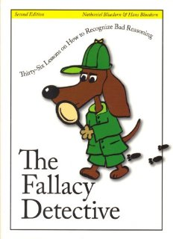
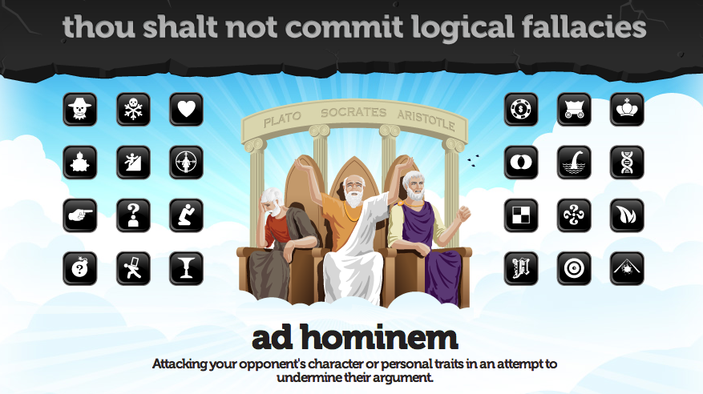
Sources & Resources
str.org
ISBN: 0974531502
ISBN: 0310282921
yourlogicalfallacyis.com
apologetics315.com
Notes:
Rational Wiki is an Atheist website. To discount them as a resource would be to commit the Genetic Fallacy.

Slide 9
Lessons in Logic
Informal Logic & Fallacies

Slide 10
Informal Logical Fallacies
Flawed reasoning in argumentation
Attempts to prove the point, but fails
Involves natural, everyday language
“It doesn’t follow”
Informal fallacies are not necessarily wrong, but the premise does not lead to, or prove the desired conclusion

Slide 11
Classes of Logical Fallacies
Fallacies don’t always fit nicely into classes
Different sources have different ways of classifying fallacies
Red Herring Fallacies
Ad Hominem Fallacies
Association Fallacies
False Assumptions
Statistical Fallacies
Propaganda
Notes:
Sources went so far as to not only disagree on the classification of fallacies, they varied on whether some fallacies were formal or informal.

Slide 12
Red Herring Fallacies
Avoiding the Question
Red Herring
Straw Man
Appeal to Nature
Naturalistic Fallacy (Is-Ought Fallacy)
Two Wrongs make a Right
Burden of Proof
Moving the Goalposts (Special Pleading)
No True Scotsman
Argument from Anecdote
Ad Hominem Fallacies
Association Fallacies
Notes:
9

Slide 13
Ad Hominem Fallacies
Attack the arguer rather than the argument
Ad Hominem
Genetic Fallacy
Poisoning the Well
Tu Quoque (“You too”)
Notes:
4(13)

Slide 14
Association Fallacies
Transfers positive or negative qualities from one thing to another by way of an irrelevant association
Guilt By Association
Transfer
Reductio ad Hitlerum/Argumentum ad Hitlerum (The Nazi Card)
Notes:
3(16)

Slide 15
False Assumptions
The premise in which one draws a conclusion is based on a faulty assumption.
Circular Reasoning
Begging the Question
Equivocation
Loaded Question
Composition (Part to whole)
Division (Whole to part)
False Dichotomy
Middle Ground
Etymological Fallacy
Argument from Fallacy (The Fallacy Fallacy)
Notes:
10(26)

Slide 16
Statistical Fallacies
Appeal to people or data that are statistically insignificant or irrelevant to the premise
Appeal to Authority (false authority)
Hasty Generalization
Weak Analogy
Post Hoc, Ergo Propter Hoc
Appeal to Ignorance
Texas Sharpshooter
Gambler’s Fallacy
Notes:
7(33)

Slide 17
Propaganda
Persuasion by Manipulation
Appeal to Emotion
Appeal to the People (Bandwagon)
Reverse Appeal to the People (Snob Appeal)
Appeal to Tradition
Appeal to Novelty
Argumentum ad Nauseum (Repetition)
Thought-Terminating Cliché
Contextomy (Quoting out of Context)
Notes:
8(41)

Slide 18
Red Herring fallacies
Section 1

Slide 19
The Red Herring Fallacy
A debate tactic or fallacy meant to distract the opponent or audience from the subject being debated. Typically, it introduces ideas that are easier to address.
Believed to refer to the practice of dragging a pungent fish over a scent trail to get blood hounds headed in the wrong direction.
Red Herring is specifically a fallacy itself, and a general category of fallacies.

Slide 20
Example of a Red Herring Fallacy
Bob DeWaay to Doug Pagitt: “Logic applies. For instance Doug, you will walk out through the door, not the wall.”
Doug Pagitt: “Radio waves go through the wall.”

Slide 21
The Straw Man
Changing or exaggerating an opponent’s position in such a way that is easier to refute than the actual position.
Constructing a new position that is superficially similar to the one actually held by an opponent.
Example: distorting the desire for smaller, more limited government in such a way as to be indistinguishable from having no government at all.
Conversely: distorting the desire for more government involvement in such a way as to be indistinguishable from having a totalitarian government.

Slide 22
The Straw Man

Slide 23
Straw Man in Scripture
And [the serpent] said to the woman, “Indeed, has God said, ‘You shall not eat from any tree of the garden’?” - Genesis 3:1b
Notes:
The serpent distorted what God actually said. God forbade Adam & Eve from eating from the tree of knowledge of good and evil, not every tree in the garden.

Slide 24
Appeal to Nature
A claim that something is good because it is natural, or bad because it is unnatural.
Addresses material matters
Examples:
Medication & home remedies
Food & nutrition
Clothing
Notes:
Hemlock is natural, protein shakes are not. However, hemlock is not good for you, but protein shakes can be.

Slide 25
Naturalistic Fallacy
Also called the Is-Ought Fallacy
The claim that something is good because it is found in nature. Something “is”, and therefore “ought to be”.
Addresses moral matters

Slide 26
Naturalistic Fallacy
Example:
Homosexuality is sometimes found among animals in nature. Advocates cite this as a reason homosexuality should not be considered immoral.
Some of those very same animals also eat their young, yet no one advocates eating children.

Slide 27
Two Wrongs Make a Right
Supposes that if one wrong is committed, another wrong can (or will) cancel it out.
Often used to excuse the wrongdoing of politicians.
If a Republican lies to Congress, it is then okay for a Democrat to also lie to Congress (or vice-versa).
A more specific form of this fallacy is “Tu Quoque”, which we’ll get to under “Ad Hominem Fallacies”.
Notes:
This fallacy is often appealed to by those who oppose the death penalty. They will say that executing our worst criminals is wrong, and it doesn’t right the wrongs committed by the criminals themselves. However, this is a false example of the two wrongs make a right fallacy. Scripture tells us that the government does not bear the sword in vain (Romans 13:4), and that when man sheds another man’s blood, by man should his blood be shed (Genesis 9:6).

Slide 28
Burden of Proof
Person ‘A’ makes a claim. Person ‘B’ doubts or disagrees with that claim. Person ‘A’ expects ‘B’ to prove it wrong.
The burden to prove a claim true or false rests on the person making the claim (person ‘A’.)
For person ‘A’ to rely on the (possible) fact that person ‘B’ cannot disprove the claim would also commit the “Appeal to Ignorance” fallacy (coming up under Statistical Fallacies).
Notes:
Strange Fire
Continuationism vs Cessationism
Continuationists claim that cessationists bear the burden of proof to show that the Gifts have ceased.
The Scriptures place the burden on the one claiming to speak for God (the continuationist)

Slide 29
Moving the Goalposts
Also called “Special Pleading” or “Raising the Bar.”
Changing the standards in the debate, or appealing to unique exceptions to save a bad argument.
Example: When people who say that God cannot be known write books about who God is.
Notes:
Example: In the Abortion debate, a pro-lifer proves that the fetus is a human being using self-evident truths of biology. The pro-abortionist whom he’s talking to then shifts the discussion to the standard of living the child will have if it’s born to a poor family, arguing that killing it would be better than allowing it to grow up in poverty. The standard changed from “what is it?” to “how shall it live?”

Slide 30
No True Scotsman
A form of “Moving the Goalposts”
Disregards counterexamples with an arbitrary purity test.
Example*: Angus declares that Scotsmen do not put sugar on their porridge, to which Lachlan points out that he is a Scotsman and puts sugar on his porridge. Furious, like a true Scot, Angus yells that no true Scotsman sugars his porridge.
Consider the No True Scotsman Fallacy in regards to “political correctness”, especially in regards to ‘tolerance’.
*Source: yourlogicalfallacyis.com/no-true-scotsman
Notes:
PC: “Tolerant people don’t oppose legal recognition of same-sex “marriage”.

Slide 31
No True Scotsman
Example: The Pharisees accuse the disciples of being “impure” (ie. not real Jews) because they don’t wash their hands before they eat (Mark 7:1-13). Their standard, that they wash their hands, is arbitrary; it’s not required by Scripture.
Atheists have accused Christians of engaging in “No True Scotsman” fallacies when we declare that people who do not “bear good fruit” describe themselves as Christian to our protest. For example, Eric Rudolph murdered people and admired the teachings of atheist philosopher Nitchze. Declaring that he is not a Christian because he murdered people is not an arbitrary purity test, because the Scriptures declare that it is wrong to murder.
Notes:
PC: “Tolerant people don’t oppose legal recognition of same-sex “marriage”.

Slide 32
Argument from Anecdote
General rules, by definition, have exceptions. Appealing to a real-life exception to a well-established general rule is to argue from anecdote.
Eating candy for breakfast every day for 30 years will, generally speaking, result in an increased risk of dental cavities. Appealing to your friend’s cousin’s shop teacher who ate candy for breakfast every day for 30 years and has never had a cavity to disprove the general rule is a fallacious argument from anecdote.
Argument from Anecdote is a common manipulative tactic in politics when trying to advance unpopular legislation.
Argument from Anecdote is commonly used in support of alternative medicine and natural remedies.

Slide 33
Argument from Anecdote
Example using Scripture:
Proverbs 13:1 says “A wise son hears his father's instruction, but a scoffer does not listen to rebuke.”
The father may be abusive or teach evil. Using this example to “disprove” the general rule that a father instructs his children in wisdom would be a fallacious argument from anecdote.

Slide 34
Ad Hominem fallacies
Section 1A

Slide 35
Ad Hominem Fallacy
Avoids the argument being made and attacks the person making the argument instead.
“Ad Hominem” is Latin for ‘Against the Man’
Fallacious because the truth is independent of any person. Bad people are capable of making good, logical arguments.

Slide 36
Ad Hominem Fallacy
John 8:39-41 says “They answered and said to Him, ‘Abraham is our father.’ Jesus said to them, ‘If you are Abraham’s children, do the deeds of Abraham. But as it is, you are seeking to kill Me, a man who has told you the truth, which I heard from God; this Abraham did not do. You are doing the deeds of your father.’ They said to Him, ‘We were not born of fornication; we have one Father: God.’”

Slide 37
The Genetic Fallacy
Seeks to disprove an argument by discrediting the source of the argument.
One source consulted for this seminar was “Rational Wiki,” (rationalwiki.org) an atheistic, anti-Christian website. Disregarding their presentation of logic because of their atheistic worldview would be to commit the Genetic Fallacy.
Example: Philip found Nathanael and told him, “We have found the one Moses wrote about in the Law, and about whom the prophets also wrote—Jesus of Nazareth, the son of Joseph.” “Nazareth! Can anything good come from there?” Nathanael asked. (John 1:45-46)

Slide 38
Poisoning the Well
A preemptive ad hominem.
Seeks to form a negative bias against an opponent or his source before he can make a logical argument.
Example: “My opponent has been known to cite Ben Franklin as a source in support of the US Postal Service. Before he does, you should know that Ben Franklin is a known womanizer and philanderer.”

Slide 39
Tu Quoque
From the Latin for “you too.” This is the “you did it too” fallacy.
Sometimes referred to as an appeal to hypocrisy.
A more specific form of the “two wrongs make a right” fallacy. This pits one side of a debate against the other, excusing the behavior of one side because of similar behavior by the other side.

