Slide 1
Lessons in Logic
Statistical Fallacies
& Propaganda

Slide 2
Statistical fallacies
Section 3

Slide 3
Appeal to Authority
An appeal to the testimony of “experts”
In order for an appeal to authority to be valid (not fallacious), there must be 1)Expert consensus, & 2)Legitimate expertise. If either is missing, or misused, the argument is fallacious.
Expertise must be directly related to the point being made.

Slide 4
Appeal to Authority
Examples of fallacious appeals to authority:
The testimony of a brain surgeon on the subject of rocket science
The testimony of a world-class tailor on the subject of auto repair.
The testimony of a 5-Star general on the subject of Constitutional Law
The testimony of apostates about what Jesus may or may not have said during his time on Earth.

Slide 5
Hasty Generalization
Drawing conclusions based on insufficient evidence, or an incomplete statistical sampling.
Examples:
Everybody loves pepperoni pizza
All roads lead to Rome
There are no honest politicians
Notes:
It was six men of Indostan To learning much inclined, Who went to see the Elephant (Though all of them were blind), That each by observation Might satisfy his mind. The First approach'd the Elephant, And happening to fall Against his broad and sturdy side, At once began to bawl: "God bless me! but the Elephant Is very like a wall!" The Second, feeling of the tusk, Cried, -"Ho! what have we here So very round and smooth and sharp? To me 'tis mighty clear This wonder of an Elephant Is very like a spear!" The Third approached the animal, And happening to take The squirming trunk within his hands, Thus boldly up and spake: "I see," quoth he, "the Elephant Is very like a snake!" The Fourth reached out his eager hand, And felt about the knee. "What most this wondrous beast is like Is mighty plain," quoth he, "'Tis clear enough the Elephant Is very like a tree!" The Fifth, who chanced to touch the ear, Said: "E'en the blindest man Can tell what this resembles most; Deny the fact who can, This marvel of an Elephant Is very like a fan!" The Sixth no sooner had begun About the beast to grope, Then, seizing on the swinging tail That fell within his scope, "I see," quoth he, "the Elephant Is very like a rope!" And so these men of Indostan Disputed loud and long, Each in his own opinion Exceeding stiff and strong, Though each was partly in the right, And all were in the wrong!

Slide 6
Weak Analogy
An illustration of similarities between two things that are insufficiently similar.
May help illustrate an opinion, but does not prove a fact.
A common example is: “…If you want to make an omelet, you have to break a few eggs.”
Atheist: “The Christian God is like a bad parent that leaves an unguarded chainsaw in a room with little children.”

Slide 7
Post Hoc, Ergo Propter Hoc
Latin for “After this, therefore because of this”
Also called a “False Cause” fallacy
A sequence of events may imply that earlier events cause later events.
Examples:
It rains after a jet flies over.
A car crashes after a dog barks.
A friend jokes about the Vikings losing their next game, and they do.
Correlation does not prove causation.

Slide 8
Post Hoc, Ergo Propter Hoc
Example: Pointing to a fancy chart, Roger shows how temperatures have been rising over the past few centuries, whilst at the same time the numbers of pirates have been decreasing; thus pirates cool the world and global warming is a hoax.
yourfallacyis.com/false-cause

Slide 9
Appeal to Ignorance
An appeal to a lack of contrary evidence.
Sometimes referred to as an argument from incredulity.
Assumes a false dichotomy; if you can’t prove something false, it must be true (and vice-versa). Leaves no room for a third option.
Example:
No one can prove that God exists, therefore He doesn’t.
Keep in mind that the person making a claim bears the Burden of Proof.

Slide 10
Texas Sharpshooter
Unrelated bits of information are associated with each other in order to present the appearance of a pattern.
The name comes from a joke about a Texan who fires some shots at the side of a barn, then paints a target centered on the biggest cluster of hits and claims to be a sharpshooter. (Wikipedia)

Slide 11
Texas Sharpshooter Example
A Swedish study in 1992 tried to determine whether or not power lines caused some kind of poor health effects. The researchers surveyed everyone living within 300 meters of high-voltage power lines over a 25-year period and looked for statistically significant increases in rates of over 800 ailments. The study found that the incidence of childhood leukemia was four times higher among those that lived closest to the power lines, and it spurred calls to action by the Swedish government. The problem with the conclusion, however, was that the number of potential ailments, i.e. over 800, was so large that it created a high probability that at least one ailment would exhibit statistically significant difference just by chance alone. Subsequent studies failed to show any links between power lines and childhood leukemia, neither in causation nor even in correlation. (Source: Wikipedia)

Slide 12
Gambler’s Fallacy
Belief that a statistically random event is “due”, often based on ‘runs’ of similar results.
Example: 10 coin flips come up ‘heads’; the gambler’s fallacy would lead one to believe the next flip must be ‘tails’.
In reality, every coin flip is independent of every other flip, the 11th flip is no more (or less) likely to be ‘tails’ than the first 10.

Slide 13
Propaganda
Section 4

Slide 14
What is Propaganda?
Propaganda is a form of communication aimed towards influencing the attitude of the community toward some cause or position by presenting only one side of an argument. Propaganda statements may be partly false and partly true. Propaganda is usually repeated and dispersed over a wide variety of media in order to create the chosen result in audience attitudes.
While the term propaganda has acquired a strongly negative connotation by association with its most manipulative and jingoistic examples (e.g. Nazi propaganda used to justify the Holocaust), propaganda in its original sense was neutral, and could refer to uses that were generally benign or innocuous, such as public health recommendations, signs encouraging citizens to participate in a census or election, or messages encouraging persons to report crimes to law enforcement, among others.
Source: Wikipedia

Slide 15
Appeal to Emotion
Uses emotion to manipulate people into conformity and/or agreement.
Appeal to Emotion is sometimes broken down into Appeal to Fear, Pity, Pride, etc.
Example from childhood: “Eat your dinner, there are starving children in China.”
In Advertizing: Appealing to your sense of fear or disgust by showing your bathroom surfaces at the microscopic level to get you to buy antibacterial cleaners.

Slide 16
Appeal to the People (Bandwagon)
Popularity “proves the point”
Sometimes divided into two separate fallacies
Appeal to the People: appeals to popularity as evidence of authority (attempts to “prove” facts)
Bandwagon: Appeals to popularity as evidence of quality (attempts to shape opinion)
Example: The crowd choosing Barabbas over Jesus in Luke 23:13-25 (popularity, instead of guilt).

Slide 17
Reverse Appeal to the People (Snob Appeal)
Appeals to the desire to stand out from the crowd, or be different from everyone else.
Examples from Advertising:
“The few. The proud. The Marines.”
“Think Different” (Apple campaign 1997-2002)

Slide 18
Appeal to Tradition
Attempts to prove a point or shape opinion based on longevity, antiquity, tradition, or nostalgia.
Examples in advertising:
Established in 1954
Serving Minnesota for over 150 years
Appeal to tradition is a powerful, yet fallacious argument used by Roman Catholicism to prove that they are “the one true church.”

Slide 19
Appeal to Novelty
Opposite of Appeal to Tradition
Attempts to prove a point or shape opinion based on how new something is.
Latest and greatest
New and improved
When combined with Snob Appeal, it’s a powerful motivator for technological early adopters.

Slide 20
Argumentum ad Nauseum (Repetition)
Repeats an argument over and over (to the point of nausea), so that most people will want to avoid any mention of it again.
May also be used in the hopes that if it is repeated often enough, people will believe it.

Slide 21
Thought-Terminating Cliché
a cliché that is a commonly used phrase, sometimes passing as folk wisdom, used to quell cognitive dissonance. Though the clichéd phrase in and of itself may be valid in certain contexts, its application as a means of dismissing dissent or justifying fallacious logic is what makes it thought-terminating. Source: Wikipedia

Slide 22
Thought-Terminating Cliché
Examples:
Life is unfair
What goes around comes around
You only live once
Only God can judge /Who are you to judge?/You shouldn’t judge
…If you want to make an omelet, you have to break a few eggs (which we also saw as an example of a Weak Analogy)

Slide 23
Contextomy (Quoting out of Context)
Misquotes someone while removing the surrounding context.
When it misrepresents a person’s position on an issue, it is a form of Straw Man.
When it misrepresents expert testimony, it is a form of the Appeal to Authority fallacy.
May also be subcategorized as Cherry Picking or Proof texting.
Notes:
Misquoting scripture usually makes this an Appeal to Authority fallacy.
In Christian theology, we’d consider proof texting a form of eisegesis.

Slide 24
Practice
Section 5

Slide 25
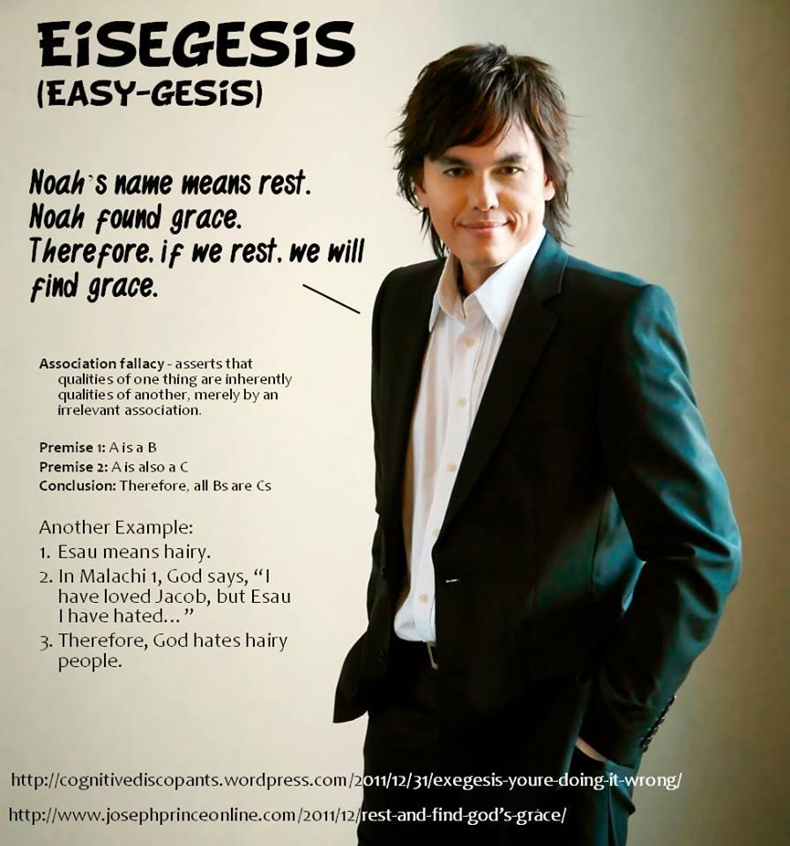
Seeker-Sensitive Association Fallacies
Notes:
Joseph Prince – Word of Faith preacher from Singapore

Slide 26
Name the Fallacy
“If you don’t want your tax dollars going to help the poor, then STOP saying you want a country based on Christian values, because you don’t.” -Jimmy Carter
Notes:
Red Herring – a distraction
No True Scotsman – True Christians want tax dollars to go to the poor
Begging the Question – The conclusion, using tax dollars to help the poor, is built into the premise that doing so is a Christian value

Slide 27
Name the Fallacy
Florida: America’s most popular tourism destination.
Notes:
Bandwagon/Appeal to the People

Slide 28
Name the Fallacy
“My tummy hurts because I took a nap.” -Levi Olson (age 3)
Notes:
Post Hoc, Ergo Propter Hoc

Slide 29
Name the Fallacy
Piers Morgan to Larry Pratt (President of Gun Owners of America): “Your solution to the problem would be to arm every school, every church, every hospital, everywhere that members of the public could be.”
Notes:
Straw Man

Slide 30
Name the Fallacy
What we have here is the non-homogeneous linear systems and Cauchy Euler equations utilizing the exponential matrix functions and the concavity of points of inflection to find the quasi-static expansions of an ideal equation. -Eric Douma
Notes:
Appeal to Authority – gibberish that sounds like it must be meaningful to experts

Slide 31
Name the Fallacy
You shouldn’t pray to the God of the Bible because He doesn’t exist. But you should pray to your dead ancestors, because you couldn’t pray to them if they didn’t exist. From: The Fallacy Detective
Notes:
Begging the Question

Slide 32
Name the Fallacy
Gary Cooper brushed his teeth with Colgate From: The Fallacy Detective
Notes:
Fallacious Appeal to Authority

Slide 33
Name the Fallacy
Humans share about 99% of our DNA with Chimpanzees, which is proof that we have a common evolutionary ancestor.
Notes:
Weak Analogy (False Assumption)
It could also be compelling evidence of a common Creator that reuses mechanisms that have a common purpose

