Slide 1
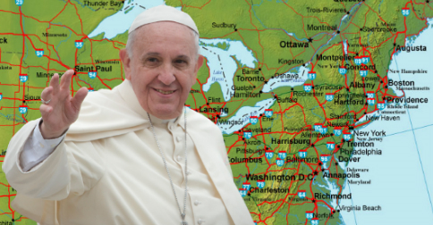
Who is The Holy Father?… A look at the Papacy in advance of Pope Francis’ visit to the USA
…contend earnestly for the faith which was once for all delivered to the saints. Jude 3
by Dan Flaherty
Gospel of Grace Fellowship
September 6, 2015
Notes:
Welcome everyone! As you can see Eric is away enjoying a weekend with his family so he asked if I would share some more about the Roman Catholic system. I thought this would be a great time to talk a bit about the RC papacy since we will soon be engulfed in a media frenzy surrounding the upcoming visit the end of this month of Pope Francis. You and I may have friends, family members, co-workers asking about this curious man and all the attention he seems to get everywhere he goes. We may even be asked by some about the Christian faith in relation to the Pope. So often the world associates Christianity with the papacy and Roman Catholicism. Notice on any news channel (Fox included) – on an important holiday associated with Christianity such as Christmas or Easter – what’s the first thing the stations show – the Pope celebrating Mass at the Vatican or somewhere around the world as if somehow this is what true Christianity looks like. As we have shown before (and we will touch on again) the Roman Catholic church is not another denomination of Christianity – it is an apostate, heretical system that has a different gospel than the one we find in Scripture. John MacArthur has said about Roman Catholicism: “In the long war on the truth, the most formidable, relentless and deceptive enemy has been Roman Catholicism. It is an apostate, corrupt, heretical, false Christianity. It is a front for the kingdom of Satan. The true church of the Lord Jesus Christ has always understood this.” – It took me a while to appreciate this statement but the longer I am exposed to expository preaching the more sense it makes.
What we want to do for this morning is listen to a 41 minute sermon by John MacArthur entitled “Usurping the Seat of Christ” which he delivered back on March 17, 2013, only 4 days after Pope Francis was elected Pope by the Cardinals.
What is a “Usurper”? Someone who seizes and holds an office or title without legal right – in this case Pope Francis as the newest “Holy Father” of the Roman Catholic Church.
After listening to the sermon we will discuss further the Papacy – especially considering a Christian response to the visit from Pope
Francis.

Slide 2
The World Bows to the Papacy
President Obama bows to Pope Benedict XVI
Notes:
The next few slides will just prepare you for the onslaught of bowing & kissing and various other reverential actions that await “His Holiness” – yikes!

Slide 3
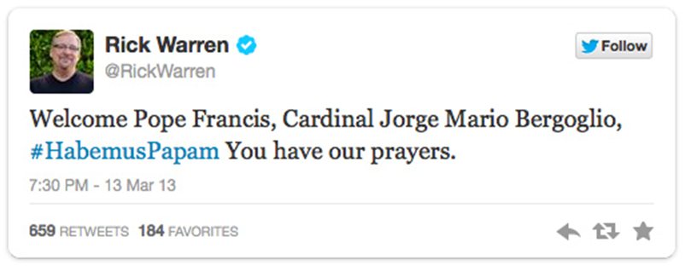
The World Bows to the Papacy
Rick Warren & Pope Francis

Slide 4
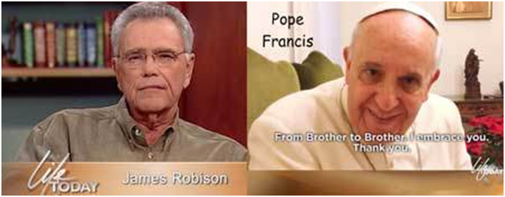
The World Bows to the Papacy
Kenneth Copeland & James Robison with Pope Francis

Slide 5
The World Bows to the Papacy
Nancy Pelosi kissing the ring of Pope Benedict XVI

Slide 6
The World Bows to the Papacy
Jeb Bush kneels before Pope Benedict XVI
Notes:
This chair that Benedict is sitting in reminds me that a special chair has been brought in for Pope Francis’ visit

Slide 7
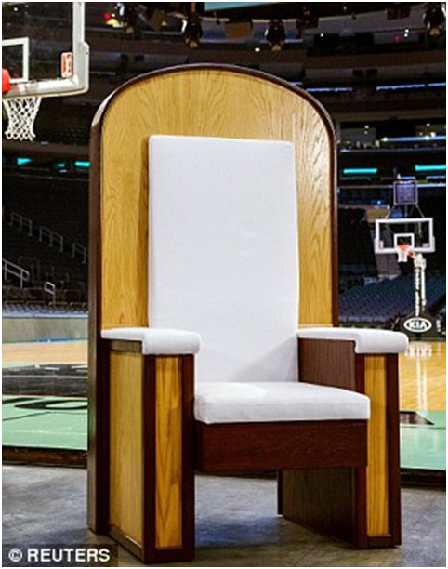
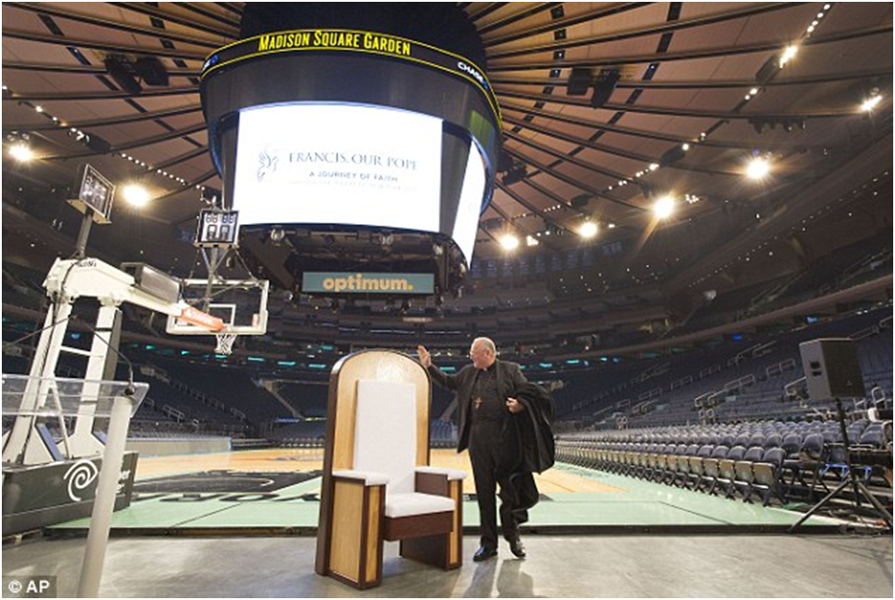
The World Bows to the Papacy
The Chair that Pope Francis will use when “celebrating” Mass is unveiled
Notes:
Chair! The chair was constructed by a group of immigrant day laborers in a garage in Port Chester. The Archdiocese of New York said immigrants were specifically chosen because of Francis' concern over those who are marginalized and for his desire for justice in the world
Read more: http://www.dailymail.co.uk/news/article-3220202/Chair-built-Pope-Francis-NYC-Mass-unveiled-s-revealed-D-C-mass-Spanish.html#ixzz3kxAvJzYV
Follow us: @MailOnline on Twitter | DailyMail on Facebook

Slide 8
The Papacy …
The Roman Catholic Church claims Pope Francis
(Jorge Mario Bergoglio from Argentina) is the 266th Roman Pontiff – dating back to Peter the Apostle

Slide 9
Some definitions …
Papacy:
1. the office, dignity, or jurisdiction of the pope.
2. the system of ecclesiastical government in which the pope is recognized as the supreme head.
3. the period during which a certain pope is in office.
4. the succession or line of the popes.
Roman Curia: the papal court and government of the Roman Catholic Church
The Holy See: the vast organizational structure of the Church, of which the Pope is the head.
The Vatican: references the small area of land in Rome where the headquarters of the Holy See are located.
Notes:
The Holy See is the vast organizational structure of the Church, of which the Pope is the head. The Vatican references the small area of land in Rome where the headquarters of the Holy See are located. The Lateran Pacts, ratified in 1929, Italy gave the land of the Vatican City to the Holy See. It is helpful to think about the distinction as such: when the Pope (or his delegates) are talking on moral/cultural/religious matters, they are acting on behalf of the Holy See. When they are discussing merely geographical/passports/stamps/police/gov... things, they are talking as the Vatican City. In a sense, when people commonly talk about "the Vatican said so-and-so about X contentious issues" they 99/100 times really mean "the Holy See said...."
Further, what makes understanding the Holy See so difficult is that the Holy See operates a lot like a multi-national corporation and has a truly unique place in geopolitical history. Due to the vast importance of the Catholic Church in the last 1,500 years of history, countries maintain country-like relations with the Holy See, although it truly operates like a corporation, not a country. Unlike any other religion in the world, countries basically have diplomatic relations with the organization of a religion.

Slide 10
The Papacy ruling from the Vatican…
Vatican City is the smallest sovereign country on earth – both physically (110 acres) and by population (842 from July, 2014 census)
Notes:
With an area of approximately 44 hectares (110 acres), and a population of 842,[3] it is the smallest internationally recognized independent state in the world by both area and population.
It is an ecclesiastical[3] or sacerdotal-monarchical[7] state ruled by the Bishop of Rome – the Pope. The highest state functionaries are all Catholic clergy of various national origins.
My quess is the Edina High School campus we are sitting at is larger than Vatican City

Slide 11
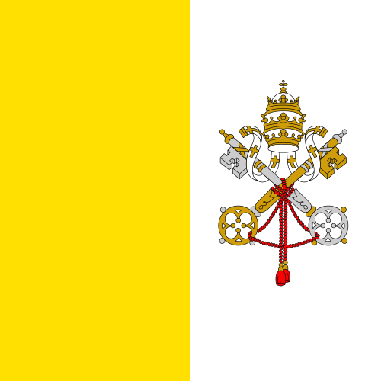
The Flag and Coat of Arms of the Vatican City State
Notes:
The keys[edit]
The keys refer to the promise of Christ to Peter, "I will entrust to you the keys of the kingdom of heaven. Whatever you declare bound on earth shall be bound in heaven; whatever you declare loosed on earth shall be loosed in heaven."[27] They are a symbol of the power the Catholic Church believes that Christ gave to Saint Peter and his successors,[28] with the gold key signifying that the power reaches to heaven and the silver key that it extends to all the faithful on earth, the interlacing indicating the linking between the two aspects of the power, and the handles of the key being at the base to symbolize the power being in the hands of the pope.[18]
The tiara[edit]
While actual wearing of the Papal tiara has been discontinued by Pope John Paul I and his successors, it remains a papal heraldic symbol. A crown was added to the headgear of the Pope in 1130 to symbolize sovereignty over the Papal States. In 1301, Pope Boniface VIII, at that time in conflict with Philip the Fair of France, added a second crown to indicate that his spiritual authority was superior to any civil power. In 1342, Pope Benedict XII added a third crown to symbolize the superiority of papal religious authority over that of non-religious monarchs. The original significance of the three crowns was lost over time and they came to represent instead the Pope's powers as priest, ruler and teacher.[28]

Slide 12
A Brief History of the Papacy
The Gradual Rise of Papal Rome
Emperor Constantine and Emperor Licinius in AD 313 – Issued the Edit of Milan –
Removal of the seat of power from Rome to Constantinople AD 330
Barbarian invasions in the 5th century left a leadership vacuum in Rome which the Bishop of Rome filled
Emperor Justinian I (527-65) laid the legal foundations in giving power to the Bishop of Rome
Fraudulent Documents and the Rise of the Papacy in the 8th century – Temporal power grows
Lust for power grows – Pope Gregory VII (also known as Hildebrand) – claims the reign of the Pope was in fact the reign of God on earth
The 605 years of the Inquisition – The Papacy drunk with the blood of the saints
The Reformation of the 16th century restores the Gospel with the Scriptures, learned men and the invention of the printing press
Notes:
The papal church is a magnificently rich, splendidly housed political and ecclesiastical power, with headquarters in Rome. It stands in stark contrast to what started there in the first century, with some pastors ministering to small congregations. The differences are striking. The early home churches under their pastors looked to the authority of God’s Word as received in the gospel accounts of the life of the Lord and the writings of the apostles, together with the Old Testament. They had a true and living faith in God’s grace through the Gospel (See page 53 of Richard Bennett’s Catholicism for entire quote if needed) this decree established the policy of religious freedom for both paganism and Christianity. This caused the gospel to become diluted, pagan practices introduced – true Christianity was whitewashed with an external form of piety

Slide 13
The Counter Reformation
The Jesuit Order of Ignatius of Loyola
Formed in 1530 – officially recognized by Pope Paul III a decade later
Primary task to train his followers to high proficiency in various professions with the aim of converting the children of Bible believers back to Catholicism – in places where the Reformation had taken hold the Jesuits relentlessly sought to undermine what had been achieved - the Jesuits’ objective – then and now – is indoctrination
Self Discipline & Mystical Experiences – Intended to draw people back to Rome
Notes:
See page 76 & 77 RB Catholicism
Much of what papal Rome has achieved since the Reormation and in modern times has been due to the planning and strategy of the Jesuits (pg. 77)

Slide 14
The Papacy Reorganized to Meet the Modern World
Papal Rome loses it’s civil power in 1798 but not it’s ambition to rule the world – both spiritually and temporally
Benito Mussolini signs the Lateran Treaty with Pope Pius XI and the Roman Catholic Church becomes a modern civil state
Vatican involvement in world affairs – yes, even in the modern era - has led to conflict, turmoil, and misery
Papal Power through Civil Law in many nations – “Concordats”
Power through Economic teaching
Power through Ecological alarmist teaching and laws
He’s coming to the USA this September to lecture all of us – whether Catholic or not – on what we need to do for the “common good” – Be warned!
Notes:
See page 78 RB Catholicism, page 84 as well. Page 88 on socialism
Talk about the dynamic of the Reformation and how this changed everything about people and nations operated on a daily basis (see pg 15 of Ecc Mega)
Read page 18! VERY IMPORTANT!

Slide 15
Pope Francis comes to the USA
Speech before the Joint session of Congress September 24, 2015 – first time in history a pope has addressed the US Congress – the Democrats are pushing for the pope to address minimum wage, hunger and environment issues.
Speech at the UN – Environmentalism, Global warming, Sustainable Development, Agenda 21, redistribution of wealth, etc…
Notes:
Economics & the Papacy This “universal ownership of all goods” – a principle coming out of the ecumenical council of Vatican II and emphatically teaches (end of page 86 and all of page 87)
See Eccle Megla and talk about capitalism and the outworking of the true gospel on
Environment and the Papacy WASHINGTON—U.S. House Democrats are pushing Pope Francis to address the minimum wage, hunger and the environment in his historic speech to Congress later this month, hoping his embrace will give momentum to three party priorities.
In a letter to the pontiff, 94 House Democrats lauded Francis’s schedule during his six-day U.S. trip, which includes visits to a Philadelphia prison and a school in New York’s Harlem neighborhood.
“Your powerful example of solidarity with the poor and the marginalized will undoubtedly help inform our current debates around major U.S. policy affecting all Americans,” the lawmakers wrote.
“Your message of hope could not come at a more crucial time, in particular to those in our nation that are struggling on a minimum wage salary, or relying on public assistance to put food on the table.”
The Democrats cited instances in which Republicans have blocked Democratic efforts to increase the federal minimum wage and bolster food and environment programs. “We look forward with great anticipation to your visit and to your words on all these issues,” they said.
Francis’s visit will include a Sept. 24 address to Congress, the first by a pope, and is certain to bring throngs of people to the capital. He arrives in the U.S. on Sept. 22.

Slide 16
Titles of the Pope and how he has stolen them from God the Father, God the Son, and God the Holy Spirit
He is called “Holy Father”. He has usurped the title intended for God.
He is called the “Head of the Church”. He’s usurped a title intended for Jesus Christ the Son.
He’s called the “Vicar of Christ”, vicar connected to the word vicarious – the one who stands in the place of Christ. And he has stolen that from the Holy Spirit.
He has set himself in the place of God, he has set himself in the place of Christ and he has set himself in the place of the Holy Spirit and that is overstepping your bounds.”
(taken from a sermon from John MacArthur – “the Pope & the Papacy”)

Slide 17
True Ecumenism vs. False Ecumenism
True Ecumenism: There is a genuine unity of all true believers throughout the world. There is but one true faith. All believers are converted by the Holy Spirit, and by the same work of grace have been placed in Christ. Though all do not have the same measure of wisdom and spiritual knowledge, yet they are all believers who trust in God alone and His written Word alone. They are saved by the all-holy God, by grace alone, through faith alone, in Christ alone, and all praise is to God alone. These five biblical principles (the solas, or ‘alones’ of the Reformation) show forth the foundation of true unity in the Lord. They have helped the persecuted church throughout the centuries to hold fast to the simplicity of the gospel. True ecumenism is sharing fellowship or working together in adherence to these five basic biblical principles that maintain the foundation of true unity in the Lord. To the degree to which these key basic biblical standards are embraced, true unity will be evident.
False Ecumenism: False ecumenism, on the other hand, is typically institutionalized and joins professing Christian groups in a purported ‘common cause’. In such endeavors, few are concerned that some of the parties involved are unconverted. While claiming to confess the Lord Jesus Christ according to the Scriptures, these groups often in fact compromise the five biblical principles that display the basis for true unity in the Lord. The extent to which these principles are not upheld usually shows the inclination of a church or group to submit to Rome. The World Council of Churches is such an institution. Within it, there is no agreement on any of the five biblical principles. The Church of Rome, likewise in apostasy, repudiates all five biblical standards. Counterfeiting the body of the Lord Jesus Christ, Rome is intent on finding successful ways to bind all ‘believers’ to a visible and formal unity achieved through the dominion of ecclesiastical machinery. This institutionalized ‘unity’ generates only infidelity to the Lord and the gospel.”
(taken from “Catholicism – East of Eden” by Richard Bennett, pg. 261)
Notes:
Like Bob has said there are no second class Christians

Slide 18
Some warnings from Luther about the papacy
“What is the papacy but a beautiful false front and a deceptively glittering holiness under which the wretched devil lies in hiding? The devil always desires to imitate God in this way. He cannot bear to observe God speaking. If he cannot prevent it or hinder God’s Word by force, he opposes it with a semblance of piety, takes the very words God has spoken and so twists them as to peddle his lies and poison under their name.” (What Luther Says, II: 10007)
“The negotiation about doctrinal agreement displeases me altogether, for this is utterly impossible unless the pop has the papacy abolished. Therefore avoid and flee those who seek the middle of the road. Think of me after I am dead and such middle of the road men arise, for nothing good will come of it. There can be no compromise.” (What Luther Says, II: 1019)
“What kind of a church is the pope’s church? It is an uncertain, vacillating and tottering church. Indeed, it is a deceitful, lying church, doubting and unbelieving, without God’s Word. For the pope with his wrong keys teaches his church to doubt and to be uncertain. If it is a vacillating church, then it is not the church of faith, for the latter is founded upon a rock, and the gates of hell cannot prevail against it (Matt. 16:18). If it is not the church of faith, then it is not the Christian church, but it must be unchristian, anti-Christian, and faithless church which destroys and ruins the real, holy, Christian church. (Luther’s Works, vol. 40, Church and Ministry II, The Keys, p.348)
Notes:
It goes back to the garden in Genesis 3 – Has God said????

Slide 19
What’s Our Response to The Papacy?
Notes:
See page 78 RB Catholicism, page 84 as well. Page 88 on socialism

