Slide 1
Technology
Youth culture night
Spring 2025

Slide 2
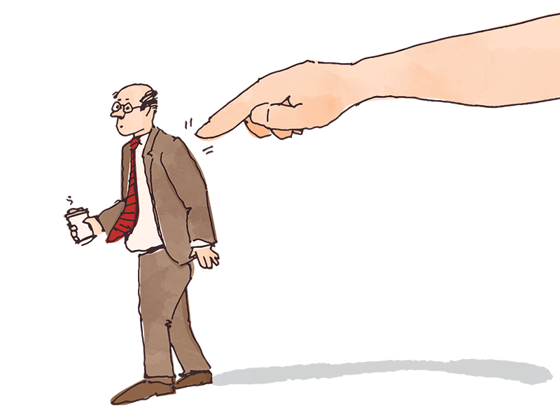

Slide 3
Where are we really at with tech?
Phones: Consumer Affairs (2025): Almost all Americans (98%) own a mobile phone. This translates to almost 331 million people. More than nine out of 10 (91%) of Americans own a smartphone. Each day Americans spend 4 hours and 30 minutes on their mobile phones and check their phone 144 times per day. Nearly 57% of Americans consider themselves 'mobile phone addicts.' Over half (62.79%) of the world's internet traffic comes from mobile phones.
Tablets/Computers: Census.gov (2024) — Reporting on Computer and Internet Use in the United States: 2021 — Smartphones were the most common computing device in U.S. households (90%), followed by desktop or laptop computers (81%) and tablets (64%) in 2021.

Slide 4
Where are we really at with tech?
Video Games/VR: Entertainment Software Associate (2024): 190.6m people in U.S. play video games; 61% of U.S. population play at least one hour a week; Today, 29% of players are 50 or older.
In 2004, only 17% of players were aged 50+. In 1999, this number was even lower at just 9%. Average age for player in 2004 was 29, average age for player today is 36
Percentage of people who play for 1+ hrs a week
Gen Alpha = 76% of females, 82% of males
Gen Z = 82% of males, 68% of females

Slide 5
Where are we really at with tech?
Entertainment/TV: U.S. Bureau of Labor Statistics (2018): In the 2013–17 period, the U.S. civilian non-institutional population ages 15 and older spent an average of 2 hours 46 minutes per day watching TV. This amounted to more than half (55.2 percent) of the total time per day they spent in leisure and sports activities.
Forbes (2024): “U.S. Media Consumption Report watching TV for more than 3 hours a day is at 61%.”

Slide 6
Where are we really at with tech?
Social Media, Podcasts, YouTube: Pew Research (2024): Findings survey of 5,733 U.S. adults conducted May 19-Sept. 5, 2023. Roughly eight-in-ten U.S. adults (83%) report ever using YouTube. Most Americans (68%) report using Facebook. Roughly half of U.S. adults (47%) say they use Instagram.
27% to 35% of U.S. adults use Pinterest, TikTok, LinkedIn, WhatsApp and Snapchat.
78% of 18- to 29-year-olds say they use Instagram, far higher than the share among those 65 and older (15%).
65% of U.S. adults under 30 report using Snapchat, compared with just 4% of the oldest age cohort.
62% of 18-29 year-olds say they use TikTok, much higher than the share among adults ages 65 years and older (10%).

Slide 7
“Teens get an average of 8 hours per day of screen time. Over 50% of Americans believe they are addicted to their phones. One study found that around 35% of the population has internet addiction. Up to 60% of teens show signs of cell phone addiction. Over 60 million people across the globe struggle with video game addiction. People with internet addiction are 2.2 times more likely to have sleep problems than people who don’t.
Around 30% of those with phone addiction live an unhealthy lifestyle, with more fast food and less exercise. Over 30% of people with smartphone addiction also experience symptoms of depression. Teens who spend over 4 hours on their phones daily are significantly more likely to have suicidal thoughts.
Instagram and other image-based social media platforms are significantly linked with body dysmorphia. People who use social media excessively as teens are more likely to be suicidal as adults.”
Center for Internet & Technology Addiction (2024)

Slide 8
What are the effects?
Fortune Well (2023): Turns out that teens spend an average of 8½ hours on screens per day, and tweens – that’s ages 8 to 12 – are not far behind, at 5½ hours daily.
Yale School of Medicine (2023): It found that youth who spent the most time on their digital technology were statistically more likely to exhibit higher levels of internalizing problems two years later. Internalizing problems include depression, anxiety, social anxiety, somatic complaints, and other concerns.
PudMed Central (2021): The use of technology affects the neuroplasticity in children and adolescent resulting in change that might be transient or permanent. Early infancy and adolescence are crucial years for brain growth and reorganization; thus, experiences and environmental variables can have a significant impact on future brain functioning.
“The Social Dilemma” — Netflix 2020

Slide 9
“With overexposure we develop illness—such as anxiety disorders and certain forms of PTSD… Technology has reduced our abilities to observe, integrate information, and be creative. In essence, we have less ability to sustain focus on the normal, the baseline, including states of observation, contemplation, and transitions from which ideas spark—what many under the age of 20 now consider a void, proclaiming [it] boredom. We now feel agitated when not externally stimulated; we need to be occupied, entertained.
Affects us with sound and stimulation, anxiety and depression, brain development, learning style and development, playing with others, socialization, the business agendas driving how technology is developed and how it hooks us, political manipulation, 'attention economy’, sex and sexuality.”
Mary Swingle in i-Minds

Slide 10
Quotes from important books
Cal Newport in Digital Minimalism: “Because digital minimalists spend so much less time connected than their peers, it’s easy to think of their lifestyle as extreme, but the ‘minimalists’ would argue that this perception is backward: what’s extreme is how much time everyone else spends staring at their screens.”
Zena Hitz in Lost In Thought: “An inner life is fed not just in privacy, solitude, and silence but also by preoccupation with some object or other. Reading novels or philosophy cultivates the inner life of a person, just as would a burning interest in geometric problems, or an enchantment with the lives of birds. Yet not every preoccupation develops the inner life in this sense: hours upon hours spent alone watching YouTube is not the same sort of thing as…retreat.”

Slide 11
“Our integration of these tools into our daily lives has blurred the boundary between ‘virtual’ things—things not grounded in physical reality that we encounter while online or via mediating technologies—and ‘real’ things embedded in physical space. These technologies mediate between us and our world…More and more people mistrust their own experiences. More and more people create their own realities rather than live in the world around them. We can no longer assume that reality is a matter of consensus…Today, many of us choose to live in a form of pseudo-reality governed by algorithmically-enabled individual experiences. Much of what passes for authentic experience today is vicarious and virtual.”
Christine Rosen in The Extinction of Experience

Slide 12
“It follows that time management, broadly defined, should be everyone’s chief concern. Arguably, time management is all life is… The world is bursting with wonder, and yet it’s the rare productivity guru who seems to have considered the possibility that the ultimate point of all our frenetic doing might be to experience more of that wonder… And yet busyness is really only the beginning. Many other complaints, when you stop to think about them, are essentially complaints about our limited time. Take the daily battle of online distraction, and the alarming sense that our attention spans have shriveled to such a degree that even those of us who were bookworms as children now struggle to make it through a paragraph without experiencing the urge to reach for our phones. What makes this so troubling is that it represents a failure to make the best use of a small supply of time… It’s because our time and attention are so limited, and therefore valuable, that social media companies are incentivized to grab as much of them as they can, by any means necessary—which is why they show users material guaranteed to drive them into rage, instead of the more boring and accurate stuff.”
Oliver Burkeman in Four Thousand Weeks

Slide 13
Quotes from important books
Adam Alter in Irresistible: “For ninety minutes [during the famous unveiling of the iPad], Steve Jobs explained why the iPad was the best way to look at photos, listen to music, take classes on iTunesU, browse Facebook, play games, and navigate thousands of apps. He believed everyone should own an iPad. But he refused to let his kids use the device. In late 2010, Jobs told New York Times journalist Nick Bilton that his children had never used the iPad. ‘We limit how much technology our kids use in the home.’ …It seemed as if the people producing tech products were following the cardinal rule of drug dealing: never get high on your own supply. This is unsettling. Why are the world’s greatest public technocrats also it’s greater private technophobes?”
Max Frisch, Homo Faber (1957): “Technology…the knack of so arranging the world so that we need not experience it.”

Slide 14
So, what do we do???

Slide 15
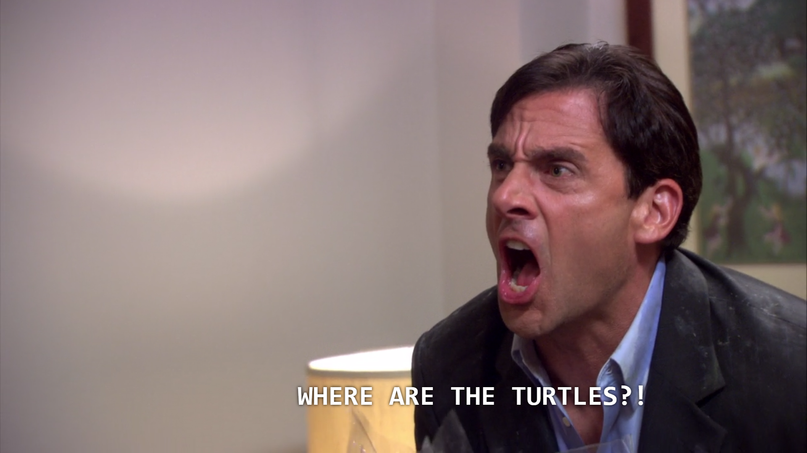

Slide 16
Our mission
Gen. 1:28 “And God blessed them. And God said to them, ‘Be fruitful and multiply and fill the earth and subdue it, and have dominion over the fish of the sea and over the birds of the heavens and over every living thing that moves on the earth.’”
Rom. 12:2 “Do not be conformed to this world, but be transformed by the renewal of your mind, that by testing you may discern what is the will of God, what is good and acceptable and perfect.”
Titus 2:11-12 “For the grace of God has appeared, bringing salvation for all people, training us to renounce ungodliness and worldly passions, and to live self-controlled, upright, and godly lives in the present age.”

Slide 17
What does grace do?
Grace implies sin.
Grace forgives.
Grace empowers.
Grace is not a thing but a Person.

Slide 18
Grace implies sin & Suffering
Heavy technology use has affected…
Relationship with God (Worship, theology, Christian life, godly relationships, etc.)
Barna Group research (2020): Within the first hour of waking up, 86% of 13-21 year olds check their phones while only 19% pray and only 6% read the Bible
Mental health
Family, friendships, interactions with those whom we disagree with
Identity and Purpose
Learning
Creativity, wonder, production

Slide 19
Technology sins
Gen. 11:1-4 “Now the whole earth had one language and the same words. And as people migrated from the east, they found a plain in the land of Shinar and settled there. And they said to one another, ‘Come, let us make bricks, and burn them thoroughly.’ And they had brick for stone, and bitumen for mortar. Then they said, ‘Come, let us build ourselves a city and a tower with its top in the heavens, and let us make a name for ourselves, lest we be dispersed over the face of the whole earth.’”

Slide 21
Grace grants repentance
Biblical Worldview
Barna Group (2020): “How often are your parents talking to you about sex?” = 5% daily, 8% weekly, 14% monthly, 36% less often, 37% never
Beauty
Ethics
Identity & Purpose
Barna Group (2020): Do you agree or disagree with the following statement (for ages 13-21): “I’ve had suicidal thoughts” = 18% somewhat agreed, 15% strongly agreed; “I’m depressed/sad a lot of the time = 19% somewhat agreed, 11% strongly agreed; “I hate myself” = 11% somewhat agreed, 8% strongly agreed

Slide 22
The competing values
Biblical worldview/heavenly-mindedness vs Worldliness
Participation vs Nominalism
Information vs Teachers/Wisdom
Truth vs Fake News
Biblical self vs selfish self
John Stonestreet: Lies technology teaches us: “I am the center of my own universe. I deserve to be happy all the time. I must have choices. I am my own authority. Information is all I need, not teachers.”

Slide 23
What happens when we give in?
Political turmoil, division, tension
Addictions (tech, substance, porn)
Affluence, consumerism, materialism, “likes”
Terror, tragedy, bad news
Paralysis of choice
Learning & work ethic
Affect on theology & Christian living

Slide 24
“We ignore our flesh and blood. We crave immediate approval. We become like what we ‘like’. We get lonely. We get comfortable in secret vices. We lose meaning. We become harsh to one another. We lose our place in time.”
Tony Reinke in 12 Ways Your Phone Is Changing You

Slide 25
Pornography, Sex, Sexuality
Damon Brown, Author of Playboy’s Greatest Covers: “It seems so obvious: If we invent a machine, the first thing we are going to do—after making a profit—is use it to watch porn.”
32% of teenagers said it was common for peers to send/receive nudes
Covenant Eyes: 38% of teens do not believe watching porn is wrong. 61% of the general population report viewing pornography. 78% of men watch pornography. 44% of women watch pornography. 75% of Christian men watch pornography. 40% of Christian women consume pornography. 22% of Christians view pornography at least once a week, compared to 31% of non-Christians who view pornography at least weekly. 73% of teens have consumed pornography. 12 is the average age of first exposure.

Slide 26
“In 2023, estimates for the global industry range from $58 billion all the way to $287 billion. There’s no way to calculate the exact amount of porn online. But experts estimate 4% of the internet is pornography. According to data aggregator SemRush, in September 2024, [one pornographic website] was the sixth most popular website in the world and boasted over 5.6 billion views. One website, a platform for individuals to upload their own content for subscribers, was launched in 2016. It now produces $6.6 billion in annual revenue.”
Covenant Eyes

Slide 27
We need MORE gospel preaching, not less.

Slide 28
What are the rewards?
True productivity
True theology, discipleship
Service, fellowship, missions, evangelism
Learning & Reading
John Stonestreet in A Practical Guide to Culture: “Talk about worldview early and often. Explain non-Christian worldviews. Strongly encourage your kids to read good books. Discuss ideas whenever possible. Ask good questions.”
Sleep!!!

Slide 29
“Cutting out some screen time at night is likely the number one thing you can do to improve your sleep quality immediately. Computers, iPads, televisions, smartphones, etc., kick out a sleep-sucking blue spectrum of light that can give you major sleep problems. The artificial blue light emitted by electronic screen triggers your body to produce more daytime hormones (such as cortisol) and disorients your body’s natural preparation for sleep… Mariana Figueiro, PhD, of the Lighting Research Center…and her team showed that just two hours of computer screen time before bed was enough to significantly suppress people’s nighttime release of melatonin.”
Shawn Stevenson in Sleep Smarter

Slide 30
“Within the brain, sleep enriches a diversity of functions, including our ability to learn, memorize, and make logical decisions and choices. Benevolently servicing our psychological health, sleep recalibrates our emotional brain circuits, allowing us to navigate next-day social and psychological challenges with cool-headed composure.”
Matthew Walker in Why We Sleep

Slide 31
What are the rewards?
Corporate Worship
Something & Someone far more beautiful
Let’s not use background images on the projector in worship that are unnecessarily distracting or very captivating.
Let’s not turn down the lights and fix our eyes on a screen where we think it’s just “me and God”
Let’s not make people look at the Bible on their screen or the screen but open the Word and leave it open
Let’s not settle for “I’ll just watch via livestream because it’s basically the same”

Slide 32
“The singing life of the church was built on the foundational principle of engagement—gathering to sing, create, and worship together. But in the digital age, this principle has devolved into an almost unrecognizable (to most of church history, at least) form of entertainment… Everything we do must invite people to engage and participate and not let them off the hook, to simply sit back and be entertained.”
Jay Kim in Analog Church

Slide 33
“The church was never meant to be a derivative of the cultural moment but a disruption of it… The greatest disruption that every church, small or large, can offer is an uncompromising invitation to the kitchen table, the living room sofa, the warmth of a sanctuary, the conversations in the courtyard—the spaces people are truly longing for in the midst of their speedy and impatient, choice-laden and shallow, individualistic and isolated lives.”
Jay Kim in Analog Church

Slide 34
Now what?
Doers: Worker bees, recruit and motivate other doers
Tech-minimal church, devotions, studies
Suppliers: Financial, human, material resources (what do we need moving forward?)
Help people know where to begin (resources, coaching, disciplines, etc.)
Influencers: Those who can sway individuals or groups, spread the idea; NOT trendy but genuine
Sabbath Day observance, family worship; family dinners, car rides, movies
Innovators: New ways to grow, workplace environment or product developing
Tech-minimal work, those who develop technology

