Slide 1
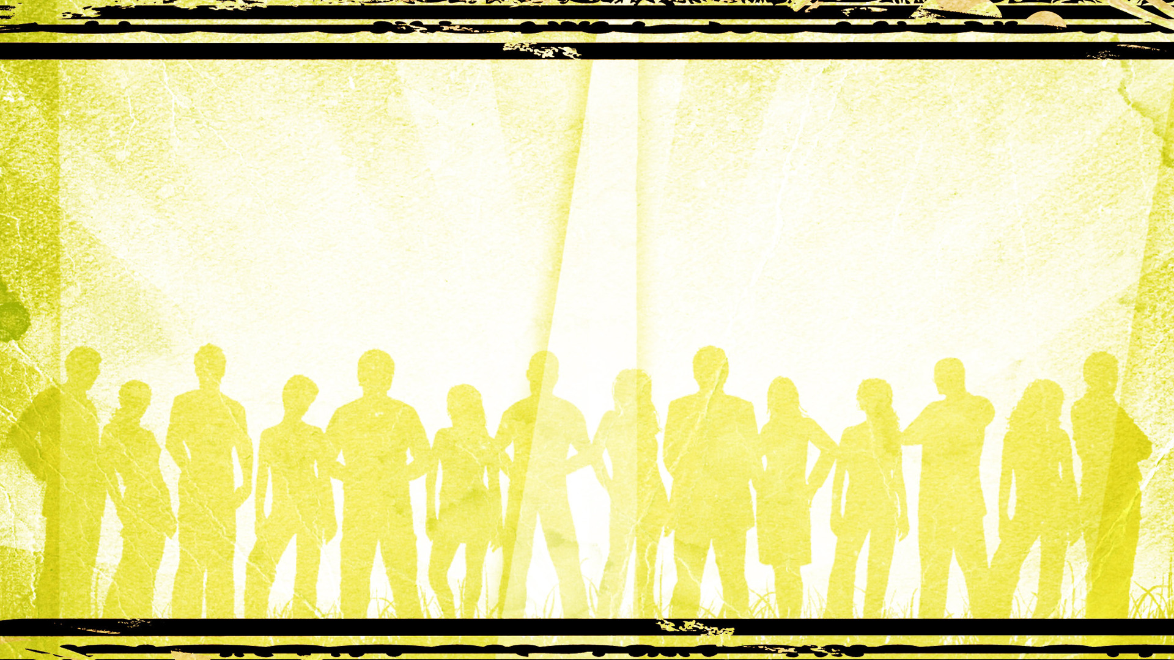
Marks of the Children of God
1 John 3:1-22

Slide 2
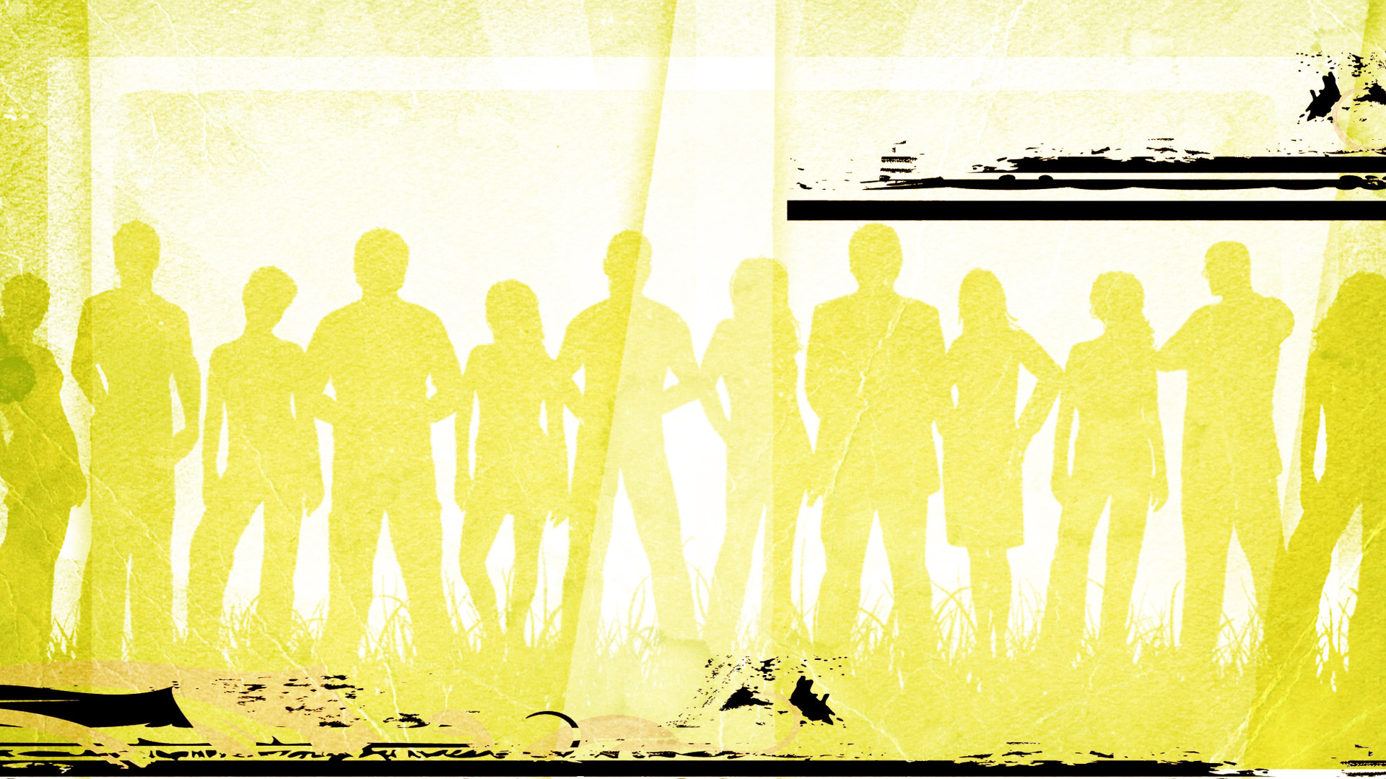
Marks of the Children of God
But to all who received him (speaking of Jesus), who believed in his name, he gave the right to become children of God.
John 1:12

Slide 3
Marks of the Children of God
1 John 3:1-22

Slide 4
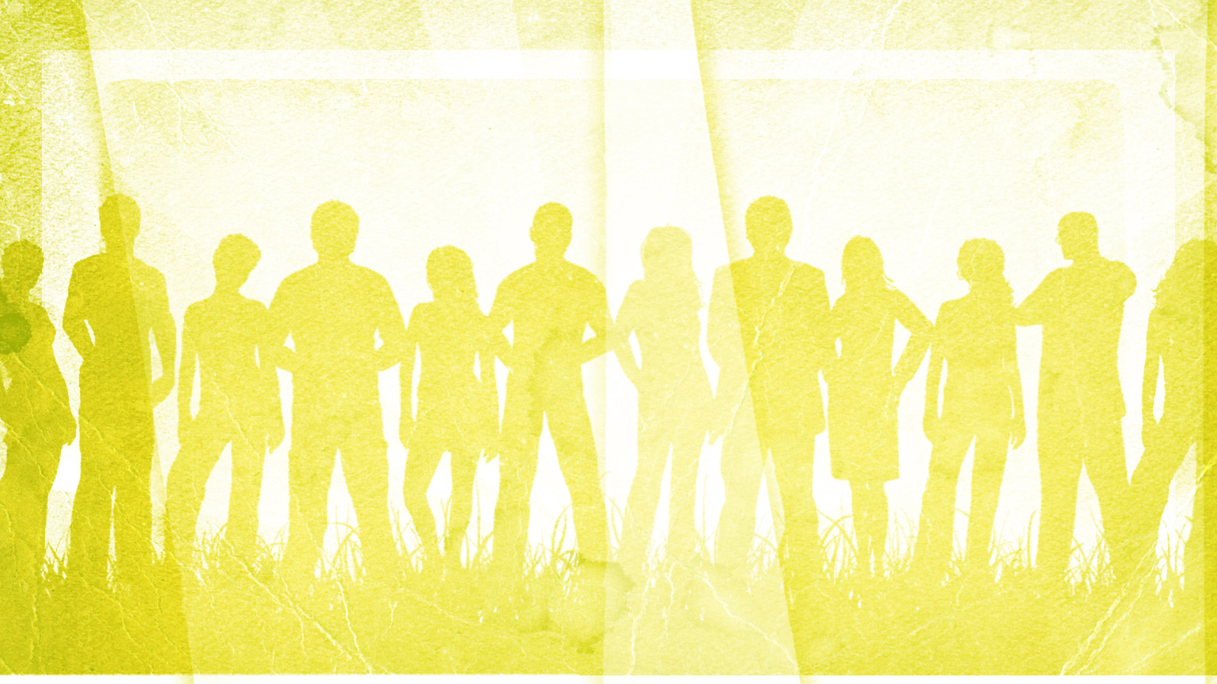
But I will sing of your strength; I will sing aloud of your steadfast love in the morning. For you have been to me a fortress and a refuge in the day of my distress. O my Strength, I will sing praises to you, for you, O God, are my fortress, the God who shows me steadfast love.
Psalm 59:16-17

Slide 5
I will give thanks to you, O LORD, among the peoples; I will sing praises to you among the nations. For your steadfast love is great above the heavens; your faithfulness reaches to the clouds.
Psalm 108:3-4

Slide 6
Marks of the Children of God
But God demonstrates his love for us in that while we were still sinners, Christ died for us.
Romans 5:8

Slide 7
For I am sure that neither death nor life, nor angels nor rulers, nor things present nor things to come, nor powers, nor height nor depth, nor anything else in all creation, will be able to separate us from the love of God in Christ Jesus our Lord.
Romans 8:38-39

Slide 8
Marks of the Children of God
1 John 3:1-22

Slide 9
Marks of the Children of God
For those whom he foreknew he also predestined to be conformed to the image of his Son, in order that he might be the firstborn among many brothers.
Romans 8:29

Slide 10
Marks of the Children of God
Questions? Comments?
Text Chris @ 703.944.4766

Slide 11
How do we demonstrate that we belong to Christ?
Marks of the Children of God
1) There is a growing conviction to order one’s life towards righteousness. 1 John 3:3-10

Slide 12
Marks of the Children of God
Either make the tree good and its fruit good, or make the tree bad and its fruit bad, for the tree is known by its fruit.
Matthew 12:33

Slide 13
Marks of the Children of God
1 John 3:1-22

Slide 14
How do we demonstrate that we belong to Christ?
Marks of the Children of God
1) There is a growing conviction to order one’s life towards righteousness.
2) There is a growing commitment to love others just as Christ has loved us. 1 John 3:11-18

Slide 15
You shall love the Lord your God with all your heart and with all your soul and with all your mind. This is the great and first commandment. And a second is like it: You shall love your neighbor as yourself. On these two commandments depend all the Law and the Prophets.
Matthew 22:37-40

Slide 16
You have heard that it was said to those of old, “You shall not murder; and whoever murders will be liable to judgment.” But I say to you that everyone who is angry with his brother will be liable to judgment; whoever insults his brother will be liable to the council; and whoever says, “You fool!” will be liable to the hell of fire.
Matthew 5:21-22

Slide 17
Marks of the Children of God
Questions? Comments?
Text Chris @ 703.944.4766

Slide 18
So if there is any encouragement in Christ, any comfort from love, any participation in the Spirit, any affection and sympathy, complete my joy by being of the same mind, having the same love, being in full accord and of one mind. Do nothing from selfish ambition or conceit, but in humility count others more significant than yourselves. Let each of you look not only to his own interests, but also the interests of others.
Philippians 2:1-4

Slide 19
Marks of the Children of God
Questions? Comments?
Text Chris @ 703.944.4766

Slide 20
How do we demonstrate that we belong to Christ?
Marks of the Children of God
1) There is a growing conviction to order one’s life towards righteousness.
2) There is a growing commitment to love others just as Christ has loved us.
3) There is a growing confidence in what God has declared and what I demonstrate. 1 John 3:19-22

Slide 21
Marks of the Children of God
Questions? Comments?
Text Chris @ 703.944.4766

