Slide 1

  Addition And Remodeling Plan
Strategic Planning Committee Recommendations
Approved by the Session

Slide 2

Church History
Thomas Hayes
Roots
Journey
  Salisbury Christian School
  Local Bank
Fundraising for Existing Building (2001-2002)

Slide 3
Church History
Thomas Hayes
Improvements
  Farmhouse Addition
  Playground
  Second Floor Classrooms
  Landscaping
  Pavilion
  Volley Ball Court
  Expanded Parking Lot

Slide 4
No Current Debt!

Slide 5

Needs Assessment
Presentations by:
Donna Anderson: Fellowship Committee
Joann Katzaman: Nursery Worker/Teacher
Kevin Griswold: Former head of Deacons

Slide 6
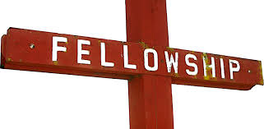

Fellowship & Sunday School
Donna Anderson
Adequate seating for our entire Congregation
Appropriate, adequate and suitable facilities for our many ministry opportunities

Slide 7
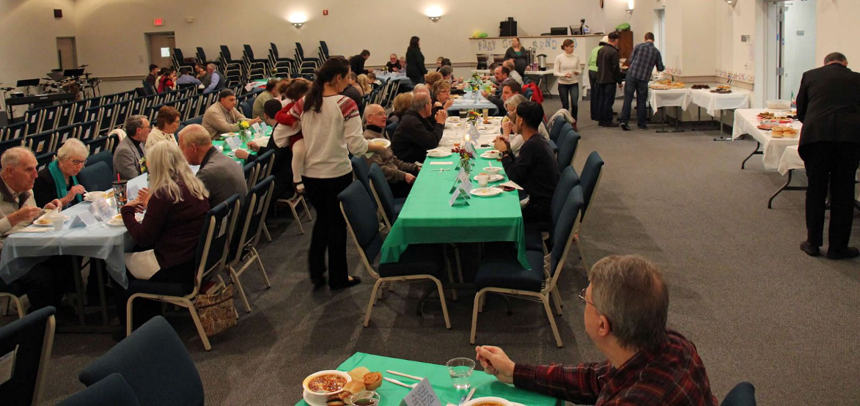
Conferences & Meetings
Reformation Conference Mission’s Conference Presbytery Meetings

Slide 8
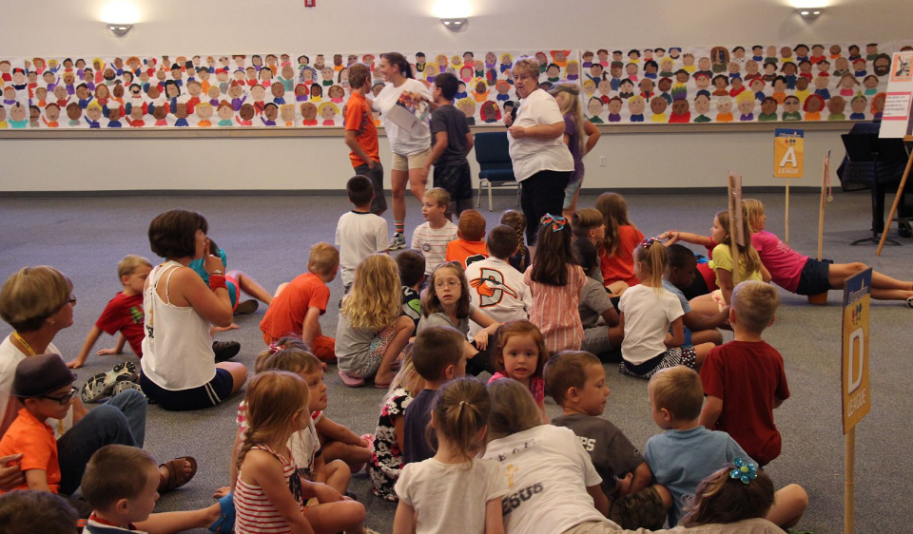
Vacation Bible School

Slide 9
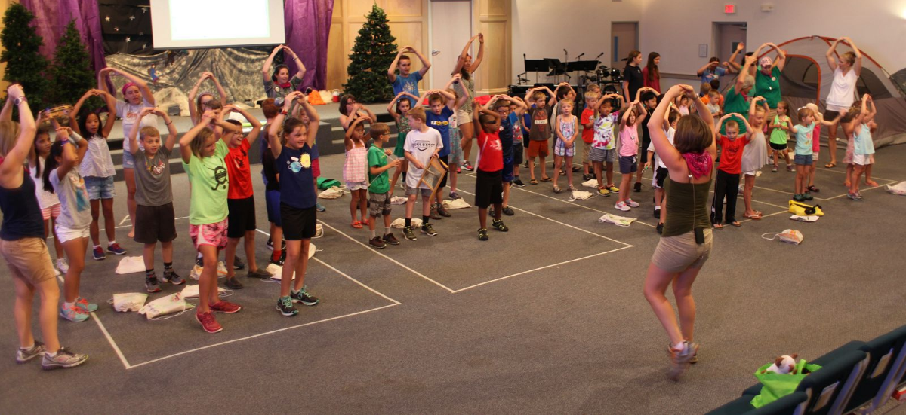
Vacation Bible School

Slide 10
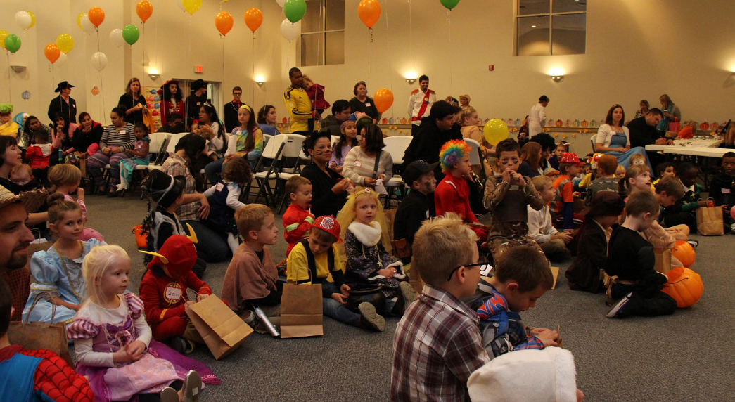
Harvest Party

Slide 11
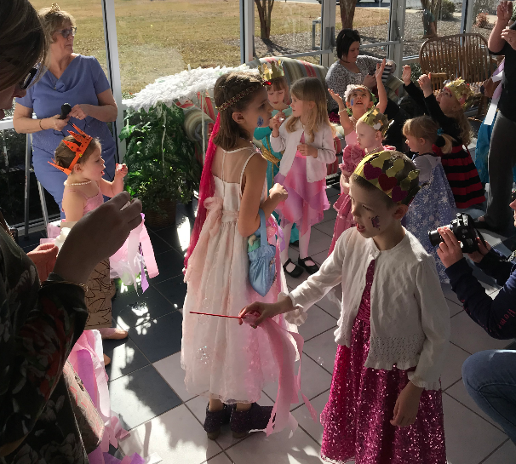
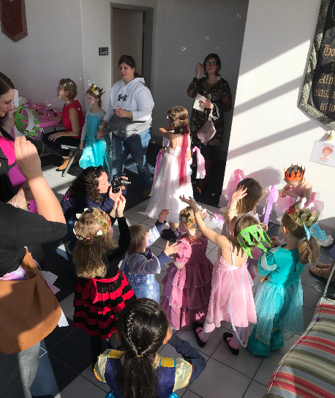
Maidens Preparing for the Princess Tea

Slide 12
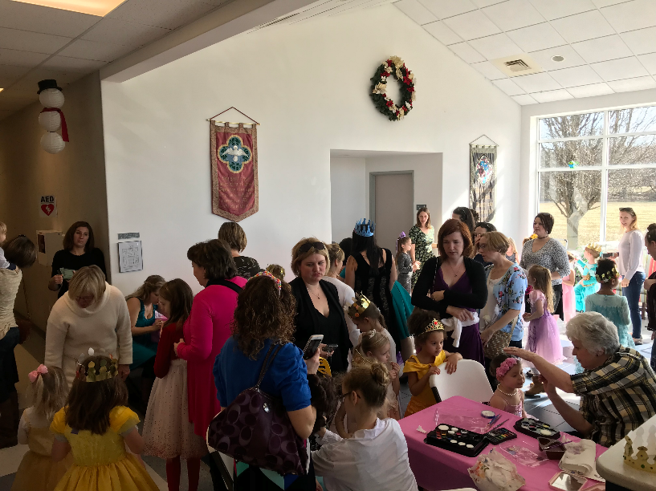
Princess
Tea
Extremely Crowded
  Over 60 moms & children
Major Makeover
  Nails painted
  Hair styled
  Faces painted

Slide 13
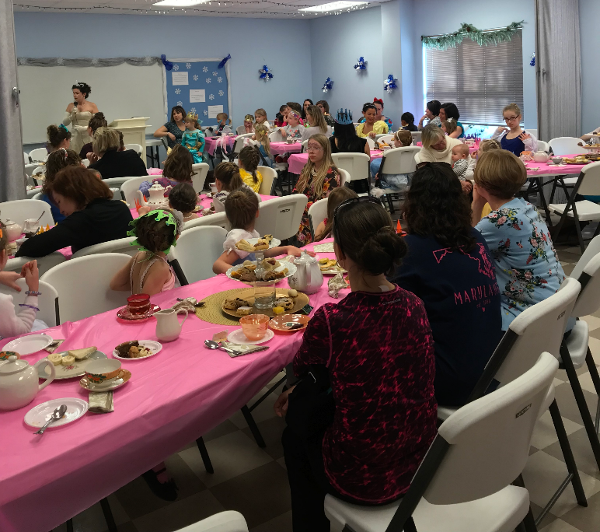
Fellowship
Hall
Seating +/- 60 persons
  Very crowded room

Slide 14
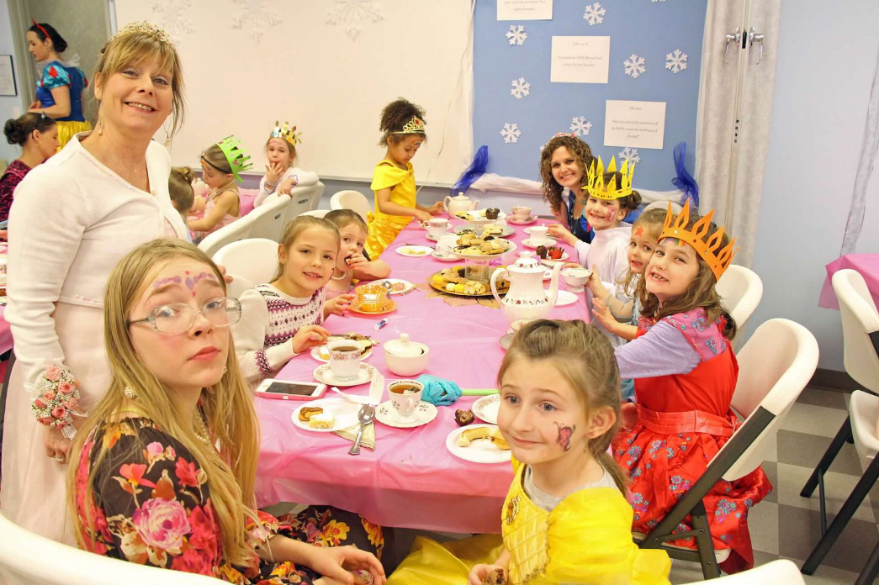

Slide 15


We are Blessed!
They need space for food and fun!

Slide 16

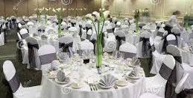
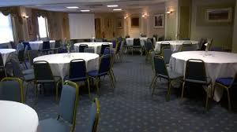


ESL is growing
Weddings and Funerals
New Opportunities:
Such as
MOPS and ???

Slide 17
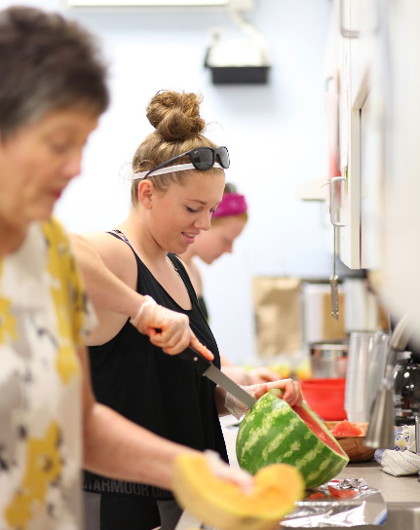
Our Warming Kitchen Needs
2 Ovens
Commercial warming oven
Adequate electrical outlets
Counters to prepare and serve food
Space to work on

Slide 18
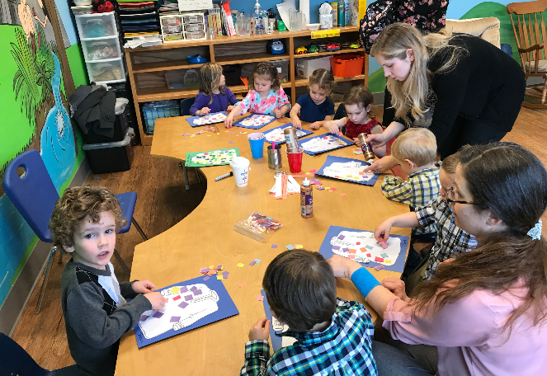
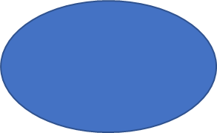
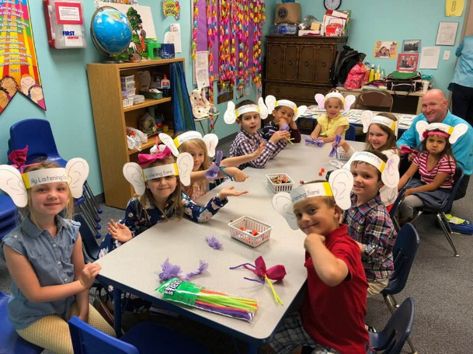
Our Largest Growing Group
Classroom Space Needed!
Larger Rooms Needed!
Pre K
& K
2 & 3’s
From Nursery to 5th Grade
We have over 45 People

Slide 19
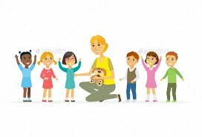
Needs Assessment
Nursery: Joann Katzaman
Need for enlarged and updated facilities
Place to wash hands
Toilets for toddlers
Bathrooms available beside classroom

Slide 20
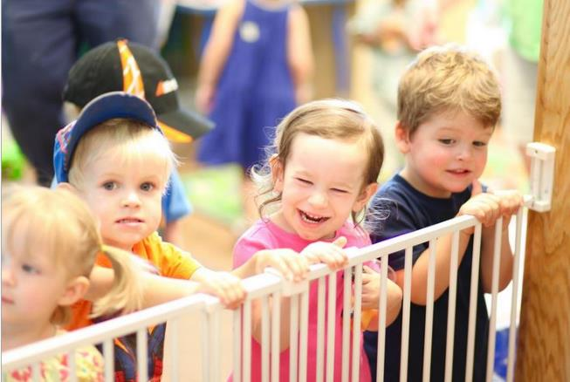
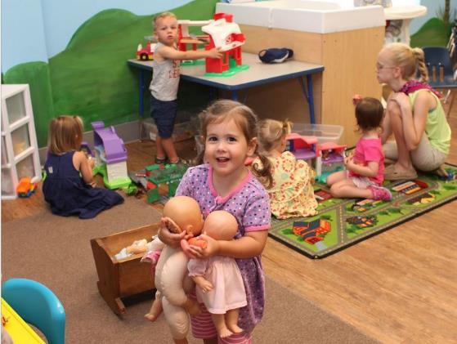
No Place to
wash hands
Long walk down
the hall to toilets

Slide 21
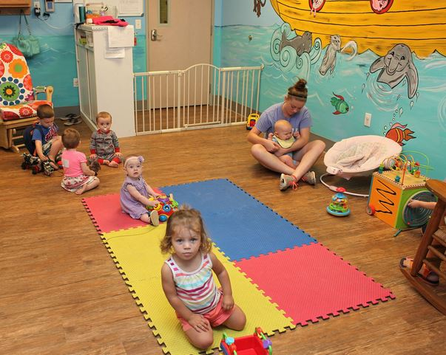
Need more
room for
our growing
number of
toddlers

Slide 22
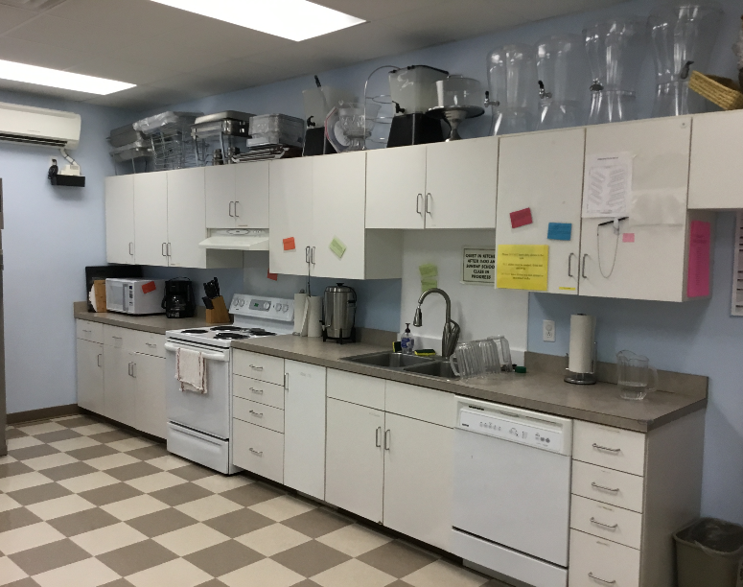
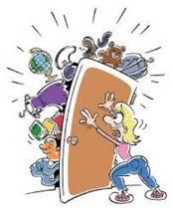
Storage
Kevin Griswold
Lack of Storage in the kitchen

Slide 23
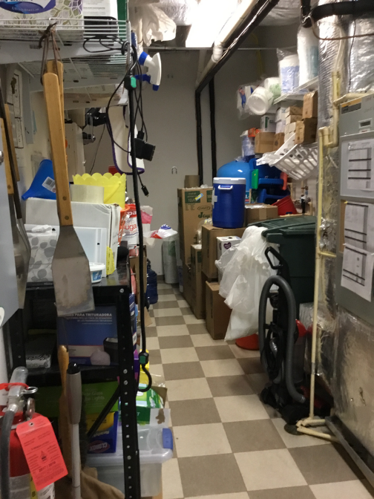
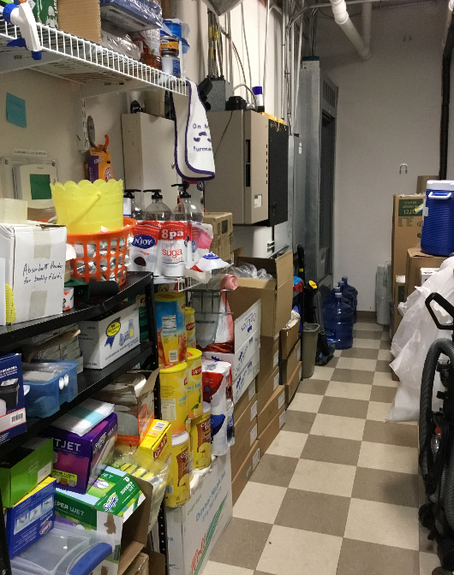
Closet behind the Kitchen

Slide 24
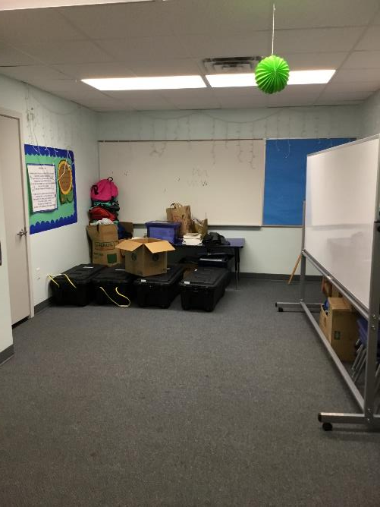
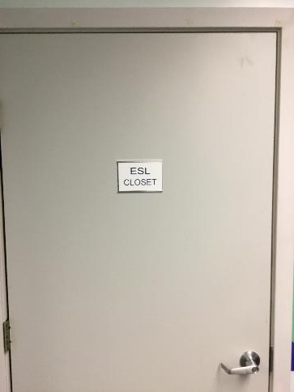
Lack of Storage
ESL &
Education

Slide 25
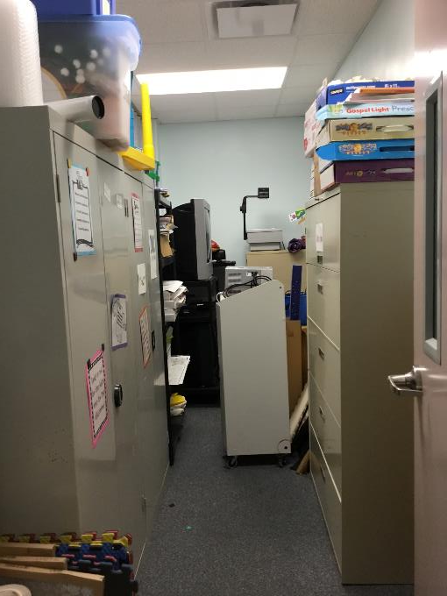
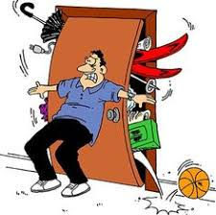

Slide 26
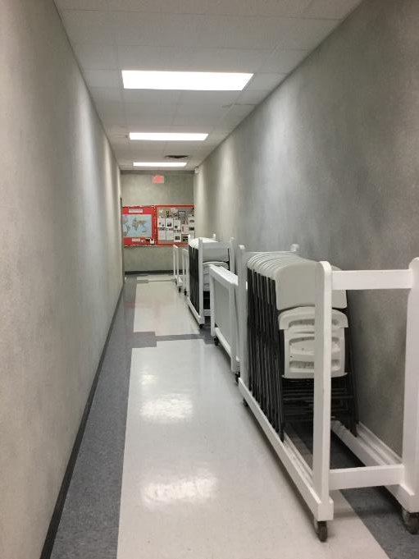
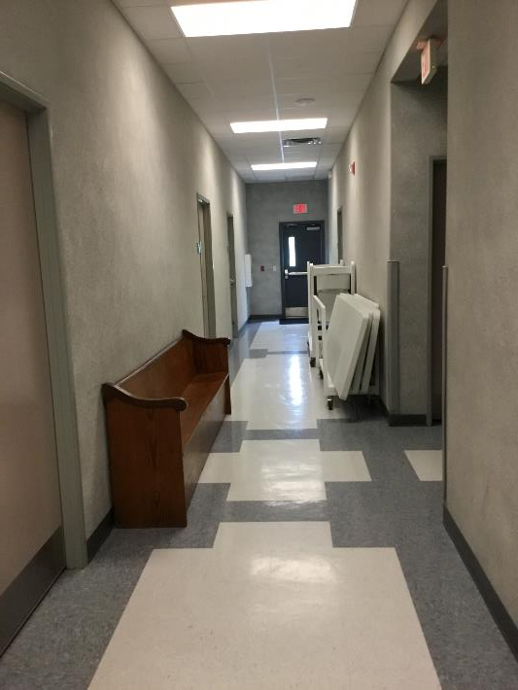
Halls
Are
Filled!

Slide 27
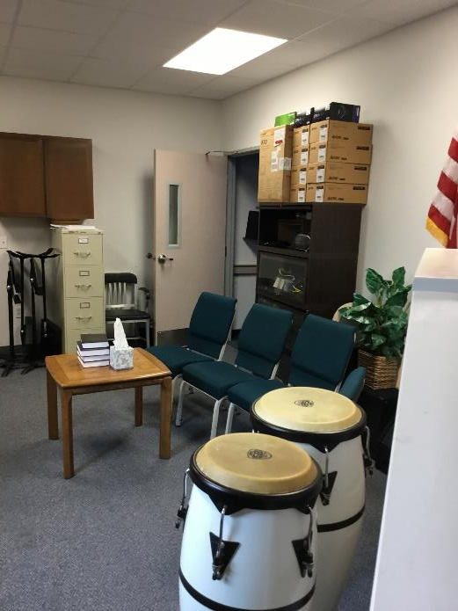
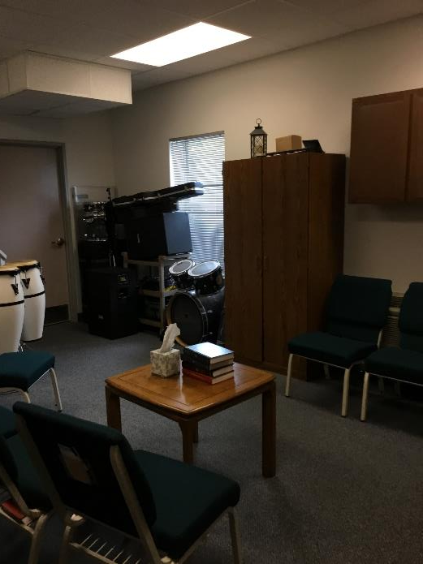
Prayer Room Full of Stuff

Slide 28
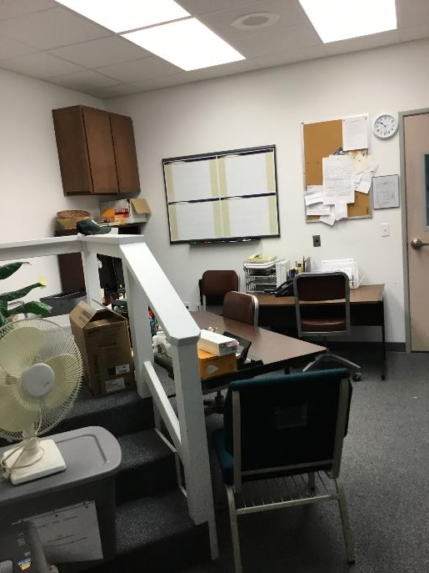
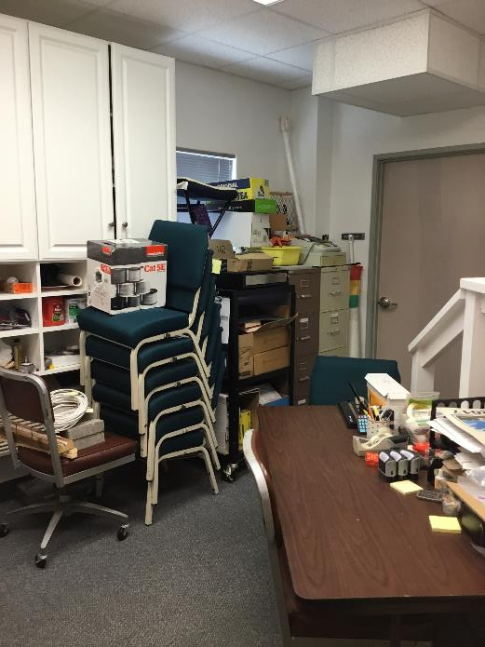
Deacon’s Financial Office

Slide 29
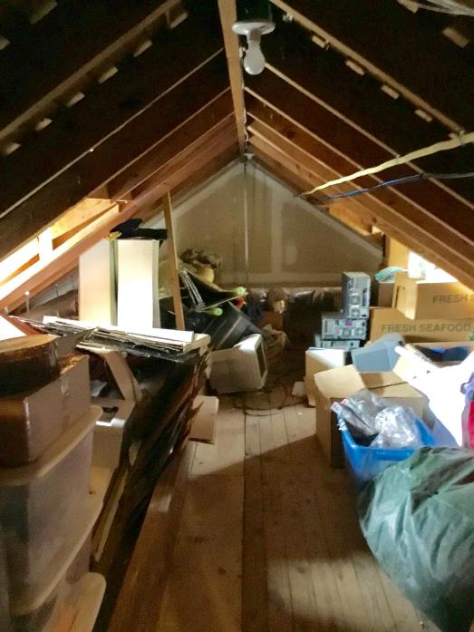
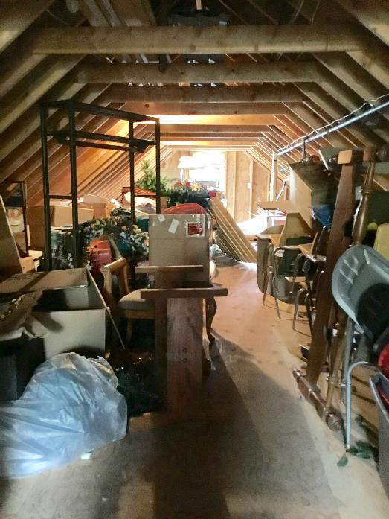
Attic Storage in Office Building

Slide 30
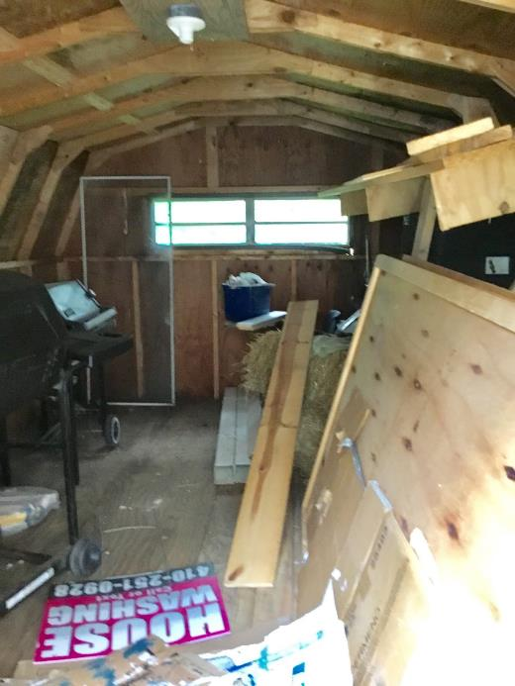
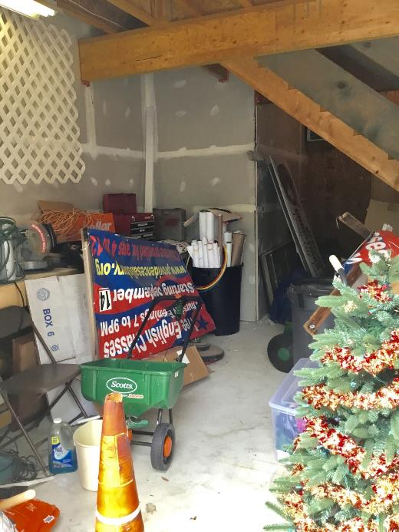
Deacon’s Storage Sites

Slide 31
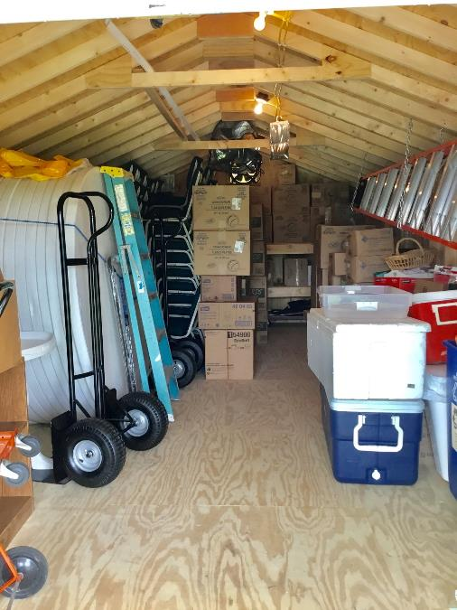
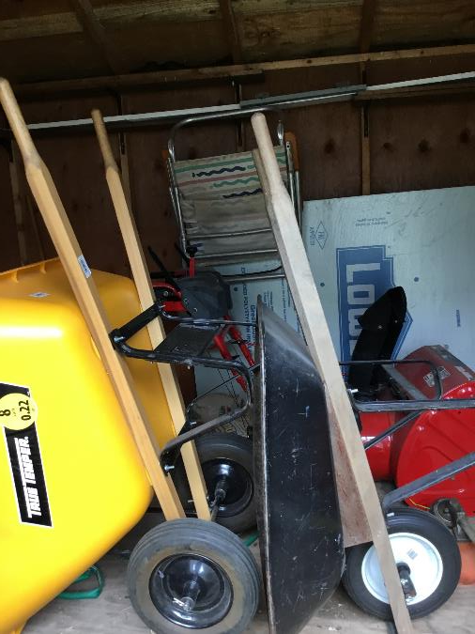


Slide 32
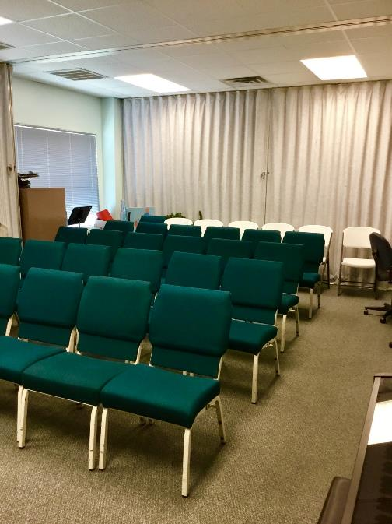
Inadequate
Sunday School
Adult Classrooms

Slide 33
Solutions!
Presentations by:
Thomas Hayes, R.A.: Chair, Strategic Planning Committee
Matthew Smith, P.E. Member, Strategic Planning Committee

Slide 34
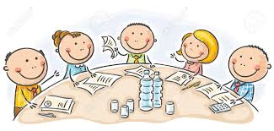
Strategic Planning Committee
Tom Hayes
Needs recognized by the Session
  Brought to the Strategic Planning Committee for possible solutions
Strategic Planning Committee met over the last 8 months
  Looked at 5 different schemes
Proposal addresses all four major needs
  Minimizes construction costs
Utilized a local contractor to provide preliminary pricing

Slide 35
Proposed Building Expansion

Slide 36
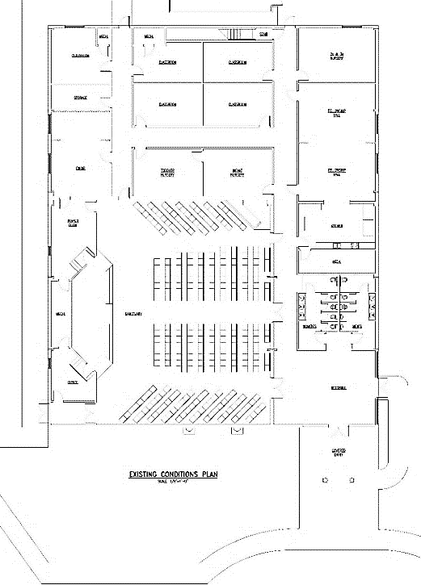
Proposed Expansion:
Matthew Smith
Existing Building

Slide 37
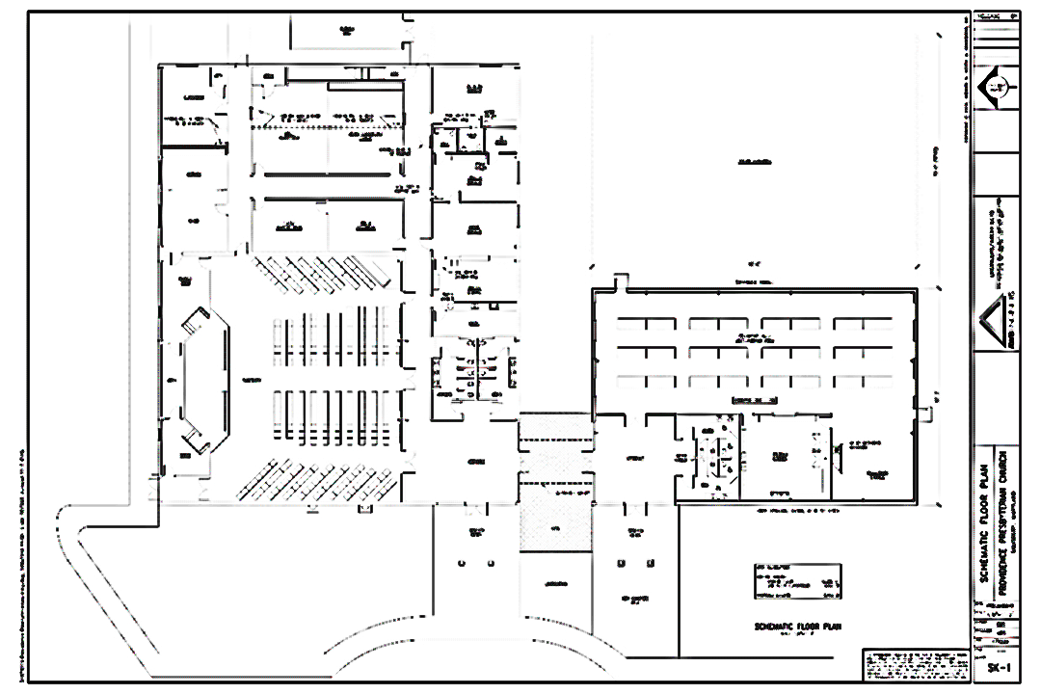
Addition Floor Plan

Slide 38
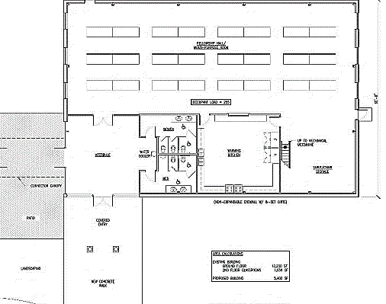
Proposed Expansion:
Matthew Smith
Fellowship Hall/ Multi-Purpose Room
Occupancy = 255
Addition
Warming
Kitchen
Vestibule
Connecting
Canopy
Covered
Entry
Bathrooms
Landscape
New Concrete Walk

Slide 39
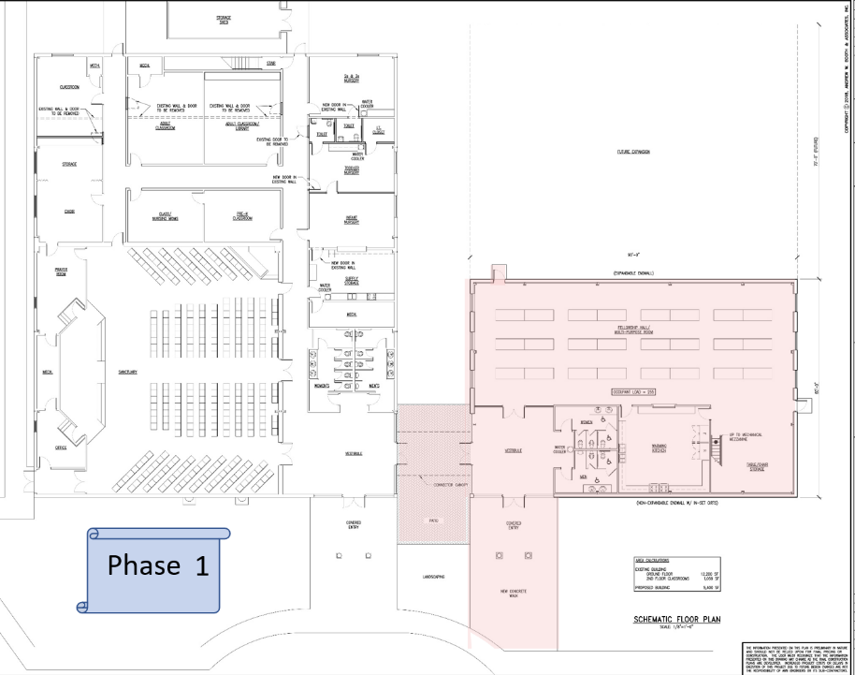

Slide 40

Fellowship Hall/ Multi-Purpose Room
Occupancy = 255
Phase 1
Warming
Kitchen
Vestibule
Connecting
Canopy
Covered
Entry
Bathrooms
Landscape
New Concrete Walk

Slide 41
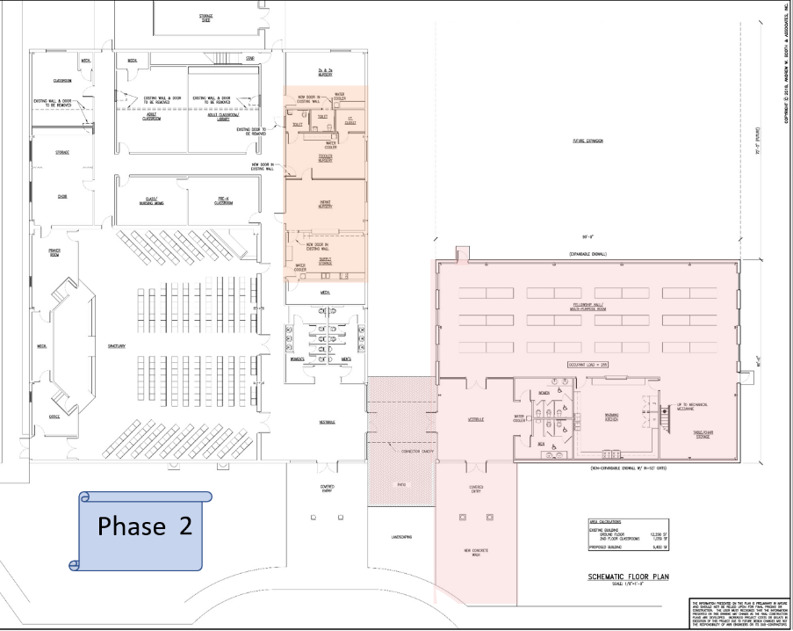

Slide 42
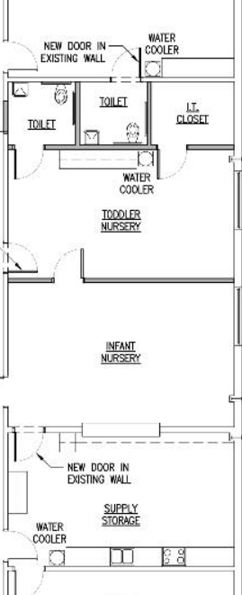

Phase 2

Slide 43
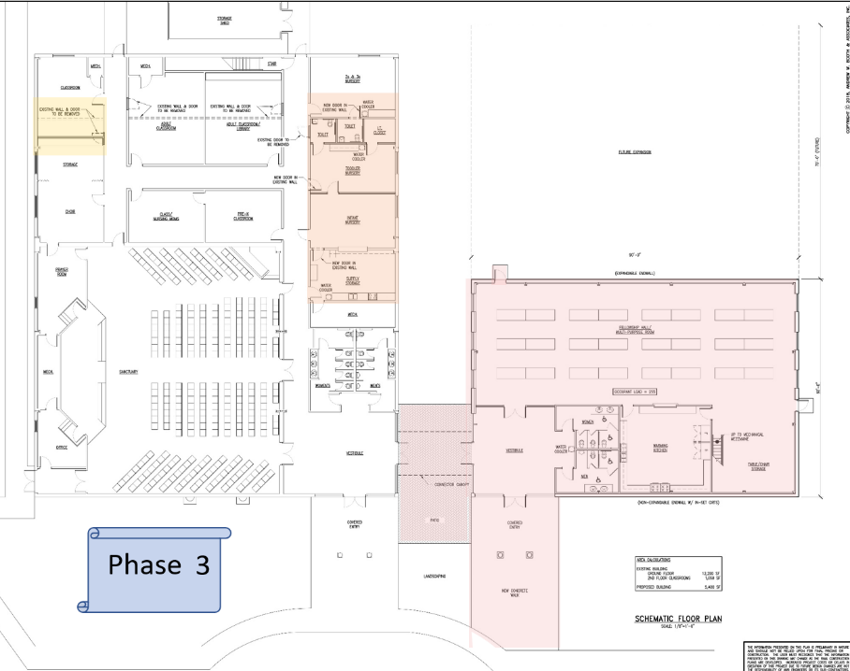

Slide 44
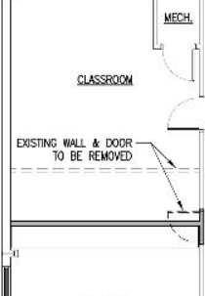

Phase 3

Slide 45


Slide 46

Phase 4

Slide 48


Slide 49


Slide 50

Projected Cost of Addition and Improvements
Estimated Cost for addition and improvements: $800,000.00
  Preliminary cost estimates based on construction sources
Session calls for the Building Fund to reach $400,000 before ground breaking takes place.
Cost per month with $400,000 mortgage:
  4.25% - 5.00% Interest
    $454 Additional per Week
    $1,967 Additional per Month
    $23,613 Additional per Year
Notes:
The elders have taken a careful look at the economics of building this addition
That is the reason that we will not break ground until we have $400,000 in our building fund.
We would prefer to have the full amount, but we are willing to begin when we have half.
We are asking you to pledge to this building program so the Session or elders can determine whether we can plan to move on with this program within the next 12 months
We well not break ground until we reach $400,000, but we can begin to get permits and prepare other documents if we get positive commitments from you.

Slide 51
Notes:
The average weekly attendance has stayed about the same over the past 4 years
The Annual budget has actually gone down over the past 4 years
Paid off the mortgage
Don’t have as many full time staff
Elders have attempted to be good stewards of God’s monies
Considering the rate of inflation over the past 4 years, we should have increased the budget from 2014 about 12%

Slide 52
Notes:
The green bar shows what it would additional weekly giving we would need to carry a $400,000 mortgage at 4.5%
According to the census bureau, Salisbury’s median household income is $66,334.00 for 2015. So it is higher today…
With over 100 families attending our church, if we were just to use this figure as the family income, a tithe to our church would be $663,000 annually which is $160,000 higher than our current budget .
If we were to have most of our families to tithe as God asks us, we would not have any issues taking care of this extra monies needed to finance the new fellowship hall.

Slide 53
Our church is growing and
Our city is growing
Maryland
Fastest-growing metropolitan area: Salisbury
  2010-2017 pop. growth: +8.3% (+31,030)
  2010-2017 pop. growth, Maryland: +4.6% (+264,078)
  Feb. 2018 unemployment: 5.4% (State: 4.2%)
  Largest driver of growth: Domestic migration
Source: USA Today and Delawareonline.com
Notes:
We have a growing population in Salisbury and we need to expand our facilities to handle our growth.
Furthermore we want to expand our ministries and outreach beyond what we are doing today.
Updated and enlarged facilities will help us be more hospitable and accommodating.
This is the place to stop and answer questions.

Slide 54

Moses said to all the congregation of the people of Israel, “This is the thing that the Lord has commanded. Take from among you a contribution to the Lord. Whoever is of a generous heart, let him bring the Lord’s contribution: gold, silver, and bronze; blue and purple and scarlet yarns and fine twined linen; goats’ hair, tanned rams’ skins, and goatskins; acacia wood, oil for the light, spices for the anointing oil and for the fragrant incense, and onyx stones and stones for setting, for the ephod and for the breastpiece. “Let every skillful craftsman among you come and make all that the Lord has commanded: Exodus 35:4-10
Notes:
Moses received from the Lord the plan for the temple. He communicated with the congregation the plan and than said, …(Above)
The people immediately began to give to Moses and Aaron the things required for the temple…
This from people who just escaped from Egypt and had not homes, but only the things they could carry out from Egypt
They did not hold out for their new homes, their retirement or even for their immediate pleasures.
Notice that they brought whatever they had that would help get the project finished.
We also are ready and willing to accept your various contributions that will help us build the addition:
Gold, silver, real or personal property, stocks and/or bonds and of course cash. We can convert these readily…
Remember, you can give directly from your IRA and will count as your Required Minimum Distribution.. These will pass tax free for you as donations to the church if done correctly
If you need help with this, we can help you.
I agreed to be an elder because I was convinced that God called us to build so we could have additional space to take care of our many ministries.

Slide 55

And Moses called Bezalel and Oholiab and every craftsman in whose mind the Lord had put skill, everyone whose heart stirred him up to come to do the work. And they received from Moses all the contribution that the people of Israel had brought for doing the work on the sanctuary. They still kept bringing him freewill offerings every morning, so that all the craftsmen who were doing every sort of task on the sanctuary came, each from the task that he was doing, and said to Moses, “The people bring much more than enough for doing the work that the Lord has commanded us to do.” So Moses gave command, and word was proclaimed throughout the camp, “Let no man or woman do anything more for the contribution for the sanctuary.” So the people were restrained from bringing, for the material they had was sufficient to do all the work, and more. Exodus 36:2-7
Notes:
Even though these newly released slaves had no permanent home and only the promises of the Lord to take them to the promised land, they kept on giving and giving to build the temple because they were so glad to honor the Lord since they had been set free!
This is the hope that I have for our fellowship… that we are so happy that Jesus has set us free that we want to offer him our money and our abilities to him for this project.
Notice that Hearts were stirred up and we are praying that your heart is stirred up like the God’s Covenant people in the old testament
Pray with your elders that hearts will be stirred to give and this project can be completed in short order.
The Strategic Planning Committee has faithfully fulfilled their role and will likely continue to do so until the project is complete.
The Session has begun to back this project by working and giving on this project.
Working by patiently guiding the process since the beginning of last year
Elders personally already donated $50,000 to the Building Fund to seed the giving
Session members will continue to give both time and money to this project to see its completion.
Now we are presenting this to you to allow you to give of your time and money to this project as well.
We are asking you to give: We are praying that God will stir your hearts as he did the Israelites & that you too will pray the same for yourselves and each other.

