Slide 1
OBJECTIVES:
BETTER UNDERSTAND OUR FAITH, CHRISTIANITY, AS COMPARED TO OTHER MAJOR RELIGIONS
AND
EQUIP APOLOGISTS FOR CHRIST

Slide 2
WE LIVE IN A RELIGIOUS TOLERANT COUNTRY
THE US IS CONSIDERED MODERATDELY
DIVERSE

Slide 3
DANGERS FROM THE CONTEXT
MISUNDERSTANDING
AMBIVALENCE
CONDESCENSION
FEAR OF OFFENDING
REJECTION OF OTHERS
CONTEXT
CULTURAL TOLERANCE
GURANTEED CONDITION BY THE BILL OF RIGHTS
SHEMA
MINIMAL KNOWLEDGE

Slide 4
LENSES WITH WHICH TO VIEW OTHER RELIGIONS
EVERY HUMAN BEING IS MADE IN THE IMAGE OF GOD, REGARDLESS OF RELIGION
EVERY RELIGION HAS ELEMENTS OF MORALITY – GOLDEN RULE
WE MUST RESPECT OTHERS ETHICAL CODE – ABRAHAM
WHAT IS THE ENTRANCE REQUIREMENTS
WHERE IS MERIT IN THE RELIGION
WHAT IS THE DESTINATION
IS THERE A DIETY AND IF, WHAT IS THE UNDERSTANDING
CULTURAL CONTEXT

Slide 5
John Lennox Christianity Vs Other religions

Slide 6
OVER THE NEXT 3 WEEKS
WE WILL EXAMINE ISLAM, HINDUISM, BUDDHISM, CONFUCIANISM, JUDAISM, MORMONS, CHRISTIAN SCIENCE, AND JEHOVAH WITNESSES

Slide 7
Christianity vs world religions
Building Apologists for Christ
Week Two
ALL SAINTS ANGLICAN CHURCH, PEACHTREE CITY, GA

Slide 8
Four Dominant World Religions by Population
Other includes folk and traditional religions, Baha’i, Taoism (Confucianism, Jainism, Shintoism, Sikhism, Tenrikyo, Zoroastrianism and Wicca
World Population by Religion, P. Wasserman, populationeducation.org, 1/12/24

Slide 9
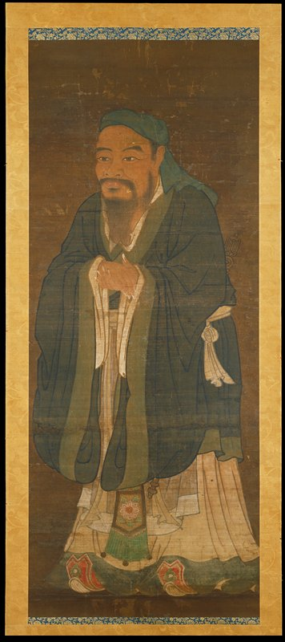
Religions of Eastern Origin
HINDUISM BUDDHISM CONFUCIANISM

Slide 10
Hinduism
Thought to be the world’s oldest religion
Approximately 1.2 billion followers worldwide
Believe that it is flawed to insist one’s path towards God is the only and true meaningful path
Leadership: Gurus, holy men, Brahmin priests
The trinity of Hindu gods: Brahma (creator), Vishnu (preserver) and Shiva (destroyer)
Avatars or extension of gods to address a situation that is out-of-balance to restore balance in universe
Reincarnation continual until the soul returns to Brahman (creation) – Transmigration based on Karma
Caste system – originally based on skills/abilities not birth – ensured continuity

Slide 11
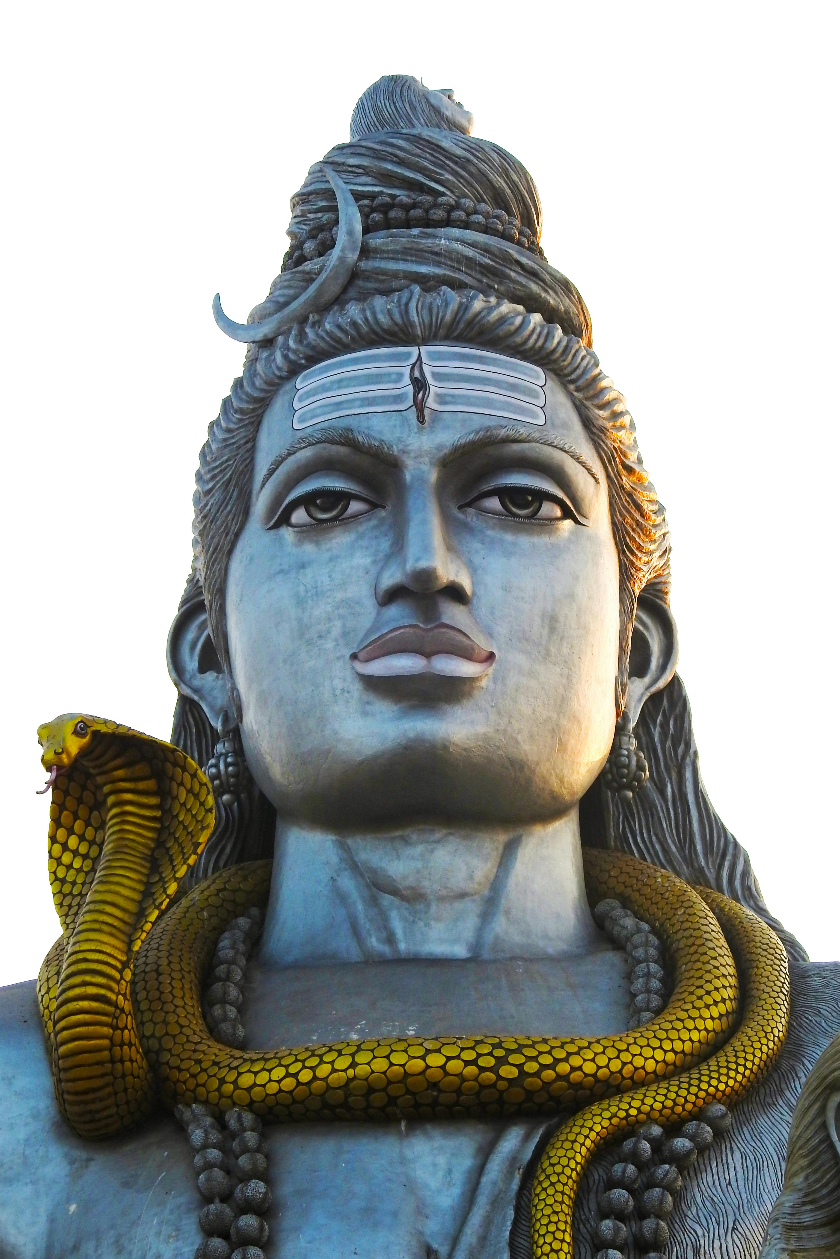
Hinduism
Core Books: Veda (songs), Yajuv (Sacred rites), Sama (songs of praise) and Athvarva (charms and curses)
Core Beliefs:
One universal soul (Brahman)
Immortal and individual soul (Atman)
Karma or action
Moksha (return to Brahman)
Vedas (sacred books)
Cyclical time (no beginning or ending)
Dharma (proper behavior or balance, each being has their own.

Slide 12
Buddhism
Originated on the Indian sub-continent during the 6th century BCE
Founded by “The Buddha” Prince Siddhartha Guatama
Rejects the belief in an omniscient, omnipotent, omnipresent creator.
No one book – sacred texts including the Dhammapada
Worship practices:
Meditation
The Eightfold Path; right view, right aspiration, right speech, right action, right livelihood, right effort, right mindfulness and right concentration
https://www.diffen.com/difference /Buddhism vs Confuscianism

Slide 13
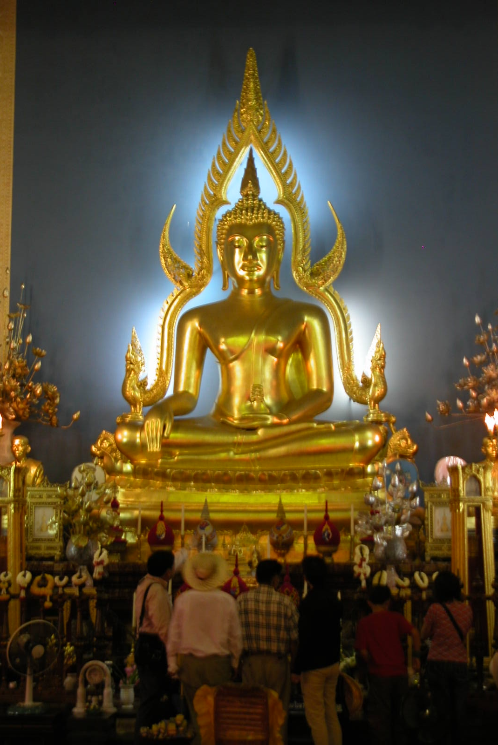
Buddhism
Rebirth is central. We are in an endless cycle of birth, death and re-birth. All are ignorant and suffer mentally. Goal is to achieve enlightenment.
Nirvana (is a transcendent state void of suffering desire, sense of self and the individual is released from the effects of Karma and the cycle of death.
Dharma means doctrine, law, way, teaching or discipline means all other doctrines are rejected.
Symbols: Aum (Om) first sound of creation; Bell promotes focus and release of worries: Bodhi leaf or tree represents tree where Bhudda achieved awakening; Enso or circle of life, Lion representing royalty, strength and bravery, Lotus Flower symbolizes Buddha’s awakening and the potential for all; Mala recitation beads; Pearl said to grant wishes and pacify desires; Swastika represents peace, good luck and positivity (one of the oldest symbols in the world): Vajra a ritual battle club symbolizing the properties of a diamond and thunderbolt (indestructible and irestible)

Slide 14
Confucianism
Over 6 million practitioners worldwide.
Founded by Confucius (born Kong Qiu) in China sixth century BCE.
No specific deity. However, many view Confucius as a god.
Confucianism is a structure for social order.
Originated on the Indian sub-continent.
Eternal life is not a focus, but ancestors and heritage is important.
Sacred text are the Analects of Confucius and Mencius.
Temples are visited to pay homage to Ti’en (social power).

Slide 15
Confucianism
Humanity is viewed through a need to respect those superior to them. Interestingly, women are considered socially inferior to men.
No designated clergy. Led by bureaucrats.
Many who are Confucians follow Bhudda.
Goal of the practice is to achieve social harmony.
Taoism, the impersonal and enigmatic process of transformation, key component.
Basic beliefs:
Social order, harmony and good government that is based on strong family relationships.
Respect for parents and elders.
Education is important both to the welfare of the individual and society

Slide 16
NEXt WEEK
WE WILL EXAMINE THOSE RELIGIONS THOUGHT TO BE ORIGINATING FROM ABRAHAM

Slide 17
Christianity vs world religions
Building Apologists for Christ
Week Three
ALL SAINTS ANGLICAN CHURCH, PEACHTREE CITY, GA

Slide 18
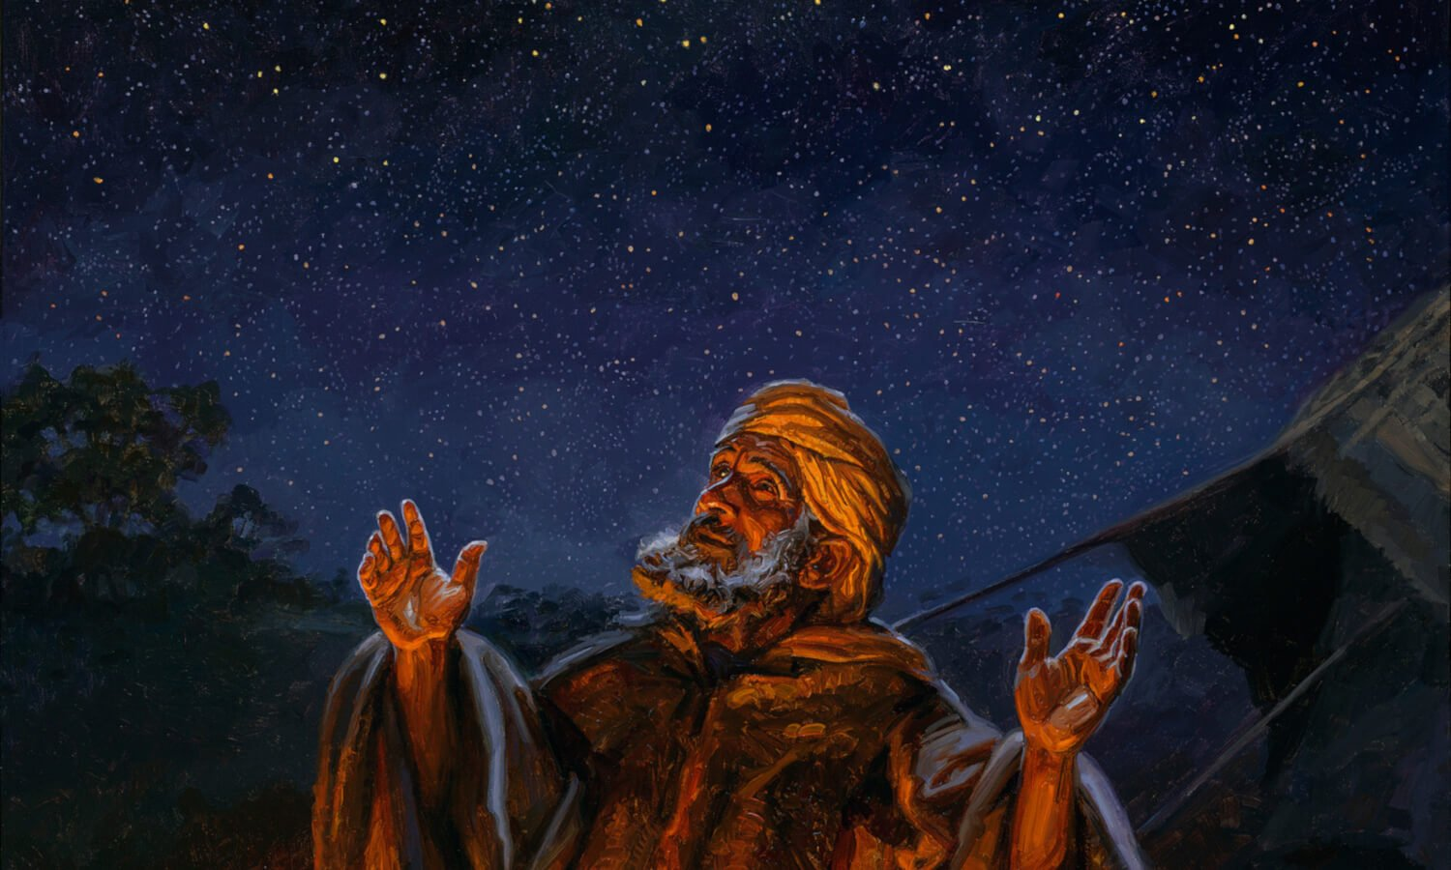
Abrahamic Religions

Slide 19
WHY ARE THEY CALLED THE “ABRAHAMIC” RELIGIONS
https://www.youtube.com/embed/1GQhGBsNHyc?feature=oembed

Slide 20
Overview
 | Christianity | Judaism | Islam
Adherents | 2 Billion | 14.5 Million | 1.2 Billion
Diety | Triune God (Father, Son and Holy Spirit) | God, Yahweh, Elohim, Adonai | Allah
Holy Book | The Bible | Hebrew Bible including the Torah | Qur’an, Hadith
Leadership | Bishops, Priests, Deacons | Rabbis | Imam and prayers Ulama
Founder | Jesus | Abraham | Muhammad
Heritage | Abraham (Romans 4:12) | Abraham | Abraham/Ishmael
Date of origin | 1 st Century CE (AD) | 1800 BCE | 6th Century BCE
Life After Death | Eternal Live in Heaven through grace/Jesus | Olam ha blah “Reserved place”. Can be lost due to sin | Paradise based on works but dependent of Allah

Slide 21
WHY IS BEING AN APOLOGIST FOR CHRIST SO IMPORTANT?
John 14:6
Jesus said to him, “I am the way, and the truth, and the life. No one comes to the Father except through me.

Slide 22
NEXt WEEK
WE WILL EXAMINE THE MORMONS, CHRISTIAN SCIENCE,
AND JEHOVAH WITNESSES RELIGIONS

Slide 23
Mormons (Church of the Later Day Saints, Christian Science and Jehovah Religions
Religions in America Presenting as Christian
Week Four

Slide 24
Mormonism, Is It Christian?

Slide 25
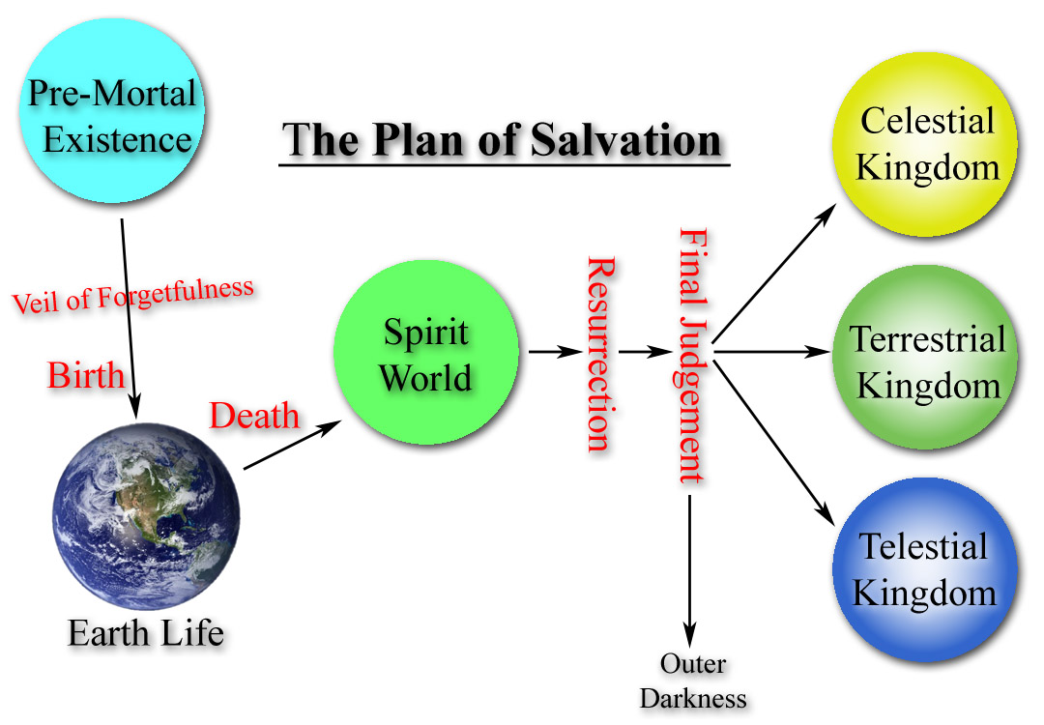
Understanding of Eternal Life in Mormon Teaching
As man is, God once was, and as God is, man may become. LDS teaching.
Fast Facts on False Teachings, Ron Carlson and Ed, Decker, Harvest House Publishers, 1994, p167

Slide 26
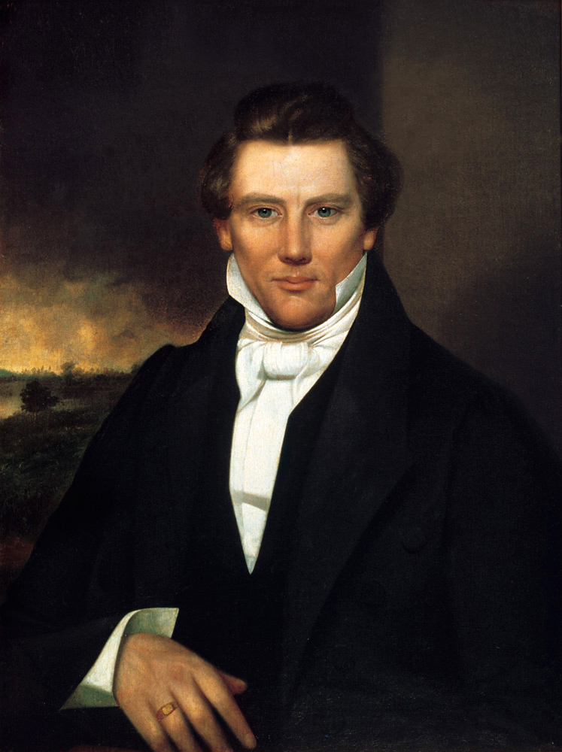
Mormon – Church of Later Day Saints
Founded in 1830 by Joseph Smith
17 million members worldwide
Membership is a closed culture, but missionaries are sent out
Jesus is was our elder brother who pointed the way, But Is Not The Way
Jesus suffered for our sins in the Garden of Gethsemane and general salvation was accomplished on the cross. Both provide path for our works which may lead to godhood.
Water is used in the place of wine in their sacrament in that it washes away the blood which denies grace.
God: 1) God the Father has a body of flesh and bones, 2) God evolved from mortal man, 3)polytheism (many gods), 4) Every Mormon male strives to become a god
Books: Bible, Book of Mormon, Doctrine and Covenants and Pearl of Great Price
Adherents are committed to a controlled program in search of exaltation and godhood, their own planet to rule
Fast Facts on False Teachings, Ron Carlson and Ed, Decker, Harvest House Publishers, 1994, p170-175

Slide 27
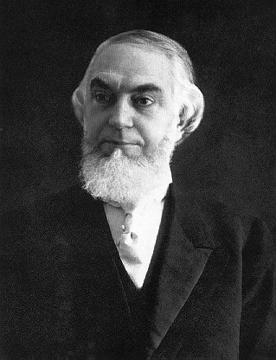
Jehovah Witnesses
Formed in 1879 in Pittsburgh by Charles T. Russell out of the Bible Study Movement
Referred to as Watchtower Bible & Tract Society
Governed by elders and assisted by ministerial servants
All baptized Witnesses are ordained ministers and share in preaching and teaching
Witnesses are organized into congregations of about 100 believers
Believe the destruction of the world system at Armageddon is imminent, and the establishment of God’s kingdom over earth is the only solution to all of humanity’s problems
Charles Taze Russell
www.jw.org

Slide 28
Jehovah Witnesses see the Watchtower Organizations As:
The Prophet of God.
God’s sole channel for His truth.
Rejection of the Organization is to reject God.
The Organization is the only one, not individuals, who can interpret the Bible.
Watchtower magazine contains God’s truth directed by Him.

Slide 29
Jehovah Witnesses Teachings:
Jesus is a created being.
Jesus is actually, Michael the Archangel.
Jesus was not resurrected bodily – but as a spirit being.
Jesus returned invisibly in 1974 to the Organization only.
Jesus was only a man on earth.
The Holy Spirit is only an active force.
Hell is the grave.
Heaven is available only to 144,000 Witnesses.
Majority of Witnesses must remain on earth.
Salvation is only found through the Organization and can only be maintained by energetic works.
Satan is the author of the doctrine of the trinity.
Jesus cannot be worshipped, but only honored as Jehovah’s first creation.
Those baptized who leave the Organization are shunned.
Fast Facts on False Teachings, Ron Carlson and Ed, Decker, Harvest House Publishers, 1994, p121-122

Slide 30
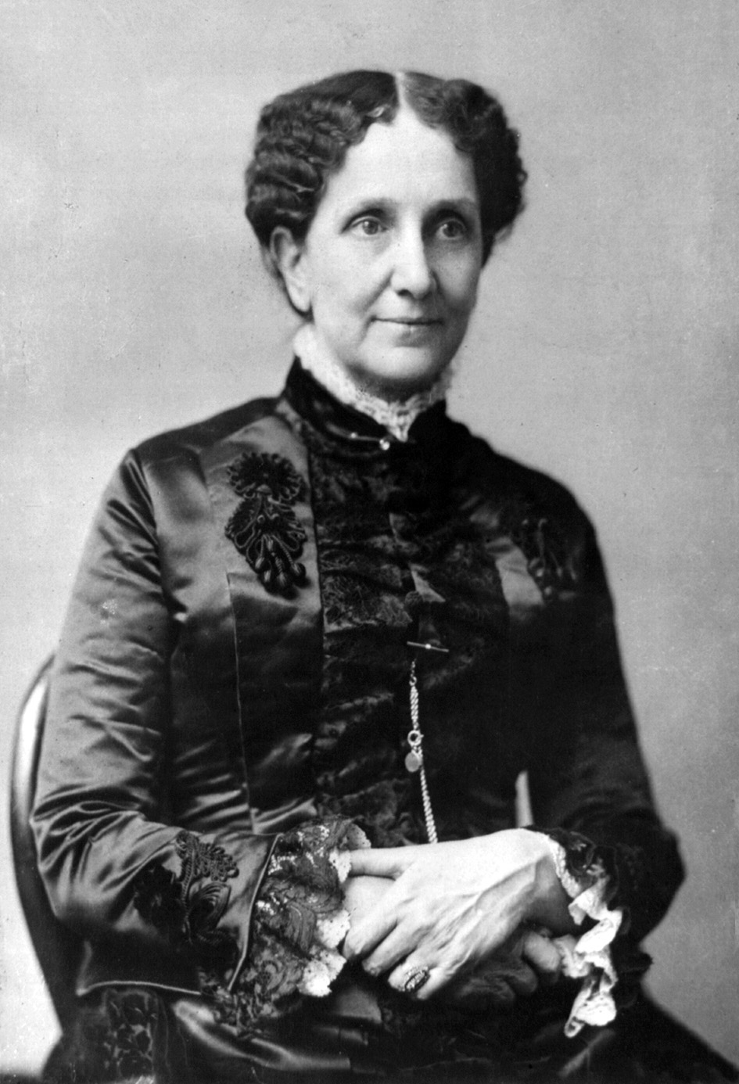
Christian Science
Founded in 1879 in Massachusetts by Mary Baker Eddy
Membership has declined to under 50,000 by 2009
Central texts are: Bible and Science and Health with Key to the Scriptures, written by Eddy – This is the ”Pastor over the Mother Church”
Described as a return to “primitive Christianity and its lost elements of healing.”
Based on a belief that reality is purely spiritual and the material world an illusion.
Disease is a mental error rather than a physical disorder.
Sick should be treated by a form of prayer that seeks correct beliefs responsible for the illusion of ill health.
Mary Baker Eddy
https://www.christianscience.com/what-is-Christian-science/beliefs-and-teachings

Slide 31
Tenets of Christian Science
As adherents of Truth, we take the inspired Word of the Bible as our sufficient guide to eternal Life.
We acknowledge and adore one supreme and infinite God. We acknowledge His Son, one Christ; the Holy Ghost or divine Comforter; and man in God's image and likeness.
We acknowledge God's forgiveness of sin in the destruction of sin and the spiritual understanding that casts out evil as unreal. But the belief in sin is punished so long as the belief lasts.
We acknowledge Jesus' atonement as the evidence of divine, efficacious Love, unfolding man's unity with God through Christ Jesus the Way-shower; and we acknowledge that man is saved through Christ, through Truth, Life, and Love as demonstrated by the Galilean Prophet in healing the sick and overcoming sin and death.
We acknowledge that the crucifixion of Jesus and his resurrection served to uplift faith to understand eternal Life, even the allness of Soul, Spirit, and the nothingness of matter.
And we solemnly promise to watch, and pray for that Mind to be in us which was also in Christ Jesus; to do unto others as we would have them do unto us; and to be merciful, just, and pure.
https://www.christianscience.com/what-is-Christian-science/beliefs-and-teachings

Slide 32
REMEMBER OUR OBJECTIVES:
BETTER UNDERSTAND OUR FAITH, CHRISTIANITY, AS COMPARED TO OTHER MAJOR RELIGIONS
AND
EQUIP APOLOGISTS FOR CHRIST
And he said to him, “You shall love the Lord your God with all your heart and with all your soul and with all your mind.This is the great and first commandment. And a second is like it: You shall love your neighbor as yourself. Matthew 22:37-39

