Slide 1

Finishing Well 2025
“…I have fought the good fight, I have finished the race , I have kept the faith.”

Slide 2

Session One – We are but mortal…….
“…I have fought the good fight, I have finished the race , I have kept the faith.”

Slide 3
Finishing Well 2025
Preface
The Book of Common Prayer has always admonished Christians to be mindful of their mortality. It is therefore the duty of all Christians, as faithful stewards, to draw up a Last Will and Testament, making provision for the well-being of their families and not neglecting to leave bequests for the mission of the Church.
In addition, it is important while in health to provide direction for one’s own funeral arrangements, place of burial and the Scripture readings and hymns of the burial liturgy, and to make them known to the priest.
2019 Book of Common Prayer, p.246

Slide 4
Scripture Speaks to Our Mortality……
We all have a life that is measured in years, days, hours……
But even the hairs of your head are all numbered. Matthew 10:30
We do not know when we will be called home………
But know this, that if the master of the house had known in what part of the night the thief was coming, he would have stayed awake and would not have let his house be broken into. Matthew 24:23
We are reminded to be ready………………
Therefore you also must be ready for the Son of Man is coming at an hour you do not expect Matthew 24:44

Slide 5
Don’t let anxiety around the subject keep you from Finishing Well
Anticipatory grief is the “beginning of the end” in our minds. We now operate in two worlds; the safe world that we are used to and the unsafe world where a loved one might die. We feel that sadness and the unconscious need to prepare our psyche.
Anticipatory grief is generally more silent than grief after a loss. We are often not as verbal. It’s a grief we keep to ourselves. We want little active intervention. There is little or no needs for words, it is much more of a feeling that can be comforted by the touch of a hand or a silently sitting together. Most of the time in grief we are focused on the loss in the past, but in anticipatory grief we occupy ourselves with the loss ahead.
www.grief.com

Slide 6

Well, I live this life
Until this life won’t let me live here anymore.
Then I will walk, yes I will walk
With patience through that open door.
I have no fears…….
Live this Life, John Rich and Big Kenny

Slide 7
We are called to live our life and Finish Well……
We are people who have hope …..John 3:16
This is a time of preparation……
Spiritual Examination
Health Examination
Legal Affairs
Funeral Plans
Comfort and Faithfulness

Slide 8

Running the laps in the medical arena
Prepare
Communicate
Manage Expectations
We are people who have hope …..John 3:16
This is a time of preparation……

Slide 9

Be Prepared
Have a list of all current medications to include drug, dosage and frequency
List of contacts if necessary
Have a current Advance Directives (Included in handout)
Be ready to articulate accurate information about present complaints, past illnesses, hospitalizations, medical matters relating to one’s health
Assertively ask questions when unclear about your healthcare or expectations of you in regard to treatment
Set pride aside and assume the responsibility for following the treatment plan
Know the patient’s rights (Included in handout)
Communication is key – listen closely or have someone with you to listen
Do not self-diagnose based on Google

Slide 10
As a patient, you have the right to:
Timely access to medical care.
Be treated with dignity and respect by each MED Health Unit staff member.
Medical care that is free from discrimination on the basis of age, sex*, race, ethnicity, national origin, language, disease, disability, or religion.
Easy-to-understand information about your diagnosis and treatment options from your MED medical service provider.
Ask your MED medical service provider questions so that you can make informed decisions about your health.
Request the professional qualifications of the primary MED medical service provider rendering care.
Communicate confidentially with your MED medical service provider.
Privacy and confidentiality as outlined in the Notice of Privacy Practices (available at your Health Unit).
Know the Rules!

Slide 11
As a patient, you have the right to:
Withdraw your consent, delay, or otherwise refuse examination, intervention, or treatment.
• Continuity of care – if for any reason you decide to seek care elsewhere, your MED medical service provider will work to coordinate your care in accordance with your wishes.
• Review and request amendments to your medical records.
• Provide confidential feedback about any matter that occurs in MED Health Units by available means, including the MED Feedback Survey, accessible at www.bit.ly/MEDFeedbackSurvey
Know the Rules!

Slide 12
How the Rules Apply to You?
As a patient, you have a responsibility to:
Conduct all your interactions with MED Health Unit staff members, other patients, and visitors in a respectful and polite manner. Verbal or physical intimidation, violence, or the threat of violence towards anyone will not be tolerated and will be reported to the appropriate authorities.
Be honest and forthcoming with your MED medical service provider about the symptoms you are experiencing.
Provide as complete a medical history as you can, which includes details and information about past illnesses, medications, hospitalizations, and other matters related to current health.
Cooperate with agreed-upon treatment plans.
Coordinate routine medical care and delivery of needed medications if you accept an assignment at a post where such care or medication may not be available.
Fulfill financial responsibilities that are incurred when seeking medical care on the local economy.
Understand that the Health Unit operates in a manner intended to protect patient safety, safeguard confidentiality, and reduce the risk of medical errors. Health Units adhere to established business hours, observe standard operating procedures, and provide care consistent with health unit capabilities and available resources.
https://www.state.gov/patient-bill-of-rights-and-responsibilities/

Slide 13

Communication Is Important In All Arenas
As An Outpatient:
1. Make certain your physician is board certified in the relevant medical specialty.
2. If the doctor is good but staff is underperforming – you may want to find a new doctor.
3. Always try to establish a good rapport with the clinician.
4. With permission, consider audio recording your visit to the office.
5. Be descriptive and precise with your problems and anticipate follow-up questions.
6. For new medications, try to find projected cost before obtaining the prescription.
7. If you work daily, start the new drug over the weekend when you are off.
8. If you have a complex medical issue, consider getting a second opinion.
9. When you see multiple specialist, make sure your records are sent to primary physician.

Slide 14

Communication Is Important In All Arenas
Emergency:
1.If you have not done so, make sure you have completed advance directive.
2. Be patient, unless it is truly an emergency, expect to burn half a day in a busy ER for urgent matters.
3. Understand the ER physician’s main job is triage-treat and release versus admission versus transfer.

Slide 15

Communication Is Important In All Arenas
Inpatient:
1.Be patient but assertive – welcome to the bureaucracy known as hospital medicine. The physicians who do inpatient medicine are called hospitalists. Hospitalist will see you once per day unless it is an emergency. You will not see your regular physician.
2. Your most frequent interactions will be with nursing.
3. You will see the doctors when they make rounds, which is once daily.
4. If something is confusing or doesn’t make sense, speak up.
5. When it comes to deciding on a plan or course of action, make sure the treating team lays out the proposed plan and the alternatives.

Slide 16
Communication Is Important In All Arenas
Interventions:
1.Invasive procedures, no matter how routine, can lead to serious injury or death.
2. Communicate in advance your wishes by way of Advance Directives:
Part One: Health Care Agent – Someone to make health care decisions for you
Part Two: Treatment Preferences
Part Three: Guardianship - This part allows you to nominate a person to be your guardian should one ever be needed.
Part Four: Effectiveness and Signatures

Slide 17
Communication Is Important In All Arenas
End of Life Discussions:
End of life discussions are usually a difficult one for Physicians
Now mandated by insurance companies to be discussed and documented
End of life discussion should start in out-patient setting
Code status

Slide 18
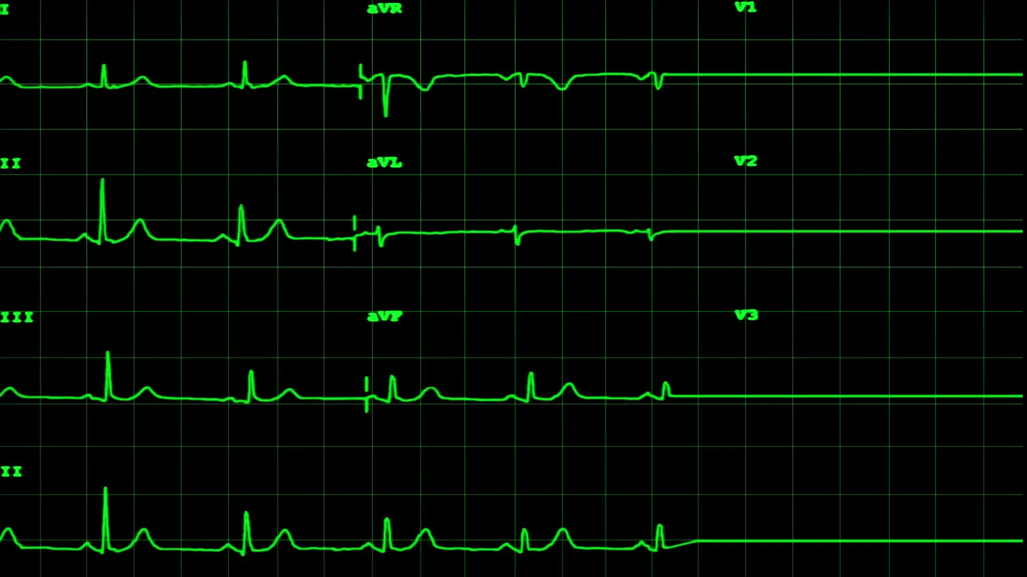
Full Code Status
Full Code: Full and complete cardiopulmonary resuscitation efforts will be performed in the setting of cardiac/pulmonary arrest
ACLS (Advanced Cardiovascular life support)
CPR (Cardio Pulmonary Resuscitation)
Connect to monitor/defibrillator and determine rhythm
Shockable (VF/VT) vs non shockable (Asystole/PEA) rhythms
Epinephrine or vasopressin/Amiodarone/atropine
Post resuscitation care

Slide 19

DNAR (Code)
Withhold those measures used to attempt to restore or support cardiac or pulmonary function in the event of a cardiac or respiratory arrest.
The order ONLY applies in the setting of Cardiac or Respiratory Arrest.
Patient can still be intubated in the setting of Respiratory Distress

Slide 20

DNAR/DNI (Code)
Withhold those measures used to attempt to restore or support Cardiac or Pulmonary function in the event of a Cardiac or Respiratory Arrest
Also, forgo intubation in circumstances other than Cardiac or Respiratory arrest such as during instances of moderate to severe Respiratory distress

Slide 21
Legal Hiearchy for Decision Makers for Code Discussion
Patient/Self
Healthcare agent per Advance Directive
Spouse
Court appointed guardian
Adult Child(ren)
Parent(s)
Adult Sibling(s)
Ethics Recommendation
Without one of the authorized decision makers listed, code status cannot be changed to DNAR or DNI/DNAR

Slide 22

Code Status
Conclusion
Discuss your wishes with family members.
Make your wishes known to your Primary care physician
Include your wishes in your living will and make updates as needed.

Slide 23
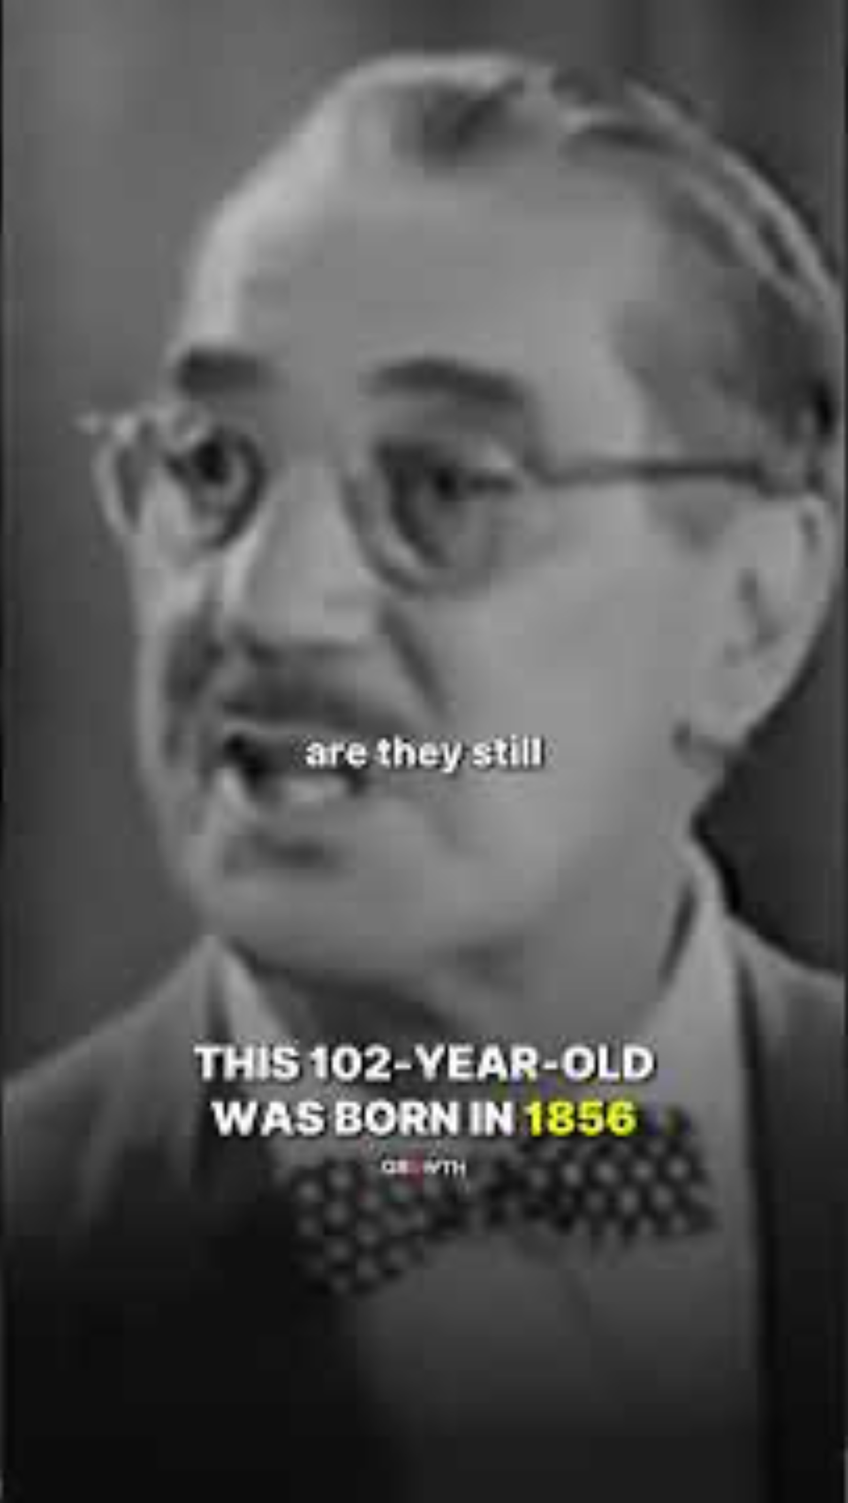

“…I have fought the good fight, I have finished the race , I have kept the faith.”

Slide 24
Jousting In The Legal Issues in a Litigious World
Hospice and Alternate Residency
Last Wills and Testaments
Review of Advance Directives

Slide 25

Care for All – Hospice – The Caring Alternative
The primary goals of hospice care are to: Relieve the physical, mental, emotional and spiritual suffering of our patients and those who care for them. Promote the dignity and independence of our patients to the greatest extent possible.

Slide 26
Hospice Care – Key Facts
The primary goals of hospice care are to: Relieve the physical, mental, emotional and spiritual suffering of our patients and those who care for them. Promote the dignity and independence of our patients to the greatest extent possible.
Hospice is for people who have a limited life expectancy.
Hospice care can begin when a doctor decides the patient's life expectancy is six months or less if the illness follows its usual path. The doctor can recertify the patient for longer periods if your loved one lives beyond six months.

Slide 27

Hospice Care – Key Facts
The hospice team includes medical professionals ranging from doctors to registered nurses, hospice aides, dieticians, and physical therapists. A medical diagnosis is always required before starting hospice care and a patient's own doctor can attend them while they are under hospice care.
Hospice doesn't include the placement of feeding tubes, or any other steps taken to prolong life at this stage of care. However, patients who already have a feeding tube in place may benefit from hospice services. ... Sometimes, very close to the end of life, patients may choose to have feeding tubes removed
Hospices Must Provide Medications for Related Conditions This means that the hospice must supply medications to relieve the symptoms related to the terminal illness. However, the hospice does not have to pay for medications which are unrelated to the terminal illness. A hospice will not pay for such medications.

Slide 28
Hospice Care – Key Facts
Hospice is not about giving up; it's about living in comfort and dignity for the time one has left. Hospice does not make death come sooner. ... There are no studies that indicate that hospice can hasten death, but there have been studies showing that some patients live longer when receiving hospice services.
There is no homebound rule for hospice patients. They are encouraged to travel outside the home as much as they are able. If you have an emergency unrelated to the hospice terminal diagnosis, you will have regular medical benefits for hospitalizations.
For the first benefit period after election of the Medicare hospice benefit, the certification must be signed and dated by the:
Medical director of the hospice or the physician member of the hospice interdisciplinary group (IDG); and.
The beneficiary's attending physician (if they have one).

Slide 29
Hospice Care – Key Facts
In addition to pain and symptom management, hospice care benefits include a variety of support services for patients and their families: education, emotional and spiritual support, help with financial issues, help with the patient's personal care and hygiene, and respite care to give a family caregiver
Restated: The primary goals of hospice care are to: Relieve the physical, mental, emotional and spiritual suffering of our patients and those who care for them. Promote the dignity and independence of our patients to the greatest extent possible.

Slide 30

Jousting In The Legal Issues in a Litigious World
And you shall love the Lord your God with all your heart and with all your soul and with all your mind and with all your strength.’ The second is this: ‘You shall love your neighbor as yourself.’ There is no other commandment greater than these.” Mark 12:30-31
Estate:
1) Living Will (Advanced Directives)
2) Last Will and Testament
3)Power of Attorney and/or Financial Power of Attorney

Slide 31
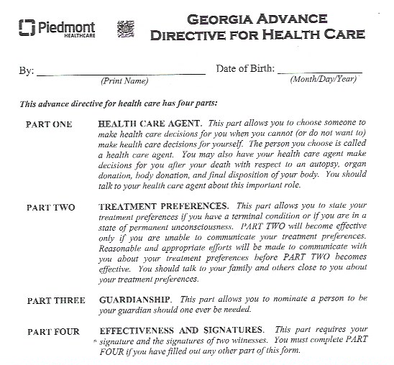
Advance Directives
Also known as a ”Living Will” this is part one of caring for your personal estate.
An accompanying document that would be helpful in the event of extended illness is extending a “financial power of attorney” as someone who may access your assets on your behalf for financial reasons such as payment of debts, etc.
A complete form is available in the class packet

Slide 32
Basics of a ”Will”
“Will” is a short for “Last Will and Testament.”
It is one of the principal documents of an estate plan.
In a will your wishes are specified regarding property and minor children should you pass away.
It is the document in which you name an “Executor” who is in charge of settling your affairs.
Do You Need a Will
Yes, it is important for all adults, single or married and regardless of assets.
Saves loved ones from uncertainty and disputes about what you would have wanted done.
Extremely important in the event of minor children where guardianship is a possibility.

Slide 33
Legal Requirements of a Will
Although it varies by state, a testator must be of legal age (usually 18).
The testator must be of “sound mind” at the time the will is written (means having an understanding of one’s actions).
A will is not valid it created through “undue influence” or if the testator is under “duress.”
A will must be properly signed. If not the entire will is invalid.
Two witnesses are required to sign in the presence of the testator thereby authenticating it is the will of the testator.

Slide 34
Do I Need An Attorney?
No. However, it is advisable and very helpful particularly if:
You have children with special needs and you wish to set up a trust or another instrument to ensure their care.
You have a concern about Federal estate taxes.
You have a complex property distribution.
Your will should be reviewed frequently and changed to be compatible with the law of the state in which you reside, changes in beneficiaries, executors and guardians or minor children. It is important to note that property follows the state where it is located.

Slide 35
Self Proving Affidavit
Separate document form the actual will.
It is best practice for a will to include a ”self proving affidavit” in which the testator and witnesses swear before a notary public (or other officer of the court) that the will was signed by the testator and the witnesses.
This is submitted to the probate court and eliminates the need for the witnesses to appear in court to testify as to the validity of the will.

Slide 36

How a ”Will” Works
The heart of a will is the “Property Distribution” section where the “Testator” (person making the will) states who should receive his/her property upon their death.
Generally you can leave your property to anyone or in any manner you like with one exception.
Exception: If there is a surviving spouse, depending on the state law, they are entitled to a portion of your assets designated by the specification of state law.

Slide 37
Back Up Beneficiaries
Most will name backups who receive property ONLY if a primary beneficiary is not alive at the time of the testator’s death.
Residuary Clause
Comprehensive wills include a “catch all” provision for any property not specifically mentioned in the will

Slide 38
Executor(s) and Guardians
Extremely important and to be discussed in advance to determine willingness to execute the required action.
Are they:
Trustworthy
Organized
Nothing to be gained by serving
Will they have the free time to manage the process of probate or guardianship
Failure to choose an executor or guardian means the court will choose one based on the state law.

Slide 39
Executor(s)
Upon your death, even if there is a last will and testament, property isn’t automatically transferred to new owners and debts will not be automatically paid.
Executors are personal representatives of the estate.
Works with the probate court to gather and inventory estate assets, settle estate debts and distribute assets.
Probate process is a legal process that takes place in a probate court in the county in which the deceased lived.
Executor works with the probate court during the process, including carrying out the terms of testator’s will.
It is IMPORTANT to include in the will a waiver of the bond for the executor, a waiver of the inventory and a waiver of the annual return to keep the involvement of the executor with the probate court to a minimum.
The entire process is done under the supervision of the probate court and settles the financial and other obligations of the the decease and distributes property.

Slide 40
Guardians
Responsible for caring for a minor child if no parent is alive or able to do so. There are two types.
Personal Guardian: Cares for and has custody of the minor child personally.
Property Guardian: In charge of any property left to the minor child until the child becomes an adult or other conditions are met.
They can be done by a single person or a guardian for each need.
Strong wills specifies both and back ups.

Slide 41

Dying Without A Will
The government basically decides everything for you through a process called “Administration.”
The state in which the property is located designates who will receive your property.
A court through will determine who will care for minor children.

Slide 42

Finishing Well Celebrating Life

Slide 43
Celebration of Life
For none of us lives to himself, and none of us dies to himself. For if we live, we live to the Lord, and if we die, we die to the Lord. So then, whether we live or whether we die, we are the Lord’s. Romans 14:7-9
Therefore you also must be ready, for the Son of Man is coming at an hour you do not expect. Matthew 24:44
The Key to Finishing Well is as in Living Well: Faithfulness, Preparation and Communication

Slide 44
Death of a Loved One
If the death occurs at home: Call 911 or the hospice organization for pronouncement.
If the death occurs in the hospital the staff will notify the authorities and if you have given them the funeral home’s name they will contact them as well.
Registration of the death: medical certificate
Notifying Family and Friends: Designate someone to do that for you.
Notify Church Family and access plan documents on file.

Slide 45
If There Are No Prearrangements Loved Ones Must Choose:*
Should the deceased be embalmed?
Do I need to purchase a casket?
Will I care for loved one’s physical remains through burial or cremation?
What sort of funeral or memorial service should I plan?
Are there any religious traditions or customs I need to plan for? Should I engage the services of a clergy member?
Planning now can take the burden from your loved ones.
Source: Mowell Funeral Home and Cremation services “When Death Occurs”

Slide 46
Plan or Prepay for Funeral Services While You Are Alive:
Ensures you will be given the care and service you wanted.
Number of death certificates
Accessibility of military documents
Takes the opportunity for anxiety and discord out of the planning discussions.

Slide 47
Plan Your Burial While You Are Living:
Loving and caring thing to do for those you love.
ASAC has a form to pre-plan your burial. We will retain on file.
Designate and communicate your needs to all who should know.
Order of service can be found on page 249 of the 2019 BCP and on page 324 of the 1928 BCP. (2019 BCP in handout)
Key is choosing the scripture that is meaningful to you and the hymns that speak to your spirit and journey with the Lord.
Choose meaningful sacred hymns
Holy Communion is encouraged.
Determine how memorials should be designated.

Slide 48
Finishing Well When everyone goes home……
Be gracious to me, O Lord, for I am languishing; heal me, O Lord, for my bones are troubled. My soul also is greatly troubled. But you, O Lord—how long?
Psalm 6:2-3
Grief becomes a constant companion for many……

Slide 49

A Perspective on Grief

Slide 50

THE SIX STAGES OF GRIEF: *Shelley Klammer@ShelleyKlammer.com
1. NUMBNESS AND DENIAL
To initially cope with loss it is common to go in a state of shock and denial. Denial helps you to pace your feelings of grief but it also makes you feel numb, hard and frozen. As you proceed through the grieving process, all the feelings you have been denying about your loss will eventually need to surface.
2. ANXIETY AND PANIC *
When you feel anxiety, deeper feelings about your loss will be piercing through your denial. Anxiety and panic will chip away at your emotional numbness, hardness or frozenness to indicate that you need to go into the deeper stages of grief so that it can be resolved.
3. BARGAINING AND CONTROL
The normal reaction to feelings of helplessness and vulnerability is to try to regain control through a series of “If only” statements. This is an attempt to bargain. Guilt often accompanies bargaining. You might believe there was something you could have done differently to avoid your loss. You might become lost in a maze of “If only…” or “What if…” statements.

Slide 51
4. FRUSTRATION AND ANGER
Intense emotion deflected from your vulnerable core most often gets redirected and expressed as anger. After bargaining and your attempts to control do not work, you will likely get frustrated and you will have to face your loss at a deeper level.
You might resent a person for causing you pain or for leaving you. Your anger and frustration might be aimed at inanimate objects, complete strangers, friends or family. Anger, most especially, might be directed toward the person you have lost.
5. DEPRESSION AND DESPAIR
After bargaining and attempts to control, grief enters into a much deeper level. You might want to withdraw from life for a time to truly process what you have lost. You might feel intense heartbreak and sadness. You might wonder despairingly if there is any point in going on. When a loss fully settles into your being there will be a deep realization that your life will not continue on as it as before.
6. ACCEPTANCE AND PEACE
Eventually, you will learn to live with your loss. You must now live in a world where your loved one is missing. You might need to give up your hope that your emotional needs from the past will be met. Or you might need to accept that your cherished dreams for your future will not come to fruition.

Slide 52
Finishing Well
The 3 “N’s of Grief:
Normal
Natural
Necessary
Give yourself permission to grieve!
Source: Kenneth C. Haugk, A Time to Grieve, Book One, (Stephen Ministries St. Louis, 2004) 3-4

Slide 53
Emotions Experienced in Grief:
Shock
Question of sanity – Am I going crazy?
Pressure to be strong
Your own grief – Your loss is unique to you, and you will grieve in the manner in which you need.

Slide 54

Finish Well with Him……………….
He heals the brokenhearted and binds up their wounds.
Psalm 147:3

Slide 55
Take Care of Yourself:
Emotional Needs – don’t deflect or deny in favor of other responsibilities
Physical Needs – Pay attention to your body
Acknowledge the Possibility of the “Fog” of Grief – a sort of “going through the motions existence”
Do not dwell on shortcomings, You Did the Best You Could.
Source: Haugk, 24-30

Slide 56
Myths About Grief:
People with strong faith don’t grieve
A strong person should be able to cope during a loss without showing emotion
You should be back to normal after two or three months
Expressing strong feelings is losing control of yourself
Crying is a sign of weakness, men don’t cry
Grief gets easier as you grow older
Getting angry at God or asking God difficult questions means you have a weak faith
Loved for lost can be measured by the depth of grief
Losing an infant doesn’t hurt because parents didn’t have time to know the child
Resolving grief means dismissing loved ones from your mind and moving on with your life
A strong person should be able to deal with grief alone

Slide 57
Myths About Grief
Christians shouldn’t grieve if they know their loved one is in heaven. They should feel joy.
It’s better to deal with grief on an intellectual manner than emotionally
Only immediate family members will experience significant grief
Continuing to talk about the person who died only makes the pain last longer
Grief proceeds through very predictable and orderly stages
After a loved one has died you can never be happy again
Source: Haugk, 31-33

Slide 58
Find Coping Methods That Work for You
Music
Artwork
Meditation, prayer and Scripture
Write letters
Exercise
Scream
Read
Talk

Slide 59
If God Seems Far Away
Be yourself with God
Be honest with God
Don’t mistake feeling abandoned by God for being abandoned by God
God is there grieving and suffering with you
What God does is not always immediately evident to human eyes.
Rev. John Claypool, “Tracks of a Fellow Struggler” source: Haugk, 38-41

Slide 60
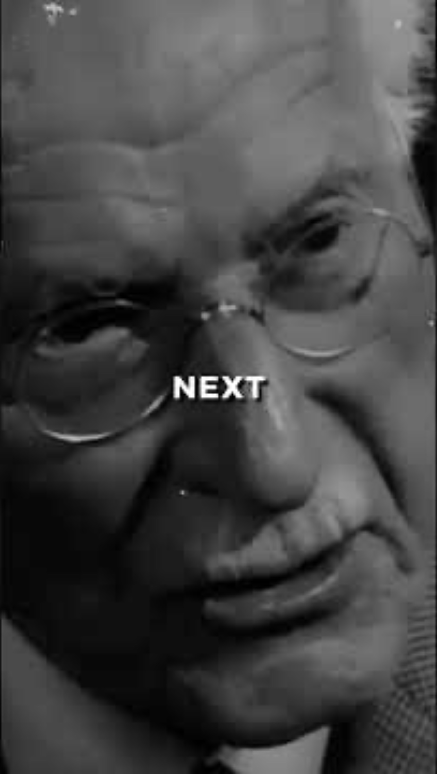
Live the Life God Has Given You….
You make known to me the path of life; in your presence there is fullness of joy; at your right hand are pleasures forevermore.
Psalm 16:11

Slide 61
Finishing Well 2025
“…I have fought the good fight, I have finished the race , I have kept the faith.”

