Slide 1
Discipleship: An Introduction to Systematic Theology and Apologetics
The Doctrines of Redemption: The Jewish Holidays
The Heights Church September 24, 2017

Slide 2
The Old Testament Sacrificial System – Major Jewish Holidays Booths also known as Tabernacles (Leviticus 23:33-43)
And the LORD spoke to Moses, saying, "Speak to the people of Israel, saying, On the fifteenth day of this seventh month and for seven days is the Feast of Booths to the LORD. On the first day shall be a holy convocation; you shall not do any ordinary work. For seven days you shall present food offerings to the LORD. On the eighth day you shall hold a holy convocation and present a food offering to the LORD. It is a solemn assembly; you shall not do any ordinary work "These are the appointed feasts of the LORD, which you shall proclaim as times of holy convocation, for presenting to the LORD food offerings, burnt offerings and grain offerings, sacrifices and drink offerings, each on its proper day, besides the LORD's Sabbaths and besides your gifts and besides all your vow offerings and besides all your freewill offerings, which you give to the LORD On the fifteenth day of the seventh month, when you have gathered in the produce of the land, you shall celebrate the feast of the LORD seven days. On the first day shall be a solemn rest, and on the eighth day shall be a solemn rest.

Slide 3
The Old Testament Sacrificial System – Major Jewish Holidays Booths also known as Tabernacles (Leviticus 23:33-43)
And you shall take on the first day the fruit of splendid trees, branches of palm trees and boughs of leafy trees and willows of the brook, and you shall rejoice before the LORD your God seven days. You shall celebrate it as a feast to the LORD for seven days in the year. It is a statute forever throughout your generations; you shall celebrate it in the seventh month. You shall dwell in booths for seven days. All native Israelites shall dwell in booths, that your generations may know that I made the people of Israel dwell in booths when I brought them out of the land of Egypt: I am the LORD your God.“

Slide 4
The Old Testament Sacrificial System – Major Jewish Holidays Booths also known as Tabernacles
The Hebrew word for booths (sukkot) originally meant woven.
Tabernacles comes a transliteration of the Latin tabernacula from the Vulgate. It alludes to temporary. Non-Jews often refer to the holiday as Tabernacles instead of Booths
It was also referred to as the “Feast of Ingathering” The Feast of Booths, The Feast of the Lord or simply the Feast. It was a joyous time to celebrate the harvest.
It marked the end of the agricultural year and changing of the seasons just prior to the beginning of a rainy season.
Though not conclusive, many believe Solomon dedicated the Temple during Booths.

Slide 5
The Old Testament Sacrificial System – Major Jewish Holidays Booths also known as Tabernacles
At the time of Jesus more animals were sacrificed during the week of Booths than any week of the year.
Doing the math from Numbers 29 the numbers for the seven days are:
70 bulls
14 rams
98 lambs
Notice all these are divisible by 7 (the number of completeness/perfection) in the 7th month.
Grain and drink offerings would have also been required with these amounting to about 20 bushels of grain and 44 gallons of wine for the week.

Slide 6
The Old Testament Sacrificial System – Major Jewish Holidays Booths also known as Tabernacles
At the time of Jesus the celebration of Booths drew more people to Jerusalem than any other holiday. Thus it was a perfect time for Jesus to preach to the people.
A key feature of the celebration was the water drawing ceremony that was a fairly recent rabbinic addition.
Accompanied by flutists and worshipers a Levitical Priest descended to the Pool of Siloam and filled a golden pitcher with water. He then returned with the throng through the Water Gate to the Temple to the sound of shofars and trumpets.
There were two silver bowls on the SW side of the alter. One contained the wine of the drink offering and into the other the Priest poured the water from the Pool of Siloam to the chanting of Psalm 118:25.

Slide 7
The Old Testament Sacrificial System – Major Jewish Holidays Booths also known as Tabernacles
24 This is the day that the LORD has made; let us rejoice and be glad in it.
25 Save us, we pray, O LORD! O LORD, we pray, give us success!
26 Blessed is he who comes in the name of the LORD! We bless you from the house of the LORD.
As soon as the Priest poured the water the crowd would shout, “Raise thy hand. Raise thy hand.” This was to assure the water had been poured into the bowl. According to tradition in about 95 B.C. Alexander Jannaeus (Maccabean priest king) poured the water on the ground. The crowd pelted him with fruit and the incident escalated into a riot resulting in the massacre of about 6000 Jews.

Slide 8
The Old Testament Sacrificial System – Major Jewish Holidays Booths also known as Tabernacles
According to rabbinical understanding the meaning of the water ceremony was much deeper than merely an agricultural metaphor for the rain was symbolic of the Holy Spirit.
It pointed to Joel 2:28 "And it shall come to pass afterward, that I will pour out my Spirit on all flesh; your sons and your daughters shall prophesy, your old men shall dream dreams, and your young men shall see visions.
It pointed to Isaiah 12:3
2"Behold, God is my salvation; I will trust, and will not be afraid; for the LORD GOD is my strength and my song, and he has become my salvation."
3 With joy you will draw water from the wells of salvation.
4 And you will say in that day: "Give thanks to the LORD, call upon his name, make known his deeds among the peoples, proclaim that his name is exalted.

Slide 9
The Old Testament Sacrificial System – Major Jewish Holidays Booths also known as Tabernacles
It is against this backdrop that Jesus appears on the 7th day of the feast in John 7:37-43
On the last day of the feast, the great day, Jesus stood up and cried out, "If anyone thirsts, let him come to me and drink. Whoever believes in me, as the Scripture has said, Out of his heart will flow rivers of living water." Now this he said about the Spirit, whom those who believed in him were to receive, for as yet the Spirit had not been given, because Jesus was not yet glorified. When they heard these words, some of the people said, "This really is the Prophet." Others said, "This is the Christ." But some said, "Is the Christ to come from Galilee? Has not the Scripture said that the Christ comes from the offspring of David, and comes from Bethlehem, the village where David was?" So there was a division among the people over him.

Slide 10
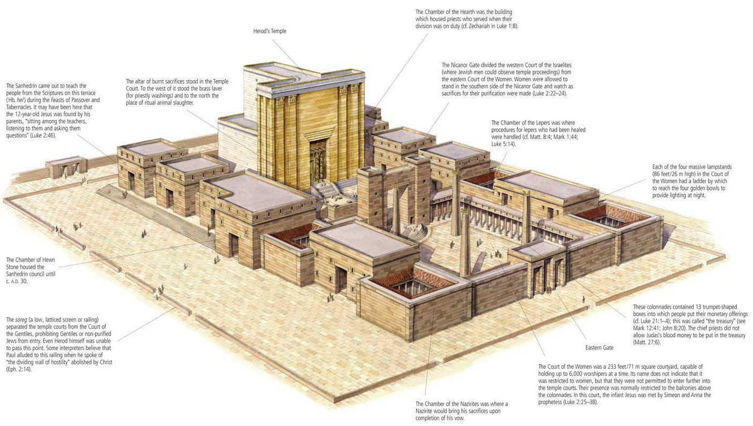
The Old Testament Sacrificial System – Major Jewish Holidays Booths also known as Tabernacles
Another traditional ceremony at Booths was the Illumination of the Temple.

Slide 11
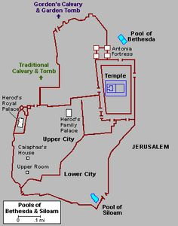
The Old Testament Sacrificial System – Major Jewish Holidays Booths also known as Tabernacles
Another traditional ceremony at Booths was the Illumination of the Temple.

Slide 12
The Old Testament Sacrificial System – Major Jewish Holidays Booths also known as Tabernacles
The illumination of Temple was only done on the first day. Four 50 cubit high lampstands were set up in the Court of Women with 10 gallon basins filled with oil. Using wicks made or worn out priest’s robes the Temple and all of Jerusalem was illuminated until dawn.
It was a night of rejoicing, music and dancing. The light being symbolic of the Shekinah glory that once filled the Temple.
When the rooster crowed at dawn two Priest’s blew the shofar and led the people east out of the Beautiful Gate. Once through the gate they turned to face the Temple in the light of sunrise. reciting the ancient prayer: Our ancestors, when they were in this place, turned with their backs unto the Temple and their faces towards the east and they prostrated themselves eastward towards the sun, but as for us our eyes are turned to the eternal.

Slide 13
The Old Testament Sacrificial System – Major Jewish Holidays Booths also known as Tabernacles
Against this backdrop we have John 8:12-19
Again Jesus spoke to them, saying, "I am the light of the world. Whoever follows me will not walk in darkness, but will have the light of life. "So the Pharisees said to him, "You are bearing witness about yourself; your testimony is not true." Jesus answered, "Even if I do bear witness about myself, my testimony is true, for I know where I came from and where I am going, but you do not know where I come from or where I am going. You judge according to the flesh; I judge no one. Yet even if I do judge, my judgment is true, for it is not I alone who judge, but I and the Father who sent me. In your Law it is written that the testimony of two people is true. I am the one who bears witness about myself, and the Father who sent me bears witness about me." They said to him therefore, "Where is your Father?" Jesus answered, "You know neither me nor my Father. If you knew me, you would know my Father also."

Slide 14
Redemptive History/Doctrines of Redemption Syllabus
The Fall (Completed 2016/2017)
The Covenants (Completed 2016/2017)
The Law (Completed 2016/2017)
The Old Testament Sacrificial System
Jesus the God-Man
The Work of the Holy Spirit
Pre-Reformation Roman Catholicism
Protestant Reformation Theology
Post Reformation Doctrinal Debates
The Old Testament Era
(BC)
The New Testament Era
(~1st Century A.D.)
The Church Era (2nd Century A.D. to present)

Slide 15
The Reformation – Setting the Table for October 31, 1517
During this study of the development of Roman Catholicism leading up to Reformation we need to be mindful of:
God is sovereign and the first cause of everything that happens.
The Fall means we err and sin.
This study is intended to equip us to effectively engage Roman Catholics with biblical truths regarding their false doctrines.
We should celebrate the doctrinal truths that Roman Catholics have traditionally affirmed:

