Slide 1
Discipleship: An Introduction to Systematic Theology and Apologetics
Protestant Reformation Doctrines of Salvation
The Heights Church October 7, 2018

Slide 2
Protestant Reformation Doctrines of Salvation
The Fall - Original Sin
Jesus the God-man
The Atonement
The Role of the Holy Spirit
Grace (Common vs Saving)
Regeneration
Conversion
Justification
Adoption
Sanctification
Death and the Intermediate State
Union with Christ
The Doctrines of Grace
5 Points of Calvinism

Slide 3
Key Protestant Reformation Doctrines – The Fall – five possibilities
Of the five possibilities the first four (Pelagianism, Baptismal Regeneration, Semi – Pelagianism and Arminianism) depend upon the actions/initiatives of humans while the Reformed view depends upon the actions/initiatives of God.
In 1610 the followers of Jacob Arminius issued the Five Articles of the Remonstrants stating five objections to the Belgic Confession of Faith. The Synod of Dort (1618 – 1619) rejected the Five Articles with what became known as the Five Points of Calvinism

Slide 4
Brief History of the “Reformed” Catechisms and Confessions of Faith
1529 Luther’s Small and Large Catechism
1536 Calvin’s Institutes of the Christian Religion (Last edition 1559)
1546 Luther dies
1560 The Scot’s Confession
1561 Belgic Confession
1563 Heidelberg Catechism
1564 Calvin dies
1646-7 Westminster Confession of Faith and Catechisms
1689 London Baptist Confession of Faith

Slide 5
The Reformation – Summary of Post Reformation European Religious Wars
Date | Name | ~ Death Toll | Summary of the conflict
1524 -1525 | German Peasant War | 150,000 | Economic and religious war between peasants and Protestant/Catholic landowners.
1562 - 1598 | French Wars of Religion | 3,000,000 | Religious war between Protestants (mainly reformed ) and Catholics.
1568 - 1648 | Eighty Years War | 1,200,000 | Religious war between Protestants (mainly reformed ) and Catholics in the Low Countries of the Holy Roman Empire.
1618 - 1648 | Thirty Years War | 7,250,000 | Initially a religious war between Protestants (Lutheran and Reformed) and Catholics in the fragmented Holy Roman Empire. It became a French-Habsburg War for European political pre-eminence.
1639 - 1651 | War of Three Kingdoms | 500,000 | Civil, religion-state relation and religious freedom issues, with a national element involving Great Britain and Ireland.

Slide 6
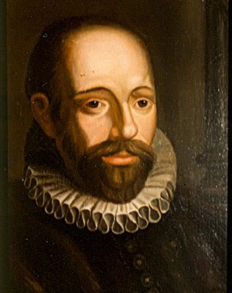
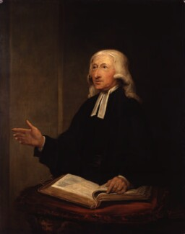
Key Protestant Reformation Doctrines – The Synod of Dort 1618 - 1619
Jacob Arminius 1560 - 1609
John Wesley 1703 - 1791

Slide 7
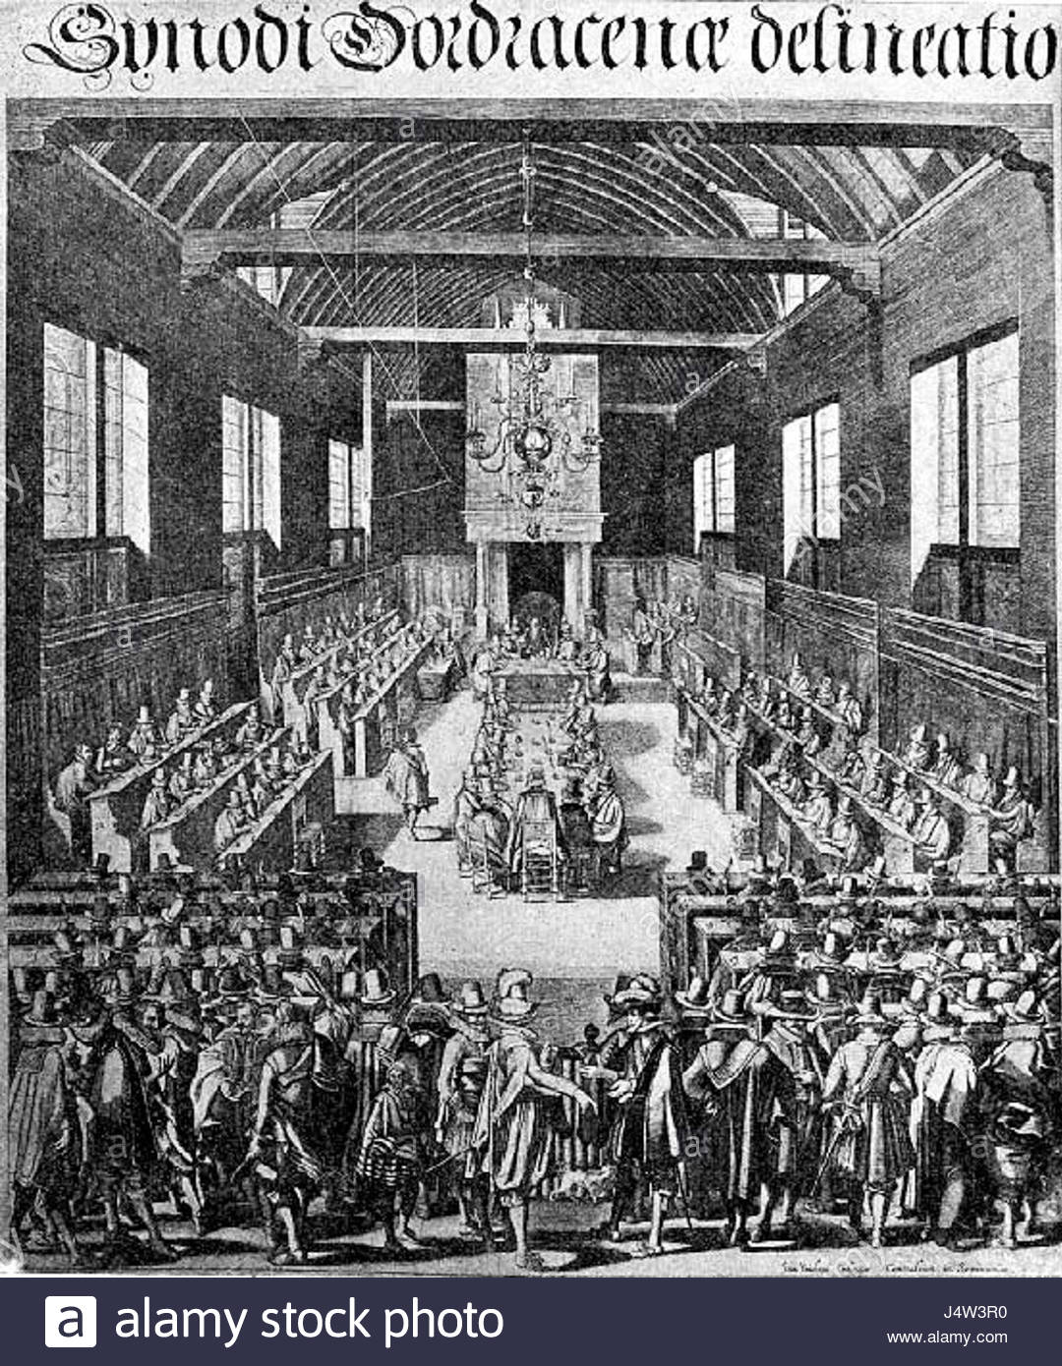
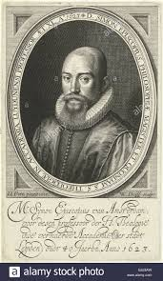
Key Protestant Reformation Doctrines – The Synod of Dort 1618 - 1619
Simon Episcopius 1583 - 1643

Slide 8
Key Protestant Reformation Doctrines – The Five Articles vs. The Five Points
Five Articles of the Remonstrance | Five Points of Calvinism
1. Conditional Election | 1. Total Depravity
2. Unlimited Atonement | 2. Unconditional Election
3. Total Depravity | 3. Limited Atonement
4. Resistible/Prevenient Grace | 4. Irresistible Grace
5. Conditional Preservation | 5. Perseverance of the Saints

Slide 9
Reformed vs Arminian Soteriology - Total Depravity
Originally Arminius agreed with Total Depravity.
“In this state [man’s fallen condition], the Free Will of man toward the True God is not only wounded, maimed, infirm, bent, and weakened; but it is also imprisoned, destroyed and lost. And its powers are not only debilitated and useless unless they be assisted by grace, but it has no powers whatever except such as are excited by Divine grace.”
Arminius not only affirms the bondage of the will, but insists that natural man, being dead in sin, exists in a state of moral inability or impotence.” R. C. Sproul
That man has not saving grace of himself, nor of the energy of his free will, inasmuch as he, in the state of apostasy and sin, can of and by himself neither think, will, nor do anything that is truly good (such as having faith); but that it is needful that he be born again of God in Christ, through his Holy Spirit, and renewed in understanding, inclination, or will, and all his powers, in order that he may rightly understand, think, will, and effect what is truly good, according to the word of Christ, John xv. 5: "Without me ye can do nothing. Article 3 of the Remonstrants
“The contemporary idea today is that there’s some residual good left in the sinner.” John Mac Arthur

Slide 10
Reformed vs Arminian Soteriology - Total Depravity
If Augustine was correct that the Fall causes every naturally born person to be morally unable to believe in Christ, then the only way for anyone to believe in Christ is for God alone to bring them to faith.
Total Depravity does not mean an unbeliever is as bad as is possible but rather that all human attributes (body, mind, will and soul) are profoundly affected by the Fall.
So are all of Adam’s descendants really unable to believe in Christ?
What then? Are we Jews any better off? No, not at all. For we have already charged that all, both Jews and Greeks, are under sin, as it is written: "None is righteous, no, not one; no one understands; no one seeks for God. All have turned aside; together they have become worthless; no one does good, not even one." (Romans 3:9 – 12)

Slide 11
Reformed vs Arminian Soteriology - Total Depravity
For the mind that is set on the flesh is hostile to God, for it does not submit to God's law; indeed, it cannot. Those who are in the flesh cannot please God. (Romans 8:7-8)
Because:
For the word of the cross is folly to those who are perishing, but to us who are being saved it is the power of God. (1 Corinthians 1:18)
The natural person does not accept the things of the Spirit of God, for they are folly to him, and he is not able to understand them because they are spiritually discerned. (1 Corinthians 2:14)
So the result is:
And you were dead in the trespasses and sins in which you once walked, following the course of this world, following the prince of the power of the air, the spirit that is now at work in the sons of disobedience - among whom we all once lived in the passions of our flesh, carrying out the desires of the body and the mind, and were by nature children of wrath, like the rest of mankind. (Ephesians 2:1-4)

Slide 12
Reformed vs Arminian Soteriology - Total Depravity
No one can* (dunamai) come to me unless the Father who sent me draws him. And I will raise him up on the last day...It is the Spirit who gives life; the flesh is no help at all. The words that I have spoken to you are spirit and life. But there are some of you who do not believe." (For Jesus knew from the beginning who those were who did not believe, and who it was who would betray him.) And he said, "This is why I told you that no one can come to me unless it is granted** (didōmi) him by the Father." After this many of his disciples turned back and no longer walked with him. So Jesus said to the Twelve, "Do you want to go away as well?" Simon Peter answered him, "Lord, to whom shall we go? You have the words of eternal life, and we have believed, and have come to know, that you are the Holy One of God." Jesus answered them, "Did I not choose you, the Twelve? And yet one of you is a devil.” (John 6:44; 63 – 70)
* Dunamai means to be able or have power in Greek (from the root word to do).
** Didōmi is usually translated as a form of give (also from the root word to do).

Slide 13
Elder Affirmation of Faith - Total Depravity
5.2 We believe that, as the head of the human race, Adam‘s fall became the fall of all his posterity, in such a way that corruption, guilt, death, and condemnation belong properly to every person (60). All persons are thus corrupt by nature (61), enslaved to sin (62), and morally unable (63) to delight in God and overcome their own proud preference for the fleeting pleasures of self-rule.
(60) ROMANS 5:12-19. (61) EPHESIANS 2:2-3. (62) ROMANS 6:16, 20. (63) 1 CORINTHIANS 2:14; ROMANS 8:7-8; DEUTERONOMY 29:4.
But to this day the LORD has not given you a heart to understand or eyes to see or ears to hear. (Deuteronomy 29:4)

