Slide 1
Discipleship: An Introduction to Systematic Theology and Apologetics
Protestant Reformation Doctrines of Salvation
The Heights Church March 3, 2019

Slide 2
What is at stake in the Arminian/Calvinist Debate?
God’s Sovereignty: If Human Free Will ultimately decides who is saved and who isn’t, then God’s Sovereignty is compromised.
The Glory of God: If human Free Will decides who is saved and who isn’t, then God’s glory is diminished because the individual believer logically deserves some credit for their salvation.
The inerrancy and infallibility of Scripture: If Scripture teaches both Synergistic (Free Will) and Monergistic (Reformed) Soteriology then there are contradictions in the Bible and it is neither inerrant nor infallibly inspired.

Slide 3
What is at stake in the Arminian/Calvinist Debate?
The Reliability of the most foundational writings of the Reformation: Bondage of the Will, Institutes of the Christian Religion, Belgic Confession, Heidelberg Catechism, Westminster Catechisms and Confession, The Death of Death in the Death of Christ, 1689 London Baptist Confession of Faith, Freedom of the Will and many others.
The Credibility of key Protestant leaders: Luther, Calvin, Knox, Owen, Whitfield, Edwards, Spurgeon, MacArthur, Sproul, Piper and many others.

Slide 4
Arminian Soteriology lacks explicit Biblical passages that support:
God has given every naturally born person “Free Will.”
God values human freedom of choice above his sovereignty.
God elects based upon his omniscience of whether or not a person will “accept” Christ by their “Free Will” with God’s assistance.
If Salvation is by human autonomy why is election needed at all?
If human autonomy is God’s highest priority, exceeding his sovereignty, why would election be allowed at all since it would violate God’s highest priority?

Slide 5
Arminian Soteriology lacks explicit Biblical passages that support:
The Atonement covers every person in the same way.
God’s gracious call can be rejected even if God has elected/predestined any given individual.
A true believer can choose to reject God after they have truly “accepted” him and were really saved for some period of time.
Arminian Soteriology needs to be able to explain how a NT author could have written very clear verses that support the Reformed view and written verses that Arminians interpret to refute the Reformed view.

Slide 6
The Elder Affirmation of Faith:
The following slides cover what the Elder Affirmation of Faith says about the Doctrines of Grace.
The order and titles of the Doctrines of Grace does not follow the classic acrostic of TULIP.
To view the entire Elder Affirmation of Faith including the supporting Biblical passages go to:
http://www.theheightschurchmn.org/elder-affirmation-of-faith

Slide 7
The Elder Affirmation of Faith: 3.3 Unconditional Election
We believe that God‘s election is an unconditional act of free grace which was given through His Son Christ Jesus before the world began. By this act God chose, before the foundation of the world, those who would be delivered from bondage to sin and brought to repentance and saving faith in His Son Christ Jesus.

Slide 8
The Elder Affirmation of Faith: 5.2 Total Depravity
We believe that, as the head of the human race, Adam‘s fall became the fall of all his posterity, in such a way that corruption, guilt, death, and condemnation belong properly to every person. All persons are thus corrupt by nature, enslaved to sin, and morally unable to delight in God and overcome their own proud preference for the fleeting pleasures of self-rule.

Slide 9
The Elder Affirmation of Faith: 7.3 Particular Redemption
We believe, moreover, that the death of Christ did obtain more than the bona fide offer of the gospel for all; it also obtained the omnipotent New Covenant mercy of repentance and faith for God‘s elect. Christ died for all, but not for all in the same way. In His death, Christ expressed a special covenant love to His friends, His sheep, His bride. For them He obtained the infallible and effectual working of the Spirit to triumph over their resistance and bring them to saving faith.

Slide 10
The Elder Affirmation of Faith: 8.3 Total Depravity/ Irresistible Call
We believe that, apart from the effectual work of the Spirit, no one would come to faith, because all are dead in trespasses and sins; that they are hostile to God, and morally unable to submit to God or please Him, because the pleasures of sin appear greater than the pleasures of God. Thus, for God‘s elect, the Spirit triumphs over all resistance, wakens the dead, removes blindness, and manifests Christ in such a compellingly beautiful way through the Gospel that He becomes irresistibly attractive to the regenerate heart.

Slide 11
The Elder Affirmation of Faith: 10.6 Perseverance
We believe that all who are justified will win this fight. They will persevere in faith and never surrender to the enemy of their souls. This perseverance is the promise of the New Covenant, obtained by the blood of Christ, and worked in us by God Himself, yet not so as to diminish, but only to empower and encourage, our vigilance; so that we may say in the end, I have fought the good fight, but it was not I, but the grace of God which was with me.

Slide 12
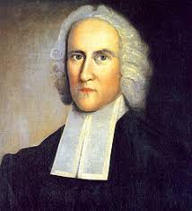
Personal Testimonies: Jonathan Edwards (1703 – 1758)
There has been a wonderful alteration in my mind, in respect to the doctrine of God’s sovereignty, from that day to this… God’s absolute sovereignty…is what my mind seems to rest assured of, as much as of anything that I see with my eyes. The doctrine has often
appeared exceeding pleasant , bright, and sweet. Absolute sovereignty is what I love to ascribe to God ... God’s sovereignty has ever appeared to me, a great part of his glory. It has often been my delight to approach God, and adore him as a sovereign God.

Slide 13
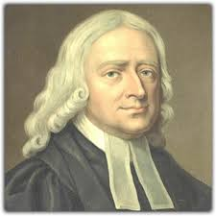
Personal Testimonies: John Wesley (1703 – 1791)
At Oxford, he joined the “Holy Club” a society (founded by his brother Charles) whose members took vows to lead holy lives, take Communion once a week, pray daily, visit prisons regularly and spend three hours every afternoon studying the Bible and other devotional material.
Converted on May 24, 1738.
Founder of Methodism based upon 24 of the 39 Articles in the Confession of Faith of the Church of England.
Credited with about 18,000 sermons

Slide 14
Personal Testimonies: John Wesley (1703 – 1791)
"In the evening, I went very unwillingly to a society in Aldersgate Street, where one was reading Luther's preface to the Epistle to the Romans. About a quarter before nine, while he was describing the change which God works in the heart through faith in Christ, I felt my heart strangely warmed. I felt I did trust in Christ, Christ alone for salvation, and an assurance was given me that he had taken away my sins, even mine, and saved me from the law of sin and death.”
Though he would become a fervent Arminian, there is not a hint that he did anything (“made a decision” or “accepted Christ”). Indeed it would be a strong Calvinist testimony as is his brother Charles’s testimony that follows.

Slide 15
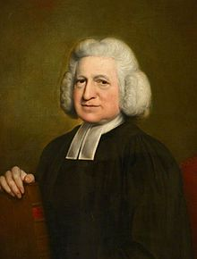
Personal Testimonies: Charles Wesley (1707 – 1788)
Long my imprisoned spirit lay, Fast bound in sin and nature’s night; Thine eye diffused a quick’ning ray— I woke, the dungeon flamed with light; My chains fell off, my heart was free, I rose, went forth, and followed Thee.*
*And Can it Be was written immediately following his conversion (May 21, 1738).
He is Credited with at least 6000 hymns.

Slide 16
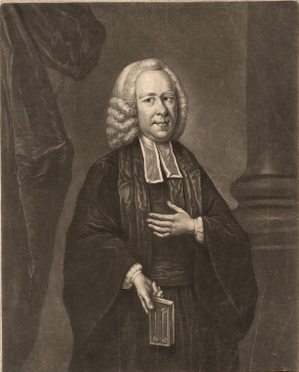
Personal Testimonies: George Whitefield (1714 – 1770)
Edwards wept openly when Whitefield preached at Edward’s church.
“I embrace the Calvinistic scheme, not because of Calvin, but Jesus Christ has taught it to me.”
The doctrines of our election, and free justification in Christ Jesus are daily more and more pressed upon my heart. They fill my soul with a holy fire and afford me great confidence in God my Saviour.

Slide 17
Personal Testimonies: George Whitefield (1714 – 1770)
Oh, the excellency of the doctrine of election and of the saints’ final perseverance! I am persuaded, till a man comes to believe and feel these important truths, he cannot come out of himself, but when convinced of these and assured of their application to his own heart, he then walks by faith indeed!
All others leave free will in man and make him, in part at least, a saviour to himself. My soul, come not thou near the secret of those who teach such things.

Slide 18
George Whitefield (1714 – 1770)
I know Christ is all in all. Man is nothing: he hath a free will to go to hell, but none to go to heaven, till God worketh in him to will and to do his good pleasure.

Slide 19
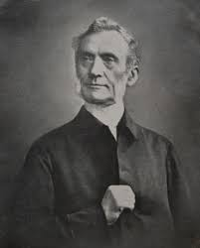
Personal Testimonies: George Mueller (1805 – 1898)
George Mueller is famous for the orphanages he founded and the amazing faith he had to pray for God’s provision. In 1829, he had an experience which he later recorded.
Before this period [when I came to prize the Bible alone as my standard of judgment] I had been much opposed to the doctrines of election, particular redemption (limited atonement), and final persevering grace. But now I was brought to examine these precious truths by the Word of God.

Slide 20
Personal Testimonies: George Mueller (1805 – 1898)
Being made willing to have no glory of my own in the conversion of sinners, but to consider myself merely an instrument; and being made willing to receive what the Scriptures said, I went to the Word, reading the New Testament from the beginning, with a particular reference to these truths.
To my great astonishment I found that the passages which speak decidedly for election and persevering grace, were about four times as many as those which speak apparently against these truths; and even those few, shortly after, when I had examined and understood them, served to confirm me in the above doctrines.

Slide 21
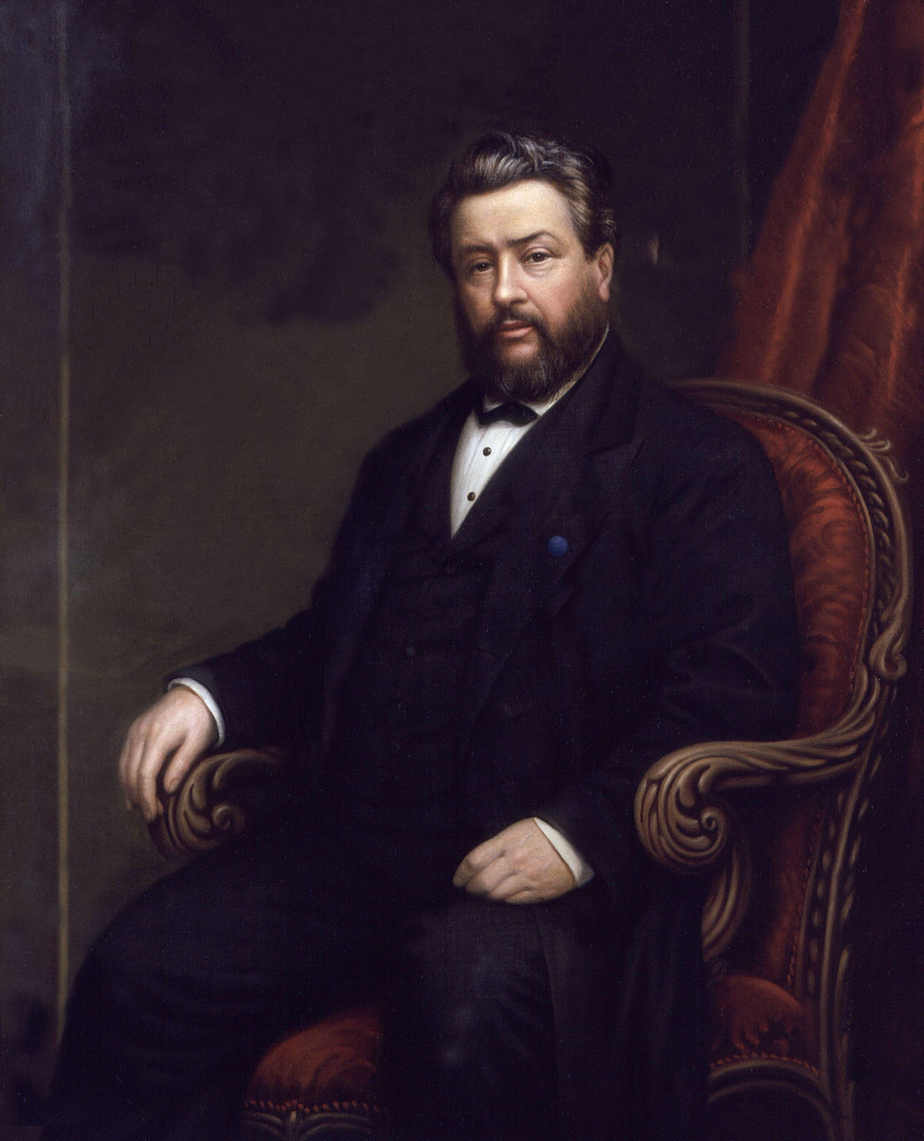
Personal Testimonies: Charles Spurgeon (1834 – 1892)
Spurgeon was a Baptist and the pastor of the Metropolitan Tabernacle in London. He was the most famous pastor of his day. His preaching was powerful and held thousands spellbound each week.
When Spurgeon was 16 he came to understand the Doctrines of Grace.

Slide 22
Personal Testimonies: Charles Spurgeon (1834 – 1892)
Born, as all of us are by nature, an Arminian, I still believed the old things I had heard continually from the pulpit, and did not see the grace of God. When I was coming to Christ, I thought I was doing it all myself, and though I sought the Lord earnestly, I had no idea the Lord was seeking me. ... I can recall the very day and hour when first I received those truths in my own soul—when they were, as John Bunyan says, burnt into my heart as with a hot iron. ...

Slide 23
Personal Testimonies: Charles Spurgeon (1834 – 1892)
One week-night, when I was sitting in the house of God, I was not thinking much about the preacher’s sermon, for I did not believe it. The thought struck me, “How did you come to be a Christian?” I sought the Lord. “But how did you come to seek the Lord?” The truth flashed across my mind in a moment—I should not have sought Him unless there had been some previous influence in my mind to make me seek Him. I prayed, thought I, but then I asked myself, How came I to pray? I was induced to pray by reading the Scriptures. How came I to read the Scriptures? I did read them, but what led me to do so?

Slide 24
Personal Testimonies: Charles Spurgeon (1834 – 1892)
Then, in a moment, I saw that God was at the bottom of it all, and that He was the Author of my faith, and so the whole doctrine of grace opened up to me, and from that doctrine I have not departed to this day, and I desire to make this my constant confession, “I ascribe my change wholly to God.”

Slide 25
Personal Testimonies: Charles Spurgeon (1834 – 1892)
Spurgeon started a college for pastors and was intent that the key to being a worthy teacher in the church was to grasp these doctrines of grace. Arminianism is thus guilty of confusing doctrines and of acting as an obstruction to a clear and lucid grasp of the Scripture; because it misstates or ignores the eternal purpose of God, it dislocates the meaning of the whole plan of redemption. Indeed confusion is inevitable apart from this foundational truth [of election]. Without it there is a lack of unity of thought, and generally speaking they have no idea whatever of a system of divinity.

Slide 26
Personal Testimonies: Charles Spurgeon (1834 – 1892)
It is almost impossible to make a man a theologian unless you begin with this [doctrine of election]. You may if you please put a young believer to college for years, but unless you shew him this ground-plan of the everlasting covenant, he will make little progress, because his studies do not cohere, he does not see how one truth fits with another, and how all truths must harmonize together...

Slide 27
Personal Testimonies: Charles Spurgeon (1834 – 1892)
Take any county throughout England, you will find poor men hedging and ditching that have a better knowledge of divinity than one half of those who come from our academies and colleges, for the reason simply and entirely that these men have first learned in their youth the system of which election is a centre, and have afterwards found their own experience exactly squares with it.

