Slide 1
Discipleship: An Introduction to Systematic Theology and Apologetics
Protestant Reformation Doctrines of Salvation
The Heights Church September 23, 2018

Slide 2
The Fall – Review
The Fall in Genesis 3 should be considered Historical Narrative.
Because of Adam’s sin every natural born person is counted guilty.
Because of Adam’s sin we have a sinful nature.
Before the Law was given people died because they had inherited Adam’s sin BUT their sins were not counted as infractions of the Law.
Before we were born God thought of us as sinners because we had descended from Adam.

Slide 3
The Fall – What is inherited sin?
1. We are counted guilty because of Adam’s sin.
We have imputed sin from Adam meaning “to think of belonging to someone and therefore to cause it to belong to that person.”
Inherited sin is usually called original sin. Original does not refer to Adam’s first sin but that Adam represented every human and when Adam disobeyed, God counted every naturally born human as also guilty.
Inherited sin seems unfair BUT (1) we have all willingly committed many other sins for which we are guilty. (2) If we had been Adam we probably would have done the same thing. (3) If someone thinks it is unfair to be represented by Adam and have imputed sin and guilt then why is it fair to be represented by Christ and have imputed righteousness?
Blaise Pascal (1623-1662) said, “The doctrine of original sin seems an offense to reason, but once accepted it makes total sense of the human condition.”

Slide 4
The Fall – What is inherited sin?
We have a sinful nature because of Adam’s sin.
Behold, I was brought forth in iniquity, and in sin did my mother conceive me. (Psalm 51:5)
It is not necessary to teach a child how to sin!
But we are not as bad as we could be due to the constraints of civil law, expectations of others, the conviction of our conscience and most of all by common grace (undeserved favor given to all people in varying amounts).
Nevertheless our unregenerated natures totally lack spiritual good before God.
Every part of our being is affected by sin

Slide 5
The Fall – What is inherited sin?
Our natures totally lack spiritual good before God. Every part of our being is affected by sin.
The heart* is deceitful above all things, and desperately sick; who can understand it? (Jeremiah 17:9)
For I know that nothing good dwells in me, that is, in my flesh. For I have the desire to do what is right, but not the ability to carry it out. (Romans 7:18)
We are unable to do spiritual good before God. This does not mean that unbelievers cannot do anything “good” (especially as the world defines good) but that they cannot do good in the sense of pleasing God.
I am the vine; you are the branches. Whoever abides in me and I in him, he it is that bears much fruit, for apart from me you can do nothing. (John 15:5)
* center of our desires and decision-making

Slide 6
The Fall – What is inherited sin?
For the mind that is set on the flesh is hostile to God, for it does not submit to God's law; indeed, it cannot. Those who are in the flesh cannot please God. (Romans 8:7-8)
Because:
For the word of the cross is folly to those who are perishing, but to us who are being saved it is the power of God. (1 Corinthians 1:18)
The natural person does not accept the things of the Spirit of God, for they are folly to him, and he is not able to understand them because they are spiritually discerned. (1 Corinthians 2:14)
So the result is:
And you were dead in the trespasses and sins in which you once walked, following the course of this world, following the prince of the power of the air, the spirit that is now at work in the sons of disobedience - among whom we all once lived in the passions of our flesh, carrying out the desires of the body and the mind, and were by nature children of wrath, like the rest of mankind. (Ephesians 2:1-4)

Slide 7
The Fall – Possible Effects
Universalist: The Fall is not an actual historical event. Everyone goes to heaven when they die.
Pelagian: Adam’s sin is not imputed to anyone. We have equal standing at birth with Adam before he fell.
Semi-pelagian (Arminianism): Original sin is imputed to everyone. However, free will is not totally lost so that everyone is able to freely choose to sin or not sin (i.e. believe in Jesus).
Reformed: (Augustinian, Calvinist, Doctrines of Grace): Original sin is imputed to everyone and we are born without free will. Hence unbelievers are morally unable to not sin.

Slide 8
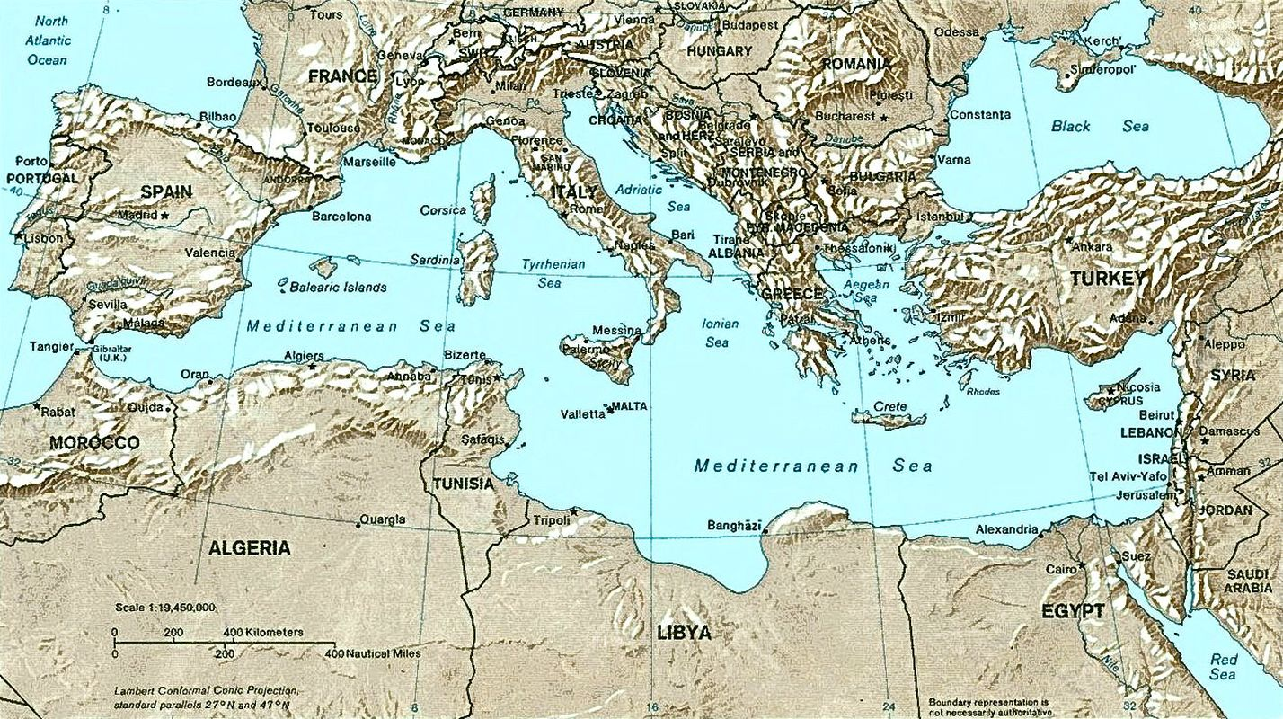
The Fall – Great Church Councils
Constantinople & Chalcedon
Orange
Hippo
Carthage
Toledo
Ephesus
Nicea

Slide 9
The Fall
The British monk Pelagius (circa 360-418): disagreed with Augustine’s prayer, “Oh God, grant what Thou commandest, and command what Thou dost desire,”
Pelagius had no problems with the second part. He believed that God’s highest attribute was His righteousness, and from that righteousness He had the perfect right Himself to obligate His creatures to obey Him according to His law.
Pelagius reacted to the first part by saying that whatever God commands implies the ability of the one who receives the command to obey it. Man should not have to ask for grace in order to be obedient.
At the Council of Carthage in 418 Pelagius was declared a heretic. This was upheld in 431 by the first Council of Ephesus.

Slide 10
The Fall
The Council of Carthage in 418 also declared:
Infants must be baptized to be cleansed from original sin.
Children dying without baptism are excluded from both the kingdom of heaven and eternal life.
Death came from sin, not man's physical nature.
The grace of Christ imparts strength and will to act out God's commandments.
No good works can come without God's grace.
For by grace you have been saved through faith. And this is not your own doing; it is the gift of God, not a result of works, so that no one may boast. For we are his workmanship, created in Christ Jesus for good works, which God prepared beforehand, that we should walk in them. Ephesians 2:8 – 10)

Slide 11
The Fall
On the other hand according to Saint Augustine (354-430):
Adam and Eve were created with Liberty (i.e. free will), the moral ability to sin and the moral ability to not sin.
In the fall they lost the moral ability to not sin.
The LORD saw that the wickedness of man was great in the earth, and that every intention of the thoughts of his heart was only evil continually. (Genesis 6:5)
We have all become like one who is unclean, and all our righteous deeds are like a polluted garment. We all fade like a leaf, and our iniquities, like the wind, take us away. (Isaiah 64:6)
“None is righteous, no, not one; no one understands; no one seeks for God. All have turned aside; together they have become worthless; no one does good, not even one.” (Romans 3:10-12)

Slide 12
The Fall – Augustine of Hippo’s Definition of Original (inherited) Sin
 | Humanity as created | Fallen Humanity | Modern Definition/Latin term
Free Agency (Liberty*) | yes | yes | Ability to choose whatever is most pleasing.
Free Will (Moral Liberty*) | yes | no | Ability to chose any available moral option.
Able to sin | yes | yes | Posse peccare
Able to not sin | yes | no | Posse non pecarre
Unable to not sin | no | yes | Non posse non peccare
* Augustine’s original words

