Slide 1
Discipleship: An Introduction to Systematic Theology and Apologetics
Protestant Reformation Doctrines of Salvation
The Heights Church May 19, 2019

Slide 2
The Atonement – Historical Development (Review)
Ransom to Satan – Origen (185 – 254) taught that the ransom Christ paid was to Satan. It is without any Biblical support.

Slide 3
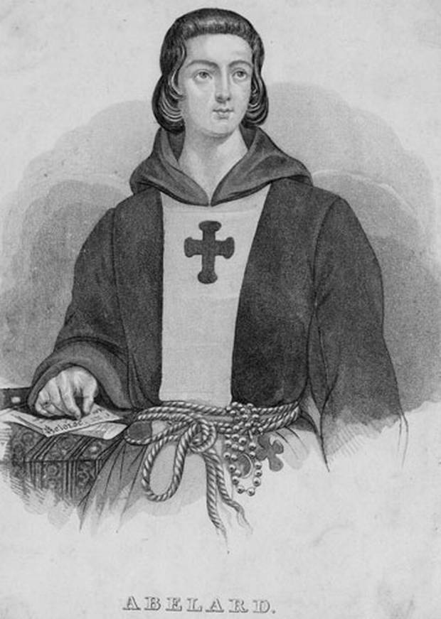
The Atonement – Other False Views Regarding the Atonement
The Moral Influence Theory – Peter Abelard (1079 – 1142) taught that God did not require the payment of a penalty for sin, but Christ’s death was a way in which God showed how much he loved humans by identifying with their sufferings to the point of death. It neglects all the passages of Scripture that speak of Christ dying for sin, bearing our sin, or dying as a propitiation.

Slide 4
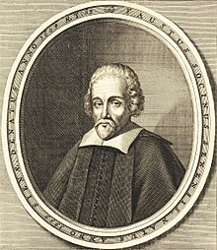
The Atonement – Other False Views Regarding the Atonement
The Example Theory – Fausto Socinus (1539 – 1604) put forth a theory that became very popular denying that God’s justice requires payment for sin. In this case Christ’s death is an example of how we should live by perfectly trusting and obeying God to the point of a horrible death.

Slide 5
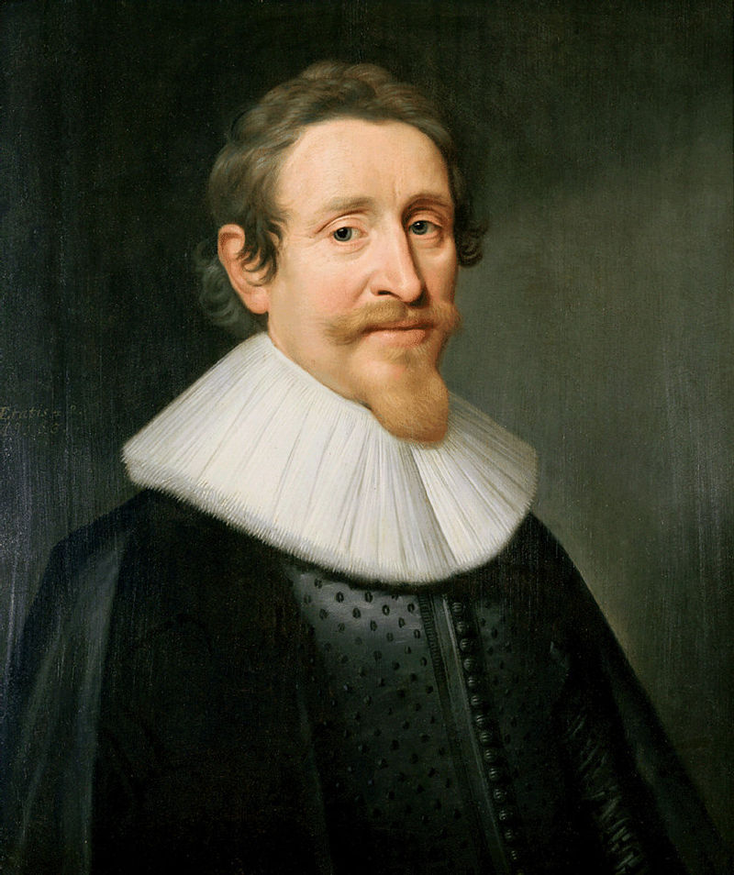
The Atonement – Other False Views Regarding the Atonement
The Governmental Theory – Hugo Grotius (1583 – 1645) taught that God did not actually have to require a payment for sin because he was omnipresent he could have continually forgiven sins. In this case Christ died to demonstrate when God’s laws are broken, as the moral lawgiver and governor of the universe, some penalty must be paid. So Christ did not pay the penalty of actual sins of people but suffered to show that when God’s laws are broken some penalty must be paid.

Slide 6
The Atonement – Additional Points Regarding the Death of Christ
The penalty was inflicted by God the Father
God’s justice required that sin be paid for and among the members of the Trinity. It was God the Father’s role to require the payment.
God the Son voluntarily took the role of bearing the penalty for sin.
For our sake he made him to be sin who knew no sin, so that in him we might become the righteousness of God. (2 Corinthians 5:21)

Slide 7
The Atonement – Additional Points Regarding the Death of Christ
Jesus Made Complete Payment Without Suffering Eternally
If we had to pay the penalty for our sin we would have to suffer eternally because we could not ever live perfectly because we would still be sinners. We could never make ourselves righteous.

Slide 8
The Atonement – Additional Points Regarding the Death of Christ
Jesus, by the union of the divine and human nature could bear all the wrath of God in a fixed amount of time. Out of the anguish of his soul he shall see and be satisfied; by his knowledge shall the righteous one, my servant, make many to be accounted righteous, and he shall bear their iniquities. (Isaiah 53:11) When Jesus had received the sour wine, he said, "It is finished," and he bowed his head and gave up his spirit. (John 19:30) There is therefore now no condemnation for those who are in Christ Jesus. (Romans 8:1)

Slide 9
The Atonement – Additional Points Regarding the Death of Christ
Unlike Roman Catholic teaching, the Protestant understanding of the atonement is that is was complete and final with no remaining penalty for sin to be addressed by repeating the sacrifice in every mass.

Slide 10
The Atonement – Additional Points Regarding the Death of Christ
Nor was it to offer himself repeatedly, as the high priest enters the holy places every year with blood not his own, for then he would have had to suffer repeatedly since the foundation of the world. But as it is, he has appeared once for all at the end of the ages to put away sin by the sacrifice of himself. And just as it is appointed for man to die once, and after that comes judgment, so Christ, having been offered once to bear the sins of many, will appear a second time, not to deal with sin but to save those who are eagerly waiting for him. (Hebrews 9:25 – 28)

Slide 11
The Atonement – Additional Points Regarding the Death of Christ
The Blood of Christ (saving aspects of Christs death)
Jesus died paying a penalty imposed by a human judge and by God.
There is a clear connection between pouring out the blood of a sacrificed animal and the one time sacrifice of Christ.
While Christ’s death (shed blood) refers primarily to removal of our judicial guilt, it has other benefits:

Slide 12
The Atonement – Additional Points Regarding the Death of Christ
how much more will the blood of Christ, who through the eternal Spirit offered himself without blemish to God, purify our conscience from dead works to serve the living God. (Hebrews 9:14)
Therefore, brothers, since we have confidence to enter the holy places by the blood of Jesus (Hebrews 10:19)
But if we walk in the light, as he is in the light, we have fellowship with one another, and the blood of Jesus his Son cleanses us from all sin. (1 John 1:7)

Slide 13
The Atonement – Additional Points Regarding the Death of Christ
And I heard a loud voice in heaven, saying, "Now the salvation and the power and the kingdom of our God and the authority of his Christ have come, for the accuser of our brothers has been thrown down, who accuses them day and night before our God. And they have conquered him by the blood of the Lamb and by the word of their testimony, for they loved not their lives even unto death. (Revelation 12:10 – 11)
knowing that you were ransomed from the futile ways inherited from your forefathers, not with perishable things such as silver or gold, but with the precious blood of Christ, like that of a lamb without blemish or spot. (1 Peter 1:18 – 19)
Notes:
(

Slide 14
The Atonement – Additional Points Regarding the Death of Christ
Penal Substitution
Christ bore a penalty when he died
He was a substitute for the elect.
This sometimes called Vicarious Atonement - namely a Vicar is someone who stands in the place of another.
As Sinners we have four needs. Christ’s death meet each one.
We deserve to die as penalty for our sins. But as it is, he has appeared once for all at the end of the ages to put away sin by the sacrifice of himself. (Hebrews 9:26b)
We deserve to bear God’s wrath. In this is love, not that we have loved God but that he loved us and sent his Son to be the propitiation for our sins. (1 John 4:10)

Slide 15
The Atonement – Additional Points Regarding the Death of Christ
We are separated from God because of sin. All this is from God, who through Christ reconciled us to himself and gave us the ministry of reconciliation; that is, in Christ God was reconciling the world to himself, not counting their trespasses against them, and entrusting to us the message of reconciliation. (2 Corinthians 5:18 – 19)
We are in bondage to sin and the kingdom of Satan.
For even the Son of Man came not to be served but to serve, and to give his life as a ransom for many. (Mark 10:45)
We know that we are from God, and the whole world lies in the power of the evil one. (1 John 5:19)
He has delivered us from the domain of darkness and transferred us to the kingdom of his beloved Son, (Colossians 1:13)

Slide 16
The Atonement – Additional Points Regarding the Death of Christ
Did Jesus Descend Into Hell?
The Apostles Creed was developed between about A.D. 200 – 750.
The Apostles Creed was not written or approved by a single church Counsel
“descended into hell” first appeared in a version about 390 produced by a monk named Rufinus. He thought it meant Jesus was buried not that he actually descended into hell.

Slide 17
The Atonement – Additional Points Regarding the Death of Christ
Starting about 650 “descended into hell” appeared in all subsequent versions. However who added it is unknown.
Various attempts have been made to explain it.
Calvin said it meant that Christ not only died bodily but that it was expedient for him to undergo the severity of God’s vengeance to appease God’s wrath and satisfy his just judgment.

Slide 18
The Atonement – Additional Points Regarding the Death of Christ
The Heidelberg Catechism Question 44 asks, Why is it added: He descended into Hades?
Answer: That in my greatest temptations I may be assured that Christ, my Lord, by his inexpressible anguish, pains, and terrors which he suffered in his soul on the cross and before, has redeemed me from the anguish and torment of hell.

Slide 19
The Atonement – Additional Points Regarding the Death of Christ
The Westminster Larger Catechism, Question/Answer 50 :
Christ’s humiliation after his death consisted in his being buried and continuing in the state of the dead, under the power of death till the third day; which hath been otherwise expressed in these words, He descended into hell.
Neither the Heidelberg Catechism nor the Westminster Larger Catechism really address the literal meaning of “descended into hell.”

Slide 20
The Atonement – Additional Points Regarding the Death of Christ
There are no NT proof texts that conclusively teach Christ was in hell for any reason following his death on the cross.
1 Peter 3:18 – 20 is the most often cited text to support a literal entry to hell.
For Christ also suffered once for sins, the righteous for the unrighteous, that he might bring us to God, being put to death in the flesh but made alive in the spirit, in which he went and proclaimed to the spirits in prison, because they formerly did not obey, when God's patience waited in the days of Noah, while the ark was being prepared, in which a few, that is, eight persons, were brought safely through water. (1 Peter 3:18 -20)

Slide 21
The Atonement – Additional Points Regarding the Death of Christ
The best explanation of 1 Peter 3:18 – 20 probably is the one given by Augustine that it does not refer to what Jesus did after his death but that when Noah was building the Arc, Christ, in spirit, was preaching through Noah to the hostile unbelievers around him.

Slide 22
The Atonement – Additional Points Regarding the Death of Christ
The best NT texts that refute the idea that Jesus actually entered hell following his death are:
And he said to him, "Truly, I say to you, today you will be with me in Paradise.“ (Luke 23:43)
Then Jesus, calling out with a loud voice, said, "Father, into your hands I commit my spirit!“ (Luke 23:46)

Slide 23
The Atonement – Additional Points Regarding the Death of Christ
Since no adequate explanation exists as to who added the phrase “he descended into hell,” what it really means and the lack of any proof texts, given the evidence of Luke 23:43 and 46 it seems best that the phase should not be include in the Apostles Creed despite its long history of inclusion.

Slide 24
The Atonement – Summary of 13 Essential Doctrinal Truths
The atonement is sufficient for every sin of every person throughout all of history BUT only efficacious for the elect’s sins.
The heart of the atonement is the eternal, unchangeable requirement of God’s holiness and justice that demands sin must be paid for.
God required that sin be paid for among the members of the Trinity.
It was God the Father’s role to require the payment.
God the Son voluntarily took the role of bearing the penalty for all of the elect’s sins as their substitute.

Slide 25
The Atonement – Summary of 13 Essential Doctrinal Truths
Before the atonement could be effective for the elect, it had to affect God’s relationship with the sinners he planned to redeem by quenching his wrath over the elect’s sins.
Jesus ransomed the elect from the wrath of God – not from Satan.
The cause of the atonement is God’s love for the elect.
The only way to save the elect from their sins was through the work Christ did in his life and death to earn the elect’s salvation.

Slide 26
The Atonement – Summary of 13 Essential Doctrinal Truths
Jesus in his human nature needed to “fulfill all righteousness” for the elect so that all of the elect had a record of obedience that merited God’s favor and eternal life with him.
Jesus, by the union of the divine and human nature could bear all the wrath of God against all of the elect’s sin in a fixed amount of time.
Jesus paid the penalty for all the sins of the elect through all of his sufferings in body and soul throughout his entire life lived in a fallen world and in his death on the cross.

Slide 27
The Atonement – Summary of 13 Essential Doctrinal Truths
It was not unfair for God to have Jesus bear all the elect’s sin, because God is the standard of what is just. If God said that this satisfied the demands of his justice and righteousness, then it did!

