Slide 1
Discipleship: An Introduction to Systematic Theology and Apologetics
The Doctrines of Redemption: The Reformation
The Heights Church December 17, 2017

Slide 2
The Reformation (14th – 15th century) – Renaissance (14th -17th Century)
The intellectual basis of the Renaissance was its own invented version of humanism, derived from the concept of Roman Humanitas (loving what makes us human, education and Roman code of conduct) and the rediscovery of classical Greek philosophy, such as that of Protagoras, who said that "Man is the measure of all things." This new thinking became manifest in art, architecture, politics, science and literature.
Renaissance literally means rebirth.
Ad Fontes “literally to the fountains” or to the sources
The intellectual idea was that while the middle ages had been good the previous Roman (Latin era) was better and the Greek era even better.
Mysticism was a movement of the Renaissance with its roots in Plato’s view of ontology (the nature of being) that influenced epistemology ( the nature of how we know).
Plato thought knowledge came by reason (a priori) not experience (a posteriori). To Plato the body was the soul’s prison.

Slide 3
The Reformation (14th – 15th century) – Renaissance
Mystics sought personal experiences of the connection of their soul with God and believed this could be cultivated.
Plato’s view of knowledge
Senses
Reason & Will
(Scholastics)
Synteresis
(conscience deep with us that connect directly to God)

Slide 4
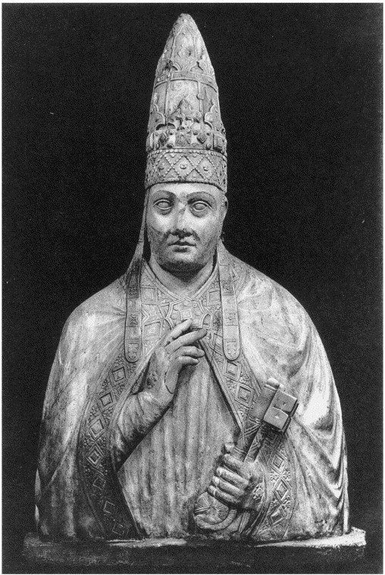
The Reformation (14th century) – Pope Boniface VIII
Born: 1230
Died: October 11, 1303
Papacy: December 24, 1294 – October 11, 1303
At this time Canon Lawyers were trying to determine how much the authority the pope really had. Was the Pope an absolute monarch over spiritual and civil matters and could only be removed by God or was the pope a limited monarch who could be removed for heresy, immorality and so on?
The other important question was what would happen if pope “A” was removed and replaced by pope “B” but pope “A” fought back resulting in two men claiming to be pope?

Slide 5
The Reformation (14th century) – Pope Boniface VIII
Innocent III had made many strong claims but Boniface VIII went further. In his Papal bull of 1302, Unam sanctam Boniface VIII stated that since the Church is one, since the Church is necessary for salvation, and since Christ appointed Peter to lead it, it is "absolutely necessary for salvation that every human creature be subject to the Roman pontiff". These views, and his chronic intervention in "temporal" affairs, led to many bitter quarrels with the Albert I of Germany and Philip IV of France,
On September 7, 1303, King Philip's army attacked Boniface at his Palace next to the Cathedral. The Pope responded with a bull dated September 8, 1303, in which Philip and Philip's chief minister were excommunicated. The French Chancellor demanded the Pope's resignation; Boniface VIII responded that he would "sooner die". In response, he was severely beaten.
In 1309 he was tried posthumously but not convicted.

Slide 6
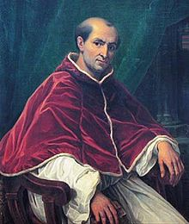
The Reformation (14th century) – Pope Clement V
Born: 1264?
Died: April 20, 1314
Papacy: June 5, 1305– April 20, 1314
In 1309 Clement V tired of Rome and moved the papacy to his native France in Avignon.
The pope resided at Avignon until 1377 when Pope Gregory XI moved the papacy back to Rome.
This became known as the Babylonian Captivity of the Church because it was approximately 70 years.
In 1378 Urban VI became pope but the French Cardinals didn’t like him and elected their own pope in Avignon beginning the Western Schism.
The leaders of Europe quickly chose sides as to which pope they recognized.

Slide 7
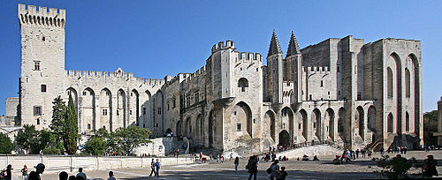
The Reformation (14th century) – Papal Palace in Avignon

Slide 8
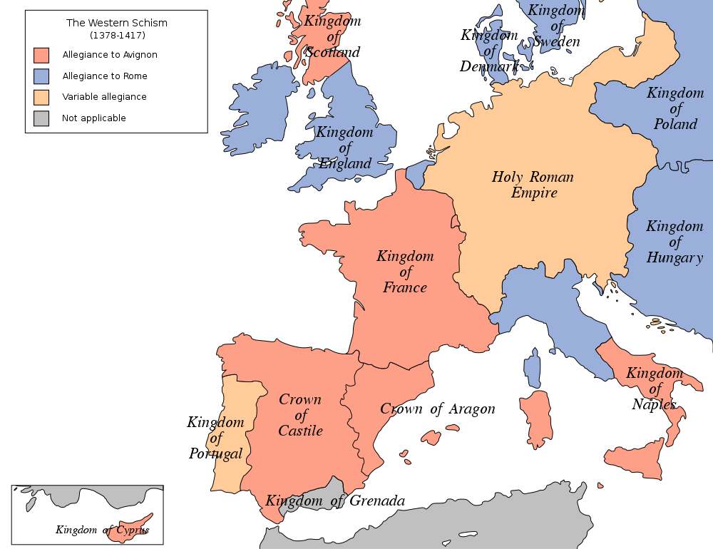

Slide 9
The Reformation (15th century) – Council of Constance
Each Pope excommunicated everyone under the jurisdiction of a leader who selected the other pope so very quickly all of Europe was excommunicated.
In 1409 the Canon Lawyers held an ecumenical council in Pisa and decided both popes should resign and the council would elect the official pope.
Both popes refused to resign so the council deposed both popes and elected a new pope. Now Europe had three popes.
Was a council superior to a pope or vice versa? The Council of Constance was called and met from 1414 – 1418
Between July 4, 1415 and November 11, 1417 there was no recognized pope.
Finally the council elected Pope Martin V declaring the whole church is bound by a duly elected council and the Pope must call a council at least every ten years to govern the church.
Europe was tired of this conflict and went along with the ruling.

Slide 10
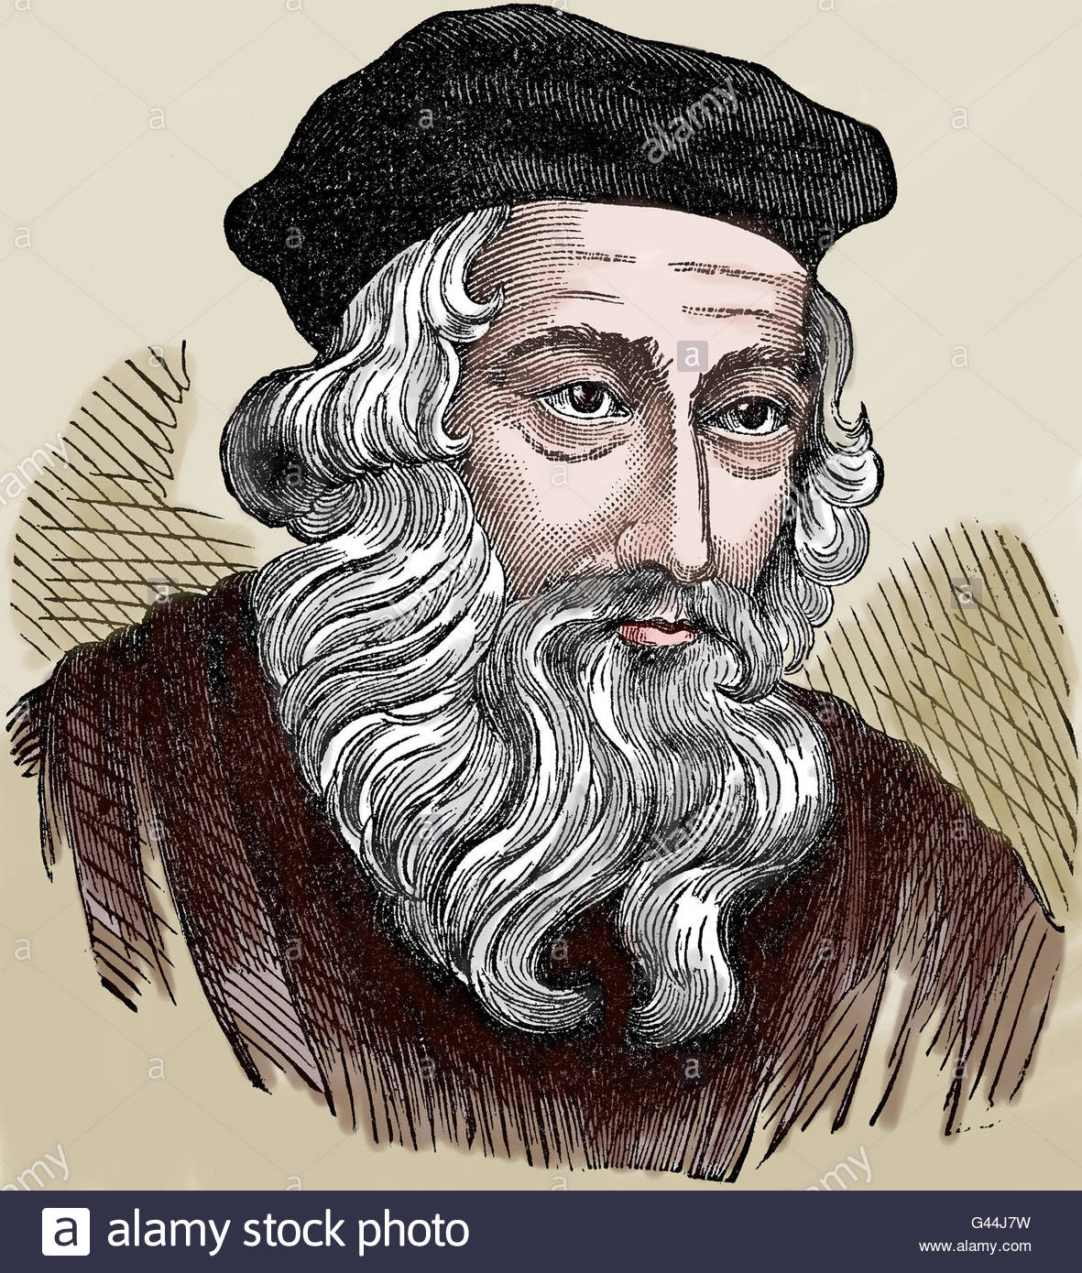
The Reformation – John Wycliffe ~1325 - 1384
During the distractions of the Babylonian Captivity of the Church, an English Scholastic theologian/professor at Oxford seminary arose.
Wycliffe was called the bright morning star of the reformation.
Wycliffe first attacked the privileged status of the clergy, which was central to their powerful role in England. He then attacked the luxury and pomp of local parishes and their ceremonies.
His followers were called Lollards, the popular derogatory nickname given to those without an academic background, and educated (if at all) only in English. By the mid-15th century, "lollard" had come to mean a heretic in general.

Slide 11
The Reformation – John Wycliffe ~1325 - 1384
Lollards followed his lead in advocating Predestination, Iconoclasm , and the supremacy of the king over the priesthood. He rejected the concept of purgatory, and disapproved pilgrimages, the selling of indulgences and praying to saints, while attacking the veneration of Saints, the Sacraments , Requiem Masses, monasticism, and the very existence of the Papacy.
Wycliffe insisted that the Bible formed the only valid source of doctrine and the only pertinent measure of legitimacy. (sola scriptura)
Wycliffe said the church is the elect of God, he called the Pope antichrist, Christ is the only head of the church, and celibacy is not Biblical.
Wycliffe raised the first serious challenge to transubstantiation maintaining that the Eucharist remained physically bread and wine, while becoming spiritually the body and blood of Christ. This is where he got into serious trouble.
Wycliffe was summoned before the Bishop of London, on February 19, 1377. The exact charges are not known, as the matter did not get as far as a definite examination.
In 1381 He was dismissed by Oxford University for his criticism of the Roman Catholic Church.

Slide 12
The Reformation – John Wycliffe ~1325 - 1384
In 1382 the Archbishop of Canterbury, called an ecclesiastical assembly of notables at London. During the consultations on May 21 an earthquake occurred; the participants were terrified and wished to break up the assembly, but the Archbishop declared the earthquake a favorable sign which meant the purification of the earth from erroneous doctrine.
Of the 24 propositions attributed to Wycliffe, ten were declared heretical and fourteen erroneous. It was forbidden to hold these opinions, or use them in sermons or academic discussions. To enforce this decision the help of the State was necessary; but the House of Commons rejected the bill. The king, however, had a decree issued which permitted the arrest of those in error.
On 17 November 1382, Wycliffe was summoned before a synod at Oxford. He still commanded the favor of the court and of Parliament. He was neither excommunicated then, nor deprived of his living.

Slide 13
The Reformation – John Wycliffe ~1325 - 1384
He completed a translation directly from the Vulgate into Middle English in 1382 (or 1384), now known as Wycliffe's Bible. It is probable that he personally translated the Gospels; and it is possible he translated the entire New Testament, while his associates translated the Old Testament. Additional updated versions were done by Wycliffe's assistant John Purvey and others in 1388 and 1395.
More than 250 manuscripts of the Wycliffe Bible survive. One copy sold at auction on December 5, 2016 for $1,692,500.
As he was saying Mass, December 28, 1384, he suffered a stroke, and died December 31.
In 1401 England's parliament instituted death by fire for heresy, and in 1407 English language Bibles were banned.
The Council of Constance declared Wycliffe a heretic on 4 May 1415, and banned his writings, effectively both excommunicating him retroactively and making him an early forerunner of Protestantism. The Council decreed that Wycliffe's works should be burned and his remains removed from consecrated ground. This order, confirmed by Pope Martin V, was carried out in 1428. Wycliffe's corpse was exhumed and burned and the ashes cast into the River Swift, in south central England.

Slide 14
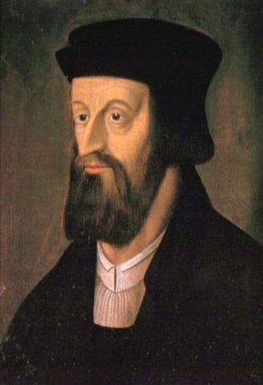
The Reformation – Council of Constance (Jan Hus 1369 – 1415)
Jan Hus was a Czech scholar and rector at the University of Prague. He had been attracted by the writings of Wycliffe.
In 1402 he began preaching Wycliffe and attracted a large following.
Czechs had been complaining about what they saw as the immorality of the clergy. Most of their priests were German, and their resentment against Germans accompanied their dislike for clergy privileges and their demand that scripture be translated into Czech.
Hus was called to the Council of Constance to defend his views. He was declared a heretic and burned at the stake on July 6, 1415. Hus means goose in Czech. It was said Hus laid the egg Luther hatched. His last words were You are going to burn a goose but in a century you will have a swan which you can neither roast nor boil.

Slide 15
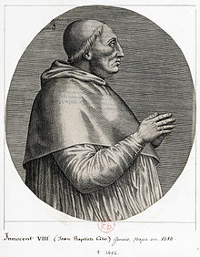
The Reformation (15th century) – Pope Innocent VIII
Born: 1432 Papacy: Aug. 29, 1484 – July 25, 1492
He had two illegitimate children before he entered the clergy.
Innocent published a decree allowing concubines in Rome for clergy and laity alike.
In 1487 he married his elder son to the daughter of Lorenzo de' Medici. Pope Innocent VIII then got de' Medici,s thirteen-year-old son Giovanni appointed a Cardinal. He later became Pope Leo X!
In July 1492 He contracted a fever and was given the world's first blood transfusion by his Jewish physician who had him drink the blood of three 10-year-old boys.
The inscription on his tomb in Saint Peter in Rome states: During his Pontificate, the glory of the discovery of a new world. He died seven days before the departure of Christopher Columbus raising speculations that Columbus discovered the Americas before the supposed date of October 12, 1492.

