Slide 1
Discipleship: An Introduction to Systematic Theology and Apologetics
The Doctrines of Redemption: The Reformation
The Heights Church October 8, 2017

Slide 2
The Reformation – Setting the Table for October 31, 1517
Two key misconceptions regarding Roman Catholicism
There is an unbroken chain of Popes from the present back to Peter (the first Pope).
Roman Catholicism is the one, holy, catholic and apostolic church which has had consistent Theology and Doctrines dating back to the Apostles.

Slide 3
The Reformation – Summary of the last five of Popes
POPE | Reign | Comments
Paul VI | June 21, 1963 – August 6, 1978 | Last Pope crowned with the tiara. First Pope since 1809 to travel outside Italy. Closed the second Vatican Council
John Paul I | 26 August 1978 – 28 September 1978 | Shortest Reign since Urban VII (1590)
John Paul II | 16 October 1978 – 2 April 2005 | First non-Italian Pope since Adrian VI (1522–1523) Third longest reign after Pius IX (June 16, 1846 – February 7, 1878) and Saint Peter
Benedict XVI | 19 April 2005 – 28 February 2013 | First Pope to renounce the papacy on his own initiative since Celestine V (1294)
Francis | March 13, 2013 to present | First Jesuit Pope and first Pope named Francis First Pope born outside Europe since Gregory III (731 – 741)
Notes:
Gregory12 1415; constance; Benedict 16 4th oldest pope; trained as a chemistry teacher not theologian; Paul 6 came to U.S. in oct 1965 to address the UN and met with LBJ

Slide 4
The Reformation – Was Peter the first of an unbroken chain of Popes?
According to Roman Catholics Pope Francis is the 266th Pope (Latin for papa). The Apostle Peter was the first and longest reigning Pope serving from April 1, 33 A.D. until June 29, 67 A.D. The average reign of a Pope has been about 7.5 years.
Roman Catholics agree the most likely day Jesus died on the cross was Friday April 3, 33 A.D.
The first bishop of Rome to be contemporaneously referred to as "Pope" was Damasus I (366-384). He was the 37th Pope!
A.D.445 during the reign of Pope Leo I was the first record of the belief that Peter was the first Pope.
Roman Catholics see Matthew 16:13-18 as the basis for Peter being the first Pope.
Notes:
Jesus meets Peter leaving Rome saying he has come to Rome to be crucified again DVD series history or R.C.; April 3 from catholic answers magazine newton calculated april 3, 33; lunar eclipse at about the right time calculated in 1910; 4/3/33 national catholic register; majority opinion of protestants is april 7 30 AD

Slide 5
The Reformation – Was Peter the first of an unbroken chain of Popes?
Now when Jesus came into the district of Caesarea Philippi, he asked his disciples, "Who do people say that the Son of Man is?" And they said, "Some say John the Baptist, others say Elijah, and others Jeremiah or one of the prophets." He said to them, "But who do you say that I am?" Simon Peter replied, "You are the Christ, the Son of the living God." And Jesus answered him, "Blessed are you, Simon Bar-Jonah! For flesh and blood has not revealed this to you, but my Father who is in heaven. And I tell you, you are Peter, and on this rock I will build my church, and the gates of hell shall not prevail against it. (Matthew 16:13-18)
Versus
So then you are no longer strangers and aliens, but you are fellow citizens with the saints and members of the household of God, built on the foundation of the apostles and prophets, Christ Jesus himself being the cornerstone (Ephesians 2:19 – 20)
Notes:
Petros = peter masculine boulder; Petras feminine massive rock so is the rock God’s revelation or the confession? BUT eph 2:20 does not set peter above or apart JESUS builds church on people GOD GIVES HIM???

Slide 6
The Reformation – Was Peter the first of an unbroken chain of Popes?
Impetuous Peter is anything but a rock and an unlikely candidate to become the first pope.
From that time Jesus began to show his disciples that he must go to Jerusalem and suffer many things from the elders and chief priests and scribes, and be killed, and on the third day be raised. And Peter took him aside and began to rebuke him, saying, "Far be it from you, Lord! This shall never happen to you." But he turned and said to Peter, "Get behind me, Satan! You are a hindrance to me. For you are not setting your mind on the things of God, but on the things of man." (Matthew 16:21-23)
Notes:
Peter; jesus; peter’s confession

Slide 7
The Reformation – Was Peter the first of an unbroken chain of Popes?
Paul rebuked Peter when he would have been serving as Pope.
But when Cephas came to Antioch, I opposed him to his face, because he stood condemned. For before certain men came from James, he was eating with the Gentiles; but when they came he drew back and separated himself, fearing the circumcision party. And the rest of the Jews acted hypocritically along with him, so that even Barnabas was led astray by their hypocrisy. But when I saw that their conduct was not in step with the truth of the gospel, I said to Cephas before them all, "If you, though a Jew, live like a Gentile and not like a Jew, how can you force the Gentiles to live like Jews?" (Galatians 2:11-14)

Slide 8
The Reformation – Was Peter the first of an unbroken chain of Popes?
James not Peter seems to be in charge at the Jerusalem Council.
And after there had been much debate, Peter stood up and said to them, "Brothers, you know that in the early days God made a choice among you, that by my mouth the Gentiles should hear the word of the gospel and believe (Acts 15:7).
After they finished speaking, James replied, "Brothers, listen to me. (Act 15:13)
Therefore my judgment is that we should not trouble those of the Gentiles who turn to God, but should write to them to abstain from the things polluted by idols, and from sexual immorality, and from what has been strangled, and from blood. (Acts 15:19-20)

Slide 9
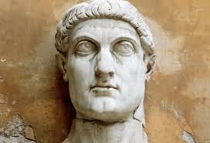
The Reformation – Constantine the Great
Born: February 27, 272
Died: May 22, 337
Reigned : July 25, 306– May 22, 337
The Doctrine of Constantine: The LORD gave me a vast empire that is difficult to rule so I (Constantine) give the West to the Pope.
It is now believed that the Doctrine of Constantine was written about 750.
Constantine issued the Edict of Milan in February 313 giving Christianity a legal status in the Roman Empire.
In 325 Constantine called the Council of Nicea. In 335 he exiled Athinasius for defending the Council’s ruling that Arius was a heretic. Athinasius would be exiled four more times in his life for defending the Council of Nicea
In 380 Emperor Theodosius I made Christianity the official religion of the Roman empire.
Notes:
. The Nicene Creed states that Christ was of “the same substance” as the Father. In Greek he is homoousios. MILIVIAN Bridge oct 28, 312; chi and rho (ΧΡ

Slide 10
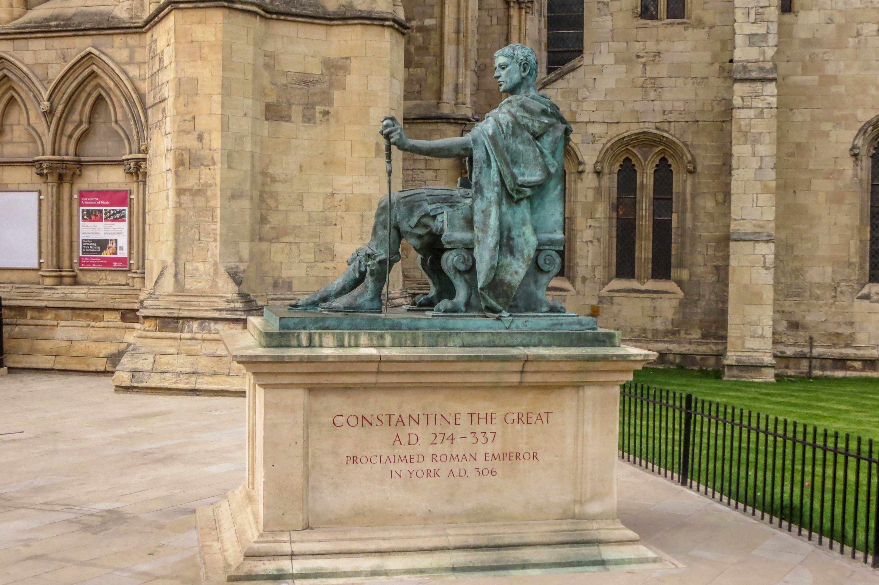
The Reformation – Constantine the Great

Slide 11
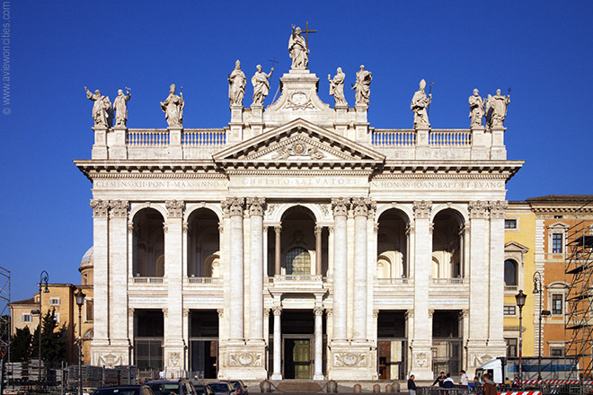
The Reformation – Archbasilica of St. John Lateran
Built on the site of the first “legal” church in the Roman Empire.
Officially the Cathedral of the Bishop Rome and the highest ranking Cathedral in Roman Catholicism.
Pope Clement XII dedicated this building to Christ the Savior, in honor of Saints John the Baptist and John the Evangelist“ in 1735.
Notes:
highly abbreviated inscription translates to: ". Christ is on top 2.5 miles from vatican

Slide 12
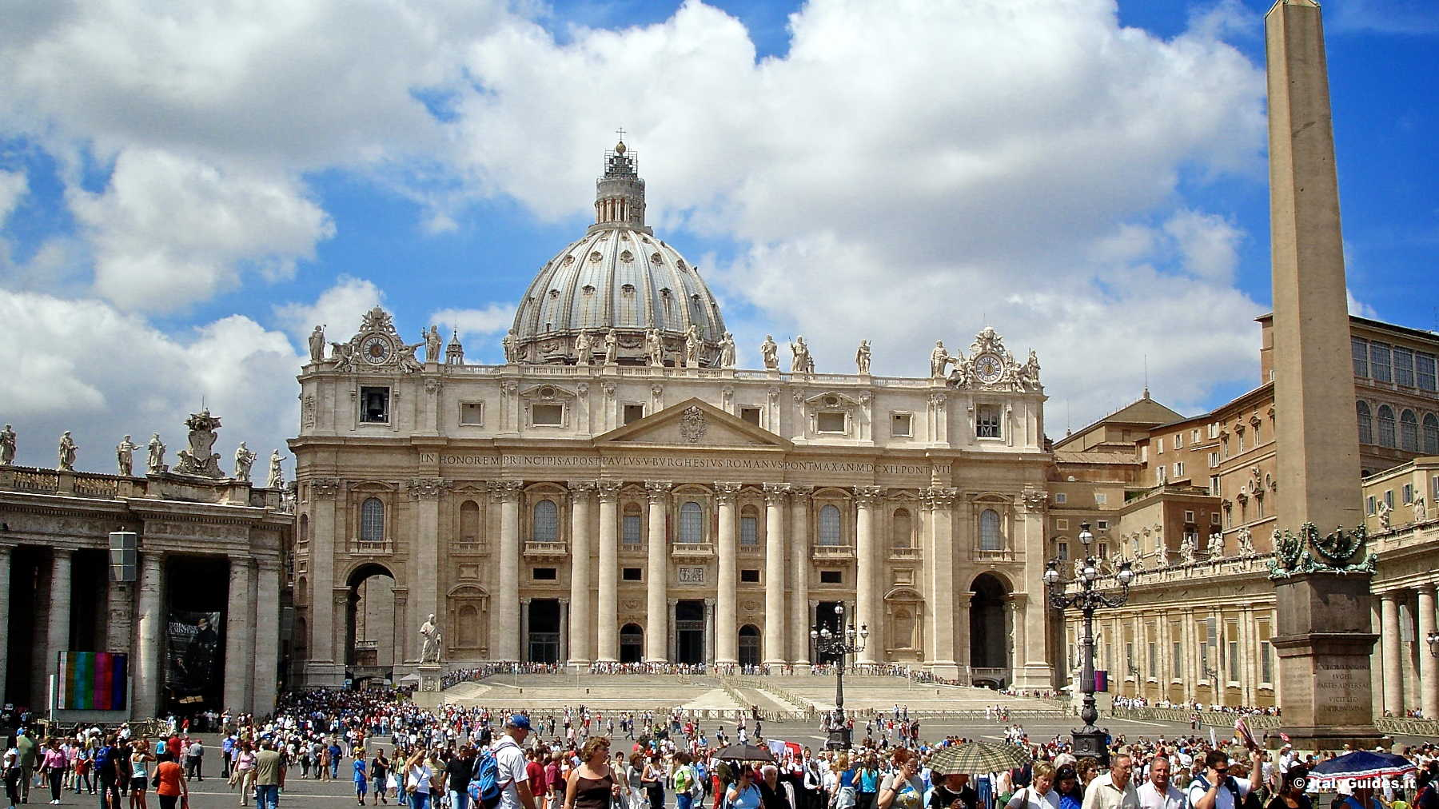
The Reformation – St Peter’s Basilica
Originally built by Constantine in 319 – 333 over the supposed burial place of St Peter.
Refurbished from 1505 -1655 financed in large part by the selling indulgences.
On 23 December 1950, in his pre-Christmas radio broadcast to the world, Pope Pius XII announced the discovery of Saint Peter's tomb.
Notes:
Mn capital dome was based on this design by Michelangelo Mn dome is 220 feet vs 151 for st pete 284 ft Wisconsin us 288

