Slide 1
Discipleship: An Introduction to Systematic Theology and Apologetics
The Doctrines of Redemption: The Reformation
The Heights Church October 15, 2017

Slide 2
The Reformation – Setting the Table for October 31, 1517
Pre-Reformation Roman Catholicism
“Church Fathers” preserve Christianity
Constantine to Charlemagne (306 – 800)
11th and 12th Century theologians
13th Century (The Wondrous Century)
14th and 15th Century
16th century through the Council of Trent
Notes:
pre-existence of souls, the final reconciliation of all creatures, including perhaps even the devil(the apokatastasis),^{[4]} and his possible^{[5][6]} belief that God the Son was subordinate to God the Father, not a saint Origen; speculative theology, Acquinas said only literal interpretation for doctrine , logos sent to earth to work out sin

Slide 3
The Trinity 3 basic errors about the Person of Christ
Deity
Ebionism: Denies the deity of Christ. Jesus was a normal human empowered by God.
Arianism: Denies Christ is eternal and hence is not fully divine.
Humanity
Apollinarianism: Denies the full humanity of Christ. The person of Christ had a human body but not a human mind or spirit. Christ’s mind and spirit were from the divine nature of the Son of God
Docetism: Denies the humanity of Christ. Jesus’ body was an illusion.
Two Natures
Nestorianism: Denies the two natures exist in one person i.e. Christ is a human person and a divine person.
Eutychianism: Denies the distinction of the natures. Christ had one nature. The human nature of Christ was taken up and absorbed into the divine nature creating a 3rd New Nature.

Slide 4
The Trinity 3 basic errors about the Person of Christ
Council of Nicea 325
Council of Constantinople 381
Council of Chalcedon 451
Regional Church Council at Toledo 589
Notes:
Pope approves in 1017; John 15:26 & 16:7; 4th and 5th centuries and 19th-21st century

Slide 5
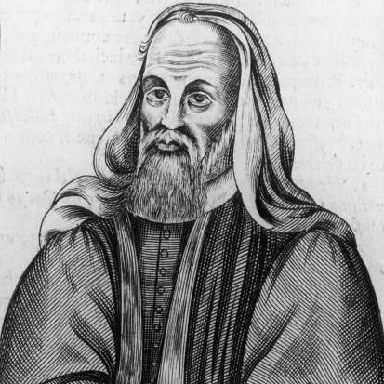
The Reformation – Pelagius (360 – 418)
He was educated in Greek, Latin and theology.
He was an ascetic, well known in Rome, for his harsh asceticism and powerful, persuasive speech.
His reputation earned him praise early in his career from Augustine who referred to him as a "saintly man.”
Pelagius denied original sin and predestination.
Pelagius was declared a heretic by the Council of Carthage (416 and 418) and the Council of Ephesus in 431.
Pelagius taught that human beings have a natural capacity to reject evil and seek God. Man is basically good and moral and even pagans can enter heaven through their virtuous moral actions.
Until Charles Finney (1792 – 1875) no pure Pelagianism was taught. Finney taught we are all born in a state of moral neutrality, able to choose between good and evil—to choose between being good or being sinful.
Notes:
Innocent 1 died two months after excom him in 416; british

Slide 6
The Reformation – Pelagius (360 – 418)
Augustine charged Pelagius with denying the following doctrinal “truths:”
Death came from sin, not man's physical nature.
Infants must be baptized to be cleansed from original sin.
Justifying grace covers past sins and helps avoid future sins.
The grace of Christ imparts strength and will to act out God's commandments.
No good works can come without God's grace.
We confess we are sinners because it is true, not from humility.
The saints ask for forgiveness for their own sins.
The saints also confess to be sinners because they are.
Children dying without baptism are excluded from both the kingdom of heaven and eternal life.

Slide 7
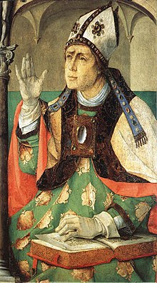
The Reformation – Augustine of Hippo (13 November 354 – 28 August 430)
Greatest Theologian between the Apostles and Aquinas.
Bishop of Hippo 395-430.
Converted August 386, prompted by a childlike voice he heard telling him to "take up and read.”
Romans 13:13-14 Let us walk properly as in the daytime, not in orgies and drunkenness, not in sexual immorality and sensuality, not in quarreling and jealousy. But put on the Lord Jesus Christ, and make no provision for the flesh, to gratify its desires.
Augustine is credited with helping develop many key doctrines such as : original sin and the Trinity (Nicea and Constantinople).
He developed a philosophical synthesis of Plato and Christianity - humans were the perfect unity of soul and body though he did not set forth a system for this.
Notes:
Hippo extreme ne algeria

Slide 8
The Reformation – Augustine of Hippo (13 November 354 – 28 August 430)
Long before Descartes famous maxim “I think therefore I am” that established existence, Augustine had said If I err, I am.”
He argued senus divinitatis as Calvin later would that the knowledge of God is innate in the human soul. People’s ignorance about God’s existence is willful and therefore sinful. For although they knew God, they did not honor him as God or give thanks to him, but they became futile in their thinking, and their foolish hearts were darkened. (Romans 1:21)
“Mathematics is a source of objective and indubitable truth and like logic independent on sensory data.”
Just as an external source of light is needed for seeing, so an external revelation from God is needed for knowing.”
Notes:
Believing is seeing; do you agree or don’t you understand yet?

Slide 9
The Reformation – Augustine of Hippo (13 November 354 – 28 August 430)
“I believe in order to understand.” All knowledge begins in faith which is prior to reason. For Augustine faith is always reasonable. Believing is seeing! Jesus said to her, "Did I not tell you that if you believed you would see the glory of God?“ (John 11:40) Many of the Jews therefore, who had come with Mary and had seen what he did, believed in him, but some of them went to the Pharisees and told them what Jesus had done. (John 11:45 – 46)
Augustine said God created ex nihlo. God’s work of creation was voluntary and purposive but not necessary. It did not violate either the Law of Noncontradiction or Out of nothing, nothing comes.” When asked what was God doing before he created the world he answered, “ Creating hell for curious souls.”
Since God is good, everything God created is good including material things BUT he did not create things immutably good so the Fall could occur.
Evil is a lack, privation or negation of the good.
He vigorously condemned abortion, and although he disapproved of an abortion during any stage of pregnancy, he made a distinction between early abortions and later ones.
He was the first theologian to work out the doctrine of amillennialism.

Slide 10
The Reformation – Augustine of Hippo (13 November 354 – 28 August 430)
In his book, The City of God, he presents the development of slavery as a product of sin and as contrary to God's divine plan. He wrote that God "did not intend that this rational creature, who was made in his image, should have dominion over anything but the irrational creation – not man over man, but man over the beasts."
Although Augustine did not develop an independent Mariology, his statements on Mary surpass in number and depth those of other early writers. Even before the Council of Ephesus, he defended the Ever-Virgin Mary as the Mother of God, believing her to be "full of grace" (following earlier Latin writers such as Jerome) on account of her sexual integrity and innocence. Likewise, he affirmed that the Virgin Mary "conceived as virgin, gave birth as virgin and stayed virgin forever.“
Augustine taught that sacraments administered outside the Catholic Church, though true sacraments, avail nothing. However, he also stated that baptism, while it does not confer any grace when done outside the Church, does confer grace as soon as one is received into the Catholic Church.

Slide 11
The Reformation – Augustine of Hippo (13 November 354 – 28 August 430)
Augustine is probably best known for his Confessions, which is a personal account of his earlier life, and for The City of God, consisting of 22 books, which he wrote to restore the confidence of his fellow Christians, which was badly shaken by the sack of Rome by the Visigoths in 410.
Augustine strongly stressed the importance of infant baptism. About the question whether baptism is an absolute necessity for salvation, however, Augustine appears to have refined his beliefs during his lifetime, causing some confusion among later theologians about his position. He said in one of his sermons that only the baptized are saved. This belief was shared by many early Christians. However, a passage from his City of God, concerning the Apocalypse, may indicate that Augustine did believe in an exception for children born to Christian parents.

