Slide 1
Discipleship: An Introduction to Systematic Theology and Apologetics
The Doctrines of Redemption: The Reformation
The Heights Church October 29, 2017

Slide 2
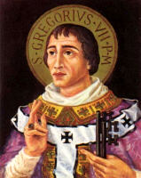
The Reformation (11th century)– Gregory VII
Born: 1015 - 1025
Died: May 25 1085
Reigned : April 22, 1073-May 25, 1085
Reform minded and dedicated to ending Investiture (lay involvement in selection of Bishops and Abbots) Gregory VII said God selects the Bishop or Abbot who bows to the Pope.
Excommunicated Holy Roman Emperor Henry IV twice.
Established that the College of Cardinals selects the Pope. Enforced celibacy for all clergy.

Slide 3
The Reformation – The Schism of 1054
Christianity organized itself around the Roman Empire with centers in Rome and Constantinople.
From the beginning it was clear that there were differences in doctrinal emphasis in the west and east.
The West always has seen the Atonement as most important while the East has always seen the Incarnation as most important
Veneration of Idols
The filioque clause
Papal Supremacy

Slide 4
The Reformation – The Schism of 1054– Veneration of Idols (Second Council of Nicea 787)
It was determined that "As the sacred and life-giving cross is everywhere set up as a symbol, so also should the images of Jesus Christ, the Virgin Mary, the holy angels, as well as those of the saints and other pious and holy men be embodied in the manufacture of sacred vessels, tapestries, vestments, etc., and exhibited on the walls of churches, in the homes, and in all conspicuous places, by the roadside and everywhere, to be revered by all who might see them. For the more they are contemplated, the more they move to fervent memory of their prototypes. Therefore, it is proper to accord to them a fervent and reverent adoration, not, however, the veritable worship which, according to our faith, belongs to the Divine Being alone — for the honor accorded to the image passes over to its prototype, and whoever venerate the image venerate in it the reality of what is there represented.“
The council also decreed that every altar should contain a relic, which remains the case in modern Catholic and Orthodox regulations (Canon VII).

Slide 5
The Reformation – The Schism of 1054 – The Filoque clause
filioque is a Latin term that means “and from the Son”
In A.D. 589 a regional church council at Toledo added to the Nicean Creed that the Holy Spirit proceeds from the Father and from the Son.
But when the Helper comes, whom I will send to you from the Father, the Spirit of truth, who proceeds from the Father, he will bear witness about me. John 15:26
if I do not go away, the Helper will not come to you. But if I go, I will send him to you. John 16:7
Officially adopted by the Pope in 1017.
To this day Orthodox believers say this is incorrect.

Slide 6
The Reformation – The Schism of 1054 – Papal Supremacy
At first the Eastern leaders agreed to the concept of the Pope was the first among equals.
As the Eastern church expanded east into Russia limited communication led to a more independent form of church organization.
Disagreements between East and West were often not carried out in a charitable manner.
The “last straw” came in 1017 when the Pope added the filioque clause without consulting the Eastern Churches.
To this day there is still a Latin Bishop of Constantinople as well as a Greek Orthodox Bishop.

Slide 7
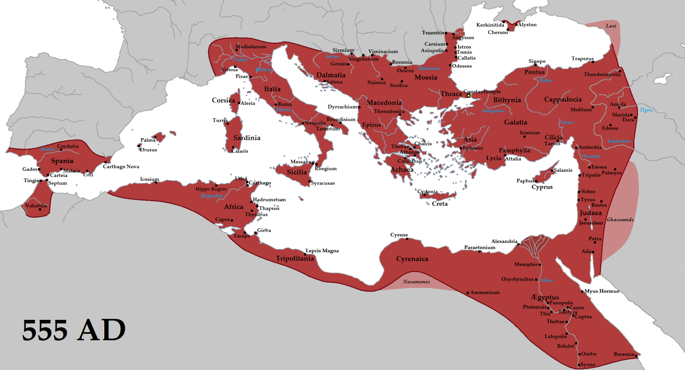
The Reformation – The Crusades
Historians generally agree the Western Roman Empire ended with the fall of Rome on Sept. 4, 476.
Constantinople was the capital of what became known as the Byzantine Empire (remnant of the former Roman Empire) That reached it maximum extent in 555)

Slide 8
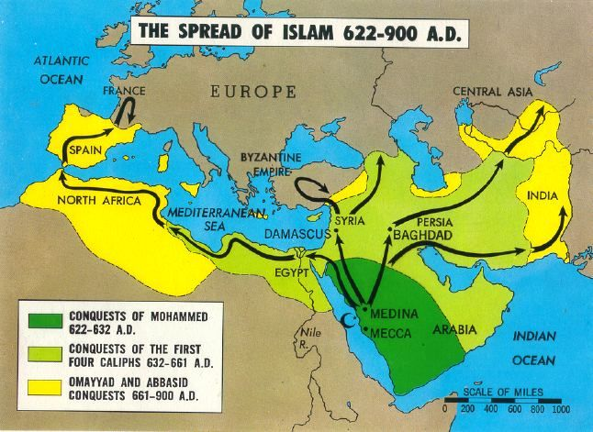
The Reformation – Charlemagne (Islam A.D. 800 )

Slide 9
The Reformation – The Reformation – The Crusades (Executive Summary)
The word Crusade is a French word meaning “way of the cross.”
Historians struggle to explain why the crusades ever happened.
Prior to the Crusades Christians had gone to war for the state but never for the church.
Later time off from purgatory was offered to crusaders, but at the start that was not the motive.
The motive seems to have been that about 1000 years had passed since the time of Christ and they anticipated a second coming.
A desire to make pilgrimages arose and rumors said that the Muslims were restricting Christian access to Jerusalem.
It is estimated an army of about 100,000 men left on the first crusade.

Slide 10
The Reformation – The Reformation – The Crusades (Executive Summary)
There were 6 major and 3 minor Crusades:
1096 – 1099 Called by Pope Urban II it captured Jerusalem July 15, 1099. There was a great slaughter of Jews and Muslims exceeding the violence of the Muslim capture in 638. Conquered lands were supposed to be returned to the Byzantine Empire but the leaders of the crusade divided the territories among themselves. and established themselves as the rulers of the newly formed crusader states in the Holy Land.
1145 – 1149 After modern Turkey fell to the Muslims in 1144 kings, Louis VII of France and Conrad III of Germany, decided to lead the crusade. One year later, they laid siege to Damascus but after failing to capture the city, they withdrew.
1189 – 1192 Launched after the fall of Jerusalem to the Muslims in 1187 by the kings of Germany, France and England. The German king died in route, France and England were on the verge of conflict so the King of France went home. Richard I won several notable battles but failed to recapture Jerusalem. Before returning to Europe, Richard I negotiated a free access to Jerusalem for Christian pilgrims that lasted about 15 years.

Slide 11
The Reformation – The Reformation – The Crusades (Executive Summary)
There were 6 major and 3 minor Crusades:
4. 1200 – 1204 Pope Innocent III raised an army of crusaders who never made it to the Holy Land. On their way to Jerusalem, they got involved in the struggle for the Byzantine throne. Instead of recapturing Jerusalem as the Pope hoped, the Fourth Crusade ended with the Sack of Constantinople and formation of the short-lived Latin Empire in the conquered Byzantine territories.
5. 1213 or 1217 – 1221 Pope Innocent’s successor Honorius III managed to convince Andrew II of Hungary and Leopold VI, Duke of Austria to lead the expedition. They started in Egypt but despite some early victories the crusaders were forced to return home without capturing either Egypt or the holy cities.
6. 1228 – 1229 The Sixth Crusade was a major success for the crusaders despite the fact that it saw little action. The Holy Roman Emperor Frederic II led the campaign under excommunication. Shortly after arriving in the Holy Land, Frederick II entered into negotiations with the Egyptian sultan who agreed to give Jerusalem, Nazareth, Bethlehem and other holy cities to the Christians.

Slide 12
The Reformation – The Reformation – The Crusades (Executive Summary)
The three minor Crusades:
7. 1248 – 1254 King Louis IX of France decided to recapture the Holy Land by conquering Egypt first. He was taken captive but released after a ransom was paid. However, before he reached the Holy Land he received word his mother died and he returned to France.
8. 1270 King Louis IX tried again starting from Tunis. Disease broke out among the troops shortly after landing and the French king died shortly thereafter. His brother Charles arrived one day before his death and immediately entered into negotiations with the Caliph of Tunis to ensure safe departure of the crusader army.
9. 1271 – 1272 After King Louis IX’s death and the departure of the French crusaders, Prince Edward of England decided to launch his own expedition. In 1271, he landed in Northern Israel and tried to win support for his cause but lack of interest and news from England about his father’s illness prompted him to return home. With Prince Edward’s departure, the attempts of Christian Europe to capture the Holy Land finally came to an end.

Slide 13
The Reformation – The Reformation – The Crusades
What lessons can be learned from the crusades?
The complete defeat of Islam would have been necessary to recapture the Holy Land long term.
The leadership generally lacked commitment and competency for such a large undertaking.
Christianity is not ultimately about a particular piece of property.
Christianity does not advance by the sword.
What did the Crusades accomplish?
They left behind a legacy of hatred and distrust with Islam.
They dashed any hope of reconciliation with the East by sacking Constantinople.

Slide 14
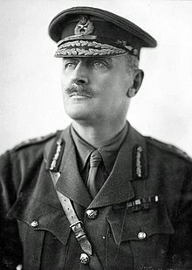
The Reformation – The Crusades -General Allenby
Captured Jerusalem December 9, 1917.
Defeated Ottomans at Megiddo September 21, 1918.
Defeated Ottomans at Allepo October 25, 1918.
Ottoman Empire surrendered October 30, 1918.

