Slide 1
Discipleship: An Introduction to Systematic Theology and Apologetics
The Doctrines of Redemption: The Reformation
The Heights Church November 5, 2017

Slide 2
The Reformation (11th - 12th century) –Scholastics
The first universities began in this era; Bologna in 1088, Oxford in 1096?, and Cambridge in 1209.
The Scholastics* (school) arose about 1100 and were an important group until about 1700. Anselm and Abelard were Scholastics. Thomas Aquinas was a Dominican Scholastic. Aquinas’ Summa Theologica is considered to be the pinnacle of scholastic, medieval, and Christian philosophy.
*the system of theology and philosophy taught in medieval European universities, based on Aristotelian logic, the writings of the early Church Fathers and having a strong emphasis on tradition and dogma.
Scholasticism developed a technical vocabulary for theology.
Scholastics were accused of getting involved in irrelevant issues.
The classic indictment of scholastics was they worried about how many angels could dance on the head of a pin. However, this is an important question – are angels physical or spiritual?

Slide 3
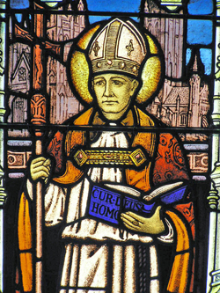
The Reformation (11th - 12th century) – Anselm
Born: 1033
Died: April 21, 1109
Archbishop of Canterbury : 1093 - 1109
Regarded the greatest theologian between Augustine and Thomas Aquinas, Anselm wrestles with the relationship between faith and reason.
His most famous work is Cur Deus Homo (Why the God man).
His other great work is the Proslogium (How to prove God exists)

Slide 4
The Reformation (11th - 12th century) – Anselm: Cur Deus Homo
Anselm saw sin as a debt that God could not or would not overlook.
The question then is: Was the cross the only way or was the cross the way God decided to atone for sin? Anselm seems to say it was the only way.
In simple terms his argument was:
Man owed a debt but couldn’t pay it.
God could pay the debt but didn’t owe it.
Only the God man could owe the debt and pay it.

Slide 5
The Reformation (11th - 12th century) – Anselm: Proslogium
The original title of the work was Faith Seeking Understanding. Proslogium translates into English as Discourse on the Existence of God.
Anselm’s a priori ontological argument for the existence of God is:
One can imagine a being than which none greater can be conceived. .
We know that existence in reality is greater than existence in the mind alone.
If the being we imagine exists only in our mind, then it is not a "being than which none greater can be conceived".
A being than which none greater can be conceived must also exist in reality.
Failure to exist in reality would be failure to be a being than which none greater can be conceived.
Thus a being than which none greater can be conceived must exist, and we call this being God.
Throughout history the greatest minds have been about equally divided on the veracity of this argument.

Slide 6
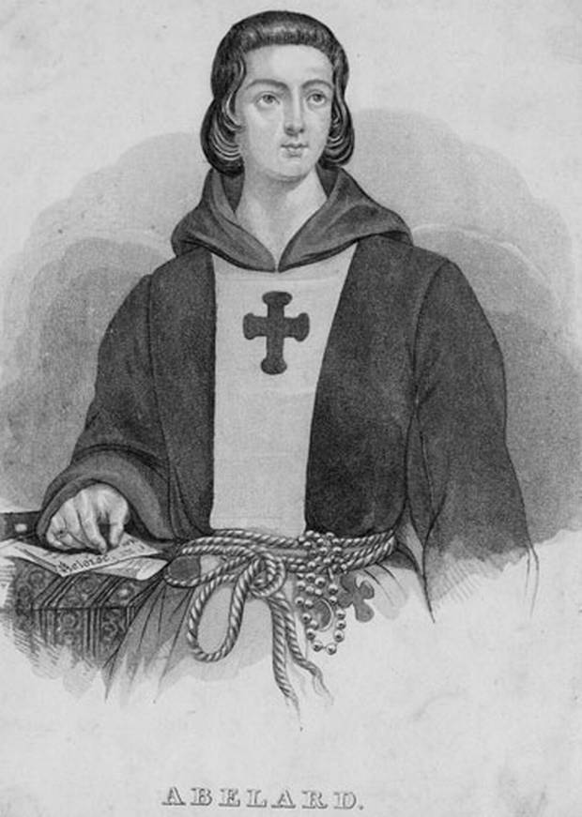
The Reformation (11th - 12th century) – Peter Abelard
Born: 1079
Died: April 21, 1142
Abelard studied the opinions of various theologians and showed there was often no consensus.
His famous work was SIC ET NON translated as Thus and No.
He disagreed with Anselm and said there was not a necessary debt that had to be repaid. Jesus became a man to show us the love of God.
He was appalled that God would have to be appeased.
But how does crucifying your son show the love of God unless the crucifixion does something else?

Slide 7
The Reformation (11th - 12th century) – Peter Abelard
Regarding unbaptized who die in infancy, Abelard—emphasized the goodness of God and interpreted St. Augustine’s "mildest punishment" as the pain of loss at being denied the beatific vision*, without hope of obtaining it, but with no additional punishments. His thought contributed to the forming of Limbo of Infants** theory in the 12th–13th centuries.
* beatific vision is the ultimate direct self communication of God to the individual person. A person possessing the beatific vision reaches, as a member of redeemed humanity in the communion of saints, perfect salvation in its entirety.
** The Limbo of Infants is a hypothesis about the permanent status of the unbaptized who die in infancy, too young to have committed personal sins, but not having been freed from original sin. Recent Catholic theological speculation tends to stress the hope, though not the certainty, that these infants may attain heaven instead of the supposed state of Limbo (edge of hell).

Slide 8
The Reformation (11th - 12th century) – St Bernard of Clairvaux
Born: 1090
Died: August 20, 1153
St Bernard was instrumental in raising public support for the Second Crusade. When it failed he was widely blamed for its failure.
History has been kind to St Bernard and he came to be regarded as the ultimate Monk. In 1830 Pope Pius VIII bestowed upon Bernard the title "Doctor of the Church“.
St Bernard argued against some of Abelard’s work. Abelard was excommunicated, silenced and his books burned by Pope Innocent II in 1141. In the 13th century the essence of Abelard’s work was approved by the pope.

Slide 9
The Reformation (11th - 12th century) – St Bernard of Clairvaux
Bernard raised the following objections to Abelard’s work:
Abelard said that while God the Father was full power, God the Son was only ‘a certain power’ and the Holy Spirit ‘no power at all’; that the Holy Spirit was not of the substance of the Father and Son; that Christ did not come to free humanity from the yoke of the devil; and that omnipotence belonged to the Father alone.”
Abelard said, “A person could do virtually anything and be guiltless if his intentions were “good.” St. Bernard, said “hell is full of good wishes or desires.” That quote became the basis for the saying “The road to hell is paved with good intentions.”

Slide 10
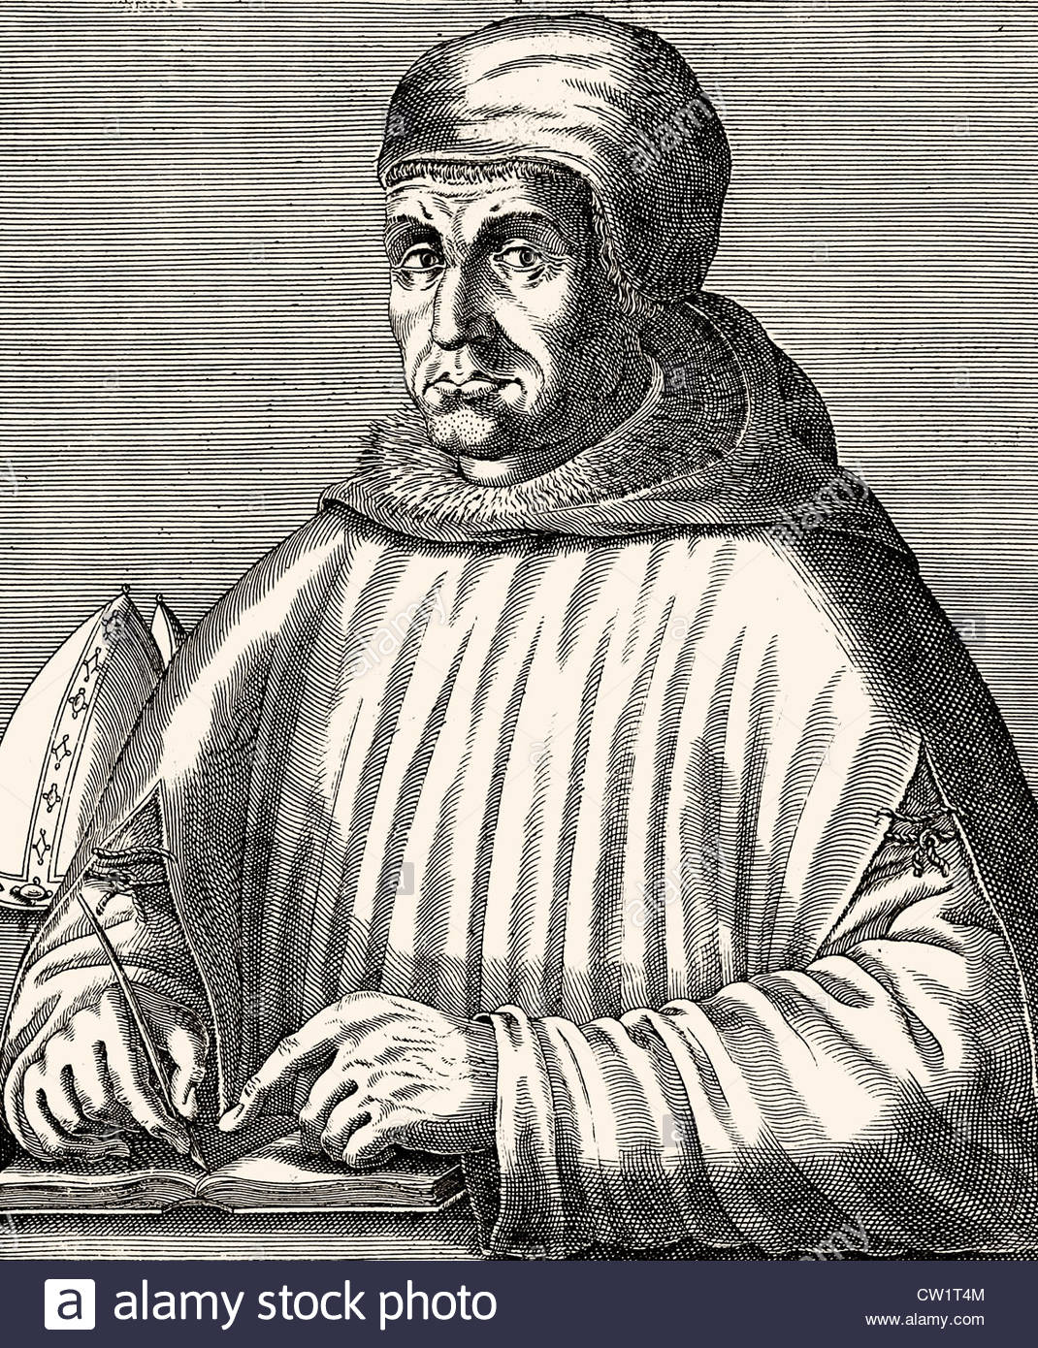
The Reformation (11th - 12th century) – Peter Lombard (1100 – 1160 or 1164?)
Lombard was not a great theologian but had a very systematic mind. He wrote the Four Sentences, a Systematic theology book that would be used throughout the Middle Ages.
In 1509 Luther received a bachelor’s degree in Lombard’s Sentences.
Like Abelard he gathered the works of other theologians. However, he selected what he thought was the truth and about 80% was Augustine’s work.

Slide 11
The Reformation (11th - 12th century) – Peter Lombard (1100 – 1160 or 1164?)
Lombard endorsed the concept of a physical purgatory where venial sins were consumed by fire and that masses and alms can be of value to souls in purgatory if they had lead a “worthy” life.
each one's work will become manifest, for the Day will disclose it, because it will be revealed by fire, and the fire will test what sort of work each one has done. If the work that anyone has built on the foundation survives, he will receive a reward. If anyone's work is burned up, he will suffer loss, though he himself will be saved, but only as through fire. (1 Corinthians 3:13-15)
Although denying the existence of purgatory as in Roman Catholicism, the Anglican and Methodist traditions along with Eastern Orthodox, affirm the existence of an intermediate state, Hades, and thus pray for the dead, as do many Lutheran Churches, which remembers “the faithful departed” in the Prayers of the People every Sunday, including those who have recently died and those commemorated on the church calendar of saints. Eastern Orthodox Churches believe in the possibility of a change of situation for the souls of the dead through the prayers of the living.

Slide 12
The Reformation (11th - 12th century) – Peter Lombard (1100 – 1160 or 1164?)
He is the first to ask if Christ died for every person or just the elect and concluded Christ’s death was sufficient to save every person but efficacious for only the elect.
But I said to you that you have seen me and yet do not believe. All that the Father gives me will come to me, and whoever comes to me I will never cast out. For I have come down from heaven, not to do my own will but the will of him who sent me. And this is the will of him who sent me, that I should lose nothing of all that he has given me, but raise it up on the last day. For this is the will of my Father, that everyone who looks on the Son and believes in him should have eternal life, and I will raise him up on the last day." (John 6:36-40)

