Slide 1
Discipleship:
An
Introduction to
Systematic Theology and
Apologetics
The Doctrines of Creation:
The Heights Church May 8, 2016

Slide 2
Intelligent Design: Evolution vs Genesis 1:3 - 31
There are three classic arguments for the existence of God.
The Ontological Argument: God has the power of being.
The Cosmological Argument proceeds via Cause and Effect from the existence of the universe to conclude an eternal being created the universe out of nothing.
The Teleological Argument: The universe was created by an intelligent being because of the order of the universe (Romans 1:19-20)

Slide 3
Intelligent Design: Evolution vs Genesis 1:3 - 31
With any Teleological argument (Intelligent Design in today’s vocabulary) the fundamental question is whether or not the subject is the product of a succession of random, purposeless events or if reason requires a purposeful, intelligence that lies behind the origin of the subject.
For the wrath of God is revealed from heaven against all ungodliness and unrighteousness of men, who by their unrighteousness suppress the truth. For what can be known about God is plain to them, because God has shown it to them. For his invisible attributes, namely, his eternal power and divine nature, have been clearly perceived, ever since the creation of the world, in the things that have been made. So they are without excuse. Romans 1:18-20

Slide 4
Intelligent Design: Evolution vs Genesis 1:3 - 31
In considering the human heart example continually ask yourself two questions:
Could the four chamber human heart arise purely by an undirected cascade of random events?
Could the overall cardiovascular system arise independently purely by an undirected cascade of random events such that it perfectly operates with the four chamber heart?

Slide 5
Intelligent Design: Evolution vs Genesis 1:3 - 31
CO = SV x HR
CO = Cardiac Output (volume of blood pumped per minute)
SV = Stroke Volume (volume of blood pumped per beat)
HR = Heart Rate (number of beats per minute)
In an average healthy adult at rest
CO ~ 5 liters/min.
SV ~ 71 ml/beat
HR ~ 70 beats/min.
Notes:
Do the car example, pop can = 355 ml @ 70 bpm SV = 71 ml = 5 beats per pop can = 14 cans per minute
5 l/min = 5x60x24 = 7200 l/day = 50,400 l/week, =2,620,000 l/year = 196,560,000 l/75 years use 75 years from Psalm 90:10 3 score and 10, 4 score if he is strong
Fills a lake 10 acres (about 8 football fields) by 16.5 feet deep or 7 minutes flow of Colorado river at 17,000 cubic feet per minute. Moore Lake east of 65 is about 30 acres but it is probably about 5 feet deep on average!
In a week at 20 mpg can go 265,000 miles, in a life time one billion miles (earth - sun- saturn) at 55 mph takes 2153 years Julius Caesar born 100 BC
At rest typical O2 content is 20ml/100 cc of blood in the arteries and 15ml/100cc in the veins. Typical partial pressure of oxygen is 100mmHg. At atmospheric pressure 97% of max O2 can be carried by blood. If you breathe pure O2 get 100% Hyperbaric chamber saturates O2 which speeds healing.

Slide 6
Intelligent Design: Evolution vs Genesis 1:3 - 31
Allocation of Cardiac Output (ml/minute)
Organ | Rest | Walking | Jogging | Maximal
Brain | 750 | 750 | 750 | 750
Heart | 250 | 350 | 750 | 1100
Muscle | 1200 | 4500 | 12,500 | 22,000
Skin | 500 | 1600 | 1900 | 600
Kidney | 1100 | 900 | 600 | 250
Abdomen | 1400 | 1100 | 680 | 300
Other | 600 | 400 | 400 | 100
Total C.O. | 5,800 | 9,600 | 17,580 | 25,100

Slide 7
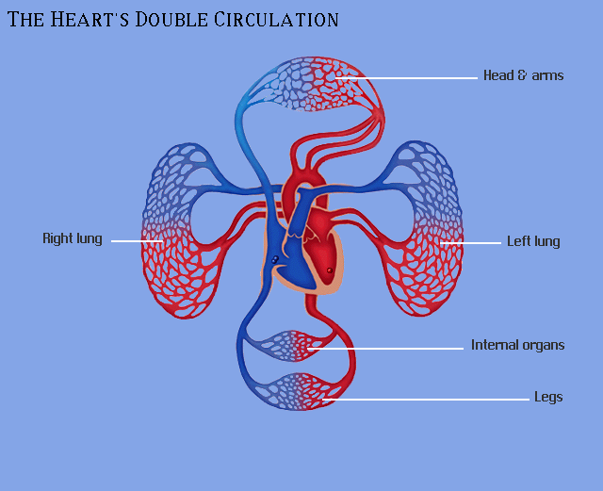
Intelligent Design: Evolution vs Genesis 1:3 - 31

Slide 8
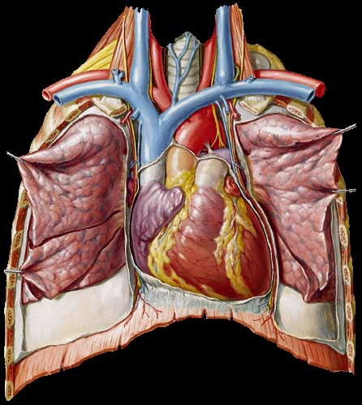
Intelligent Design: Evolution vs Genesis 1:3 - 31
RA
RV
LV

Slide 9
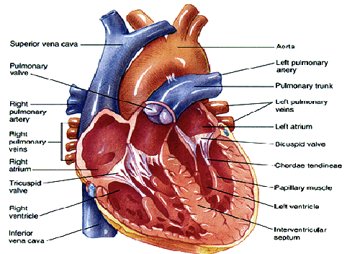
Intelligent Design: Evolution vs Genesis 1:3 - 31

Slide 10
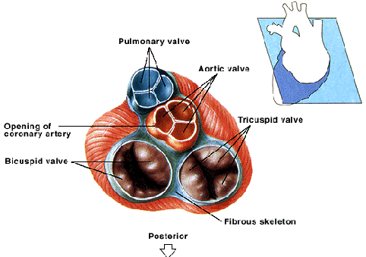
Intelligent Design: Evolution vs Genesis 1:3 - 31

Slide 11
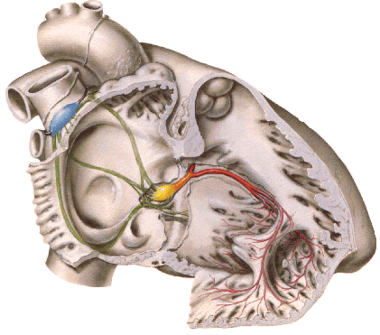
Intelligent Design: Evolution vs Genesis 1:3 - 31
Note the location and Function of …
  SinoAtrial Node
  Interatrial conduction system
  AtrioVentricular Node & fibrous skeleton
  Bundle of His
  Bundle Branches
  Purkinje Fibers
  Cell to cell

Slide 12
Intelligent Design: Evolution vs Genesis 1:3 - 31
At 5 liters per minute the heart pumps 60X5 = 300 liters per hour
X 24 hours per day = 7200 liters per day
X365.25 days per year = 2,629,800 liters per year
X 80 years = 210,380,000 liters per life time
= 20 acre lake 8.5 feet deep (about 15 football fields including end zones)

Slide 13
Intelligent Design: Evolution vs Genesis 1:3 - 31
If the 210,380,000 liters was gasoline in a vehicle that got 20 miles per gallon you could drive 1.1 billion miles. (approximately 6 roundtrips from earth to the sun and back.)
If you drove continuously, averaging 60 mph, it would take 2091 years to complete the trip. Therefore, you would have had to leave in 75B.C. when Julius Caesar was 25 years old.

