Slide 1
Discipleship: An Introduction to Systematic Theology and Apologetics
The Doctrines of Creation:
The Heights Church March 20, 2016

Slide 2
What is the Doctrine of Creation?
Critique of Pure Reason
Possibly the most impactful philosophical book of all time.
Kant set out to save science from Hume’s work and in retrospect unwittingly found a better way to corrupt it.
Kant divided the world into two realms:
Phenomenal: the empirical observable by the senses.
Noumenal: things not directly observable like the essence of something, the self, and God.
Kant hypothesized an un-crossable wall separating the two realms. Thus it is impossible to be sure if God exists or is the creator of the universe.

Slide 3
What is the Doctrine of Creation?
Critique of Pure Reason
There are three problems with Kant’s hypothesis:
It contradicts Romans 1:18-20. Indeed it is a double truth conundrum of faith versus supposed reason. If Kant is correct Paul is wrong and Scripture is not inerrant. BUT if Paul is correct, then Kant is wrong.
For the wrath of God is revealed from heaven against all ungodliness and unrighteousness of men, who by their unrighteousness suppress the truth. For what can be known about God is plain to them, because God has shown it to them. For his invisible attributes, namely, his eternal power and divine nature, have been clearly perceived, ever since the creation of the world, in the things that have been made. So they are without excuse. Romans 1:18-20

Slide 4
What is the Doctrine of Creation?
Critique of Pure Reason
There are three problems with Kant’s hypothesis:
2. Kant has set the stage for evolution by declaring his hypothesis to be true when the proof by rigorous empirical evidence is impossible. This would ultimately result in the short lived, though not dead, Logical Positivism that states something is true only if it can be shown to be true empirically.
3. God’s attributes, especially omnipotence, trumps the possibility of an unmovable object or an un-crossable wall.

Slide 5
What is the Doctrine of Creation?
Origin of the Species ( published in 1859)
Written for general not scientific readers between 1839 and 1844
Not a new idea (Erasmus Darwin)
The three premises in Origin of the Species
Each individual in a species is different
All living creatures tend to produce more offspring than the environment can support
The fittest individual in an environment survives to pass on it genes.

Slide 6
What is the Doctrine of Creation?
Origin of the Species ( published in 1859)
By 1880 evolution was accepted by the scientific community but natural selection was not thought to be the primary force.
Taxonomy by 1883 was based upon morphology using the assumption that evolution was true.
Between 1880-1900 theistic evolution or one step major mutation was thought to be the process.
The use of species in the title is often missed since in the 1900’s the idea of the origin of orders or higher classification arises.

Slide 7
What is the Doctrine of Creation?
Basic Taxonomy
Kingdom: Animal
Phylum: Chordata
Class: (fish, amphibian, reptiles, birds, mammals)
Order: (carnivores, primates, rodents, even/odd toed ungulates, etc.)
Family: (canines, felines, bears, raccoons, weasels, etc.)
Genus: (Foxes, dogs, wolves, coyotes, jackals)
Species: (red fox, artic fox etc.)

Slide 8
What is the Big Bang?
The classical conception of the Big Bang explanation for the beginning of the universe is that about 13.77 billion years ago a singular event (unknown origin and cause) occurred.
12 to 14 billion years ago, the portion of the universe we can see today was only a few millimeters across. It has since expanded from this hot dense state into the vast and much cooler cosmos we currently inhabit.
We can see remnants of this hot dense matter as the now very cold cosmic microwave background radiation which still pervades the universe and is visible to microwave detectors as a uniform glow across the entire sky.

Slide 9
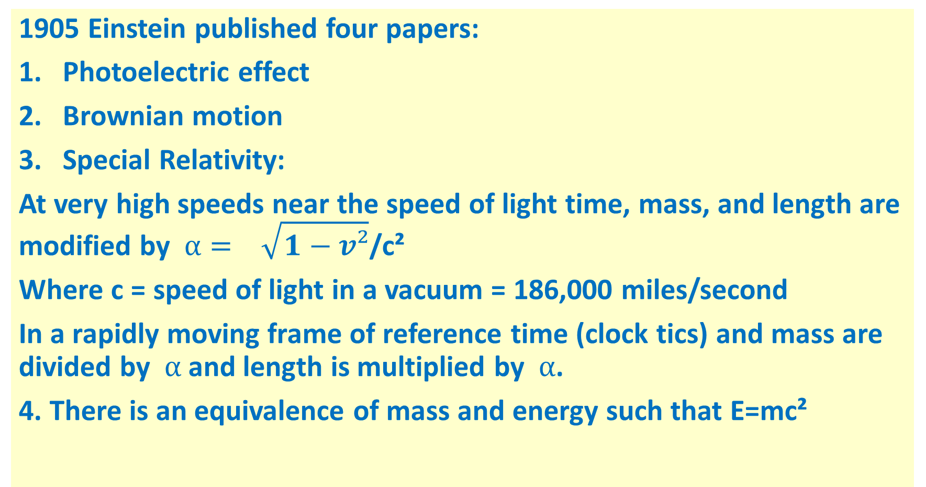
What is the Doctrine of Creation?
1905 Einstein published four papers:
Photoelectric effect
Brownian motion
Special Relativity:
At very high speeds near the speed of light time, mass, and length are modified by $α= \sqrt{1−v²}$/c²
Where c = speed of light in a vacuum = 186,000 miles/second
In a rapidly moving frame of reference time (clock tics) and mass are divided by $α$ and length is multiplied by $α$.
4. There is an equivalence of mass and energy such that E=mc²

Slide 10
What is the Big Bang?
The Big Bang is the prevailing theoretical conception of the universe based upon two early 20th century ideas.
Einstein's theory of general relativity. Gravitation is not a force of attraction between centers of mass as Newton taught. Gravitation is a distortion of space and time. Matter tells space how to curve, and space tells matter how to move. However, at low speeds, General relativity becomes Newton’s gravitation.
The Cosmological Principle: The distribution of matter in the universe is homogeneous and isotropic. Roughly 6 hydrogen atoms per cubic meter.

Slide 11
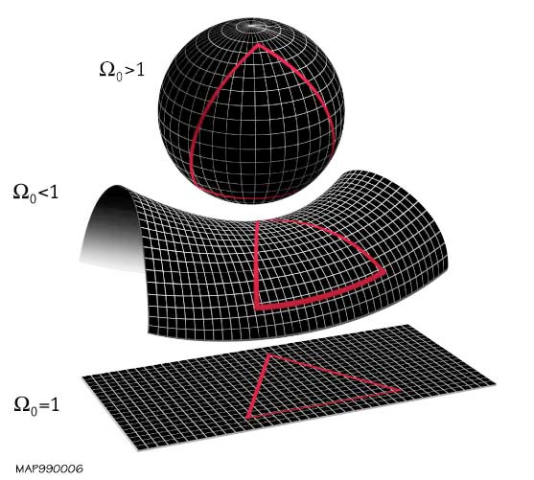
What is the Big Bang?

Slide 12
What is the Big Bang? Source: 2014 NASA Publication
The Big Bang did not occur at a single point in space as an "explosion." It is better thought of as the simultaneous appearance of space everywhere in the universe.
By definition, the universe encompasses all of space and time as we know it, so it is beyond the realm of the Big Bang model to postulate what the universe is expanding into.
It is beyond the realm of the Big Bang Model to say what gave rise to the Big Bang. There are a number of speculative theories about this topic, but none of them make realistically testable predictions as of yet.

