Slide 1
Discipleship:
An
Introduction to
Systematic Theology and
Apologetics
The Doctrines of Creation:
The Heights Church April 10, 2016

Slide 2
The rational origin of the universe
There are three classic arguments for the existence of God.
The Ontological Argument: God has the power of being.
The Cosmological Argument proceeds via Cause and Effect from the existence of the universe to conclude an eternal being created the universe out of nothing.
The Teleological Argument: The universe was created by an intelligent being because of the order of the universe (Romans 1:19-20)

Slide 3
The Cosmological Argument Review
In the beginning, God created the heavens and the earth. Genesis 1:1
For what can be known about God is plain to them, because God has shown it to them. For his invisible attributes, namely, his eternal power and divine nature, have been clearly perceived, ever since the creation of the world, in the things that have been made. So they are without excuse. Romans 1:19-20
  Of old you laid the foundation of the earth, and the heavens are the work of your hands. They will perish, but you will remain; they will all wear out like a garment. You will change them like a robe, and they will pass away, but you are the same, and your years have no end. Psalm 102:25-27

Slide 4
The Cosmological Argument Review
Only four possibilities for the origin of the universe have ever been proposed.
  The universe is an illusion. It does not exist. UN TRUE
  The universe has the power of being and is therefore eternal. DOES NOT SQUARE WITH EMPIRICAL SCIENTIFIC DATA
  The universe “popped into existence without a cause. It simply happened. Essentially it created itself in a chicken and egg scenario. IRRATIONAL
  The universe was created by an eternal being (God).

Slide 5
The Cosmological Argument
  God created the universe.
  This is the only possibility that remains.
  It does not violate the fallacy of the false dilemma because there are no other possibilities that have ever been proposed.
  It does not violate out of nothing, nothing comes because God is not nothing! Indeed, out of God everything comes!
  Just because we do not understand how God created the universe, does not mean that God did not create the universe.
  Unbelief is irrational so we should not expect rational argument to persuade an unbeliever prior to the unbeliever experiencing true conversion.

Slide 6
The Cosmological Argument
  God created the universe.
  What caused God? There are two misunderstandings in this question.
  Eternal does not require cause because it always existed. However, if something is not eternal, then a cause is required for it to begin.
  Not everything requires a cause. The Law of Cause and Effect does not say everything requires a cause, BUT every effect has a cause.

Slide 7
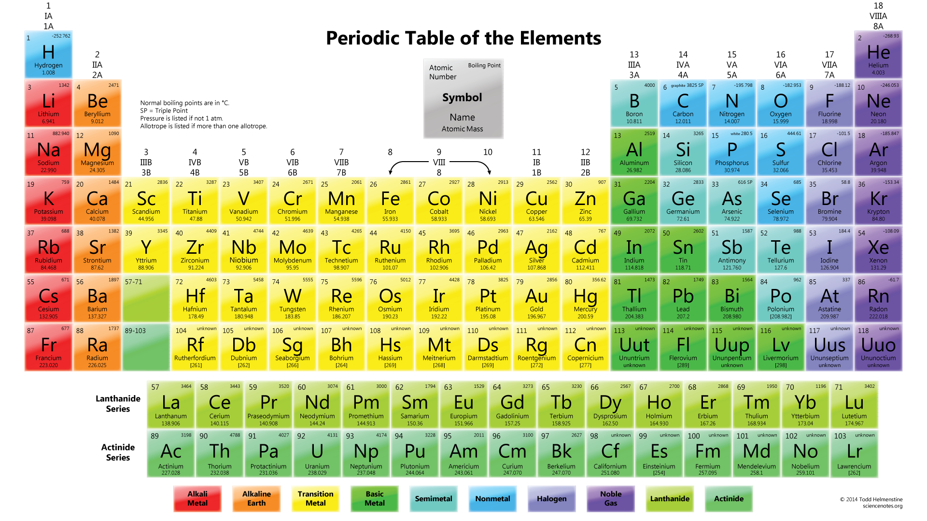
A Teleological Argument for the Inanimate Universe

