Slide 1
Discipleship:
An
Introduction to
Systematic Theology and
Apologetics
The Doctrines of God: The Trinity Part 4
The Heights Church January 31, 2016

Slide 2
The Trinity Historic Trinity Controversies
Arianism: God the Son was created by God the Father and before the creation of the Son the Holy Spirit did not exist.
He is the image of the invisible God, the firstborn of all creation. (Colossians 1:15)
Firstborn (protokos in Greek) is a derived from two Greek words. It is best understood as Christ has the privileges and authority of a first born. The NIV translates this as firstborn over all creation.
And I will make him the firstborn, the highest of the kings of the earth. (Psalm 89:27) i.e. the highest ranking one or Lord of lords and King of kings.
How Christ was eternally begotten has never been fully defined. It somehow refers to something eternally true of the relationship between the Father and the Son in which the Father has some kind of eternal primacy over the Son.

Slide 3
The Trinity Historic Trinity Controversies
Arianism: God the Son was created by God the Father and before the creation of the Son the Holy Spirit did not exist.
The Nicene Creed states that Christ was of “the same substance” as the Father. In Greek he is homoousios.
  Homo = same; ousios = nature
  Arius said he is homoiousios; homoi = similar
  Much of fourth century theology was consumed by the Greek letter iota leading to the popular saying: It makes not one iota of difference. BUT it does make a huge difference because Jesus is homoousios!
  For in him the whole fullness of deity dwells bodily, Colossians 2:9

Slide 4
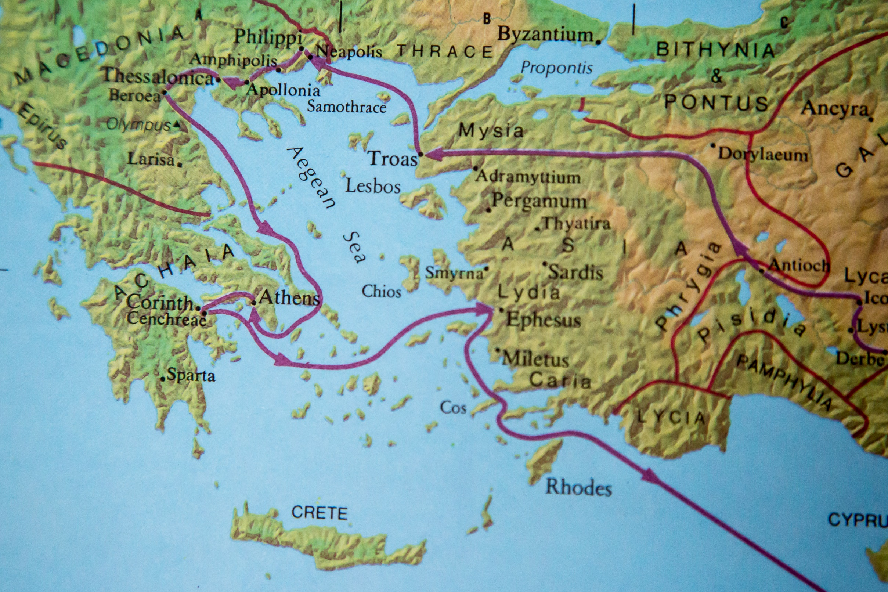

Slide 5
The Trinity Council of Nicea A.D. 325
The Council of Nicea was the first attempt to officially establish the Doctrine of the Trinity and was greatly influenced by Athanasius
We believe in one God, the Father Almighty, Maker of all things visible and invisible.
And in one Lord Jesus Christ, the Son of God, begotten of the Father the only-begotten; that is, of the essence of the Father, God of God, Light of Light, very God of very God, begotten, not made, being of one substance with the Father; By whom all things were made both in heaven and on earth; Who for us men, and for our salvation, came down and was incarnate and was made man; He suffered, and the third day he rose again, ascended into heaven; from thence he shall come to judge the quick and the dead.
And in the Holy Ghost,

Slide 6
The Trinity Council of Constantinople A.D. 381
The Council of Constantinople settled two basic issues: the deity of the Holy Spirit and the true humanity of Christ.
It is often referred to as the Nicene Creed of 381" or the Niceno-Constantinopolitan Creed since it clarified and expanded upon the Nicean Creed of 325.
The changes from the Nicean Creed were as follows:
We believe in one God, the Father Almighty, Maker of all things visible and invisible. Becomes
We believe in one God, the Father Almighty, Maker of heaven and earth, and of all things visible and invisible.

Slide 7
The Trinity Council of Constantinople A.D. 381
And in one Lord Jesus Christ, the Son of God, begotten of the Father the only-begotten; that is, of the essence of the Father, God of God, Light of Light, very God of very God, begotten, not made, being of one substance with the Father; Becomes
And in one Lord Jesus Christ, the only-begotten Son of God, begotten of the Father before all worlds, Light of Light, very God of very God, begotten, not made, being of one substance with the Father;

Slide 8
The Trinity Council of Constantinople A.D. 381
By whom all things were made both in heaven and on earth;
Becomes
by whom all things were made;

Slide 9
The Trinity Council of Constantinople A.D. 381
Who for us men, and for our salvation, came down and was incarnate and was made man;
Becomes
who for us men, and for our salvation, came down from heaven, and was incarnate by the Holy Ghost of the Virgin Mary, and was made man;

Slide 10
The Trinity Council of Constantinople A.D. 381
He suffered, and the third day he rose again, ascended into heaven;
Becomes
he was crucified for us under Pontius Pilate, and suffered, and was buried, and the third day he rose again, according to the Scriptures, and ascended into heaven, and sitteth on the right hand of the Father;

Slide 11
The Trinity Council of Constantinople A.D. 381
From thence he shall come to judge the quick and the dead.
Becomes
from thence he shall come again, with glory, to judge the quick and the dead.

Slide 12
The Trinity Council of Constantinople A.D. 381
And in the Holy Ghost, Becomes
And in the Holy Ghost, the Lord and Giver of life, who proceedeth from the Father, who with the Father and the Son together is worshiped and glorified, who spake by the prophets.

Slide 13
The Trinity Council of Constantinople A.D. 381
We believe in one God, the Father Almighty, Maker of heaven and earth, and of all things visible and invisible.
And in one Lord Jesus Christ, the only-begotten Son of God, begotten of the Father before all worlds, Light of Light, very God of very God, begotten, not made, being of one substance with the Father; by whom all things were made; Who for us men, and for our salvation, came down and was incarnate and was made man; he was crucified for us under Pontius Pilate, and suffered, and was buried, and the third day he rose again, according to the Scriptures, and ascended into heaven, and sitteth on the right hand of the Father; from thence he shall come again, with glory, to judge the quick and the dead.
And in the Holy Ghost, the Lord and Giver of life, who proceedeth from the Father, who with the Father and the Son together is worshiped and glorified, who spake by the prophets.

Slide 14
The Trinity 5 other errors about the Person of Christ
Apollinarianism: named after Apollinaris, Bishop of Laodicea about A.D. 361. The person of Christ had a human body but not a human mind or spirit. Christ’s mind and spirit were from the divine nature of the Son of God
Nestorianism: named after Nestorius Bishop of Constantinople mid 5th century. Christ is a human person and a divine person.
Monophysitism (Eutychianism): Leader of the monastery in Constantinople early-mid 5th century. Christ had one nature. The human nature of Christ was taken up and absorbed into the divine nature creating a 3rd New Nature.
Docetism: Jesus’ physical humanity was an illusion.
Ebionism: Denies the diety of Christ.

Slide 15
The Trinity Council of Chalcedon A.D. 451
We, then, following the holy Fathers, all with one consent, teach men to confess one and the same Son, our Lord Jesus Christ, the same perfect in Godhead and also perfect in manhood; truly God and truly man, of a reasonable [rational] soul and body; consubstantial [co-essential] with the Father according to the Godhead, and consubstantial with us according to the Manhood; in all things like unto us, without sin; begotten before all ages of the Father according to the Godhead, and in these latter days, for us and for our salvation, born of the Virgin Mary, the Mother of God, according to the Manhood; one and the same Christ, Son, Lord, only begotten, to be acknowledged in two natures, inconfusedly, unchangeably, indivisibly, inseparably; the distinction of natures being by no means taken away by the union, but rather the property of each nature being preserved, and concurring in one Person and one Subsistence, not parted or divided into two persons, but one and the same Son,

Slide 16
The Trinity Council of Chalcedon A.D. 451
and only begotten, God the Word, the Lord Jesus Christ; as the prophets from the beginning [have declared] concerning Him, and the Lord Jesus Christ Himself has taught us, and the Creed of the holy Fathers has handed down to us.

Slide 17
The Trinity Council of Chalcedon A.D. 451
The council of Chalcedon taught the church how to talk about the two natures of Christ without falling into errors.
One nature of Christ is sometimes seen doing things in which the other nature does not share.
Anything either nature does is done by the person of Christ.
In the incarnation Christ gave up the glory of divine life but not the possession of divine powers.
In the incarnation Christ gained human attributes without giving up divine attributes.
The initiative foe the incarnation came from God and not man.

