Slide 1
Discipleship: An Introduction to Systematic Theology and Apologetics
The Doctrines of Redemption: Key Protestant Reformation Doctrines
The Heights Church May 6, 2018

Slide 2
Liberalism (19th Century)
According to Liberalism we acquire knowledge about God from universal human experience. Revelation may still have a role but it must be evaluated by human experience which is the ultimate judge.
Liberalism sought to be genuinely Christian, modern and progressive without external authority. Religious knowledge and experience not Scripture became the true authority.
The Bible was a human book so it could not be without error.
Supernatural events in the Bible must be explainable by ordinary causes. Much of the OT was fictional. Many persons and places never existed and many events never happened.
The NT portrait of Jesus was historically inaccurate.
Liberal Protestants reasoned that since the Bible was not inerrant Scripture was not a reliable source of knowledge regarding spiritual/religious matters.
Doctrine must be evaluated based upon human reflection on religious experience that could “evolve” from generation to generation. So what was true for first century Christians may not be true today.

Slide 3
Liberalism (19th Century)
Biblical authors had simply accommodated their writings to the myths, fallacies and primitive understanding of the cosmos by their culture.
Higher/Biblical criticism is the scholarly "study and investigation of biblical writings that seeks to make discerning judgments about these writings in order to establish the authorship, date, and place of composition of the original text. Viewing biblical texts as being ordinary pieces of literature, rather than set apart from other literature, as in the traditional view, it asked when and where a particular text originated; how, why, by whom, for whom, and in what circumstances it was produced; what influences were at work in its production; what sources were used in its composition; and what message was it intended to convey.
Textual criticism is concerned with the identification of textual variants in manuscripts. Scribes can make alterations when copying manuscripts by hand. Given a manuscript copy, several or many copies, but not the original document, the textual critic seeks to reconstruct the original text (the archetype or autograph) as closely as possible. The objective of the textual critic's work is a better understanding of the creation and historical transmission of texts.

Slide 4
The Conservative Response (20th Century)
The 20th century saw a resurgence of orthodox doctrine regarding the authority of Scripture and other Protestant Reformation doctrine with the rise of:
Intellectual Fundamentalism
Mainline Denominational Splits into Liberal and Conservative Denominations
Evangelicalism
A number of other movements also arose that sought on one hand a return to orthodoxy but acknowledged on the other hand some revised interpretation of the Scriptures were necessary to make Christianity relevant.
Neo Orthodoxy
Populist Fundamentalists
Dispensationalists
Pentecostals
Charismatics

Slide 5
Early 20th Century Conservatives Respond – The Fundamentalists
Two varieties of Fundamentalism arose.
Populist fundamentalists (Dispensationalists) like Scofield and Billy Sunday.
Intellectual Fundamentalists at Princeton Seminary (J. Gresham Machen).
In 1910 The General Assembly of the Presbyterian Church established a Five Point Declaration in order to be ordained:
The inspiration and inerrancy of Scripture
The virgin birth of Christ
The substitutionary atonement of Christ
The bodily (historical) resurrection of Christ
The miracles of Christ
Notes:
MLK was a liberal who denied the virgin birth, the substitutionary atonement, the bodily resurrection, original sin, and the inerrancy of Scripture. Arguments continued into the 1970’s.

Slide 6
The Evangelicals
What’s an Evangelical?
Originally it was equivalent to a Protestant who sought to defend and recover the “gospel.”
The National Association of Evangelicals says an Evangelical affirms four things:
Authority and sufficiency of Scripture
Atoning work of Christ on the cross
Lives need to be transformed through a “born-again” experience and a life long process of following Jesus.
Expression and demonstration of the gospel in missionary and social reform efforts.
Notes:
Naf founded by carl f. henry

Slide 7
Key Protestant Reformation Doctrines – Neo - Orthodoxy
Neo-orthodoxy is a religious movement that began after World War I as a reaction against the failed ideas of liberal Protestantism. It was developed primarily by Swiss theologians Karl Barth and Emil Brunner.
Some saw “neo-orthodoxy” as a revival of the old Reformed theology. Neo-orthodoxy differs from “old” orthodoxy in its views of the Word of God and sin.
Neo-orthodoxy defines the Word of God as Jesus (John 1:1) and says that the Bible is simply man’s interpretation of the Word’s actions. Thus, the Bible is not inspired by God, and, being a human document, various parts of it may not be literally true. God spoke through “redemptive history,” and He speaks now as people “encounter” Jesus, but the Bible itself is not objective truth.
Revelation depends on the experience (or personal interpretation) of each individual. The Bible only “becomes” the Word of God when God uses its words to point someone to Christ. The details of the Bible are not as important as having a life-changing encounter with Jesus. Truth thus becomes a mystical experience and is not definitively stated in the Bible.

Slide 8
Key Protestant Reformation Doctrines – Neo - Orthodoxy
The neo-orthodox view of sin is that it is a rejection of our responsibility to treat our fellow man well. The result of sin is dehumanization, accompanied by unkindness, unforgiveness, loneliness, and a myriad of societal ills. Salvation comes to those who have a subjective encounter with Christ—no acceptance of a set of truths is necessary. Neo-orthodoxy places an emphasis on social work and our ethical responsibility to love others.
Neo-orthodoxy has influenced the less-conservative branches of the Presbyterian and Lutheran churches in America, along with other denominations. While its original purpose, to provide a more biblical alternative to liberalism, is commendable, neo-orthodox teaching nevertheless carries some inherent dangers. Any time that truth is determined according to what is relevant to my experience, the possibility of relativism exists. Any doctrine that sees the Bible as a wholly human document containing errors erodes the very foundation of biblical Christianity.

Slide 9
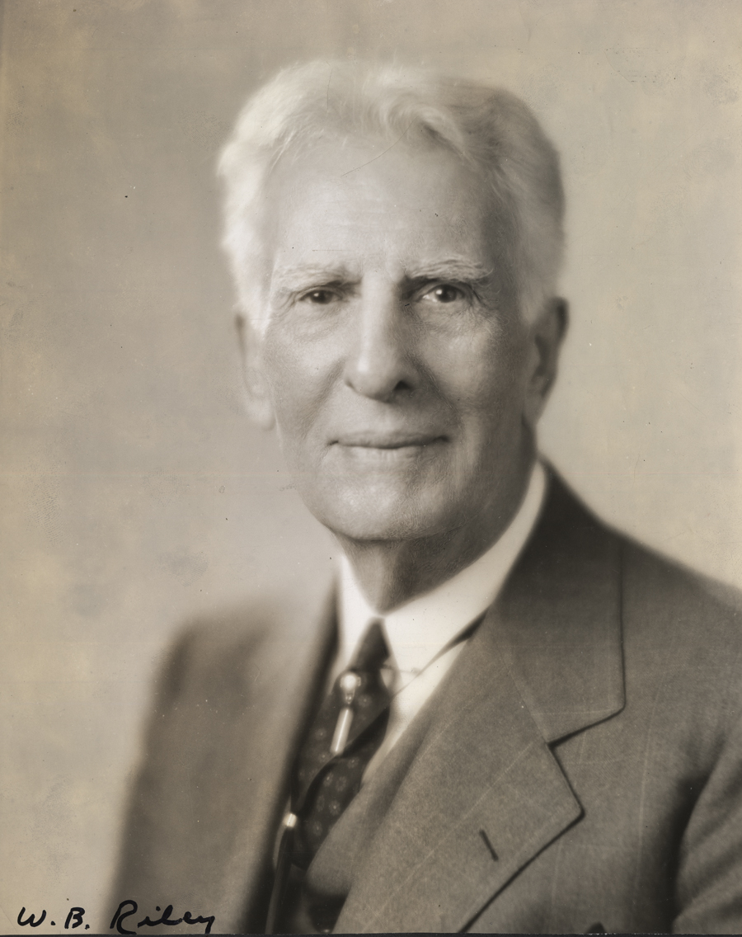
William Bell Riley (1861 – 1947)– “The Grand Old Man of Fundamentalism”
In 1888 he graduated from the Southern Baptist Theological Seminary in Louisville, Kentucky.
He became the pastor of The First Baptist Church in Minneapolis in 1897.
Riley, founded Northwestern Bible and Missionary Training School in 1902.
In 1919, Riley created the World Christian Fundamentals Association (WCFA).
The WCFA was originally formed to launch "a new Protestantism" based upon premillennial eschatology, but soon focused on opposition to evolution.
Riley subscribed to the New Hampshire Confession of Faith of 1833.
Riley advocated a form of "Day-Age Creationism".
Riley claimed "an international Jewish-Bolshevik-Darwinist conspiracy was behind the curriculum changes in the 1920s. He softened his anti-Semitic views after WW2.
Notes:
Augustine the "days" in Genesis could not be literal days, if only because Genesis itself tells us that the sun was not made until the fourth "day".^{[1]}

Slide 10
1833 New Hampshire Confession of Faith
III. Of the Fall of Man We believe that man was created in holiness, under the law of his Maker, but by voluntary transgression fell from that holy and happy state; in consequence of which all mankind are now sinners, not by constraint but choice; being by nature utterly void of that holiness required by the law of God, positively inclined to evil; and therefore under just condemnation to eternal ruin, without defense or excuse.
VII. Of Grace in Regeneration We believe that in order to be saved, sinners must be regenerated, or born again; that regeneration consists in giving a holy disposition to the mind; that it is effected in a manner above our comprehension by the power of the Holy Spirit, in connection with divine truth, so as to secure our voluntary obedience to the gospel; and that its proper evidence appears in the holy fruits of repentance and faith and newness of life.
Notes:
MLK was a liberal who denied the virgin birth, the substitutionary atonement, the bodily resurrection, original sin, and the inerrancy of Scripture. Arguments continued into the 1970’s.

Slide 11
1833 New Hampshire Confession of Faith
IX. Of God’s Purpose of Grace We believe that election is the eternal purpose of God, according to which he graciously regenerates, sanctifies, and saves sinners; that being perfectly consistent with the free agency of man, it comprehends all the means in connection with the end; that it is a most glorious display of God's sovereign goodness, being infinitely free, wise, holy and unchangeable; that it utterly excludes boasting, and promotes humility, love, prayer, praise, trust in God, and active imitation of his free mercy; that it encourages the use of means in the highest degree; that it may be ascertained by its effects in all who truly believe the gospel, that it is the foundation of Christian assurance; and that to ascertain it with regard to ourselves demands and deserves the utmost diligence.
Notes:
MLK was a liberal who denied the virgin birth, the substitutionary atonement, the bodily resurrection, original sin, and the inerrancy of Scripture. Arguments continued into the 1970’s.

Slide 12
Early 20th Century Conservatives Respond – The Dispensationalists
Dispensationalism was introduced to North America by James Inglis (1813–72) through the monthly magazine Waymarks in the Wilderness, published intermittently between 1854 and 1872.
Cyrus Ingerson Scofield (August 19, 1843 – July 24, 1921) was an American theologian, minister, and writer whose best-selling annotated Bible popularized futurism and dispensationalism among fundamentalist Christians.
Hal Lindsey’s Late Great Planet Earth and Tim LaHaye’s and Jerry Jenkin’s Left Behind series of novels are popular Dispensational based books.
Moody Bible Institute (1886), the Bible Institute of Los Angeles (now Biola University), Bob Jones University and Dallas Theological Seminary are well known Dispensationalist educational institutions.
Notes:
It began with a meeting on April 9, 1906, and continued until roughly 1915.

