Slide 1
Discipleship: An Introduction to Systematic Theology and Apologetics
The Doctrines of Redemption:
The Heights Church January 8, 2017

Slide 2
The Covenants – What is a Covenant? (Review)
Alternative Organizational View of the Covenants
The Covenant of Redemption (synthēkē)
The Old Covenant (Testament) (diathēkē)
Works
Grace
Noah
Abraham
Moses
David
The New Covenant (Testament) (diathēkē)

Slide 3
The Covenants – The Covenant of Redemption (Review)
God the Father:
initiated the plan of salvation
agreed to give the Son a people to redeem for his own possession
sent the Son to be believer’s representative
prepared a body for God the Son to dwell in
accepted Jesus as the representative for all true believers
gave Jesus all authority in heaven and on earth
God the Son:
accomplished the redemption of all true believers
came into the world as a man and lived as a man under the Mosaic Law.
was perfectly obedient to all the commands of the Father
Redeemed (is redeeming) everyone the Father had given him
God the Holy Spirit:
applied redemption to the personal lives of true believers.
agreed to fill and empower Jesus to carry out his work on earth
agreed to apply the benefits of Christ’s redemptive work to all believers after Jesus returned to heaven

Slide 4
The Covenants – The Covenant of Works (Review)
Legally binding provisions are given and the two parties are present as God also gave a direct command to Adam.
And the LORD God commanded the man, saying, “You may surely eat of every tree of the garden, but of the tree of the knowledge of good and evil you shall not eat, for in the day that you eat of it you shall surely die.” (Genesis 2:16-17)
Punishment is also promised if the command is disobeyed and by implication blessing for obedience that is opposite of death.
Death should be understood as every kind, physical, spiritual and eternal separation from God.
Note: that spiritual death was immediate but physical death was usually carried out slowly as their bodies aged.

Slide 5
The Covenants – The Covenant of Works (Review)
In some ways the Covenant of Works is still in effect.
If anyone could perfectly obey all of God’s laws they would have eternal life.
The punishment (death) for breaking the covenant is still in effect.
In some ways the Covenant of works is not in effect today.
There is no tree of the knowledge of good and evil.
Since every person has inherited a sinful nature it is not possible for anyone to obey the Covenant of Works.
Christ has fulfilled the Covenant of Works once for all so Christians are freed from the Covenant of Works and credited with the benefits of Christ’s obedience.

Slide 6
The Covenants – The Covenant(s) of Grace
The Covenant with Noah (Genesis 9:8-17)
Then God said to Noah and to his sons with him, “Behold, I establish my covenant with you and your offspring after you, and with every living creature that is with you, the birds, the livestock, and every beast of the earth with you, as many as came out of the ark; it is for every beast of the earth. I establish my covenant with you, that never again shall all flesh be cut off by the waters of the flood, and never again shall there be a flood to destroy the earth.” And God said, “This is the sign of the covenant that I make between me and you and every living creature that is with you, for all future generations: I have set my bow in the cloud, and it shall be a sign of the covenant between me and the earth. When I bring clouds over the earth and the bow is seen in the clouds, I will remember my covenant that is between me and you and every living creature of all flesh. And the waters shall never again become a flood to destroy all flesh. When the bow is in the clouds, I will see it and remember the everlasting covenant between God and every living creature of all flesh that is on the earth.” God said to Noah, “This is the sign of the covenant that I have established between me and all flesh that is on the earth.”

Slide 7
The Covenants – The Covenant(s) of Grace
The Covenant with Noah (Genesis 9:8-17)
The promise is to not destroy all humans and animals again by a flood.
While there is grace involved, there are no promises of eternal life or redemption.
The covenant is with all humans not just the redeemed.
There are no human requirements to be fulfilled or obeyed.
The sign of the covenant is the rainbow and requires no human participation.

Slide 8
The Covenants – The Covenant(s) of Grace
The Covenant with Abraham
Now these are the generations of Terah. Terah fathered Abram, Nahor, and Haran; and Haran fathered Lot. Haran died in the presence of his father Terah in the land of his kindred, in Ur of the Chaldeans. And Abram and Nahor took wives. The name of Abram's wife was Sarai, and the name of Nahor's wife, Milcah, the daughter of Haran the father of Milcah and Iscah. Now Sarai was barren; she had no child.
Terah took Abram his son and Lot the son of Haran, his grandson, and Sarai his daughter-in-law, his son Abram's wife, and they went forth together from Ur of the Chaldeans to go into the land of Canaan, but when they came to Haran, they settled there. The days of Terah were 205 years, and Terah died in Haran. (Genesis 11:27-32)
Now the LORD said to Abram, “Go from your country and your kindred and your father's house to the land that I will show you. And I will make of you a great nation, and I will bless you and make your name great, so that you will be a blessing. I will bless those who bless you, and him who dishonors you I will curse, and in you all the families of the earth shall be blessed.” (Genesis 12:1-3)

Slide 9
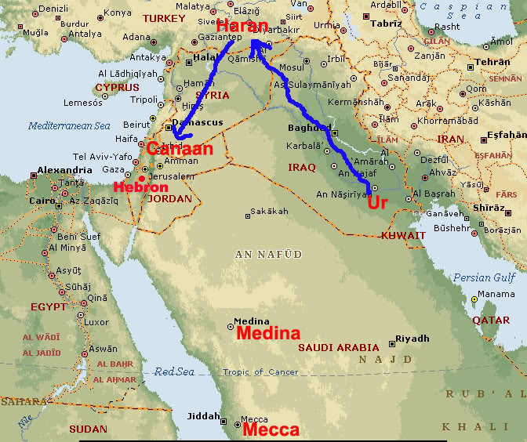
The Covenants – The Covenant(s) of Grace
The Covenant with Abraham

