Slide 1
Discipleship: An Introduction to Systematic Theology and Apologetics
The Doctrines of Redemption:
The Heights Church January 15, 2017

Slide 2
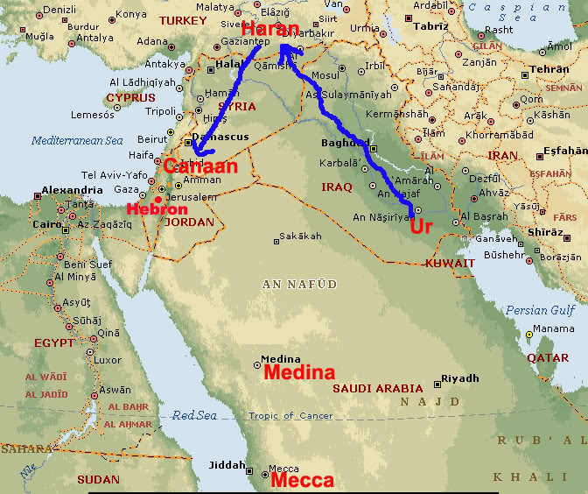
The Covenants – The Covenant(s) of Grace
The Covenant with Abraham (Review)

Slide 3
The Covenants – The Covenant(s) of Grace
The Covenant with Abraham
Now the LORD said to Abram, “Go from your country and your kindred and your father's house to the land that I will show you. And I will make of you a great nation, and I will bless you and make your name great, so that you will be a blessing. I will bless those who bless you, and him who dishonors you I will curse, and in you all the families of the earth shall be blessed.” (Genesis 12:1-3)
And he brought him outside and said, “Look toward heaven, and number the stars, if you are able to number them.” Then he said to him, “So shall your offspring be.” And he believed the LORD, and he counted it to him as righteousness. And he said to him, “I am the LORD who brought you out from Ur of the Chaldeans to give you this land to possess.” (Genesis 15:5-7)

Slide 4
The Covenants – The Covenant(s) of Grace
The Covenant with Abraham
But he said, “O Lord GOD, how am I to know that I shall possess it?” He said to him, “Bring me a heifer three years old, a female goat three years old, a ram three years old, a turtledove, and a young pigeon.” And he brought him all these, cut them in half, and laid each half over against the other. But he did not cut the birds in half. And when birds of prey came down on the carcasses, Abram drove them away. As the sun was going down, a deep sleep fell on Abram. And behold, dreadful and great darkness fell upon him. Then the LORD said to Abram, “Know for certain that your offspring will be sojourners in a land that is not theirs and will be servants there, and they will be afflicted for four hundred years. But I will bring judgment on the nation that they serve, and afterward they shall come out with great possessions. As for you, you shall go to your fathers in peace; you shall be buried in a good old age. And they shall come back here in the fourth generation, for the iniquity of the Amorites is not yet complete.” (Genesis 15:8-16)

Slide 5
The Covenants – The Covenant(s) of Grace
The Covenant with Abraham
When the sun had gone down and it was dark, behold, a smoking fire pot and a flaming torch passed between these pieces. On that day the LORD made a covenant with Abram, saying, “To your offspring I give this land, from the river of Egypt to the great river, the river Euphrates, the land of the Kenites, the Kenizzites, the Kadmonites, the Hittites, the Perizzites, the Rephaim, the Amorites, the Canaanites, the Girgashites and the Jebusites.” (Genesis 15:17-21)

Slide 6
The Covenants – The Covenant(s) of Grace
The Covenant with Abraham
When Abram was ninety-nine years old the LORD appeared to Abram and said to him, “I am God Almighty; walk before me, and be blameless, that I may make my covenant between me and you, and may multiply you greatly.” Then Abram fell on his face. And God said to him, “Behold, my covenant is with you, and you shall be the father of a multitude of nations. No longer shall your name be called Abram, but your name shall be Abraham, for I have made you the father of a multitude of nations. I will make you exceedingly fruitful, and I will make you into nations, and kings shall come from you. And I will establish my covenant between me and you and your offspring after you throughout their generations for an everlasting covenant, to be God to you and to your offspring after you. And I will give to you and to your offspring after you the land of your sojournings, all the land of Canaan, for an everlasting possession, and I will be their God.” Genesis (17:1-8)

Slide 7
The Covenants – The Covenant(s) of Grace
The Covenant with Abraham
And God said to Abraham, “As for you, you shall keep my covenant, you and your offspring after you throughout their generations. This is my covenant, which you shall keep, between me and you and your offspring after you: Every male among you shall be circumcised. (Genesis 17:9-10)

Slide 8
The Covenants – The Covenant(s) of Grace
The Covenant with Abraham
Abraham is a father in four different ways.
Physical offspring (Ishmael and Isaac)
Special physical offspring tied to God’s electing/saving purposes (Isaac – Jacob – the twelve tribes, and so on)
Promised offspring (culminating in Jesus)
4. Spiritual offspring (All who trust in the Messiah)

Slide 9
The Covenants – The Covenant(s) of Grace
The Covenant with Abraham
As for Sarai your wife, you shall not call her name Sarai, but Sarah shall be her name. I will bless her, and moreover, I will give you a son by her. I will bless her, and she shall become nations; kings of peoples shall come from her.” Then Abraham fell on his face and laughed and said to himself, “Shall a child be born to a man who is a hundred years old? Shall Sarah, who is ninety years old, bear a child?” And Abraham said to God, “Oh that Ishmael might live before you!” God said, “No, but Sarah your wife shall bear you a son, and you shall call his name Isaac. I will establish my covenant with him as an everlasting covenant for his offspring after him. As for Ishmael, I have heard you; behold, I have blessed him and will make him fruitful and multiply him greatly. He shall father twelve princes, and I will make him into a great nation. But I will establish my covenant with Isaac, whom Sarah shall bear to you at this time next year.” (Genesis 17:15-21)

