Slide 1
Discipleship: An Introduction to Systematic Theology and Apologetics
The Doctrines of Redemption:
The Heights Church October 9, 2016

Slide 2
The Fall – Review
The Fall in Genesis 3 should be considered Historical Narrative.
Because of Adam’s sin every natural born person is counted guilty.
Because of Adam’s sin we have a sinful nature.
Before the Law was given people died because they had inherited Adam’s sin BUT their sins were not counted as infractions of the Law.
Before we were born God thought of us as sinners because we had descended from Adam.

Slide 3
The Fall –Possible interpretations of the Fall
In large measure your theology of redemption is based upon your understanding of the Fall.
Theology of Redemption | The Fall | Heaven | Hell | Original Sin | Free Will (Moral ability to sin or not sin)
Universalist | Irrelevant | Exists | Does not exist | NA Everyone goes to heaven when they die. | NA
Pelagian | Irrelevant | Exists | Exists | NA | Yes
Semi-Pelagian (Arminian) | Historical Narrative | Exists | Exists | Every natural born person has Original Sin. | Not totally lost in the Fall.
Reformed (Doctrines of Grace) (Calvinism) (Augustinian) | Historical Narrative | Exists | Exists | Every natural born person has Original Sin. | No. Morally unable to not sin.

Slide 4
The Fall – Possible interpretations of the Fall
According to Saint Augustine (354-430):
Adam and Eve were created with free will, the moral ability to sin and the moral ability to not sin.
In the fall they lost the moral ability to not sin.
The LORD saw that the wickedness of man was great in the earth, and that every intention of the thoughts of his heart was only evil continually. (Genesis 6:5)
We have all become like one who is unclean, and all our righteous deeds are like a polluted garment. We all fade like a leaf, and our iniquities, like the wind, take us away. (Isaiah 64:6)
“None is righteous, no, not one; no one understands; no one seeks for God. All have turned aside; together they have become worthless; no one does good, not even one.” (Romans 3:10-12)

Slide 5
The Fall – Possible interpretations of the Fall
Jesus answered them, “Truly, truly, I say to you, everyone who practices sin is a slave to sin. (John 8:34)
For the mind that is set on the flesh is hostile to God, for it does not submit to God's law; indeed, it cannot. Those who are in the flesh cannot please God. (Romans 8:7-8)
The natural person does not accept the things of the Spirit of God, for they are folly to him, and he is not able to understand them because they are spiritually discerned. (1 Corinthians 2:14)

Slide 6
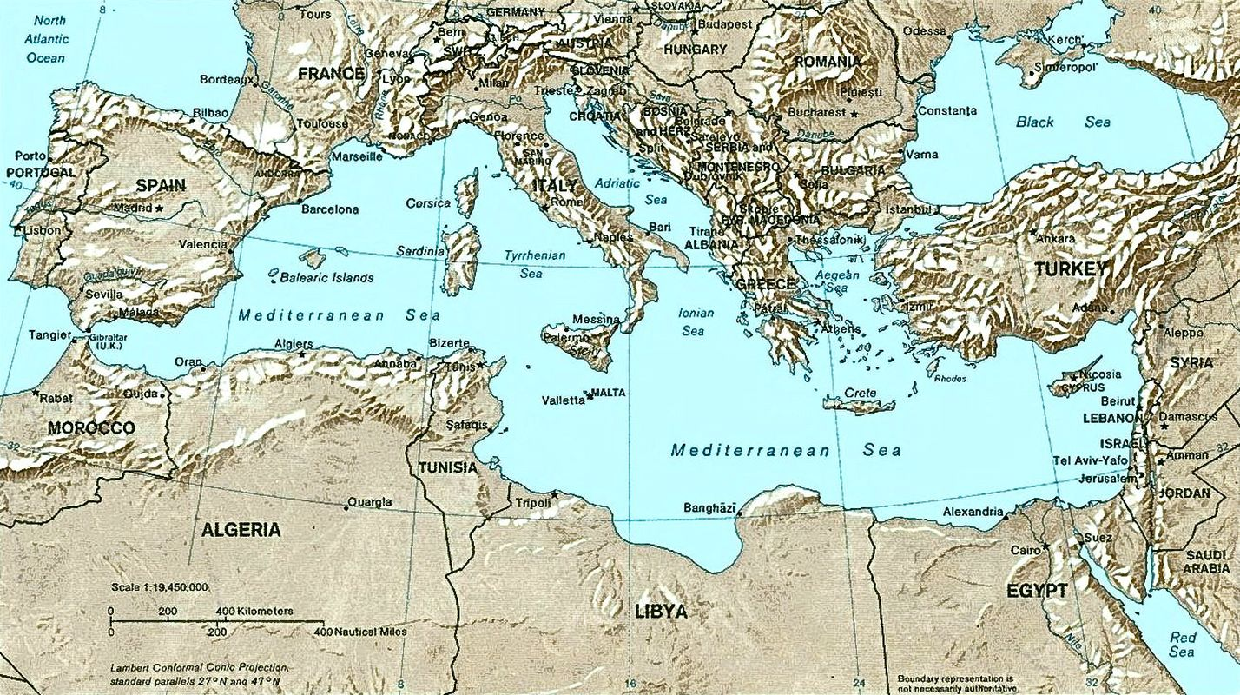
The Fall – Possible interpretations of the Fall
Constantinople/ Chalcedon
Orange
Hippo
Carthage
Nicea

Slide 7
The Fall – Possible interpretations of the Fall
According to a British monk Pelagius (circa 360-418):
We do not inherit Adam’s sin. We are all born in the same state as Adam was created.
We do not need grace because God would not ask us to do something that he does not also give us the ability to do.
At the Council of Carthage in 418 Pelagius was declared a heretic.
This Council also declared:
Infants must be baptized to be cleansed from original sin.
Children dying without baptism are excluded from both the kingdom of heaven and eternal life.
Death came from sin, not man's physical nature.
The grace of Christ imparts strength and will to act out God's commandments.
No good works can come without God's grace.

