Slide 1
Discipleship:
An
Introduction to
Systematic Theology and
Apologetics
The Doctrines of Redemption: The Law
The Heights Church February 5, 2017

Slide 2
Systematic Theology Syllabus
The Doctrines of the Bible (Completed 2015/2016)
The Doctrines of God (Completed 2015/2016)
The Doctrines of Creation (2015/2016)
The Doctrines of Redemption
The Doctrines of the Church
The Doctrines of the Future

Slide 3
Redemptive History/Doctrines of Redemption Syllabus
The Fall
The Covenants
The Law
The Old Testament Sacrificial System
Jesus the God-Man
The Work of the Holy Spirit
Pre-Reformation Roman Catholicism
Protestant Reformation Theology
Post Reformation Doctrinal Debates
The Old Testament Era
(BC)
The New Testament Era
(~1st Century A.D.)
The Church Era (2nd Century A.D. to present)

Slide 4
The Law – The Mosaic Covenant Review (Exodus 19 – 24)
  The Ten Commandments (20:1-21)
  The Law (20:22-23:33)
  Confirmation of the Covenant
  Moses came and told the people all the words of the LORD and all the rules. And all the people answered with one voice and said, "All the words that the LORD has spoken we will do.” (Exodus 24:3)
  In addition Exodus 25 – 30 contains detailed instructions for the construction of the Tabernacle

Slide 5
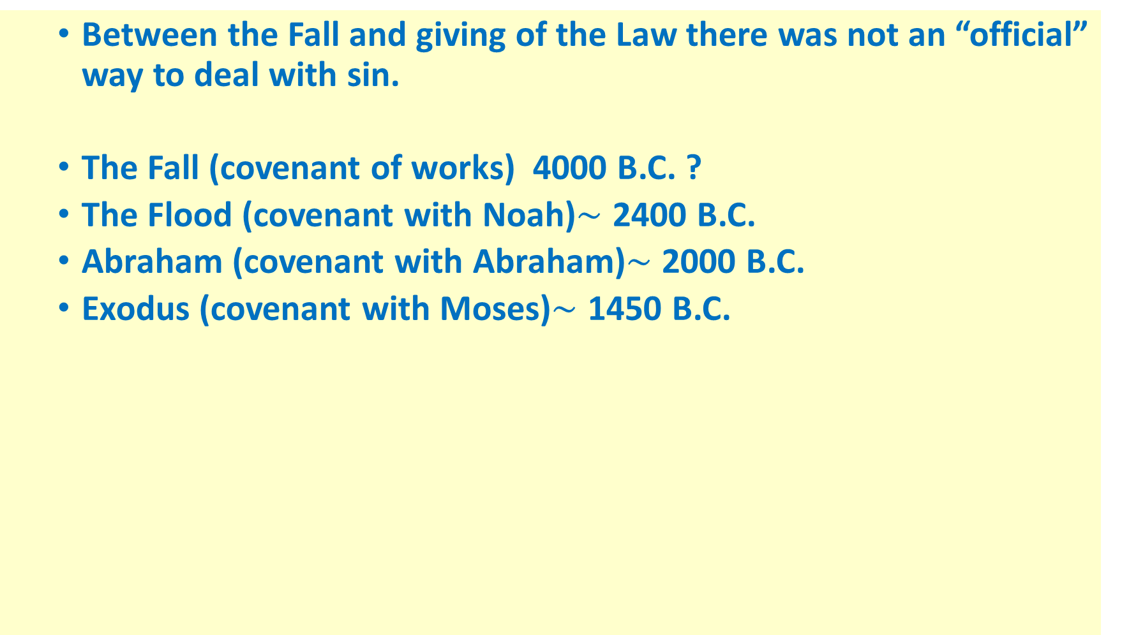
The Law
  Between the Fall and giving of the Law there was not an “official” way to deal with sin.
  The Fall (covenant of works) 4000 B.C. ?
  The Flood (covenant with Noah)$\sim$ 2400 B.C.
  Abraham (covenant with Abraham)$\sim$ 2000 B.C.
  Exodus (covenant with Moses)$\sim$ 1450 B.C.

Slide 6
The Law
  Between the Fall and giving of the Law there was not an “official” way to deal with sin.
Therefore, just as sin came into the world through one man, and death through sin, and so death spread to all men because all sinned - for sin indeed was in the world before the law was given, but sin is not counted where there is no law. Yet death reigned from Adam to Moses, even over those whose sinning was not like the transgression of Adam, who was a type of the one who was to come. (Romans 5:12 – 14)

Slide 7
The Law
  Between the Fall and giving of the Law there was not an “official” way to deal with sin.
O foolish Galatians! Who has bewitched you? It was before your eyes that Jesus Christ was publicly portrayed as crucified. Let me ask you only this: Did you receive the Spirit by works of the law or by hearing with faith? Are you so foolish? Having begun by the Spirit, are you now being perfected by the flesh? Did you suffer so many things in vain--if indeed it was in vain? Does he who supplies the Spirit to you and works miracles among you do so by works of the law, or by hearing with faith-- just as Abraham "believed God, and it was counted to him as righteousness"? Know then that it is those of faith who are the sons of Abraham. And the Scripture, foreseeing that God would justify the Gentiles by faith, preached the gospel beforehand to Abraham, saying, "In you shall all the nations be blessed." So then, those who are of faith are blessed along with Abraham, the man of faith For all who rely on works of the law are under a curse; for it is written, "Cursed be everyone who does not abide by all things written in the Book of the Law, and do them." Now it is evident that no one is justified before God by the law, for "The righteous shall live by faith." But the law is not of faith, rather "The one who does them shall live by them." Christ redeemed us from the curse of the law by becoming a curse for us--for it is written, "Cursed is everyone who is hanged on a tree"-- so that in Christ Jesus the blessing of Abraham might come to the Gentiles, so that we might receive the promised Spirit through faith. (Galatians 3:1 – 14)

Slide 8
The Law
  There are two primary sources for studying the Law.
    The Hebrew Bible (begun approximately 1450 BC and completed about 450 BC)
      The Septuagint (Greek translation of the OT begun as early as the 3rd century BC by 70 Jewish scholars and in use during Jesus’ lifetime.)
    The Oral Law (passed down by word of mouth from the time of Moses until the 2nd century AD)

Slide 9
The Hebrew Bible is organized differently than the OT in our modern Bibles.
  The Law
    Genesis
    Exodus
    Leviticus
    Numbers
    Deuteronomy
  The Prophets
    Joshua
    Judges
    Samuel
    The Twelve (minor prophets)
    Kings
    Isaiah
    Jerimiah
    Ezekiel
  The Writings
    Psalms
    Proverbs
    Job
    Song of Songs
    Ruth
    Lamentations
    Ecclesiastics
    Esther
    Daniel
    Ezra (including Nehemiah)
    Chronicles

Slide 10
The Law
  In the “Protestant Bible” The order of the OT books follows the order in the Septuagint.
  The Hebrew Bible ends with:
Now in the first year of Cyrus king of Persia, that the word of the LORD by the mouth of Jeremiah might be fulfilled, the LORD stirred up the spirit of Cyrus king of Persia, so that he made a proclamation throughout all his kingdom and also put it in writing: "Thus says Cyrus king of Persia, 'The LORD, the God of heaven, has given me all the kingdoms of the earth, and he has charged me to build him a house at Jerusalem, which is in Judah. Whoever is among you of all his people, may the LORD his God be with him. Let him go up.'" (2 Chronicles 26:22 - 23)

Slide 11
The Law
  The Protestant OT and Septuagint ends with:
"For behold, the day is coming, burning like an oven, when all the arrogant and all evil doers will be stubble. The day that is coming shall set them ablaze, says the LORD of hosts, so that it will leave them neither root nor branch. But for you who fear my name, the sun of righteousness shall rise with healing in its wings. You shall go out leaping like calves from the stall. And you shall tread down the wicked, for they will be ashes under the soles of your feet, on the day when I act, says the LORD of hosts. "Remember the law of my servant Moses, the statutes and rules that I commanded him at Horeb for all Israel. "Behold, I will send you Elijah the prophet before the great and awesome day of the LORD comes. And he will turn the hearts of fathers to their children and the hearts of children to their fathers, lest I come and strike the land with a decree of utter destruction.“ (Malachi 4)

