Slide 1
Discipleship:
An
Introduction to
Systematic Theology and
Apologetics
The Doctrines of Redemption: The Law
The Heights Church May 7, 2017

Slide 2
Systematic Theology Syllabus
The Doctrines of the Bible (Completed 2015/2016)
The Doctrines of God (Completed 2015/2016)
The Doctrines of Creation (2015/2016)
The Doctrines of Redemption
The Doctrines of the Church
The Doctrines of the Future

Slide 3
Redemptive History/Doctrines of Redemption Syllabus
The Fall
The Covenants
The Law
The Old Testament Sacrificial System
Jesus the God-Man
The Work of the Holy Spirit
Pre-Reformation Roman Catholicism
Protestant Reformation Theology
Post Reformation Doctrinal Debates
The Old Testament Era
(BC)
The New Testament Era
(~1st Century A.D.)
The Church Era (2nd Century A.D. to present)

Slide 4
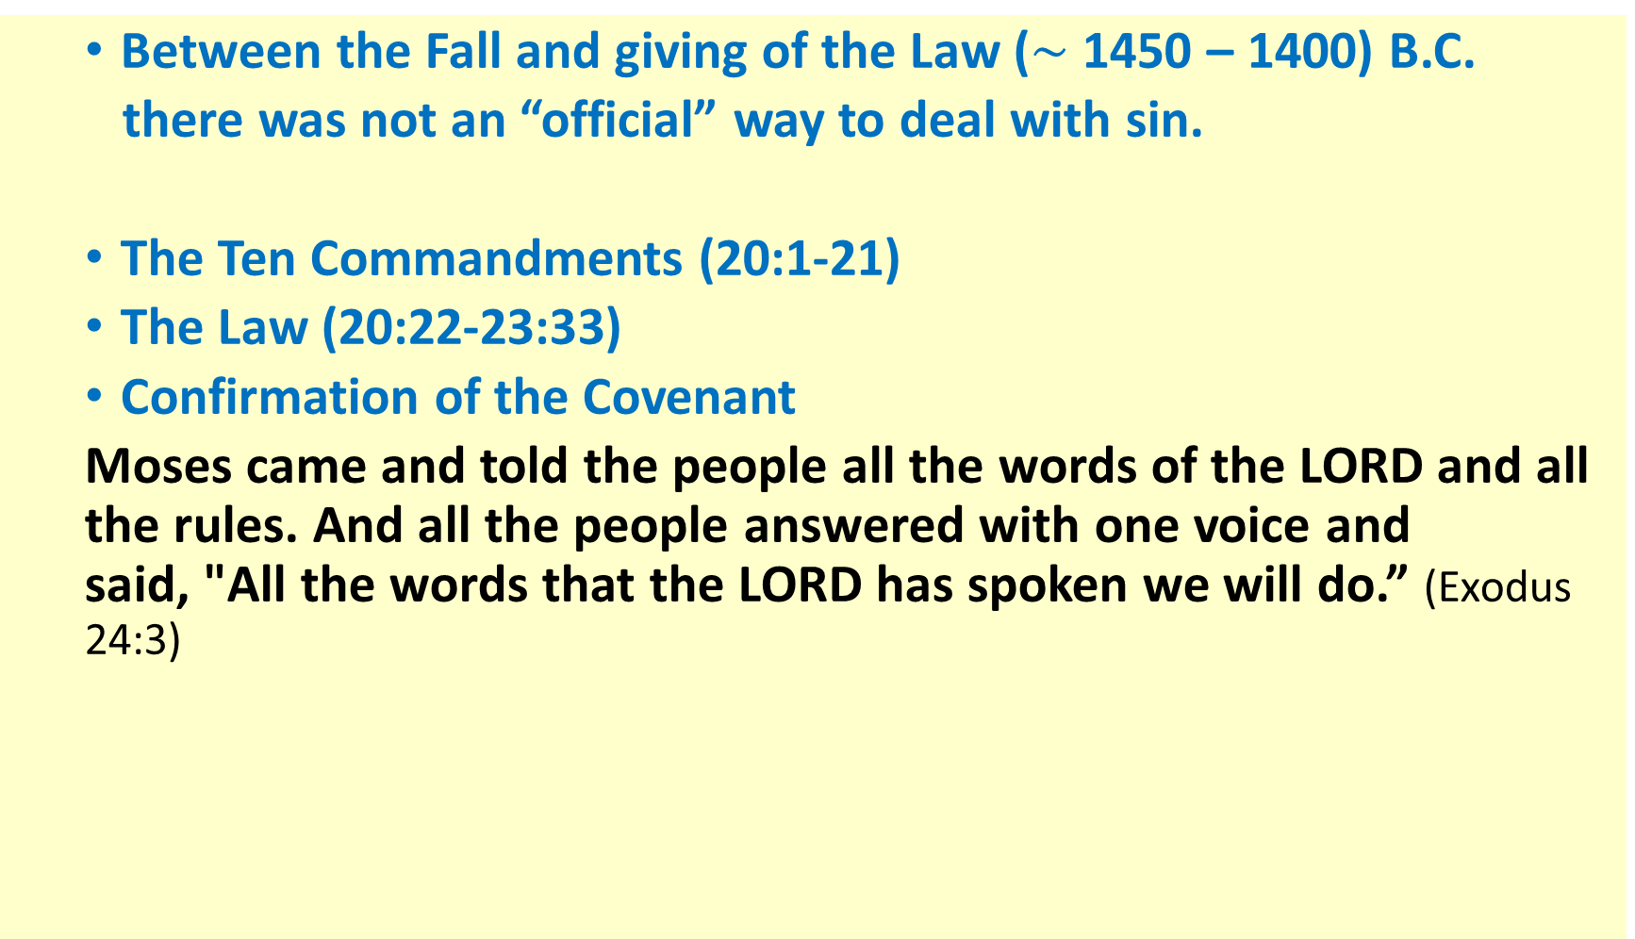
The Law – The Mosaic Covenant Review (Exodus 19 – 24)
  Between the Fall and giving of the Law ($\sim$ 1450 – 1400) B.C.
  there was not an “official” way to deal with sin.
  The Ten Commandments (20:1-21)
  The Law (20:22-23:33)
  Confirmation of the Covenant
  Moses came and told the people all the words of the LORD and all the rules. And all the people answered with one voice and said, "All the words that the LORD has spoken we will do.” (Exodus 24:3)

Slide 5
The Law – The Mosaic Law
The Mosaic Laws had three* main purposes:
  To show human sinfulness and God’s perfect righteousness.
  To restrain evil by requiring physical punishment for offenses.
  To guide people to the good works that please God.
There were three categories of laws:
  Moral Law commanded what pleased God and forbade what offended him.
  Political Law applied the Moral Law to Israel’ s theocracy.
  Ceremonial Laws on diet, purity and sacrifice that enacted symbolically what Jesus fulfilled.
As Christians we follow only the Moral Law.
*Three is traditional but the Law also set the Jews apart from all the other nations they would encounter.

Slide 6
The Law – The Mosaic Law
The Mosaic Law is comprised of 613 laws though there is not an absolutely universally agreed upon list.
According to the Talmud Deuteronomy 33:4 is to be interpreted to mean that Moses transmitted the "Torah“ (literally the law) from God to the Israelites. when Moses commanded us a law, as a possession for the assembly of Jacob. (Deuteronomy 33:4)
The Talmud notes that the Hebrew numerical value of the word "Torah" is 611, and combining Moses's 611 commandments with the first two of the Ten Commandments which were the only ones heard directly from God, adds up to 613. The Talmud attributes the number 613 to Rabbi Simlai.
There are 365 negative laws (Thou shall not) and 248 positive laws (Thou shall).

Slide 7
The Law – The Mosaic Law
Tradition says that there is one negative command for each day of the year (365) and 248 positive ones that correspond to the number bones in the human body plus the number of internal organs!
Following the destruction of the Temple in A.D. 70 it is possible to only observe 77 positive commandments and 194 negative commandments. However, of the ones that can still be obeyed 26 can only be obeyed in Israel.
  Laws regarding services at the Temple
  Laws regarding the government and the king.
  Laws regarding products of the land.
  Health regulations.
  Laws regarding the Sanhedrin.

Slide 8
The Law – The Mosaic Law
Distribution of the 613 Laws within the Torah.
Book | Hebrew Meaning | Septuagint Meaning | # of Laws
Genesis | “In the beginning” | origins | 3
Exodus | “Names” | exit or departure | 117
Leviticus | “He called” | about Levites | 241
Numbers | “In the wilderness” | Numbers | 52
Deuteronomy | (spoken) “words” | repetition of the Law or 2nd Law* | 200
 |  | Total # of Laws | 613
* Mistranslation of the Hebrew phrase “a copy of this law."

Slide 9
The Law – The Mosaic Law
The Law can be divided into 34 categories per the following referenced website:
To read all 613 laws go to jewfaq.org/613.htm
The laws are derived from the Torah and contained in the Mishnah (oral law).
The following two slides list the 34 categories with the number of laws in each category.
Each law on the list has the Scripture reference.

Slide 10
The Law – The Mosaic Law
God 10
Torah 6
Signs/symbols 5
Prayer/blessings 4
Love/brotherhood 14
Poor/unfortunate 13
Gentiles 6
Marriage/divorce
& family 23
Forbidden sexual relations 25
Times/seasons 36
Dietary laws 27
Business practices 14
Employees/servants & slaves 19
Vows/oaths/swearing 7
Sabbatical/jubilee years 17
Court/judicial procedure 36
Injuries/damages 4
Property/ property rights 11
Criminal laws 7
Punishment & restitution 24
Prophecy 3
Idolatry 46
Agriculture/animal husbandry 7
Clothing 3
First born 4
“Heave offering” & tithes/taxes 24
Temple/sanctuary&
sacred objects 33
Sacrifices/offerings 102
Ritual purity/impurity 16
Lepers/leprosy 4
The king 7
Nazarites 10
War 16

Slide 11
The Law – The Mosaic Law
Kohanim*/Levites 30
*The kohanim are the descendants of Aaron, chosen by God at the time of the incident with the Golden Calf to perform certain sacred work, particularly in connection with the animal sacrifices and the rituals related to the Temple. After the destruction of the Temple, the role of the kohanim diminished significantly in favor of the rabbis; however, Jews continue to keep track of kohein lineage. DNA research supports their claims: a study published in Nature in June 1997 shows that self-identified kohanim in three countries have common elements in the Y-chromosome, indicating that they all have a common male ancestor.

Slide 12
The Law – The Mosaic Law - The NT Perspective
Calvin listed three uses of the Law in his Institutes of the Christian Religion.
The Law reveals the character of God.
    At the same time it is a mirror reflecting our unholiness.
    The Law drives us to the gospel.
The Law is a restraint against sin.
    On the other hand the more Law the unregenerate see the more they want to break it. (Romans 7)
3. The Law reveals what pleases God.

Slide 13
The Law – The Mosaic Law - The NT Perspective
What is the purpose of the Law?
Why then the law? It was added because of transgressions, until the offspring should come to whom the promise had been made ……Now before faith came, we were held captive under the law, imprisoned until the coming faith would be revealed. So then, the law was our guardian until Christ came, in order that we might be justified by faith. But now that faith has come, we are no longer under a guardian, for in Christ Jesus you are all sons of God, through faith. Galatians 3:19, 23-26)

Slide 14
The Law – The Mosaic Law - The NT Perspective
But now the righteousness of God has been manifested apart from the law, although the Law and the Prophets bear witness to it - the righteousness of God through faith in Jesus Christ for all who believe. For there is no distinction: for all have sinned and fall short of the glory of God, and are justified by his grace as a gift, through the redemption that is in Christ Jesus, whom God put forward as a propitiation by his blood, to be received by faith. This was to show God's righteousness, because in his divine forbearance he had passed over former sins. It was to show his righteousness at the present time, so that he might be just and the justifier of the one who has faith in Jesus. Then what becomes of our boasting? It is excluded. By what kind of law? By a law of works? No, but by the law of faith. For we hold that one is justified by faith apart from works of the law. Romans 3:21 - 28

Slide 15
The Law – The Mosaic Law - The NT Perspective (Romans 7:7 – 25)
What then shall we say? That the law is sin? By no means! Yet if it had not been for the law, I would not have known sin. For I would not have known what it is to covet if the law had not said, "You shall not covet." But sin, seizing an opportunity through the commandment, produced in me all kinds of covetousness. For apart from the law, sin lies dead. I was once alive apart from the law, but when the commandment came, sin came alive and I died. The very commandment that promised life proved to be death to me. For sin, seizing an opportunity through the commandment, deceived me and through it killed me. So the law is holy, and the commandment is holy and righteous and good. Did that which is good, then, bring death to me? By no means! It was sin, producing death in me through what is good, in order that sin might be shown to be sin, and through the commandment might become sinful beyond measure. For we know that the law is spiritual, but I am of the flesh, sold under sin. For I do not understand my own actions.

Slide 16
The Law – The Mosaic Law - The NT Perspective (Romans 7:7 – 25)
For I do not do what I want, but I do the very thing I hate. Now if I do what I do not want, I agree with the law, that it is good. So now it is no longer I who do it, but sin that dwells within me. For I know that nothing good dwells in me, that is, in my flesh. For I have the desire to do what is right, but not the ability to carry it out. For I do not do the good I want, but the evil I do not want is what I keep on doing. Now if I do what I do not want, it is no longer I who do it, but sin that dwells within me. So I find it to be a law that when I want to do right, evil lies close at hand. For I delight in the law of God, in my inner being, but I see in my members another law waging war against the law of my mind and making me captive to the law of sin that dwells in my members. Wretched man that I am! Who will deliver me from this body of death? Thanks be to God through Jesus Christ our Lord! So then, I myself serve the law of God with my mind, but with my flesh I serve the law of sin.

