Slide 1
Discipleship: An Introduction to Systematic Theology and Apologetics
The Doctrines of Redemption: The Law
The Heights Church June 4, 2017

Slide 2
The Old Testament Sacrificial System – Peace Offerings (Leviticus 3)
The Hebrew word for fellowship offering is shelem, occurring 87 times in the Old Testament, meaning peace offering, requital, sacrifice for alliance or friendship, voluntary sacrifice of thanks.
There were three forms of Peace offering:
Thank offerings for prosperity or success (Leviticus 7:12, 22:29).
Vow offerings to secure a desired blessing (Numbers 6:2, 15:3, 15:8).
Freewill offerings to thank God for His bounty and assure its continuance (Leviticus 7:16, 22:18, 22:21).

Slide 3
The Old Testament Sacrificial System – Peace Offerings (Leviticus 3)
Peace offerings were unique in that the offerer could share together with the priest in the consumption of the meat, hence the name fellowship offering.
The procedure for the sacrifice was analogous to the burnt offering. However, God commanded the animal’s fat to be removed and burned on top of the burnt offering as “an aroma pleasing to the Lord” (Lev 3:5).
All fat is the LORD's. It shall be a statute forever throughout your generations, in all your dwelling places, that you eat neither fat nor blood. (Leviticus 3:16-17)

Slide 4
The Old Testament Sacrificial System – Peace Offerings (Leviticus 3)
The animal could either be an unblemished oxen or smaller cattle of either sex. (Deformed animals were allowed for a for freewill offerings - Leviticus 22:23)
Peace offerings were always accompanied by grain and drink offerings.
Public Peace offerings could be public for the nation as a whole or private for individuals.
The right shoulder was “heaved” (laid aside for the officiating priest).
The rib cage was “waived” (symbolically presented to the Lord but physically given to the priests).
The rest of the flesh belonged to the offerer.

Slide 5
The Old Testament Sacrificial System – Peace Offerings (Leviticus 3)
As the offerer had fellowship with God through his sacrifice, so can we today have fellowship with God through Christ. We are reminded of the last supper, when the believer was “invited to feast regularly upon the blood and body of the lamb of God.”

Slide 6
The Old Testament Sacrificial System – Red Heifer Offering (Numbers 19)
The purpose of this offering was to purify a person who had contact with a dead person.
An unblemished heifer that had never been yoked was killed outside the camp.
The High Priest (Eleazar or his successor) dipped his finger in the blood and sprinkled it seven times in the direction of the sanctuary.
The entire heifer was burned in the presence of the priest who cast cedar wood, hyssop and scarlet woolen material on the flames.
An undefiled man gathered the ashes and stored them outside the camp.

Slide 7
The Old Testament Sacrificial System – Red Heifer Offering (Numbers 19)
On the third and seventh day the defiled person was sprinkled using hyssop with some of the ashes over which running water had been poured.
The tent and any furniture connected to the dead person was also sprinkled.
The red heifer portrays the sacrifice of Christ that cleanses the believer from the pollution contracted from living in a fallen world.
Since death is the result of sin, the red heifer is considered a sin offering.

Slide 8
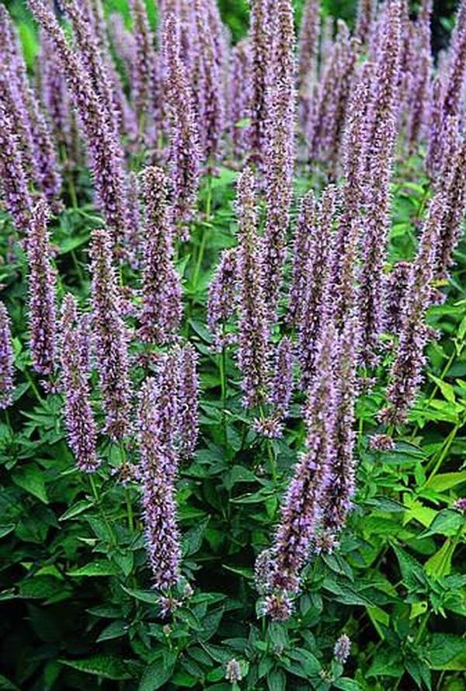
The Old Testament Sacrificial System – Red Heifer Offering (Numbers 19)
Hyssop

Slide 9
The Old Testament Sacrificial System – Major Offering Summary
Offering | Purpose | Animal | Lay Hands | Use of Blood | Priestly portion | Lay portion
Sin | Atone for sin | Cattle, Sheep, Goats, Birds | Yes | Smear on alter; sprinkle in tent (on curtain for High Priest) | Yes | No
Guilt | Reparation/ Atonement for sin | Rams | Probably | Pour on alter sides | Yes | No
Burnt | Surrender completely to God | Cattle, Sheep, Goats, Birds | Yes | Pour on alter sides | No | No
Grain | First Fruits | Grain (wine) | N/A | N/A | Yes | No
Peace | Fellowship with God | Cattle, Sheep, Goats | Yes | Pour on alter sides | Yes | Yes

Slide 10
The Old Testament Sacrificial System – The Tabernacle

Slide 11
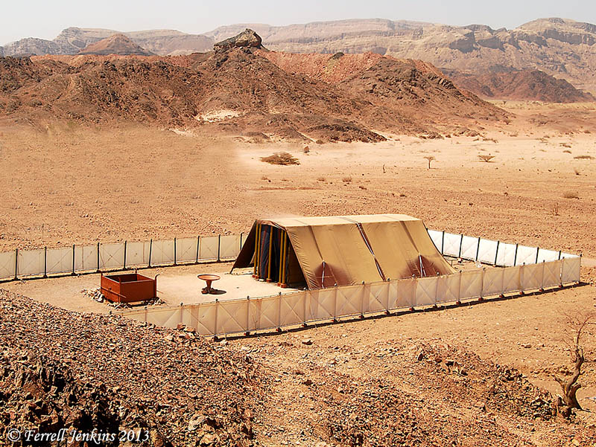
The Old Testament Sacrificial System – The Tabernacle

Slide 12
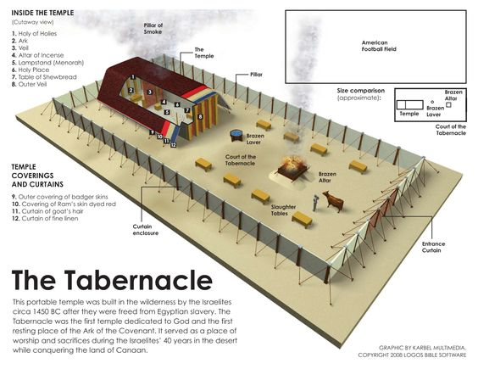
The Old Testament Sacrificial System – The Tabernacle

Slide 13
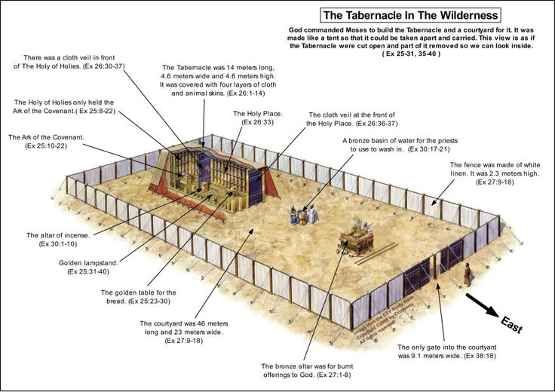
The Old Testament Sacrificial System – The Tabernacle

Slide 14
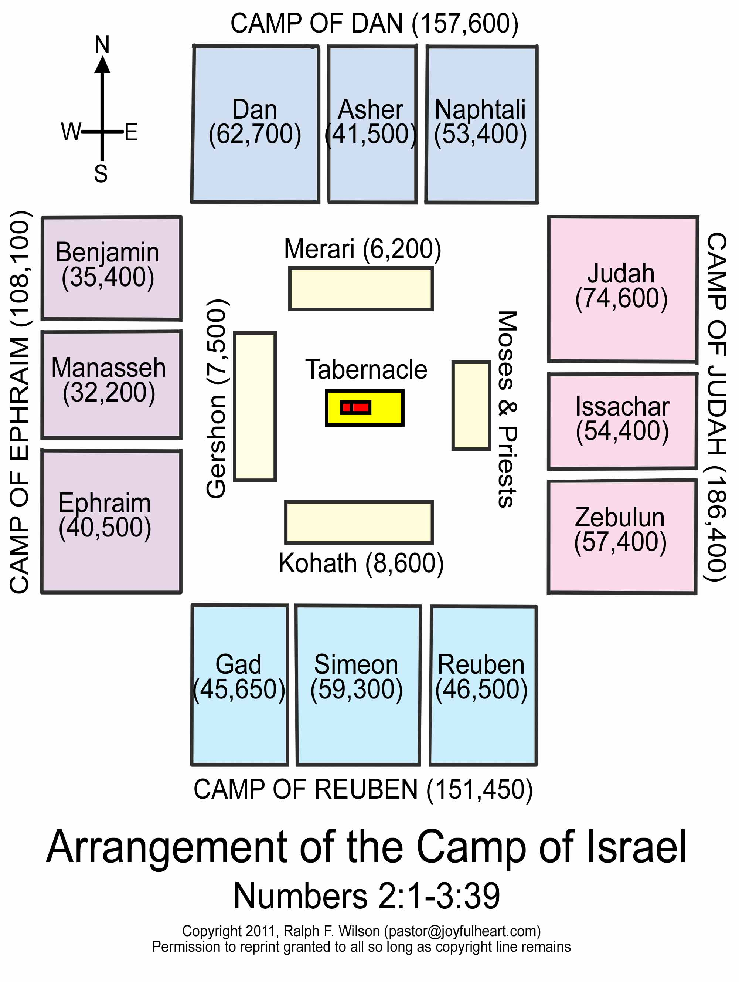
The Old Testament Sacrificial System – The Tabernacle
EAGLE
OX
LION
MAN

Slide 15
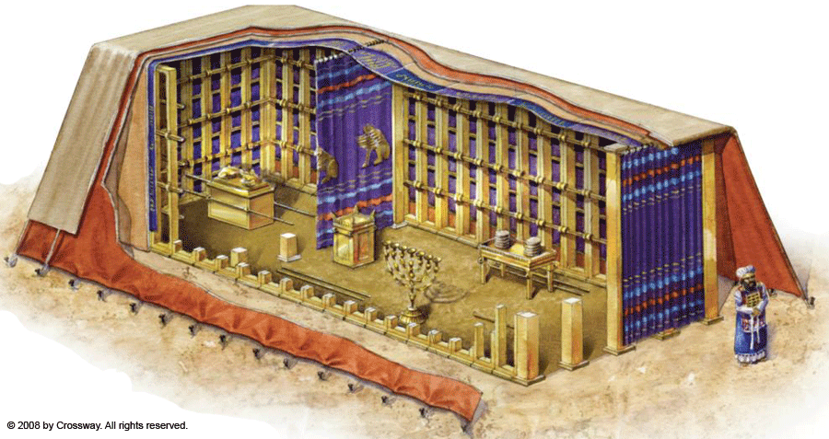
The Old Testament Sacrificial System – The Tabernacle

Slide 16
The Old Testament Sacrificial System – The Tabernacle
The Tabernacle contained:
A little over one ton of Au (gold)
3.75 tons of Ag (silver)
2.5 tons of bronze
Total value of the materials at todays prices of Au/Ag is approximately 47 – 48 million dollars.
The weight of the tabernacle and its furnishings is estimated at about ten tons (20,000 pounds).
It is estimated that there were between 32,000 and 75,000 adult male Levites!
A U.S. combat soldier carries at least 60 pounds requiring about 333.333 men to carry the Tabernacle and its furnishings.

Slide 17
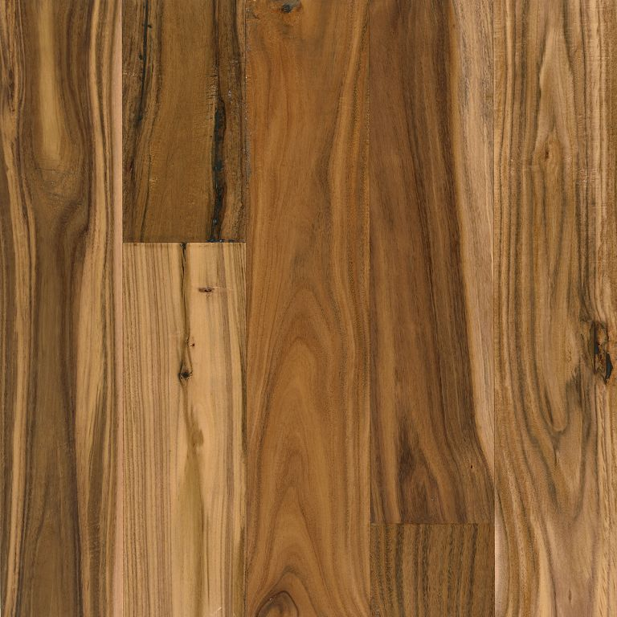
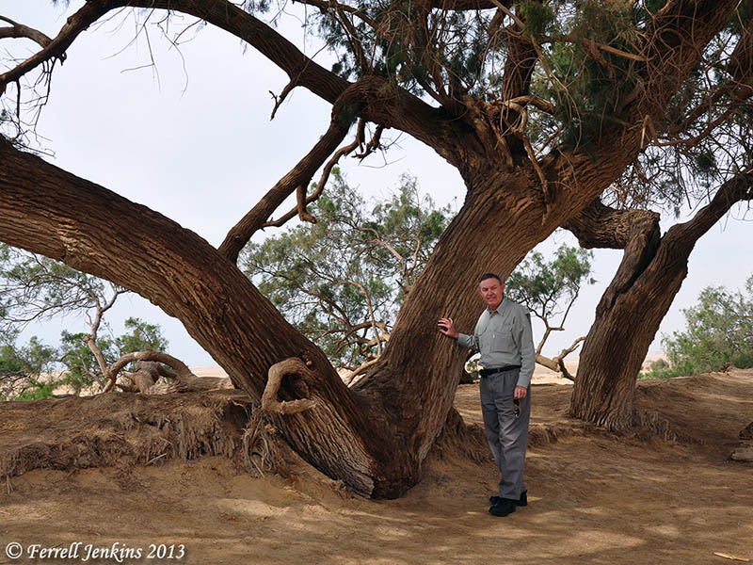
The Old Testament Sacrificial System – (Acacia Wood)
Acacia hardwood is a thick, dense byproduct of a species of tree or shrub in the Acacia family. The global Acacia family contains over 100 species of plants and trees that thrive in warm, tropical climates of Asia, Australia and Africa to the arid Middle East.

