Slide 1
Discipleship: An Introduction to Systematic Theology and Apologetics
The Doctrines of Redemption: The Law
The Heights Church June 11, 2017

Slide 2
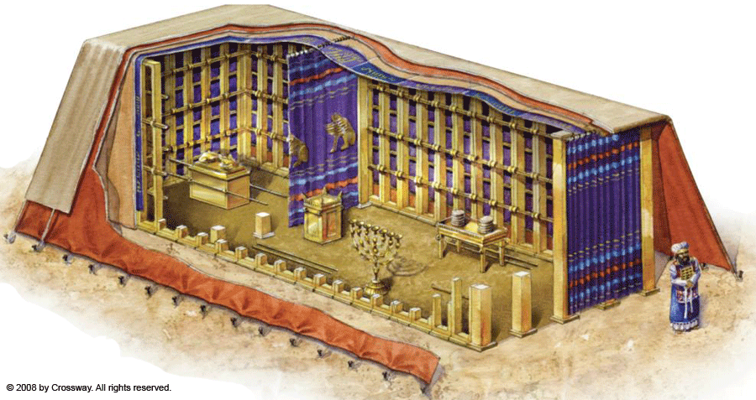
The Old Testament Sacrificial System – The Tabernacle

Slide 3
The Old Testament Sacrificial System – The Tabernacle Layers
Logically the outer layer needed to be durable to protect the Tabernacle from the elements.
The outer layer is described as Tachash (Hebrew in Exodus 26:14).
Some Hebrew scholars translate it as dugong (manatee/sea cow) with very durable hides. They were abundant in the Red Sea and easily hunted.
The Septuagint and Vulgate say Tachash is a color – dark red or dark blue.
According to the Jerusalem Talmud it means blackening of a tanned hide.
Tachash was translated as badger by Martin Luther and carried over to the Geneva Bible and KJV.
It is translated as porpoise in the NASV; sea cow in the NIV and goat skins in the (ESV)

Slide 4
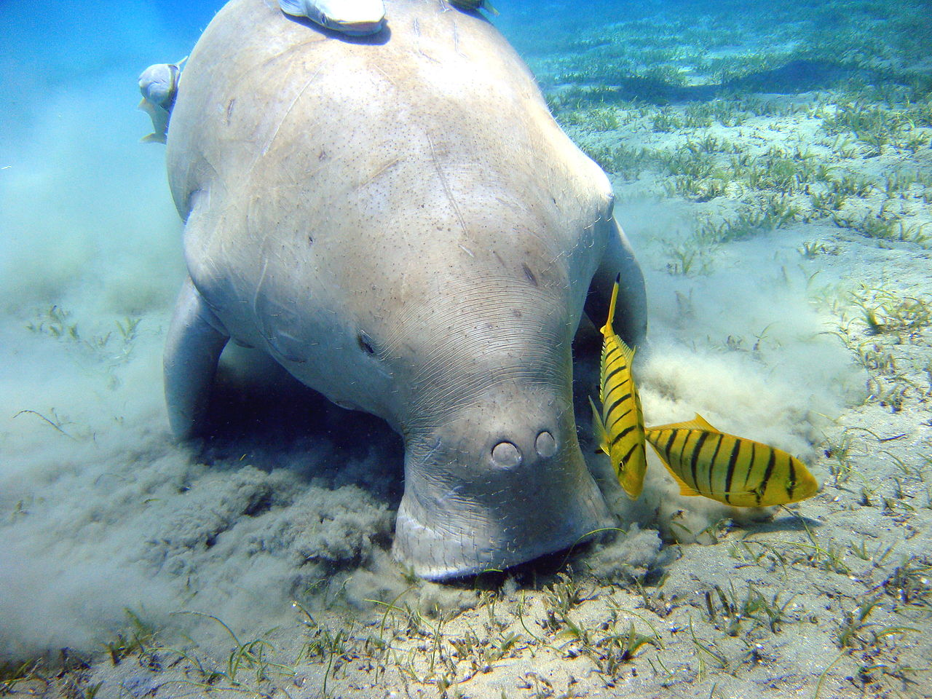
The Old Testament Sacrificial System – The Tabernacle Layers - Dugong

Slide 5
The Old Testament Sacrificial System – The Tabernacle Layers
Tachash could also be derived from the Egyptian ths - a verb used with reference to the process of stretching leather across a wooden frame. The ancient Egyptians used oil to cure their leather. This was done by dipping the hide in oil, stretching it across a wooden frame, and scraping the hide with a stone or other tool. Additionally, the Egyptian word ths appears in conjunction with tbw ("sandal") denoting the process of stretching leather for making sandals. This fits well with the appearance of the word tachash in Ezekiel where it means "sandal."

Slide 6
The Old Testament Sacrificial System – The Tabernacle Layers
The second layer was tanned ram skins died red to symbolize the sacrificial blood.
The third layer was black goat hair to symbolize sin covered by the blood.
The fourth layer (only layer visible inside) was fine linen:
Blue symbolized that while we live on earth our true home is in heaven.
Red symbolized sacrificial blood.
Purple symbolized being part of a royal family.
White symbolized purity.
The use of cherubim’s embroidered on curtains separating the Most Holy Place from the Holy Place were to remind Israel that one day they would be associated with angels.

Slide 7
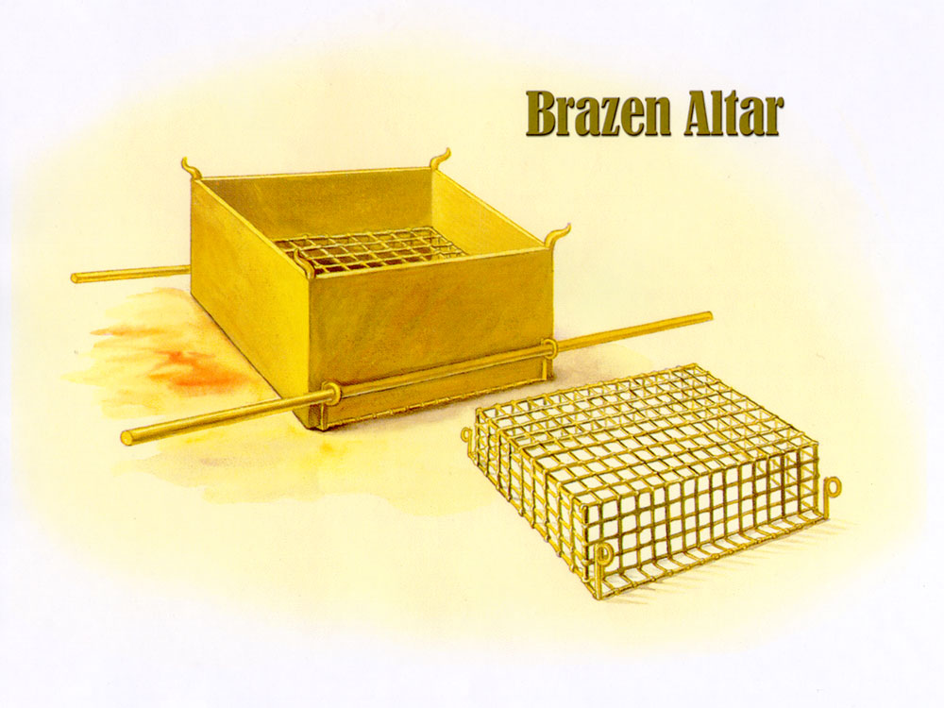
The Old Testament Sacrificial System – Bronze Alter

Slide 8
The Old Testament Sacrificial System – (Bronze Alter)
The Bronze Altar “You shall make the altar of acacia wood, five cubits long and five cubits broad. The altar shall be square, and its height shall be three cubits. And you shall make horns for it on its four corners; its horns shall be of one piece with it, and you shall overlay it with bronze. You shall make pots for it to receive its ashes, and shovels and basins and forks and fire pans. You shall make all its utensils of bronze. You shall also make for it a grating, a network of bronze, and on the net you shall make four bronze rings at its four corners. And you shall set it under the ledge of the altar so that the net extends halfway down the altar. And you shall make poles for the altar, poles of acacia wood, and overlay them with bronze. And the poles shall be put through the rings, so that the poles are on the two sides of the altar when it is carried. You shall make it hollow, with boards. As it has been shown you on the mountain, so shall it be made. (Exodus 27:1-8 )

Slide 9
The Old Testament Sacrificial System – (Bronze Alter)
Jesus’s death on the cross was the ultimate sacrifice for our sins. He is pictured in all the sacrifices God commanded Israel to bring (Leviticus 1-5; Hebrews 10:1-14).
For since the law has but a shadow of the good things to come instead of the true form of these realities, it can never, by the same sacrifices that are continually offered every year, make perfect those who draw near. Otherwise, would they not have ceased to be offered, since the worshipers, having once been cleansed, would no longer have any consciousness of sins? But in these sacrifices there is a reminder of sins every year. For it is impossible for the blood of bulls and goats to take away sins. (Hebrews 10:1-4)

Slide 10
The Old Testament Sacrificial System – (Bronze Alter)
And every priest stands daily at his service, offering repeatedly the same sacrifices, which can never take away sins. But when Christ had offered for all time a single sacrifice for sins, he sat down at the right hand of God, waiting from that time until his enemies should be made a footstool for his feet. For by a single offering he has perfected for all time those who are being sanctified. (Hebrews 10:11-14)
Therefore, brothers, since we have confidence to enter the holy places by the blood of Jesus, by the new and living way that he opened for us through the curtain, that is, through his flesh, and since we have a great priest over the house of God, let us draw near with a true heart in full assurance of faith, with our hearts sprinkled clean from an evil conscience and our bodies washed with pure water. (Hebrews 10:19-22)

Slide 11
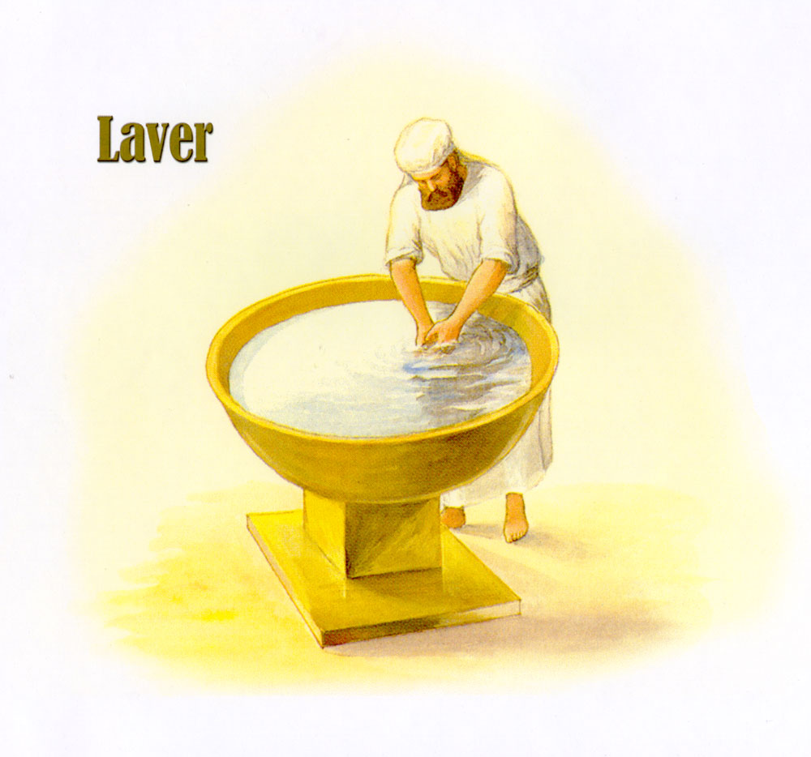
The Old Testament Sacrificial System – The Bronze Basin

Slide 12
The Old Testament Sacrificial System – (The Bronze Basin)
The Basin or Laver was to make the Priest clean of “dirt” by washing his hands and feet before approaching the alter or entering the tabernacle. It was not to remove blood.
The LORD said to Moses, “You shall also make a basin of bronze, with its stand of bronze, for washing. You shall put it between the tent of meeting and the altar, and you shall put water in it, with which Aaron and his sons shall wash their hands and their feet. When they go into the tent of meeting, or when they come near the altar to minister, to burn a food offering to the LORD, they shall wash with water, so that they may not die. (Exodus 30:17-20)

Slide 13
The Old Testament Sacrificial System – The Golden Lampstand

Slide 14
The Old Testament Sacrificial System – (The Golden Lamp Stand)
The Golden Lampstand “You shall make a lampstand of pure gold. The lampstand shall be made of hammered work: its base, its stem, its cups, its calyxes, and its flowers shall be of one piece with it. And there shall be six branches going out of its sides, three branches of the lampstand out of one side of it and three branches of the lampstand out of the other side of it; three cups made like almond blossoms, each with calyx and flower, on one branch, and three cups made like almond blossoms, each with calyx and flower, on the other branch—so for the six branches going out of the lampstand. And on the lampstand itself there shall be four cups made like almond blossoms, with their calyxes and flowers, and a calyx of one piece with it under each pair of the six branches going out from the lampstand. Their calyxes and their branches shall be of one piece with it, the whole of it a single piece of hammered work of pure gold. You shall make seven lamps for it. And the lamps shall be set up so as to give light on the space in front of it. Its tongs and their trays shall be of pure gold. It shall be made, with all these utensils, out of a talent of pure gold. And see that you make them after the pattern for them, which is being shown you on the mountain. (Exodus 25:31-40)

Slide 15
The Old Testament Sacrificial System – (The Golden Lamp Stand)
In the Holy place the furnishings were of gold while copper or bronze were used in the courtyard.
The Lampstand symbolized light from God. It was to give light continually, fueled by clear olive oil (Exodus 27:20).
God said, “Let there be light.” (Genesis 1:3)
Rev. 1:12-20 indicates local churches are represented by golden lampstands.
Jesus spoke to them, saying, “I am the light of the world. Whoever follows me will not walk in darkness, but will have the light of life.” (John 8:12)
As long as I am in the world, I am the light of the world.” (John 9:5)
Christians are to be a light to the world. (Matthew 5:14).

Slide 16
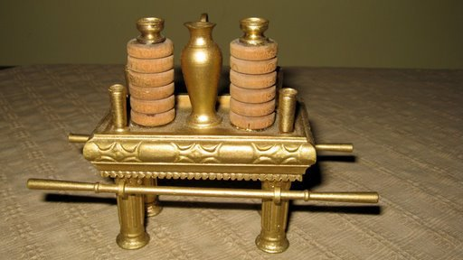
The Old Testament Sacrificial System – Table of Show Bread

Slide 17
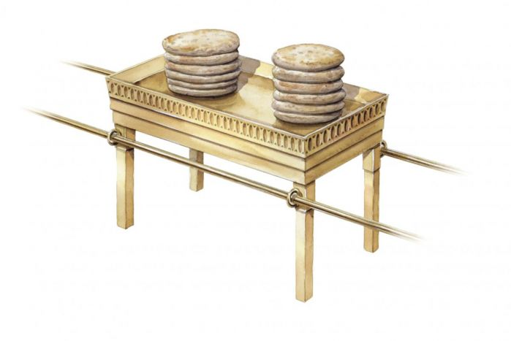
The Old Testament Sacrificial System – Table of Show Bread

Slide 18
The Old Testament Sacrificial System – (The Table of Show Bread)
The Table held the twelve loaves of bread that were a reminder that the tribes were constantly in the presence of God and that God saw all that they did The bread also reminded the people that God fed His people.
“You shall make a table of acacia wood. Two cubits shall be its length, a cubit its breadth, and a cubit and a half its height. You shall overlay it with pure gold and make a molding of gold around it. And you shall make a rim around it a handbreadth wide, and a molding of gold around the rim. And you shall make for it four rings of gold, and fasten the rings to the four corners at its four legs. Close to the frame the rings shall lie, as holders for the poles to carry the table. You shall make the poles of acacia wood, and overlay them with gold, and the table shall be carried with these. And you shall make its plates and dishes for incense, and its flagons and bowls with which to pour drink offerings; you shall make them of pure gold. And you shall set the bread of the Presence on the table before me regularly. (Exodus 25:23-30)

Slide 19
The Old Testament Sacrificial System – (The Table of Show Bread)
“You shall take fine flour and bake twelve loaves from it; two tenths of an ephah shall be in each loaf. And you shall set them in two piles, six in a pile, on the table of pure gold before the LORD. And you shall put pure frankincense on each pile, that it may go with the bread as a memorial portion as a food offering to the LORD. Every Sabbath day Aaron shall arrange it before the LORD regularly; it is from the people of Israel as a covenant forever. And it shall be for Aaron and his sons, and they shall eat it in a holy place, since it is for him a most holy portion out of the LORD's food offerings, a perpetual due.” (Leviticus 24:5-9)

Slide 20
The Old Testament Sacrificial System – (The Table of Show Bread)
He said to them, “Have you not read what David did when he was hungry, and those who were with him: how he entered the house of God and ate the bread of the Presence, which it was not lawful for him to eat nor for those who were with him, but only for the priests? (Matthew 12:3-4)
Jesus said to them, “I am the bread of life; whoever comes to me shall not hunger, and whoever believes in me shall never thirst. But I said to you that you have seen me and yet do not believe. All that the Father gives me will come to me, and whoever comes to me I will never cast out. For I have come down from heaven, not to do my own will but the will of him who sent me. And this is the will of him who sent me, that I should lose nothing of all that he has given me, but raise it up on the last day. For this is the will of my Father, that everyone who looks on the Son and believes in him should have eternal life, and I will raise him up on the last day.” (John 6:35-40)

Slide 21
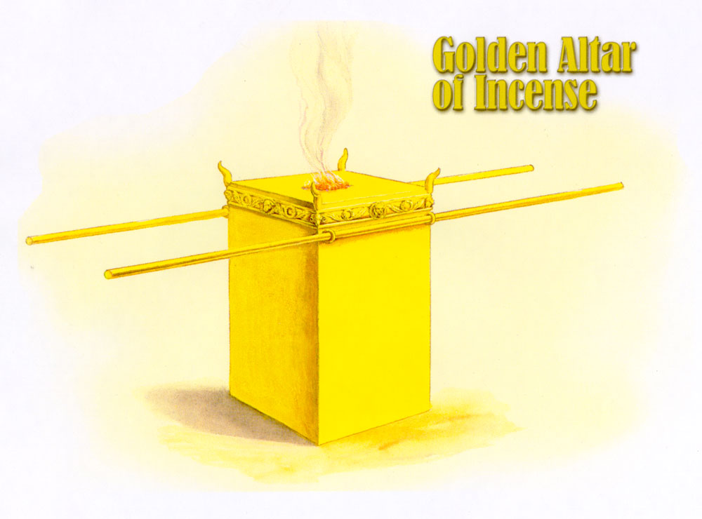
The Old Testament Sacrificial System – Golden Alter of Incense

Slide 22
The Old Testament Sacrificial System – Golden Alter of Incense
The Altar of Incense “You shall make an altar on which to burn incense; you shall make it of acacia wood. A cubit shall be its length, and a cubit its breadth. It shall be square, and two cubits shall be its height. Its horns shall be of one piece with it. You shall overlay it with pure gold, its top and around its sides and its horns. And you shall make a molding of gold around it. And you shall make two golden rings for it. Under its molding on two opposite sides of it you shall make them, and they shall be holders for poles with which to carry it. You shall make the poles of acacia wood and overlay them with gold. And you shall put it in front of the veil that is above the ark of the testimony, in front of the mercy seat that is above the testimony, where I will meet with you. And Aaron shall burn fragrant incense on it. Every morning when he dresses the lamps he shall burn it, and when Aaron sets up the lamps at twilight, he shall burn it, a regular incense offering before the LORD throughout your generations. (Exodus 30:1-8)

Slide 23
The Old Testament Sacrificial System – Golden Alter of Incense
Incense was burned the same time that the daily burnt offerings were made.
The incense was to be left burning continually throughout the day and night as a pleasing aroma to the Lord.
It was made of an equal part of four precious spices (stacte, onycha, galbanum and frankincense) and was considered holy.
God commanded the Israelites not to use the same formula outside the tabernacle to make perfume for their own consumption; otherwise, they were to be cut off from their people (Exodus 30:34-38)
The incense was a symbol of the prayers and intercession of the people going up to God as a sweet fragrance. God wanted His dwelling to be a place where people could approach Him and pray to Him.

Slide 24
The Old Testament Sacrificial System – Golden Alter of Incense
The picture of prayers wafting up to heaven like incense is captured in David’s psalm and also in John’s vision in Revelations:
Let my prayer be counted as incense before you, and the lifting up of my hands as the evening sacrifice! (Psalm 141:2)
And another angel came and stood at the altar with a golden censer, and he was given much incense to offer with the prayers of all the saints on the golden altar before the throne, and the smoke of the incense, with the prayers of the saints, rose before God from the hand of the angel. (Revelation 8:3-4)
The golden altar is a representation of Christ, who is our intercessor before God the Father.

Slide 25
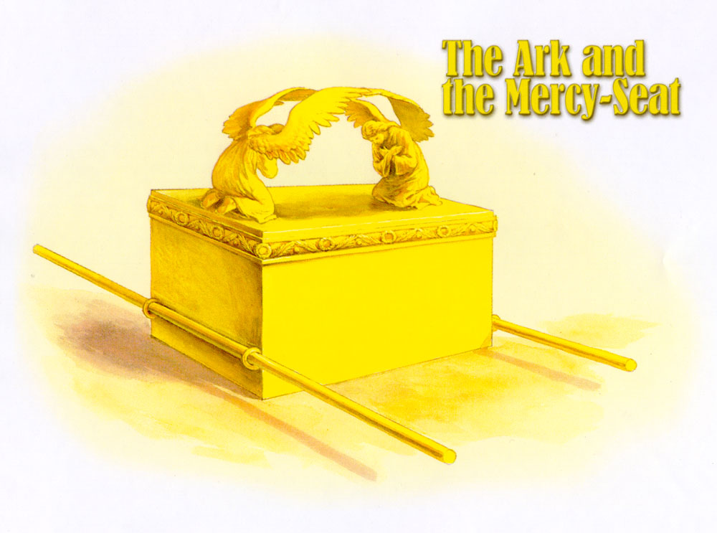
The Old Testament Sacrificial System – The Arc and the Mercy Seat)

Slide 26
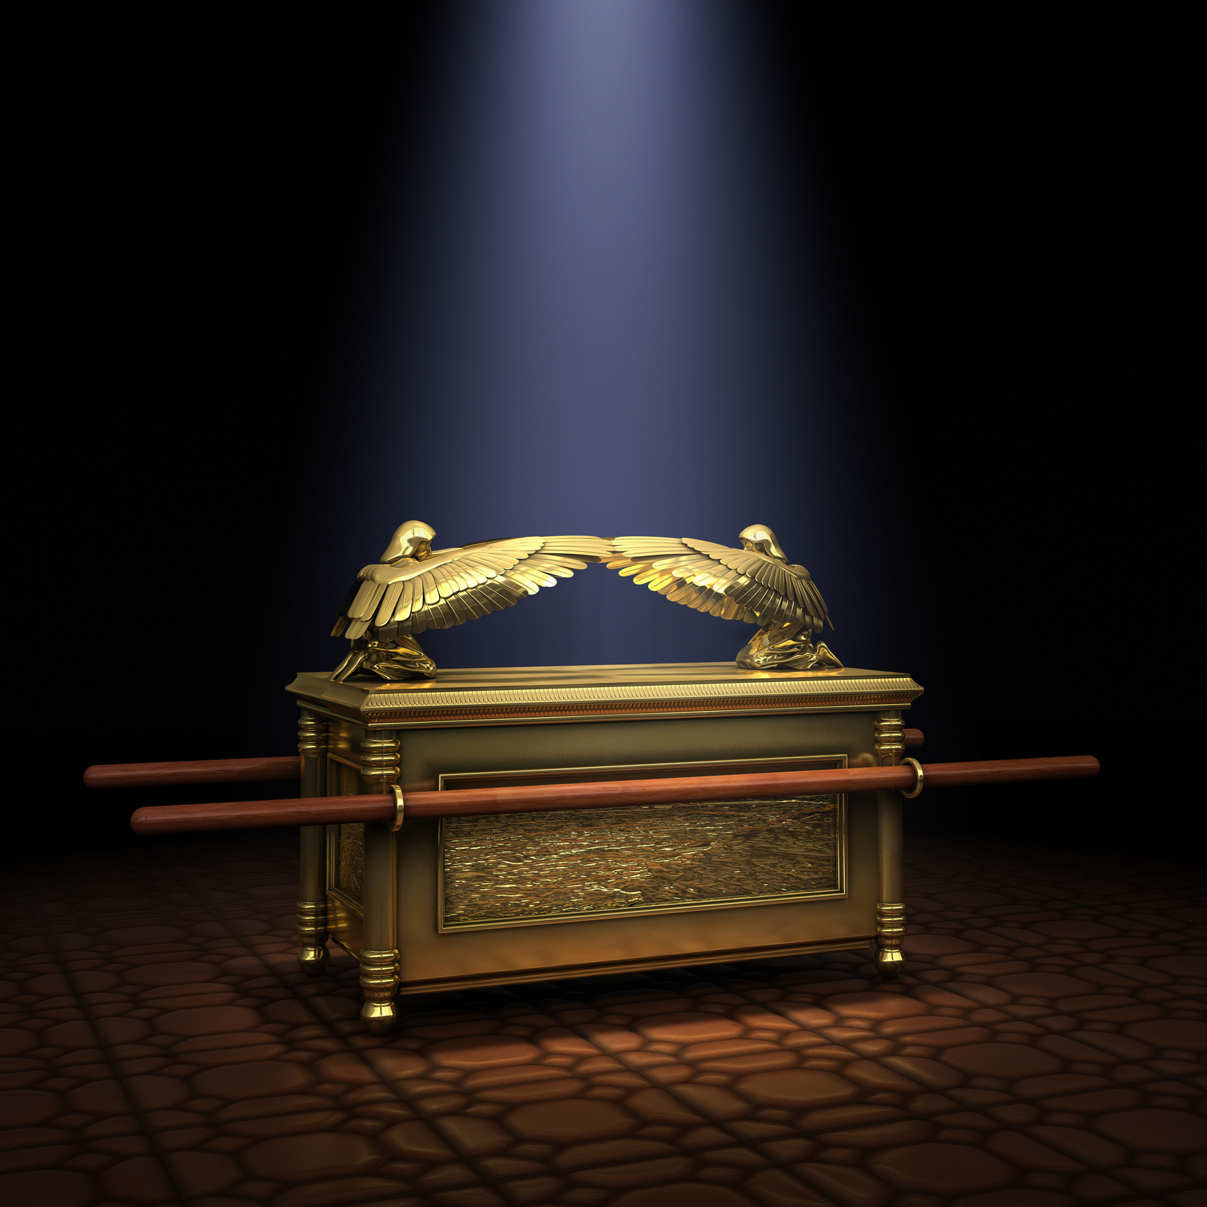
The Old Testament Sacrificial System – The Arc and the Mercy Seat

Slide 27
The Old Testament Sacrificial System – (The Arc and Mercy Seat)
A symbol of God’s law, the Ark was made of wood covered with gold. The Ark was the throne of God where His glory rested on the Mercy Seat(top), a symbol of His mercy.
The sacrificed blood was sprinkled on the Ark to cover the sins of the people.
The phrase “Mercy Seat” also means “propitiation.” Jesus is the propitiation for us today (Romans 3:25; I John 2:2.)
His blood was shed to cleanse our sins. We come to God through Him and offer our spiritual sacrifices (I Peter 2:5,9).

