Slide 1
Discipleship: An Introduction to Systematic Theology and Apologetics
The Doctrines of Redemption: The Law
The Heights Church June 18, 2017

Slide 2
The Old Testament Sacrificial System – The High Priest’s Garments

Slide 3
The Old Testament Sacrificial System – The High Priest’s Garments
The Frontlet or crown was of pure gold and engraved with “Holy to the LORD.”
Lazuli stones are a deep, celestial blue stone that remains the symbol of royalty and honor. It is a universal symbol of wisdom and truth.
You shall take two onyx stones, and engrave on them the names of the sons of Israel, six of their names on the one stone, and the names of the remaining six on the other stone, in the order of their birth. (Exodus 28:9-10)
The Breast piece was a single piece of cloth folded in half to form a pouch. Inside the pouch was the Urim and Thummim. On the front of the pouch were 12 stones each engraved with the name of one of the twelve tribes

Slide 4
The Old Testament Sacrificial System – The High Priest’s Garments
You shall set in it four rows of stones. A row of sardius, topaz, and carbuncle shall be the first row; and the second row an emerald, a sapphire, and a diamond; and the third row a jacinth, an agate, and an amethyst; and the fourth row a beryl, an onyx, and a jasper. They shall be set in gold filigree. There shall be twelve stones with their names according to the names of the sons of Israel. They shall be like signets, each engraved with its name, for the twelve tribes. (Exodus 28:17-21)

Slide 5
The Old Testament Sacrificial System – The High Priest’s Garments
So Aaron shall bear the names of the sons of Israel in the breast piece of judgment on his heart, when he goes into the Holy Place, to bring them to regular remembrance before the LORD. And in the breast piece of judgment you shall put the Urim and the Thummim, and they shall be on Aaron's heart, when he goes in before the LORD. Thus Aaron shall bear the judgment of the people of Israel on his heart before the LORD regularly. (Exodus 28:29-30)
Urim and Thummim literally mean “lights and perfection. There is no hint in Scripture of what they are or how they function.
Most scholars believe them to be two sticks or stones, perhaps precious stones, that God used in a miraculous way to reveal His will. They were used for national decisions like going to war, and for priestly matters.

Slide 6
The Old Testament Sacrificial System – The High Priest’s Garments
The High Priest’s garments were very important and designed using expensive materials for beauty and glory.
“And they shall make the ephod of gold, of blue and purple and scarlet yarns, and of fine twined linen, skillfully worked. It shall have two shoulder pieces attached to its two edges, so that it may be joined together. And the skillfully woven band on it shall be made like it and be of one piece with it, of gold, blue and purple and scarlet yarns, and fine twined linen. (Exodus 28:6-8)

Slide 7
The Old Testament Sacrificial System – The High Priest’s Garments
“You shall make the robe of the ephod all of blue. It shall have an opening for the head in the middle of it, with a woven binding around the opening, like the opening in a garment, so that it may not tear. On its hem you shall make pomegranates of blue and purple and scarlet yarns, around its hem, with bells of gold between them, a golden bell and a pomegranate, a golden bell and a pomegranate, around the hem of the robe. And it shall be on Aaron when he ministers, and its sound shall be heard when he goes into the Holy Place before the LORD, and when he comes out, so that he does not die. (Exodus 28:31-35)

Slide 8
The Old Testament Sacrificial System – The High Priest’s Garments
You shall make for them linen undergarments to cover their naked flesh. They shall reach from the hips to the thighs; and they shall be on Aaron and on his sons when they go into the tent of meeting or when they come near the altar to minister in the Holy Place, lest they bear guilt and die. This shall be a statute forever for him and for his offspring after him. (Exodus 28:42-43)
And you shall not go up by steps to my altar, that your nakedness be not exposed on it.’ (Exodus 20:26)

Slide 9
The Old Testament Sacrificial System – Solomon’s Temple
The Tabernacle was used until Solomon’s Temple was constructed.
During the conquest of Canaan, the main Israelite camp was at Gilgal, (Joshua 4:19; 5:8-10) and the Tabernacle was probably erected within the camp: Joshua 10:43 (see Numbers 1:52-2:34)
After the conquest and division of the land among the tribes, the Tabernacle was moved to Shiloh in Ephraimite territory (Joshua's tribe) to avoid disputes among the other tribes (Joshua 18:1; 19:51; 22:9; Psalm 78:60).
It remained at Shiloh during the 300-year period of the biblical judges [1 Kings 6:1; Acts 13:20].
According to Judges 20:26-28, the ark and tabernacle were at Bethel while Phinehas, grandson of Aaron, was still alive.

Slide 10
The Old Testament Sacrificial System – Solomon’s Temple
The subsequent history of the structure is separate from that of the Ark of the Covenant. After the Ark was captured by the Philistines, King Saul moved the Tabernacle to Nob, near his home town of Gibeah. After he massacred the priests (1 Samuel 21-22), it was moved to Gibeon. (1 Chronicles 21:29; 2 Chronicles 1:2-6).
The Ark was eventually brought to Jerusalem, where it was placed "inside the tent David had pitched for it" (2 Samuel 6:17; 1 Chronicles 15:1), not in the Tabernacle, which remained at Gibeon.
The altar of the Tabernacle at Gibeon was used for sacrificial worship (1 Chronicles 16:39; 21:29; 1 Kings 3:2-4), until Solomon finally brought the structure and its furnishings to Jerusalem to furnish and dedicate the Temple. (1 Kings 8:4)
There is no mention of the Tabernacle after the destruction of Jerusalem and the Temple by the Babylonians in 586 BC.

Slide 11
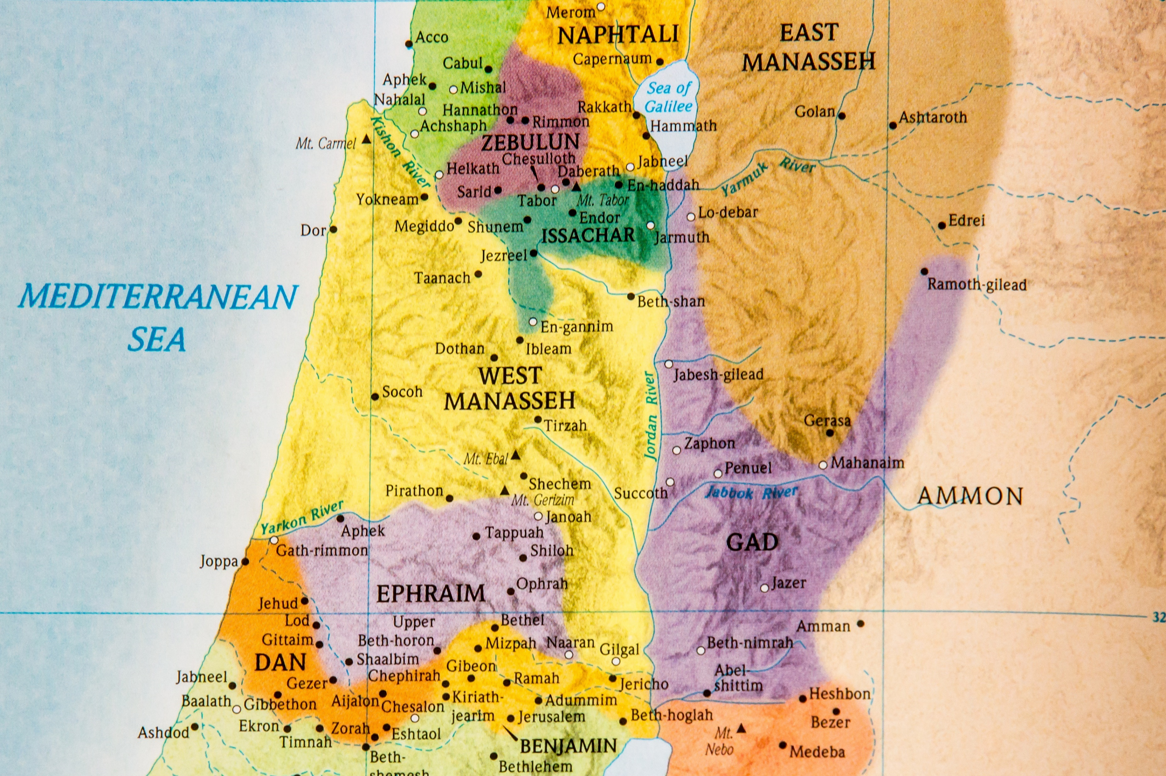
The Old Testament Sacrificial System – Tabernacle Locations
2. Shiloh
3. Bethel
5. Gibeon
6. Jerusalem
1. Gilgal
4. Nob

