Slide 1
Discipleship: An Introduction to Systematic Theology and Apologetics
The Doctrines of Redemption: The Law
The Heights Church June 25, 2017

Slide 2
The Old Testament Sacrificial System – Temple Timeline
1400 BC The Tabernacle was constructed.
960 B.C. Solomon’s temple (first temple) was finished.
586 B.C. Babylonians destroy Solomon’s temple.
516 B.C. Zerubbabel’s temple (second temple) was completed.
19 B.C. Herod’s temple was completed (second temple)
A.D. 64 Entire temple complex completed.
A.D. 70 Romans destroy Herod’s Temple.

Slide 3
The Old Testament Sacrificial System – Solomon’s Temple
With great pains I have provided for the house of the LORD 100,000 talents of gold, a million talents of silver, and bronze and iron beyond weighing, for there is so much of it; timber and stone, too, I have provided. To these you must add. (1 Chronicles 22:14)
Then David gave Solomon his son the plan of the vestibule of the temple, and of its houses, its treasuries, its upper rooms, and its inner chambers, and of the room for the mercy seat; and the plan of all that he had in mind for the courts of the house of the LORD, all the surrounding chambers, the treasuries of the house of God, and the treasuries for dedicated gifts; (1 Chronicles 28:11-12)
Now the weight of gold that came to Solomon in one year was 666 talents of gold, (1 Kings 10:14)

Slide 4
The Old Testament Sacrificial System – Solomon’s Temple
The house that King Solomon built for the LORD was sixty cubits long, twenty cubits wide, and thirty cubits high. The vestibule in front of the nave of the house was twenty cubits long, equal to the width of the house, and ten cubits deep in front of the house. (1 Kings 6:2-3)

Slide 5
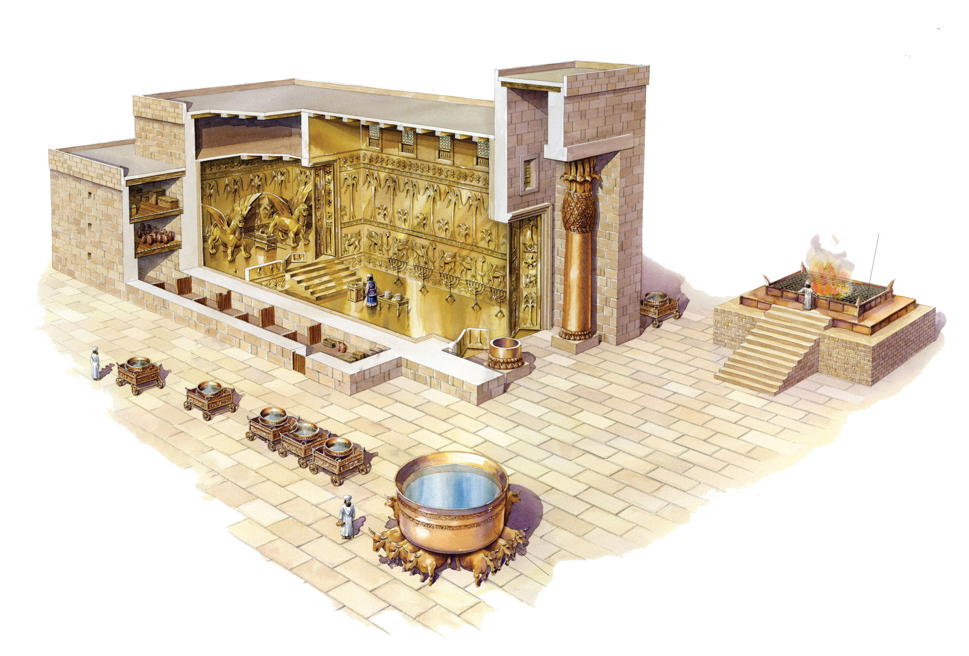
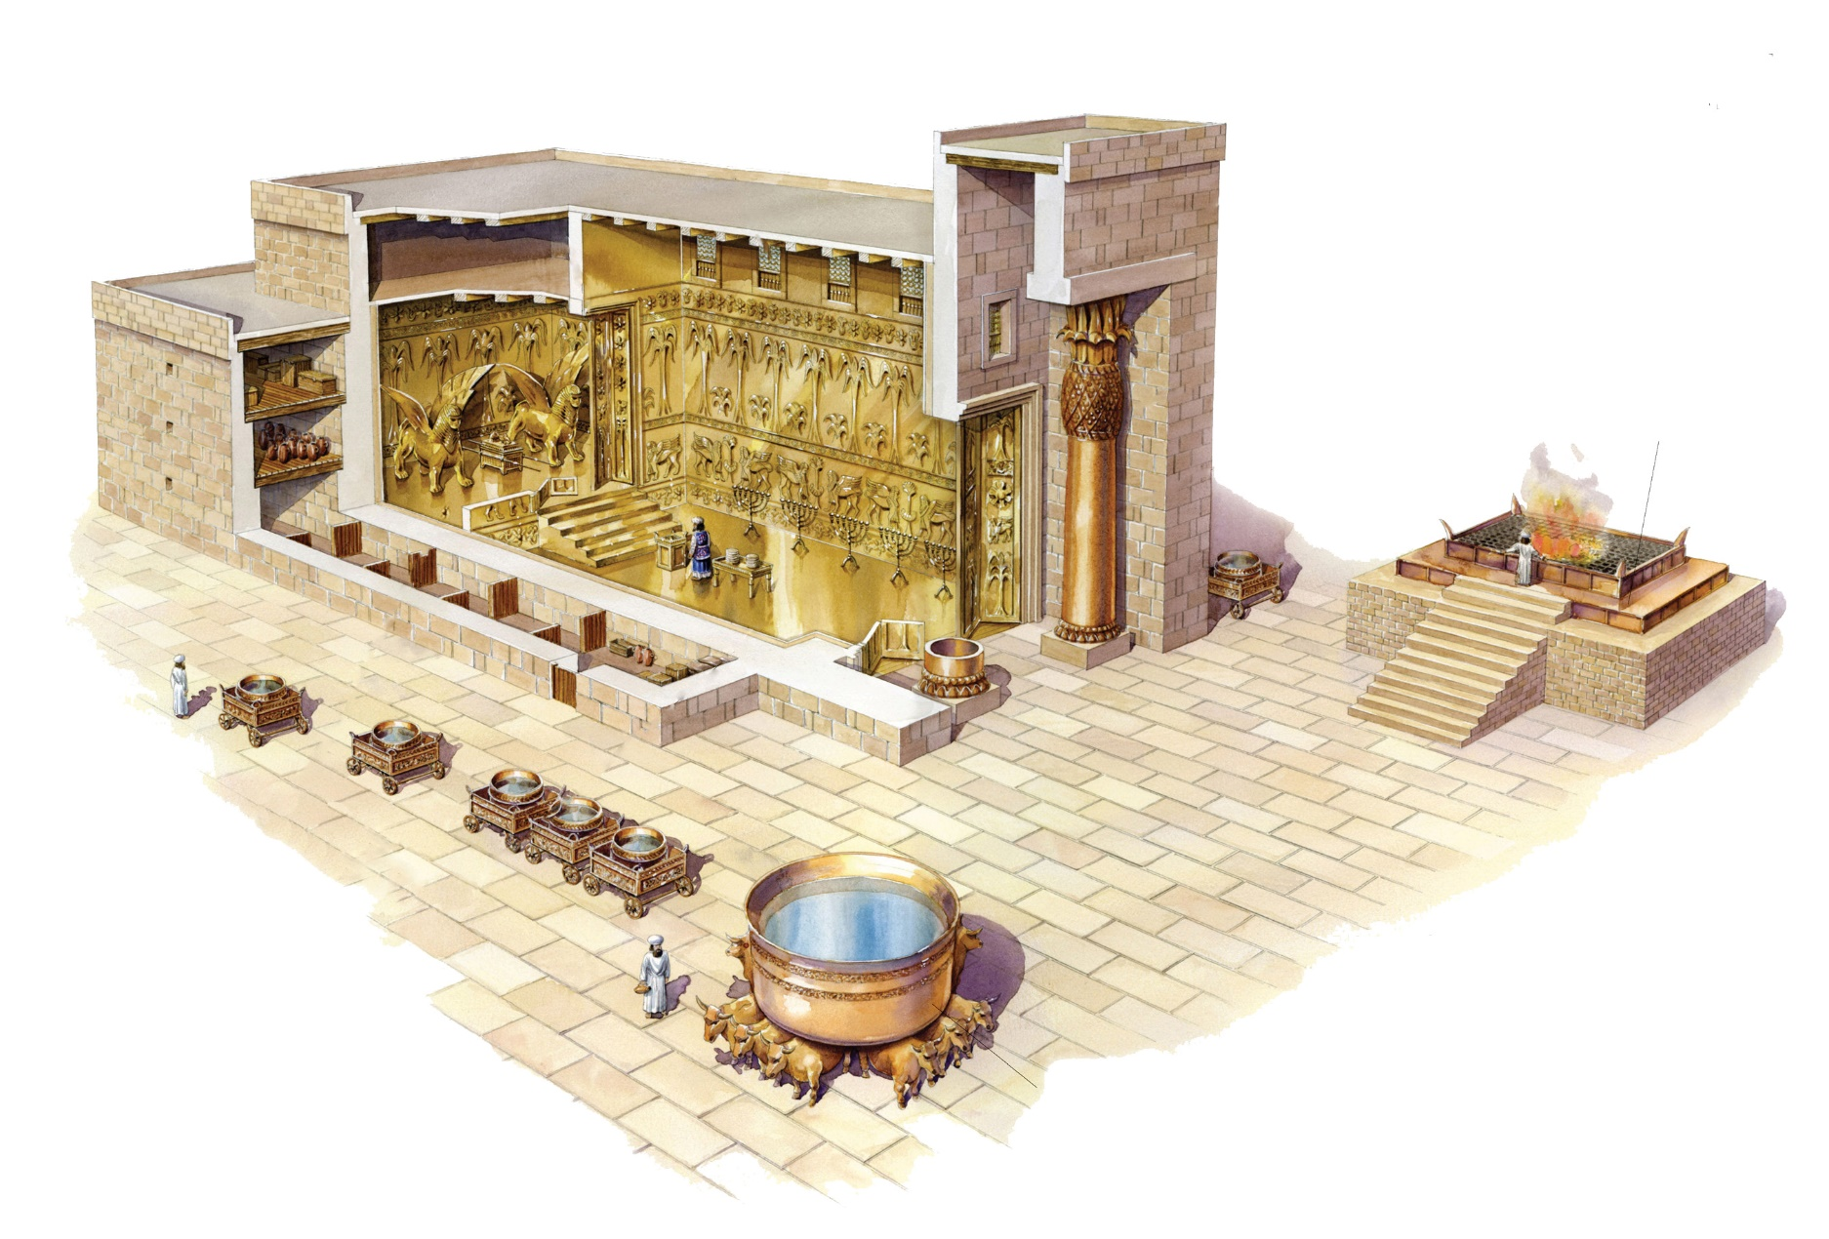
The Old Testament Sacrificial System – Solomon’s Temple

Slide 6
The Old Testament Sacrificial System – Solomon’s Temple
The inner sanctuary was twenty cubits long, twenty cubits wide, and twenty cubits high, and he overlaid it with pure gold. (1 Kings 6:20)
For the entrance to the inner sanctuary he made doors of olivewood; the lintel and the doorposts were five-sided. He covered the two doors of olivewood with carvings of cherubim, palm trees, and open flowers. He overlaid them with gold and spread gold on the cherubim and on the palm trees. (1 Kings 6:31-32)
As for the pillars, the height of the one pillar was eighteen cubits, its circumference was twelve cubits, and its thickness was four fingers, and it was hollow. On it was a capital of bronze. The height of the one capital was five cubits. (Jeremiah 52:21-22)

Slide 7
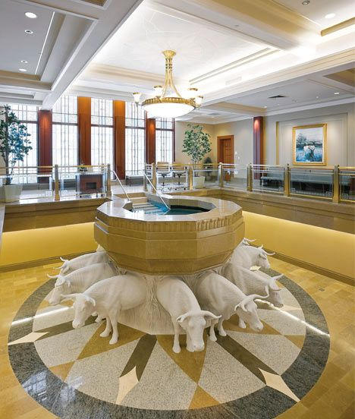
The Old Testament Sacrificial System – LDS Temple Baptismal

Slide 8
The Old Testament Sacrificial System – Zurubabel’s Temple
"And all the people shouted with a great shout when they praised the LORD, because the foundation of the house of the LORD was laid. But many of the priests and Levites and heads of fathers' houses, old men who had seen the first house, wept with a loud voice when they saw the foundation of this house being laid, though many shouted aloud for joy, so that the people could not distinguish the sound of the joyful shout from the sound of the people's weeping, for the people shouted with a great shout, and the sound was heard far away. (Ezra 3:11-13)
In the first year of Cyrus the king, Cyrus the king issued a decree: Concerning the house of God at Jerusalem, let the house be rebuilt, the place where sacrifices were offered, and let its foundations be retained. Its height shall be sixty cubits and its breadth sixty cubits, (Ezra 6:3)

Slide 9
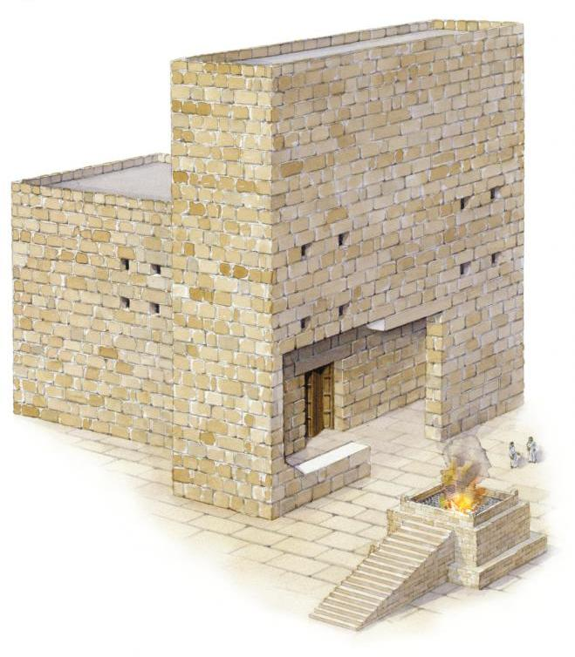
The Old Testament Sacrificial System – Zurubbabel’s Temple

Slide 10
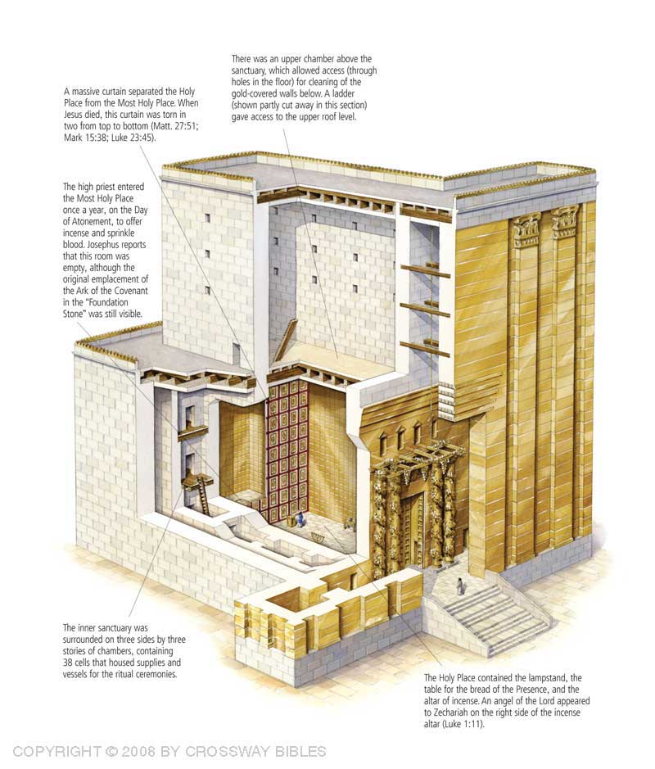
The Old Testament Sacrificial System – Herod’s Temple

Slide 11
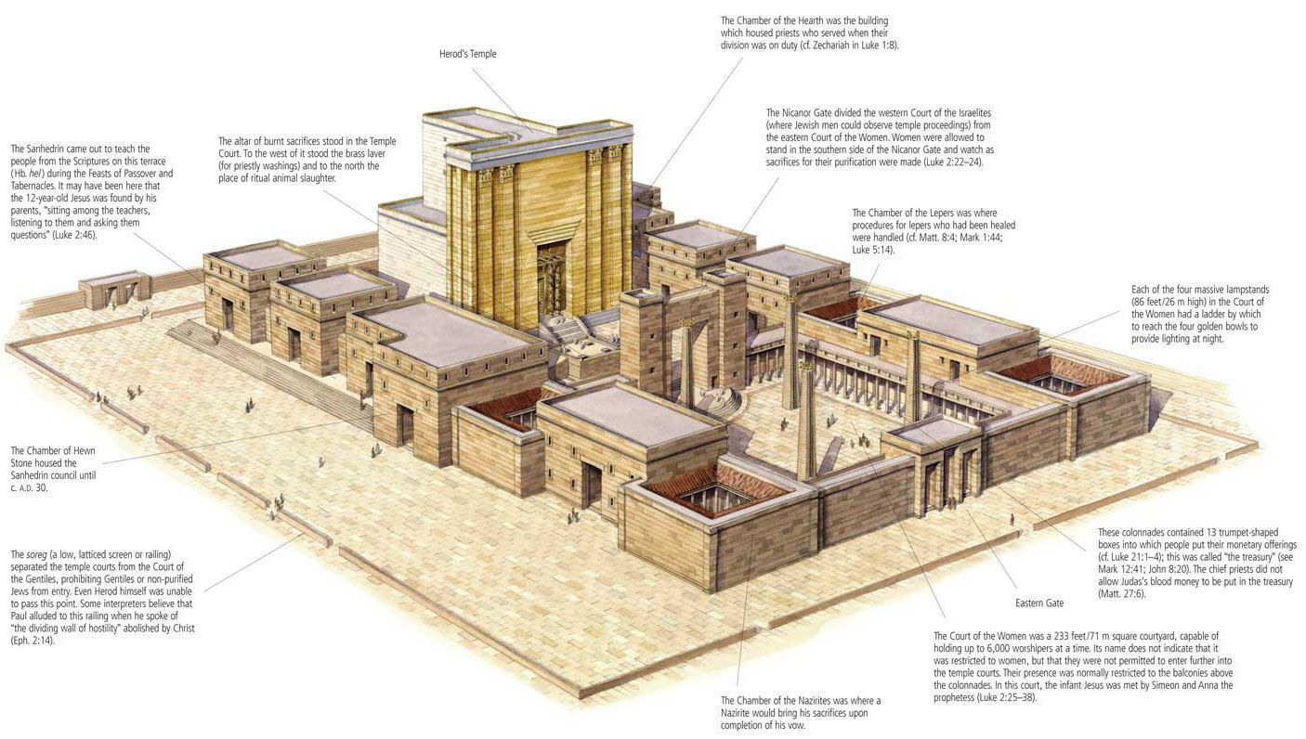
The Old Testament Sacrificial System – Herod’s Temple

Slide 12
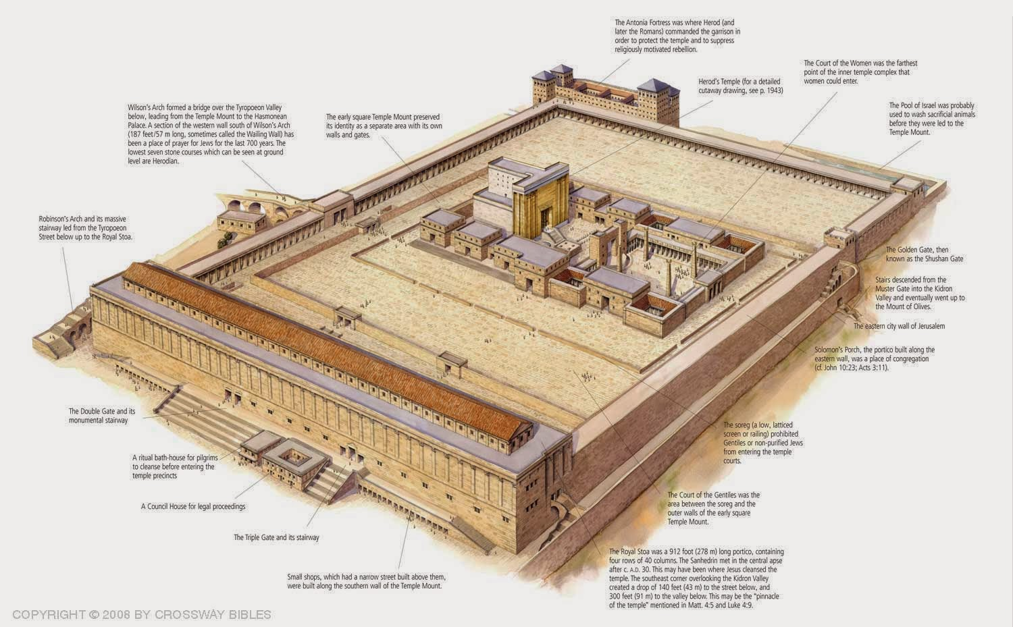
The Old Testament Sacrificial System – Herod’s Temple

Slide 13
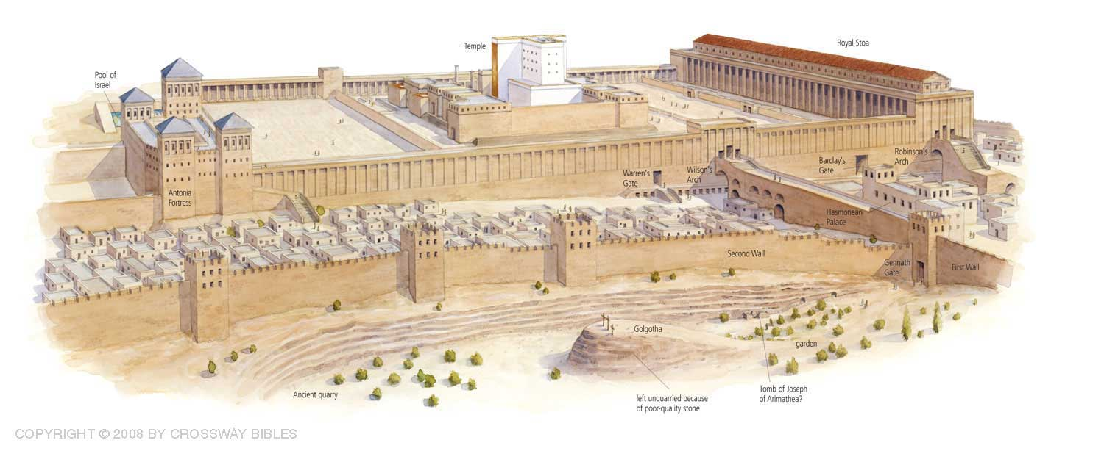
The Old Testament Sacrificial System – Herod’s Temple

