Slide 1
Discipleship: An Introduction to Systematic Theology and Apologetics
The Doctrines of Redemption: The Reformers
The Heights Church January, 7, 2018

Slide 2
The Reformation (15th century) – Renaissance
There had been previous reformations but these were primarily about morality.
THE REFORMATION (16th century) reformed theology/doctrine
It was preceded by many changes in Western Europe:
Smaller towns were forming as economic centers based on trades.
Centralization of power in large countries (Spain, England, and especially France)
The Holy Roman Emperor had lost power except in Germany and Austria.
The Roman Catholic Church was well attended, had a large income and was building magnificent facilities but was morally corrupt and plagued by erroneous doctrine.
By 1475 indulgences could not only be bought for one’s entire life but also for those in purgatory to result in their immediate transfer to heaven.
The countdown to 1517 began with three important events:
~1440 Gutenberg invented the movable printing press.
1453 Constantinople fell to the Ottoman empire.
November 10, 1483 Martin Luther is born.

Slide 3
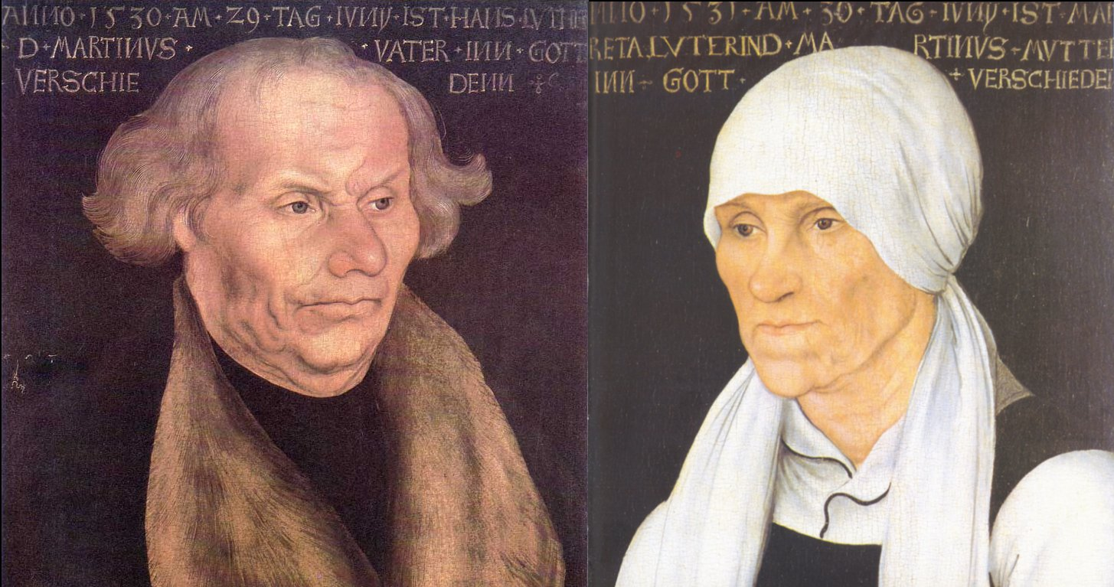
The Reformation – Martin Luther’s parents by Lucas Cranach
Martin Luther was born to Hans and Margarethe Luder on November 10, 1483 in Eisleben, Saxony. He was baptized the next morning on the feast day of St. Martin. His father was a leaseholder of copper mines and smelters and served as one of four citizen representatives on the local council. Luther's mother was a hard-working woman of "trading-class stock and middling means." .

Slide 4
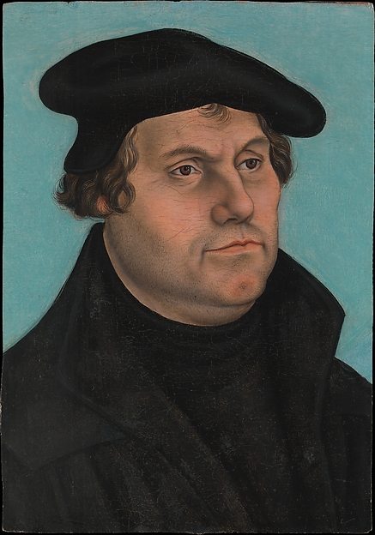
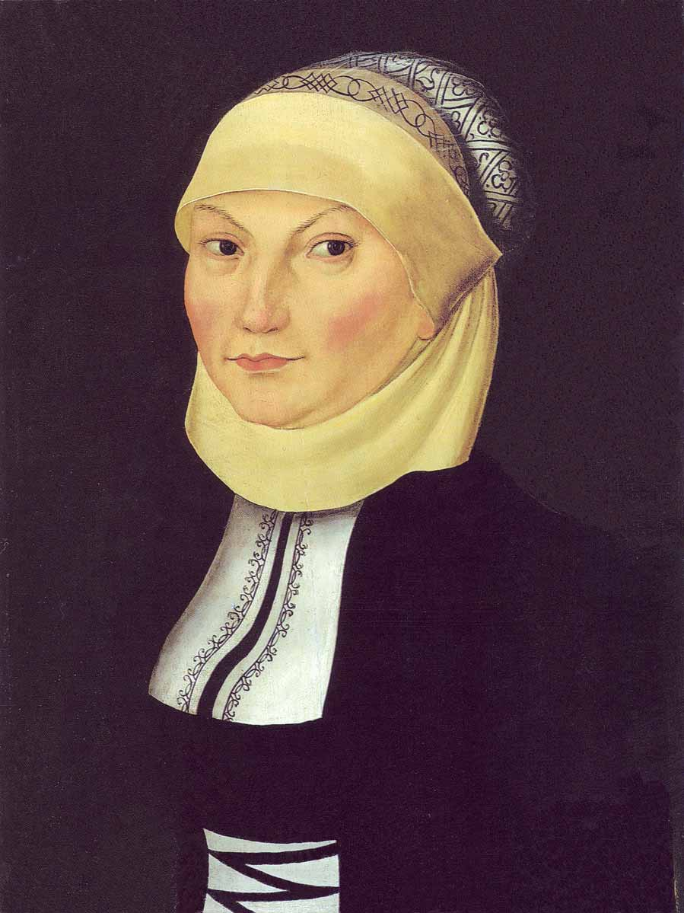
The Reformation – Martin and Katharina Luther by Lucas Cranach

Slide 5
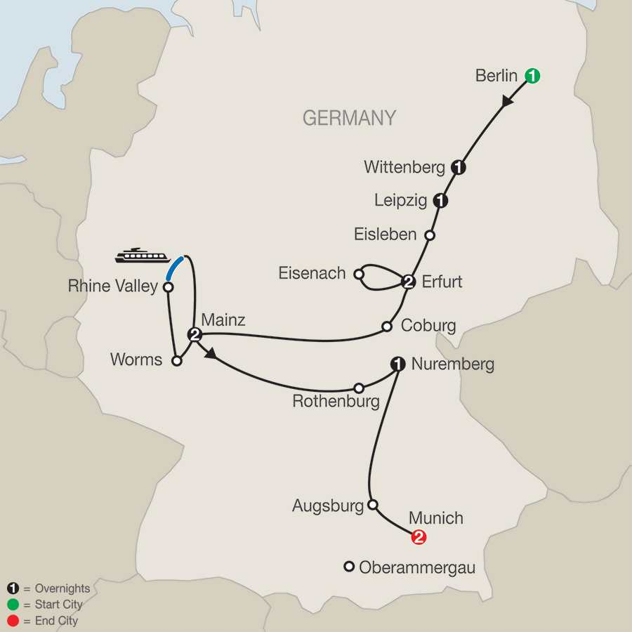
The Reformation – Luther’s Germany
University of Wittenberg
Castle Church
Leipzig Debate 1519
Luther’s
Birthplace and
Parents home
Wittenberg to Eisleben = 69miles
Erfurt to Worms = 200 miles
Erfurt to Eisleben = 56 miles
Erfurt to Eisenach = 44 miles
Erfurt to Augsburg = 260 miles
Erfurt to Heidelberg = 210 miles
Erfurt to Wittenberg = 130 miles
Wartburg
Castle
University of Erfurt
Augustinian Hermits
Erfurt Cathedral
Diet of
Worms

Slide 6
The Reformation (16th century)
1484 the family moves to Mansfeld (9 miles NW of Eisleben)
1497 Luther went to a Latin school in Magdeburg (53 miles N of Eisleben)
1498 Luther transfers to a Latin school in Eisenach
1501 Luther enters University of Erfurt .
July 2, 1505 The thunderstorm incident near Stotternheim.
July 17, 1505 Luther enters Augustinian Hermits.
April 3, 1507 Luther is ordained in Erfurt Cathedral.
May 5, 1507 Luther’s first mass
1508 von Staupitz, first dean of the newly founded University of Wittenberg, sent for Luther, to teach theology.
Luther received a bachelor's degree in Biblical studies on March 9, 1508, and another bachelor's degree in the Sentences by Peter Lombard in 1509.
John Calvin is born July 10, 1509
1510 (1511?) von Staupitz sent Luther to Rome to renew the credentials of the Augustinian order and monasteries in Erfurt.

Slide 7
The Reformation Luther’s Trip to Rome
Luther and another monk were sent to Rome to carry out some business of the Augustinian Order, of which they were apart. Luther was given ten gold florins to take care of his needs. The two traveled on foot and found food and lodging in monasteries along the way. Luther was bothered by the luxurious living, the loose morals, and the lack of interest in spiritual things among the monks they visited. Nevertheless, Luther still held high expectations for Rome itself. When the papal capitol first came into view he shouted, “Hail, holy Rome!” as ecstatically as a Jewish pilgrim catching his first glimpse of Jerusalem.
Within the city was a large staircase which was said to come from the house of Pilate. Those who climbed it on their knees were promised an indulgence from one thousand years of penance. Luther, believing the superstition, decided to try the ascent. He had climbed halfway up repeating the usual prayers when these words came to his mind: “The just shall live by faith.” He stood up and walked slowly down the stairs.
Another story says Luther went all the way to the top got up and said, “Who knows whether it is true?

