Slide 1
Discipleship: An Introduction to Systematic Theology and Apologetics
The Doctrines of Redemption: The Reformers
The Heights Church January, 14, 2018

Slide 2
The Reformation (16th century)
October 19, 1512, Luther is awarded his Doctor of Theology.
October 21, 1512, Luther is received into the senate of the theological faculty of the
University of Wittenberg, Luther succeeded von Staupitz as chair of theology.
March 9, 1513 Giovanni de' Medici becomes Pope Leo X.
1513-1515 Luther lectures on the Book of Psalms.
1515 Luther is made provincial vicar of Saxony and Thuringia for the Augustinian Hermits.
1515 – 1516 Luther lectures on Romans.
1516 Erasmus of Rotterdam published the Greek NT side by side with the Vulgate.
1516 Luther is appointed a regular preacher at Wittenberg
1516 – 1517 Luther lectures on Galatians.
1517 – 1518 Luther lectures on Hebrews.
January 1517 Johan Tetzel was made commissioner of indulgences for Archbishop Albert of Brandenburg in the dioceses of Magdeburg and Halberstadt.
October 31, 1517 Luther’s 95 Theses nailed to Wittenberg Church Door.

Slide 3
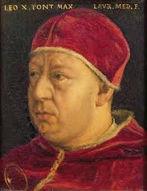
The Reformation – Pope Leo X: December 11, 1475 - December 1, 1521
Papacy: March 9, 1513 – December 1, 1521
Maximilian I, had planned since 1507 to be elected Pope
when Julius II died.
Once again France tried to move the papacy to France and Julius II excommunicated the leaders.
July 18, 1511, Julius II issued a Papal bull calling a conference which was to meet on April 19, 1512 in the Archbasilica of St. John Lateran.
In April 1512 France won a major victory over the Papal States delaying the start of the conference until May 3. The conference closed March 16, 1517.
Church discipline reforms, loans to the poor based on a pawn shop model, Bishop approval to publish a new book, war on Turkey to capture the holy land, and documented competence in preaching were proposed.
Leo X never implemented any of them.

Slide 4
The Reformation – Pope Leo X: December 11, 1475 - December 1, 1521
Born Giovanni di Lorenzo de' Medici, his father prevailed on his relative Innocent VIII to name him cardinal-deacon of Santa Maria in Domnica on March 8, 1488 when he was age 13, although he was not allowed to wear the insignia or share in the deliberations of the college until three years later.
Pope Julius II died February 21, 1513. Leo X was elected Pope on March 9, 1513 and proclaimed as Pope March 11. Upon election Leo is alleged to have said, "Since God has given us the papacy, let us enjoy it".
On March 15, 1513, he was ordained as a priest, and consecrated as a bishop on March 17. He was crowned Pope on March 19, 1513, the last non-priest to be elected Pope.
In 1514 Leo issued a Papal Bull requiring cardinals to live "... soberly, chastely, and piously, abstaining not only from evil but also from every appearance of evil" and a contemporary and eye-witness at Leo's Court, emphasized his belief that Leo was chaste all his life.
In 1517 he led a costly war that succeeded in securing his nephew as duke of Urbino, but which further damaged the papal finances. He later only narrowly escaped a plot by some cardinals to poison him.

Slide 5
The Reformation – Pope Leo X: December 11, 1475 - December 1, 1521
Leo X used the attempted poisoning to his advantage by executing one cardinal, imprisoning several and stacking the College of Cardinals with 31 new cardinals.
His Papal Bull of 1520, simply condemned Luther on a number of areas and made ongoing engagement difficult.
Leo X made elaborate plans for a crusade against the Ottomans but he was out maneuvered by Cardinal Wolsey who made England, not the pope, the arbiter between France and the Empire; and much of the money collected for the crusade from tithes and indulgences was spent in other ways.
Leo exhausted within two years the hard savings of Julius II, and precipitated a financial crisis from which he never emerged. He sold cardinals' hats and borrowed large sums from bankers, princes and Jews. The ordinary income of the pope for the year 1517 had been reckoned at about 580,000 ducats not including indulgences.
Leo failed to fully comprehend the importance of the Reformation, and in February 1518 he directed the vicar-general of the Augustinians to impose silence on his monks.

Slide 6
The Reformation – Pope Leo X: December 11, 1475 - December 1, 1521
The anti-papal rebellion in Germany and Scandinavia benefitted from Leo’s distraction by the political complications of the time, and by his own preoccupation with papal and Medicean politics. Maximillian’s death in 1519 further distracted Leo as he vacillated in his support of the various candidates.
On August 28, 1521 the Ottomans captured the citadel of Belgrade. The pope was greatly alarmed, and although he was then involved in war with France he sent about 30,000 ducats to the Hungarians.
Leo treated the Eastern Catholic Greeks with great loyalty, and by bull of 18 May 1521 forbade Latin clergy to celebrate mass in Greek churches and Latin bishops to ordain Greek clergy.
Leo was lavish in charity: retirement homes, hospitals, convents, discharged soldiers, pilgrims, poor students, exiles, cripples and the sick, unfortunates of every description were generously remembered, and more than 6,000 ducats were annually distributed in alms.
Leo X contracted pneumonia and died so suddenly that the last rites could not be administered to him.

Slide 7
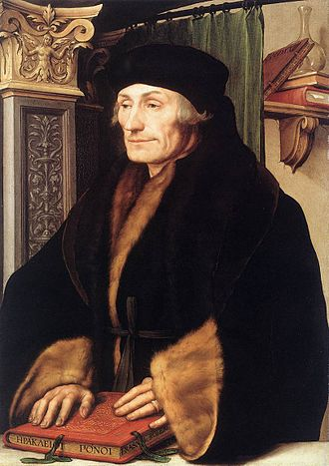
The Reformation – Erasmus of Rotterdam 1466 - 1536
Erasmus was considered the “Prince of the Humanists.”
Humanists were students of the humanities (rhetoric, ethics, history and poetry.) Erasmus was the illegitimate son of a Dutch priest. He was well educated, a friend of Thomas More and had met Henry VIII. His goal was to be the greatest Latin scholar of his day.
He published many of the early Church Fathers works. He also wrote satire. His most famous satires are Praise of Folly and Julius Excluded from Heaven.
Zwingli credited his conversion in 1514 or 1515 to reading a poem about Jesus written by Erasmus.
Erasmus was an early reformer advocating the centrality of education, Greek, the Bible, and faith of the heart as opposed to external ritual.
1516 Erasmus of Rotterdam published the Greek NT with a side by side comparison to the Vulgate.

Slide 8
The Reformation – Erasmus of Rotterdam 1466 - 1536
In 1524 Erasmus wrote On Free Will to which Luther responded in 1525 with On Bondage of the Will
Luther wrote, “I owe you no small thanks, for you have made me far more sure of my own position by letting me see the case for free choice put forward with all the energy of so distinguished and powerful a mind.”
Luther also wrote, “Moreover, I praise and commend you highly for this also, that unlike all the rest you alone have attacked the real issue, the essence of the matter in dispute, and have not wearied me with irrelevancies about the papacy, purgatory, indulgences, and such like trifles (for trifles they are rather than basic issues), with which almost everyone hitherto has gone hunting for me without success.”
In 1526 Erasmus published a response to Luther that was long and complicated and never generated any substantial interest.

Slide 9
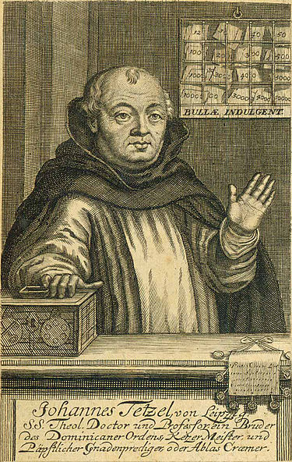
The Reformation – Johan Tetzel 1465 - 1519
Tetzel was born in Pirna, Saxony, and studied theology and philosophy at Leipzig University.
It was believed that all of the money that Tetzel raised was for the ongoing reconstruction of St. Peter's Basilica, although half the money went to the Archbishop of Mainz, Cardinal Albert of Brandenburg (under whose authority Tetzel was operating), to pay off the debts incurred in securing Albert's appointment to the archbishopric.
A clear distinction must be made between indulgences for the living and those for the dead. As regards indulgences for the living, Tetzel always taught pure (Catholic) doctrine that indulgences "apply only to the temporal punishment due to sins which have been already repented of and confessed."

Slide 10
The Reformation – Johan Tetzel 1465 - 1519
There is no doubt that Tetzel did, according to what he considered his authoritative instructions, proclaim as Christian doctrine that nothing but an offering of money was required to gain the indulgence for the dead, without there being any question of contrition or confession and that an indulgence could be applied to any given soul with unfailing effect. The Papal Bull of indulgence gave no endorsement of this proposition.
He became known for a couplet: ”As soon as the gold in the casket rings. The rescued soul to heaven springs.” This oft-quoted saying was by no means representative of the official Catholic teaching on indulgences, but rather, more a reflection of Tetzel's capacity to exaggerate.
At the time of his death, Tetzel had fallen into disrepute and was shunned by the public.
When Luther heard that Tetzel was mortally ill and on his deathbed, he wrote to comfort him, and bade him "not to be troubled, for the matter did not begin on his account, but the child had quite a different father."

